Slide 1
Magnet Strategy
Michael Lamm
Technical Division/Magnet Systems Department
Fermilab
Muon Accelerator Program Review
Fermilab, August 25, 2010

Slide 2
Outline
Magnet Issues for the Muon Collider
MAP Magnet Objective
Specific R&D Plans, Cost and Schedules
  High Field Solenoids for Final Cooling
  Collider Ring Magnets
  HCC Magnets
Comments and Conclusions

Slide 3
Today’s Magnet Presentations
Magnet Strategy (Lamm)
  How Magnet Program meets the MAP goals
Very High Field Superconducting Magnet Collaboration (VHFSMC) Status & Relationship with MAP (Larbalestier)
Magnet R&D (Tompkins)
  Present and Future Magnet R&D, how it relates to MAP strategy

Slide 4
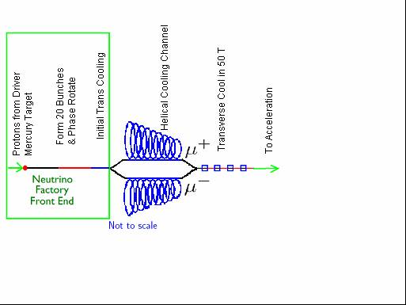
Interesting Magnets in Muon Colliders
The good news: Most magnets required for MC accelerator are simple to build
Very high field solenoids
6-D Cooling Channel
Transverse Cooling up to 50 T
Collider ring/IR Magnets ~10 T, wide aperture/open midplane
Helical cooling channel (HCC) solenoid rings 20 T and above (one of many options-most challenging magnet-wise)
Wide aperture 20 T solenoids

Slide 5
Objectives of Magnet Program
Practical conceptual design and prototype plan
  Meets or defines MC design requirements
  Must be “manufacturable”
    reproducible and in a reasonable time frame
  Enough technology development to back up design
    either through MAP or leveraged from other DOE programs or industrial application

Slide 6
Focus on Difficult Magnets
High Field Solenoid: 40 T nominal, up to 50 T
  Mechanical complexity, quench protection
Colliding Ring Dipoles and Quads
  Field quality, mechanical support related to wide aperture and/or open midplane
6-D cooling Magnets if Helical Cooling Channel (HCC)
  Logistics of incorporating RF with SC coils

Slide 7
Other Objectives/issues
Target Solenoid: 20 T Magnet
  Energy deposition, radiation damage
Rapid Cycling magnetic structures for Muon acceleration
  Power losses
Cost estimation for magnets:
  Higher risk specialty magnets
  Very large number of low risk solenoids
10-15 T solenoid R&D
  Moderate difficultly, issues with field leakage into adjacent RF structures

Slide 8
40-50 T Solenoids
Up to about 50T, luminosity increases with higher field final cooling solenoids.
The state-of-the-art for high field superconducting solenoids is about half of this field, i.e. ~25 T
  Potential for luminosity gain through higher field solenoids
Goal is to demonstrate feasibility of high field solenoid that meet all muon collider requirements
  Preliminary studies suggest that a 40 T solenoid meets the field requirements (hence the 40-50 T range)

Slide 9
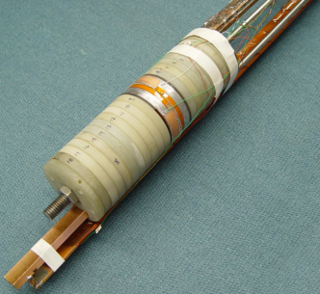
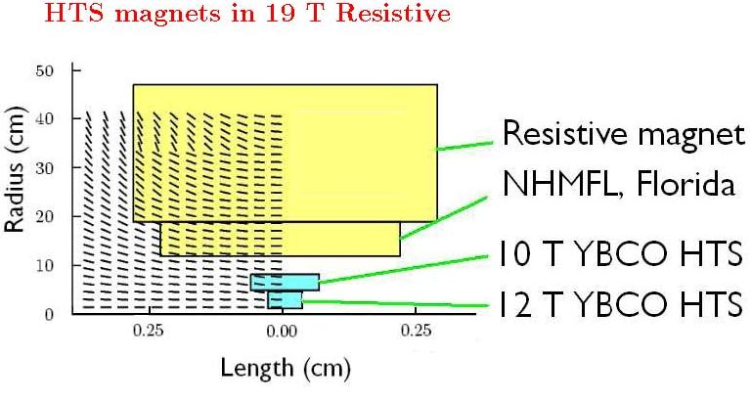
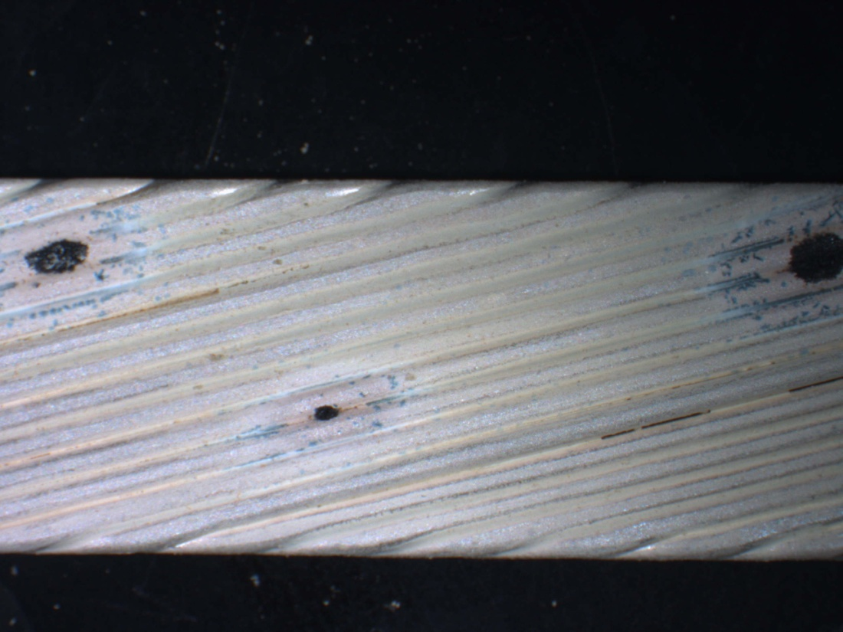
High Field Solenoid Studies
Magnet Design Studies
Conductor R&D
More details in the following two talks
Instrumentation Development
PBL SBIR
VHFSMC Supported R&D

Slide 10
Magnet Complexity Grows with Increasing Bore Field
Several magnet design studies over the past few years point to the difficulties of building high field solenoids
  Peak hoop stress grows faster than linear with field
    increase stress means larger % of magnet volume devoted to stress management
  Volume grows ~field² ➔ much more HTS
    even with hybrid magnets which employ NbTi and Nb₃Sn outserts, most of the volume increase comes from HTS materials

Slide 11
“High Field Solenoid Strategy”
Divide effort into 5 tasks….
Develop functional specifications for the high field solenoid.
2) Evaluate/compile information on state-of-the-art of conductors.
3) Build HTS and hybrid inserts to prove technology.
4) Perform conceptual designs for highest field practical magnet.
5) Present plan for building magnets in years 1-3 post plan.

Slide 12
Magnet Specifications
1) Develop functional specifications for the high field solenoid.
Preliminary Specification:
Number of magnets ~ 20 More if field is lower
Central Magnetic Fields > 30 T at start, > 40 T at end
Lengths ~ 1m at start ~ 10 cm at end
Minimum magnet bore 2 cm at start 1 cm at end
Field Quality 0.2% at start 0.2% at end
Time frame: First year (now)

Slide 13
HTS Conductor Studies
2) Evaluate state-of-the-art of conductors.
  The state-of-the-art in HTS conductor is the major factor limiting a practical High Field design. Parameters:
    engineering current densities > 500 A/mm2 at 30 T
    excellent strain tolerance
    available in long piece lengths
  We expect that there will be continued significant progress in conductor development during the multi-year window for the MAP design study.
  We expect to benefit from conductor studies conducted by other programs such as VHFSMC

Slide 14
HTS Conductor Studies
2) Evaluate state-of-the-art of conductors. Part II
  Significant effort in MAP will be devoted to short sample testing of promising materials. Studies include
    Ic as a function of temperature, field, field orientation
    strain
    magnetization
  MAP will focus on materials not covered specifically by other programs
    for example VHFSMC is studying Bi 2212 wires
  MAP will depend on outside programs such as the VHFSMC and SBIR’s to develop new conductor.
  Time frame: First half of program

Slide 15
Insert Program
  Note: inserts are not a substitute for building full scale magnets
3) Build HTS and hybrid inserts to prove technology.
  Economical approach to testing out coil technology
  Standalone tests or combined with facility outserts
  Study conductor/cable
    mechanical properties
    quench characteristics
    splice techniques
  Cabling technologies
  Time frame:
    Now throughout program
  Build~5-6 inserts/year in peak of program
  Detailed program will be dictated by needs of MAP

Slide 16
Conceptual Design
4) Perform conceptual designs for highest field practical magnet.
  Key design points
    utilizing the state-of-the art conductor
    advanced mechanical support approaches
    effective insulation schemes
  Quench protection strategies
  Insert development within and beyond MAP; build on results from SBIR
  Time Frame: Second half of program

Slide 17
Fabrication Plan
5) Develop plan for building full scale magnet after MAP is completed
  Extension of previous task
  Base on conceptual design
  Develop cost and schedule
  Time Frame: last 2 years of Plan

Slide 18
High Field Solenoid Milestones
Fabricate small HTS test magnet FY 13
  This is meant to be a significant technology demonstration. Required progress:
    baseline magnet specs
    continued progress on application of state of the art conductor
    evolution of insert program, leverage SBIR progress
Begin conceptual design of >30 T solenoid FY13
    depends on progress on previous milestone
Complete conceptual design of >30 T solenoid FY16
    task 4 and Task 5 completed

Slide 19
Collider Magnet Issues
IR and arc, dipoles and quadrupoles
Strong arc magnets, reduce ring circumference, increase luminosity
  Baseline design calls for 10 T fields
Significant energy deposition issues, electrons from muon decay
  ~0.1 kW/m in horizontal plane for storage ring
  Must be intercepted outside of the magnet helium vessel

Slide 20
Magnet Specifications
1) Develop functional specifications
  i.e. Working with collider ring design group, define parameters for magnet
    central field
    field errors/size of “good field region”
    radiation damage/energy deposition
    aperture including internal beam absorber
  Field and energy deposition indicate the need for Nb₃Sn conductor

Slide 21
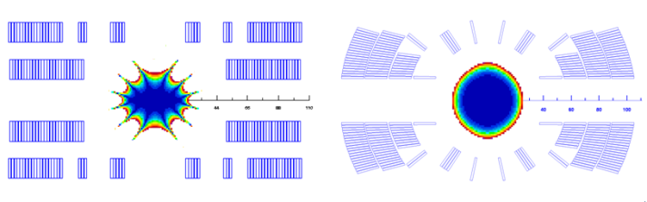
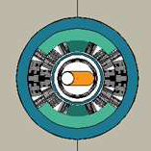
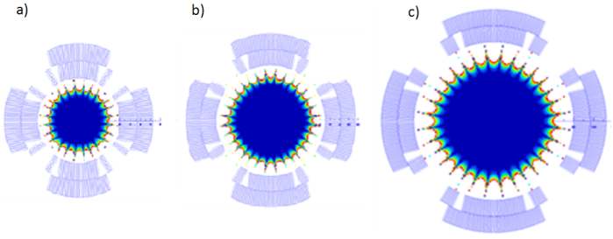
Collider Magnet Concepts
Blah
IR Separation Dipole
Arc Dipole
IR Quads
Zlobin IPAC 10
Novitski ASC 2010
2) Develop baseline designs
Note: These studies build on significant Nb₃Sn technology development from LARP and DOE core programs

Slide 22
Technology Development
3) Technology Development
  1 meter long magnets are not part of MAP scope
    expensive program based on LARP experience
  MAP Plan
    depend on core programs FNAL and LBNL
    benefit from knowledge gained on other projects and programs
      LARP wide aperture quads for future LHC upgrades in particular
        120 mm Nb₃Sn quad models being built now….
    small R&D projects will be considered depending on design directions, such as radiation hardened insulation

Slide 23
Design Studies
4) Conceptual design
  Primary goal is demonstrate feasibility of magnet fabrication
    issues:
      details of energy dissipation
      radiation damage
      mechanical structure, especially with open plan dipoles
      field quality (not as big an issue because of muon lifetime)
    IR dipole looks to be the most challenging
  Develop designs far enough along for cost estimate

Slide 24
Collider Magnet Milestone
Begin conceptual design of collider magnets FY 13
  Preliminary design work is of course progressing now
  Final conceptual design depends on
    specifications based on lattice design
    continued technology development, mostly outside of MAP

Slide 25
HCC Magnets
6- dimensional cooling is one of the highest technological risks of the muon collider
  O(10⁶) cooling required
  Several technologies are being considered
  Of these choices, Helical Cooling Channel (HCC) has the most challenging magnets because of the complicated field and close proximity to RF and cooling media.
  These field can be generated elegantly by using solenoid rings offset in a helical pattern

Slide 26
HCC Magnet Strategy
Over the past few years, studies have been performed between Fermilab and Muons Inc.
  Paper study cooling channel have been designed and studied.
    require magnets ranging from ~6 T to 25 T on conductor
  Cooling efficiency as a function of geometric and conductor parameters
  Integration of magnets with RF and absorber media
  Coil fabrication techniques both for high field and low field section of coils

Slide 27
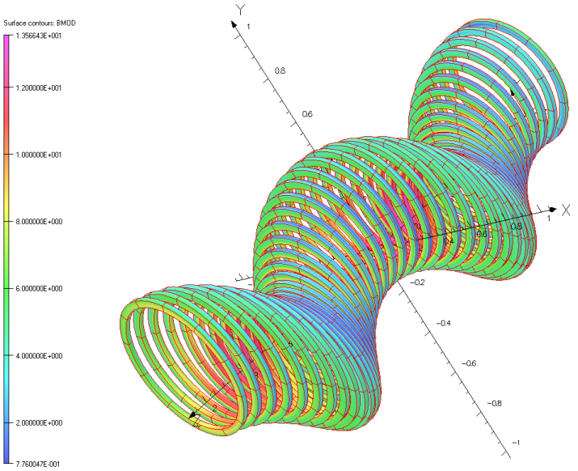
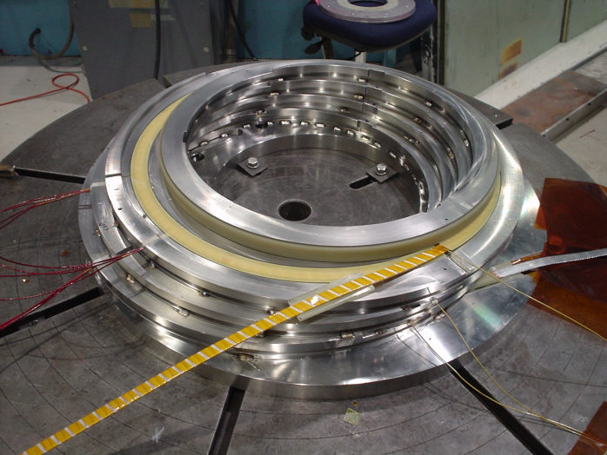
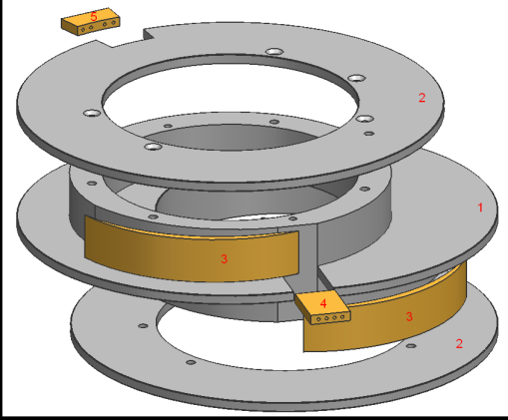
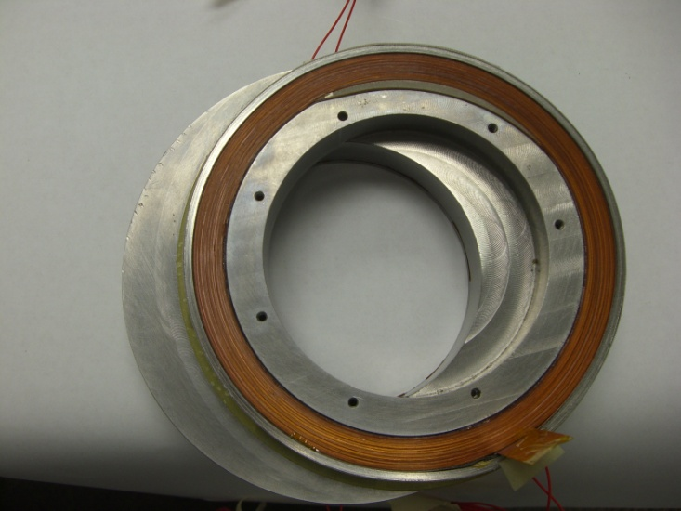
“Helical Solenoid Magnets”
Correction Schemes
Basic HC Design
Model Magnet Program NbTi
Model Magnet Program HTS

Slide 28
HCC MAP Program
Continue to support magnetic design studies to determine if HCC is the best solution of the muon collider
Continue on a low level magnet development program: Key issues:
  Economical and reliable coil fabrication
  NbTi, Nb₃Sn and HTS coil technology
  Quench protection for very long strings of solenoid rings

Slide 29
HCC MAP Program II
Future of program completely depends on technology decision in the next few years
If HCC is not chosen
  Program closed
If HCC is adapted for all or part of Cooling
  Continue magnet demonstration program
Either way
  Effort will segue to magnet support of 6-D demonstration (which is the only relevant milestone)

Slide 30
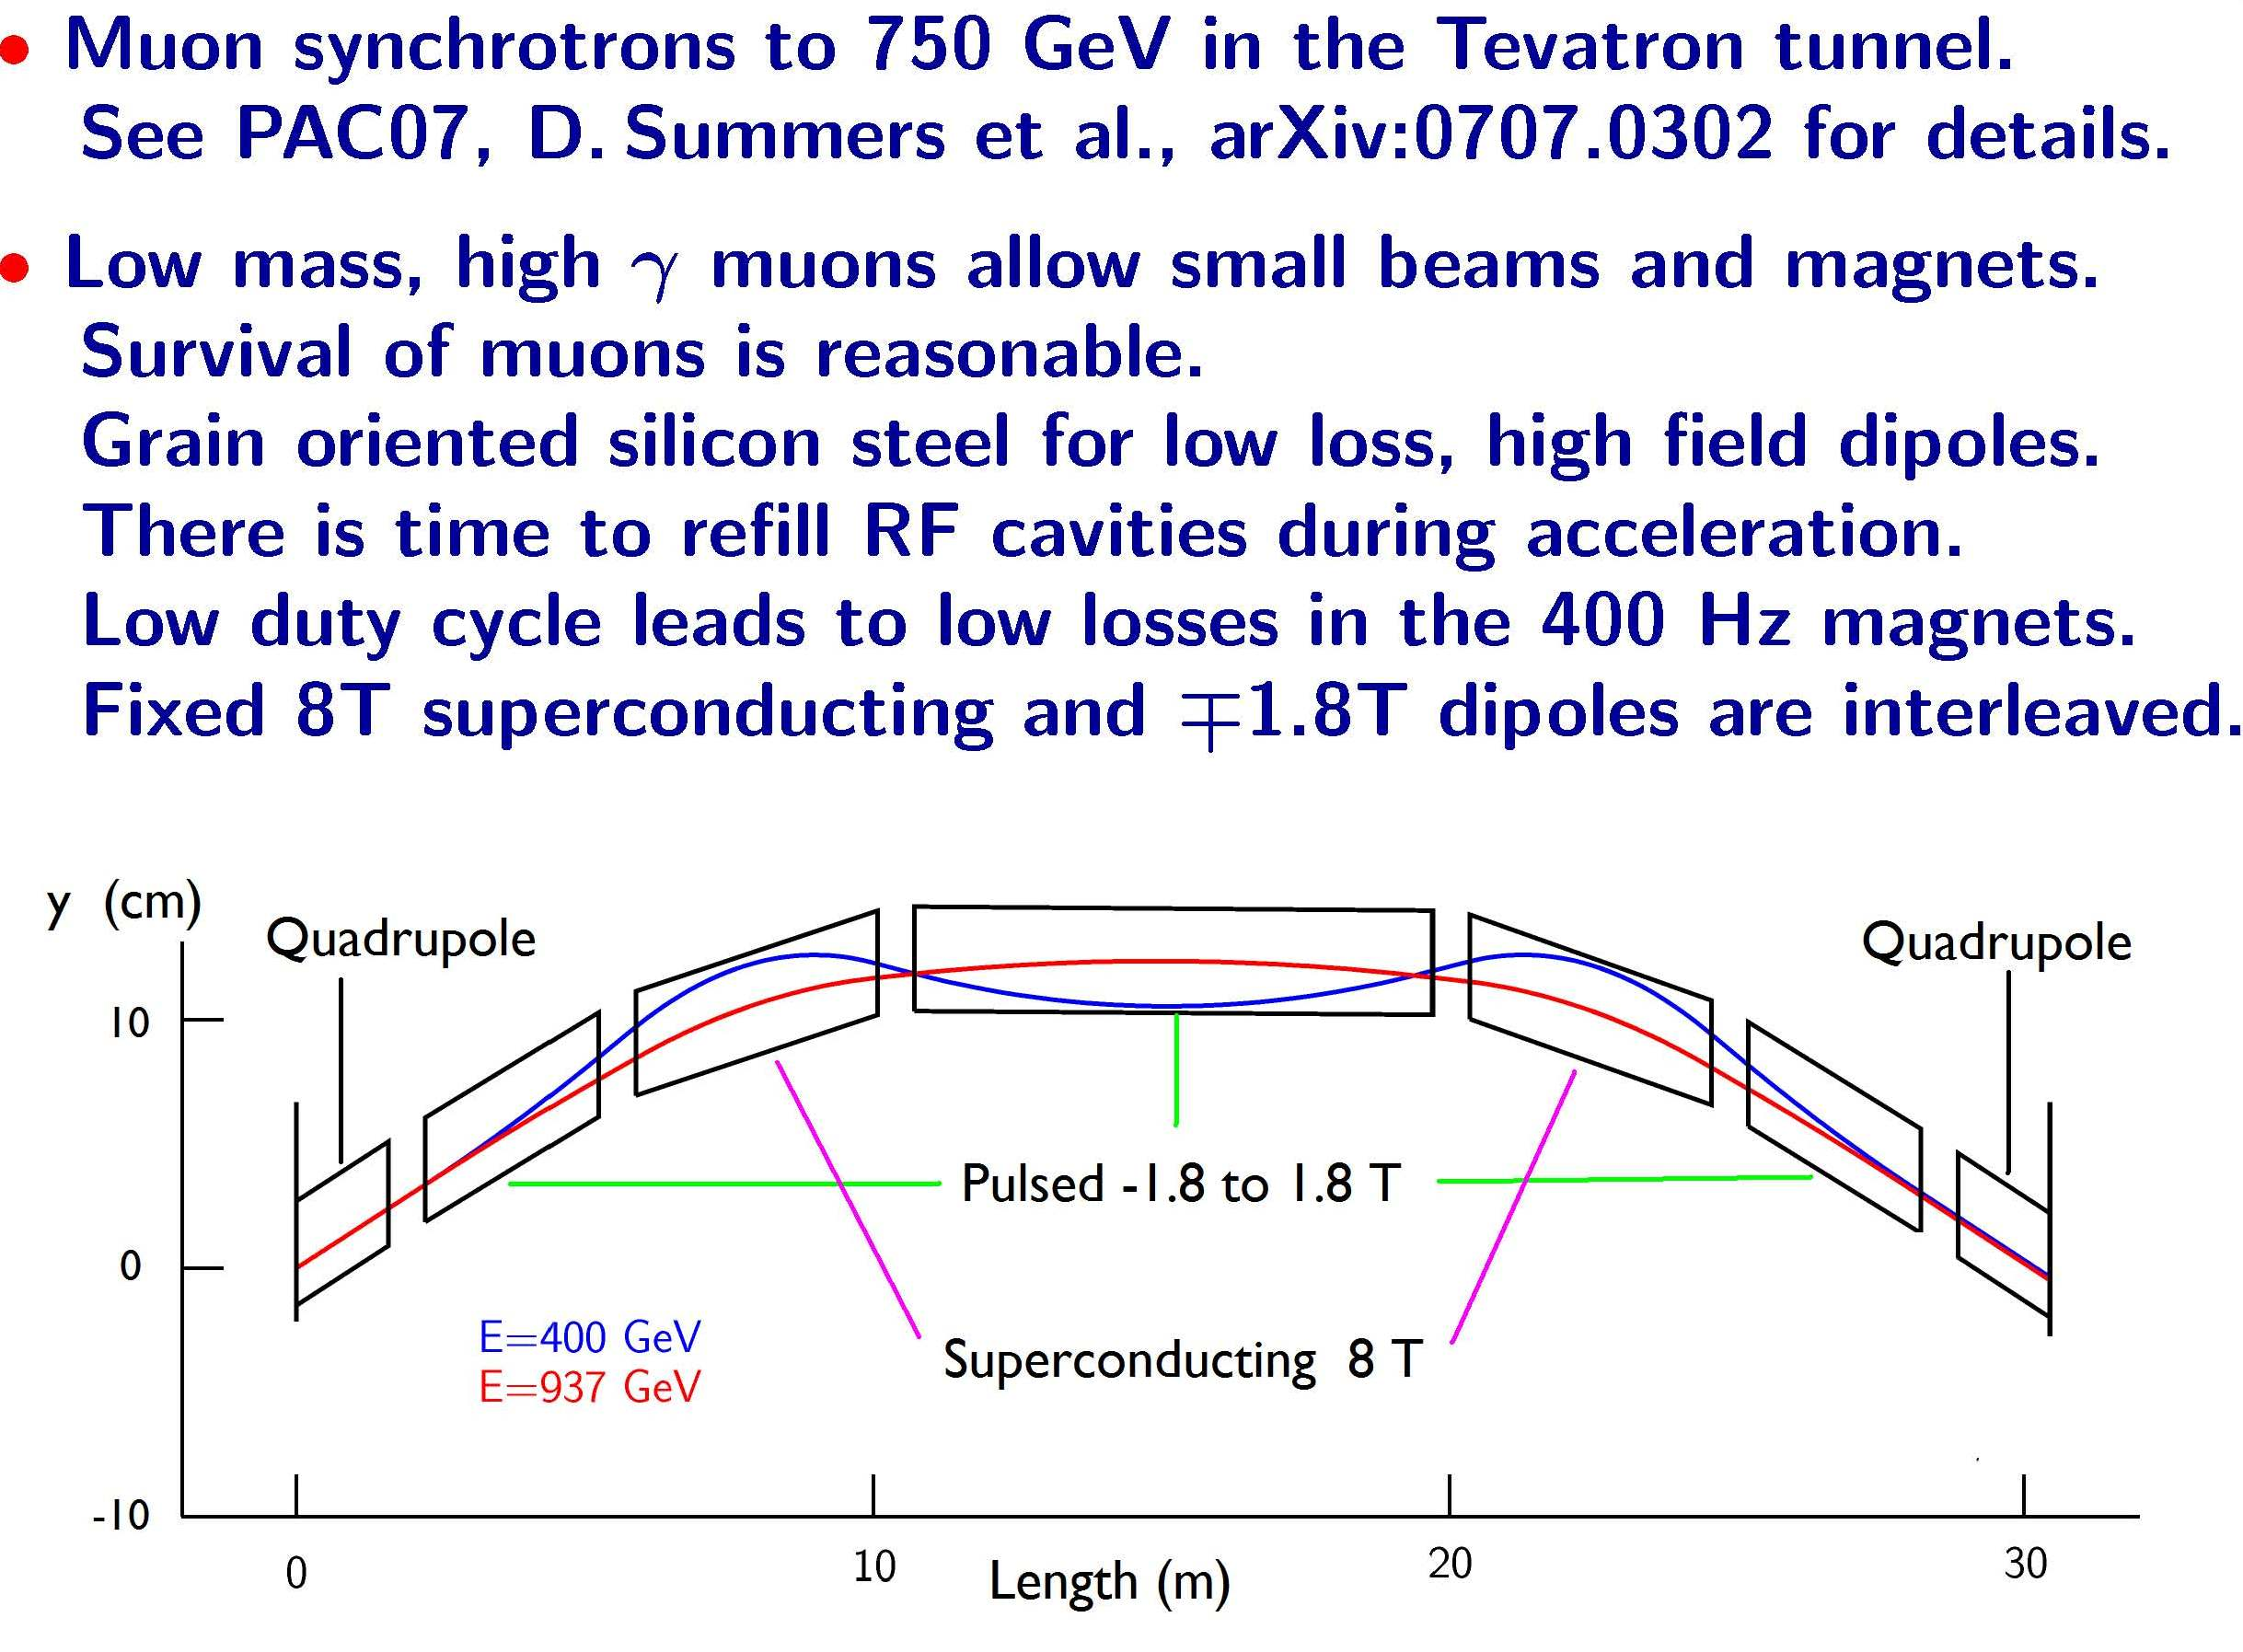
Rapid Cycling Dipoles

Slide 31
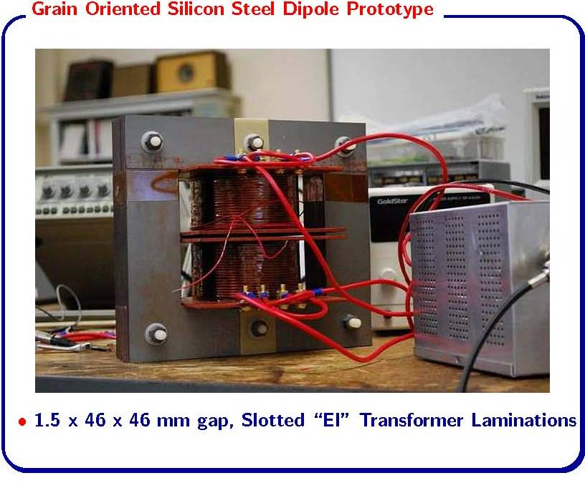
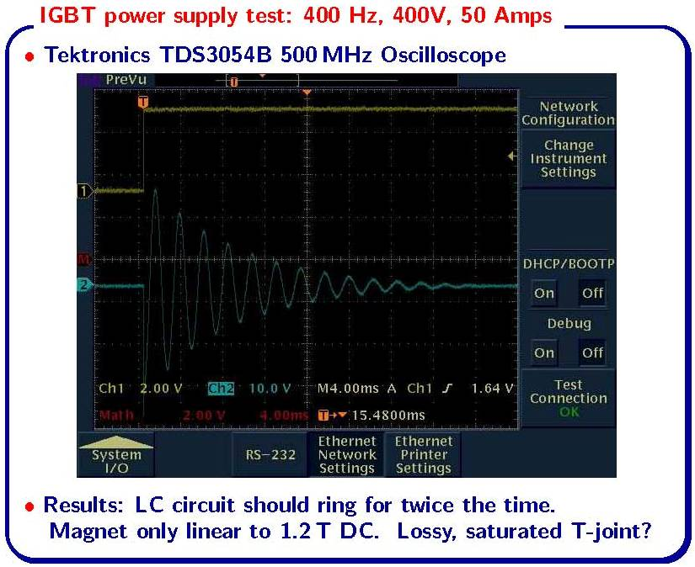
Rapid Cycling Dipole Results
Prototype Built
Prototype Tested
D. Summers U. Mississippi

Slide 32
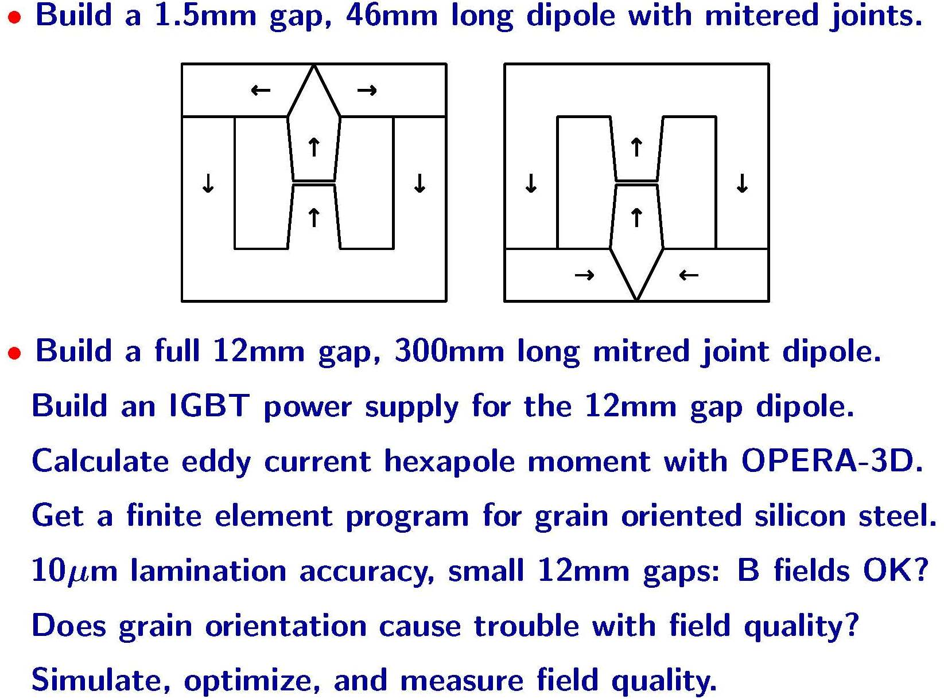
Rapid Cycling Dipole Program

Slide 33
Proposed Resource Allocation

Slide 34
Comments
As this is an R&D program, within a larger R&D program, there must be some flexibility in planning
  Program must adapt to evolving ideas in the muon collider design
  Program must adapt to anticipated and unanticipated technology breakthroughs
  Possibility to redistributing funds in later years with the broader magnet view as best needed.

Slide 35
Examples of future decisions
Technology decision for 6-D
  might scrap HCC altogether=>focus on 6-D magnet/RF integration
  Hybrid 6-D focus on HCC in higher energy regime=> Nb₃Sn or HTS
Development of HTS materials or high field solenoid technology might argue for a more significant demonstration in the later years
Refinement of IR design and LARP breakthrough in Nb₃Sn might affect IR dipole technology decision

Slide 36
Conclusion
There are significant magnet challenges for the Muon Collider
A strong magnet program within MAP is essential to building a convincing muon collider design
  Program targets key magnets with the highest technical risk. (highest % of resources to “high field solenoid”)
  Reliance on DOE programs outside of MAP for support particularly for conductor development and collider magnet R&D
  Additional resources needed for any significant magnet demonstration within MAP

