Slide 1
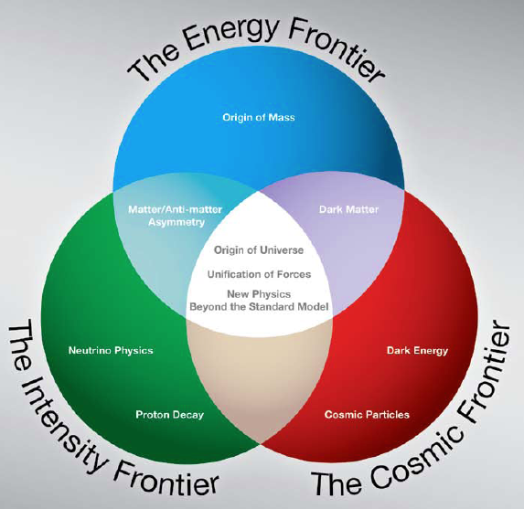
MAP Overview
Steve Geer
Accelerator Physics Center
Fermi National Accelerator Laboratory
Muon Accelerator Program Review
Fermilab, August 24, 2010
μ⁺
μ⁻
ν

Slide 2
TALKS IN SESSIONS 1 & 2
THIS TALK: Overview
Motivation & Organization
Achievements & Challenges
Goals & Resources
Physics Motivation: Eichten
More detailed R&D Plans & Resources
Design & Simulation: Fernow
Technology Development: Bross
System Tests: Kaplan
Management Plan: Zisman

Slide 3
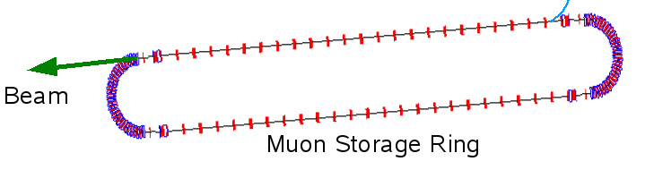
INTRODUCTION
Over the last decade there has been significant progress in developing the concepts & technologies required to create O(10²¹) muons/year & cool them to fit within an accelerator.
This enabling R&D opens the way for:
  NEUTRINO FACTORIES:
  muons decay in the straight
  section of a storage ring →
  ν beam with unique properties
  for precision oscillation
  measurements.
  MUON COLLIDERS:
  μ⁺ & μ⁻ collide in a storage
  ring to produce lepton-antilepton
  collisions up to multi-TeV energies.
Muon Decays
ν
~1000 turns
before decay
μ⁻
μ⁺

Slide 4
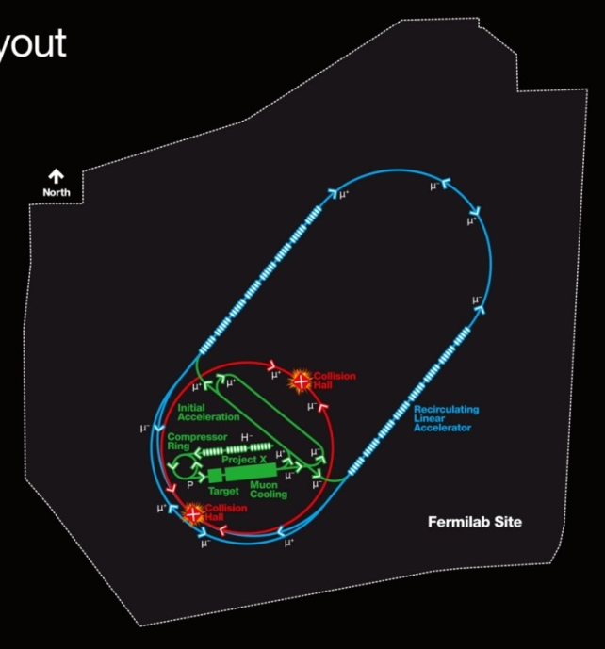
MOTIVATION - COST
Physics motivation for ν Factories & Muon Colliders
– see Estia’s talk
There is also a potential cost-effectiveness motivation for a Multi-TeV Muon Collider which arises because muons don’t radiate as readily as electrons (m_{μ} / m_{e} ~ 207):
- COMPACT
Fits on laboratory site
- MULTI-PASS ACCELERATION
Cost effective construction &
operation
- MULTIPASS COLLISIONS IN
A RING (~1000 turns)
Relaxed emittance requirements
(& hence relaxed tolerances) c.f.
single pass machines
√s=
4 TeV
FNAL SITE BOUNDARY

Slide 5
CHALLENGES
Muons are produced as tertiary particles. To make enough of them we must start with a MW scale proton source & target facility.
Muons decay ⇒ everything must be done fast and we must deal with the decay electrons (& neutrinos for CM energies above ~3 TeV).
Muons are born within a large 6D phase-space. For a MC we must cool them by O(10⁶) before they decay ⇒ New cooling technique (ionization cooling) must be demonstrated, and it requires components with demanding performance (NCRF in magnetic channel, high field solenoids.)
After cooling, beams still have relatively large emittance.

Slide 6
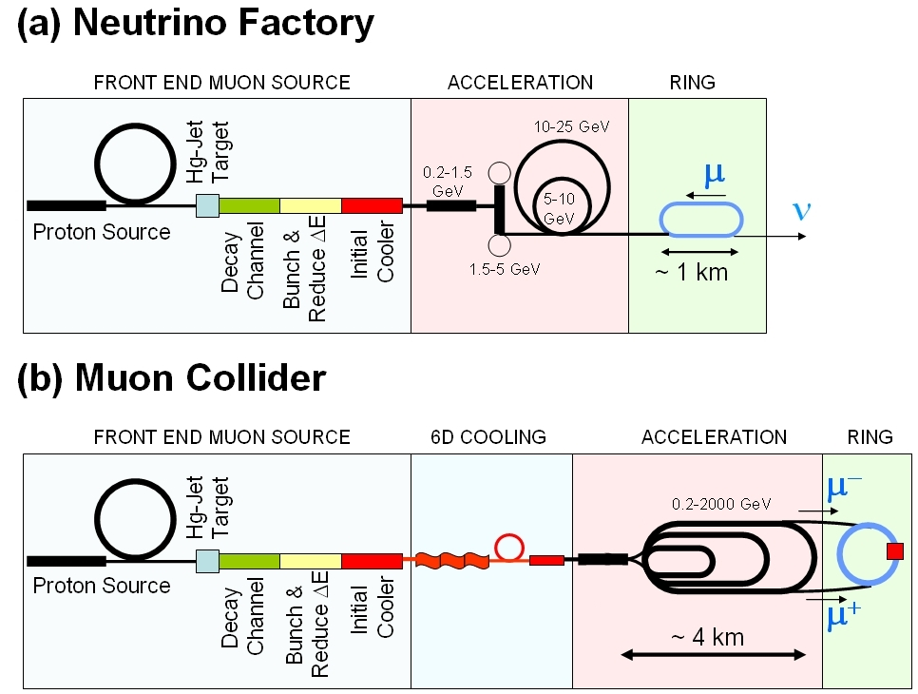
MUON COLLIDER SCHEMATIC
√s = 1.5 TeV
Circumference = 2.75 km
L = 1×10³⁴ cm⁻²s⁻¹
μ/bunch = 2x10¹²
σ(p)/p = 0.1%
ε_{⊥N} = 25 μm
β * = 1cm
Proton source: Upgraded PROJECT X (~4 MW, 2±1 ns long bunches)
10²¹ muons per year that fit within the acceptance of an accelerator

Slide 7
Muon Collider cf. Neutrino Factory
NEUTRINO
FACTORY
MUON
COLLIDER
In present MC baseline design, Front End is same as for NF

Slide 8
NFMCC & MCTF
Muon Collider (MC) & Neutrino Factory (NF) R&D has been pursued in the U.S. by:
  Neutrino Factory & Muon Collider Collaboration (NFMCC) since 1996
  Fermilab Muon Collider Task Force (MCTF) since 2006
The NFMCC & MCTF R&D programs have been coordinated by a committee comprising the NFMCC+MCTF leadership
NF R&D is international, & is pursued within the context of the International Design Study for a Neutrino Factory (IDS-NF), which aspires to deliver a Reference Design Report by ~2013.
Our international projects include 2 “systems tests”:
  MERIT: mercury-jet target experiment (complete)
  MICE: ionization cooling experiment (ongoing)

Slide 9
ACCOMPLISHMENTS
Successful completion of NF feasibility studies 1, 2, 2a, & International Scoping Study; launching of the ongoing International Design Study for a NF (IDS-NF)
  Solid basis for planning the MC Design Feasibility Study (DFS)
Development of ionization cooling simulation tools and a 6D cooling channel concept.
Successful completion of MERIT, full engagement in MICE, & establishment of the MuCool Test Area (MTA) facility.
Establishment of an ongoing technology development program (RF studies, magnet studies, …)
  Identified issue of RF breakdown in magnetic field

Slide 10
THE MAP INITIATIVE
Oct 1, 2009 letter from DOE Assoc. Director of Science for HEP to FNAL Director:
  “Our office believes that it is timely to mount a concerted national R&D program that addresses the technical challenges and feasibility issues relevant to the capabilities needed for future Neutrino Factory and multi-TeV Muon Collider facilities. ...”
Letter requested that FNAL Director put in place a new organization for a national Muon Collider & Neutrino Factory R&D program, hosted at FNAL, and designate the program director.
MAP Organization is now in place and is functioning.
214 MAP participants at birth (~31 FTE) from 14 institutions:
  ANL, BNL, FNAL, Jlab, LBNL, ORNL, SLAC, Cornell, IIT, Princeton, UCB, UCLA, UCR, U-Miss
MAP R&D proposal submitted by FNAL Director on March 1st
MAP Website: http://map.fnal.gov

Slide 11
MAP ORGANIZATION
See M. Zisman’s talk on
the Management Plan
“Level 0”
“Level 1”

Slide 12
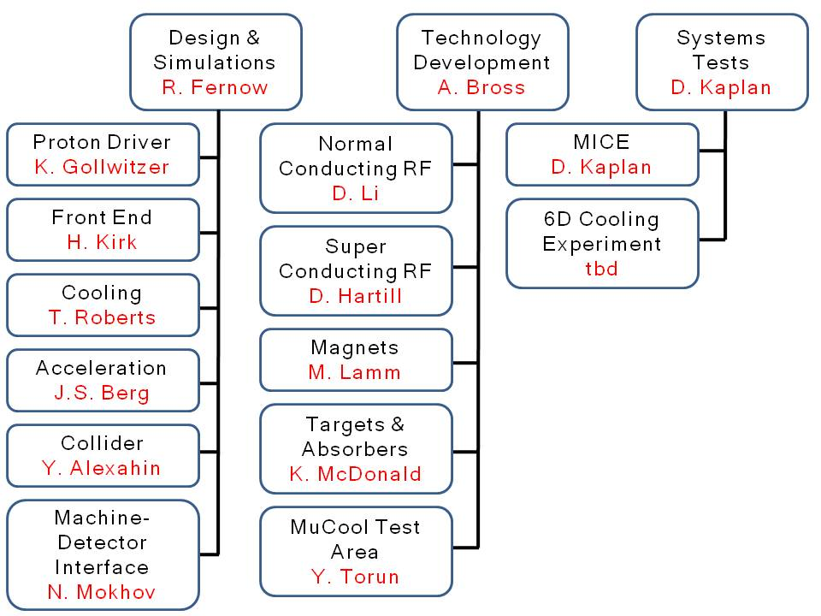
ORGANIZATION: L1 & L2
Organization populated down to L2, and is functioning
“Level 1”
L2 assignments
- FNAL; 4½ people
- Other Labs: 3 people
- Universities: 3½ people
- SBIR Companies: 1 person
See L1 talks for strength and credentials of the R&D teams

Slide 13
MAP GOALS
MC: To significantly advance the R&D from its present level (exploring technical concepts) to the next level (establishing feasibility by performing end-to-end simulations based upon hardware that is in-hand or under development).
NF: To complete MICE^{*)}, and make those significant U.S. contributions to the IDS-NF that are needed to ensure success (delivering an RDR by ~2013).
*) Also important for MC

Slide 14
PROPOSAL STRATEGY
Identify the required R&D deliverables.
Make an R&D plan that respects initial funding guidelines and achieves the deliverables.
Make an augmented plan that speeds things up by 1 year (i.e. assess how much it costs to go faster).
  Important if future developments (e.g. LHC results) motivate speeding things up
In both nominal and augmented plans, Year 1 = now (FY10) with the current funding level.
  The MAP organization is presently executing Year 1 of the MAP plan

Slide 15
MILESTONES & DELIVERABLES
Muon Collider Design Feasibility Report (FY16)
  Based on end-to-end simulation of MC complex which uses components that are in-hand or can be developed with a specified R&D program
Hardware R&D results → technology choice
MC Cost range (FY16)
Contributions to the IDS-NF RDR (FY14)
R&D plan for longer-term activities (including 6D cooling experiment)
Deliverable | Nominal schedule | Augmented schedule
MC DFS
Interim | FY14 | –––
Final + cost range | FY16 | FY15
MICE hardware completion | FY13
RF studies (down-select) | FY12
IDS-NF RDR | FY14
6D cooling definition | FY12
6D cooling section component bench test | FY16 | FY15
6D demonstration proposal | FY16 | FY15

Slide 16
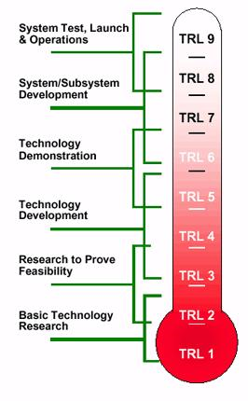
R&D PROGRESS TOWARDS
THE PROPOSED MC-DFS
NOW
7
PROPOSED MC-DFS
MUON COLLIDER PROPOSAL
7. System Prototype
6
6. Sub-System
Beam Tests
5
5. Semi-realistic
sub-systems
4
4. Early sub-system
Bench Tests
3
3. Component R&D
2
2. Technical Concept
1
1. Basic Idea
Ring
6D Cooling
Acceleration
Initial Cooling
Final Cooling
Bunch / Phase
Target & Dump
Pre-Acceleration
NASA Technology
Readiness Levels

Slide 17
ORGANIZATION/FUNDING EVOLUTION
First
~10 years
FY07 –
FY09
Now
(FY10)
≥FY11
NFMCC
+
MCTF
Interim
MAP
NFMCC
MAP
~4 M$
~9 M$
~10 M$
~15 M$ (requested)

Slide 18
COMPLEMENTARY EFFORTS
International partners (see talk by Blondel)
  MICE
  IDS-NF
Activities funded by NSF
  Contributions to MICE
  Proposed low frequency SCRF R&D (Cornell).
DOE support for VHFSMC R&D on HTS conductor
DOE supported SBIR funded activities. Examples:
  40T solenoid (PBL)
  G4BEAMLINE (Muons Inc.)

Slide 19
DOE FUNDING REQUEST
Requested funding profile respects an initial guideline of ~15 M$/yr (FY10 dollars)
More details in L1 talks
FY10
 | Y1 | Y2 | Y3 | Y4 | Y5 | Y6 | Y7
Effort (FTE) | 31 | 40 | 44 | 48 | 47 | 49 | 47
SWF ($M)^{a)} | 8.3 | 11.2 | 12.2 | 13.2 | 12.9 | 13.0 | 13.4
M&S ($M)^{a)} | 2.0 | 4.2 | 3.3 | 2.3 | 2.6 | 2.5 | 1.5
Total ($M)^{a)} | 10.3 | 15.4 | 15.5 | 15.5 | 15.5 | 15.5 | 14.9
Total ($M)^{b)} | 10.3 | 16.1 | 16.9 | 17.5 | 18.2 | 19.0 | 19.0
^{a)} FY10 dollars. ^{b)} Then-year dollars, assuming 4% annual escalation.

Slide 20
EFFORT
More details in L1 talks
Proposed effort levels agreed on with BNL, FNAL & LBNL management
FY10
 | Y1 | Y2 | Y3 | Y4 | Y5 | Y6 | Y7
BNL | 5 | 7 | 8 | 8 | 8 | 8 | 6
FNAL | 20 | 23 | 25 | 28 | 31 | 33 | 30
LBNL | 3 | 4 | 5 | 5 | 4 | 3 | 5
Other^{a)} | 3 | 6 | 6 | 7 | 4 | 5 | 6
TOTAL | 31 | 40 | 44 | 48 | 47 | 49 | 47
^{a)}Includes SBIR companies, universities, other laboratories, additional engineering from the main laboratories and/or external vendor contracts.

Slide 21
AUGMENTED PLAN
What it takes to speed
up by 1 year
 | Y1 | Y2 | Y3 | Y4 | Y5 | Y6
Effort (FTE) | 31 | 40 | 51 | 58 | 61 | 64
SWF ($M)^{a)} | 8.3 | 11.2 | 14.4 | 16.0 | 16.2 | 17.4
M&S ($M)^{a)} | 2.0 | 4.2 | 3.5 | 3.2 | 3.3 | 2.0
Total ($M)^{a)} | 10.3 | 15.4 | 17.9 | 19.2 | 19.5 | 19.4
Total ($M)^{b)} | 10.3 | 16.1 | 19.5 | 21.7 | 22.9 | 23.7
 | Y1 (FTE) | Y2 (FTE) | Y3 (FTE) | Y4 (FTE) | Y5 (FTE) | Y6 (FTE)
BNL | 5 | 7 | 8 | 9 | 9 | 10
FNAL | 20 | 23 | 30 | 34 | 37 | 37
LBNL | 3 | 4 | 5 | 6 | 6 | 6
Other^{a)} | 3 | 6 | 8 | 9 | 9 | 11
TOTAL | 31 | 40 | 51 | 58 | 61 | 64

Slide 22
RELATIONSHIP WITH PHYSICS STUDIES
Physics & detector background studies are outside the scope of MAP but …
  Within MAP we have a machine-detector interface group that optimizes final focus & shielding, and provides background files for physics studies
  We are actively engaged in helping to set up and drive forward a parallel physics-detector study effort.
    See talk by Estia
  Leader for physics/backgrounds studies will participate in the “MAP Management Council” which provides week-by-week advice to the MAP Director(s)
  The physics/background studies will deliver a report to community on detector design & physics capabilities.

Slide 23
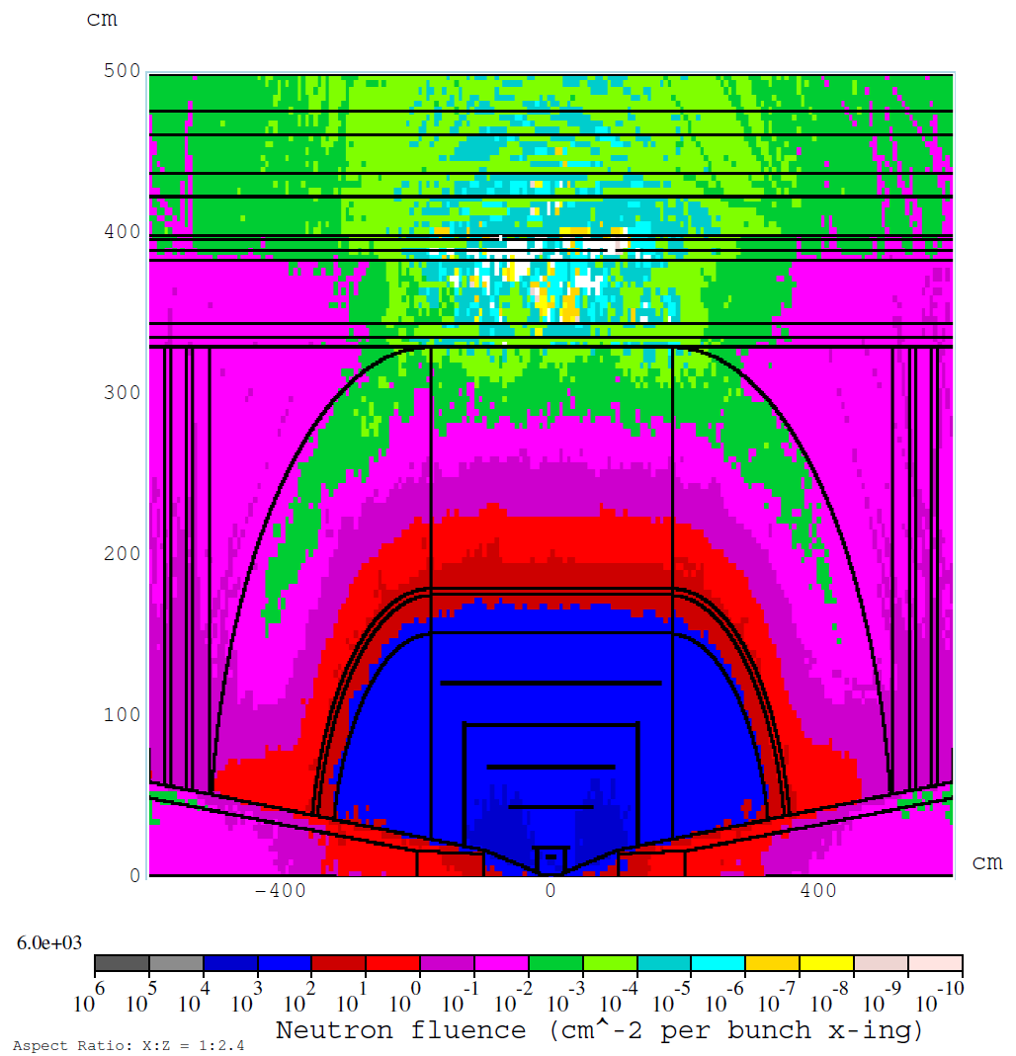
DETECTOR SHIELDING PROGRESS
Illustrative example: MARS map of background neutrons for a 1.5 TeV Muon Collider
Neutron peak/yr = 0.1xLHC@10³⁴
Total absorbed dose from all background particles in Si detector
Peak at r=4 cm:
MC: 0.1 MGy/yr
LHC: 0.2 MGy/yr @10³⁴

Slide 24
FINAL REMARKS
The proposed MAP R&D plan is built upon the experience and success from the last decade.
The proposed plan interfaces seamlessly with the ongoing R&D (Year 1 = FY10), and the MAP organization is in place and functioning.
The plan would deliver a NF-RDR by ~2013, and by ~2016 advance MC R&D from early component R&D to sub-system bench tests, MICE completion, an end-to-end simulation of a MC complex, and a MC feasibility assessment and cost range.
The R&D is challenging, and we will have to adjust the plan along the way, but we believe that with appropriate support we will succeed.

Slide 25
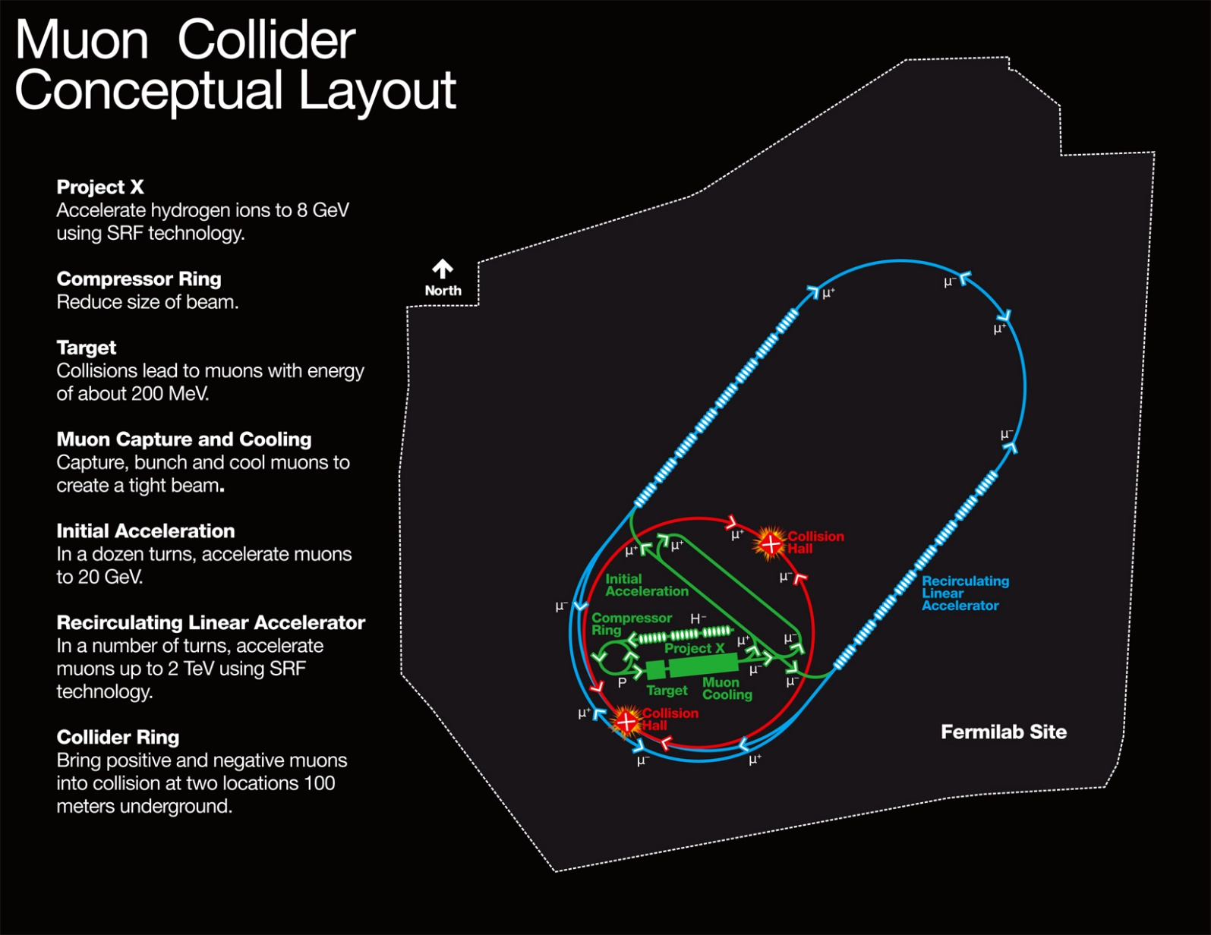
A MUON-BASED VISION

