Slide 1
Proton Source
& Site Layout
Keith Gollwitzer
Accelerator Division
Fermi National Accelerator Laboratory
Muon Accelerator Program Review
Fermilab, August 24, 2010

Slide 2
Outline
Proton Source – Proton Driver
  Design goals
  Project X
    Design criteria & description
    Upgrade path
  Challenges
Milestones
Initial concept for site layout
Summary

Slide 3
Design Goals
4 MW proton beam onto target
Proton energy 5-15 GeV
Bunch structure
  1-3 ns rms bunch length
  Neutrino Factory
    3 bunch train in 320 μs at 50 Hz
  Muon Collider
    “Single” bunch at 15 Hz

Slide 4
Project X as a Starting Point
Project X design criteria
  A neutrino beam for long baseline neutrino oscillation experiments
    2 MW proton beam with energy between 60-120 GeV
  Kaon- and muon-based precision experiments running simultaneously with the neutrino program
  A path toward a muon source for a possible future Neutrino Factory, and, potentially, a Muon Collider at the Energy Frontier

Slide 5
Project X Design Evolution
Initial design (8 GeV pulsed linac)
  Did not support kaon/muon precision measurement program
Second design (about to be released)
  CW 3 GeV 1 mA H⁻ linac
    Above kaon production threshold
    Produces low energy pions for low energy muon experiments
    Allows nuclear physics experiments
    Low energy chopping allow supporting different experiment needs
      325 MHz low energy RF system
    Splitter/switchyard to simultaneously support the experiments
  3-8 GeV pulsed linac (accumulation in Recycler)
    Satisfies neutrino 2 MW program
    Additional 8 GeV beam power available for other experiments

Slide 6
Project X: 8 GeV Numbers
1 mA CW linac to feed pulsed linac
  Design a system to deliver 300-400 kW to satisfy neutrino program & any other 8 GeV experiments
    Accumulation duty factor of 3.75% to 5%
Final Beam Energy (GeV) | MI Cycle Time (s) | Particles per MI Cycle (10¹²) | 8 GeV Beam Power (kW) | Accumulation Duty Factor (%)
60 | 0.6 | 125 | 267 | 3.33
120 | 1.33 | 139 | 133 | 1.67

Slide 7
Project X to Proton Driver
Proton Driver energy 5-15 GeV
  Project X delivers top energy of 8 GeV
Proton Driver beam power of 4 MW
  Project X designed to deliver 400 kW at 8 GeV
Proton Driver 1-3 ns bunch length at 15/50 Hz
  Will require a Proton Accumulation Ring
  Will require a Bunching Compressor Ring

Slide 8
Basic Concept for 8 GeV
Proton Accumulation Ring
  Considerations
    Space charge
    H⁻ stripping
Bunch Compressor Ring
  Considerations
    Forming 1-3 ns bunches
    NF: keeping short bunch length for many turns before 2nd and 3rd bunch extractions
    MC: one bunch or delivery of several bunches at once to target
4 MW 8 GeV
Upgraded Project X
Target Bunch
Decay Cool
Accumulation &
Compression
Proton Source
Muon Source

Slide 9
Beam Power
1 mA Project X H⁻ CW linac means 50% of beam to 8 GeV to achieve 4 MW
  Accumulation duty factor is 50%
    10 ms @ 50 Hz or 33 ms @ 15 Hz
      Overheating of stripping foil
      Development of laser stripping technology
  “Pulsed” linac for 3-8 GeV
Possible upgrade path(s) of Project X
  Increase CW linac beam current to 4-5 mA
    ~2 ms @ 50 Hz or ~8 ms @ 15 Hz
  Convert 3-8 GeV pulsed linac to CW
    If keep to 1 mA

Slide 10
Bunch Structure
  Bunch in Proton Accumulation Ring
  Transfer to Bunch Compressor Ring
  Rotate to narrow bunch length to 1-3 ns
Facility | Cycle Frequency (Hz) | Bunches | Particles per Bunch (10¹²) | Time between Bunch Extractions (µs)
NF | 50 | 3 | 21 | 160
MC | 15 | 1 | 210 | -
MC | 15 | 8 | 26 | Single-turn

Slide 11
Single-turn Multi-bunch Targeting
Bunch Compressor Ring
Trombone: 1 arc/bunch
Target
Muon Collider Proton Driver Trombone Schematic
(not to scale; bunches arrive simultaneously on target)
Each beam line provides different trajectory to target

Slide 12
Rings Design Challenges
Accumulation duty factor (stripping)
Space charge
Longitudinal stabilities
Aperture versus magnet strength
Peak RF voltage

Slide 13
Milestones
FY11 IDS-NF-IDR
  Including site specific engineering
FY11 Preliminary design of upgraded Project X
FY13 Specify Proton Driver initial configuration
FY14 Final IDS-NF RDR report
FY14 Interim MC DFS report
FY16 Final MC DFS report

Slide 14
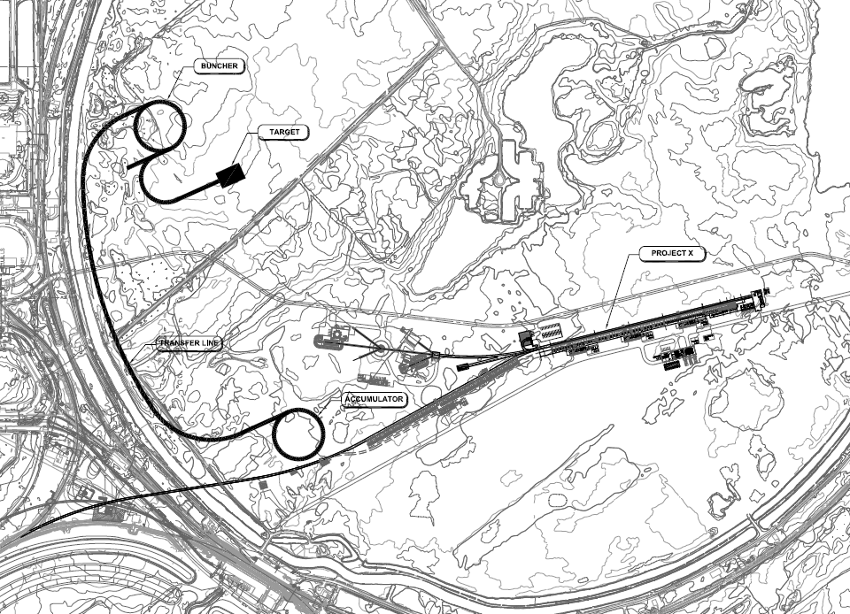
Project X to Proton Driver

Slide 15
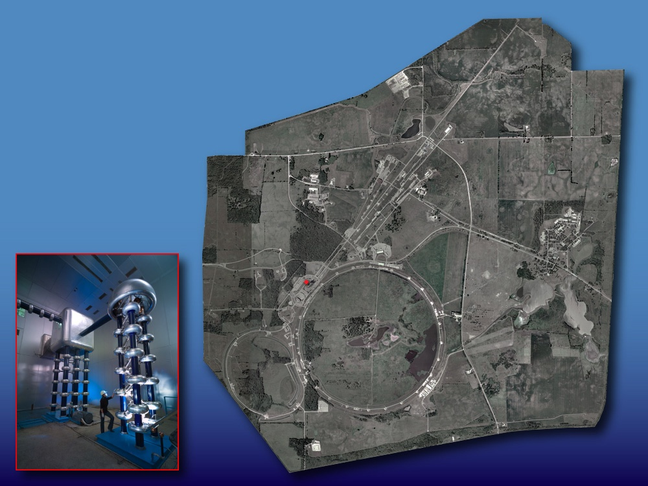
Neutrino Factory
Initial concept

Slide 16
Muon Collider
Initial concept

Slide 17
Summary
Designing Project X to allow for upgrades to support proton source for NF/MC
Designing Proton Accumulation Ring and Bunch Compressor Ring
Designing Muon Collider “single bunch” delivery system
Work upon site layout as concepts/schemes change

