Slide 1
6D Cooling Section Bench Test
and 6D Experiment Planning
Vladimir Shiltsev, Andreas Jansson*
Accelerator Physics Center
Fermi National Accelerator Laboratory
* Now at ESS, Lund, Sweden
Muon Accelerator Program Review
Fermilab, August 24, 2010

Slide 2
Content
Strategy to demonstrate 6D ionization cooling channel
Bench Test
Role of Simulations
6D Cooling demonstration experiment
Summary

Slide 3
6D Demo Strategy
MICE is both technology demo and beam experiment at the same time
Assuming MICE is successful in demonstrating transverse muon cooling and emittance exchange, our assessment is that most of the technical risk is related to remaining untested 6D cooling technology (i.e. can we build and operate the channel as designed).
Separate bench test tech demo from beam test for 6D cooling!
Only bench test will actually be carried out during the 7-year MAP programme:
  Show that the cooling channel design can be implemented in practice, and operated within its design parameters.
  No beam is needed for such a bench test demonstration.
In addition - study and make plans for a 6D cooling experiment.

Slide 4
6D Channel Section Bench Test
The section of channel tested on the bench should be long enough to address the relevant integration issues
  Cavities should be operated in their design field
  Enough cavities, magnets and absorbers should be installed to verify spatial compatibility of e.g. plumbing, etc.
The channel section for a bench test may be different (e.g., shorter) than what is needed for a beam test.
  Try to maintain compatibility

Slide 5
Bench Test in MAP
The combined efforts within the MAP Design and Simulations and Technology Development sections will enable us to identify a suitable candidate for a baseline 6D channel by the end of FY2012.
The primary selection criterion for the channel will be the simulated performance
  when operating within the limitations (e.g., on cavity gradient) established by the R&D program over the next few years.
  If there is >1 viable candidate, the secondary criterion will be estimated cost and technical risk (e.g., complexity).
Bench test can be carried out in our MTA facility within the time frame of this proposal.

Slide 6
HCC Bench Test
Helical Cooling Channel:
  Helical solenoid with pressurized gas filled RF cavities inside
  Most challenging integration, but compact
Likely layout
  1 helix period magnet
  3 or more cavities in central region (at least one powered)

Slide 7
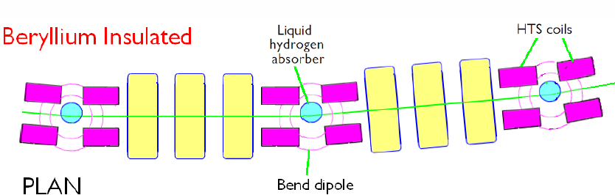
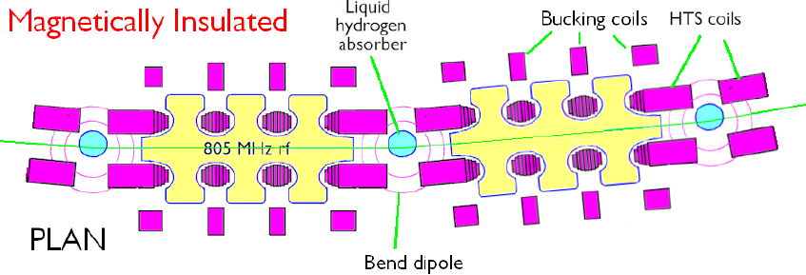
Guggenheim Bench Test
The Guggenheim cooling channel lattice options:
  RF cavities with, e.g., Be coating
  RF cavities with magnetic insulation
+ wedge absorber
Likely layout:
1 basic cell
  1 LH2 absorber
  2 focus solenoid(s)
  1 Cavity string (+ mag ins coils if needed)

Slide 8
Helical FOFO Snake Bench Test
Helical FOFO Snake channel:
  Simple, straight lattice with tilted solenoids
  Accepts muons of both charges
Possible layout: 1/2 basic cell
  3 solenoids
  2 cavity strings
  1 LiH absorber

Slide 9
Timeline and Milestones
Date | Milestone | Designation | Deliverablesa)
FY10 | Study possible minor extensions to MICE | ST10.1 | DR
FY11 | Deliver Spectrometer Solenoids to RAL | ST11.1 | DR
FY12 | Deliver first RFCC module to RAL | ST12.1 | DR, MR
FY13 | Initial specification of 6D cooling bench test | ST13.1 | DR, MR
FY14 | Finalize 6D cooling bench test specification | ST14.1 | DR, MR
FY15 | Initial component specifications for 6D cooling experiment | ST15.1 | MR
FY16 | Install 6D cooling bench test section in MTA | ST16.1 | MR
 | Prepare proposal for 6D cooling experiment | ST16.2 | FR, ER
DR: design report (MAP technical note); ER: external review; FR: formal report;
MR: MAP (internal) review.

Slide 10
6D Experiment Strategy
To arrive at an optimal experimental setup, we need to carry out
  A simulation effort to understand what aspects of the cooling channel performance need to be tested, and to what accuracy. This will include determining the required length of cooling channel, the required beam parameters, and the analysis approach.
  A diagnostics/detector effort to determine how best to measure the muon beam to the required accuracy.
  A design/integration effort to specify, and define a layout for, the experiment. This will be coordinated with the bench test activity, to ensure to the extent possible that the cooling channel hardware built for the bench test can also be used for a beam test. This will also include finding a suitable location and designing a muon beam line.
Many details undefined until baseline channel has been selected.
  Focus on making MICE a success, as it will provide valuable input

Slide 11
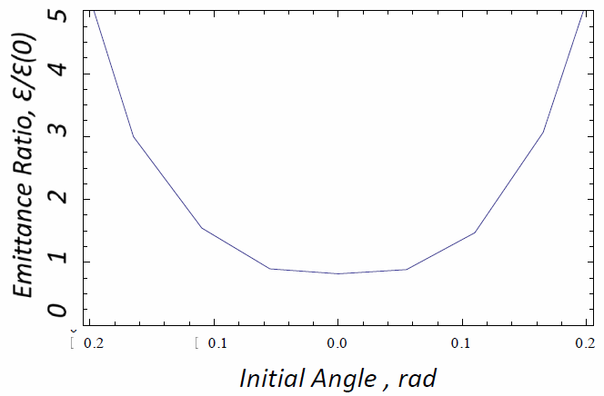
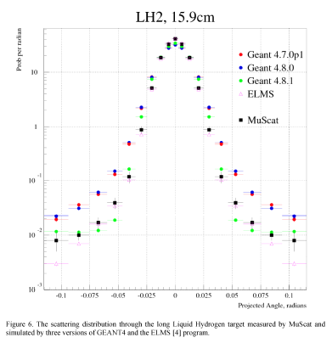
Examples: MICE Emittance vs Initial Angle & MUSCAT
Initial Angle , rad
Emittance out for pencil beam (zero initial emittance), as a function of initial angle.
Emittance out depends strongly on angle in for angles > ~50mrad.
This corresponds roughly to the tails of the H2 scattering distribution.
Results from MuScat experiment
(100-200 MeV/c muons, TRIUMF)
M Ellis et al,
AIP Conf. Proc. Vol. 896, pp. 168-177

Slide 12
Simulation Effort
Maxwell's equations, ionization energy loss and multiple scattering are quite well known.
  We expect any surprises will likely come from the a) detailed distributions (tails) and/or correlations between straggling and scattering; b) high intensity effects (space-charge, plasma, etc)
  These subtleties are not easily measured with the MICE approach of analyzing the data set as a virtual beam.
In addition, rms emittance is not a conserved quantity in a non-linear system.
  May get artificial emittance increment/decrement due to mismatch, even without absorber
  May need a blinding scheme to avoid confirmation bias.

Slide 13
Simulation Effort
Sensitivity to all kinds of errors will need to be studied
A lot of the mechanics for this study can be tested on, and benefit, MICE.

Slide 14
Muon Accelerator R&D
Test Facilities
MTA (now – 2016)
  Tests of components, RF studies, 6D channel bench test
MICE (now – 2013+)
  Demo of 4D cooling, wedge tests
6D Ionization Cooling Facility (after MAP, 2016 +)
  Demonstration of 6D cooling with intense muon beam
  Example: reduction of 6D emittance by a factor of 5 (1.7 per plane) requires ~60 m of the 6D channel

Slide 15
6D Facility Requirements
Appropriate timeline:
  The facility has to be available sometime after 2015
    when 6D cooling technology chosen and proven
Technical:
  i) space; ii) beam parameters; iii) cost
Desirable features:
  Get proton beam from existing facility
    E.g., Main Injector, or, later on, from the Project-X
  Be upgradable/expandable to take high intensity beam (eg from Project-X) for full muon bunch intensity R&D
  Possible modification to be employed as the MC or NF Front End

Slide 16
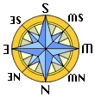
MICE Hall
  Space very limited
  ISIS is not right source
Target
Decay solenoid
Linde refrigerator
MICE Local
Control Room
  35 m
Upstream
Beamline
Downstream beamline

Slide 17
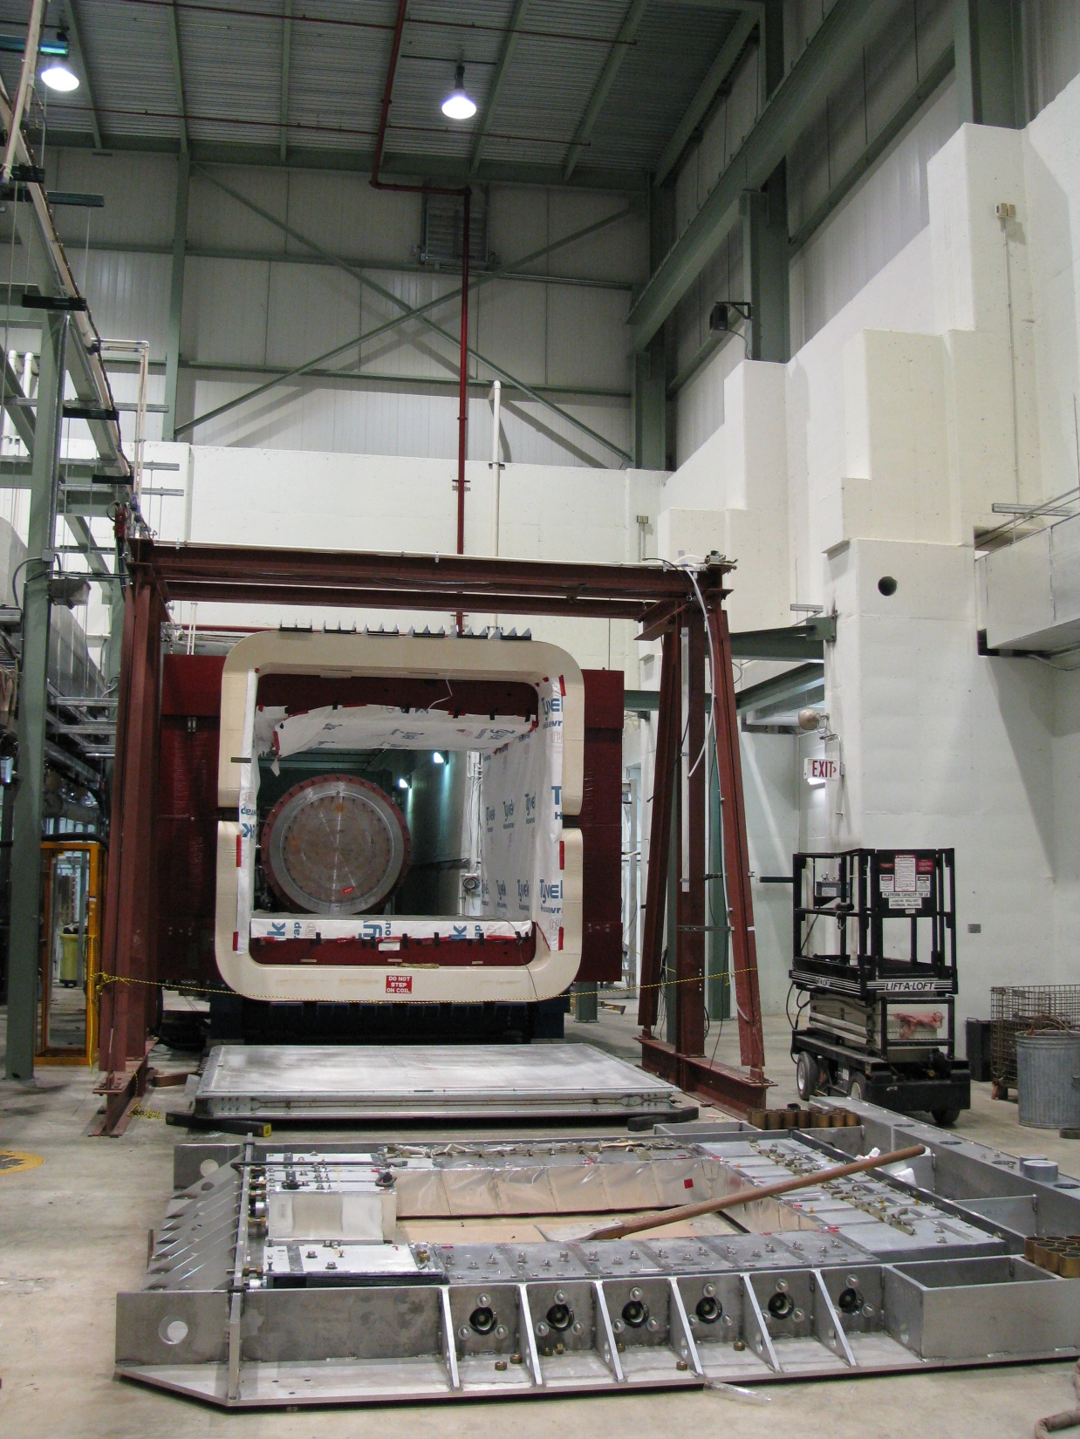
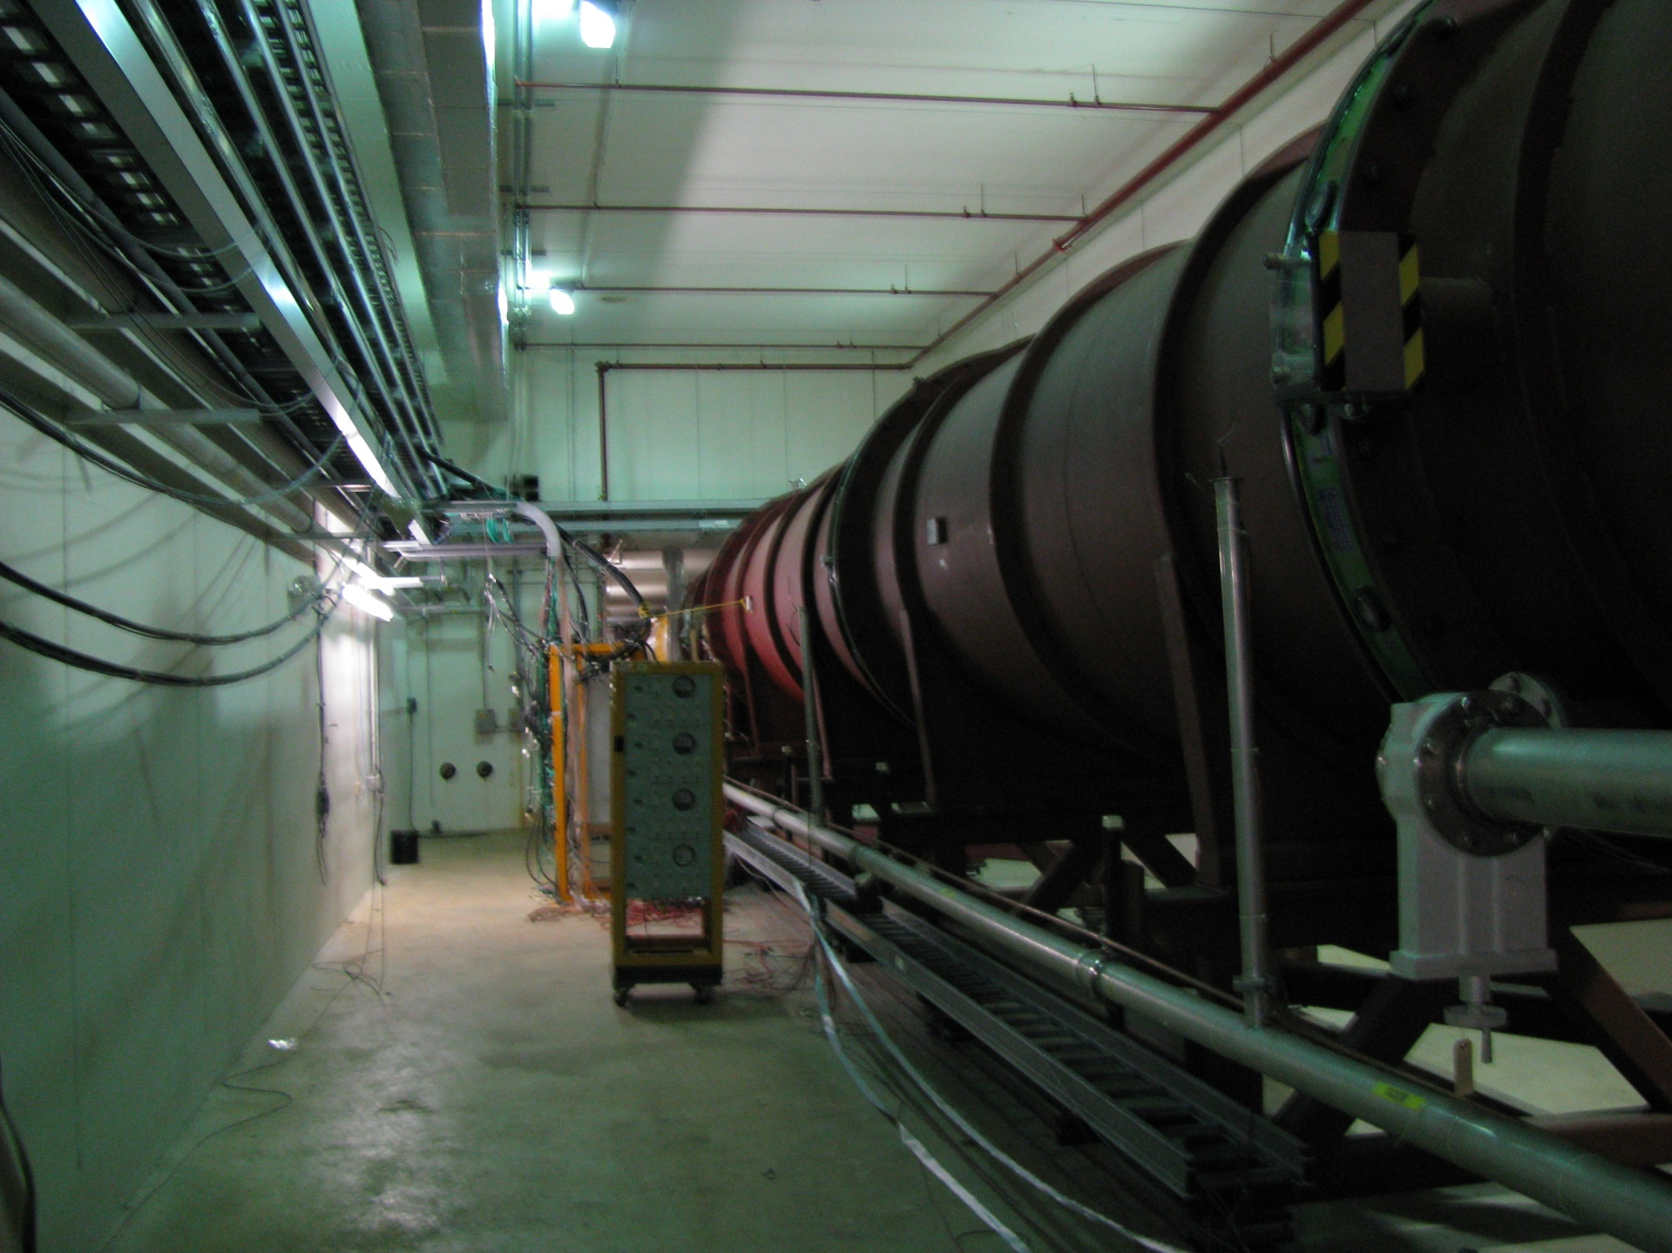
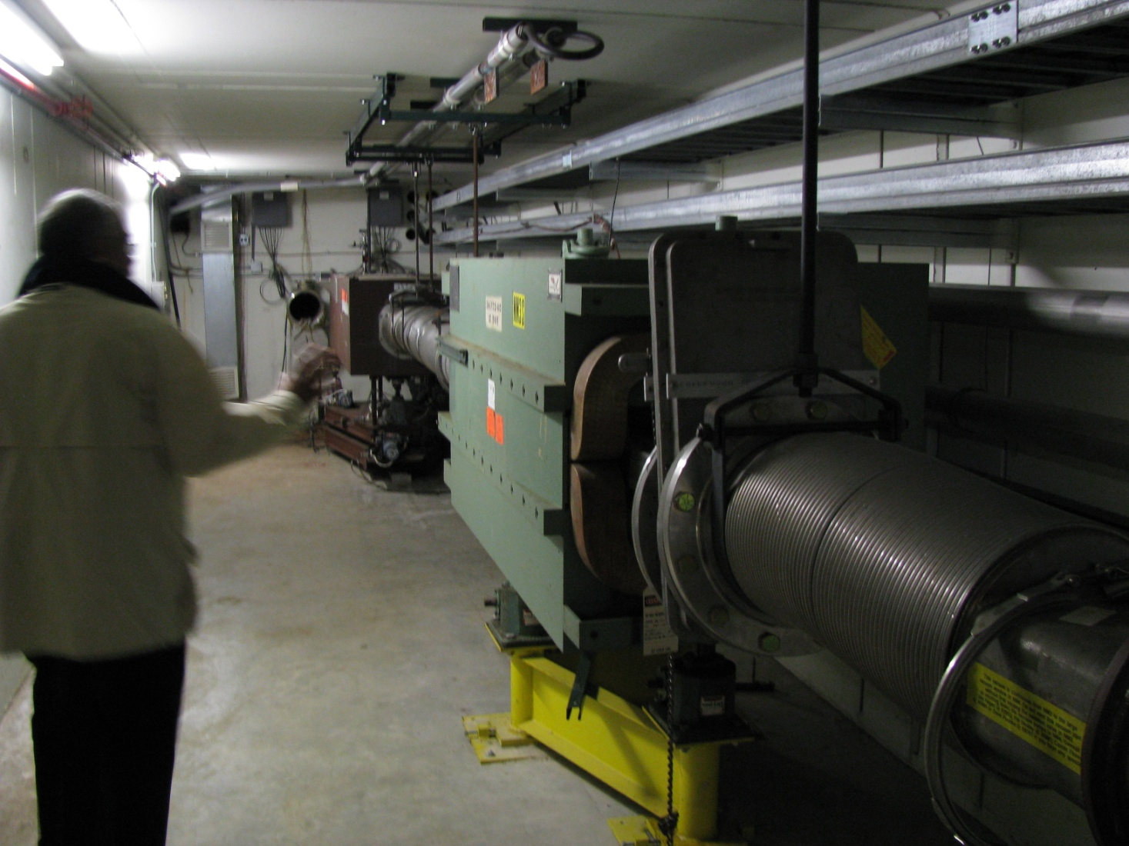
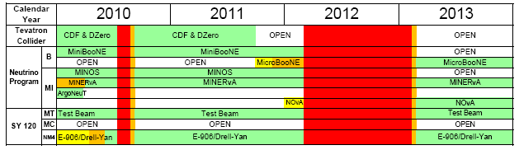
KTeV Hall

Slide 18
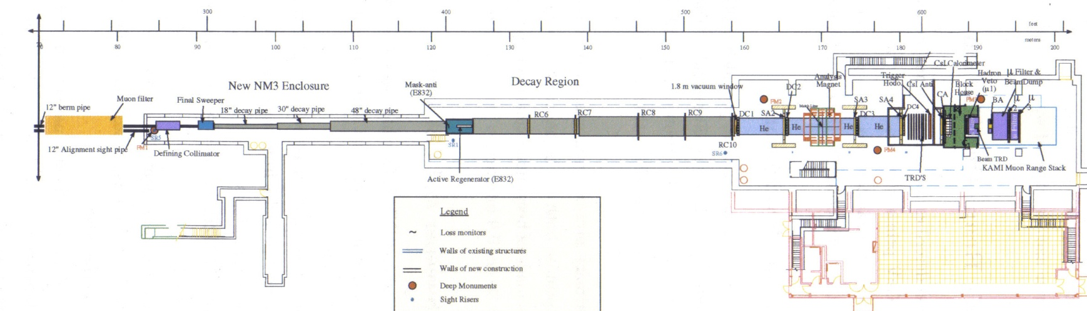
Muon R&D Facility at KTeV Hall
~120 m long: 35m x4x3m + 40m x7x6 m + 45m x17x12m
Control room and PS areas; 25-ton crane, water, lots of electric power available
120 GeV, 3-8ns short bunches from Main Injector with N_p=(1-40)e10/bunch – already available

Slide 19
Summary
6D Cooling Channel Bench Test
  Will show that the cooling channel design can be implemented in practice, and operated within its design parameters.
  The channel scheme selection anticipated by the end of FY2012
  No beam is needed for such a bench test demonstration
  Can be carried out in MTA facility
  Together with MICE, will provide input for the design of 6D cooling demonstration experiment
6D Cooling Demonstration Experiment (not part of MAP)
  the need will be assessed after the completion of MICE and bench test of a section of 6D cooling channel
  the plans for such an experiment will be developed under MAP

