Slide 1
Ecloud/TMCI Models, Dynamics Estimation, System Estimation Techniques
Ozhan Turgut
Claudio Rivetta, Themis Mastorides, John Fox, Max Swiatlowski (SLAC)
SLAC / LBL / CERN Ecloud-Feedback Collaboration
LARP Collaboration Meeting 15, November 1-3 ,2010

Slide 2
Motivation
System Identification is important for two main reasons.
To characterize beam dynamics.
To achieve a simplified model that would help with designing and testing feedback system.
For model based controller design we need system model. With that model we can use formal tools such as root locus and bode plot to design a controller. These tools will tell the limits of feedback control stability and performance.
What happens if current density changes 10% ?
It is much easier and more reliable to use system model to determine the stability margin dependence on the various system parameters , rather than running multiple simulation for each case.

Slide 3
System Identification
Error
Input, u(k)
System
Output, y(k)
+
Identification
Reduced Model
System Parameters

Slide 4
Open Loop Approach
SPS-MD Real Data is used.
In this approach , the beam is not driven with an excitation signal.
Extracted information will give an idea about worse case scenario for growth rates and tune shifts.
This information can be used in controller design.

Slide 5
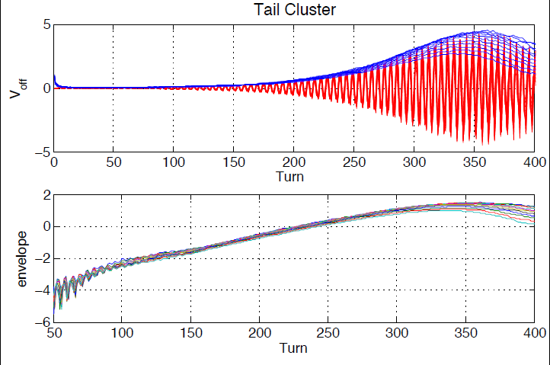
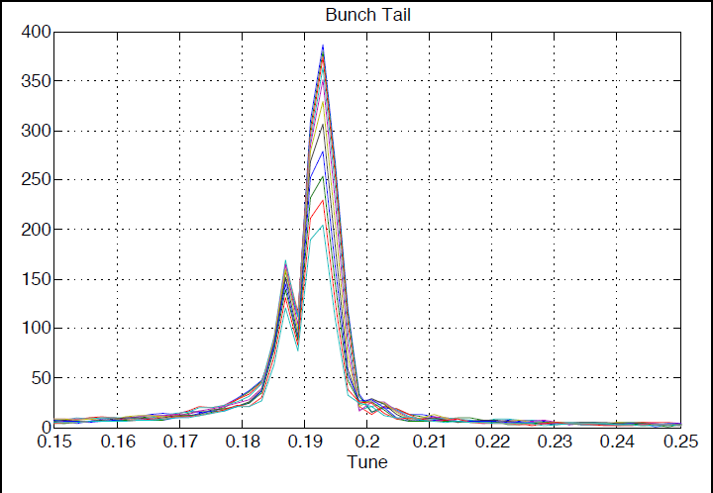
Growth Rates and Tune Shifts SPS – Real Data A few samples from the tail and limited number of turns for linearity.

Slide 6
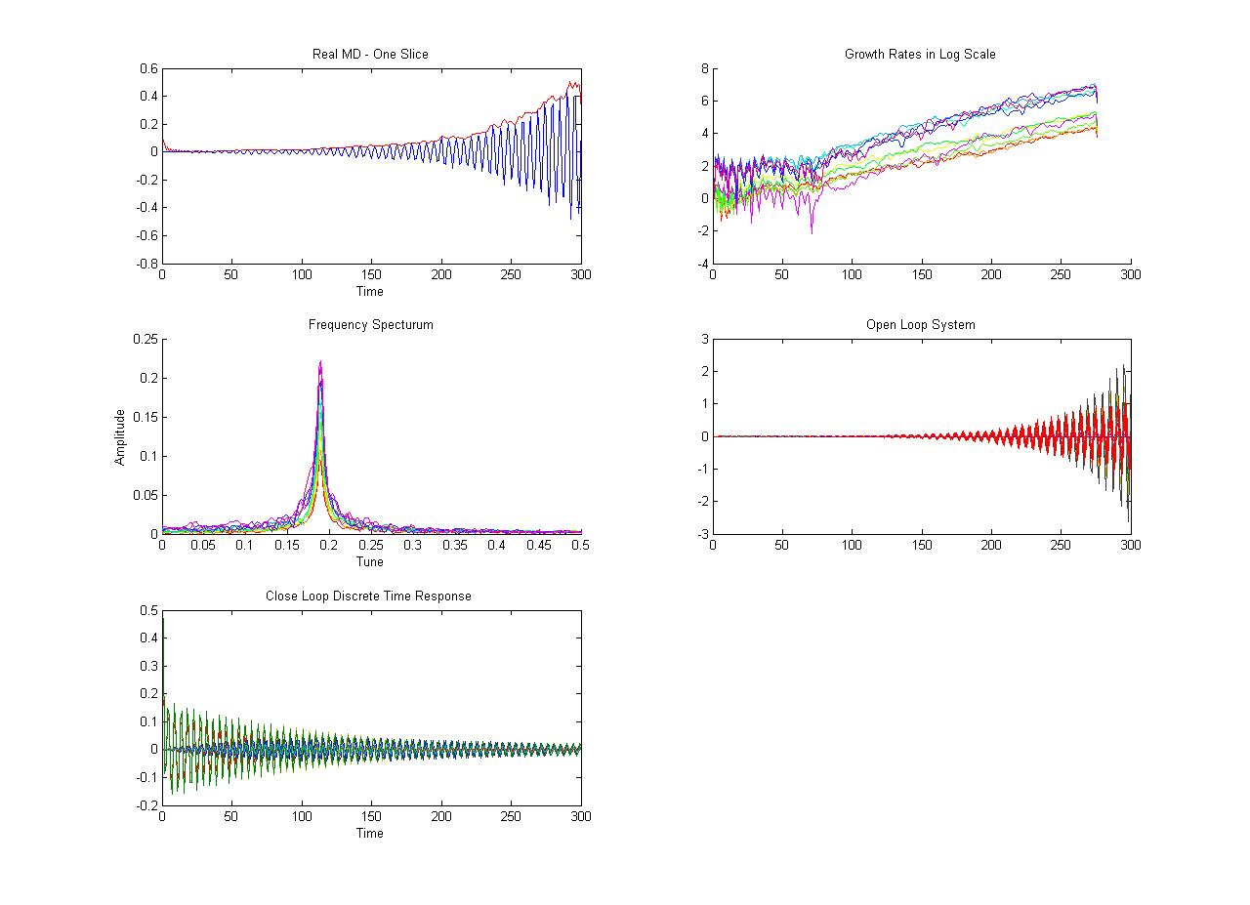
Real MD - SPS
Simulation

Slide 7
Driven Beam Approach
We are building a system to drive the beam but for now we can evaluate the approach with simulations.
Working on simulation data because we can drive beam in simulation.
Helps us get ready to have a real MD in 2011 or 2013 with new kicker.
Experience : how to drive the beam to get maximum information out of it.
We have two different models.
Linear models with uncertainty bounds.
Linear models with time dependent characteristics.

Slide 8
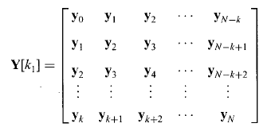
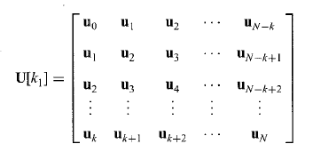
Identification Algorithm
Based on subspace model identification methods (SMI).
A class of observable canonical form is used.
For MIMO systems input and output is in higher order matrix form.

Slide 9
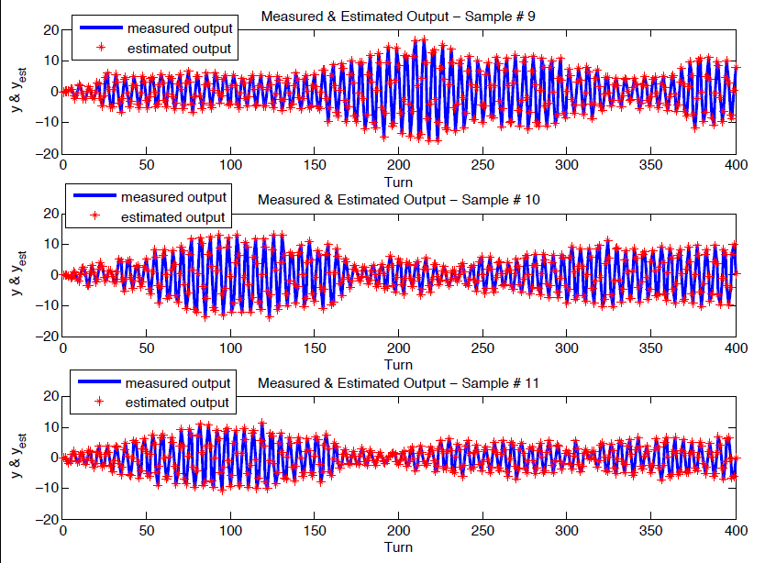
Linear Model Driven Beam

Slide 10
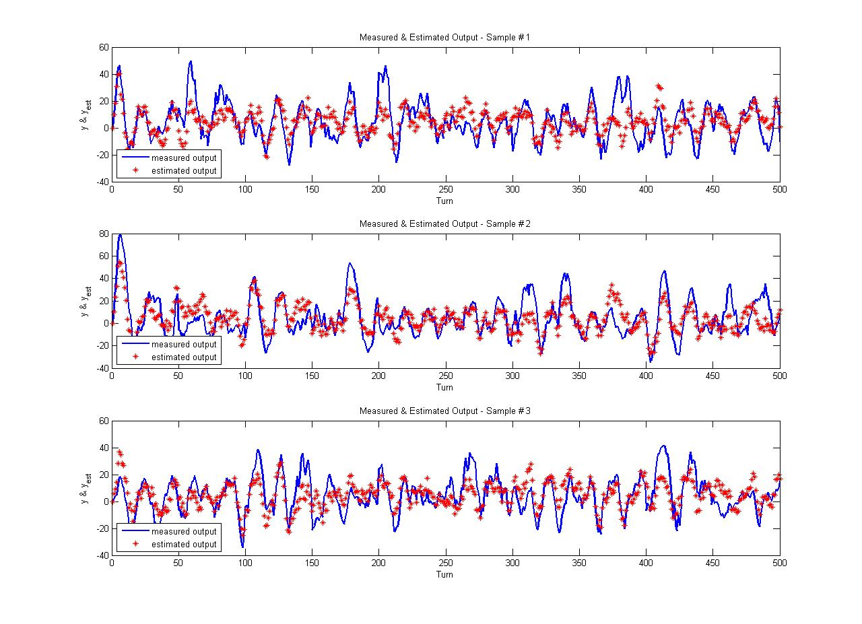
Linear Model with Time Variant Characteristics ( synchrotron motion )

Slide 11
Summary
What we need to develop is a model with enough parameters that captures the real system behavior.
Model parameters will let us construct the transfer function of the system.
Transfer function contains very crucial information about the system dynamics.
How stable the system is.
Time domain specifications.
Gain Margins, Phase Margins, Bandwidth.
Types of controller we need to stabilize the system when we have an unstable system.
This Model-Based design helps us understand the limits of controllability , evaluate benefits of different control options.

Slide 12
Thank you for attendance ! Any Questions ?
Reference
F. Al-Muthairi, S. Bingulac and M.Zribi , ‘Identification of discrete time Mimo systems using observable canonical form’ , IEE – 2002.
Maciej Niedzwiecki, ‘ Identification of Time-varying Systems with Abrupt Parameter Change’ , Automatica, 1994.

