Slide 1
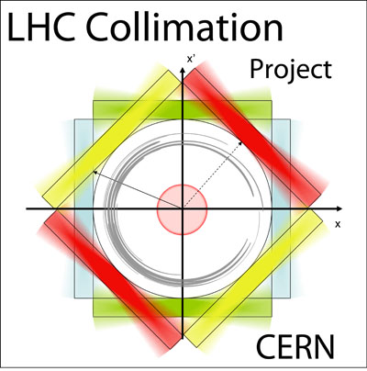
LHC Collimation Project - HL-LHC Design Study: WP5
R. Assmann
LARP CM15, 1.11.2010

Slide 2
LHC Collimation Works Well…
With already very high LHC beam intensity we see unavoidable beam losses constantly (see example for lifetime > 75 hours).
We can characterize losses. E.g. losses for beam 1 mostly in momentum cleaning → had a few RF cavity trips. Losses for beam 2 mostly in betatron cleaning → no RF trips for beam 2.
Essentially all losses intercepted at primary collimators in betatron and momentum cleaning insertions!
Small leakage to outside cleaning insertions. High efficiency!
Some local losses occur in the experimental insertions (visible on logarithmic scale): luminosity-driven losses, p-p collisions.
In addition: rare beam dumps due to tiny, fast losses in middle of arc (10 events so far → rare dust particles?). Not discussed here…

Slide 3
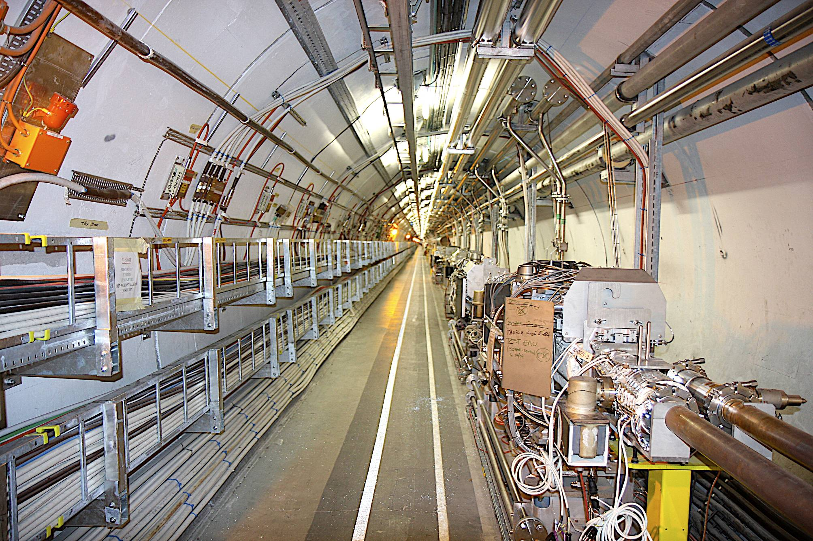
Phase I in Tunnel (Radiation-Optimized)
Implemented 2002 – 2009
LHC Collimation Project
RADIATION-HARD CABLE PATH
WATER FEEDS
COLLIMATOR
COLLIMATOR CABLE TRAYS
PHASE I/II
WATER
DISTRIBUTION
BEAM PIPES
TRANSPORT ZONE
Notes:
3

Slide 4
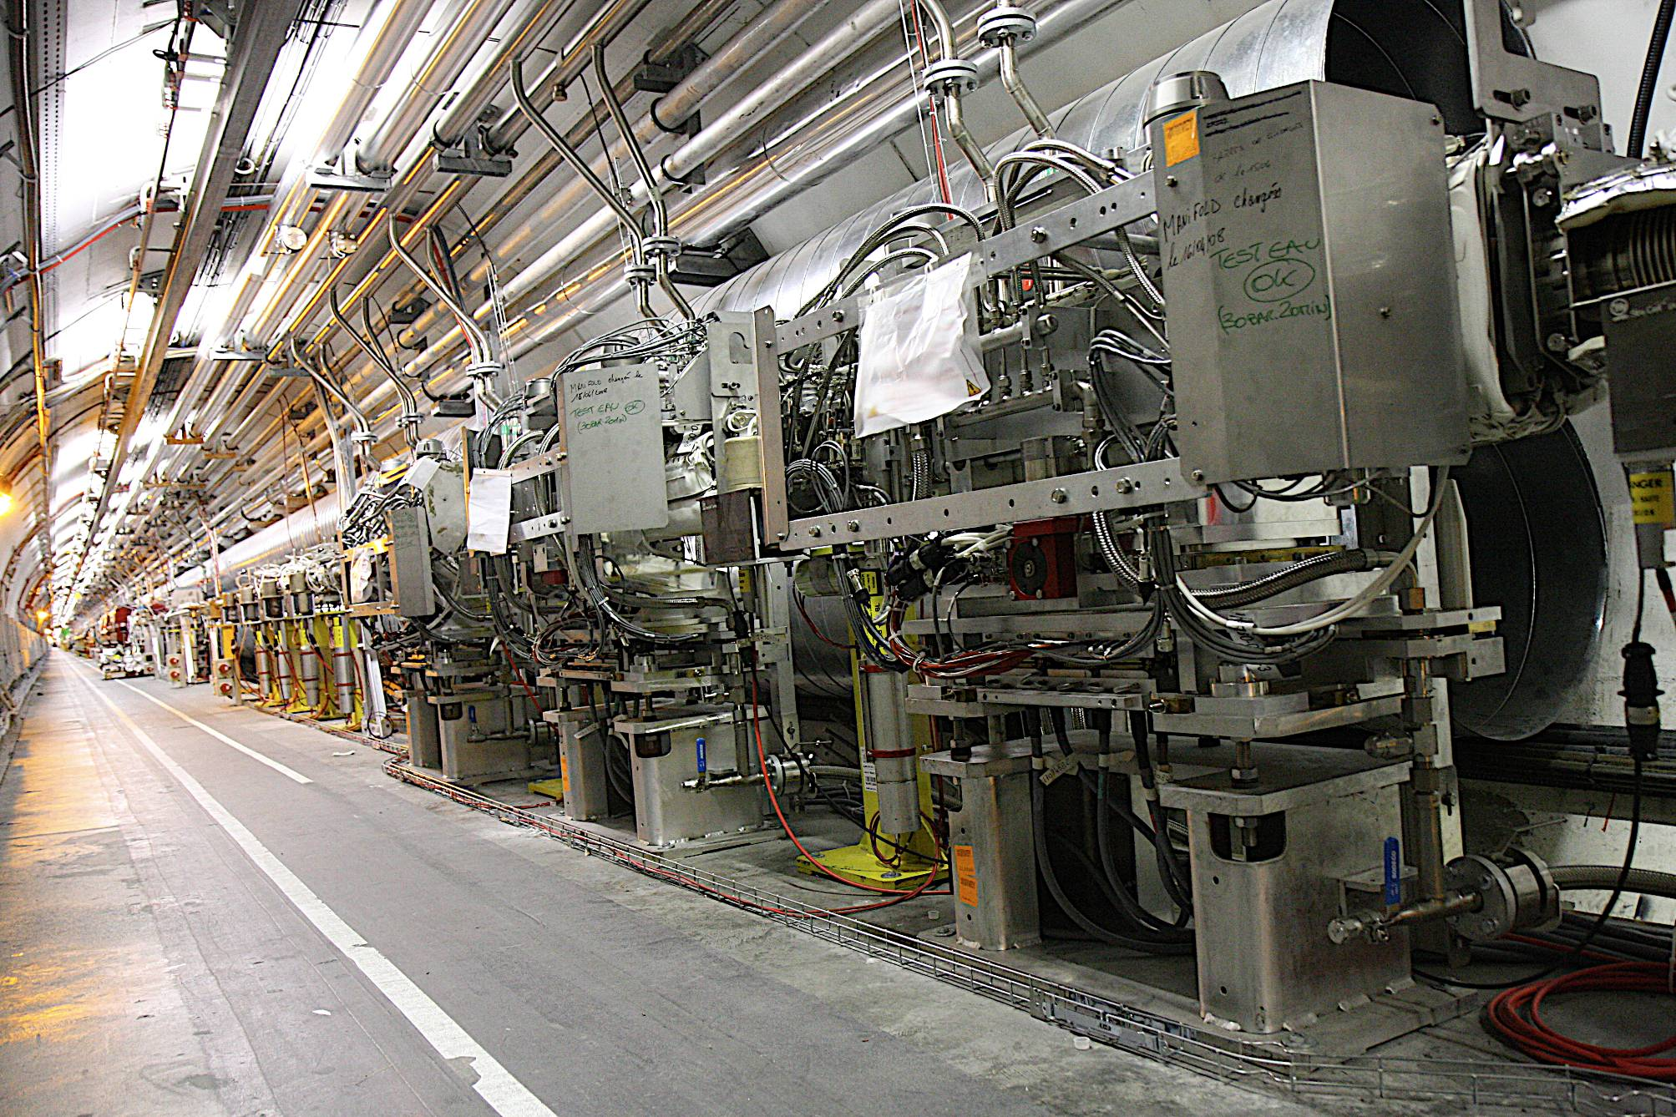
Tunnel: 3 Primary Betatron Collimators
Implemented 2002 – 2009
LHC Collimation Project

Slide 5
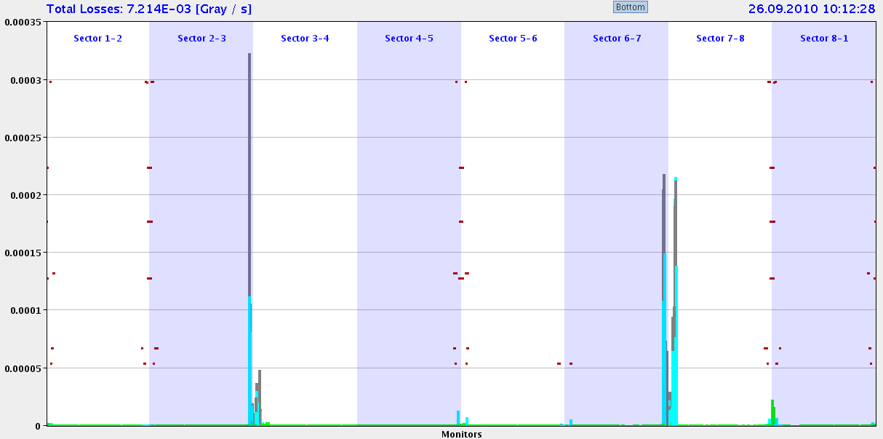
Losses Around the Ring (3.5 TeV, End Record Fill 26.9.2010, τ > 75 h)
3.5
3.0
2.5
2.0
1.5
1.0
0.5
0.0
Beam 1
Momentum
Collimation
Betatron Collimation
Beam 2
ATLAS
ALICE
CMS
LHC-b
0 – 27 km
Essentially all losses at collimators → No quench!

Slide 6
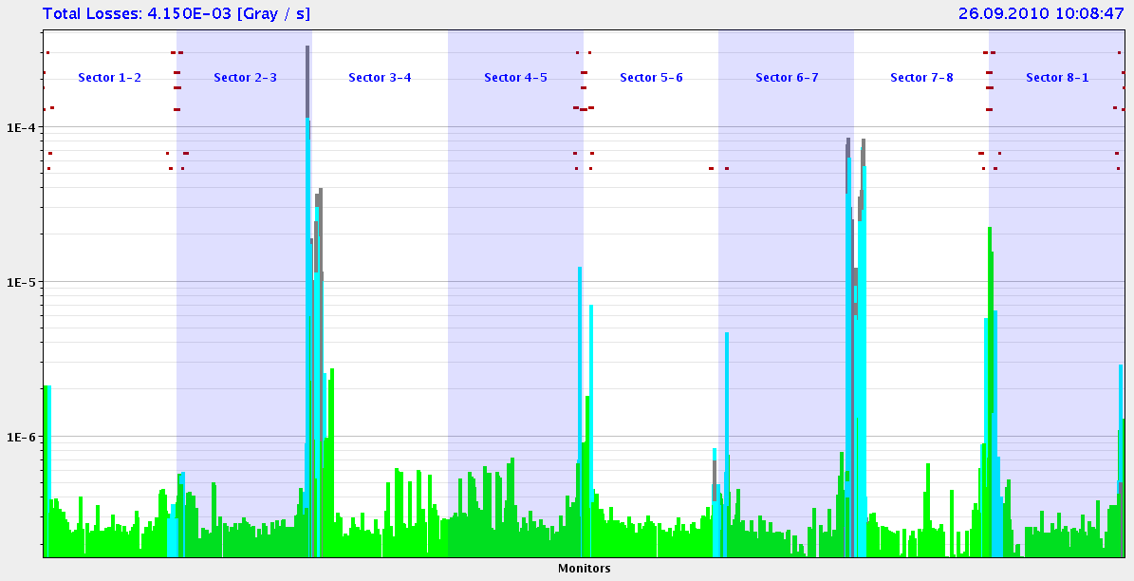
Losses Around the Ring (3.5 TeV, End Record Fill 26.9.2010, τ > 75 h)
Logarithmic scale!
Beam 1
Momentum
Collimation
Betatron Collimation
LHC-b
Beam 2
CMS
ATLAS
Dump
ALICE
0 – 27 km
Details can be seen in logarithmic scale!

Slide 7
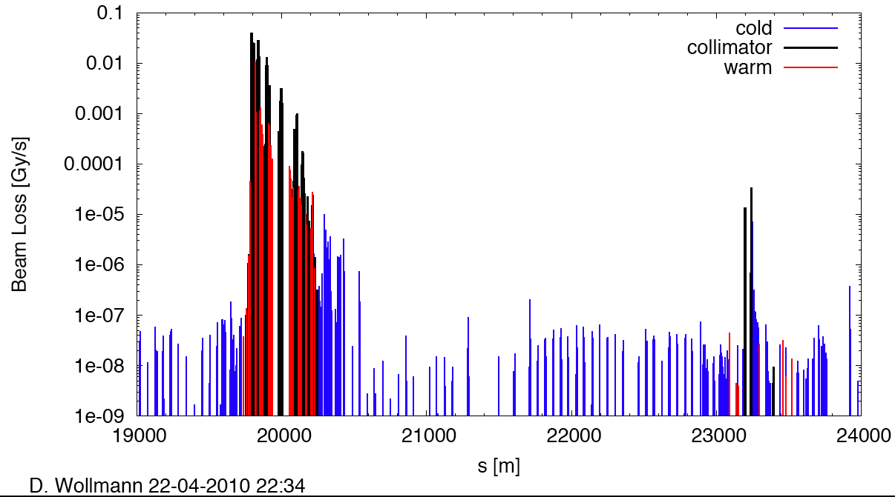
Measured Cleaning at 3.5 TeV (beam1, vertical beam loss, intermediate settings)
Betatron Cleaning
Cleaning efficiency: > 99.975%
factor 4,000
factor 1,000
factor 600,000
IR8

Slide 8
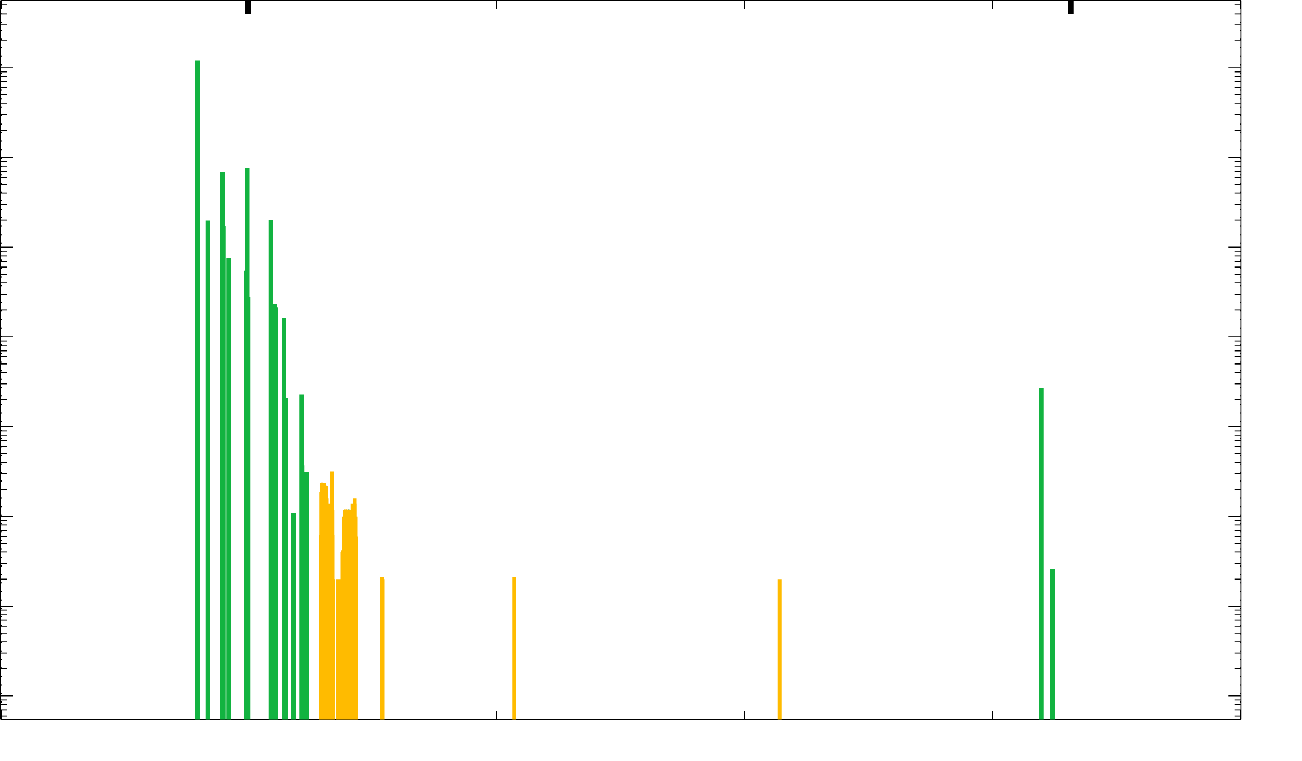
Meas. & Sim. Cleaning at 3.5 TeV (beam1, vertical beam loss, intermediate settings)
IR7
Confirms expected limiting losses in SC dispersion suppressor
IR8

Slide 9
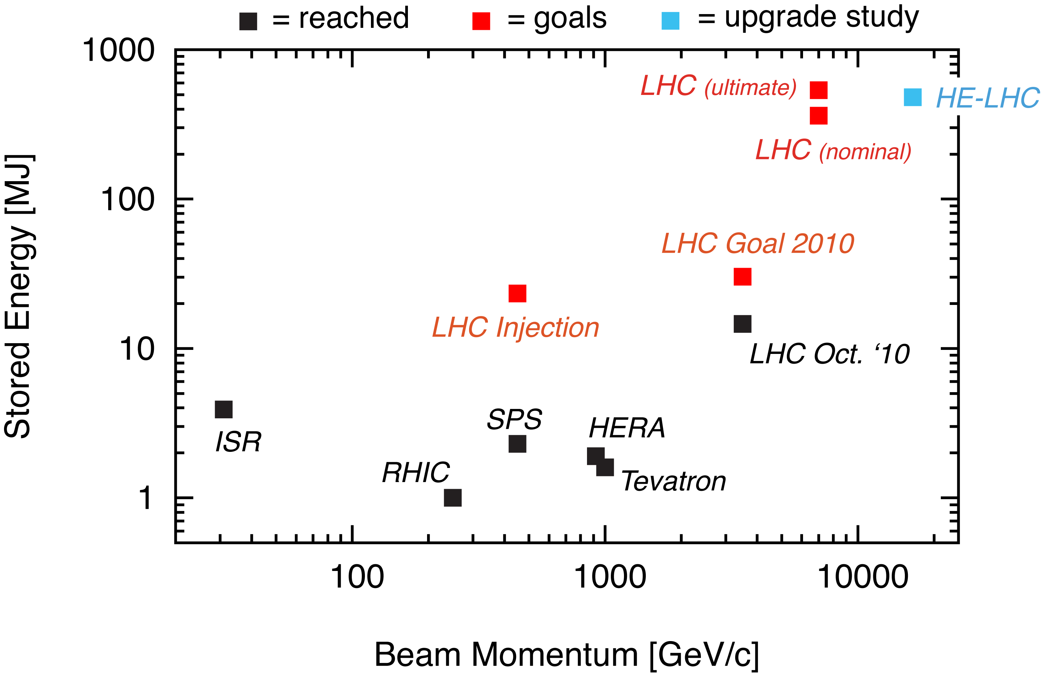
Status LHC Stored Energy

Slide 10
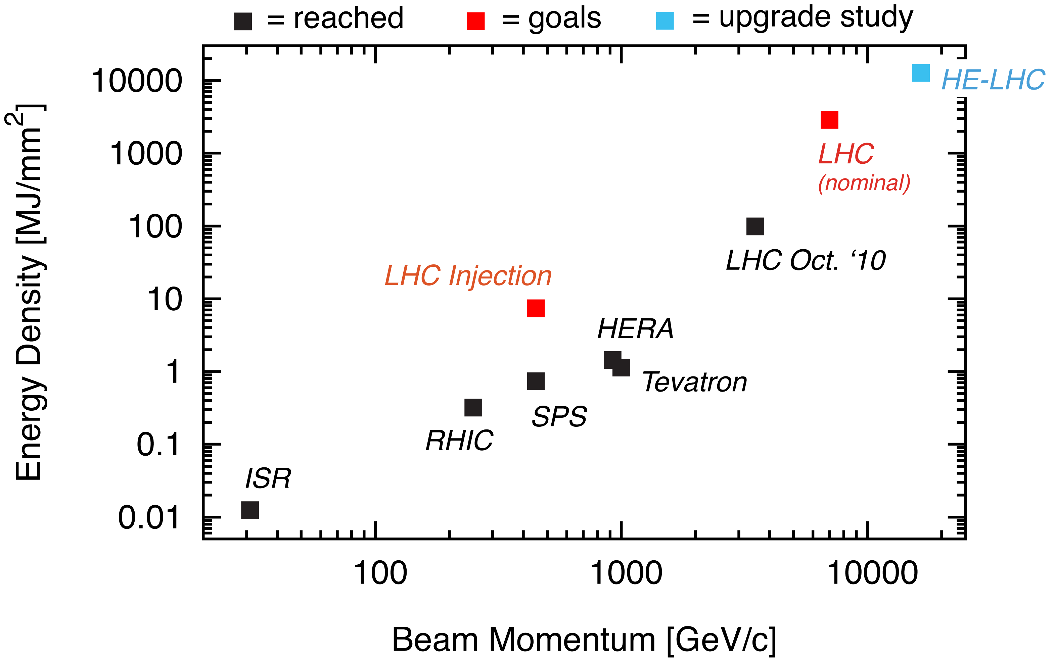
LHC Status Energy Density

Slide 11
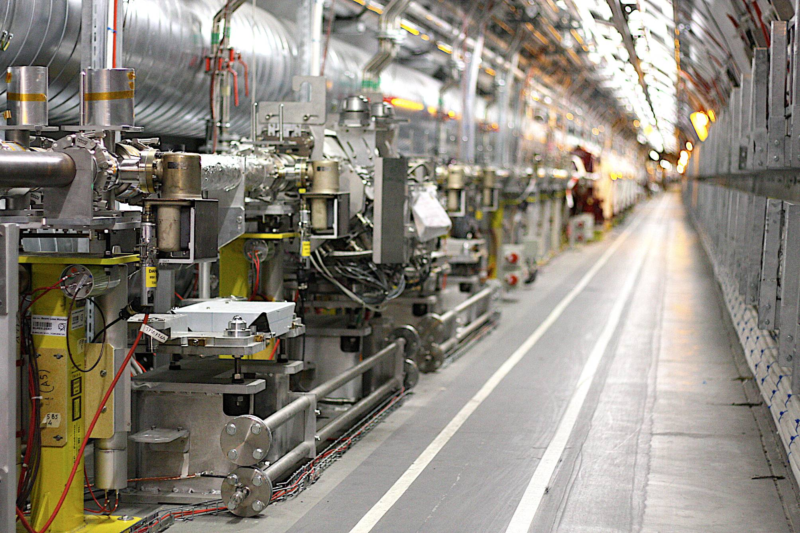
Collimation is Designed for Upgrades!
PHASE I TCSG SLOT
EMPTY PHASE II TCSM SLOT (30 IN TOTAL)

Slide 12
LHC Collimation Upgrade Work
Work is defined in three stages:
2010 – 2013: Upgrade part 1
2013 – 2017: Upgrade part 2
2020: Upgrade part 3.

Slide 13
Collimation Upgrade Part 1 (2010 – 2013)
Start date of work: 1.7.2010
End date of work: 31.12.2013
Deliverables:
Improve collimation efficiency by factor 5-10.
Implement flexibility in loss location (IR3 or IR7).

Slide 14
Collimation Upgrade Part 2 (2013 - 2017) – to be approved in 2011
Start date of project: 1.1.2013
End date of project: 31.12.2017
Deliverables:
Improve collimation efficiency by factor 2-3.
Reduce setup time by factor 100.
Implement radiation handling for highest intensities.

Slide 15
Collimation Upgrade Part 3 (2020) → WP5 in FP7 HL-LHC Design Study
Deliverables:
Same or better loss situation than before the IR upgrade (lower beta* with the same or better intensity reach).
Adapt IR collimation to the new IR layout and optics.
Design report, build hardware, implement modified IR collimation.
WP5

Slide 16
WP Structure I
WP 5.1: Coordination and Communication
WP 5.2: IR Simulations of Halo Loss
Collimation Sixtrack: CERN ABP, Valencia
Collimation Merlin: Uni Manchester
Collimation Geant: Royal Holloway
WP 5.3: IR Simulations of Energy Deposition
Mars: FNAL
FLUKA: CERN STI, Uni Manchester
Geant: Royal Holloway

Slide 17
WP Structure II
WP 5.4: Design of IR Collimation
CERN ABP
Uni Valencia
SLAC

Slide 18
Objectives I
WP 5.1: Coordination & Communication
To coordinate and schedule work package tasks
To monitor work progress and inform the project management and work package participants
To follow up the WP budget and use of resources
To prepare internal and deliverable reports
WP 5.2: IR Simulations of Halo Loss
Assess locations and magnitudes of beam loss in the experimental IR’s for various upgrade scenarios.
Study impact of imperfections on beam loss.
Explore interplay of IR beam losses with machine parameters (beta*, crossing angle).
Specify operational tolerances related to collimation and the IR upgrade.
Define beam impact scenarios for energy depositions studies and collimator design.
Prepare input for energy deposition studies.

Slide 19
Objectives II
WP 5.3: IR Simulations of Energy Deposition
Assess locations and magnitude of energy deposition in the IR’s for various upgrade scenarios including imperfections.
Investigate any possibly required shielding requirements.
Provide input to collimator design.
Prepare input for background simulations.
WP 5.4: Design of IR Collimation
Study required collimation to keep losses at the same level or below before the IR upgrade.
Specification of collimator requirements.
Integration of collimators, new layout and optics.
Feed forward to simulation WP’s.

Slide 20
Milestones (After Start of Design Study)
M12: Set up of models and implementation of upgrade optics.
M24: Assessment of beam halo losses in various upgrade scenarios.
M36: Definition of new IR collimation solution.
M42: Verification of new IR collimation solution in simulations. Possible iteration in design.
M48: Final report.

Slide 21
Conclusion
LHC collimation delivers promised performance, allowing LHC to already reach 28 MJ in stored energy.
Performance reach will be reviewed in the Chamonix workshop, January 2011.
The first phase of the LHC upgrade is ongoing in full speed.
Two more phases have been defined up to 2020.
The upgrade of IR collimation is foreseen for 2020 and is WP5 of the HL-LHC FP7 design study.

