Slide 1
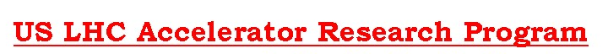
Long Quadrupole
Giorgio Ambrosio
Fermilab
LARP Collaboration Meeting 15
SLAC, Nov. 1-3, 2010
Many people contributed to this work,
most of all the Long Quadrupole Task Leaders:
Fred Nobrega (FNAL) – Coils
Jesse Schmalzle (BNL) – Coils
Paolo Ferracin (LBNL) – Structure
Helene Felice (LBNL) – Instrumentation and QP
Guram Chlachidize (FNAL) – Test preparation and test
Notes:
1

Slide 2
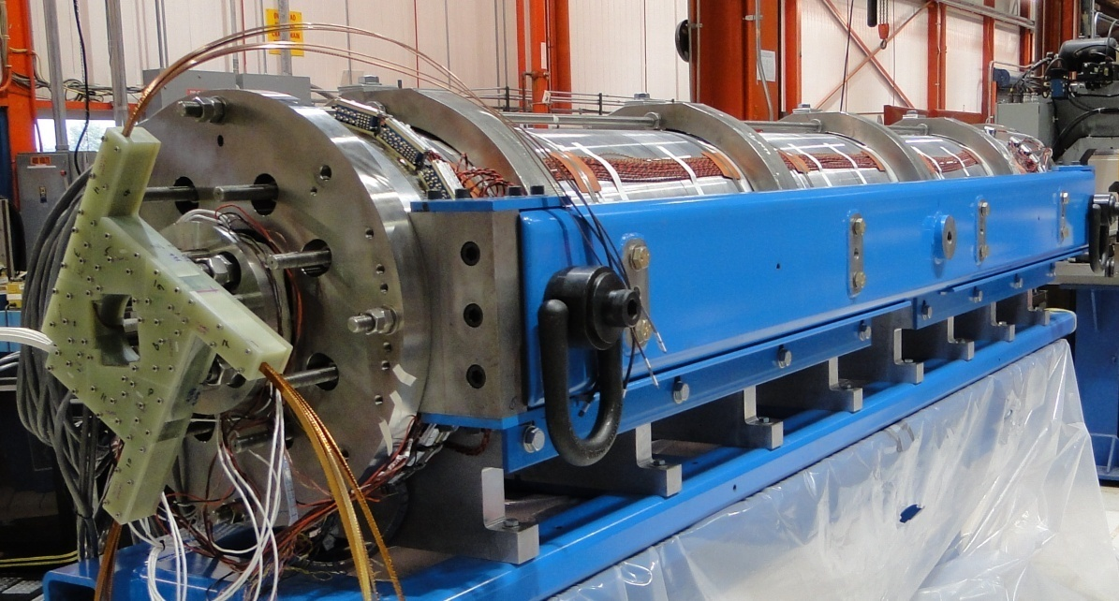
Long Nb₃Sn Quadrupole†
Main Features:
Aperture: 90 mm
magnet length: 3.7 m
Target:
Gradient: 200+ T/m
Goal:
Demonstrate Nb₃Sn magnet scale up:
  Long shell-type coils
  Long shell-based structure (bladder & keys)
  LQS01a was tested in Nov-Dec 2009
  LQS01b (same coils) test in progress
S.S.L. based on cable test is ~3% lower
LQS01 S.S.L. | 4.5 K
Current | 13.7 kA
Gradient | 240 T/m
Peak Field | 12.25 T
Stored Energy | 460 kJ/m
† LQ Design Report available online at:
https://plone4.fnal.gov/P1/USLARP/MagnetRD/longquad/LQ_DR.pdf

Slide 3
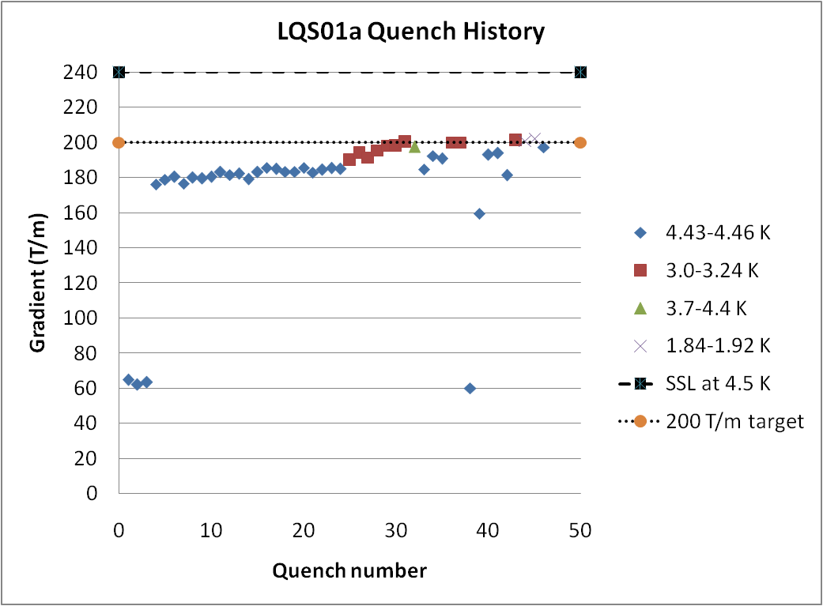
LQS01a Quench History
Slow start
  First quenches at high ramp rate (200 A/s)
  Slow training at 4.5K
    Due to low pre-load on pole turns
Faster training at 3 K
  Reached 200 T/m
Stopped training
  to avoid coil damage and to achieve better performance with optimal pre-stress
SSL at 4.5K : 240 T/m
Target: 200 T/m
200 A/s
Test report available online at:
https://plone4.fnal.gov/P1/USLARP/MagnetRD/longquad/report/TD-10-001_LQS01_test_summary.pdf

Slide 4
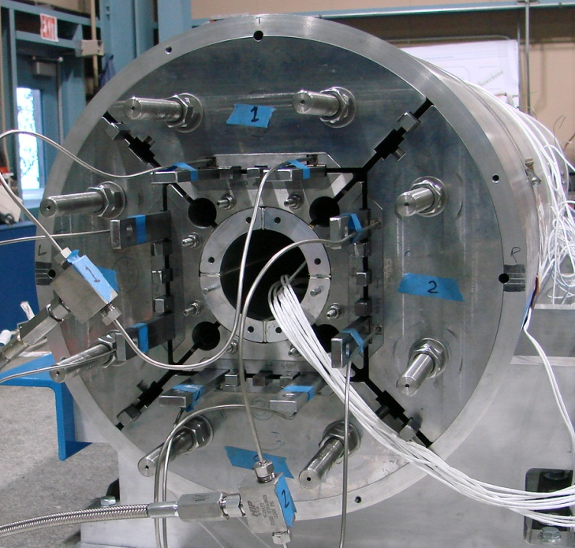
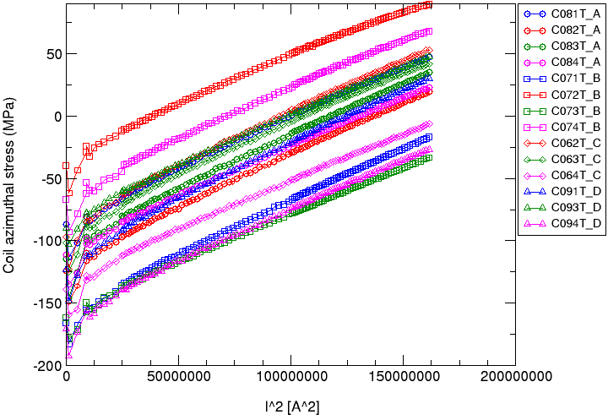
LQS01b (same coils of LQS01a)
More uniform prestress distribution in the coils
  By using thinner coil-pad shims
Higher preload based on short models (TQS03 a/b/c)
  Peak load: 190 MPa +/- 30
  No coil-pole separation in LQS01b
LQS01b: strain gauges on coil poles
4

Slide 5
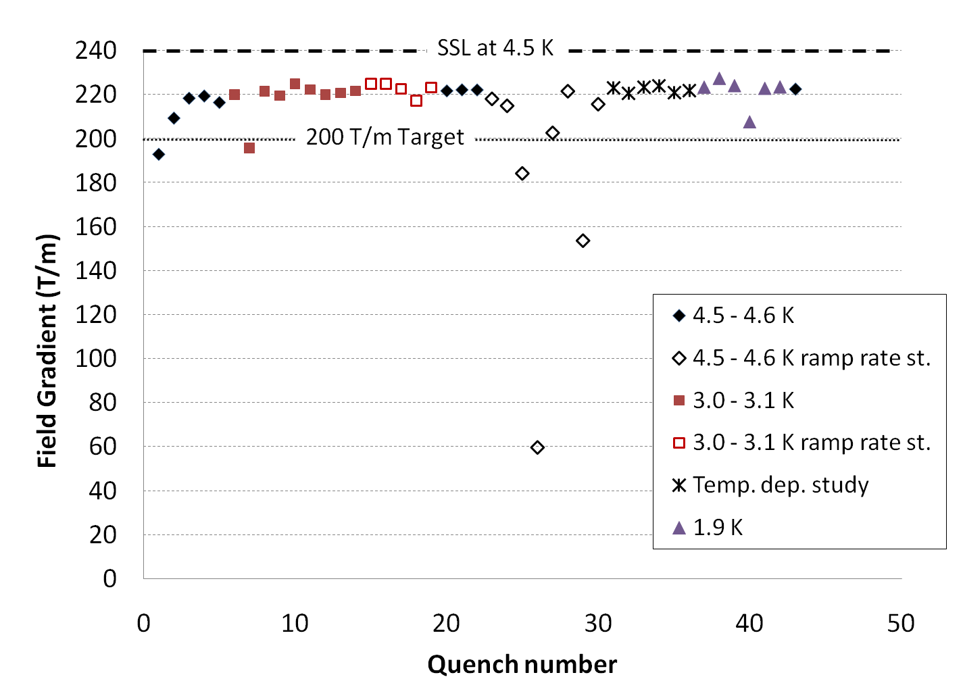
LQS01b Quench History
222 T/m
92% ssl based on strand test
(95% ssl based on cable test)
220 T/m
in 4 quenches
LARP CM15 – SLAC – Nov 1-3, 2010

Slide 6
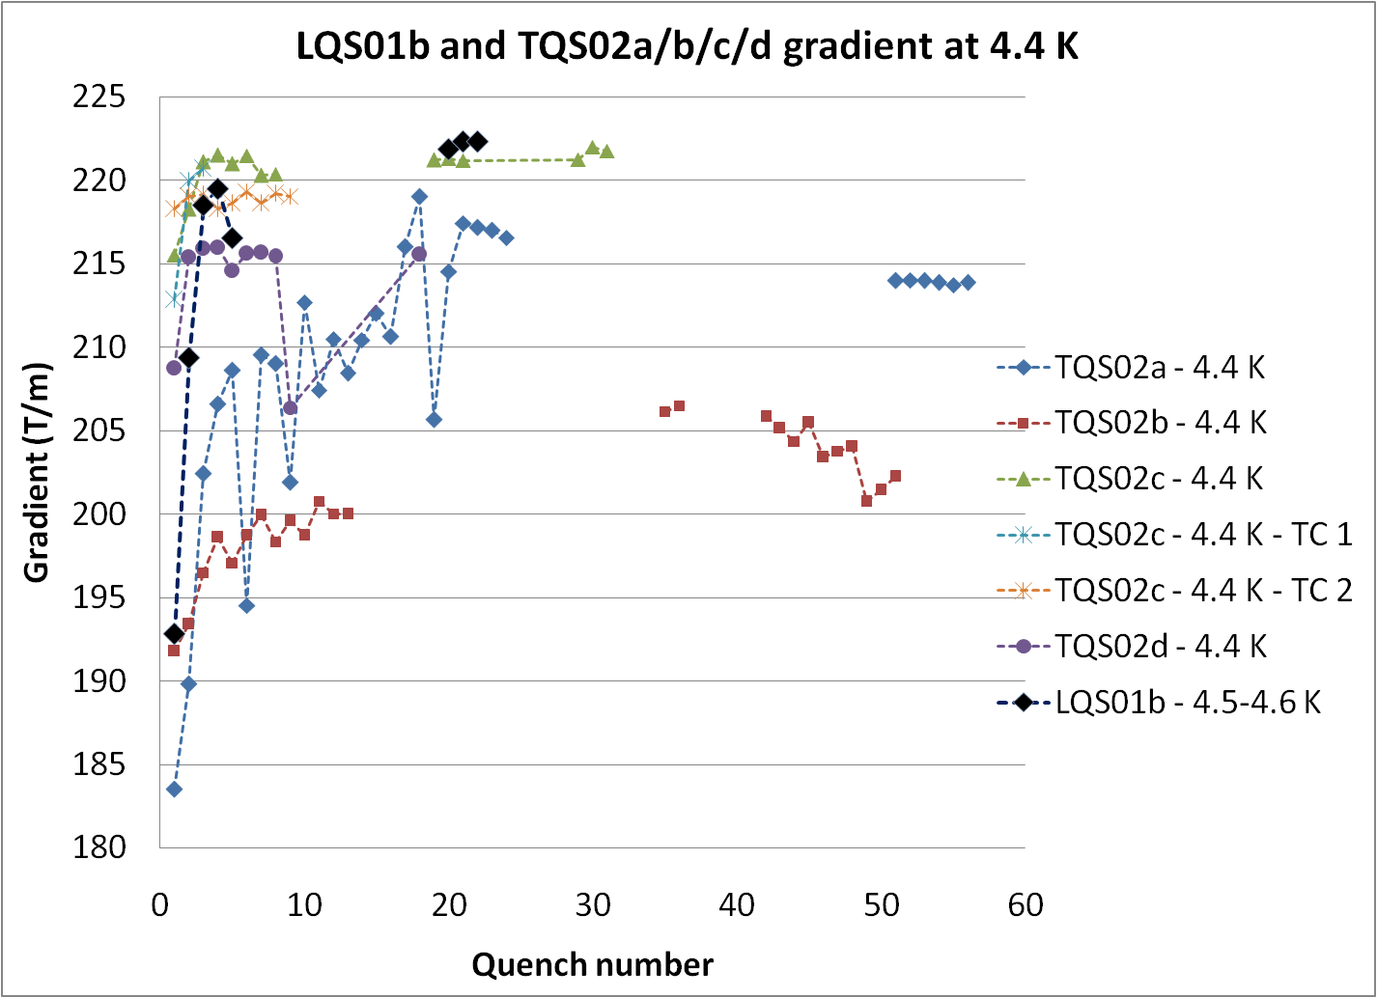
Fast training as in best TQS
All with RRP 54/61 strand
Same maximum gradient (222 T/m) of best TQS

Slide 7
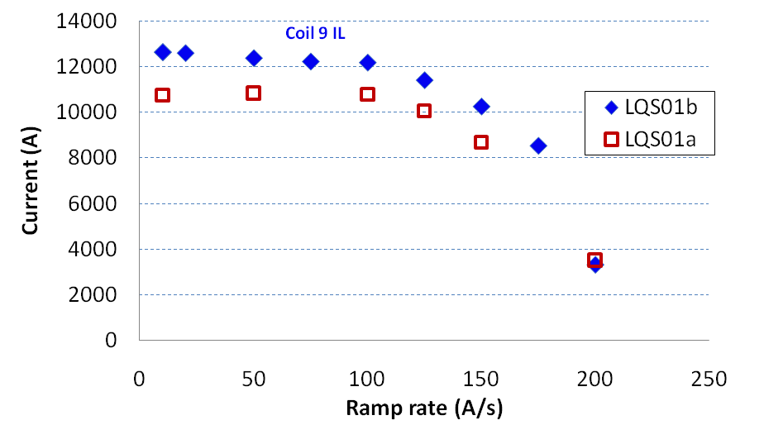
Ramp Rate at 4.5 K
Different coil at different ramp rate:
Coil 8 OL pole
Coil 9 IL midplane block
Coil 6 IL midplane block

Slide 8
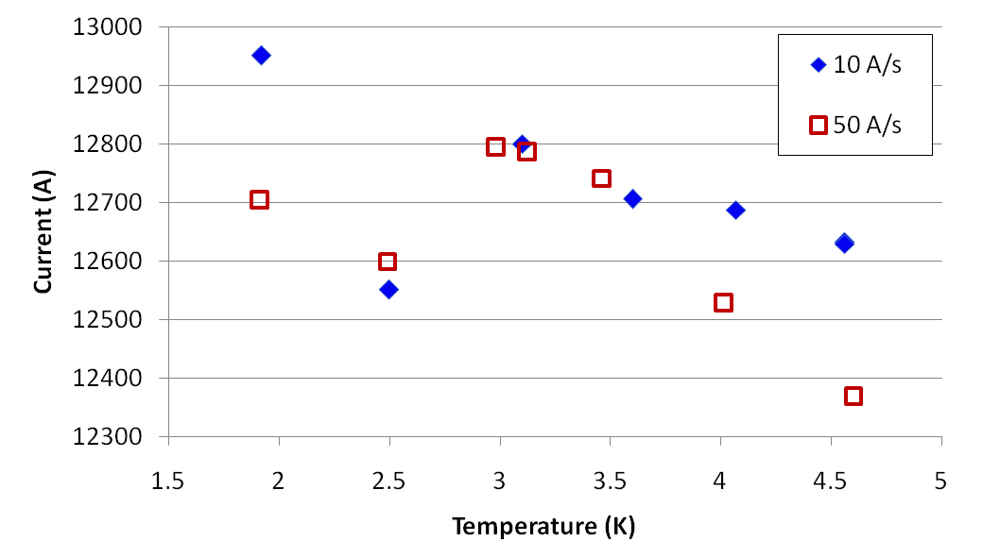
Temperature Dependence
The limited stability of the conductor (RRP 54/61) limits the performance below 4.5 K,
as seen in TQS,TQC and single TQ coils made with the same conductor.
Different coil at different temperature and ramp rate:
9
9
8
9
9
Numbers show coil where quench started; default is Coil 6

Slide 9
Limit at 4.5 K
  Voltage taps: Coil #8, outer layer, pole turn
  Quench antenna: ~ central part of straight section (No max field)
  Temperature dependence in small temperature range:
Computed ΔI/ΔT:
- 850 A/K
TC1
TC2
Possible degradation in Coil #8
outer layer pole turn
Slope - 680 A/K
# 1
Quenches at 10 A/s

Slide 10
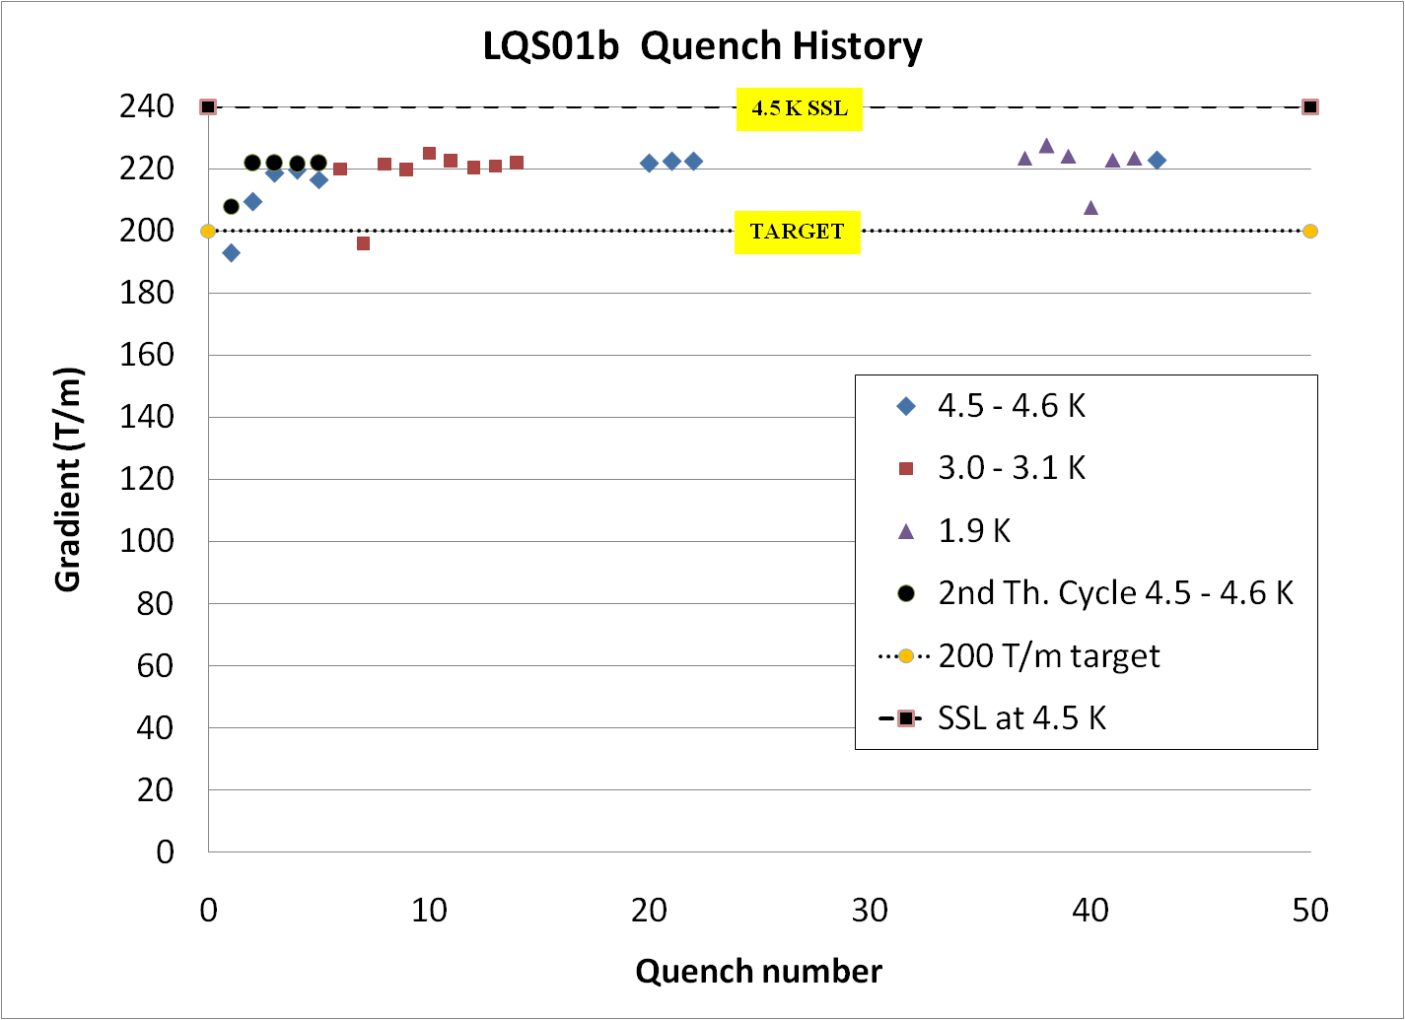
Test After Thermal Cycle
Good memory after thermal cycle with limited ΔT:
  ΔT max 100 K
- Thermal cycle with unrestricted ΔT planned for LQS02

Slide 11
Magnetic Measurement
The reference radius is presently limited by the probe radius
  New probes with larger radius, and warm bore with larger apertures are under development
  Features to be discussed tomorrow in WG B3
The Long Quadrupole, as the Technological Quadrupoles (TQ), doesn’t have alignment features
  neither during coil fabrication
  nor during magnet assembly
The HQ has alignment features and aims at testing field quality in Nb₃Sn magnets

Slide 12
Magnetic Measurement
Magnetic measurement at 4.5K:
  Some are a few units different w.r.t. computed
  Similar to short models †
  Normal octupole (b₄) may have been affected by small differences in impregnation molds
    Two molds used
b_{n} a_{n} | TQS |  |  | LQS
 | calc. | measured |  | calc. | Measured
 |  | 01 | 02
b₃ | - | -1.46 | 2.98 | - | 3.43
b₄ | - | -0.52 | 1.31 | - | 6.20
b₅ | - | 3.06 | -1.45 | - | -0.16
b₆ | 5.00 | 5.40 | 6.23 | 8.45 | 10.43
b₇ | - | 0.07 | 0.05 | - | -0.10
b₈ | - | -0.11 | -0.13 | - | -0.58
b₉ | - | 0.02 | 0.10 | - | -0.14
b₁₀ | 0.04 | 0.02 | -0.05 | -0.03 | -0.32
a₃ | - | 4.41 | 0.66 | - | 2.11
a₄ | - | -1.99 | 0.82 | - | 1.34
a₅ | - | 0.71 | -1.50 | - | 0.48
a₆ | - | -0.37 | 0.12 | - | -0.37
a₇ | - | -0.11 | -0.01 | - | -0.30
a₈ | - | -0.18 | -0.10 | - | -0.09
a₉ | - | -0.02 | 0.02 | - | -0.55
a₁₀ | - | 0.00 | -0.08 | - | 0.24
† G. Velev, et al., “Field Quality Measurements and Analysis of the LARP Technology Quadrupole Models”, IEEE Trans. On Applied Supercond. , vol.18, no.2, pp.184-187, June 2008
Average harmonics in the TQS and LQS at 45 T/m (~ 2.6 kA) at the ref. radius r₀ of 22.5 mm

Slide 13
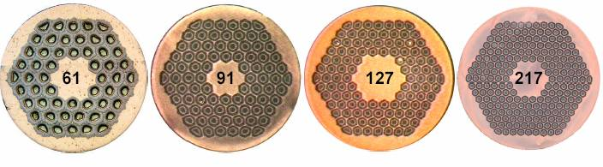
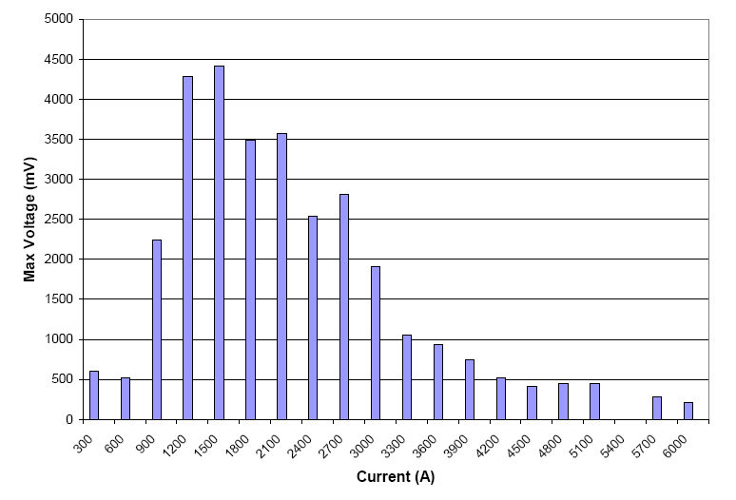
Voltage Spikes
Large voltage spikes
  Due to flux jumps
    Seen in TQ magnets using RRP 54/61
  Larger than in TQs
  ➔Variable quench detection threshold
  ➔Variable ramp-rate during training
    200 A/s ➔ 3 kA
    50 A/s ➔ 5 kA
    20 A/s ➔ 9 kA
    10 A/s ➔ quench
RRP 54/61
by OST
RRP 108/127
by OST
Will be eliminated or significantly reduced by using RRP 108/127
Maximum Voltage Spike amplitude at 4.5 K with 50 A/s ramp rate

Slide 14
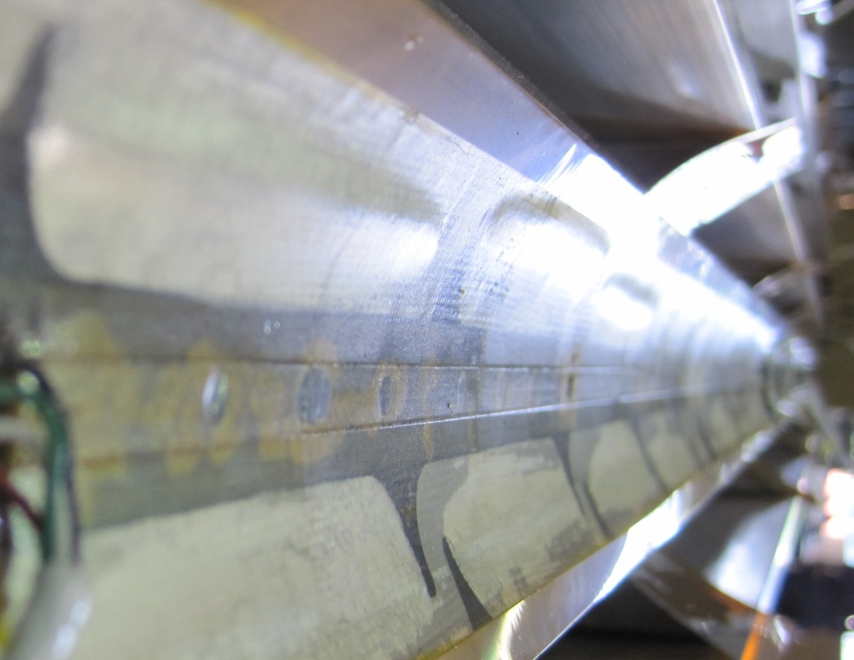
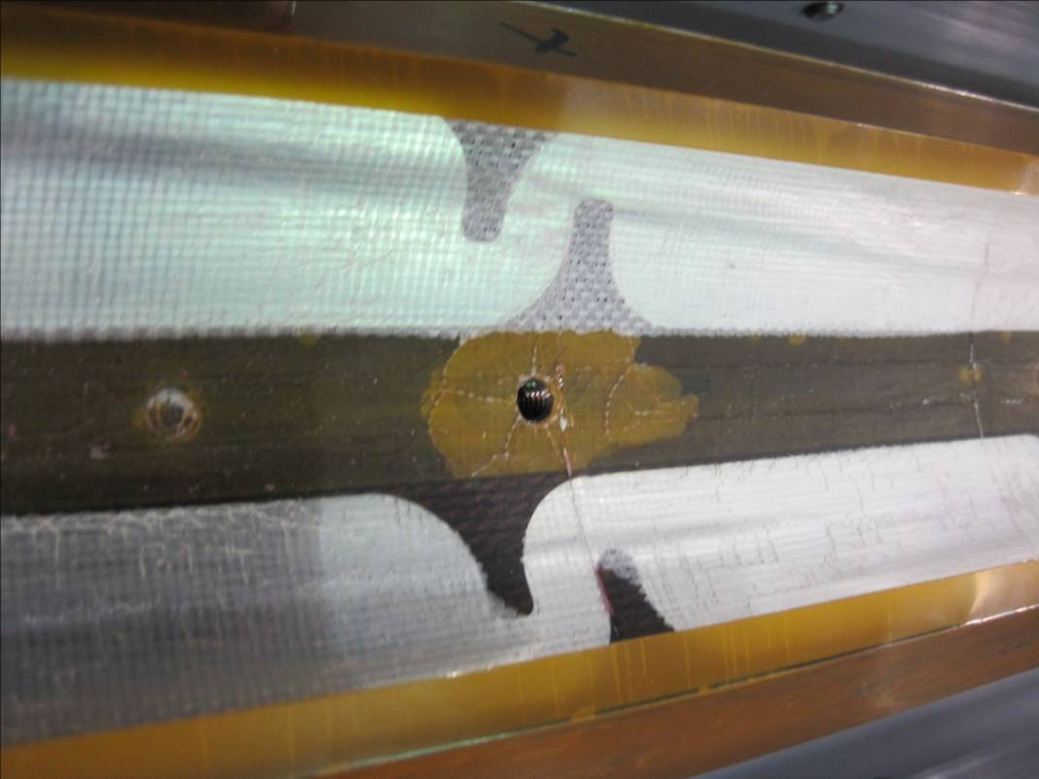
Coils after Test
Some “bubbles” on coils inner layer
  Coil-insulation separation
Possible causes:
  Superfluid helium and heat during quench
    Seen in TQ coils
  Heat from heaters on inner layer
    Only in LQ coils
Plans:
  Strengthen insulation (#13),
  Change heater location,
  Add support on coil ID

Slide 15
New Insulation Development
Used on mirrors TQM03 and LQM01 and test coil TQ36
Original Braided Sleeve
Traditional Sleeve
It’s hard to replace the TQ/LQ sleeve with an insulation having the same thickness and more suitable for long magnets:
Remove it from LQ goals,
Develop new insulation for HQ
Demonstrate it in LHQ

Slide 16
LQS01b Preliminary Observations
LQS01b reached the best performance of all TQS02!
  With the first four LQ-production coils; three of which had “severe” discrepancies
  ➔ We know how to make and fix long Nb₃Sn coils
  Al-shell-based structure is providing support (up to 227 T/m and 92% of ssl) with no signs of limitation
  ➔ Segmented shell structure can be used for long Nb₃Sn magnets with shell-type coils
  Quench protection keeps hot-spot temperature below 260 K
  ➔ We have tools (computation & instrumentation) for protecting long Nb₃Sn magnets above 2.2K
  Good memory with DT-restricted thermal cycle
  ➔ Very promising for use in particle accelertors

Slide 17
Next Steps & Goals
LQS02 Readiness Review (October 26, 2010)
OK to use coils #10-13
Slightly smaller pre-stress than in LQS01b
LQS02a with new set of 54/61 coils:
  Demonstrate reproducibility, test memory after unrestricted thermal cycle
LQS02b options:
  Change limiting coil of LQS02
  Test LQS w 4 coils made with the same mold
  Test use of 4m keys & bladders (for longer magnets)
LQS03a/b with 108/127 coils:
  Demonstrate better performance below 4.5 K, and smaller voltage spikes
Need still some R&D:
  Reliable solution for protection heaters on inner layer at 2 K

Slide 18
Extra slides

Slide 19
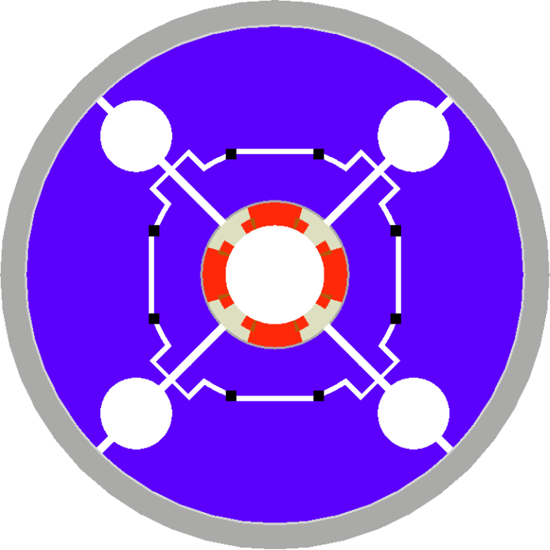
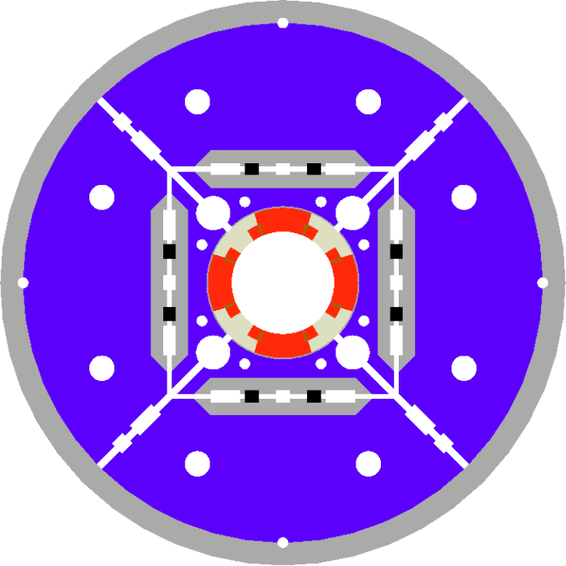
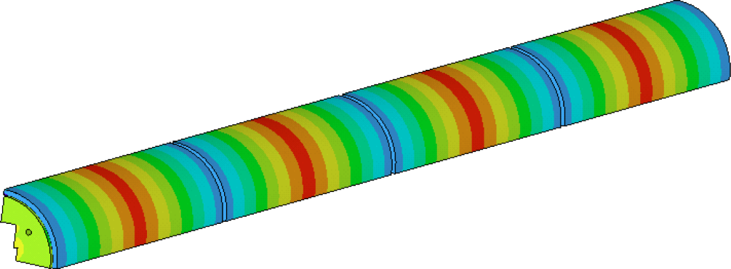
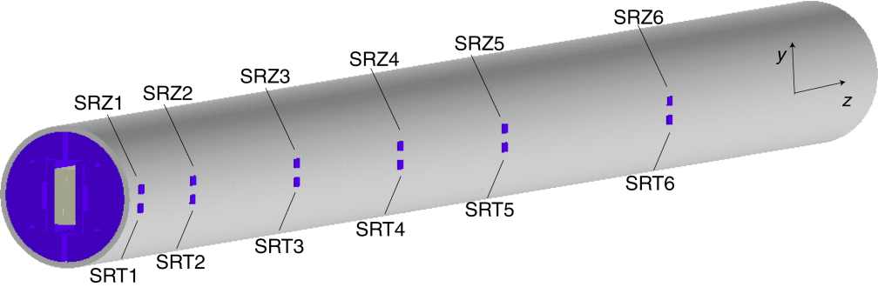
LQ Structure†
LQS is based on TQS (1m model)
and LRS (4m racetrack)
TQS Modifications:
  Added masters
  Added tie-rods for yoke & pad laminations
  Added alignment features for the structure
  Rods closer to coils
  Rods made of SS
Aluminum shell
TQS
LQS
  Segmented shell (4)
† P. Ferracin et al. “Assembly and Loading of LQS01, a Shell-Based 3.7 m Long Nb3Sn Quadrupole Magnet for LARP” IEEE Trans. on Applied Supercond.; Vol. 20, no. 3, p. 279-282, March 2010

Slide 20
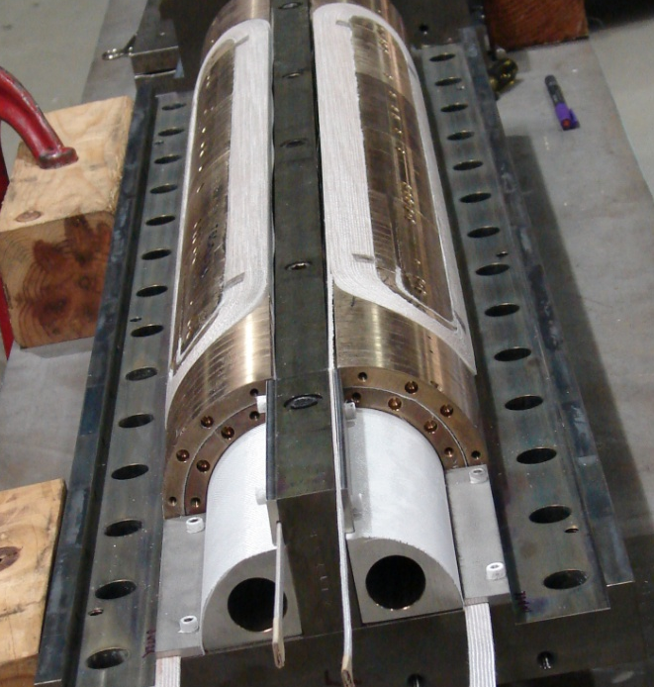
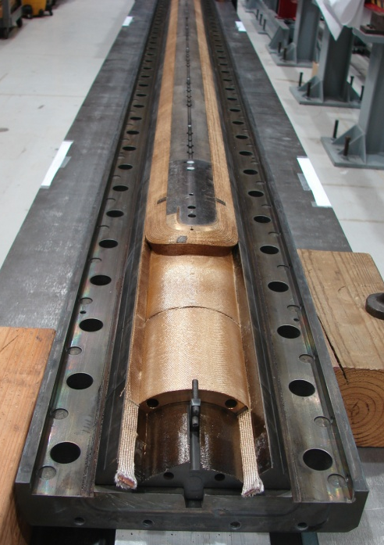
LQ Coils†
Coil design:
  LQ coils = long TQ02 coils with gaps to accommodate different CTE during HT
Fabrication technology:
  From 2-in-1 (TQ coils) to single coil fixtures (LQ)
  Mica during heat treatment
  Bridge between lead-end saddle and pole
Cross-section of TQ/LQ coil
LQ Coil Fabrication:
5 practice coils (Cu and Nb₃Sn)
coils #6-#9 ➔ LQS01
coils #10-#13 ➔ LQS02
Note: coils #6-#9 had 3 severe discrepancies
† G. Ambrosio et al. “Final Development and Test Preparation of the First 3.7 m Long Nb3Sn Quadrupole by LARP” IEEE Trans. on Applied Superconductivity; Vol. 20, no. 3, p. 283-287, March 2010.

