Slide 1
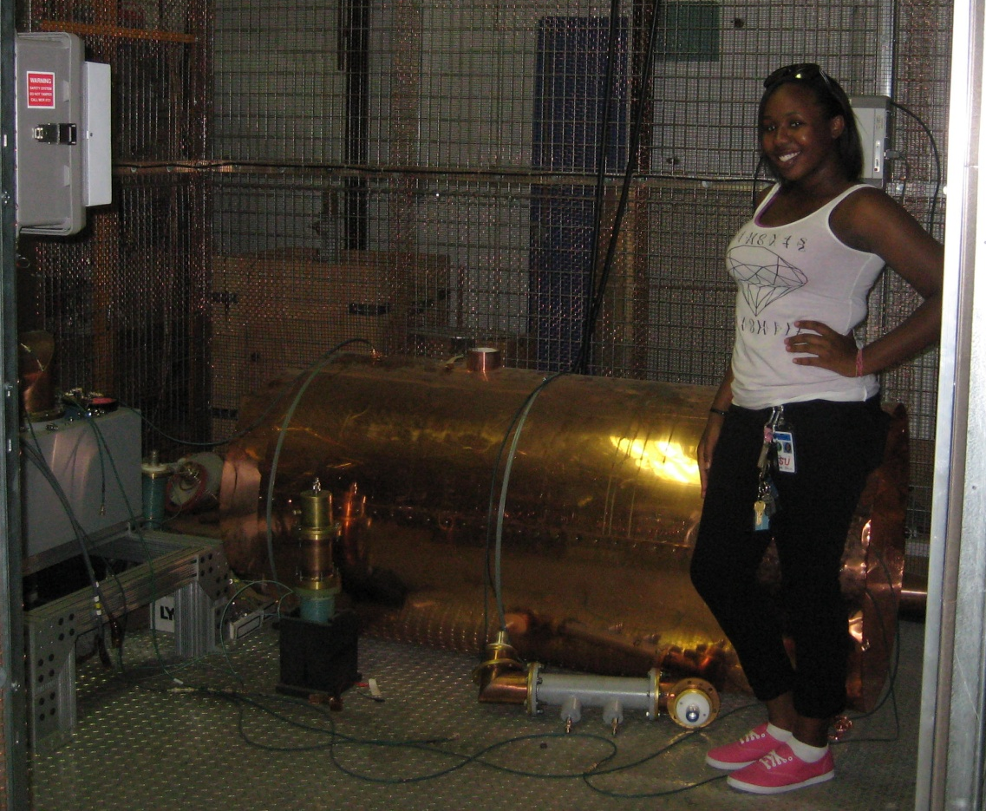
A Garnet Tuner for the NOvA Recycler 52.809 MHz RF Cavity
Presented By: Minnae Chabwera
Supervisor: Dave Wildman
Notes:
* Introduce yourself, your school, and background * Provide lots of background info--how does your project fit into the experiment or facility? How does it fit into the big picture? * Explain all of the TLAs (three letter acronyms) * What new tools or skills did you need to learn? What were some of the challenges you faced? * Was the project successful? What remains to be done? Will work continue on it at some future date?

Slide 2
General Outlook
Three quarter wave (λ/4) RF cavities with a frequency of 52.809 MHz will be needed in the Recycler Ring.
Each cavity will have a peak RF voltage of 150 kV.
The resonant frequency of these cavities needs to be continuously adjusted.
Notes:
--In this experiment there are 3 new quarter wave (λ/4) RF cavities with a frequency of 52.809 MHz.
--Why are there 3 quarter-wave RF cavities? 2 for slip-stacking (1 for one batch, 1 for another) & they are at two different frequencies. The 3rd is a spare.
--Each of these cavities will be needed in the Recycler Ring for slip-stacking proton batches from the Booster before the protons become injected into the Main Injector.
***Slip-stacking is “momentum stacking” and can also be used to
enhance the proton intensity; its objective is to increase the total
proton flux on the NOvA target.
--Each cavity will have a peak RF voltage of 150 kV.
***The peak RF voltage is the maximum voltage that the λ/4
cavity can reach and keeps the beam compact and headed in
the right direction.
--And the resonant frequency of these cavities needs to be continuously adjusted in order to compensate for the effects of temperature variations, RF power levels, and proton beam intensity.
--This is the function of the tuners.

Slide 3
Coupled Oscillators
Two pendulums coupled by a spring with spring constant, k.
Two resonant modes:
ω₁:
ω₂:
l₁
l₂
k
M₁
M₂
M₁
M₂
M₁
M₂
Notes:
--In relation to the project as a whole I am going to relate to the cavity/tuner system through the coupled oscillator model.
--The simplest coupled oscillator is two pendulums represented “here” coupled by a spring with spring constant, k.
--With the two resonant modes: ω₁: [Mass₁ & Mass₂ move together in the same direction]; with ω₂: [M₁ & M₂ move in opposite directions, away and towards each other]
***with ω being equal to 2πf
***ω₂ is always at a higher frequency than ω₁.
--With the pendulums, they will eventually reach a place where both resonant modes will be in effect.
***Physical example of how the pendulums “join” when there
becomes combination of the modes.
~m, mass, like L & C, inductance & capacitance
~the coupling k is like m, mutual inductance

Slide 4
The Electrical Analogy
Two resonant R, L, C circuits coupled by the mutual inductance, M.
Find the resonant frequencies: ω₁ & ω₂:
.
.
.
C₁
C₂
I₁
L₁
M
L₂
I₂
Notes:
--Another simpler example of the cavity/tuner system is represented with these two resonant R, L, C circuits coupled by the mutual inductance, M.
***For those who are not too familiar with mutual inductance, if two
coils are close together “as is represented ‘here’”, a steady current, I,
in one coil will set up a magnetic flux, φ, linking the other coil.
***And mutual inductance is when I is changed over time, and an
electromagnetic field, E, given by Faraday’s law appears in the second coil.
***And an RLC circuit is an oscillating electrical circuit that consists of
a resistor, an inductor, and a capacitor; all connected in a series.
However, this circuit does not have resistance because the losses in the
circuits are small.
--In order to use the given circuit to find the resonant frequencies, ω₁ & ω₂, we used Kirchhoff’s voltage law.
***Kirchhoff’s voltage law states that the sum of the voltages around
the loop is equal to zero.
***The 1st voltage drop around the loop is the capacitance, the 2nd
Inductance, and the 3rd mutual inductance, which couples the two
circuits together.
***Variables:
Q: A dimensionless parameter describing how “damped” an oscillator or resonator is.
C: Capacitance
L: Inductance
dI/dt: The derivative of the current with respect to time
M: Mutual Inductance
~Damped: any effect that tends to reduce the amplitude of oscillations in an oscillatory system.

Slide 5
Understanding the Formula
Take of both equations:
Notes:
--In order to understand these formulas we began with the half wavelength, λ/2, tuner portion of the equation and began to solve.
***In this section we take d/dt because it puts the whole formula in terms of I, the current.
***dQ/dt is equal to I.
***This is representative of the voltage of the current around the loop.

Slide 6
The Frequency Shift
Look for solutions of the form I₁e^{iωt}, I₂e^{iωt}.
Notes:
--When presented with these two formulas I ended up solving them looking for ω. When I found ω_{1,2} I received “this.” The graph displayed on the right is a
reflection of the formulas and ω_{1,2}.
--Referring back to the pendulum case, the blue line, f₁, is representative of ω₁. Where the pendulums swing in the same direction, maintaining a lower frequency than f₂.
--The red line, f₂, is representative of ω₂. Where the pendulums swing in opposite directions, producing a higher frequency than f₁.
--The Tuner Length on the x-axis is where we changed L₂ & C₂.

Slide 7
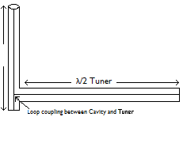
RF Cavity and Tuner
Transmission Line Representation:
C₁
C₂
I₁
L₁
M
L₂
I₂
λ/4 Cavity
λ/4 Cavity
λ/2 Tuner
Loop coupling between Cavity and Tuner
The transmission line representation’s loop coupling is equivalent to the circuit’s mutual inductance, M.
Notes:
--In this section, both diagrams have a current, capacitance, and inductance; all of which undergoes a change when the current moves from the cavity to the tuner.
--Both diagrams possess a steady mutual inductance.
--In the R, L, C circuit mutual inductance exists because the circuits are close enough together for one circuit to set up a magnetic flux linking the other.
--The transmission line has a steady mutual inductance because of loop coupling, a method of transferring energy between a waveguide and an external circuit so that electric lines of flux pass through.

Slide 8
How does the model tuner work?
Change in electrical length equals change in resonant frequency.
Notes:
--The information presented here is from the model tuner, what was worked with before I moved on to the actual prototype cavity and yttrium-iron garnet
tuner.
***The model tuner consists of RG 58 coaxial cables, or a 3-inch
copper line, which has a higher Q, meaning lower losses, and we
change its length to measure the resultant resonant frequencies
from the model cavity.
--When working with the model tuner, we physically change the length to change the electrical length. We do so by adding or removing elbows in the set-up, therefore changing the resonant frequency, ω, of the cavity/tuner system.
--We change the physical length of the tuner by adding elbows.
***The graph displays what occurred when measuring the cavity/tuner
system model. The tuner frequency gradually decreases as its length
increases from -7 to +7. As the tuner frequency decreases, the cavity
goes through several changes, it decreases, increases steeply, and then
gradually decreases again.
***F₁ can be seen in relation to the pendulum, as was seen before,
noting that it is the lower resonant frequency, like ω₁.
***F₂ is similar to the pendulum from before as well, it can be related
to ω₂, the higher resonant frequency.

Slide 9
How does the real tuner work?
How and why do we change the electrical length of the tuner?
How is the μ changed?
Notes:
--With the real tuner, instead of changing the physical length of the tuner, we change the electrical length electrically.
--This is done by changing the magnetic permeability, μ, of a 5-inch section of the tuner transmission line.
--The select 5-inches of the transmission line are filled with an aluminum doped, yttrium-iron garnet.
--The magnetic permeability is changed by applying a varying magnetic field along the axis of the transmission line with an external solenoid.
***For the real tuner we changed the bias-current solenoid.
***The given diagram is an example of the prototype cavity/tuner
system. And the garnet is used as a medium for the cavity/tuner
system and the solenoid is a wire loop used to produce a magnetic
field when the electric current flows through it.
--The tuner is 5-inches long and 3-inches wide

Slide 10
The Prototype Cavity & Garnet Tuner
Notes:
--Using prototype cavity & garnet tuner we received “the given frequency” after measuring the resonant frequency from the prototype cavity/tuner system. The range of resonant frequencies ranged from 52.792 MHz to 52. 817 MHz. This chart shows us that we were fairly accurate in our set-up because within the frequency was our preferred resonant frequency of 52.809 MHz.
--The graph is measured in amps from the solenoid bias current with respect to frequency in MHz. The solenoid bias current changes the electrical length of the tuner.
--When testing we used from 48.0 to 210.0 Amps. We used this section because the garnet is prone to more loss from 11.4 to 41.4 Amps, so we don’t operate there.
Possible Q:
μ goes from 4 to 1¹/₂.

Slide 11
Conclusion
We measured a tuning range of 5-10 kHz, which agrees with our calculations.
Notes:
--In this project we were successful in measuring a tuning range of 5-10 kHz, which is in good agreement with our calculations.
***The entire project was based on the understanding of a
cavity/tuner system and progressed into making sure that we
could find the correct resonant frequency with the addition
of the yttrium-iron garnet tuner.

Slide 12
Questions

Slide 13
Acknowledgements
Supervisor: Dave Wildman
Asst. Supervisor: Robyn Madrak
Mentor: Cosmore Sylvester
Advisor: James Davenport
SIST: Dianne Engram & Linda Diepholz

Slide 14
References:
[1] Hoppe, Patrick. "Kirchhoff's Voltage Law." WISC-ONLINE. http://www.wisc-online.com/objects/ViewObject.aspx?ID=DCE3002 [accessed July 30, 2010].
[2] "RLC Circuit." java@falstad.com. http://www.falstad.com/circuit/e-lrc.html [accessed July 28, 2010].

