Slide 1
Flying Wire Beam Profiling Detector
Joshua Hooks
Supervisor: Jim Zagel
Aug 3, 2010

Slide 2
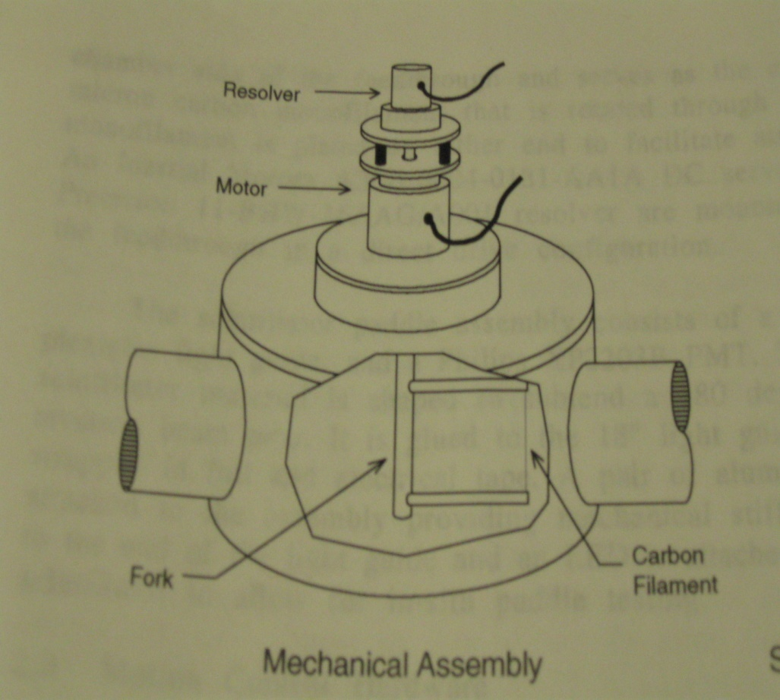
Flying Wire Beam Profiling Detector
The flying wire system measures a cross-section of the beam, by passing a 33 micron carbon filament (wire) through the beam.
Used to profile the beam - Find the general shape, location, and intensity of the beam
Beam emittance is calculated using measurements from the flying wire system
The resolver provides the position of the fork in reference to an absolute zero

Slide 3
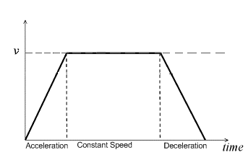
Motion Profile
The fork’s rotation follows the standard trapezoidal motion profile.
There is a clear area of acceleration, constant speed, and deceleration

Slide 4
Problem
The resolver can have error in the wire position that it records. My project was to create a program that will find wire position error, and the factors affecting this error, by comparing the position given by the resolver to the position given by an optical encoder mounted on the output shaft of the driven fork.

Slide 5
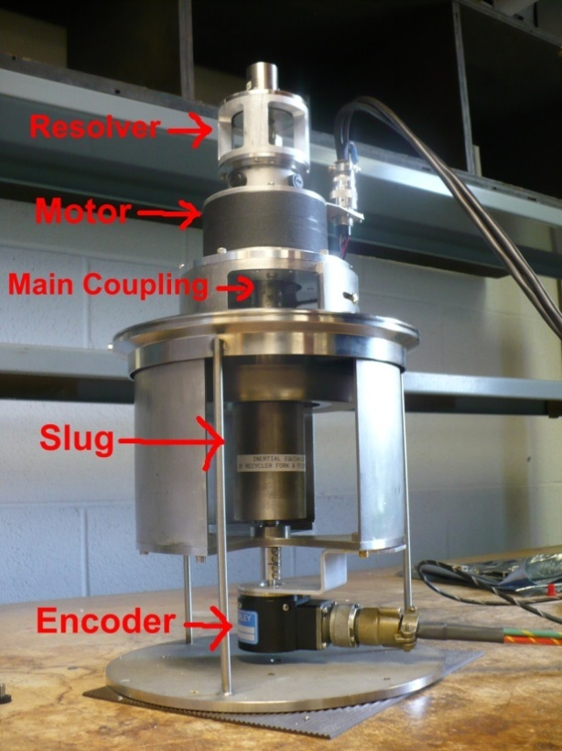
Method/Approach
Using LabVIEW programming:
Read Encoder using an Oscilloscope
Get position change in a known amount of time by configuring external waveform generator
Use waveform generator to get position from the Resolver
Test the effects of rotation direction, top speed, acceleration, deceleration, a Servometer (Servo) flexible coupling and custom solid coupling

Slide 6
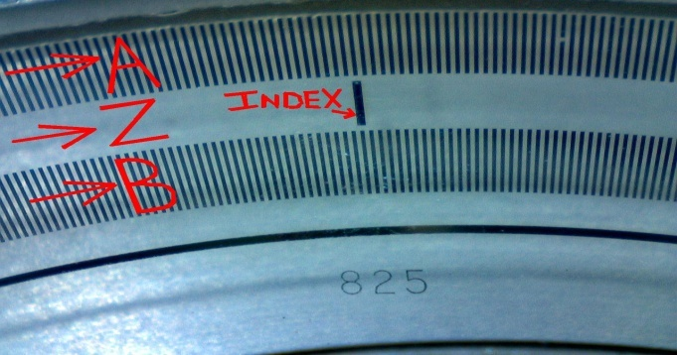
The Encoder
How it works
Uses an A,B, and Z track to report position change.
The A and B track have 4096 marks each. When A LED light shines through one a signal is made
The Z track has only one mark, known as the index, to reference position change with

Slide 7
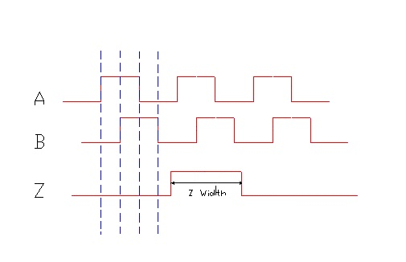
The Oscilloscope
How to Read the Encoder
An oscilloscope takes the signal created by the rotation of the encoder and displays them as highs and lows on the display.
When comparing the A and B traces 4 distinct sections are seen: A high-B low, A high-B high, A low-B high, and A low-B low
Each of these sections are known as a count, therefore making a complete revolution 16384 counts
By using the index as a trigger, we can control the portion of the rotation that the oscilloscope will display

Slide 8
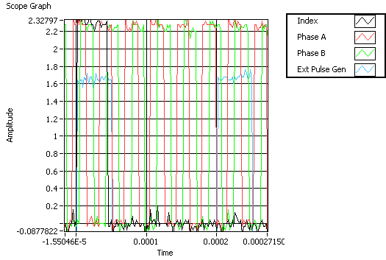
Methods cont.
Get position change of the encoder in a known amount of time by configuring external waveform generator that releases a set amount of pulses with a set period
Use waveform generator to get position from the Resolver

Slide 9
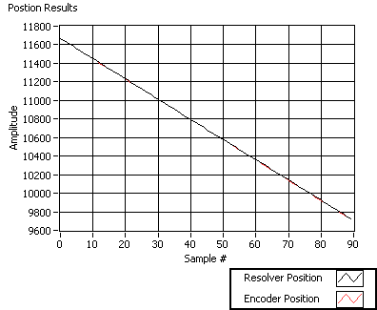
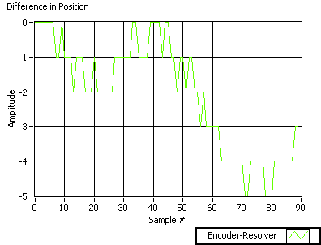
Methods cont.
Compare position graphs from the encoder and the resolver
Find the difference between corresponding position readings

Slide 10
Direction Results
For all spins, the encoder seems to be “ahead of” the resolver in position readings. The encoder is reporting positions that the resolver won’t report until a later time. This explains why clockwise spins report a positive difference in the Encoder-Resolver positions, and why counter-clockwise spins typically have negative differences

Slide 11
Target Speed Results
Altering the target top speed had relatively low impact on the magnitude of overall error

Slide 12
Acceleration and Deceleration Results
Accelerating and Decelerating had minimal effect on the amount of position error

Slide 13
Coupling Results
The solid coupling led to a noticeably smaller error than the flexible Servometer coupling for clockwise spins

Slide 14
Direction/Coupling Results
Solid coupling was more sensitive to misalignment. This lead to it’s counterclockwise spins accumulating relatively high error

Slide 15
Conclusion
The results from my tests on the flying wire model show lag in the position from the resolver when compared to the driven encoder.
Using the program developed this summer, the effects of speed and coupling types can be measured.
In the future all changes to the flying wire beam profiling detector can be tested, using this model and program, to ensure that errors do not accumulate and that profiling calculations are kept as accurate as possible.

