Slide 1
Data Link Projects - Minnesota
Roger Rusack The University of Minnesota

Slide 2
Projects
Past Projects
11,000 channels of 0.8 Gbs for the CMS crystal calorimeter readout.
1,500 channels of the same for the LHC beam loss monitors.
Power distribution by optical fibres.
Current Projects
Investigating 5 GbS CWDM signal transmission and reception in a radiation environment.
CMS HCAL upgrade to the readout and trigger.

Slide 3
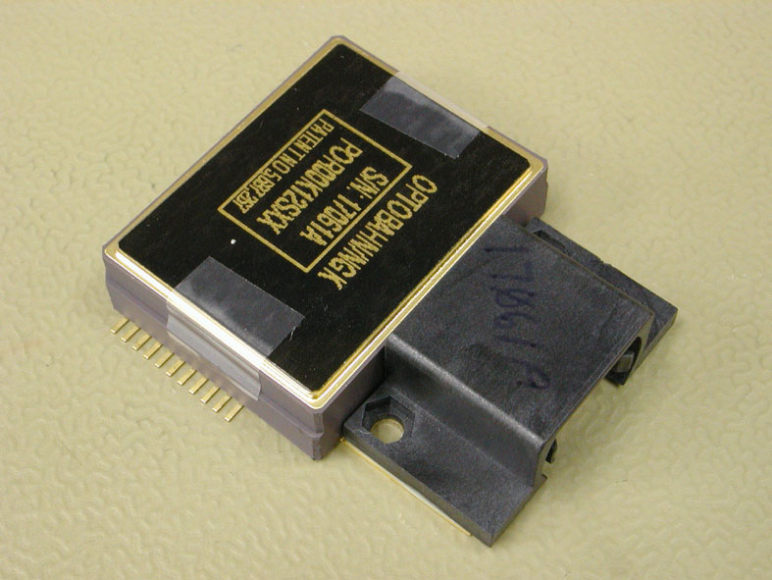
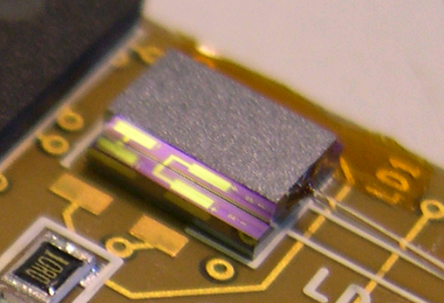
ECAL Link System
Dense multi-ribbon cable
Front End
Pigtail fiber
Ruggedized ribbon
Off Detector
12
96
Rx module
GOH
1
1
12
12
12
GOL
Laser diode
PIN photo-diode array
Digital amp. ASIC
GOL:
CERN MIC
Distributed Patch Panel
In-Line Patch Panel
Back-end Patch Panel
CMS
Digital
Receiver: NGK
Laser diode:
ST Microelectronics
GOL Opto-Hybrid (GOH): We design, prototype, qualify, define manufacturing specifications, procure the manufacture, burn in, perform final acceptance test.
12-channel NGK Rx: Off-the-shelf component: We qualify, procure, test samples during production.
Fiber, connectors and adaptors: We use Tracker components and contract options.

Slide 4
System Requirements and Specifications - 2
Some requirements and specifications, in numbers:
Link System Requirement | Minimum Link Specification | Actual Link Specification
Clean Rx eye diagram | HIPPI-6400 mask standard | same
Low jitter (GOH to Rx) | 100 ps | < 50 ps
Low Bit Error Rate | < 10⁻¹² (99% conf.) | < 10⁻¹² to < 10⁻¹³ (99% conf.)
GOH temperature | -10°C to ~+40°C (FE card) | -20°C to +60°C (FE card)
Rx module temperature | +20°C to +50°C (case) | +18°C to +80°C (case)
Magnetic field | 4 T | same
Hadronic fluence | 3×10¹⁴/cm² | same
Gamma dose | 1.5×10⁵ Gy | same
Operating life | 10 years | same
<
~

Slide 5
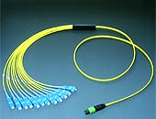
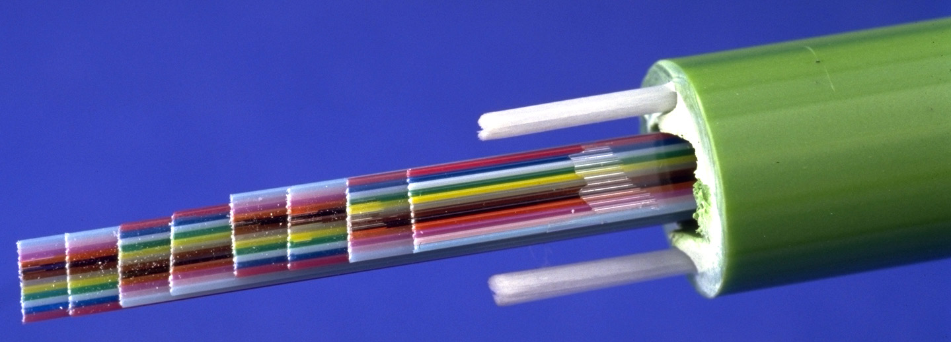
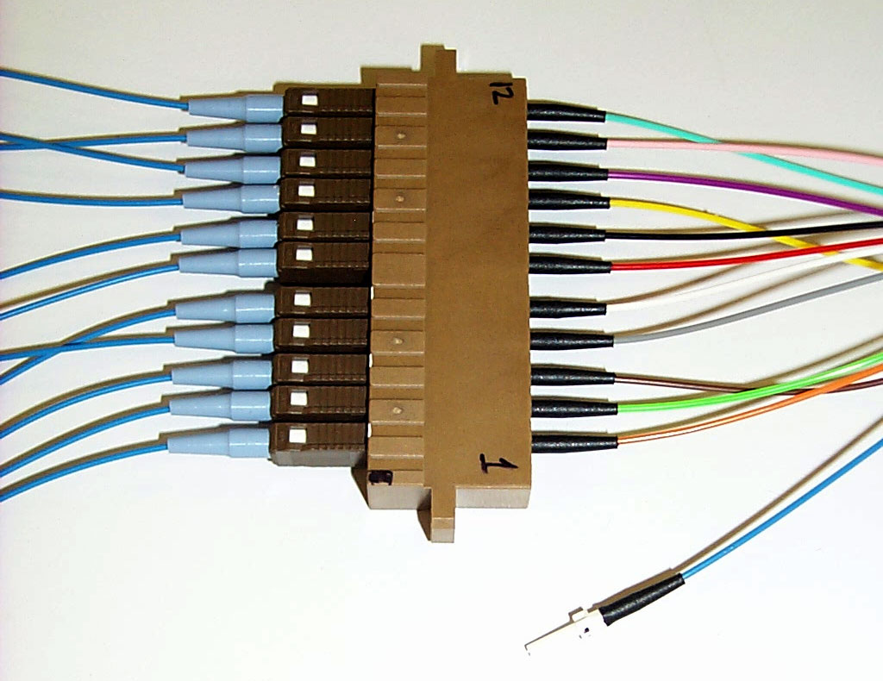
Components: Fiber and Connectors
Sub-components of the fiber system:
MFS adapter (Diamond)
sMU-MFS fanout (Ericsson, Sumitomo, Diamond)
MFS-MPO multi-ribbon cable (Ericsson, Diamond)
MU-sMU adapter (Sumitomo)
In-Line Patch Panel
12
96
1
12
Distributed Patch Panel
CMS
Back-end Patch Panel

Slide 6
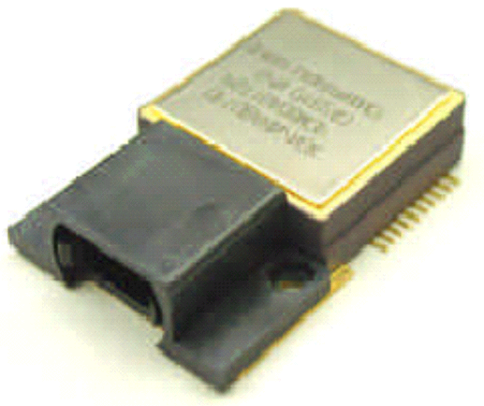
Components: Receiver
The receiver of the Data Link is the 12-channel digital Rx manufactured by NGK.
Rx module
12
12
Off-the-shelf component: Our tasks are to qualify, procure, test samples during production.
PIN photo-diode array
Digital amp. ASIC
Some characteristics and specifications of the Rx:
Accepts single-mode fiber
Operating wavelength 1310 nm
Speed: up to 1.25 Gb/s
Sensitivity: -18 dBm (typically <19 dBm)
Saturation: -5 dBm
Jitter: < 42 ps
Temperature: 0°C to 80°C
NGK Rx QA:
All channels tested by NGK (pass/fail mask test at 1.25 Gb/s, input power -20dBm, case temperature 80°C; simultaneously jitter must be < 42 ps)
We will test samples during production (see later slides).

Slide 7
Irradiation Test Setup
Ten GOH were irradiated in 60 MeV proton beam at PSI, 27-29 Feb.
One BERT GOH to observe any data errors.
Nine “sandwich” GOH to observe evolution of eye diagram vs. dose and also have some statistics in case of GOL or laser failure.
BERT GOH (data, clock, I2C)
“Sandwich” GOH (clock, I2C only)
data
data
beam
GIII Tx
GOH eval board
PC running LabVIEW control program
GOH
“Sender” card
GOH
GOH
GOH
clock
data, clock, I2C
I2C controller
Mother test card
GIII Rx
data
deser eval board
Rx eval board
scope
beam area
control room
~30 m

Slide 8
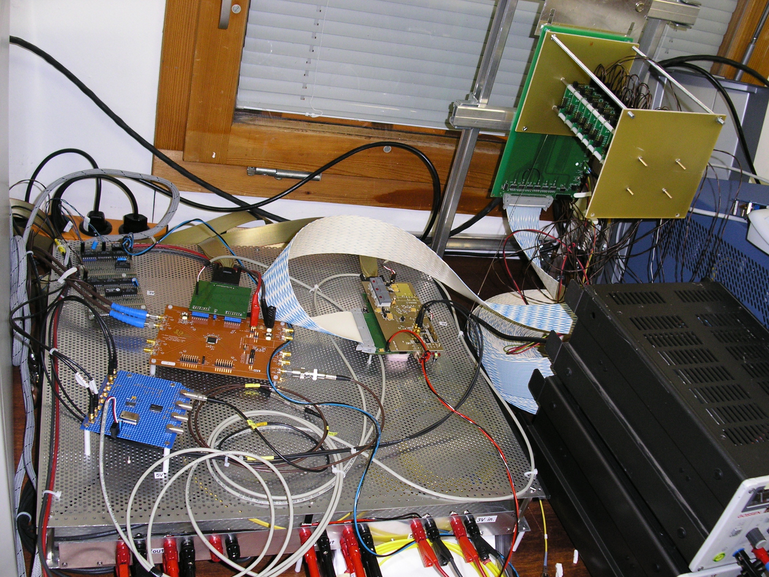
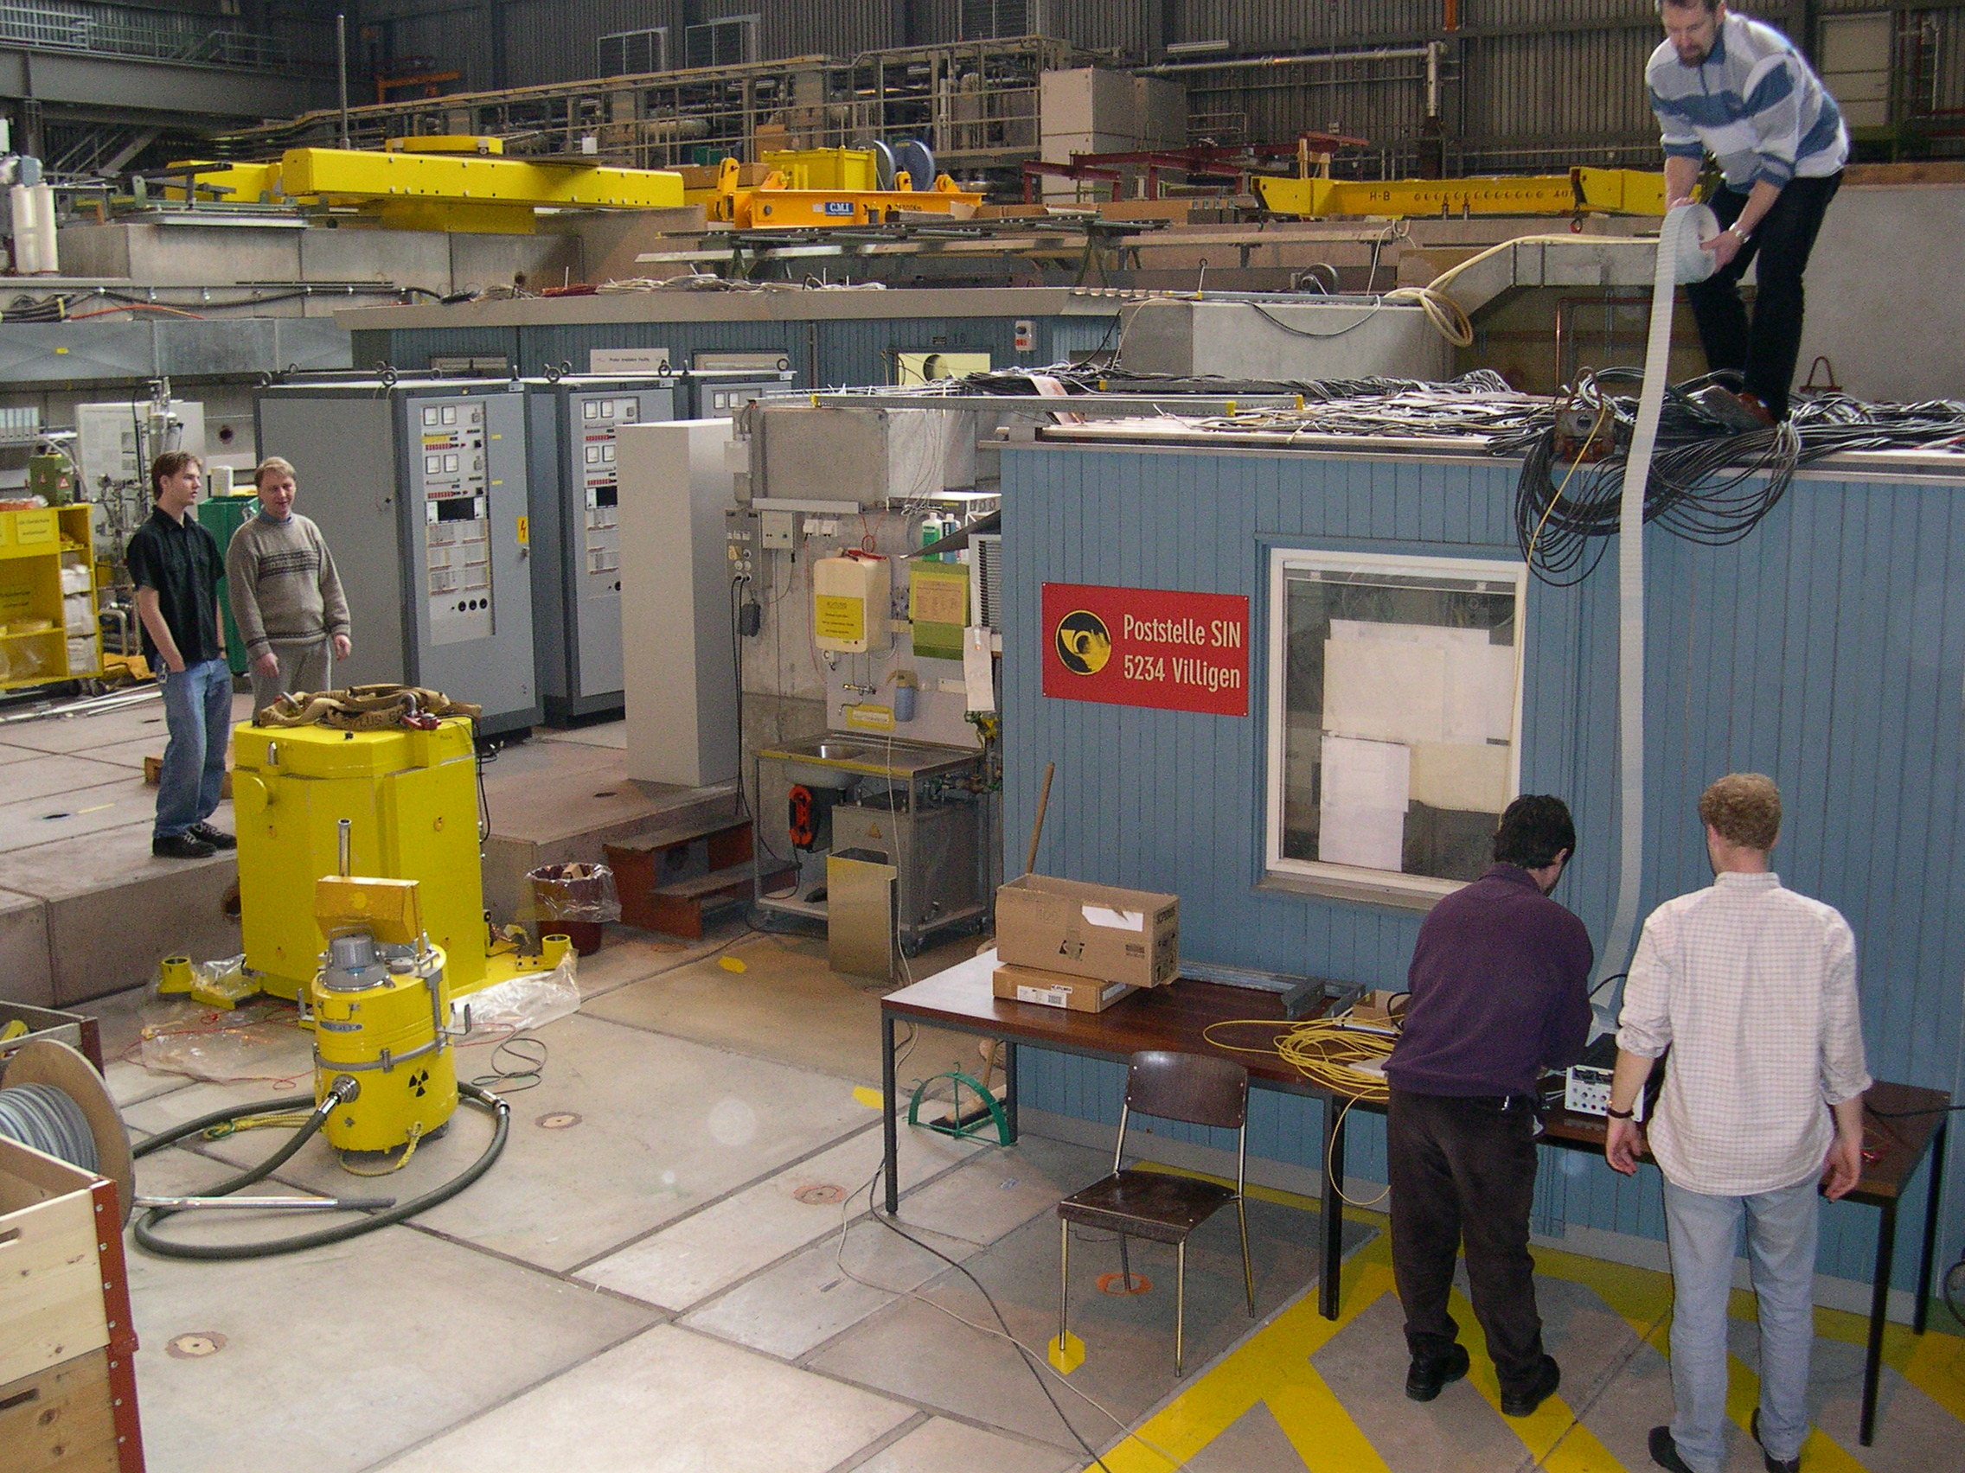
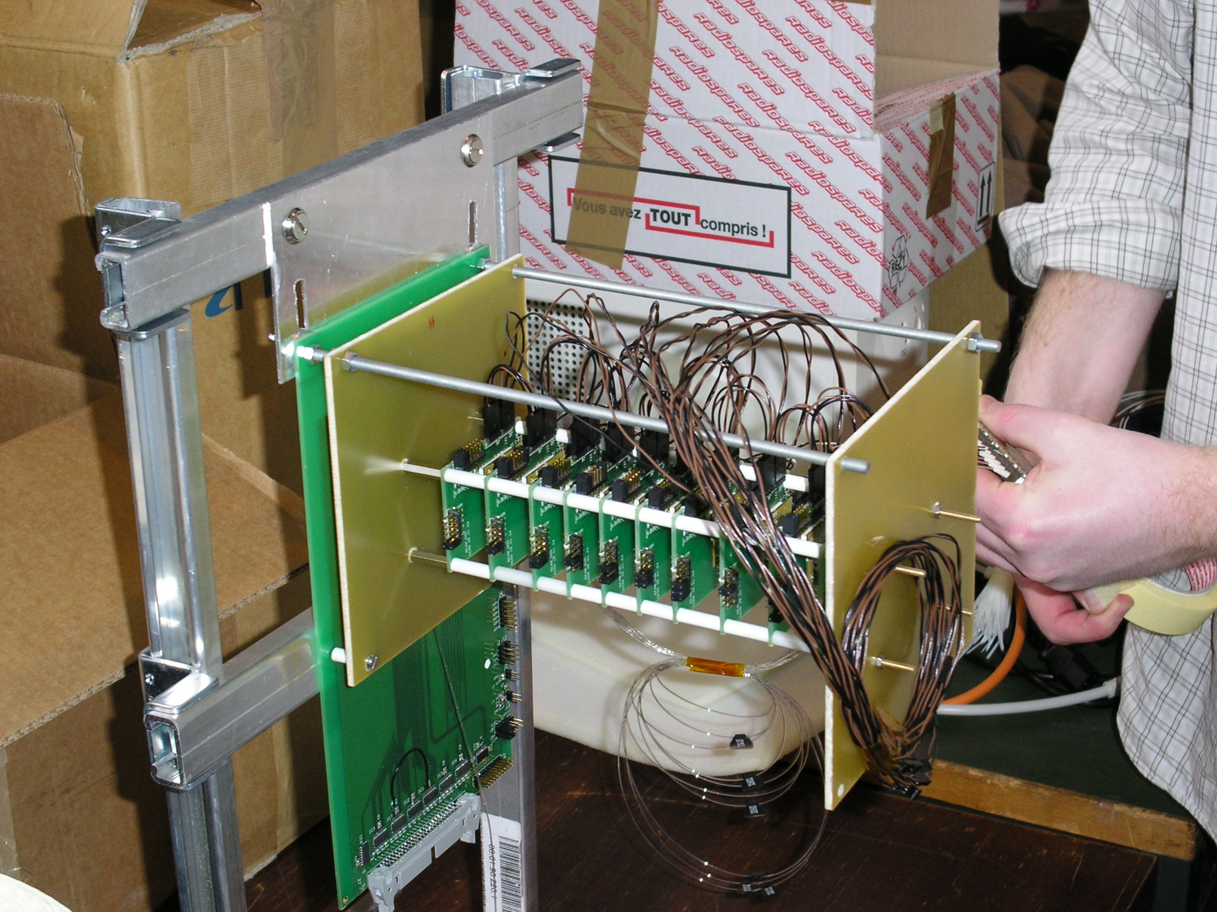
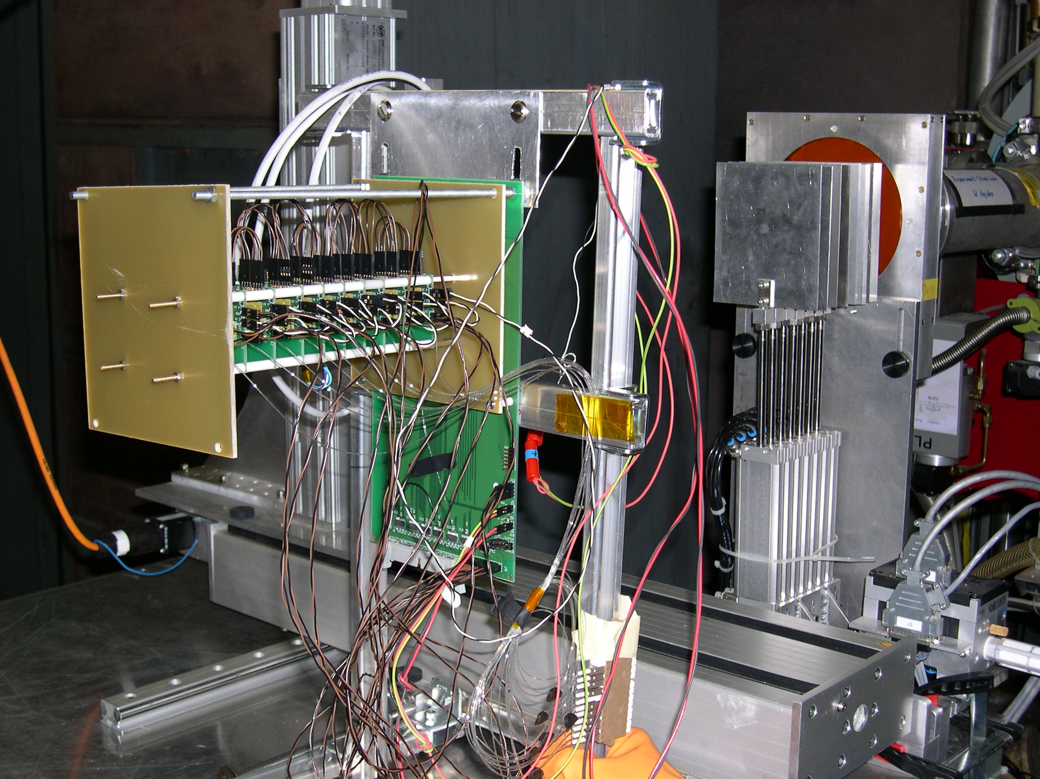
Some photos
In the control room
Serious cabling
Closeup of the GOH stack
Setup in the beam area

Slide 9
Minnesota Contributions
The complete data link - 11,000 channels:
System qualification and specifications.
Manufacture
Qualification
Installation
Test modules:
3 BERT systems. PC based, irradiator and stand alone.
3 GOH testers - QA at manufacturer and for reception. Eye diagram test.
Cable tester.
Various devices for component checking during construction.
Extended production to manufacture ~ 1500 rad hard data links for the LHC Beam Monitors.

Slide 10
Current Projects
Investigating the use of Wavelength Division Multiplexing for future HEP data systems.
Produced μTCA boards with SFP+ transmitter/receivers SNAP12 driven by a Virtex 5 FPGA.
Used to test CWDM for a control link.
Context upgrade of the readout of the hadron calorimeter.
Possible application in the electromagnetic calorimeter upgrade for HI-LHC.

Slide 11
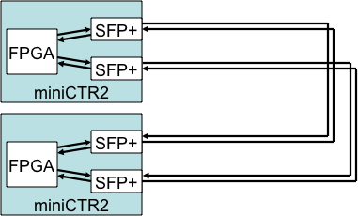
SFP+ Tests
Two miniCTR2 boards used to send and receive data 6.25 Gbs – separate clocks.

Slide 12
CCWDM Tests
Tests done with four wavelengths 1470nm, 1490nm, 1510nm, and 1530nm SFP+ 4.8 GbS.

Slide 13
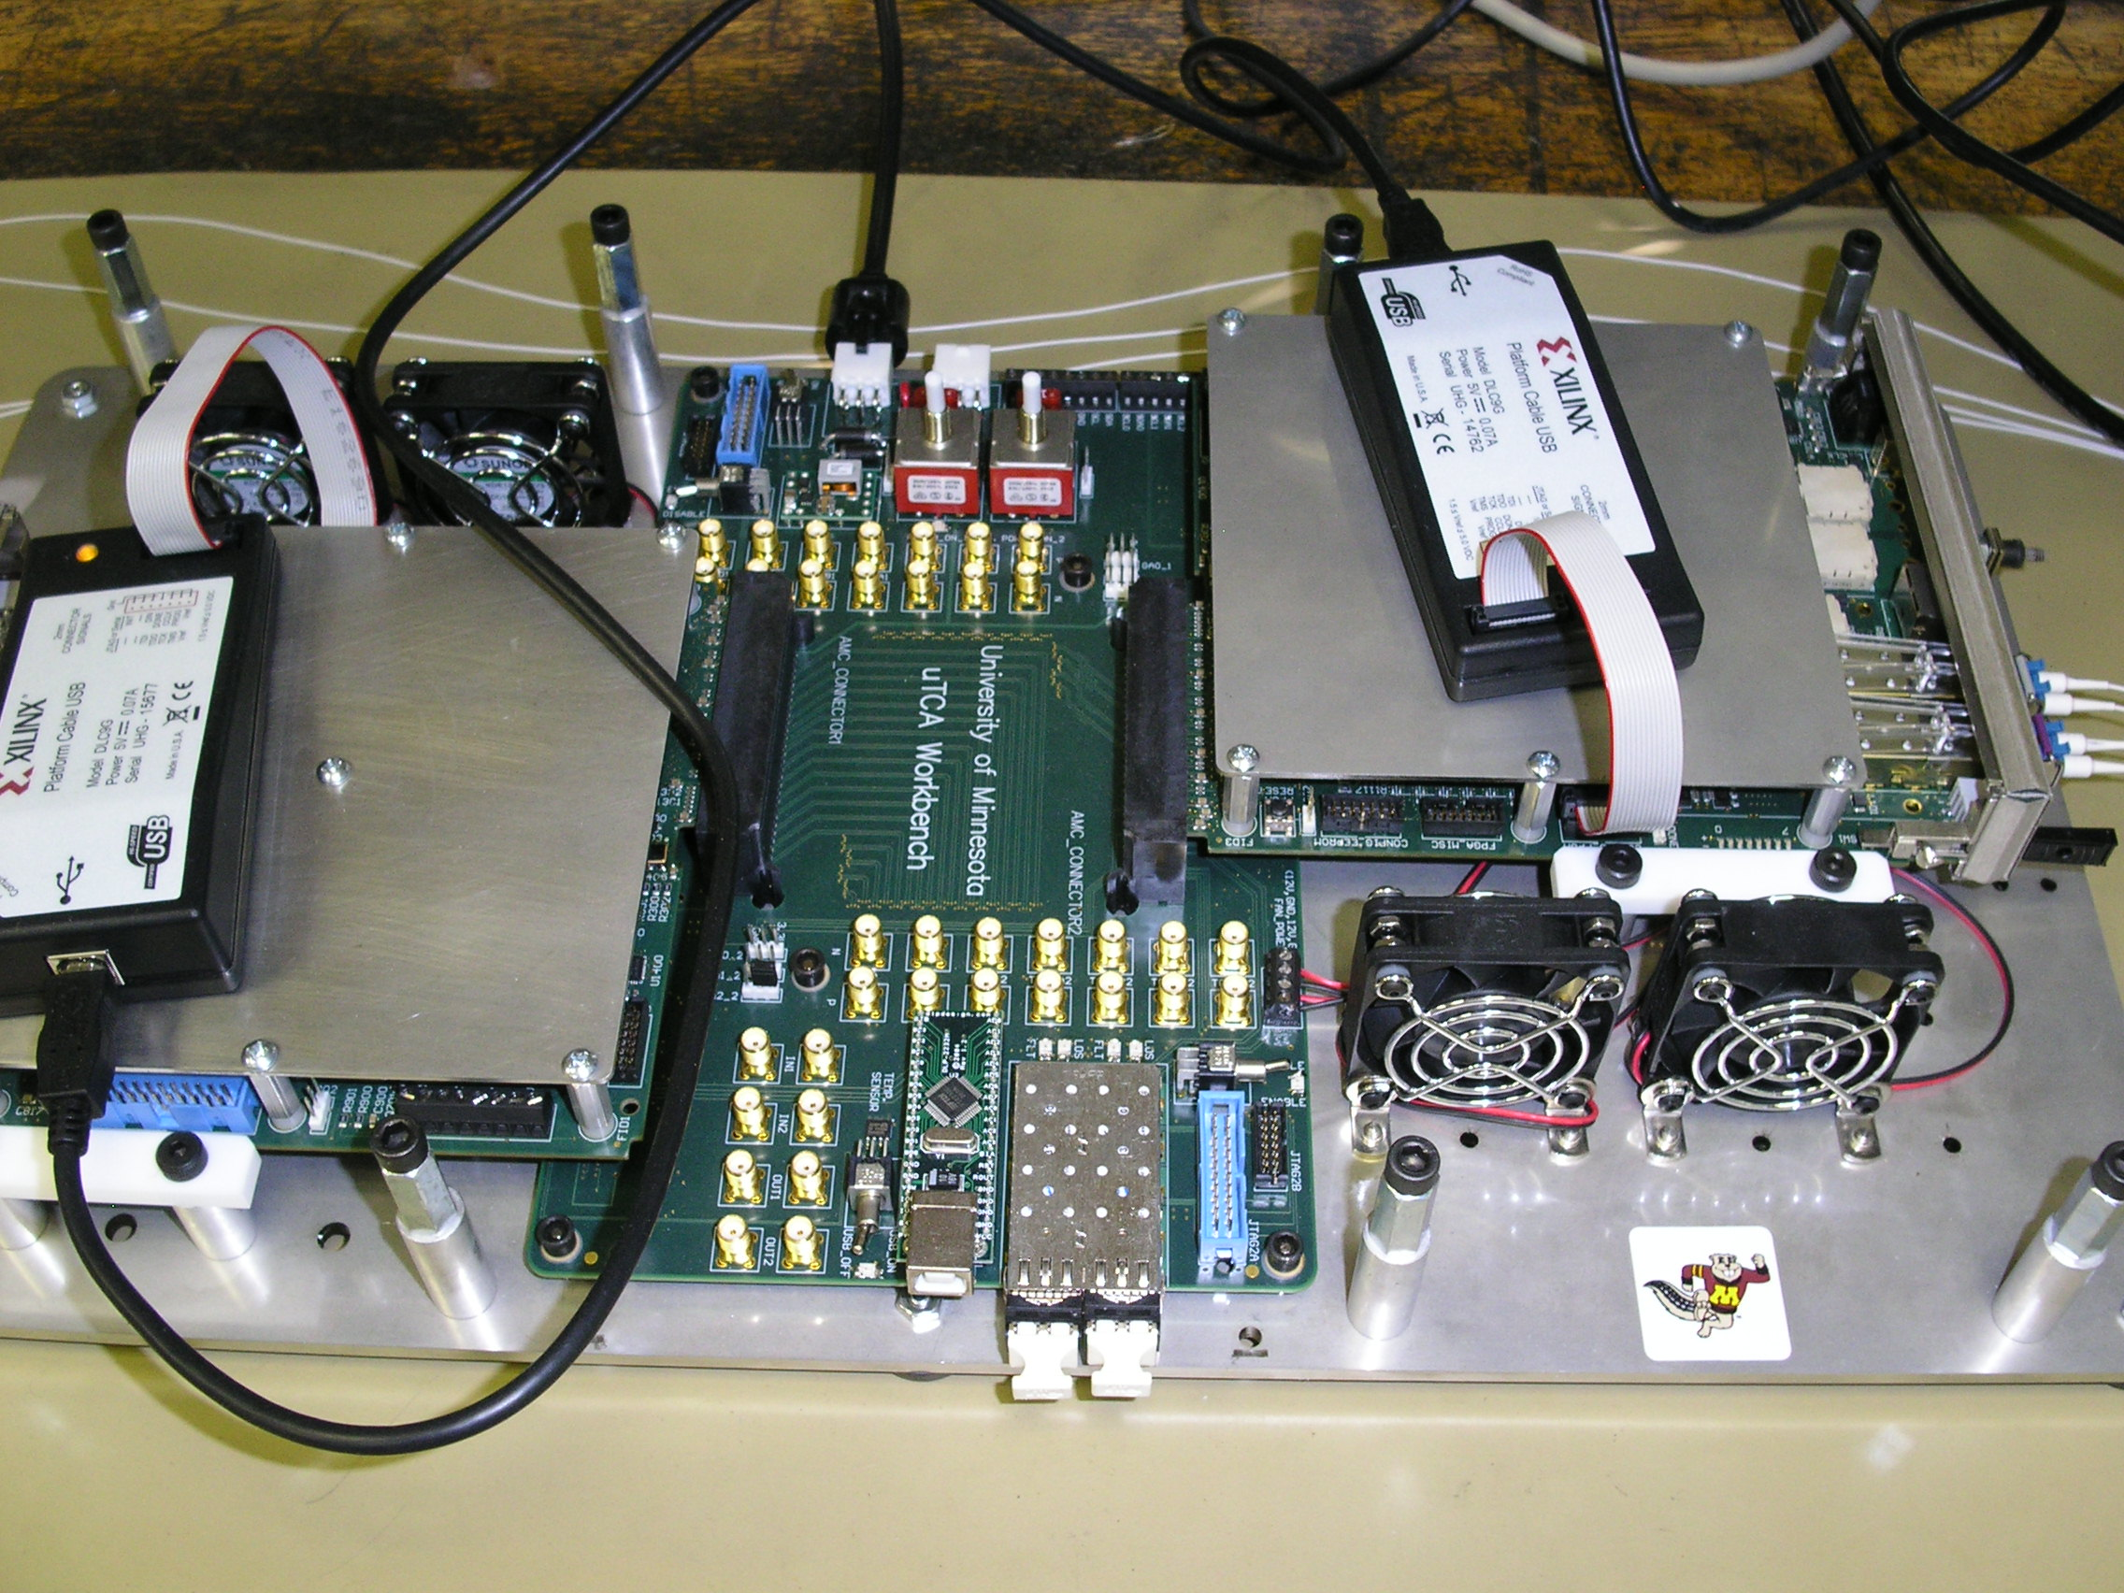
CWDM Tests

Slide 14
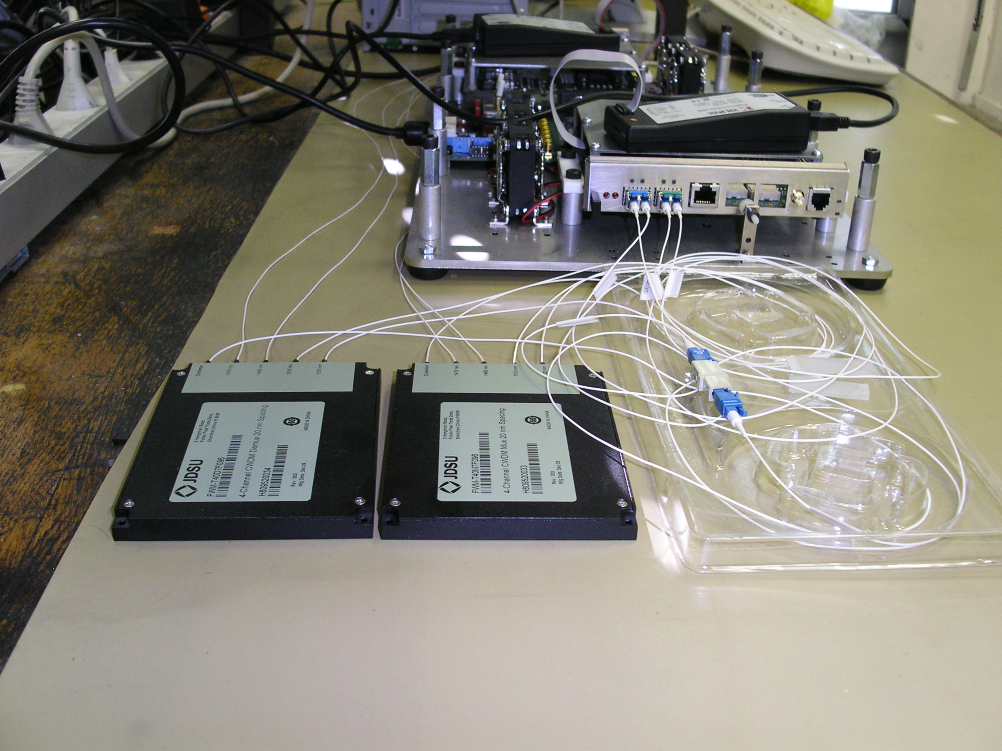

Slide 15
Future Plans
Radiation Test of WDM components.
Test with XFP.
Test with Mach-Zehnder
Radiation tests with M-Z

Slide 16
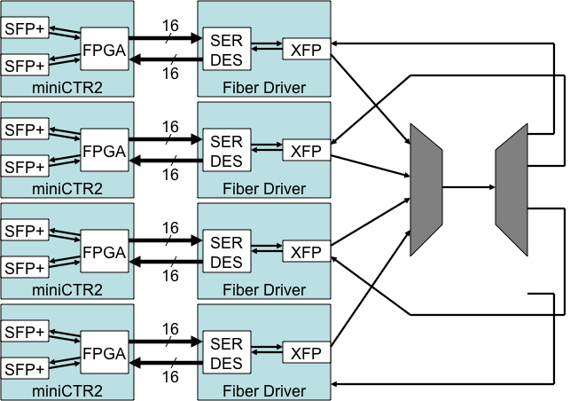
XFP Test

Slide 17
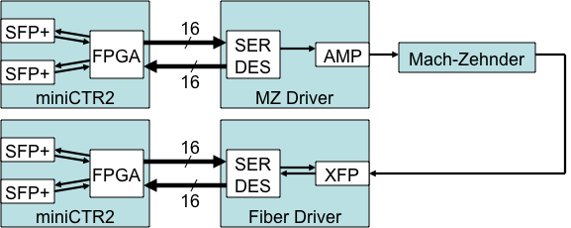
Test With Mach-Zehnder
Use Mach-Zehnder with a CW laser and overlay 10 GbS signal generated from FPGA through a SER-DES

Slide 18
Summary
Minnesota group has long experience with production and testing of large scale fibre-optic systems.
Currently exploring the SNAP12 and CDW solutions.
Doing this in the context of CMS HCAL upgrade and general R&D towards high density readout systems.

