Slide 1
Introduction
Simon Kwan
Fermilab
Mini-workshop on Optical Data Links
August 19, 2010

Slide 2
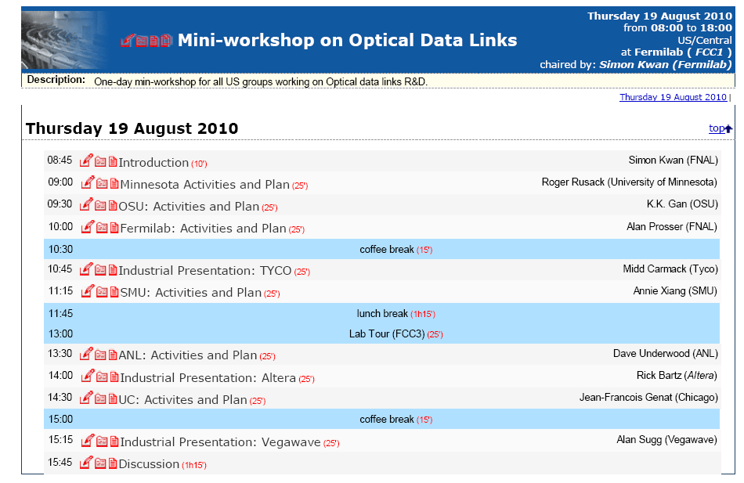
Agenda for the day

Slide 3
Goals of the Workshop
Opto-link is an important area of Detector R&D for HEP
Quite a few US groups are actively pursuing R&D in this area. This is probably the first time we have a meeting in the US for all these groups
Provides a forum for information exchange, promote common interests and objectives, explore possibilities of collaboration
Start the discussion of a national R&D program on Optical Data links for HEP; topic for discussion at the end of the day.

Slide 4
Overview of Detector R&D - Motivation
Future research in High Energy Physics requires an enabling Detector R&D program to pursue research at the energy, intensity, and cosmic frontiers.
This program should:
Develop novel detector technologies.
Improve the characteristics of existing detectors commonly used in High Energy Physics. (Increase speed, improve radiation hardness, improve energy resolution, improve precision, improve mechanical robustness, reduce intrinsic radioactivity backgrounds)
Develop less expensive technologies for large detector systems.
Glen Crawford – HEPAP presentation

Slide 5
Example of Current Detector R&D Topics
Crystal compensated calorimetry
High pressure xenon TPC development
Lepton collider detector development including resistive plate chamber digital hadron calorimetry
Chromatic Cerenkov compensation for improved timing resolution
Detector simulation toolkits
Particle flow algorithm development
High rate DAQ and trigger development
Wireless fiberless DAQ systems
DC to DC converters
---------------------------------------------------------------------------------------------------------
Color coding: Sensors Detector Systems Data Acquisition Systems
Core Technologies
Recently funded ADR proposals:
Advanced fiber optic systems for high energy physics experiments
Glen Crawford HEPAP presentation

Slide 6
HEP Requirements
Radiation tolerant for front-end components up to 500 kGy (Si) or 1.5E15 1 MeV neutron equivalent
High speed data transmission ~5 to 10 Gb/s
Operation in point-to-point or point-to-multipoint bi-directional topologies in single mode or multi-mode
Low mass components
Low power dissipation
Non-magnetic (front end components)
Inexpensive

