Slide 1
Fast Serial Links activities at the University of Chicago
Jean-Francois Genat
and
Mircea Bogdan, Anton Kapliy
Yann Peschanski, Fukun Tang
Fermilab, Aug 19th 2010

Slide 2
- ATLAS Silicon Fast Tracker
- ATLAS Tile Calorimeter
J-PARC
PET

Slide 3
ATLAS Fast TracKer (FTK)
LHC@ 10^34: 25 overlapping pp collisions
3 10^34 75 “
FTK: Early rejection of background events, provides global track reconstruction just after the start of Level 2 processing, on L1 accepts
Massively parallel processing for fast online track reconstruction
Silicon
Strips and pixels
RODs
S-links at 1.3 Gb/s
L1 100 kHz
FTK system
L2
DAQ ROBs
Jean-Francois Genat, Fermilab, Aug 19th 2010

Slide 4
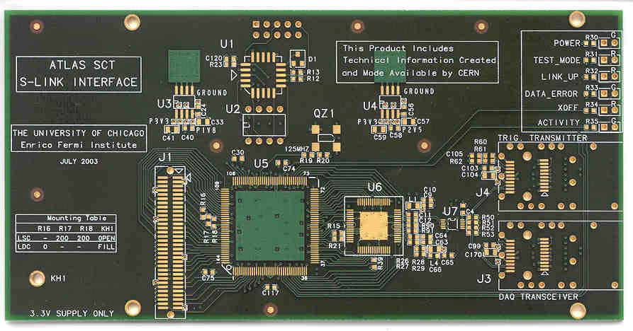
ATLAS Fast TracKer (FTK)
HOLA card: 250 units fan to DAQ and FTK detector data on two S-links at 1.3 Gb/s (805nm)
External SerDes (not FPGA embedded)
Successfully used at CDF for the Level 2 system
Jean-Francois Genat, Fermilab, Aug 19th 2010

Slide 5
ATLAS Fast TracKer Plans
- Integrate SerDes in the FPGA
Cyclone III allows up to 2Gb/s serial I/Os
Keep the Agilent optical interfaces
HOLA performance sufficient up to 2020
Jean-Francois Genat, Fermilab, Aug 19th 2010

Slide 6
ATLAS Tile Calorimeter
- 10,000 PMT channels
- Present readout is level1-triggered using G-link at 320 Mb/s
Upgrade: Digitize and send all on the fly at 12-bit 40 MHz
Requires 12.3 Gb/s on 1000 channels (total 12Tb/s !)
Jean-Francois Genat, Fermilab, Aug 19th 2010

Slide 7
Dataflow for the sLHC upgrade
256 Drawers: 4 Motherboards/drawer
Motherboards: 12 3-1 cards = 12 PMT channels
3-1 card:
2-gains: 2 channels to be sampled (12 bits) at 40 MHz
Integrator = 20 bits/ Motherboard
12 PMT channels
Assuming 12- bit words, data rate is:
[12 x 2 x 12- bits + 20- bits)] x 40 MHz = 12.3 GBit/s per Motherboard
Present is 320 MBit/s Use 3 GBT devices at 4.8 Gb/s
Jean-Francois Genat, Fermilab, Aug 19th 2010

Slide 8
ATLAS Tile Calorimeter
10,000 Photomultipliers channels
On-detector front-end electronics including ADCs
Level 1 triggered readout at 600Mb/s using G-link
Fukun Tang, Fermilab, Aug 19th 2010

Slide 9
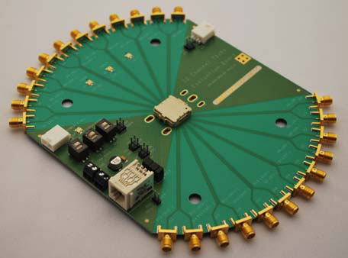
40 Gb/s ribbon fiber evaluation kit (Avago)
Single Board compatible with Transmitter and Receiver
Up to 3.5 Gb/s per test channel
Independent connection to all channels
24 SMA connectors (differential)
DC coupled high-speed signals
Control Pins for all I/O
3.3V Power Supply
Evaluation boards at 12 x 3.25 Gb/s
(Avago, Reflex Photonics)
Jean-Francois Genat, Fermilab, Aug 19th 2010
Notes:
9

Slide 10
Tests at 2 Gb/s
First test using:
- Two Avago test cards (12 x 3.5 Gb/s)
A Cyclone III device on an evaluation card from Altera
First tests of one channel at 2 Gb/s ok (no opto device, just FPGA), .
Then, set the Avago opto test cards in the path
Jean-Francois Genat, Fermilab, Aug 19th 2010

Slide 11
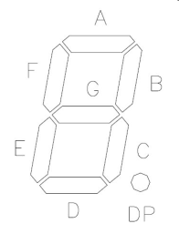
Optical interface
RX/TX
Fiber
850 nm
30m
Test Data
2.5 Gb/s
30Gb/s
1 link tested @ 2.5Gb/s
SMA
RJ45
RJ45
Error Counter
USB
FPGA
Cyclone IV GX
Transceiver Starter Kit
1 channel @ 2.5 Gb/s
Jean-Francois Genat, Fermilab, Aug 19th 2010

Slide 12
Test card under development
Test of a channel with a Stratix IV device at 6.25 Gb/s
for BER and radiation hardness (150 kRad)
USB Interface
Rx
Tx
FPGA
USB
Ribbon
Fiber
Custom PCB
Laptop
Avago SFPs
Implement in the FPGA:
- SerDes at 6.25 Gb/s
Pseudo random sequences
CERN GBT code
Fast XORs
- Error Counters
- Layout between opto devices and FPGA critical:
Use of a dedicated software (Hyperlynx) for
the crosstalk evaluation at 10 GB/s
Altera FPGA devices available:
Cyclone IV 3.125 Gb/s
Stratix IV 6.25 Gb/s
Stratix IV GT 10 Gb/s
Stratix V GT 12.5 Gb/s (28 Gb/s on 4 channels)
Jean-Francois Genat, Fermilab, Aug 19th 2010
Notes:
12

Slide 13
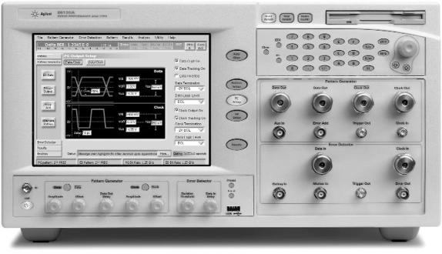
BER tests at 3.25 Gb/s
BER tests @ 3.25 Gb/s (Avago evaluation board limited)
Rx
Tx
FPGA
Ribbon
fibers
USB
Custom PCB
Laptop
Evaluation
board
FPGA used only for SerDes function on the path
Stratix IV GT evaluation kit ordered
Jean-Francois Genat, Fermilab, Aug 19th 2010
Agilent 10.6 Gbs Bit Error Rate tester
Notes:
13

Slide 14
J-PARC
- PMT channels, 16-channel regular VME modules
- Digitization on the fly at 125 MHz (upgrade at 500 MHz)
- Energy sums in parallel through 805nm multi-mode fibers (100m)
- Trigger and data on two optical channels
- Regular VME cards with 2.5 GB/s links on the front panel
- TI SerDes + Avago optical modules at 2.5 Gb/s
- Interconnected as a parallel structure:
Jean-Francois Genat, Fermilab, Aug 19th 2010

Slide 15
ATCA
- Just started, have in view a data acquisition system for a PET camera
a few hundred channels at a 100 kHz-1 MHz event rate
MicroTCA foreseen
Jean-Francois Genat, Fermilab, Aug 19th 2010

Slide 16
Conclusion
> 10Gb/s serial transmission links available today, with bunched fibers
- Thanks to Silicon-Germanium and Gallium Arsenide technologies
- Radiation hardness to be checked
- Ok for most of the present detectors needs
We are open to work with other teams, as adequate specific parts are developed and get available
Jean-Francois Genat, Fermilab, Aug 19th 2010

