Slide 1
High Intensity Neutrino Source Report
DOE Site Visit
B&R Code KA15-02-011
General Accelerator Development
Bob Webber
August 23, 2010

Slide 2
FY10 – HINS Accomplishments
Began construction of HINS beam line radiation shielding enclosure
Installed and commissioned the HINS RFQ once again following RF seal repair at the vendor’s facility
Achieved 2.5 MeV beam from RFQ; then removed RFQ to repair water-to-vacuum leaks
Completed installation of cryogenics delivery system and cavity test cryostat for HINS 325 MHz cavity test facility
Assembled first 325 MHz SSR1 cavity into helium jacket
Successfully completed full-field test of first jacketed 325 MHz SSR1 cavity to 27 MV/m @4K
Received delivery of the full complement of copper RT-CH cavities from industrial vendor
Completed assembly of first superconducting solenoid magnet into its cryostat and completed initial magnetic testing of the assembly

Slide 3
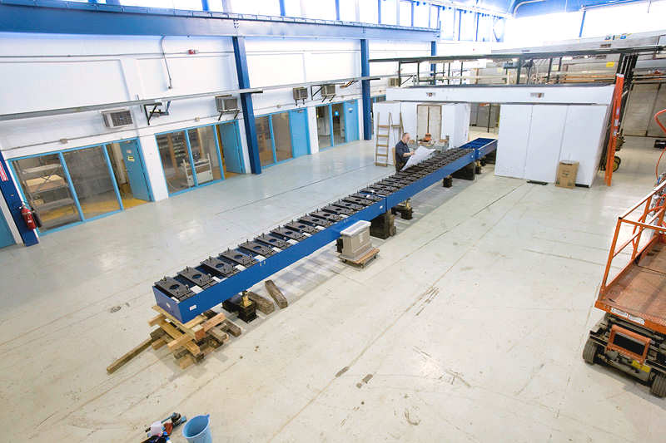
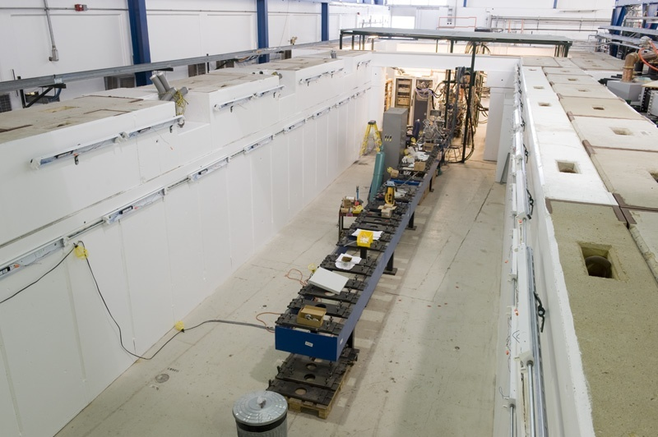
Began Construction of Beam Line Shielding Enclosure

Slide 4
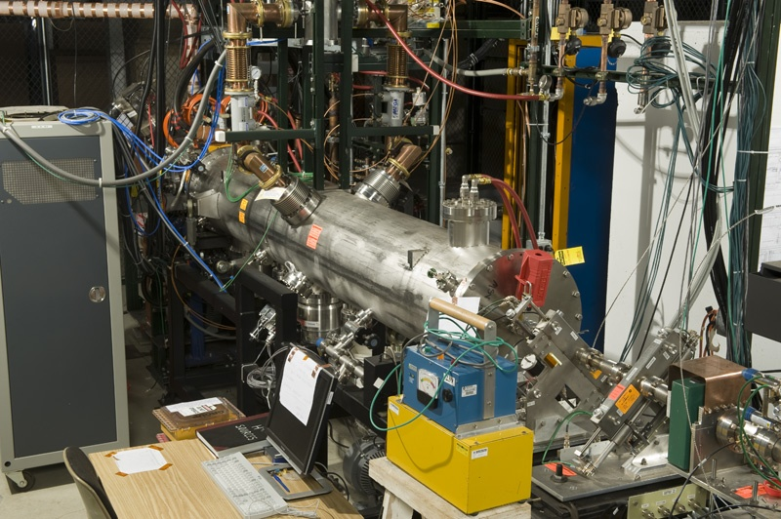
Repaired RFQ --- Re-installed and Re-commissioned

Slide 5
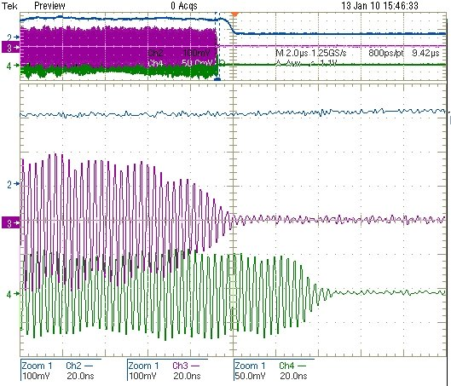
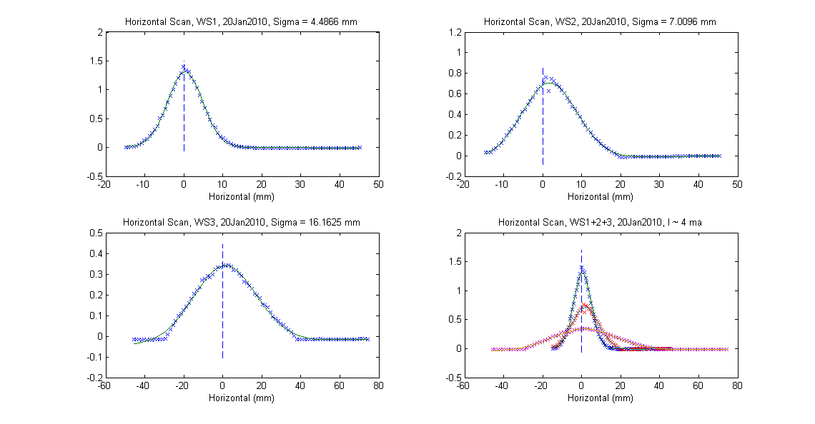
First 2.5 MeV Beam through HINS RFQ on January 13, 2010
Signals from toroid and two BPM buttons, all downstream of the RFQ
Upper display: 2 μsec/div
Lower display: 20 nsec/div
Lower display shows 44nsec transit delay expected for 2.5 MeV beam between the BPM two buttons separated by 0.96 meters
Beam current is about 3 mA
Profile measurements of 2.5 MeV beam from HINS RFQ

Slide 6
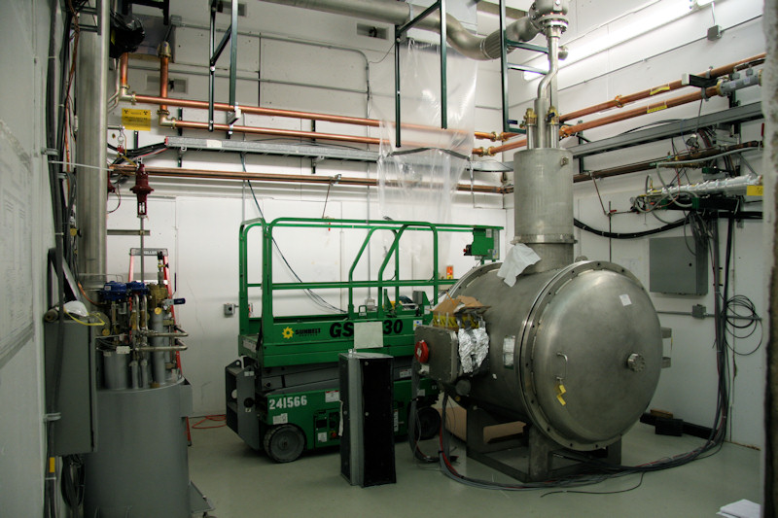
325 MHz Cavity Test Facility ---Cryogenics Delivery System and Cryostat Installed

Slide 7
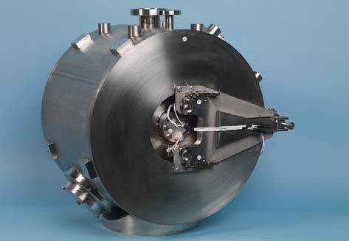
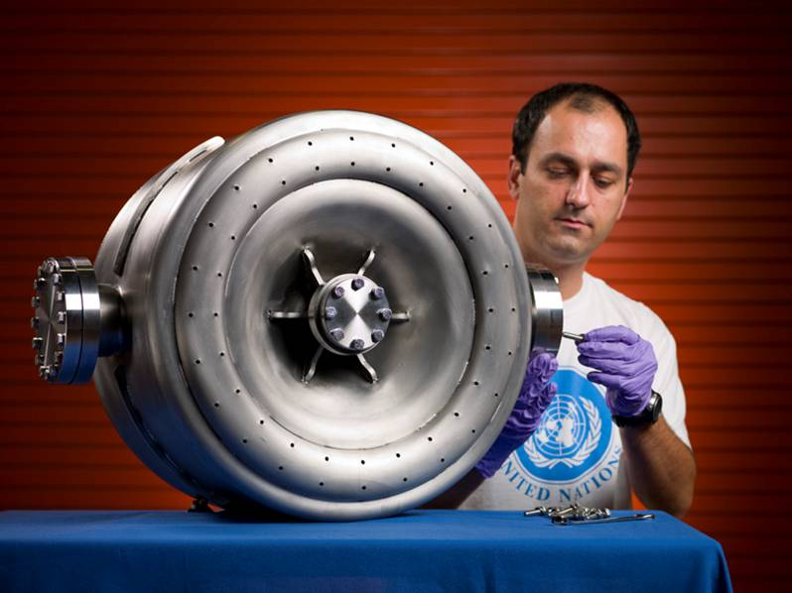
Assembled First SSR1 Cavity with Helium Jacket and Tuner

Slide 8
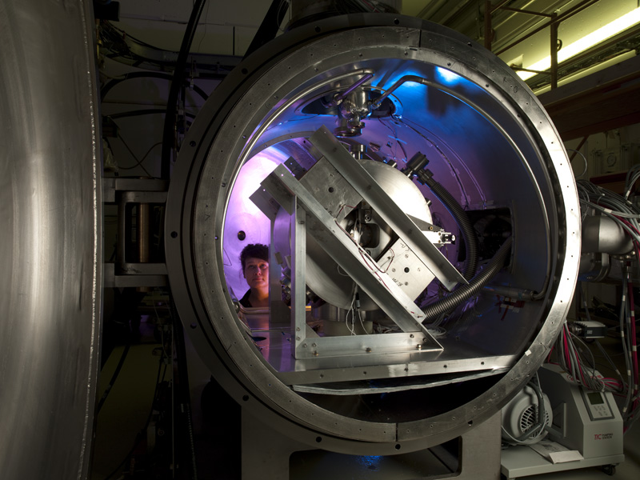
First SSR1 Jacketed Cavity Installed in Cavity Test Cryostat

Slide 9
SSR1-01 Performance in HINS Cavity Test Facility
Cavity Q₀
HINS Design Goal – 5E8 at 10 MV/m at 4°K
Spoke Cavity Accelerating Gradient - MV/meter

Slide 10
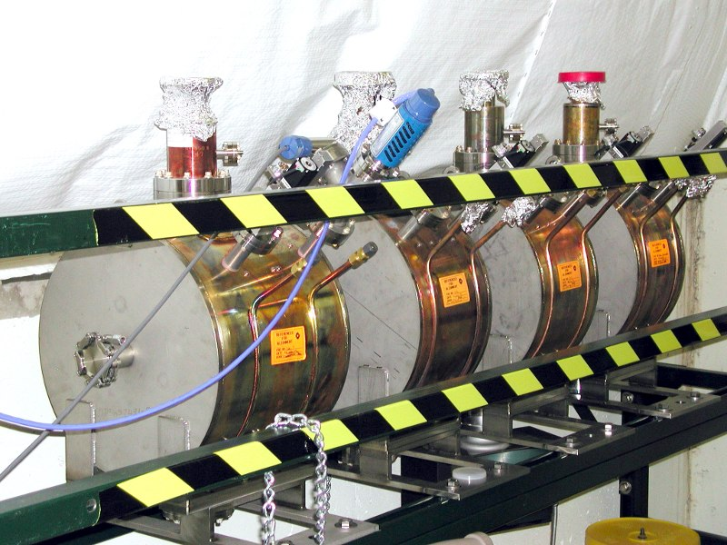
Accepted Final Delivery of Sixteen HINS RT-CH Cavities

Slide 11
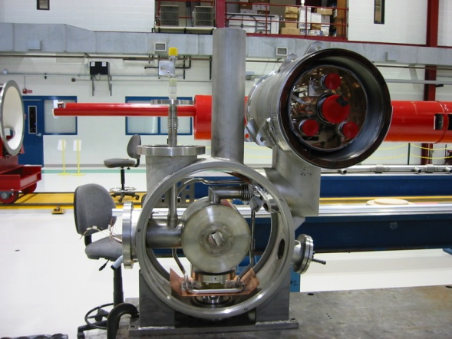
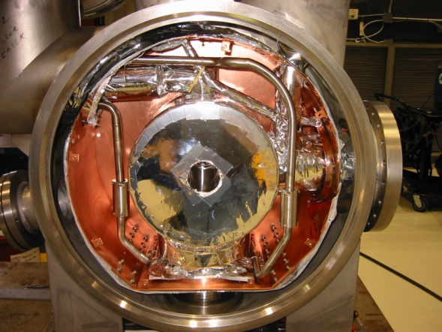
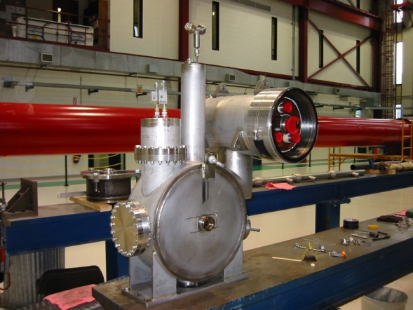
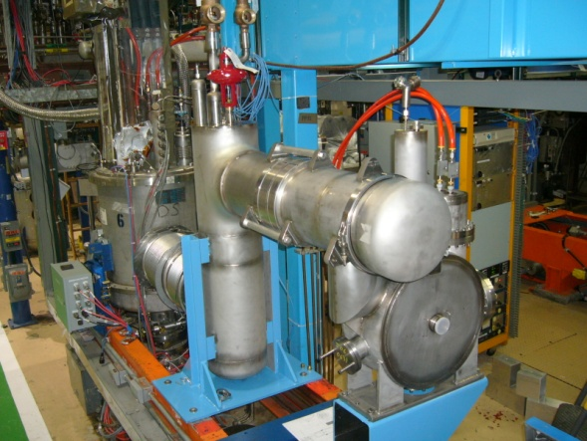
First HINS Solenoid Magnet Cryostat Assembly & Tests

Slide 12
Additional FY10 HINS Accomplishments
Produced near-final Safety Assessment and Radiation Shielding Assessment documents for the HINS beam facility
Placed purchase order for spare 325 MHz RF klystron - $560,000
Placed purchase order for ten 325 MHz SSR1 cavities from Roark/NioWave - $360,000
Began serious assessment of how past HINS development work on pulsed linac systems is best leveraged to the advantage of a CW Project X linac
  Studied 325 MHz Single Spoke cavity and helium vessel design modifications for CW operation at 2°K
  Initiated design modifications required for sub-atmospheric, 2°K, operation of the 325 MHz cavity test facility
  Worked to identify critical beam tests that might be supported

Slide 13
FY11 Transitions
HINS Linac beam facility
  Will be absorbed into and managed with pre-Project X activities
  Funding for this will be moved from General Accelerator Development KA15-02-011 to the Future Accelerators R&D KA11-02-034
HINS 325 MHz superconducting RF spoke cavity development
  Will be absorbed into and managed in an integrated manner with the overall Fermilab superconducting RF cavity development effort
  Will continue to be funded by KA15-02-011
KA15-02-011 also funds 650 MHz elliptical cavity development

Slide 14
FY11 HINS Beam Facility Scope of Work –
KA11-02-034
Complete construction of HINS beam line radiation shielding enclosure in MDB
Obtain final operational approvals for the HINS Linac
  Submit and review the Radiation Shielding Assessment
  Submit and review the Safety Assessment Document
Re-establish 2.5 MeV beam from RFQ
Quantify parameters of 2.5 MeV beam from RFQ
Replace existing HINS proton ion source with an H⁻ ion source
Configure the HINS beam line for the “Six-Cavity Test” to verify high power RF vector modulator performance with beam in preparation for Project X beam chopper tests
Begin pursuit of the Project X beam chopper test
  Finalize beam line design
  Specify needed components
  Begin initial component procurement as budget permits

Slide 15
325 and 650 MHz Programs -KA15-02-011
In FY11 and beyond, SRF technology efforts across all frequencies will be integrated
  Common planning, budgeting and staffing
  Collective prioritization of activities
  Shared design/analysis tools, engineering procedures, lessons learned…
650 MHz and, to a lesser extent, 325 MHz will build on successful 1.3 GHz SRF accomplishments
  Use existing SRF infrastructure with modifications where required
  Continue collaborations with other labs (national and international) that have been established as part of the ILC/SRF Programs
  Utilize the same skilled workforce and established procedures
325 Spoke cavities require further development and cry for first beam test
Elliptical cavities near 650 MHz are used for other programs
  704 MHz (CERN), 805 MHz (SNS)
  Nevertheless, the 650 MHz is a new cavity frequency that must be developed in detail

Slide 16
FY11 - 325 MHz Cavity Program Scope of Work
Reconfigure SSR1-0 (now in the 325 MHz Cavity Test Facility with high Q_{ext} drive antenna) with a beam line power coupler and perfom full high power pulsed testing
Jacket second SSR1 and test in HINS 325 MHz Cavity Test Facility
Finalize integrated design of 2°K, CW SSR cavity and tuner system
Complete construction of:
  Two SSR1 cavities now being built at IUAC (India)
  Ten SSR1 cavities now being fabricated at Roark/NioWave
Design and install modifications to the 325 MHz cavity test facility cryostat and cryogenics delivery systems to support sub-atmospheric, 2°K and CW operation
Complete RF and mechanical design of Project X SSR0 cavity and possibly begin fabrication of the first article

Slide 17
FY11 - 325 MHz Cryomodule Program Scope of Work
Design a short (~four cavity) prototype Project X spoke cavity cryomodule
  Integrate SSR cavities, tuners, power couplers, solenoid magnets and beam instrumentation components
  Ultimately destined for beam test in HINS Linac
Continue prototype work on solenoid magnets for SSR cryomodule
Finish assembly of three HINS individually-cryostated solenoid magnets
  Complete magnetic testing
  Investigate warm-to-cold alignment issues

Slide 18
FY11 - 650 MHz Scope of Work
Modify existing EP facility and VTS for 650 MHz cavities
Fabricate required handling and assembly fixtures
Process & test single-cell 650 MHz β = 0.9 cavities (ANL, FNAL, India)
  Six single-cell β = 0.9 cavities are being ordered in FY10
Extend the RF and mechanical design of 650 MHz cavities to five-cell structures
Continue support for work at collaborating institutions
  JLab: Single-cell β = 0.6 design, prototype, process & test, CM study
  ANL: Process β = 0.9 cavities, design study (elliptical vs. TSR)
  India: single-cell β = 0.9 design and prototype, modified Type 4 CM design
Depending on financial status and technical progress, order first prototype of 5-cell 650 MHz cavity
Design radiation shielding enclosure for 650 MHz cavity test facility in MDB
Specify and procure cryogenic delivery system components for 650 MHz cavity test facility in MDB

Slide 19
Summary
FY10
  A year of major accomplishments for the HINS program
  A year of planning and preparing for upcoming organizational and programmatic transitions
FY11 will see management and organization of the historic HINS program completely integrated into the SRF and Project X programs
FY11 will see program goals re-defined in direct support Project X and SRF objectives
A large scope of work is identified for FY11
  Within KA15-02-011 for 325 MHz and 650 MHz superconducting cavity and cryomodule development activities
  Within KA11-02-034 for the HINS Linac facility in support of Project X

Slide 20
Back-up slides

Slide 21
3 GeV CW Linac
Design based on 3 families of 325 MHz Single Spoke resonators, two families of 650 MHz elliptical cavities, then 1300 MHz ILC cavities
Ion source, RFQ
SSR0
SSR1
SSR2
β=0.6
β=0.9
ILC
MEBT
325 MHz, 2.5-160 MeV
1.3 GHz
2-3 GeV
650 MHz,
0.16-2 GeV

Slide 22
Summary of 3 GeV CW linac cavities
Section | Energy range MeV | β | Number of cavities | Type of cavities | Maximal power per cavity*, kW
SSR0 (β_{G}=0.12) | 2.5-10 | 0.073-0.146 | 26 | Single spoke cavity. | 0.5
SSR1 (β_{G}=0.22) | 10-32 | 0.146-0.261 | 18 | Single spoke cavity. | 1.5
SSR2 (β_{G}=0.4) | 32-160 | 0.261-0.52 | 44 | Single spoke cavity. | 3.2
650 MHz (β_{G}=0.61) | 160 - 500 | 0.52-0.758 | 42 | Elliptic cavity | 11.5
650 MHz (β_{G}=0.9) | 50 - 2000 | 0.758-0.95 | 96 | Elliptic cavity | 18.5
1300 MHz (β_{G}=1) | 2000-3000 | 0.95- 0.97 | 64 | Elliptic cavity | 16
*Without overhead

Slide 23
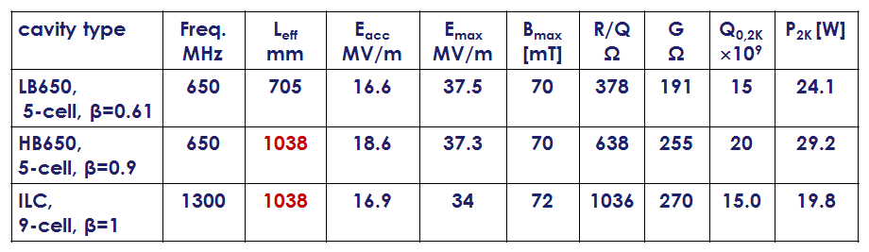
Summary of Cavity Parameters for PX

Slide 24
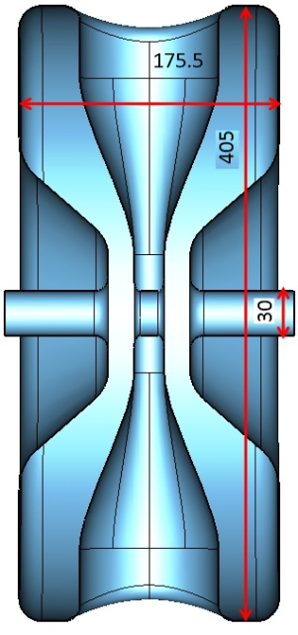
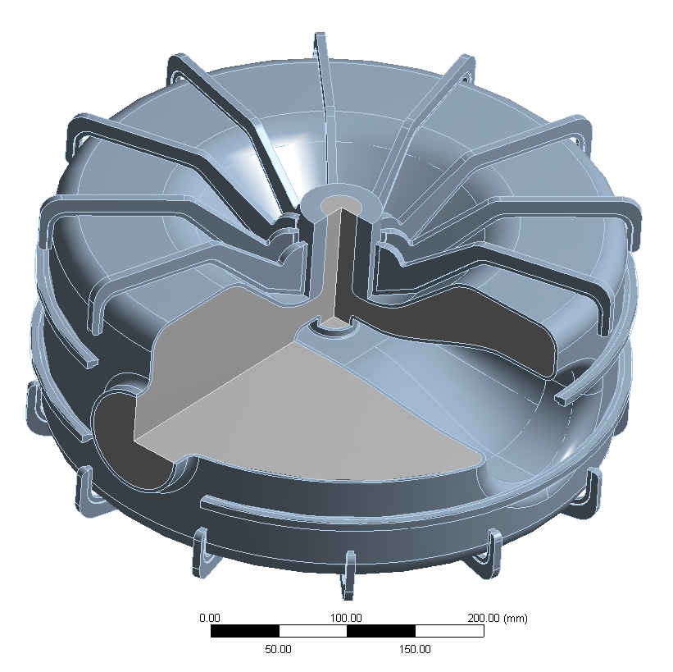
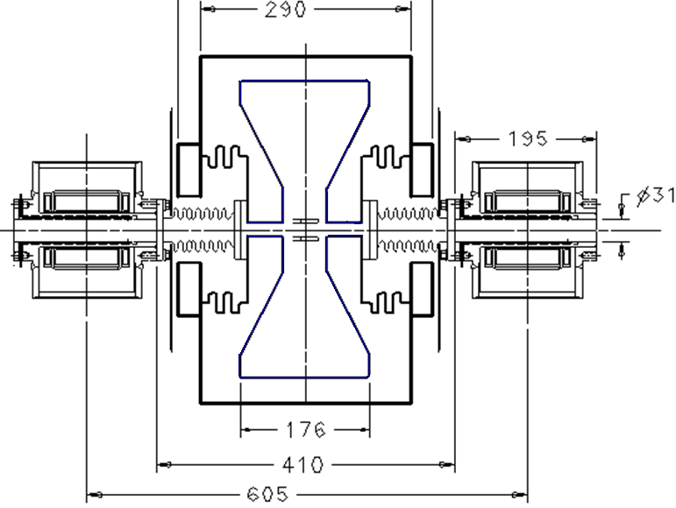
SSR0 cavity design
F(MHz) | 325 | MHz
β_{optimal} | 0.117
R_{cavity} | 204.3 | mm
L _{wall- to-wall} | 175.5 | mm
R/Q | 110 | Ω
G | 52 | Ω
E_{max}/E_{acc} | 5.97
H_{max}/E_{acc}) | 6.89 | mT/(MV/m)
D_{eff}=(2β_{opt}λ/2) | 108 | mm
Few iterations in concepts of cavity / solenoid designs to minimize period (690→605 mm)
In lattice was used: L_{p}=610 mm
Solenoid with BPM and correctors is to be designed
Mechanical design: minimizing of df/dP
RF coupler design is in progress
Tuners design

Slide 25
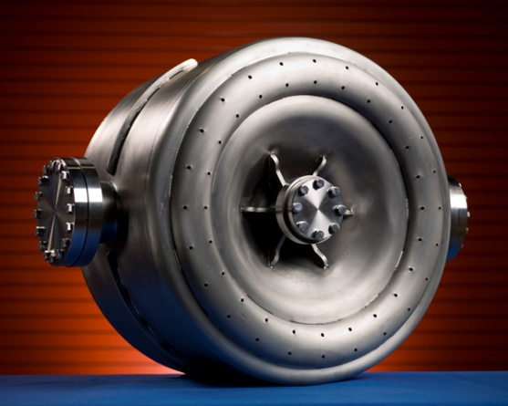
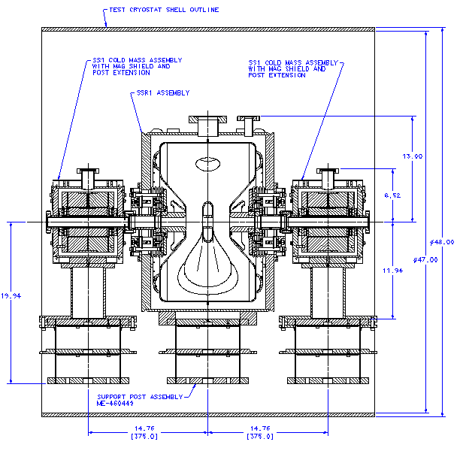
SSR1 cavity:
Solenoid status
Design is completed 2008
Prototype in production
Cryomodule
Design of spoke resonator cryomodule is starting
Problems
Initially the cavity was optimized for pulse operation.
For CW operation modifications may be required.
Section period
750 mm ➔800 mm
(increased after review)
Cavity status
2 prototypes tested
(Max gradient 34MV/m at 2K)
1st SSR1 dressed
+2 in production in India
+10 order from Roark
F(MHz) | 325 | MHz
β_{optimal} | 0.21
R_{cavity} | 245.7 | mm
L _{wall- to-wall} | 295 | mm
R/Q | 242 | Ω
G | 84 | Ω
E_{max}/E_{acc} | 3.93
H_{max}/E_{acc}) | 5.8 | mT/(MV/m)
D_{eff}=(2β_{opt}λ/2) | 193 | mm
800mm

Slide 26
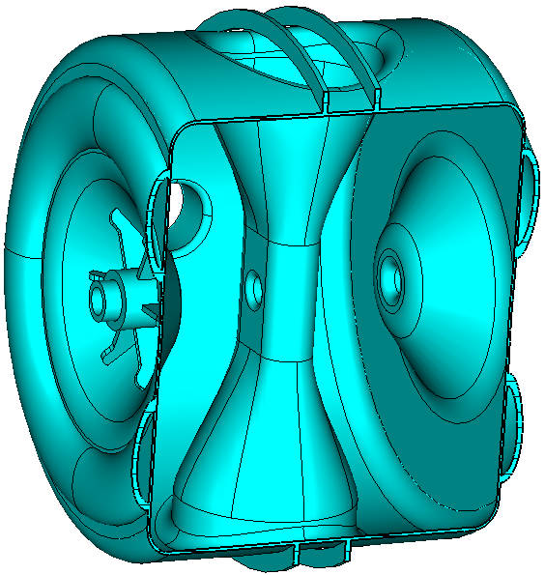
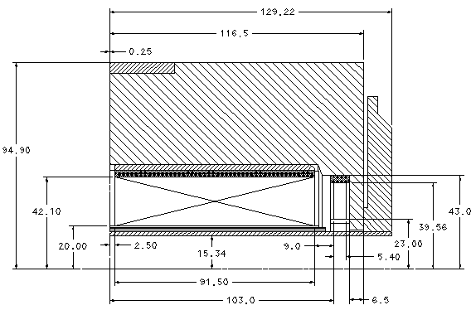
SSR2 section: cavity, solenoid
SSR2 cavity
RF design – done (possible changes)
Mech. design is to be completed.
Operating frequency | 325 | MHz
β_{G} | 0.4
Cavity Length _{from wall to wall} | 406 | mm
Dressed cavity length | ~530 | mm
Cavity diameter | 556.2 | mm
R/Q | 322 | Ω
G-factor | 112 | Ω
Max. gain per cavity (φ-0) | 3.16 | MeV
Max. surface electric field | 33 | MV/m
Max.surface magnetic field | 54 | mT
Latest changes not reflected
Solenoid:
Design completed
Prototype ready for test (w/o vessel)
Bore diameter | 30 | mm
Available slot length | <294 | mm
Squared magnetic field integral | 580 | T²-cm
Integrated strength of steering dipoles* | 0.5 | T-cm
Operating current | < 200 | A
Fringe field on the walls of cavities | <10 | μT
* Corrector provides ~6 mm solenoid centre correction
Period (sol+cav+cav+60 mm) = 1300 mm

Slide 27
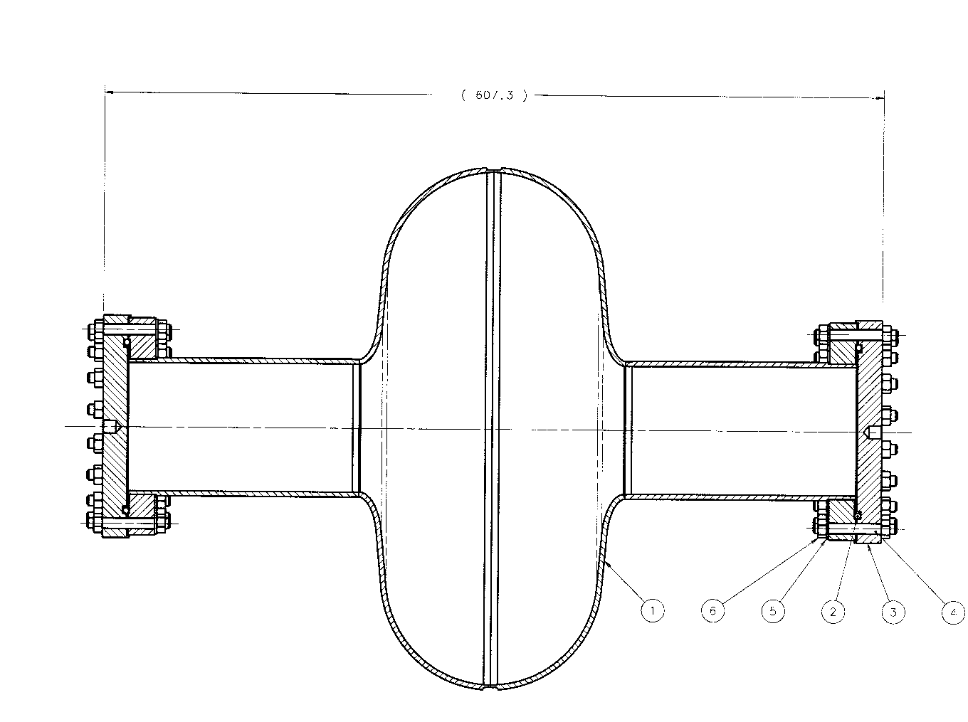
650MHz Β = 0.9 Single Cell

Slide 28
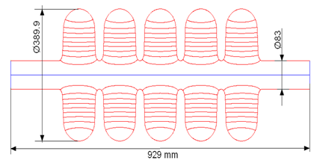
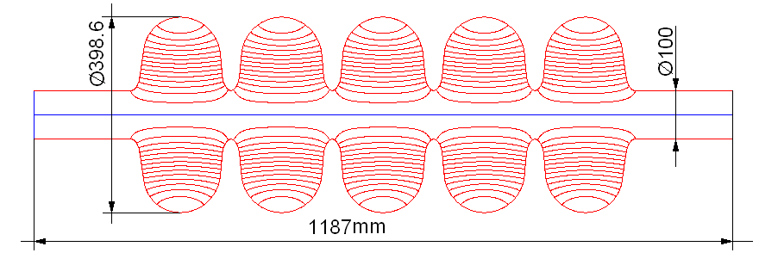
650 MHz, 5-cell cavities
Low-beta
High-beta
β_{G} | 0.61 | 0.9
Length (from iris to iris) | 705 | 1038 | mm
Aperture | 83 | 100 | mm
Cavity diameter | 389.9 | 400.6 | mm
R/Q, Ohm | 378 | 638 | Ω
G - factor | 191 | 255 | Ω
Max. gain per cavity (φ-0) | 12.0 | 19.9 | MeV
Gradient | 17.1 | 19.2 | MV/m
Max surface electric field | 38.6 | 38.4 | MV/m
Max surf electric field | 72 | 72 | mT

Slide 29
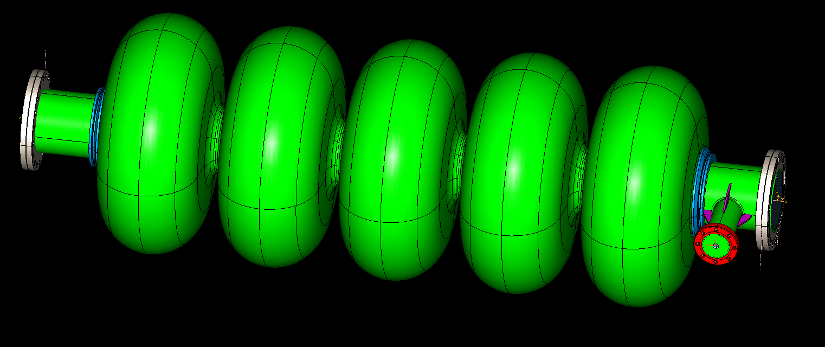
Preliminary layout of a beta=0.9 650 MHz 5-cell cavity
EM design of the cavity is finished;
Mechanical design is underway: df/dP, tuners, RF coupler
HOM couplers?

Slide 30
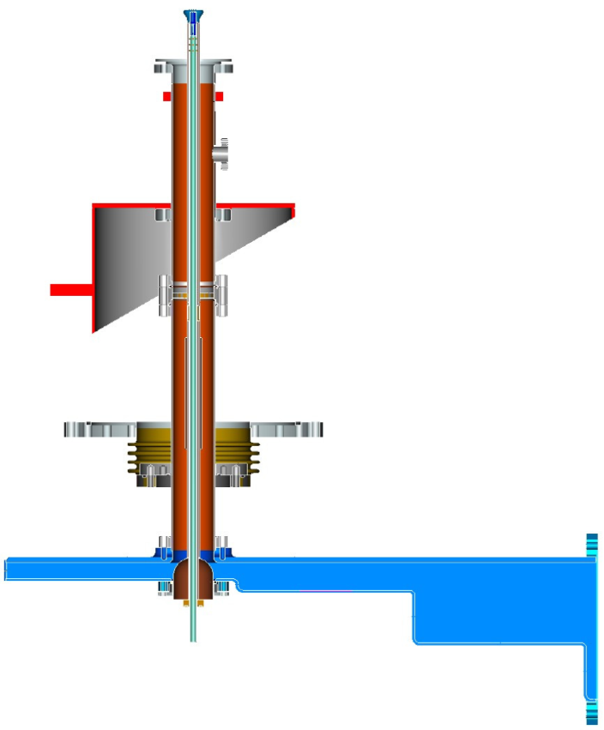
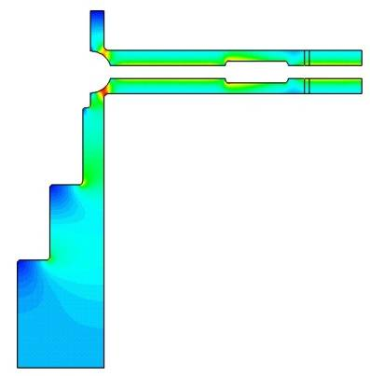
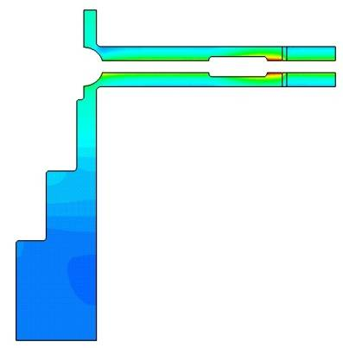
650MHz coupler, preliminary
mechanical design
One window;
Non- adjustable;
Air-cooled;
No HV bias.
E-field H-field
Max. E-field in air is 4.3 kV/cm
for 30 kW input power
Pulse power limitation ≈ 650 kW (TW)
 | 2K (Flow/Plant),W | 5K(Flow/Plant),W | 70K(Flow/Plant),W | Total plant,W
RF = 0kW | 0.04 / 28.1 | 0.99 / 196 | 7.85 / 62.8 | 287
RF = 20kW | 0.065 / 45.7 | 1.27 / 251.5 | 8.55 / 68.4 | 366
RF = 30kW | 0.078/ 54.8 | 1.41 / 279.2 | 8.87 / 71.0 | 405

Slide 31
Summary of the Cavity Parameters
Low energy SC Linac (2.5 – 160 MeV)
cavity type | F req MHz | U_{acc, max} MeV | E_{max} MV/m | B_{max} mT | R/Q, Ω | G, Ω | Q_{0,2K} ×10⁹ | P_{max,2K} W
SSR0, β=0.117 | 325 | 0.78 | 53 | 59.5 | 120 | 57 | 9.5 | 0.77
SSR1, β=0.22 | 325 | 1.53 | 34.4 | 50.8 | 242 | 84 | 14.0 | 0.94
SSR2, β=0.4 | 325 | 3.16 | 33 | 54 | 322 | 112 | 18.0 | 2.07
High energy SC Linac (160 – 3000 MeV)
cavity type | Freq. MHz | L_{eff} mm | E_{acc} MV/m | E_{max} MV/m | B_{max} [mT] | R/Q Ω | G Ω | Q_{0,2K} ×10⁹ | P_{2K} [W]
LB650, 5-cell, β=0.61 | 650 | 705 | 17.1 | 38.6 | 72 | 378 | 191 | 15.0 | 24.1
HB650, 5-cell, β=0.9 | 650 | 1038 | 19.2 | 38.4 | 72 | 638 | 255 | 20.0 | 29.2
ILC, 9-cell, β=1 | 1300 | 1038 | 16.9 | 34 | 72 | 1036 | 270 | 15.0 | 19.0

Slide 32
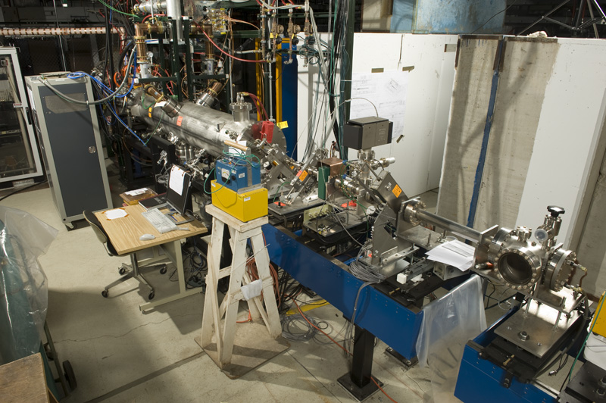
RFQ and 2.5 MeV Beamline

Slide 33
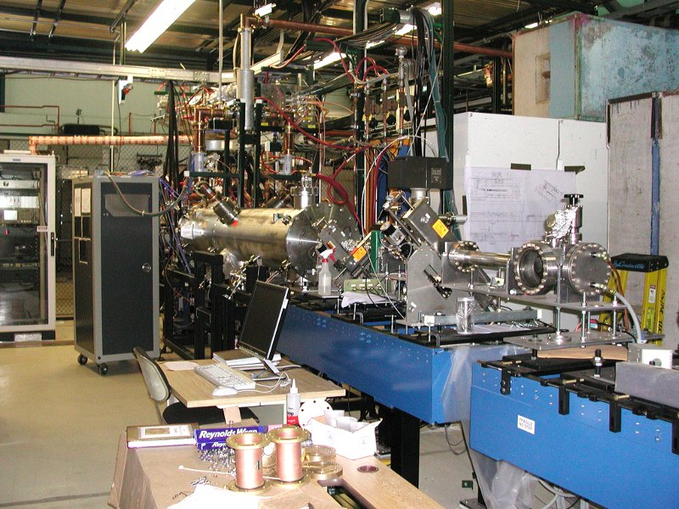
RFQ and 2.5 MeV Beamline

Slide 34
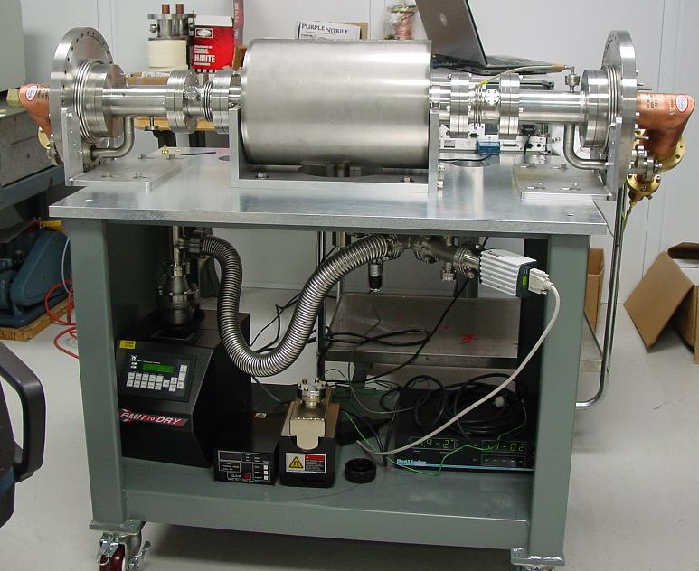
Spoke Cavity Input Coupler
Test Stand
First full-power coupler tests have been successfully completed

Slide 35
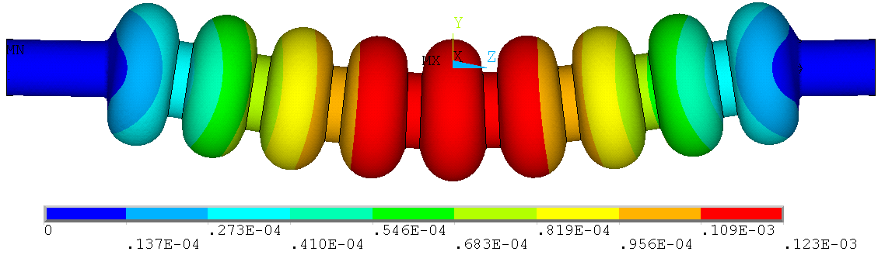
Wall Thickness for 650 MHz
Max. sag of an ILC cavity is 123 μm for 2.8mm wall thickness.
We selected the wall thickness ~ 4 mm.

Slide 36
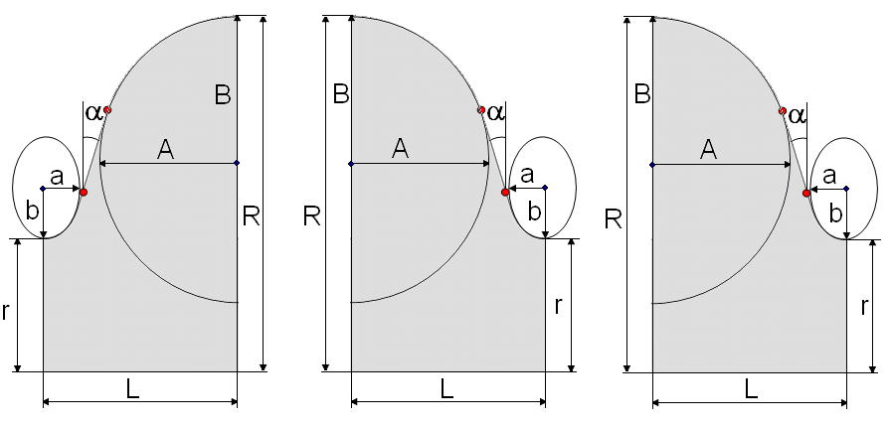
650 MHz, beta=0.9, 5 –cell cavity geometry
Left cell Regular cell Right cell
r
50
r
50
r
50
R
200.277
R
200.277
R
200.277
L
106.971
L
103.75
L
106.971
A
82.5
A
82.5
A
82.5
B
84.5
B
84
B
84.5
a
20
a
18
a
20
b
39.5
b
38
b
39.5
α
7.02
α
5.2°
α
7.02
All dimensions are in mm.

