Slide 1
General Accelerator Development
B&R KA-15-02-011
A LABORATORY-UNIVERSITY COLLABORATION TO UNDERSTAND PERFORMANCE LIMITS OF SRF CAVITIES (DE-PS02-09ER09-05) and
EQUIPMENT (INTEGRATED CAVITY PROCESSING APPARATUS AND CAVITY TUNING MACHINE)
Lance Cooley
Technical Division
SRF Materials Group Head

Slide 2
Laboratory – University Collaboration
Coordinated program to understand what limits performance in SRF cavities
  First area of focus: weld pits
$0.5 M / year x 3 years
FNAL, Florida State, IIT, UChicago, Northwestern
  Leveraged ILC support for UIC
FY10 money arrived 9/1/09, FY11 money arrived Jan 2010, $200k arrived 7/1/2010 (1.2 M total of 1.5 M already here)
MOUs with universities completed Jan. 2010, funds transmitted to universities Feb. 2010 per SOWs
FY11 SOWs in preparation now

Slide 3
SRF University Collaboration meeting 13 August 2010
Fermilab
Lance Cooley* (PI)
Alex Romanenko* (Peoples Fellow)
John Zweibohmer* (budget)
Allan Rowe*
Dmitri Sergatskov*
Donna Hicks*
Denise Ford (NWU Ph.D student)
Genfa Wu*
Mingqi Ge*
Charlie Cooper*
UIC
Robert Klie (PI)
Runzhe Tao
* Supported at FNAL by this B&R
IIT
John Zasadzinski (PI)
Sandra Bishnoi (Chem. Faculty)
Brian Albee
Chaoyue Cao
Northwestern
David Seidman (PI)
Yoon Jun Kim
U Chicago
Steve Sibener (PI)
Jim Becker
Miki Nakayama (absent)
Florida State
David Larbalestier (PI)
Peter Lee (PI)
Zu-Hawn Sung
Tolya Polyanskii
Bill Starch

Slide 4
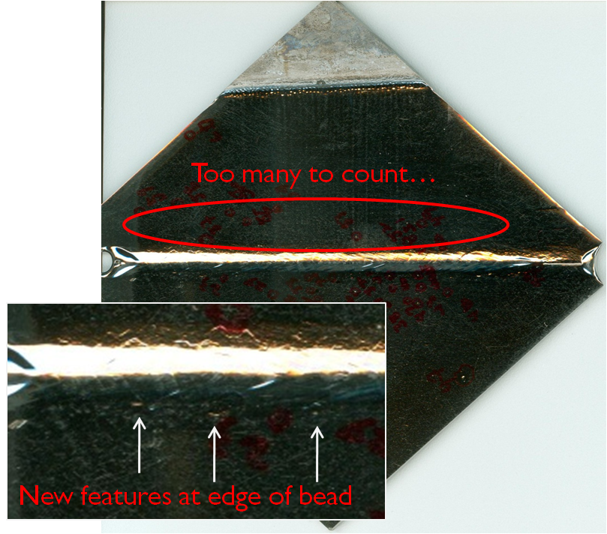
Milestones FY2010
Organized SRF Materials Workshop – Feb 2010 Tallahassee
Coupon work investigated how and why of pitting
  Invited presentation at ASC2010
  New recommendations for cavities:
    Anneal prior to EP and perhaps prior to welding
    Keep improving temperature control in EP

Slide 5


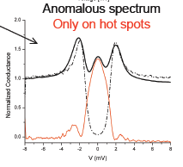
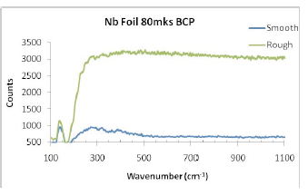
Milestones FY10
Point-contact tunneling combined with Raman spectroscopy showed dramatic role of defective Nb-oxide at hot-spots
  Proslier and Ciovati, submitted to PR-STAB 2010
FSU – Zu-Hawn Sung Ph.D.: Grain boundaries in Nb admit flux and permit dissipation
Clear Raman signature for oxidized spot

Slide 6
Anticipated Milestones FY2011
Accumulated surface science of pits will connect dots
  Cavity cut-outs added to coupons
  Cold work and/or excessive oxidation during EP ⇒ pits with defected oxide ⇒ cavity hot spots
  FSU explore, dual FIB to cut out, IIT to probe
Oxidation vs. surface orientation
  UChicago high quality Nb crystals
  UIC detailed electron microscopy – what are the defects?
Cottrell atmospheres (binding of H to Nb-vac)
  Hydrogen affects mobility of vacancies, dislocations
    Dislocations = oxygen elevators?
    Peoples Fellow Romanenko + Northwestern

Slide 7
Equipment – Integrated Cavity Proc. Apparatus
Scope: 1-cell processing R&D (acid, rinse, assemble)
Scale infrastructure for 9-cell
System | FY 2008 |  |  |  |  | FY2009 |  |  |  |  |  | FY2010 |  |  |  |  | FY2011
 | Q1 | Q2 | Q3 |  | Q4 | Q1 | Q2 |  | Q3 | Q4 |  | Q1 | Q2 |  | Q3 | Q4 | Q1 |  | Q2 | Q3 |  | Q4
Clean Room
UP Water
HPR tool
Acid work infra
EP tool
EP controls
Design
Draft /
Specify
Permit
Procure
Doc &
Review
Constr.
/ Assy.
ORC
Operation

Slide 8
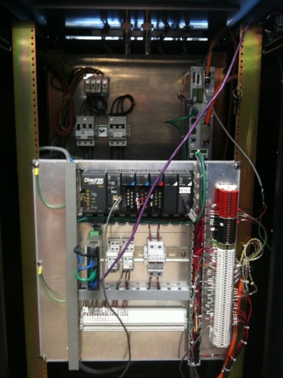
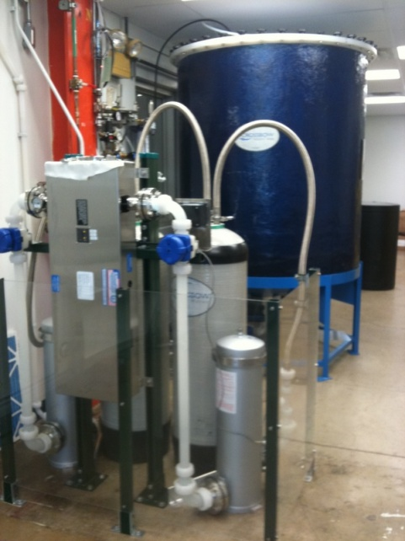
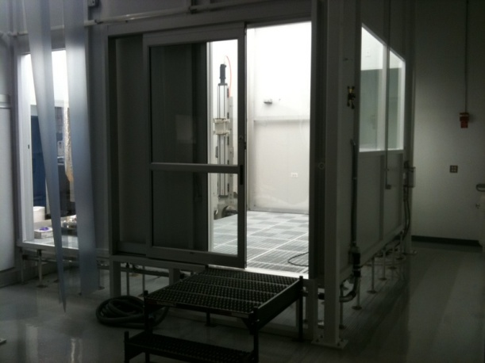
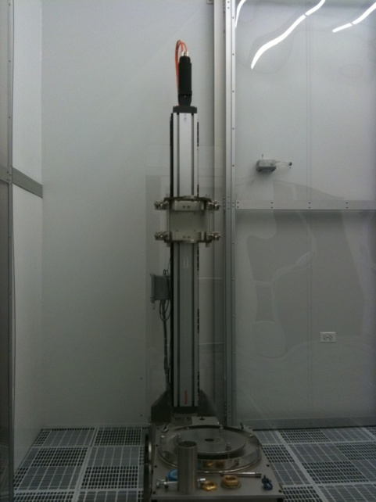
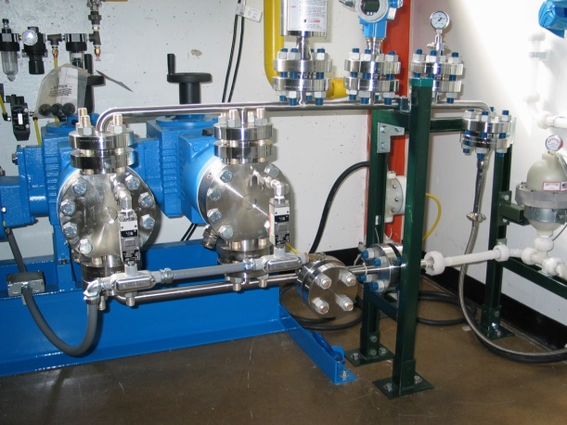
Equipment – ICPA – HPR and Clean Room
HPR control
1-cell initial R&D, 9-cell infrastructure capacity
Successful completion of Class 10 clean room, dessicator, ultrapure water plant, high-pressure pump, HPR tool, controls.
Now in ORC trials
FNAL designed and specified entire layout, and built all systems except clean room, dessicator, and UPW plant
Clean rinse and assembly capability improves on FNAL/ANL and JLab features
UPW Plant
HPR
Tool
Clean room
HPR pump

Slide 9
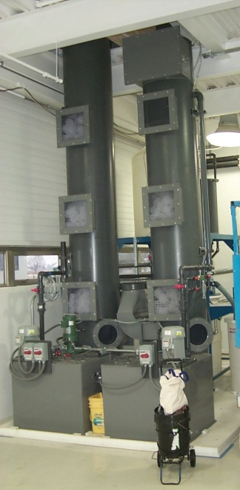
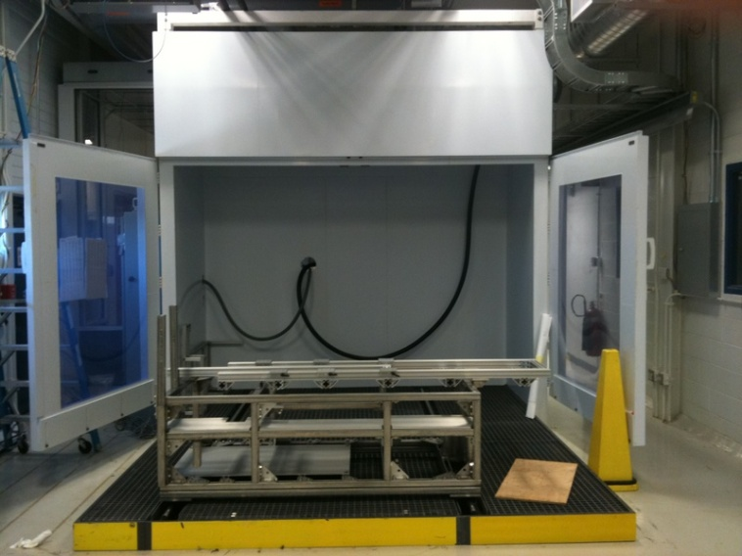
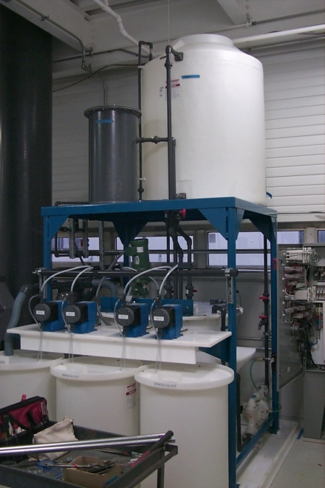
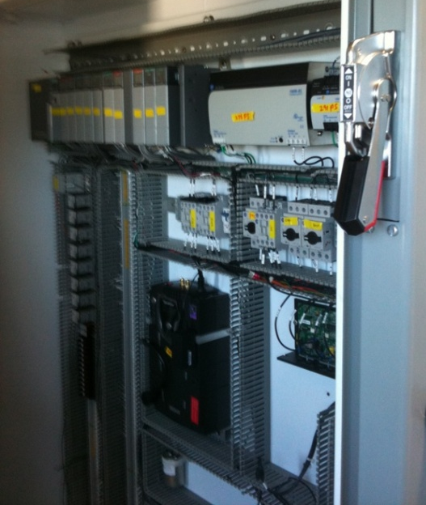
Equipment – ICPA – Chemistry Area
EP Cabinet and
Tool frame
1-cell initial R&D, 9-cell infrastructure capacity
Successful completion of all acid handling, storage, vapor scrubbing, and safety equipment
Permitting complete
FNAL designed and specified entire layout, and served as lead contractor
EP tool, acid transport, and control system designed and custom built by FNAL, in assembly stage now.
Scrubber
Neutralizer
EP Control

Slide 10
ICPA – What’s next
ORC
  Engineering triggers, Procedures
  Formal review by oversight committee
Operations
  Staffing
  Support of clean room: gowning, hardware, tools, vacuum pump cart, wash down
  Support of lab space: chemical PPE, furniture, access controls
  Support of cavity work: cavities, carts, fixtures
  Consumables: acids, filters, buffers
  Maintenance: UPW service, scrubber service
Upgrades
  9-cell ultrasonic cleaner, BCP / VEP cabinet

Slide 11
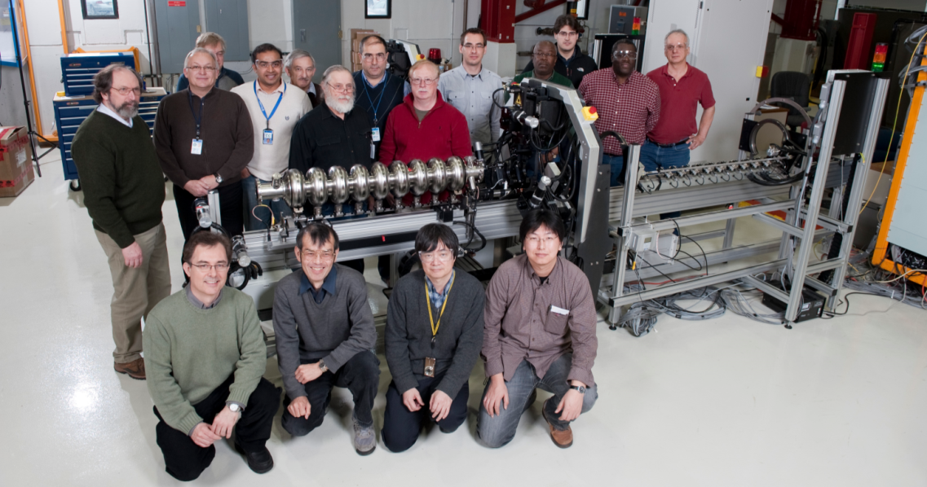
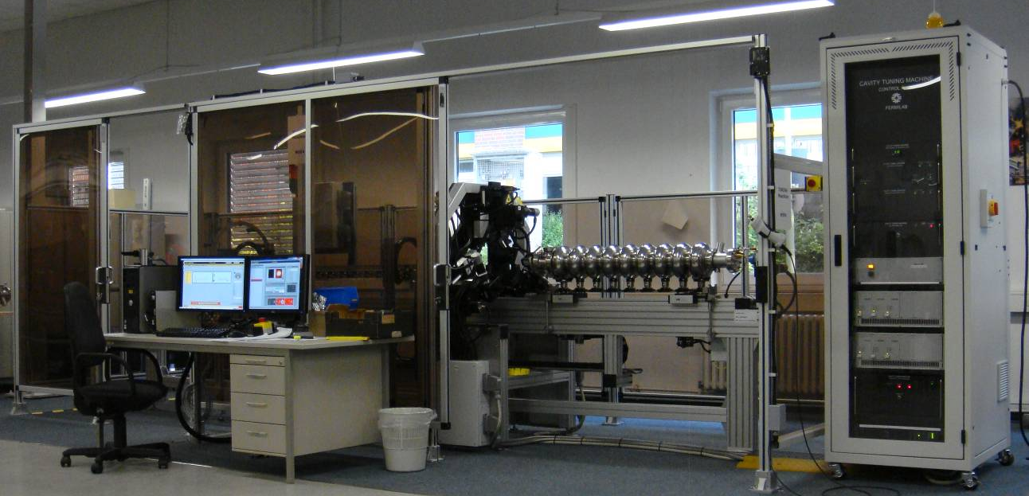
Equipment - Automatic Cavity Tuning Machines
Successful international collaboration effort by FNAL, DESY, and KEK
Four machines designed, fabricated, commissioned, and delivered to their respective institutions:
  Two for DESY, one for FNAL, one for KEK
Critical equipment for SCRF cavity industrialization and high volume production
  Allows a non RF-expert operator to tune and align a 9-cell 1.3 GHz cavity in less than 4 hours
  Both DESY machines to be used by European industry for XFEL cavity fabrication
Some members of the FNAL, DESY, and KEK collaboration during machine commissioning at FNAL
One of the two DESY machines after commissioning at DESY

Slide 12
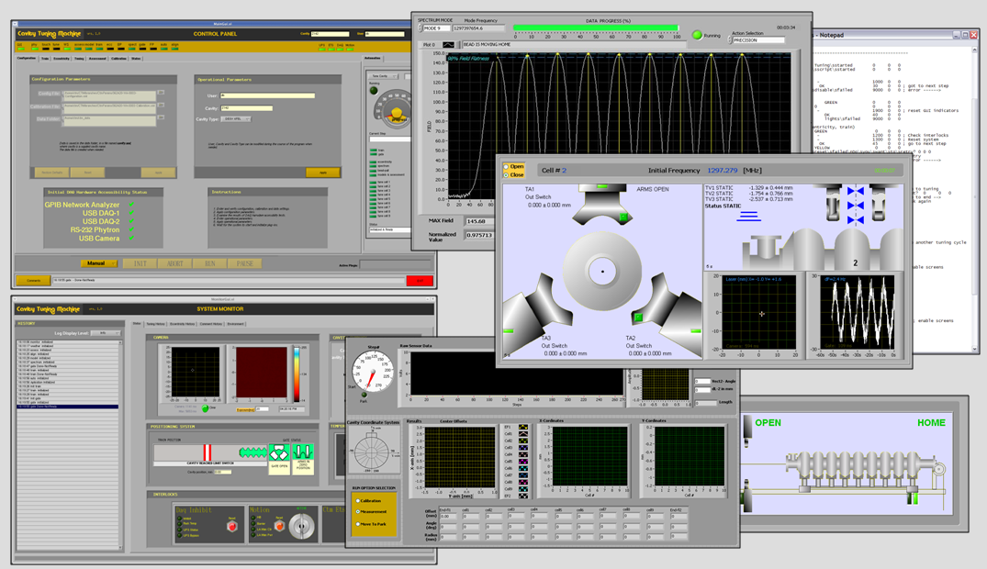
Tuning Machines – FNAL Deliverables
Control Software: Combination of Labview, Matlab, and Phytron scripts. Designed for automation, includes embedded electrical and mechanical models

Slide 13
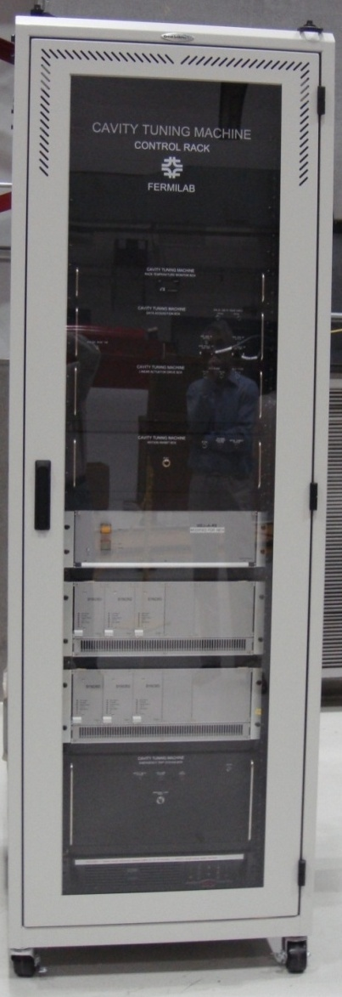
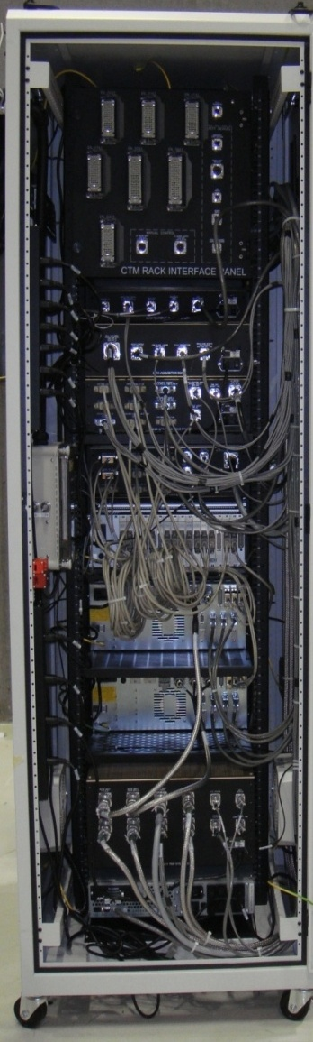
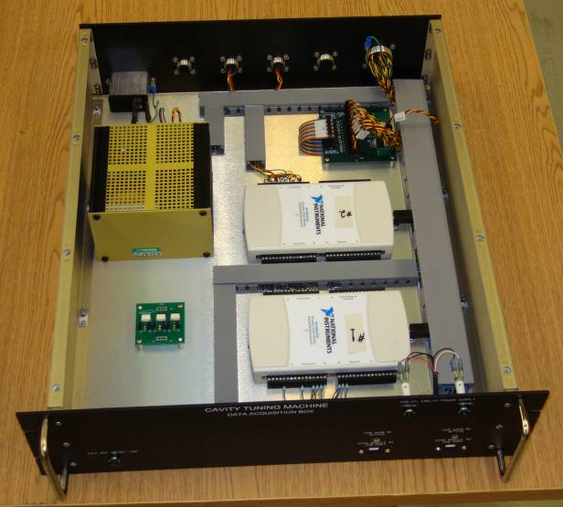
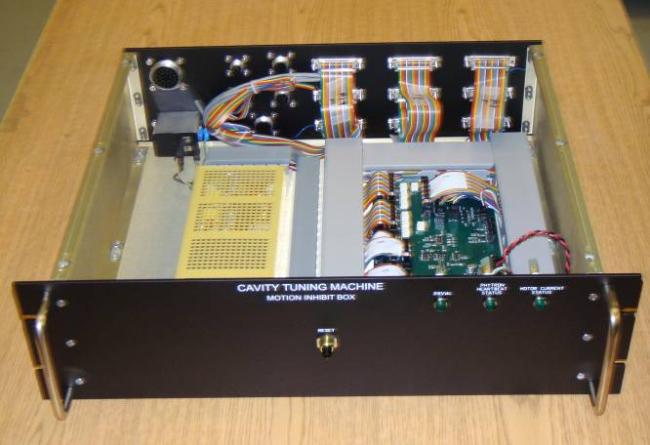
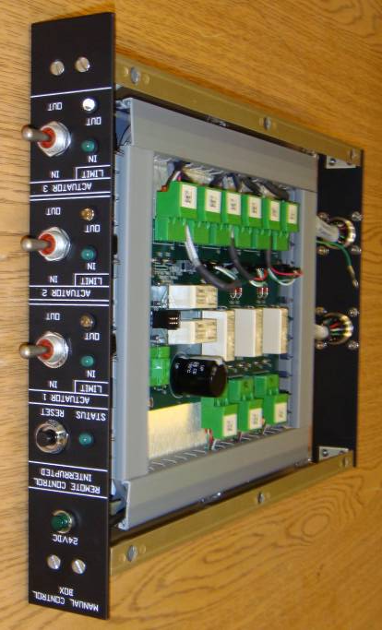
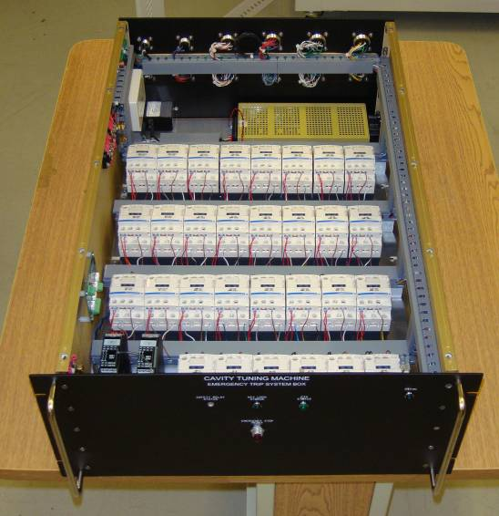
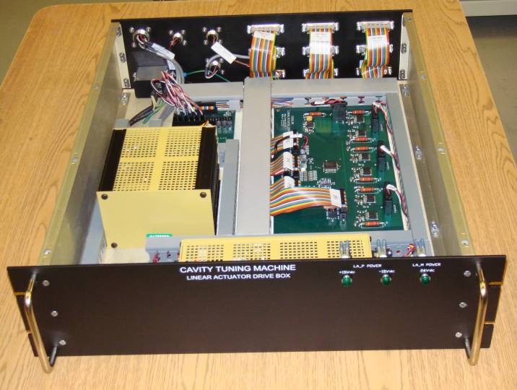
Tuning Machines – FNAL Deliverables
Control Electronics: one control rack per machine with several custom-made electronic boxes and printed circuit boards

Slide 14
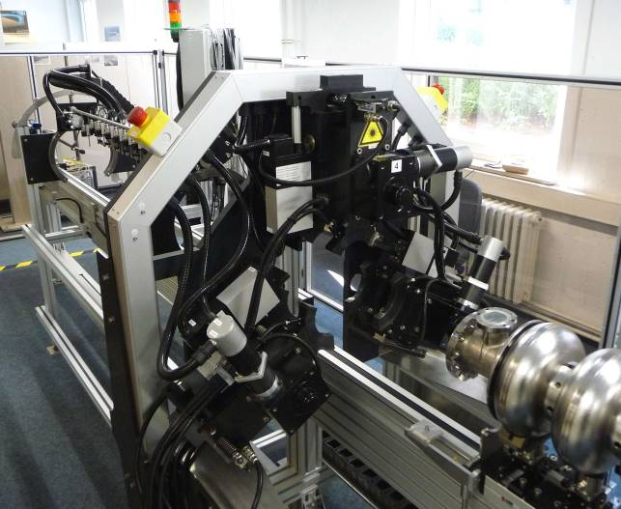
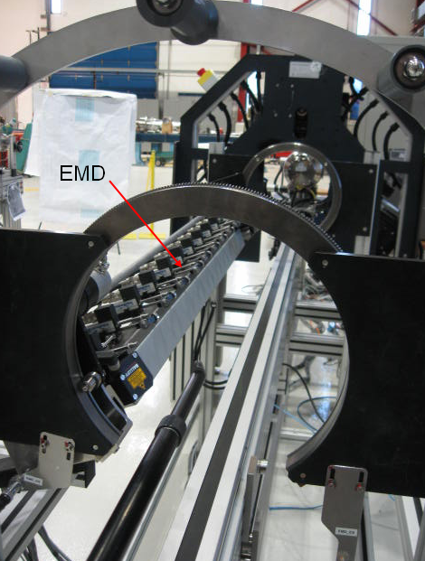
Tuning Machines - Next
Design and Fabricate a tuning machine for 650 MHz cavities?
  Mostly mechanical changes for the tuning jaws, tuning frame, and eccentricity measurement device
Eccentricity Measurement Sensors (x11)
Tuning Jaws (x3)

