Slide 1
Accelerator Simulation
Panagiotis Spentzouris, APC & CD/ADSS

Slide 2
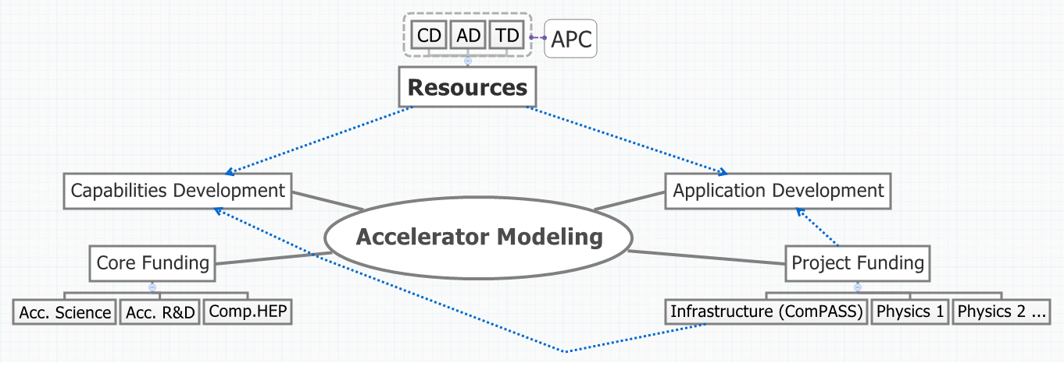
Accelerator Modeling Activity Synergies

Slide 3
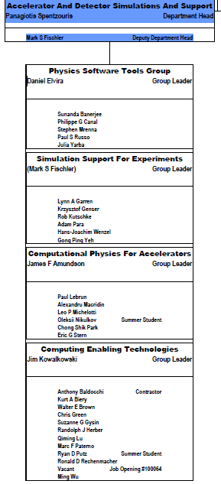
Computational Accelerator Physics at FNAL: CD/APC resources
Effort concentrated in CD/ADSS, but work closely with AD and TD personnel, in the context of the APC, to develop accelerator science applications
  4 FTE total in ADSS/CPA
    Both core and project funds (~50/50 split): SciDAC, ILC (in the past), Project-X, Mu2e
  Services and generic infrastructure development support (tools, new technologies) from ADS/CET

Slide 4
Computational Accelerator Physics mission
Develop computational tools
  Realistic physical system modeling (accelerator dynamics, accelerator components)
  Algorithm and application optimization
    Emphasis on High Performance Computing (HPC)
Provide expertise on deployment and utilization of computational tools
  Both internally (FNAL) and externally developed
  On local, distributed, and non-local facilities
Develop or contribute to the development of applications of such tools

Slide 5
Rich capability and application development program
Capabilities | Application | Code
Accelerator design | All | CHEF, MICCD, LLSC, HELIX
Beam Beam | Tevatron LHC (LARP) μ collider | BeamBeam3D, BBSIM, Lifetrac
e-cloud | Project-X ILC R&D | Posinst, VORPAL ORBIT
Space-charge & impedance | Run II Project-X μ2e | Synergia ORBIT
Beam shaping: crystal collimation, hollow beams | LARP R&D | STRUCT, MARS, WARP, Lifetrac
Highlights

Slide 6
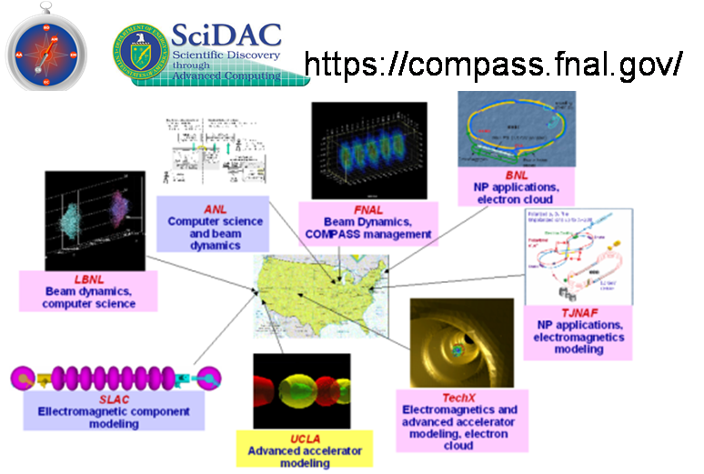
Accelerator Modeling Project: ComPASS
We lead the SciDAC2 ComPASS project. The collaboration aims to develop HPC accelerator modeling tools for
  Multi-physics, multi-scale for beam dynamics; “virtual accelerator”
  Thermal, mechanical, and electromagnetic; “virtual prototyping”
The Fermilab team focuses on beam dynamics capabilities and application development

Slide 7
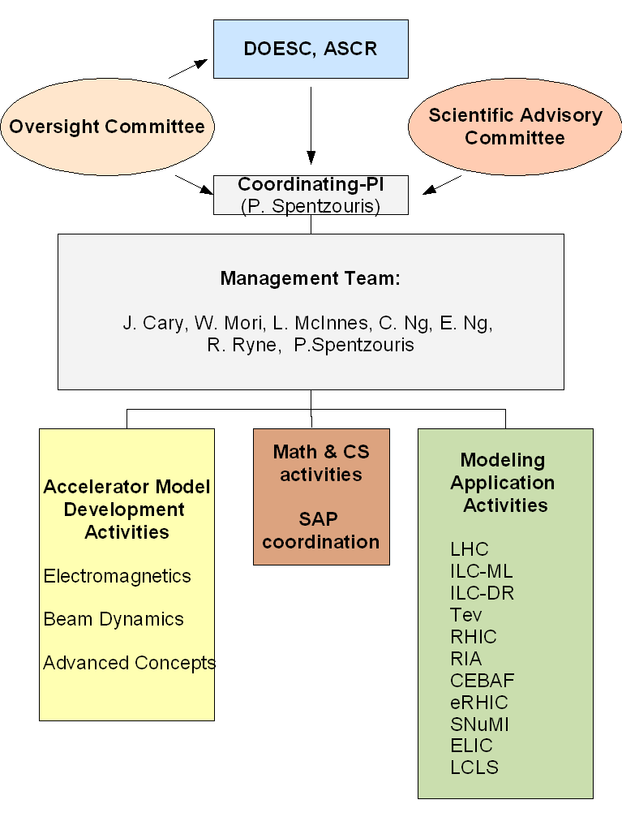
ComPASS
Total funding ~3.0 ($M)/year, for 5 years (FY07-FY11)
  FNAL receives funding for 2.2 FTE (~500 ($k)/year)
Submitted (lead institution) proposal for exascale co-design

Slide 8
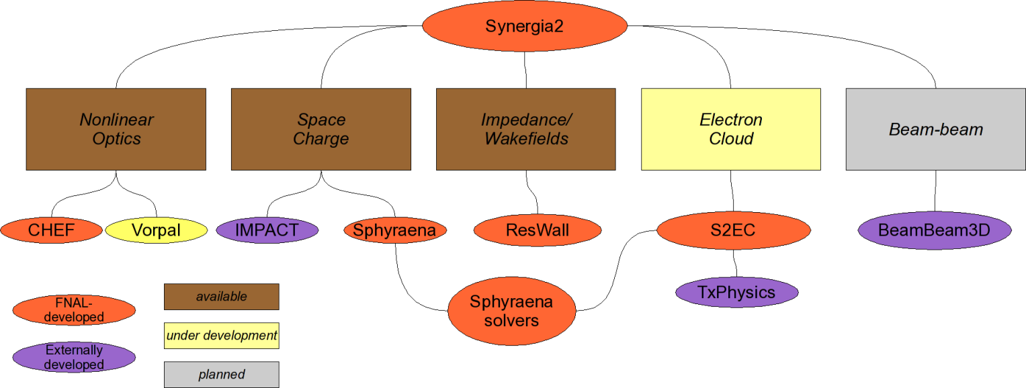
Accelerator modeling tools development: Synergia
Beam Dynamics framework with fully 3D PIC capabilities
  Utilizes both native and external physics modules/algorithms
  Includes space-charge & impedance (single and multi-bunch)
  Single-particle physics from CHEF
Runs on desktops, clusters and supercomputers
Flexible framework allows for fully dynamic simulations including ramping, feedback, etc

Slide 9
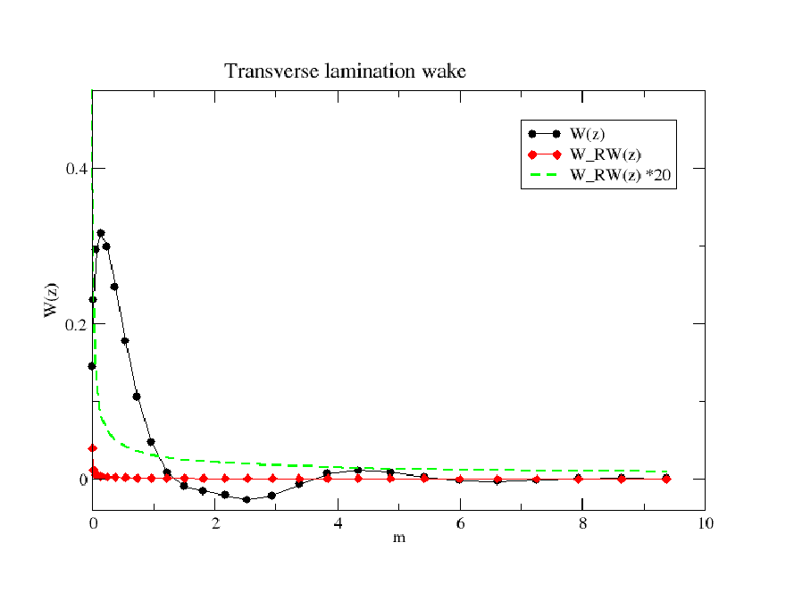
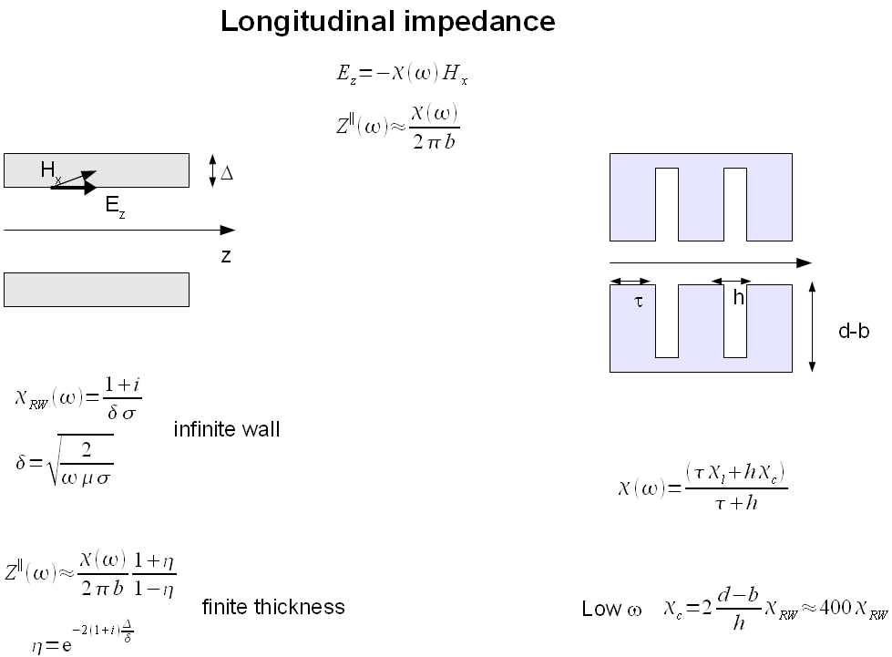
Recent Synergia development: implement careful treatment of impedance of laminated structures
Literature calculations in frequency domain involving different regimes don’t trivially translate to a “simulation ready” wake function.
Capability required for FNAL Booster modeling
Notes:
Emphasize the numerical, and purpose is the booster data

Slide 10
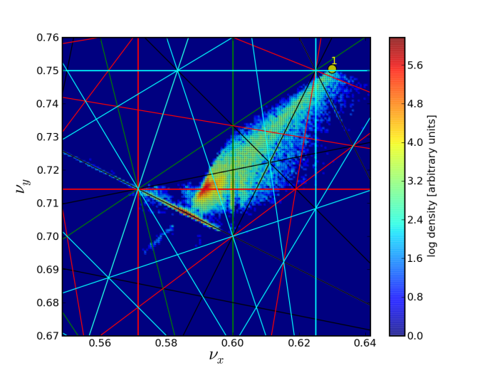
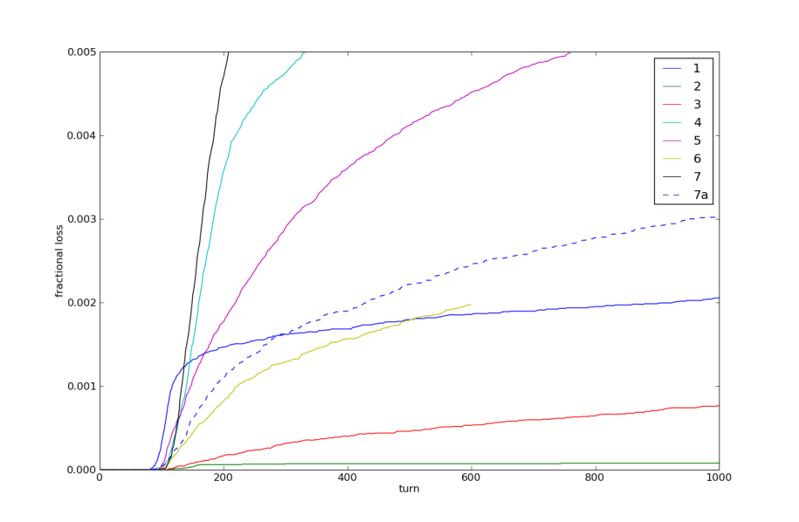
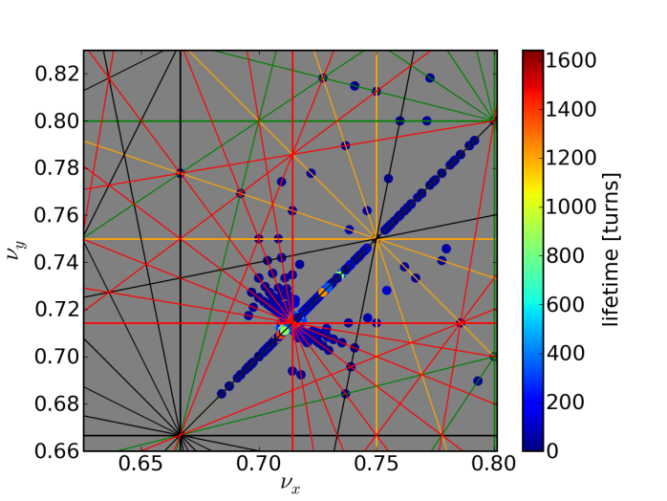
Recent Synergia application: Mu2e extraction design
Model resonant extraction including space-charge at the Debuncher : Mu2e requires 10⁵ more particles than current operations!
  Optimize tune and resonant extraction parameters to minimize losses
Notes:
proposed method for beam extraction for mu2e from the debuncher is resonant extraction that involves nonlinear dynamics, interacting with space-charge effects (there is a need for a lot of beam, thus space-charge is important and understanding its effects could make or break the planned approach). The top plot is a tune plot with various resonances marked. One sees that selecting the optimal tune is not easy.

Slide 11
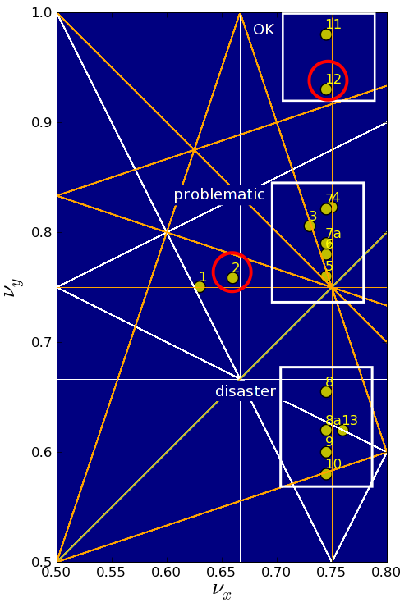
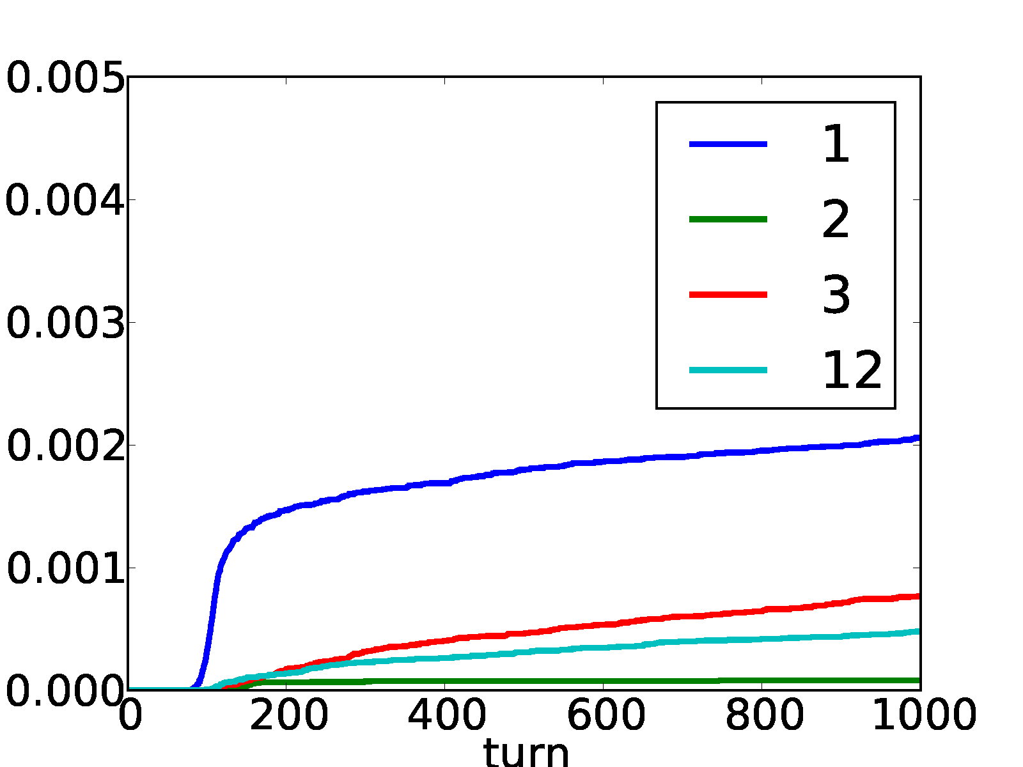
Mu2e design parameter scans
Even the most optimal case has unacceptable losses, so studies resulted in lower
Intensity design for the experiment

Slide 12
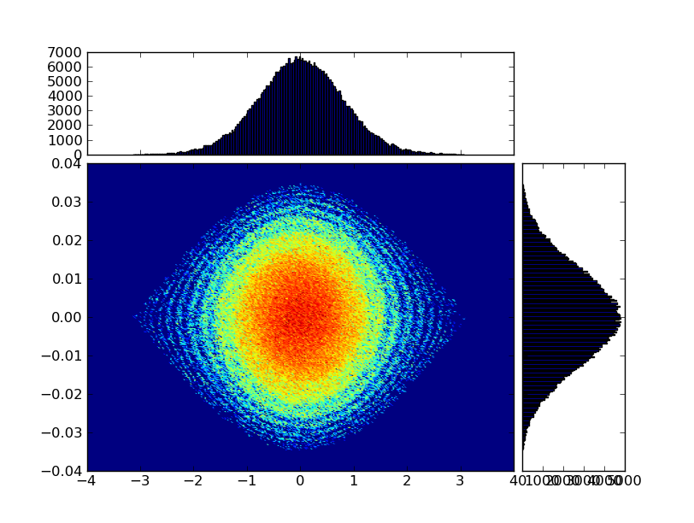
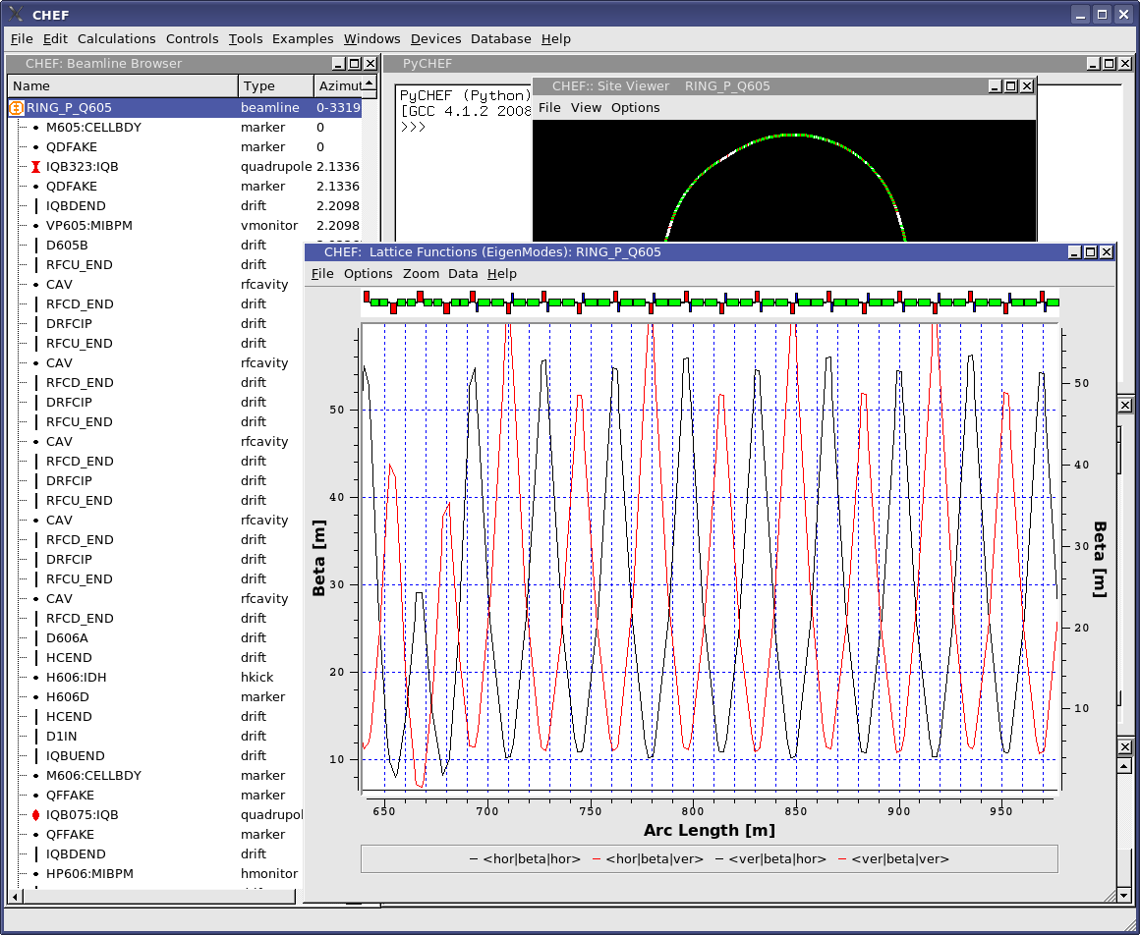
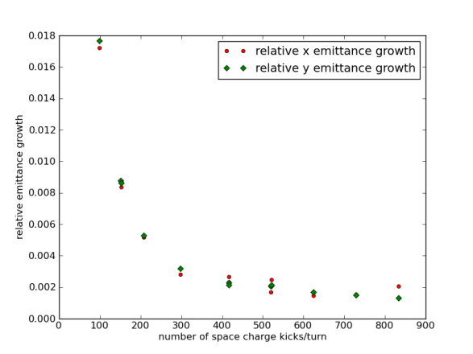
Accelerator Science Applications: MI space-charge (Synergia)
Begin modeling space charge effects and mitigation techniques for Main Injector with Project-X beam parameters
Objective is to extend the model to include realistic apertures and fringe fields and study losses and mitigation (such as 2nd harmonic rf, etc) if necessary

Slide 13
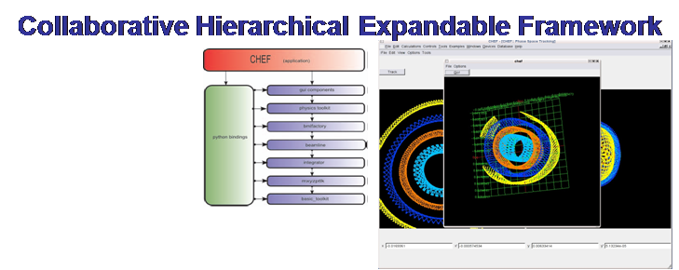
Tools development, continued: CHEF
CHEF originally developed at Fermilab starting in the early 90’s
Single-particle optics with full dynamics
Can be reduced to arbitrary-order maps
  We have done demonstration calculations in Synergia to 15th order
Supports customizable propagators (fully extendable)
MAD and XSIF parsers
  Internal representation not limited by MAD parameters
Notes:
Xstended Standard Input Format

Slide 14
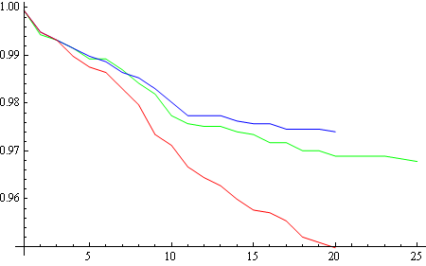
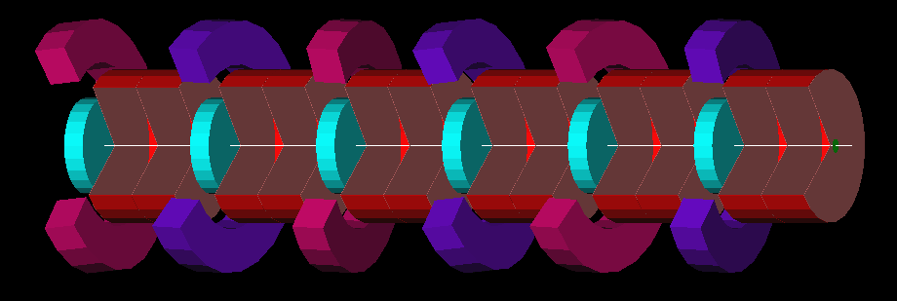
Application specific tools: Methodical Ionization Cooling Channel Design (MICCD)
A MAD-like code (in Mathematica) which includes:
• long-range fields of tilted and displaced off-axis magnetic elements,
• fully coupled 6D optics functions calculation in presence of strong damping,
• analysis of higher order effects on beam dynamics
• particle tracking (w/o stochastic effects yet)
MICCD was successfully used for Helical FOFO snake design for the 1st stage of ionization cooling,
helped to find bugs in G4beamline (tracking code used in ionization cooling studies)
N/N₀
alternating solenoids
absorbers
RF cavities
G4BL stochs. off
MICCD
G4BL stochs. on
HFOFO snake layout (1 period = 6.12 m)
Transmission vs period #
After fixing bugs in G4BL it gives very close results
Notes:
(capabilities include analysis of cooling rate dependence on the amplitudes of oscillations)

Slide 15
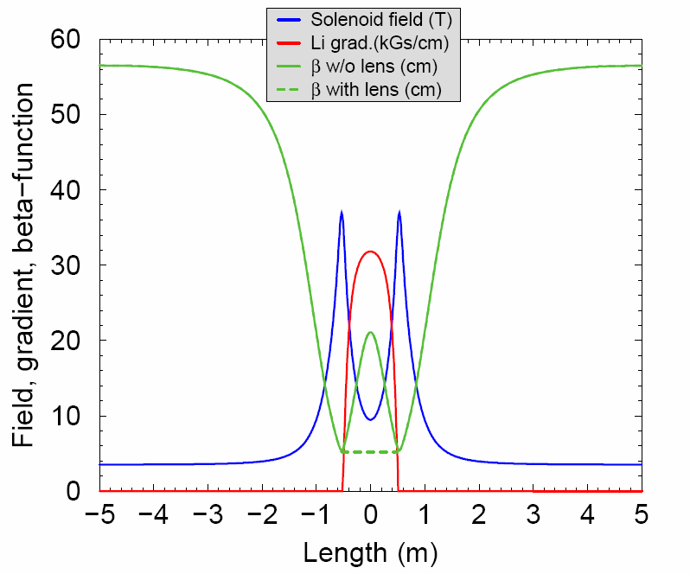
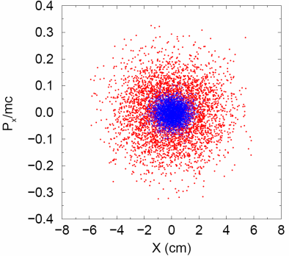
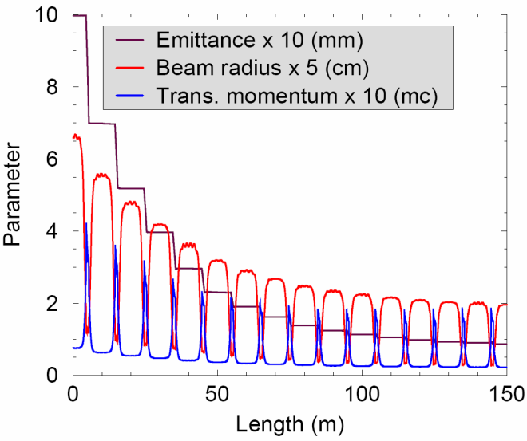
App. specific tools: LLSC (Lithium_Lenses_Solenoid_Cooling)
The program is designed for tracking and ionization cooling simulation in a channel with Li lenses, solenoids, and RF cavities, including:
  Calculation and tabbing of magnetic field of arbitrary solenoid coils, as well as the field of Li lenses of variable diameter.
  Calculation of standard channel parameters like beta-functions, tunes, etc.
  Tracking of a particle with arbitrary initial conditions to plot its trajectory in usual or phase space.
  Cooling simulation and the beam parameters calculation and plotting.
Example 1: Axial solenoid field, Li lens gradient, and beta-function of a cell
Example 2: Transverce phase space before (red) and after (blue) the cooling
Example 3: Beam evolution in 15-cell cooling channel: r.m.s. radius, transverse momentum, emittance

Slide 16
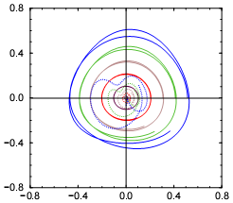
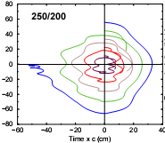
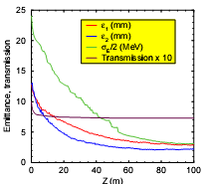
Application specific tools: HELIX
The program is designed for tracking and ionization cooling simulation in a gas filled Helical Cooling Channel with wedge absorbers and RF cavities, including:
  Calculation and tabbing of magnetic field containing arbitrary set of multipoles.
  Calculation and tabbing of magnetic field of a helical solenoid.
  With obtained helical field, determination of the natural frame and calculation of the channel beta-functions and tunes.
  Generation and injection of matched beam.
  Tracking of a particle with arbitrary initial conditions and plotting of trajectories in usual or phase space.
  Cooling simulation and the beam parameters calculation in the natural frame.
Example 1: Transverse phase trajectories in natural frame (1st mode)
Example 2: Longitudinal phase trajectories at transverse amplitude 2 cm.
Example 3: Beam evolution in 100 m cooling channel: r.m.s. emittances and transmission

Slide 17
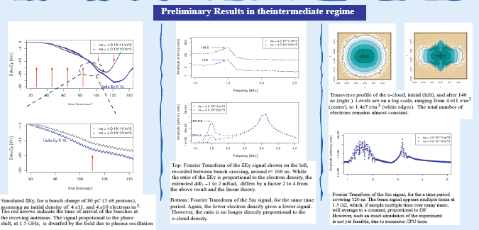
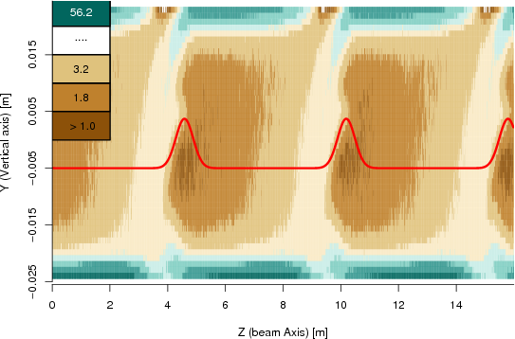
Accelerator Science Applications: Project-X ecloud generation/detection in the MI
Simulation of microwave transmission properties through an e-cloud at the Main Injector with VORPAL
  Essential for utilizing e-cloud detector based on microwave propagation
  Multi-scale, multi-physics problem
Model MI beam line: either short (0.25 m) in a dipole or long (12.6m) to fully simulate the microwave absorption experiment, which includes dipoles and a quadrupole
Notes:
First bullet: plot shows emittance growth in the ILC linac for different cases
Second bullet: this problem requires understanding microwave propagation through an electron cloud that is generated and then perturbed by multiple beam bunches crossing a section of the accelerator that also has a magnetic field; the plots shows the cross section of the cloud after distribution after a few bunch-crossings. The response of the microwave is used (in the real detector) to infer the density of the cloud, so this is a very important simulation for determining the size of the effect. The plots have labels.

Slide 18
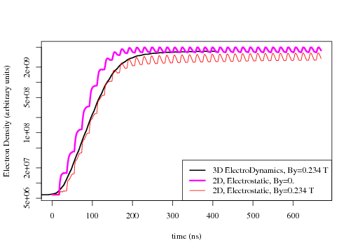
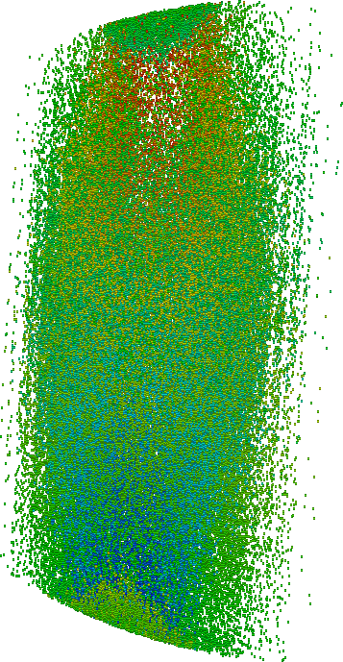
Full 3D treatment necessary
Earlier analysis modeled EM fields using 2D approximation
Our recent results comparing full VORPAL (3D) to VORPAL 3D and POSINST (ran at FNAL and LBNL) show that prediction for saturation of e-density is affected (factor ~2.5) by such approximation

Slide 19
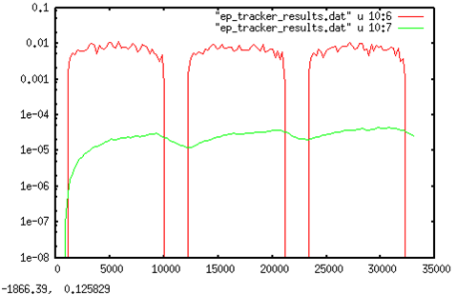
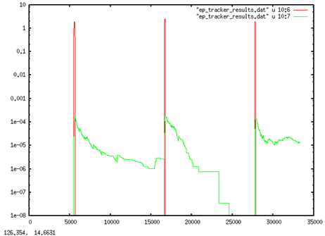
Code development: enhance ORBIT e-cloud module for multi-bunch applications
Work on addressing issues with multi-bunch e-cloud applications in ORBIT to utilize tool in Project-X applications

Slide 20
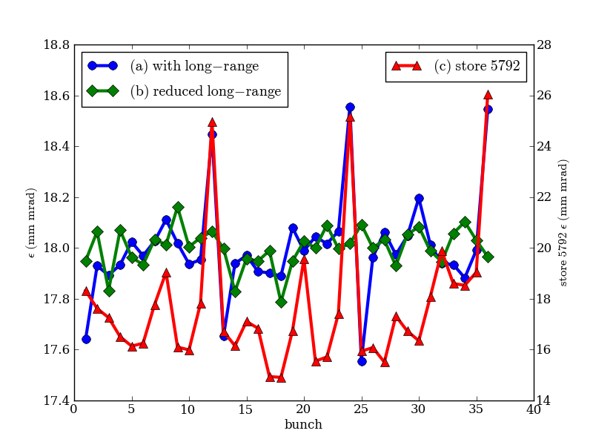
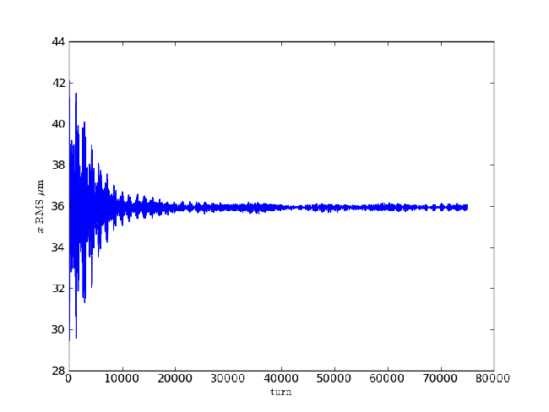
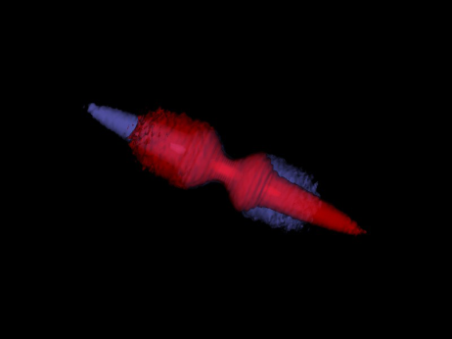
Accelerator Science Applications: Tevatron
Model strong-strong beam-beam & impedance effects with 36 on 36 bunches at the Tevatron (BeamBeam3D)
  Results used to optimize chromaticity settings at the squeeze, resulting in reduced losses

Slide 21
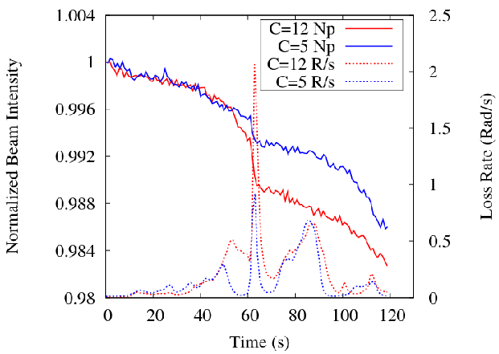
Tevatron, continued
Success! Simulations support the use of lower chromaticity during injection!
  A. Valishev, PAC2009, “Recent Tevatron Operational Experience”
  Stern et al, “Fully 3D multiple beam dynamics processes simulation for the Fermilab Tevatron”, published in PRSTAB 2010.
  Included in the highlights of the accomplishments of seven years of SciDAC
Notes:
Chromaticity=5 (blue) 12 (red) solid is intensity, dashed is losses

Slide 22
LARP beam-beam simulations
Beam-beam code (BBSIM) for 6D weak-strong simulations of hadron colliders. Authors: T. Sen and H.J. Kim
Devices in model
Wire for compensation of long-range interactions
Electron lens for head-on compensation
Crab cavity
Multiple harmonic cavities
AC dipole
Diagnostics include
Tune footprints, dynamic aperture
Frequency maps
Amplitude diffusion
Beam transfer function
Emittance growth
Lifetimes, loss rates
Applied to LHC, RHIC, SPS & Tevatron

Slide 23
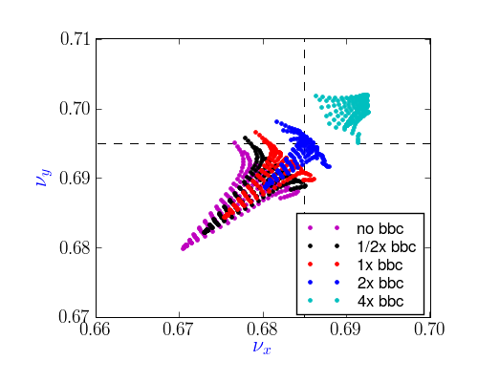
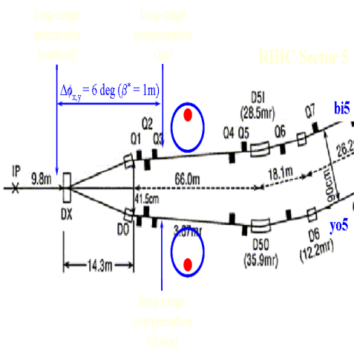
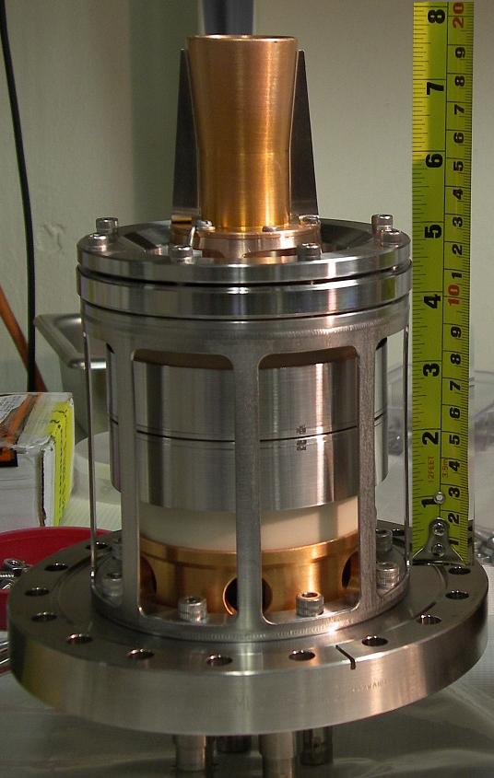
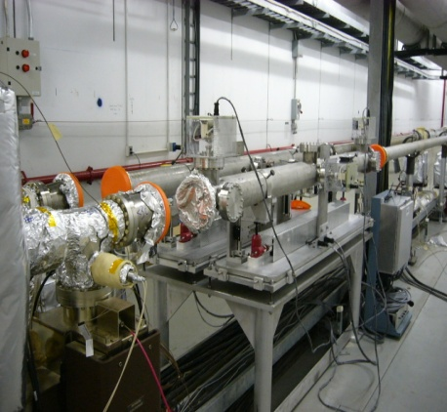
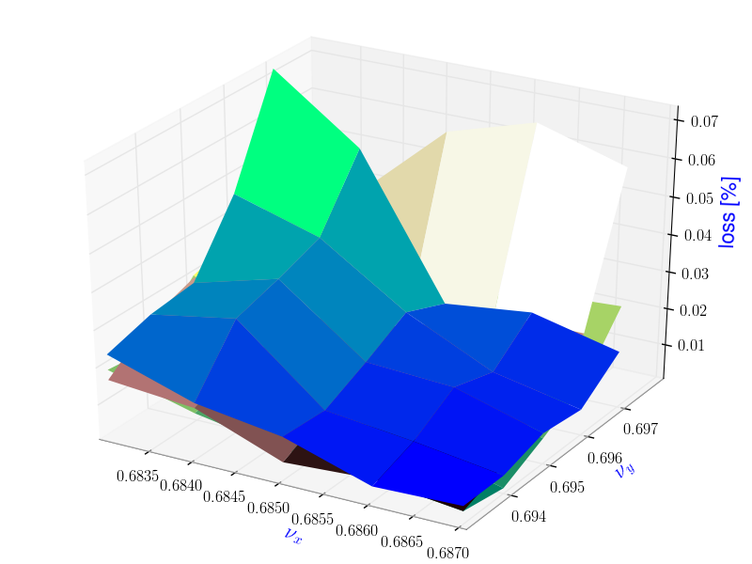
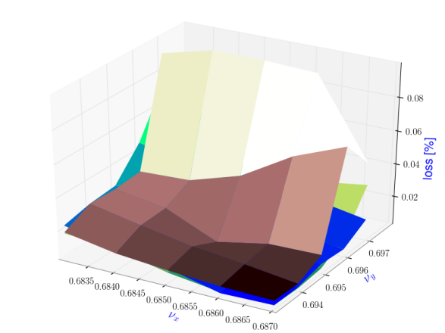
BBSIM Applications
Wire Compensation
Electron lens compensation
Footprint compensation
Locations in RHIC
No elens
No elens
4x bbc
4x bbc
1x bbc
Deuteron beam
1x bbc
Gold beam
2σ Gaussian profile
Smooth edge flat profile
Tune scan of loss rates w/wo electron lens
compensation. 1xbbc=nominal electron lens
Intensity.
DC wire in RHIC: beam loss
vs beam-wire separation

Slide 24
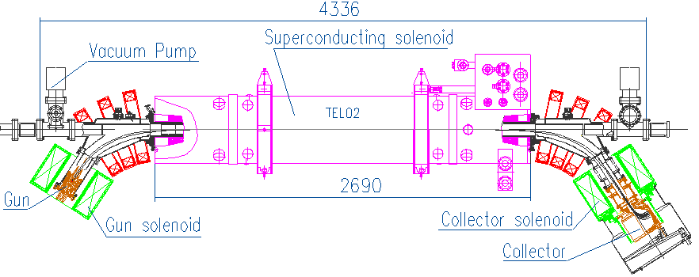
Accelerator Science application: collimation of high-intensity protons with hollow electron beams
Modeling/simulations of effects on core, collimation efficiency
Kick maps in overlap region:
analytical form / ideal case ☑
2D from measured profiles (Poisson solver) ☑
3D particle-in-cell Warp code:
  effect of TEL2 bends
  profile evolution
  misalignments
  time structure
Tracking software
with lattice and apertures:
STRUCT ☑
Lifetrac ☑
OptiM
MAD / SixTrack
A. Drozhdin, G. Stancari, A. Valishev

Slide 25
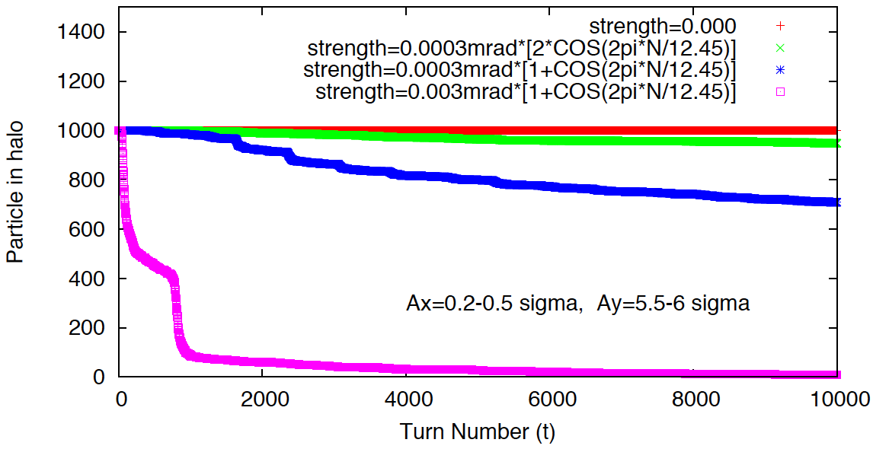
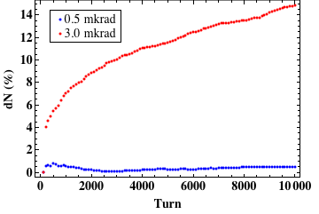
Simulations of halo cleaning with ideal hollow beam vs. kick strength and pulsing pattern. Effects should be observable in the Tevatron at 980 GeV
A. Drozhdin
STRUCT
Apertures / helices / rf cavities / sextupoles
Pulsed lens
A. Valishev
Lifetrac
3D beam-beam / nonlinearities / chromaticity
simplified apertures
DC lens

Slide 26
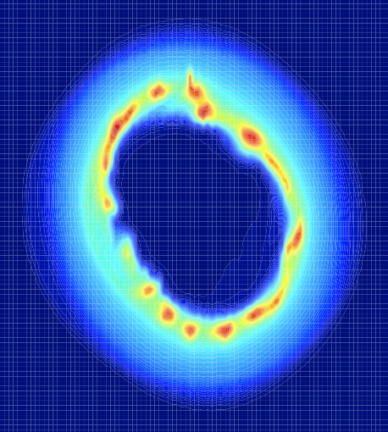
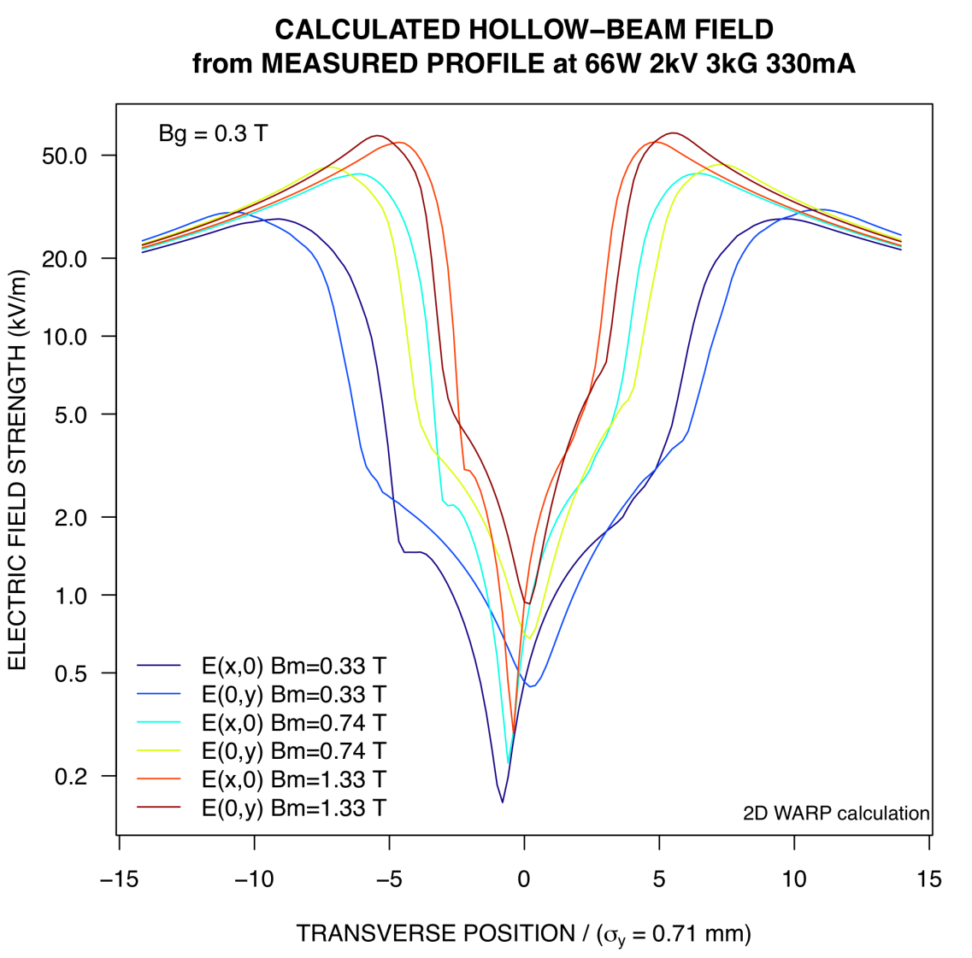
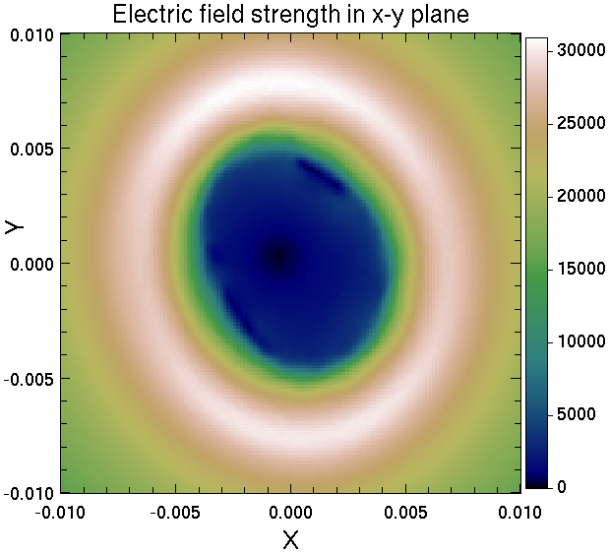
Calculation of 2D fields from measured profiles, using Warp’s 2D Poisson solver
G. Stancari

Slide 27
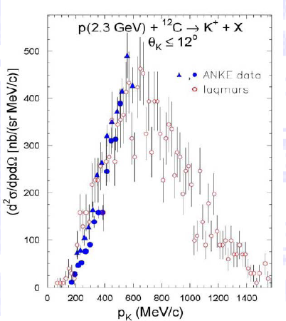
MARS15
The MARS15 code system is a set of Monte Carlo programs for the simulation of hadronic and electromagnetic cascades used for shielding, accelerator design, and detector studies. It covers a wide energy range: 1 keV-100 TeV for muons, charged hadrons, heavy ions and electromagnetic showers and 0.00215 eV-100 TeV for neutrons.
Simulation of the challenging region between 1-4 GeV/c p beam momentum.

Slide 28
Extras

Slide 29
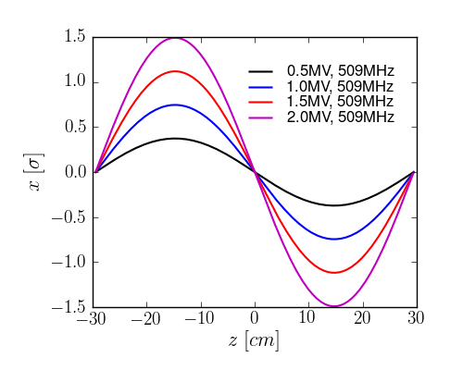
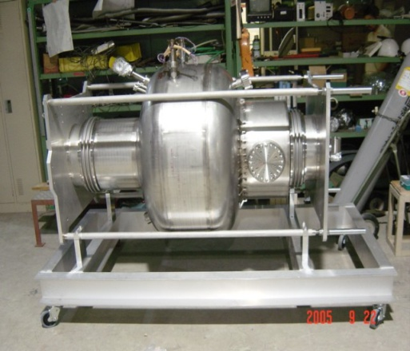
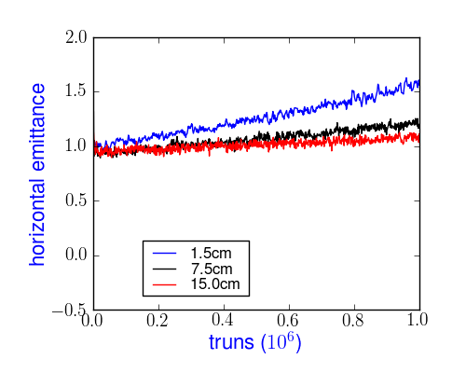

Applications (2)
Tevatron: pbar loss rates at collision
Crab cavity test in SPS
Tune scan of loss rates; bunch 6
KEK crab cavity
Closed orbit vs z
Simulations
Emittance
Beam loss
Measurements
Emittance growth and beam loss for
different bunch lengths with crab cavity at a zero dispersion location.
Comparison of losses for 3 bunches

Slide 30
Summary of results
Wire compensation: Detailed comparison with measurements in RHIC showed good agreement. Onset of sharp losses with beam-wire separation agreed to 0.5σ. In the LHC, simulations showed that chosen wire parameters are close to optimal
Electron lens compensation: Wide electron lens expected to reduce losses from head-on interactions in RHIC.
Beam lifetimes in Tevatron: Optimum working point and bunch by bunch losses are in reasonable agreement with observations.
Crab cavity test: Single crab cavity in SPS will have little impact on beam quality if tunes and dispersion at crab cavity are well chosen. Study for LHC in progress.

Slide 31


Utilization of HPC facilities
ComPASS at NERSC: 1.2M MPP hours (FY09)
  FNAL only utilized ~50k hours, because of lack of support for shared libraries on franklin
  Expect to be able to fully utilize new Cray XT at NERSC
ComPASS at the ALCF BG/P: ~15M core hours (FY09)
  FNAL utilized 5M core hours
    BG/P supports shared libraries

Slide 32


Slide 33
Accelerator modeling tools development
Strategy: apply state-of-the-art computing to enable state-of-the-art accelerator modeling
  Move beyond the era of one code per one effect
  Develop modeling capabilities to be integrated in realistic applications
    Advance to muti-physics, multi-scale models
  Develop and apply expertise in parallel computing from clusters with O(100) processors to capability machines with O(100,000) processors
    Synergistic with Lattice QCD effort
  Leverage experience with providing support for user-oriented software

Slide 34




Accelerator design: multi-scale, multi-physics problem
Wide range of scales:
  accelerator complex (10³m) → EM wavelength (10²-10 m) → component (10-1 m) → particle bunch (10⁻³ m) → PIC (10⁻¹²)
  Simulations need to connect scales and allow inclusion of multiple physics effects at each level
  Requires efficient utilization of HPC

Slide 35






Computationally challenging physics, common to most applications
Machine design: particles affected by machine components, other beam particles or beams [Beam Dynamics]
  Space charge
  Beam-beam
  Electron cloud
  Electron cooling
  Intrabeam scattering
  Accurate description (optics, position, feedback, etc)
Component design [Electromagentics]
  Impedance
  Wakefields
  multipacting
  Thermal, mechanical
New accelerator technologies [Advanced Accelerators]
  Laser and plasma wakefields
  Ionization cooling
Multi-parameter optimization

Slide 36

Exascale co-design center proposal

Slide 37



Synergia applications: FNAL Booster
Extensive modeling of the Booster with Synergia
  400 MHz structure debunching and 37.7 MHz capture
  Including machine ramping
Emittance growth and halo formation studies
  Including comparison with experiment
  Used to help optimize operating parameters
    Work with AD proton source department personnel
  NIMA570:1-9,2007

Slide 38


ComPASS at DOE HPC facilities
ComPASS specific performance on franklin (repo m778) for calendar ’09 (right), compared with all repos (left): ComPASS large jobs (>30 k cores) at ~10%, compared to 0.3% for all repos.
High concurrency for average jobs (>8k cores) for all other repos (see next talks)

Slide 39

ComPASS on LCF’s
INCITE project progress at NCSS: ~20% of the runs using ~25k cores
ALCF average job size ~8.2k cores

