Slide 1
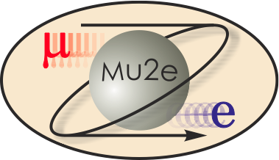
KA11 Contributions to Mu2e
R. Ray
Mu2e Project Manager

Slide 2
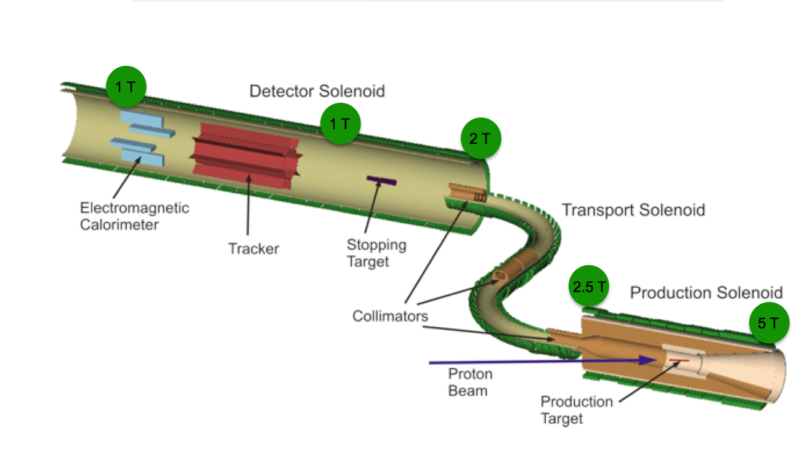
Mu2e
Search for charged lepton flavor violation with a sensitivity that is 10,000 times better than previous searches.
Challenging experiment that requires a mix of scientists, engineers, accelerator physicists, magnet experts, computing professionals, ES&H professionals and project experts.

Slide 3
Schedule
CD-1
CD-2/3a
CD-3b

Slide 4
Fermilab Scientists on Mu2e
The participation of Fermilab Scientists on Mu2e is funded in two ways
Project managers, L2 Managers and Accelerator Physicists are paid on-project.
All other scientific effort is on KA11.
The off-project KA11 effort includes
Design effort on the solenoids
Design effort on the muon channel
Design effort on the heat shield
Design effort on the Trigger and DAQ
Tracker R&D and design
Cosmic Ray Veto R&D and design
Simulations

Slide 5
Accomplishments in FY10
Received CD-0 in November.
Assembled a significant project team
8 L2 managers
Project Mechanical Engineer
2 Project controls staff
Budget officer
ES&H contact
NEPA contact
Modified conceptual design for the accelerator that addresses space charge concerns while providing large duty factor (90%).
Assembled a significant engineering and design team for the solenoids
Significant progress on Solenoid conceptual design (big job!)

Slide 6
Plans for FY11
Working hard on an aggressive schedule to get CD-1 in FY11
Lehman CD-1 Review | March 1, 2011
Director’s Review | Feb. 1, 2011
CDR complete | Jan. 15, 2011
Final cost & schedule and associated documentation. | Jan. 15, 2011
L2 CDR contributions submitted | Dec. 1, 2010
Pre CD-1 Cost and Schedule Review | Nov 15, 2010
Director’s Design Review | Nov. 1, 2010
L2 Design Reviews | October, 2010
Time
Balance of FY11 and all of FY12 devoted to working towards CD-2.

Slide 7
Solenoids
KA11 funded scientists participate in the design of the Solenoids and in simulations to support the design effort.
Sandor Fehr
Ruuji Yamada
Rick Coleman
Jim Miller (Guest Scientist from BU)
Jim Popp (Guest Scientist from CUNY)

Slide 8
Muon Channel
Muon channel includes vacuum system, collimators, stopping target, stopping target monitor, muon beam dump, absorbers.
KA11 funded scientists participate in the design of the Muon Channel and in simulations to support the design effort.
Rick Coleman
Peter Shanahan
Jim Miller (Guest Scientist from BU)
Jim Popp (Guest Scientist from CUNY)
Scientists from Los Alamos also participate

Slide 9
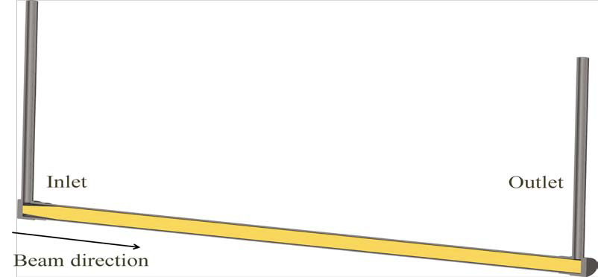
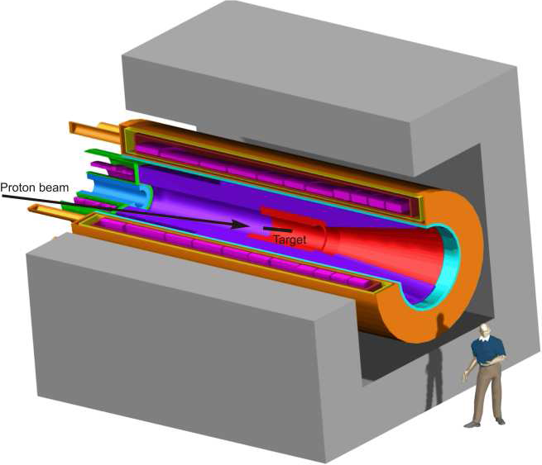
Heat Shield and Production Target
Heat shield protects Production Solenoid from target debris
KA11 funded scientists participate in the design of the Heat Shield, production target and in simulations to support the design effort.
Rick Coleman
Jim Popp (Guest Scientist from CUNY)
Production Target
Heat Shield

Slide 10
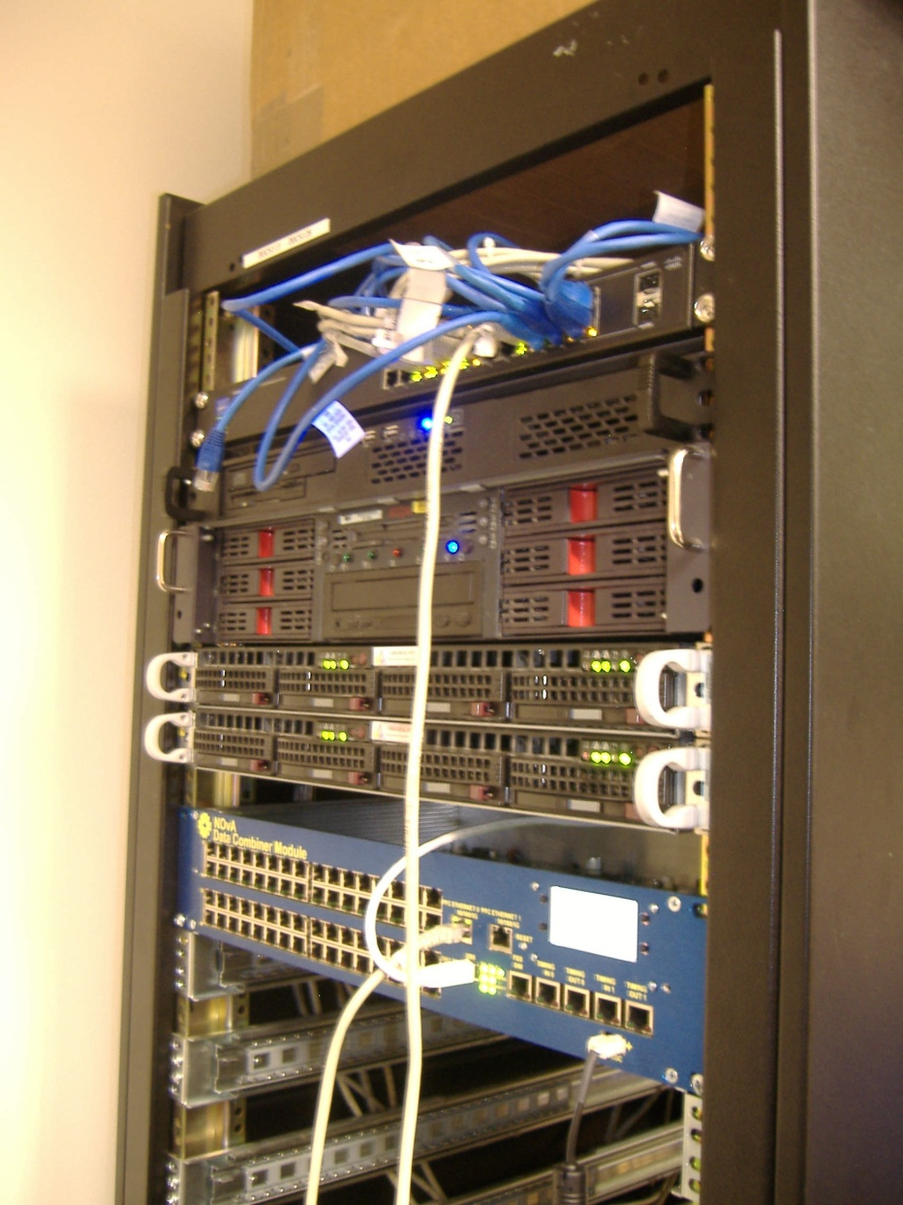
Trigger and DAQ
KA11 funded scientists participate in the design of the DAQ
Bob Tschirhart
Rob Kutschke

Slide 11
Tracker
R&D to develop straw tubes made from thinner material to improve resolution
R&D on mechanical structure
Electronics R&D
Time division studies to determine coordinate along wire.
Mechanical structure
Readout chip prototype (Berkeley/LBNL)
KA11 funded scientists who participate in R&D and design of the tracker
Aseet Mukherjee
Vadim Rusu
Hogan Nguyen
Marj Corcoran (Rice University)
Yury Kolomensky (Berkeley)
Ed Hungerford (University of Houston)*
* Just joined Mu2e and applying for funding.

Slide 12
Cosmic Ray Veto
Efficiency studies
Separating muons from neutrons
Photodetector R&D (SiPMs) and electronics prototyping.
Evaluation of neutron blind gas counters (Brookhaven)
Conceptual Design
Alternative studies
KA11 funded scientists who participate in R&D and design of the CRV
Doug Glenzinski
Craig Group (FNAL RA → UVa/FNAL)
Craig Dukes (UVa)
Peter Yamin (BNL)
Vinnie Polychronakos (BNL)
New UVa RA

Slide 13
Simulations
C++ /Geant 4 framework
Tracker pattern recognition and fitting programs
Particle flow through solenoids
Calorimeter requirements
Study of backgrounds
Extinction requirement
Cosmic Ray simulation
KA11 funded scientists who participate in Simulations
Rob Kutschke
Bob Bernstein
Rick Coleman
Dave Brown (LBNL)
Yury Kolomensky (Berkeley)
Jim Miller (Guest from BU)
Tim Ma (Berkeley student)
Avdhesh Chandra (Rice RA)
Ralf Ehrich (UVa RA)

Slide 14
FNAL Off-Project Scientific Labor
Off-Project Scientist | FTEs
Rick Coleman | 0.6
Herman White | 0.2
Giorgio Ambrosio | 0.4
Mau Lopes | 0.5
Mike Lamm | 0.1
Ryuji Yamada | 0.3
Craig Group | 0.4
Aseet Mukerjee | 0.2
Peter Shanahan | 0.1
Rob Kutschke | 0.9
Doug Glenzinski | 0.1
Hogan Nguyen | 0.1
Other | 5.4
Total | 9.5

Slide 15
International Visitors
We expect INFN to play a significant role on Mu2e.
Expected to provide L2 manager for calorimeter.
PPD is funding 3 International Fellows from Italy to work on Mu2e for 2 years.
1st has arrived.
2d is waiting for visa
3d will arrive near the end of the year after completing some Mu2e beam tests in Italy.
The 3 fellows will work on tracking and calorimeter simulations and tracker R&D.
3 students from Italy are spending the summer here working on simulations.
Visitor from Russia here for 2 months, also working on simulations.

Slide 16
Computing
We require significant computing resources to design Mu2e. CD has been very supportive.
Efficient particle transport
Background rejection
Reconstruction algorithms
Specification of requirements
Alternative analysis
Currently using 300 slots on the grid with a high duty factor. Have recently asked for more and been told it’s not a problem.
There is a learning curve associated with getting on the grid.
There is no such thing as a standard job, so providing general purpose scripts is not easy.
Nevertheless, support for novice grid users could probably be improved.
Probably requires more resources.
Universities have the same access to the grid as people at Fermilab and are using it.

Slide 17
Post Docs
We had Fermilab 1 post doc doing a small amount of work on Mu2e.
Craig Group, now faculty at Virginia with a half-time appointment at Fermilab
We have tried to recruit a number of new hire RAs, but in each case they have opted to join neutrino experiments that are running or close to running.
A Mu2e RA would have to work on a second experiment with data to obtain the requisite experience necessary to advance their careers.
We have had some success in recruiting RAs to Universities
Rice – Avdhesh Chandra, 50 – 50 on Mu2e and D0
Rice has funding for a second RA.
University of Virginia
Ralf Ehrich, 50 – 50 on Mu2e and NOvA
Funding for a second RA to replace Andrew Norman (FNAL/CD)
Craig Group has seed money from Virginia for an RA who has already started working (Yuri Oksuzian – 50 – 50 on Mu2e and CDF).

Slide 18
New Requests
We have been trying to get an RA at Berkeley/LBNL to work 50 – 50 on Mu2e and BaBar, but there is a fundamental disconnect between DOE who says that they are free to hire a Mu2e RA and Berkeley who says they don’t have the authority to hire a Mu2e RA.
The only new request is for the University of Houston - Kwong Lau and Ed Hungerford
Ed Hungerford was the L2 manager for tracking on MECO. He is a straw expert and could play a significant role on the project.
Responsible for significant chunk of tracker electronics and together with Rice would take responsibility for first level of straw tube assembly.
Kwong Lau is funded through DOE HEP to work on Daya Bay. Is interested in Cosmic Ray Veto
Submitting grant request to DOE HEP next month for funding to work on Mu2e.
The Mu2e Project strongly supports this request!

Slide 19
Summary
Scientists funded off project by KA11 make significant contributions to Mu2e.
More will be needed in the future.
Most of our scientists only spend a fraction of their time on Mu2e because of other commitments. A bigger fraction of the people we already have on board would be a big help.
Making decisions (and sticking to them!) about future collider running, g-2, MiniBooNE, etc. would also help.
Growing the contributions from Universities is also important. We appreciate the support over the past year for University-based RAs.
Some support for the University of Houston would be very helpful.
This is a challenging project with an aggressive schedule over the next year. Your continued support is critical for our success.

