Slide 1
MicroBooNE Experiment
Cat James – MicroBooNE Project Manager
DOE Managers Site Visit
August 23, 2010

Slide 2
Introduction
MicroBooNE is –
A liquid argon Time Projection Chamber (LAr-TPC), situated on the Booster Neutrino Beam.
It combines physics and hardware development goals, using both to demonstrate the technology as an option for massive neutrino detectors.
The detector design, fabrication and installation is managed as a DOE Project, with financial contributions from NSF
Total DOE project cost (TPC) is set to be under $20M

Slide 3
MicroBooNE Collaboration
13 institutions
~50 collaborators
NSF funded/DOE funded
Brookhaven Lab: F. Lanni, D. Lissauer, D. Makowiecji, V. Radeka, S. Rescia, C. Thorn, B. Yu
Columbia University: L. Camilleri, C. Mariani, M. Shaevitz, B. Willis**
FermiLab: B. Baller, C. James, S. Pordes, G. Rameika, B. Rebel, D. Schmitz, S. Zeller
Kansas State University: T. Bolton, G. Horton-Smith, D. McKee
Los Alamos Lab: G. Garvey, J. Gonzales, B. Louis, C. Mauger, G. Mills, Z. Pavlovic, R. Van de Water, H. White,
Massachusetts Institute of Technology: W. Barletta, L. Bugel, J. Conrad, C. Ignarra, B. Jones, G. Karagiorgi, T. Katori, H. Tanaka
Michigan State University: C. Bromberg, D. Edmunds
Princeton University: K. McDonald, C. Lu, Q. He
St. Marys: P. Nienaber
University of California, Los Angelas: H. Wang
University of Cincinnati: R. Johnson, A. Wickremasinghe
University of Texas at Austin: S. Kopp, K. Lang
Yale University: C. Anderson, B. T. Fleming*, S. Linden, K. Partyka, M. Soderberg, J. Spitz
*=Spokesperson, **=Deputy Spokesperson

Slide 4
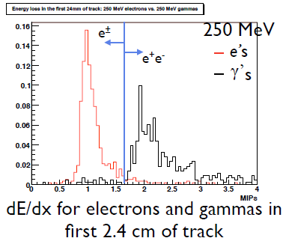
Why LAr-TPC
An attractive detector technology for neutrino physics
Fine-grained tracking, and energy deposition information
LAr-TPC detectors produce bubble-chamber like visualization of events
One can have
particle ID
capability,
from dE/dx
along a track
Monte Carlo
In particular,
electron-γαμμα separation
ArgoNeuT anti-neutrino event, 2010
Detectors for neutrino appearance experiments need good e-γ separation, to identify CC ν_{e} signal events from NC background events

Slide 5
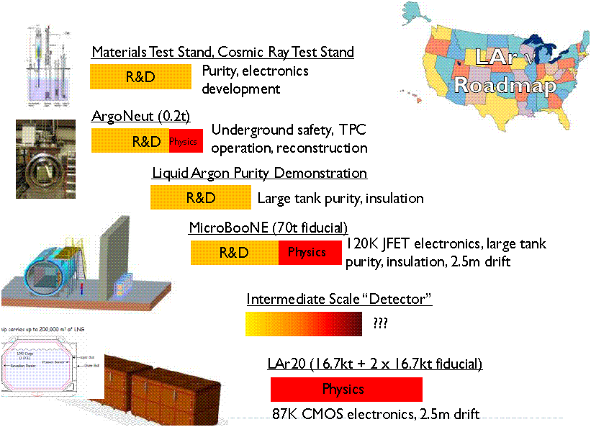
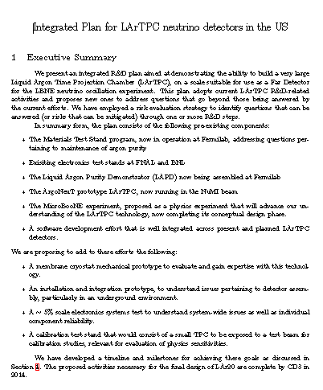
LAr-TPC Development Program at FNAL
In principle, these detectors are scalable to large sizes
Future neutrino experiments will require massive detectors
“Integrated Plan for LAr-TPC neutrino detectors in the U.S.” submitted to DOE in December
Produced by a committee of enthusiasts from the Lab and University community
The MicroBooNE detector is a part of this plan

Slide 6
FNAL Scientists on MicroBooNE
Involved in Project Management, software development, and liquid argon purity R&D
~1-2 FTE, no post-doc as yet
All these roles are shared/split with similar roles on other liquid argon detector efforts
B. Baller – LBNE PM for LAr ; ArgoNeut
C. James – MicroBooNE PM ; ArgoNeuT ; MINOS
S. Pordes – LAr R&D program coordinator ; LAPD ; ArgoNeuT
G. Rameika – MicroBooNE DPM ; LBNE Prj Scientist ; ArgoNeuT
B. Rebel – LArSoft group leader ; LAPD ; ArgoNeuT ; MINOS
D. Schmitz – LArSoft ; MINERvA
S. Zeller – LArSoft ; LBNE ; MiniBooNE

Slide 7
MicroBooNE Detector Development Goals
Develop tools for analysis
Demonstrate photon – electron identification (reconstruction)
Refine sensitivity estimates for next generation detectors (analysis)
Demonstrate ability to run at shallow depth
Purity: Test of GAr purge in large, fully instrumented vessel
Implementation of cold electronics in Gaseous Argon (GAr)
Collect scaling data for larger detectors (construction costs, operations, etc.)

Slide 8
Development Goals: Challenges
Argon purity – parts per trillion
High purity necessary for long drifts
Electronics
Signals are small, so sources of electronic noise must be strictly controlled
Wide range of pulse sizes and shapes
High sampling rate + many wires = large amount of raw data
Vacuum & cryogenics environments take special care
Every penetration into the cryostat must be leak-tight
Every penetration increases the heat load on the system
Safety issues
ODH hazards
Pressure vessel – (MicroBooNE is evacuable)

Slide 9
Project Status
Experiment given Stage 1 approval in July 2008
Project timeline
CD-0 in September 2009
Initial Director’s Review in November 2009
DOE CD-1 Review in March 2010
ESAAB/CD-1 approval : July 9, 2010
Baseline Review, CD-2, by early 2011
Currently performing internal reviews, assessing costs and schedule
Construction 2011-2012
Installed and running in 2013 – transition to operations
Collaboration and Project closely linked
Collaborators hold management roles
Complete participation in the design
NSF-funded contributions to the detector

Slide 10
Detector Overview
Single-walled insulated cylindrical vessel ~10 m long, ~3.5m diameter
Holds ~150 tons of liquid argon
~70 ton fiducial volume, inside the TPC
2.6m drift (500 V/cm E-field =1.6 ms drift time
3 readout planes (+/-30 degrees, vertical)
~8000 channels
pre-amplifiers, sitting in cold argon gas, above TPC; digitizing electronics located outside the vessel
~30 PMTs for trigger
Cryogenic system for purification and recirculation

Slide 11
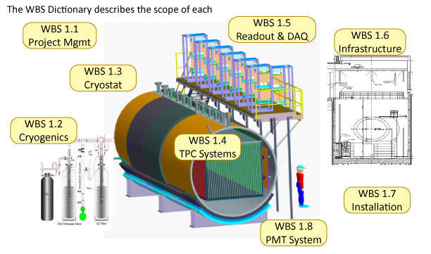

Slide 12
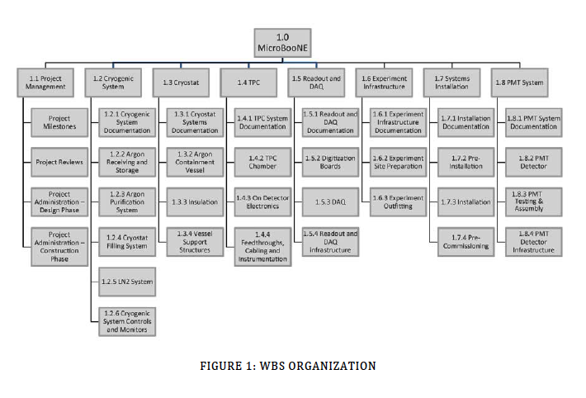
Project Work Breakdown Structure
James, Rameika
FNAL
Alber
FNAL-
FESS
Thorne
BNL
Chen
BNL
Voirin
FNAL
Conrad
MIT
Fleming
Yale
Kilmer
FNAL
Reworking the WBS to incorporate more Project Management and Integration Tasks

Slide 13
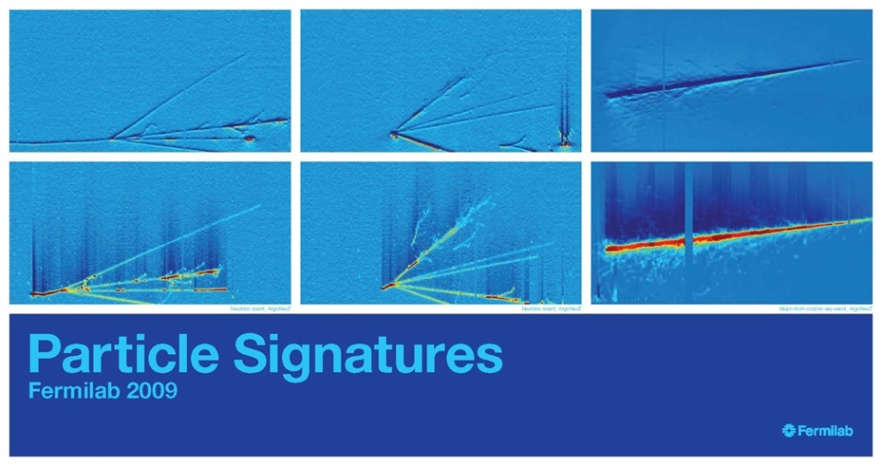
Post-Project Planning – Data Analysis
LArSoft is a collaborative software development effort, involving members of the ArgoNeuT, MicroBooNE and LBNE collaborations, with Computing Division participation
Developing both simulation and reconstruction software packages
The ArgoNeut LArTPC collected NuMI neutrino beam interactions when it was operated underground in the MINOS ND Hall for a few months in 2009-2010
Have real data to develop reconstruction algorithms on
Several graduate students are on the front-lines

Slide 14
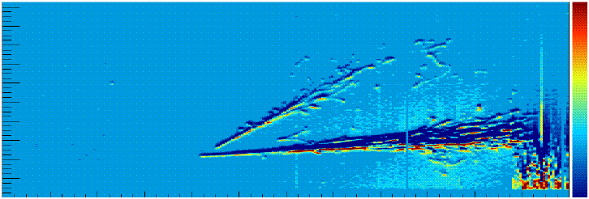
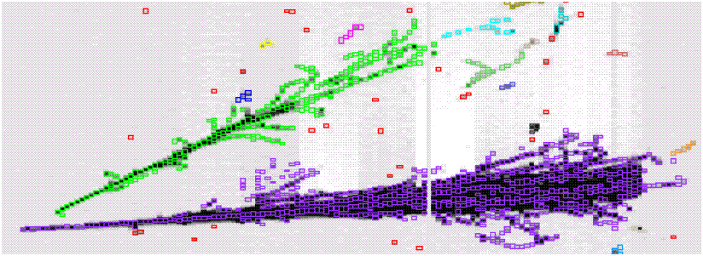
Reconstruction Software Development
Fuzzy event Displays
cleaned up - - -
using Computer Vision Software
A field in computer science that seeks methods of extracting information from images and video
Algorithms developed for shape and feature detection, and face recognition
Open source algorithms

Slide 15
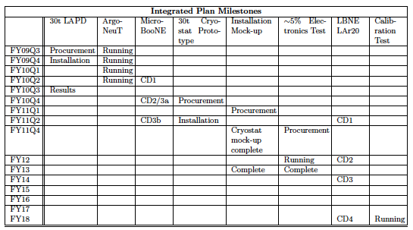
Summary
MicroBooNE combines detector development with physics
Operating with physics goals in a neutrino beam provides an excellent assessment of the strengths and weaknesses of this detector technology
Pursues development questions relevant to operation and analysis of massive LArTPC detectors
Running

Slide 16
Backup Slides

Slide 17
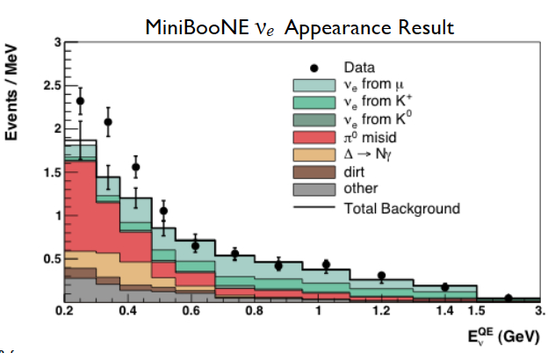
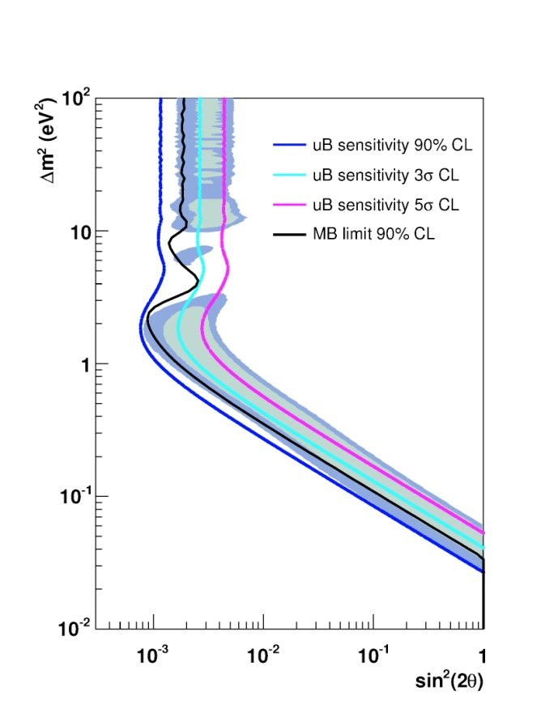
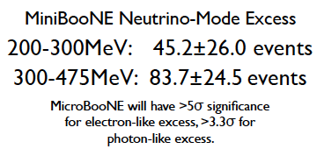
MicroBooNE Physics Goals
MiniBooNE low energy neutrino excess
Suite of low energy cross section measurements
Oscillation search
6 x 10²⁰ POT

Slide 19
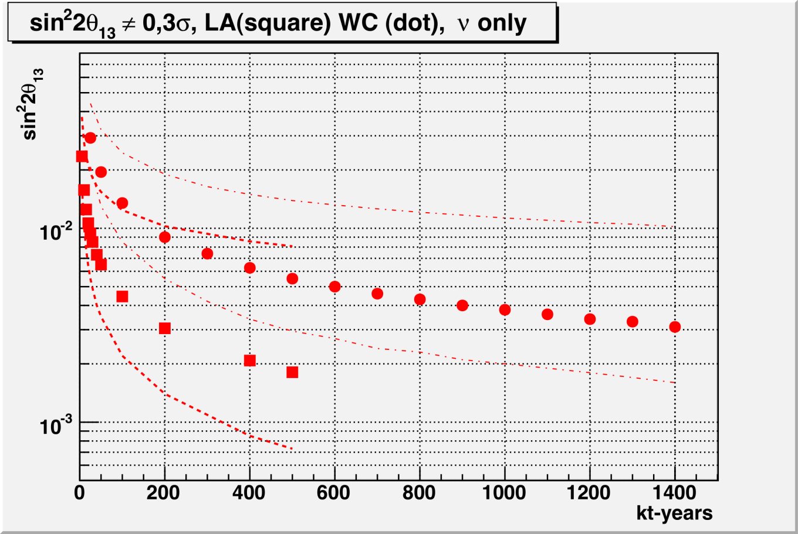
LAr – Water Cherenkov comparison
Neutrino Oscillation Sensitivities
Factor of ~6 in Mass (100kT WC ~ 17kT LAr)

Slide 20
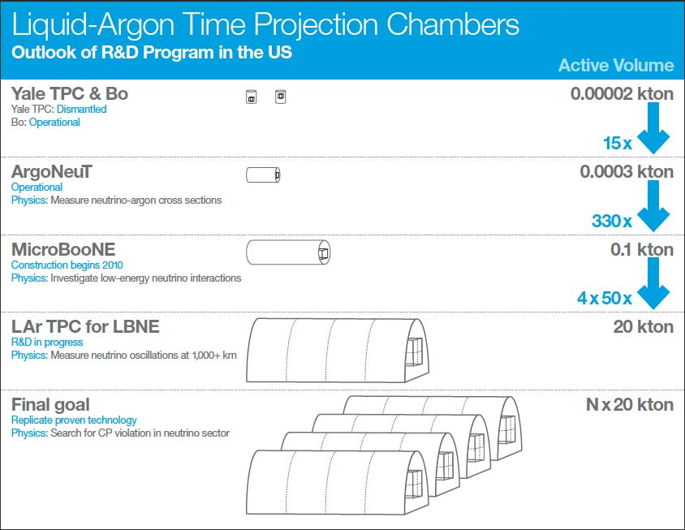

Slide 22
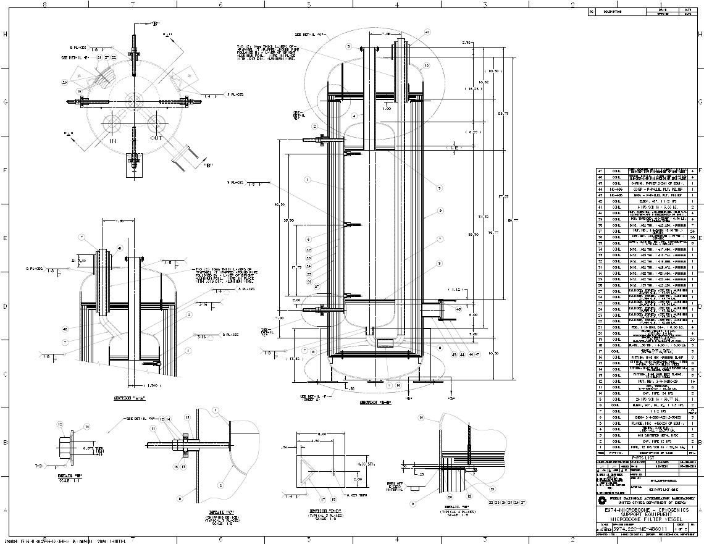
Current Work
Cryogenics and Vessel
System layout design
Purification filter tank assemblies
Pump assemblies
Integrated Vessel design
R&D at FNAL (PAB Lab) has produced a good understanding of how impurities get introduced and operating methods to filter them out

Slide 23
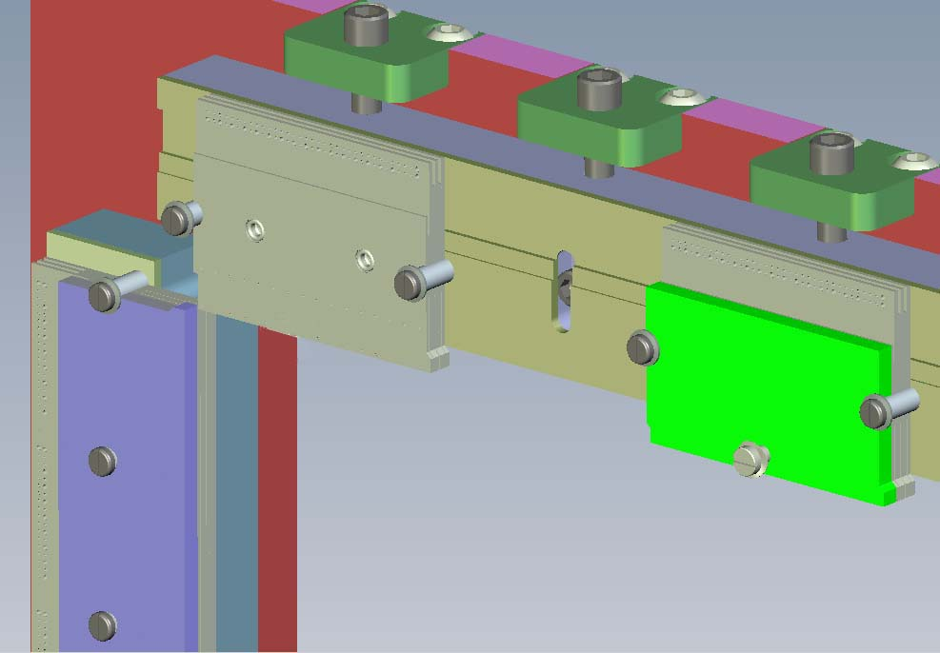
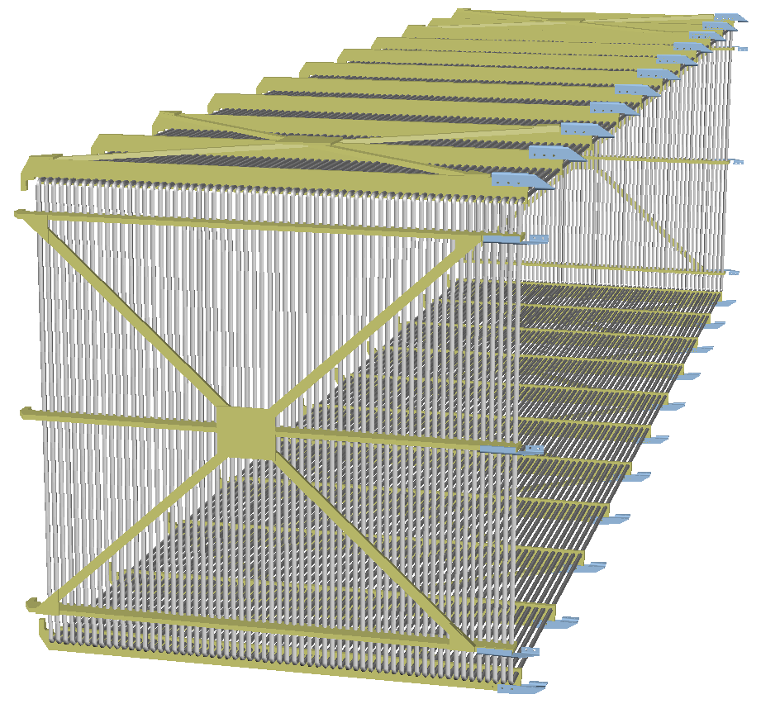
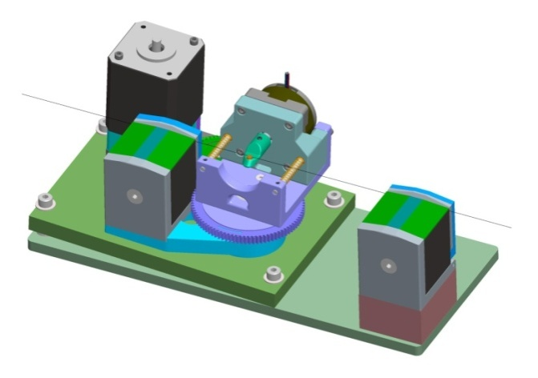
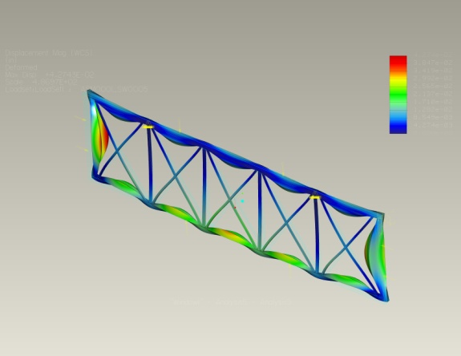
Current Work
Wire Chamber
Detailed design of the wire planes
FEA analysis of mechanical structures
Development of wire winding machine

Slide 24
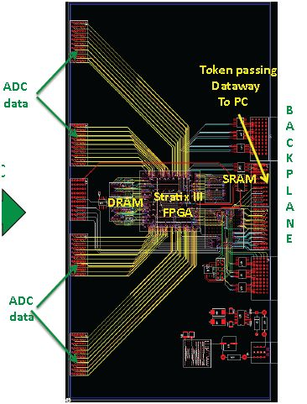
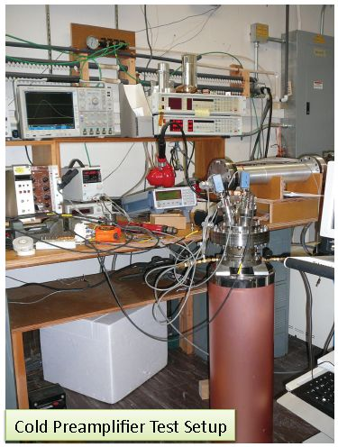
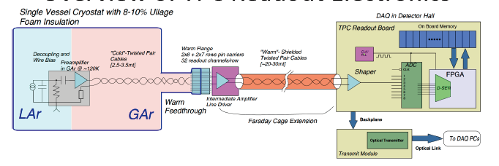
Current Work
Electronics
Constructing prototype boards based on the conceptual design

Slide 25
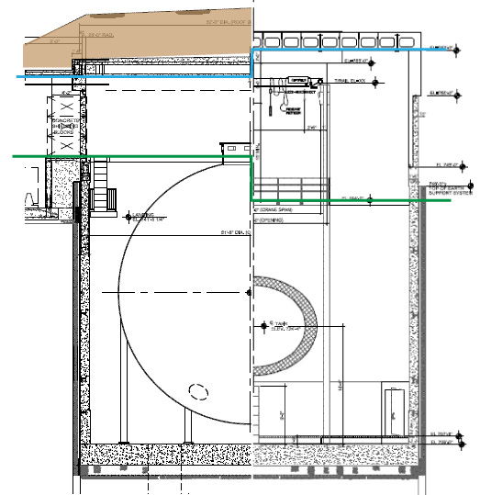
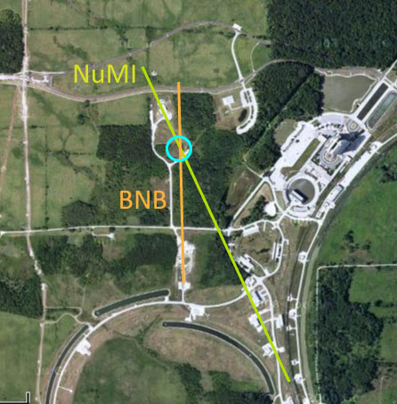
Current Work
Infrastructure and Installation
The assembly of the detector elements inside the vessel will be done at the D-Zero Assembly Bldg
Move the assembly into the MiniBooNE enclosure, after D&D and infrastructure updates

Slide 26
Post-Project Planning – Transition to Operations
The Project is completed once the detector is installed and approved for operations
All operational clearances and safety approvals completed
Initial filling of the vessel is a test of the ability to perform a gas purge of a large vessel, fully instrumented, with no prior evacuation, and reach a purity level needed to operate within a “reasonable time”
The controlled cool-down and purge process may take 3-6 weeks
Developing estimates for annual operating costs
Dominated by maintenance of the cryogenic system
Both materials and labor costs

