Slide 1
SeaQuest (E906)
David Christian
Fermilab
August 22, 2010

Slide 2
SeaQuest (E906)
Goal: Determine u and d parton distribution functions
in nucleon
in nuclear matter
Method: Measure Drell-Yan muon pair production σ(M,p_{L},p_{T}) in interactions of 120 GeV protons and
LH₂ & LD₂
Light, medium, & heavy nuclei

Slide 3
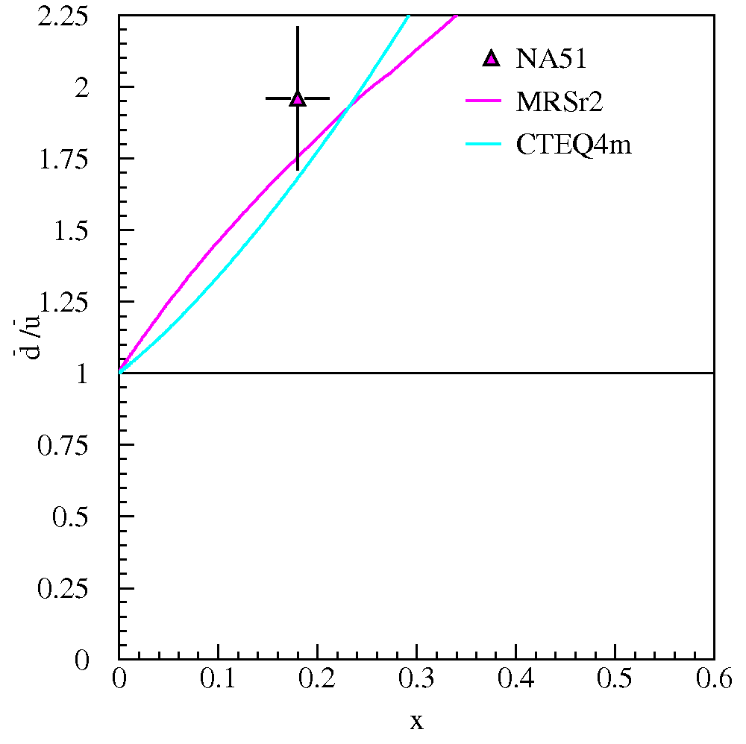
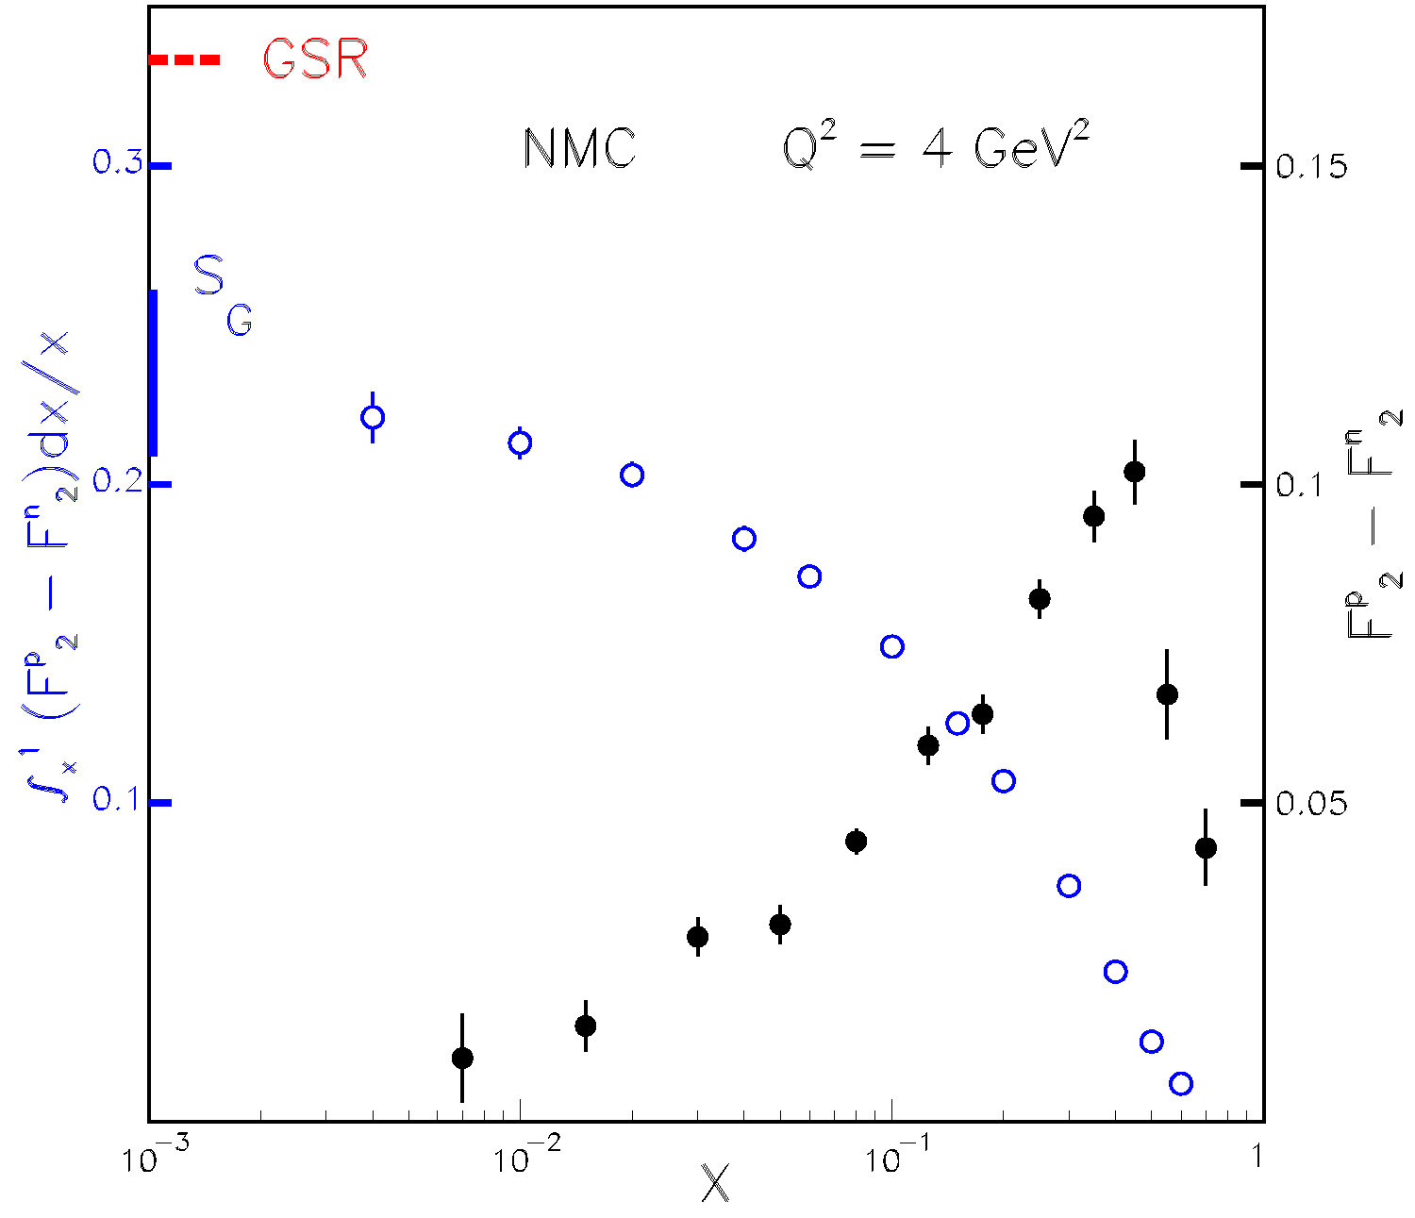
Light Antiquark Flavor Asymmetry
Naïve Assumption:
But… New Muon Collaboration F₂ measurements imply (Gottfried Sum Rule) that
Next… NA 51 confirms
d-bar(x) > u-bar(x)
(using Drell-Yan)

Slide 4
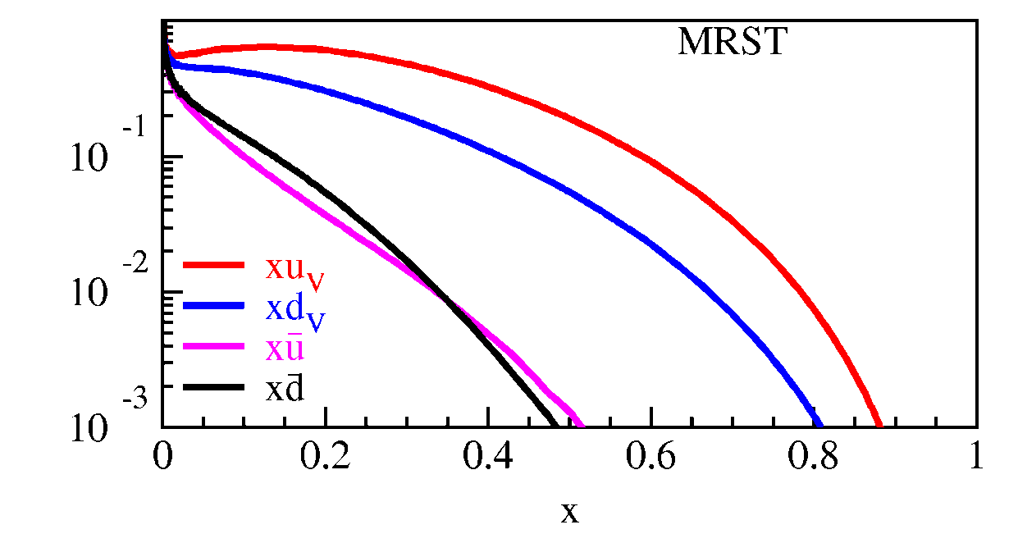
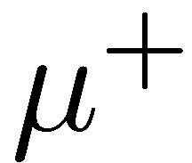
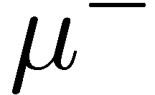
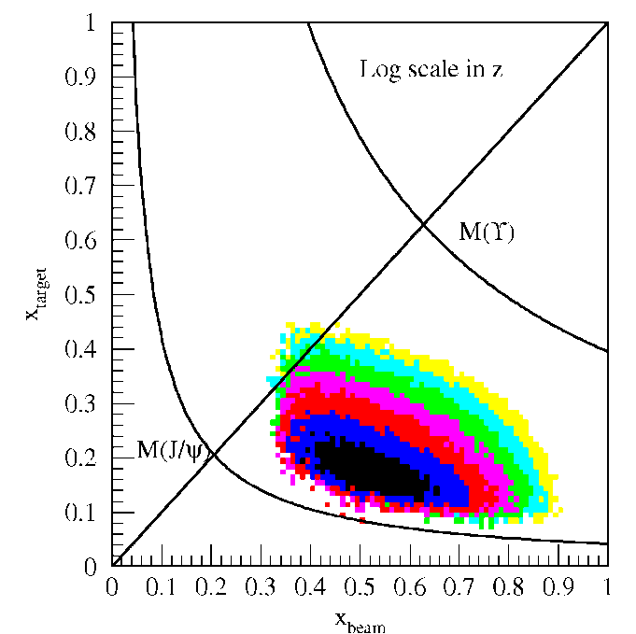
Drell-Yan scattering: A laboratory for sea quarks
FT experiment with forward spectrometer is perfect for determining antiquark PDFs:
Valence quarks in beam proton at high-x.
Sea quarks in target at low/intermediate-x.
x_{target}
x_{beam}
E906 Spect.
Monte Carlo
Isospin invariance → u in p = d in n:

Slide 5
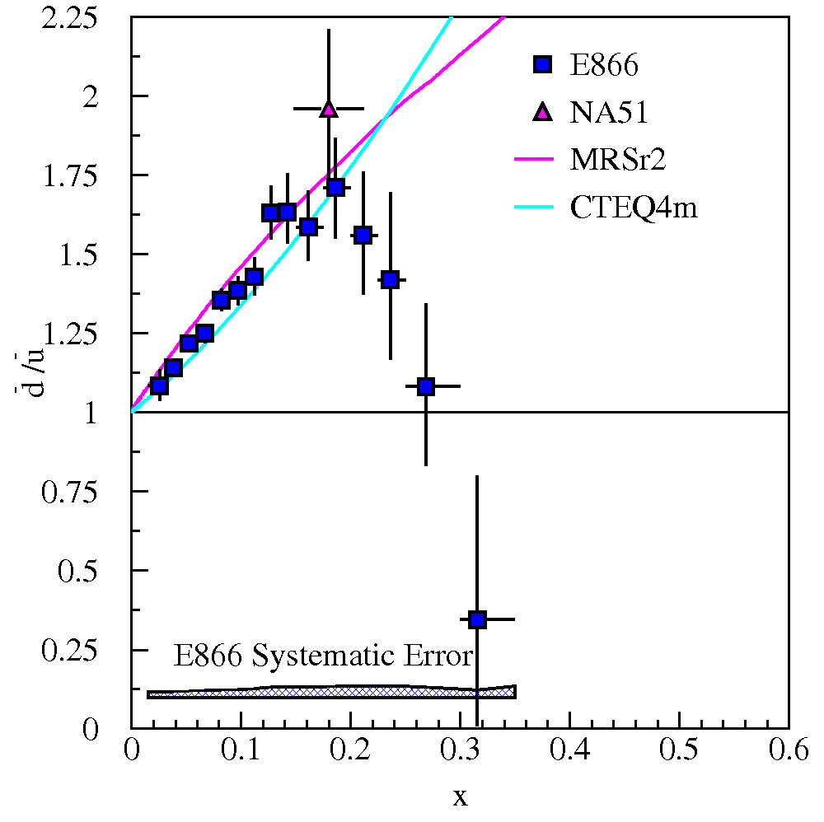
Previous FNAL Drell-Yan Antiquark Flavor Asymmetry Measurements:
E866/NuSea
800 GeV proton beam
LH₂ & LD₂ targets
Data in 1996 & 1997

Slide 6
SeaQuest is enabled by the Main Injector
Drell-Yan cross section:
Cross section scales as 1/s
120 GeV provides 7x with respect to 800 GeV beam
Backgrounds, primarily from J/ψ decays scale as s
7x Luminosity for same detector rate as 800 GeV beam
Net 50x Drell-Yan statistics for same number of interactions!!

Slide 7
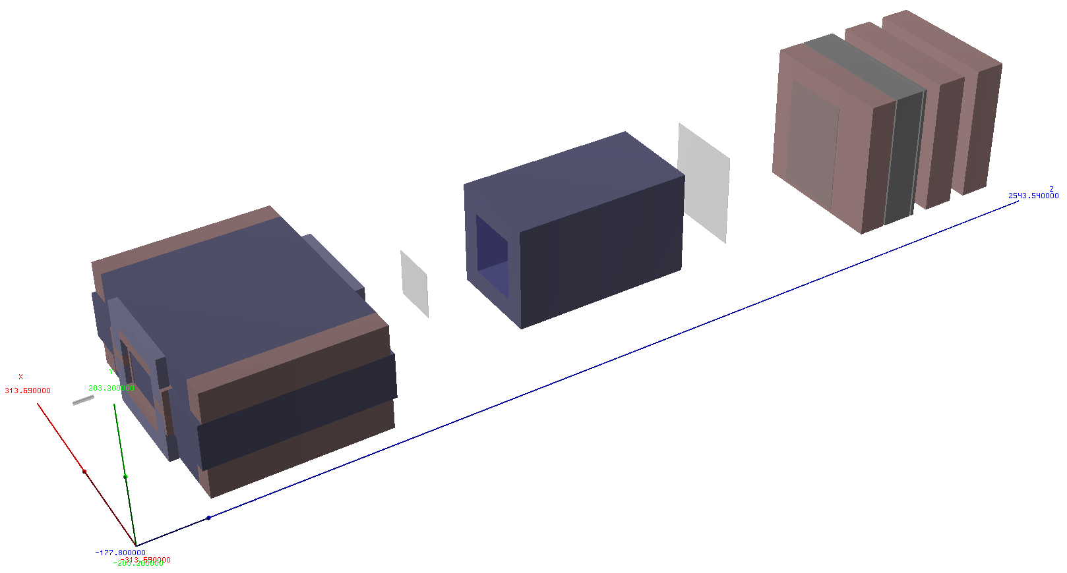
SeaQuest (E906) Spectrometer
Stations 2 and 3:
Hodoscope arrays, mix of old (E866) and new drift chambers
Hadron Absorber
Station 1:
Hodoscope array,
new 5mm drift chamber
Solid Iron Focusing Magnet, hadron absorber, and beam dump (reconfigured parts of E866)
Mom. Meas.
(KTeV Magnet)
Station 4 (muon id):
Hodoscope array,
prop tube tracking
25m

Slide 8
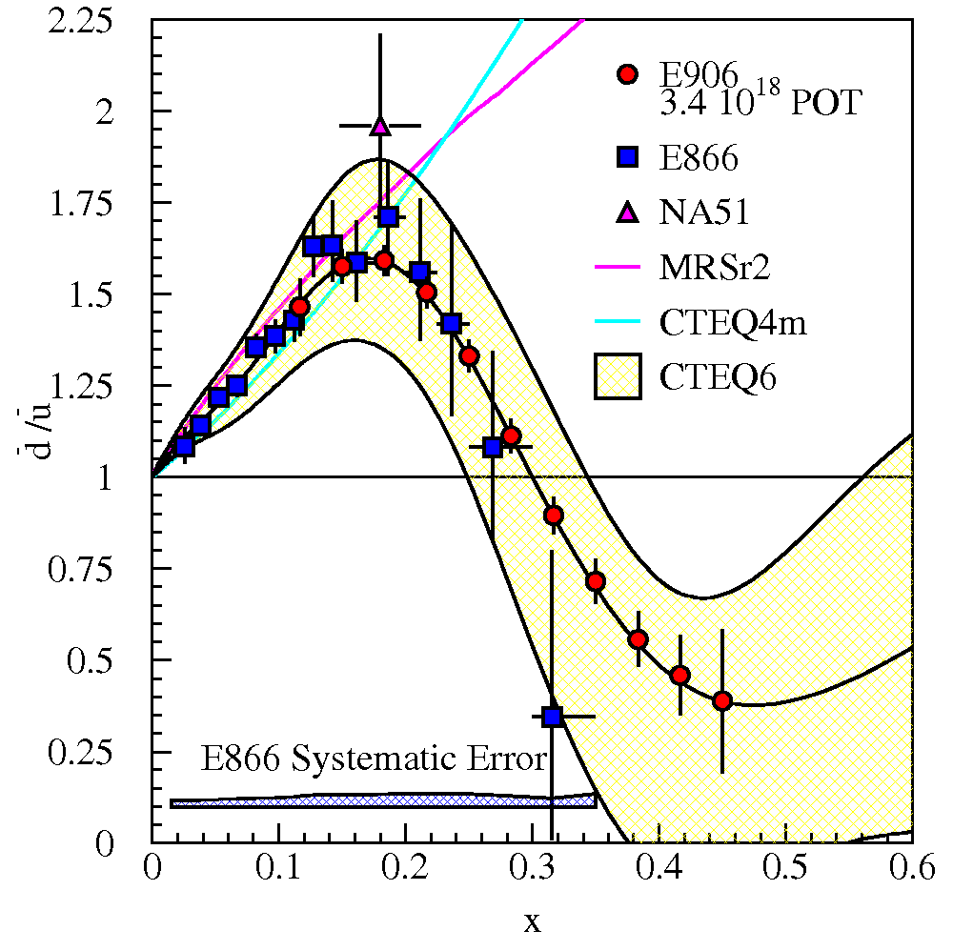
SeaQuest (E906) Reach
SeaQuest will extend E866 results to larger x_{F} and reduce statistical uncertainty.
Systematic uncertainty expected to remain at approx. 1% in cross section ratio.

Slide 9
SeaQuest Collaboration
Abilene Christian University
Donald Isenhower, Mike Sadler, Rusty Towell, Shon Watson
Academia Sinica
Wen-Chen Chang, Yen-Chu Chen, Shiu Shiuan-Hal, Da-Shung Su
Argonne National Laboratory
John Arrington, Don Geesaman*, Kawtar Hafidi,
Roy Holt, Harold Jackson, David Potterveld,
Paul E. Reimer*, Josh Rubin
University of Colorado
Joshua Braverman, Ed Kinney, Po-Ju Lin, Colin West
Fermi National Accelerator Laboratory
Chuck Brown, David Christian
University of Illinois
Bryan Dannowitz, Dan Jumper, Bryan Kerns, Naomi C.R Makins, Jen-Chieh Peng
KEK
Shin'ya Sawada
Kyoto University
KenIchi Imai, Tomo Nagae
Ling-Tung University
Ting-Hua Chang
*Co-Spokespersons
Los Alamos National Laboratory
Gerry Garvey, Mike Leitch, Han Liu, Ming Liu, Pat McGaughey, Joel Moss
University of Maryland
Betsy Beise, Kazutaka Nakahara
University of Michigan
Wolfgang Lorenzon, Richard Raymond
National Kaohsiung Normal University
Rurngsheng Guo, Su-Yin Wand
RIKEN
Yoshinori Fukao, Yuji Goto, Atsushi Taketani, Manabu Togawa
Rutgers University
Lamiaa El Fassi, Ron Gilman, Ron Ransome, Brian Tice, Ryan Thorpe, Yawei Zhang
Texas A & M University
Carl Gagliardi, Robert Tribble
Thomas Jefferson National Accelerator Facility
Dave Gaskell , Patricia Solvignon
Tokyo Tech
Ken-ichi Nakano, Toshi-Aki Shibata
Yamagata University
Yoshiyuki Miyachi

Slide 10
SeaQuest status
Beam line modifications almost complete
Start up expected about October 1.
Spectrometer magnets in place
Shielding near complete
Hodoscopes will be ready on October 1
All wire chambers except for Station 1 ready
Wire chamber electronics will be complete in late November
Station 1 expected in January

Slide 11
SeaQuest Schedule
10/2010 – early/2011: Commissioning
Early/2011 – 10/2011: Rate likely to be limited by limit on losses in Main Ring remnant (while Tevatron collider is running). Experiment will concentrate on solid targets.
Beyond 10/2011: 5000 hours at 1E13 protons per minute = 3E18 protons on target.

Slide 12
FNAL scientist involvement
Chuck Brown (retired 7/2010)
Primary link to previous experiments
E906 ← E866 ← E772 ← E605
(w/Bill Cooper) built St.2 & St.3- drift chambers
Beam line architect
Managing experiment installation
David Christian (joined collaboration 2/2009)
Took over project management in 5/2010
Wire chamber front end electronics
Trigger & DAQ consultant
Less than 1 FTE in 2010.
Less than ½ FTE in 2011 & beyond.

