Slide 1
MINOS Discussion
Robert Plunkett
DOE Site Visit
August, 2010

Slide 2
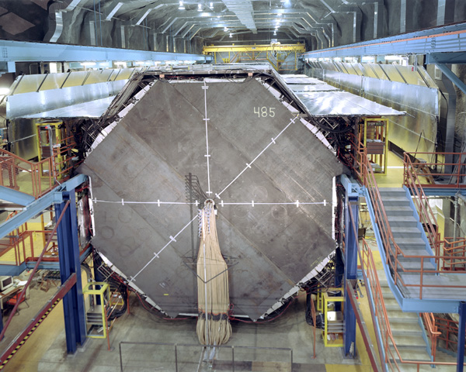
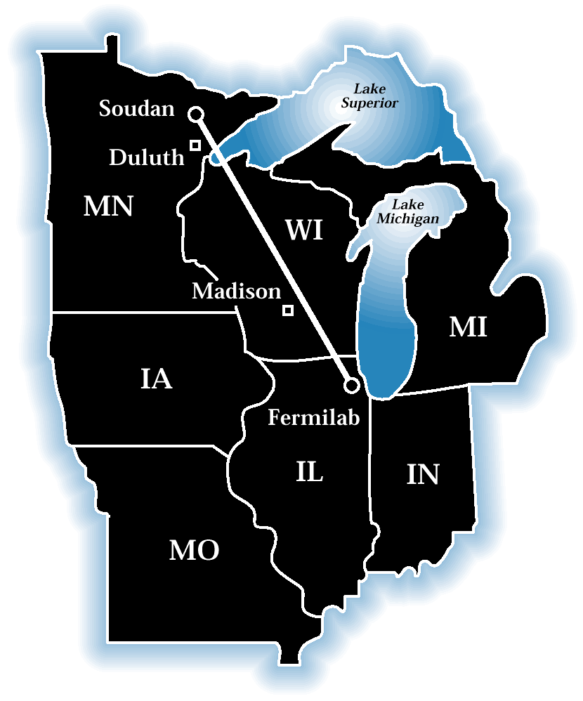
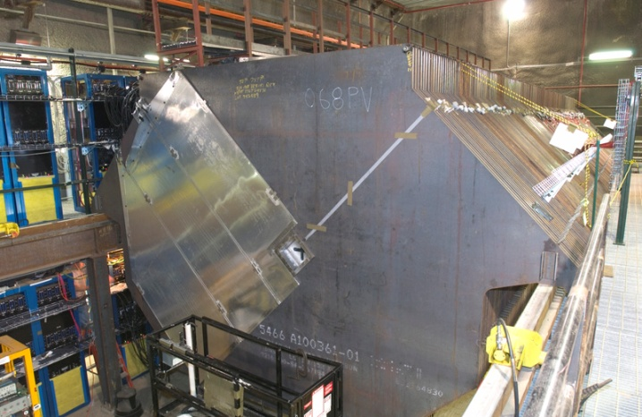
The MINOS Experiment
Two-detector, long base-line neutrino oscillation experiment
Neutrinos from NuMI beam line
L/E ~ 500 km/GeV
atmospheric Δm²
Far Detector
735 km from Source
Two detectors mitigate
systematic effects
beam flux mis-
modeling
neutrino interaction
uncertainties
Near Detector
1 km from Source
30 Institutions, ~120 collaborators, 60 FTE’s

Slide 3
Principal MINOS Physics Achievements and Goals
Precision measurements of atmospheric-scale neutrino oscillation parameters |Δm²₃₂| and sin²θ₂₃ , using disappearance of ν_{μ.} 2 PRL, 1 PRD, PRL in prep.
Measure or bound unknown neutrino oscillation parameter θ₁₃ via search for appearance of process ν_{μ} -> ν_{e} . PRL, PRD Rapid Comm.
Directly measure atmospheric-scale oscillation parameters for anti-ν_{μ} PRL in prep.
Search for possible sterile neutrinos using neutral current spectrum PRL, PRD, PRD in prep.
Notes:
P

Slide 4
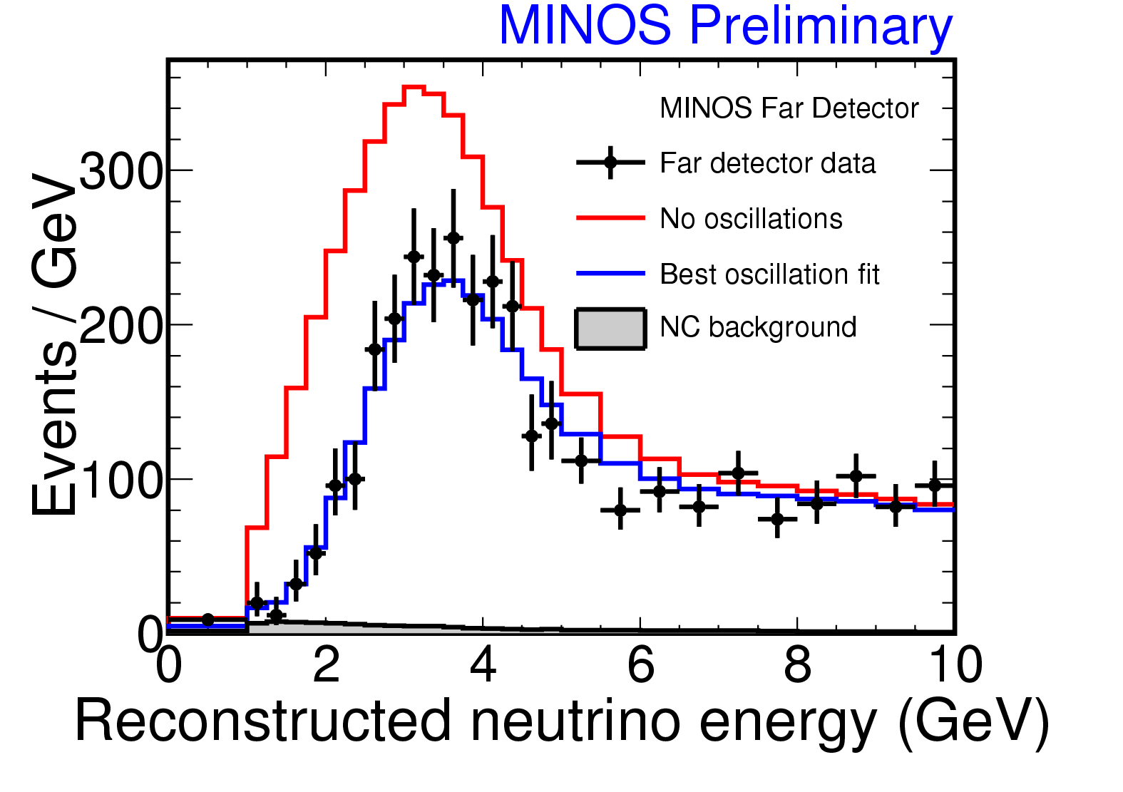
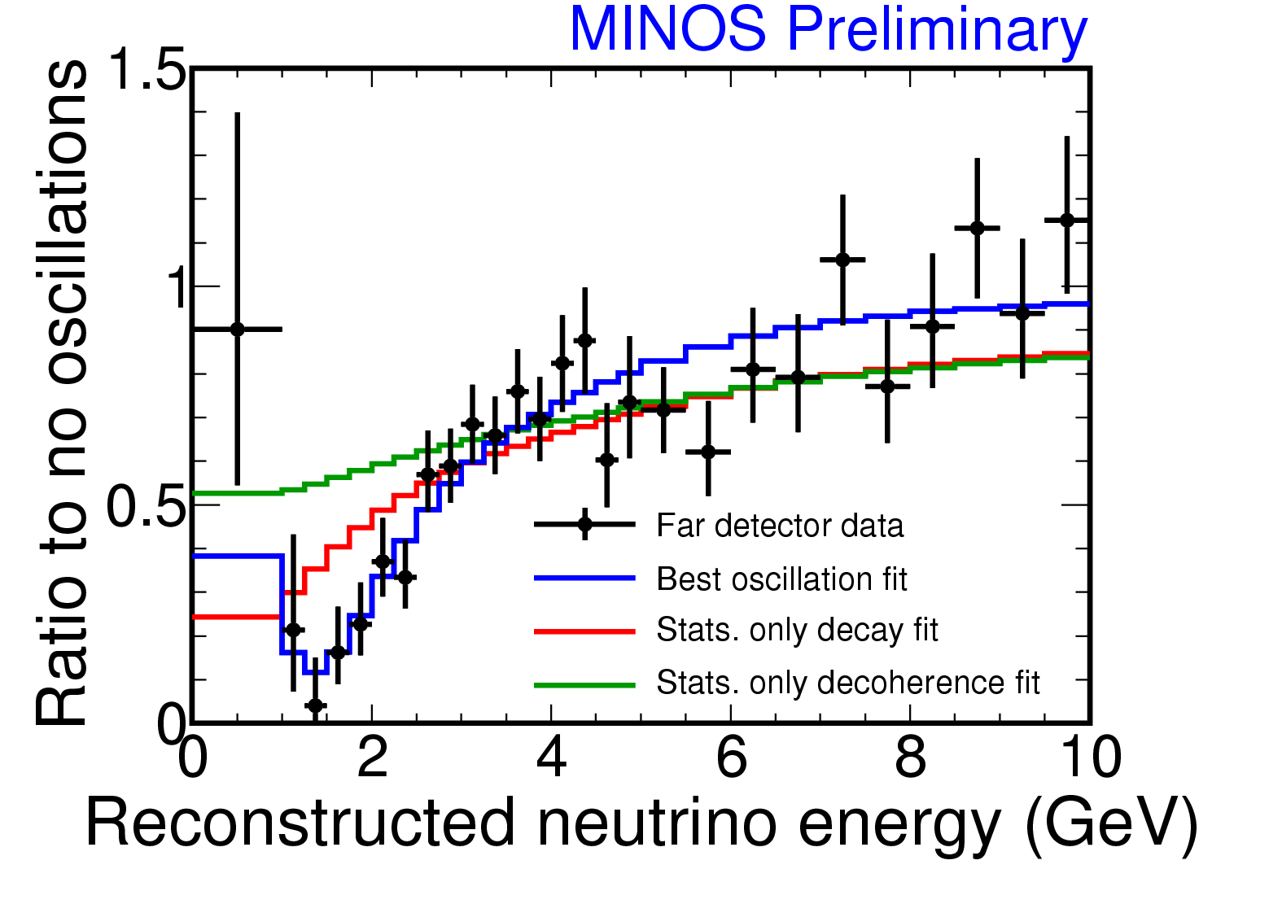
Far Detector neutrino Energy Spectrum
Oscillations fit the data well, 66% of experiments have worse χ²
Pure decoherence† disfavored: > 8σ
Pure Decay‡ disfavored: > 6σ (7.8σ if NC events included)
†G.L. Fogli et al., PRD 67:093006 (2003) ‡V. Barger et al.,PRL 82:2640 (1999)

Slide 5
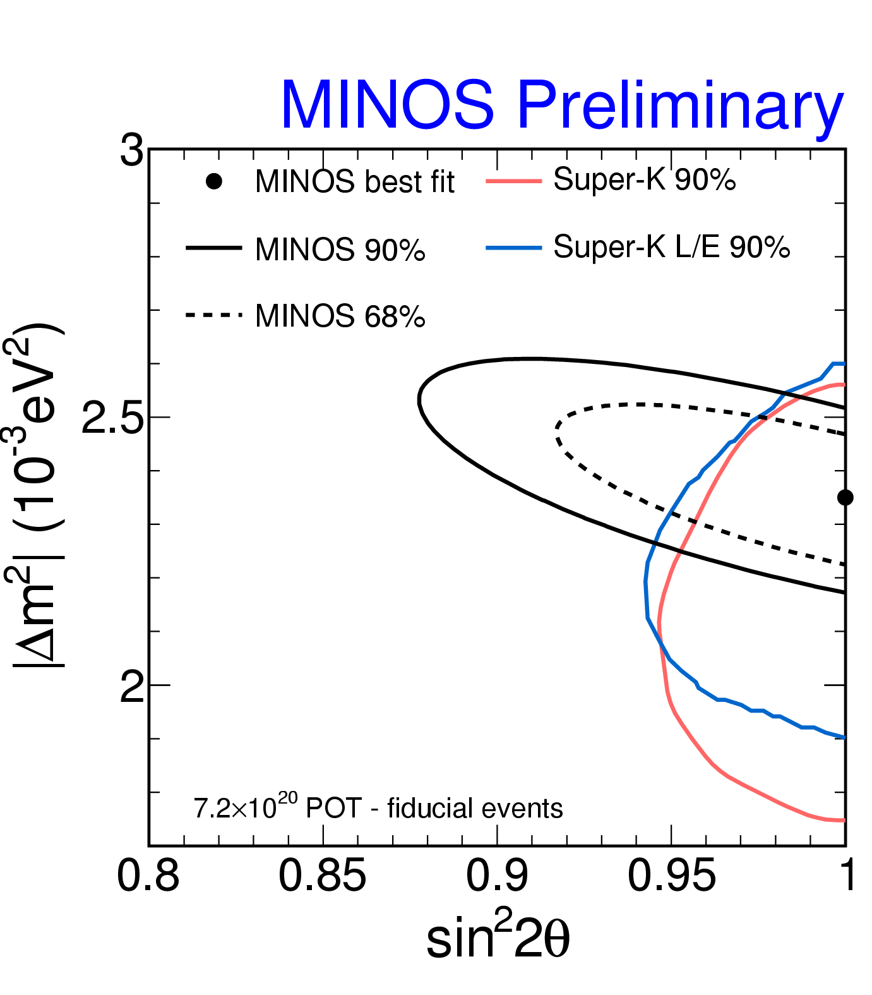
Contours
A number of analysis improvements have been implemented to improve sensitivity by about 10% over previous publications
Contour includes effects of dominant systematic uncertainties
normalization
NC background
shower energy
track energy
†
†SK preliminary

Slide 6
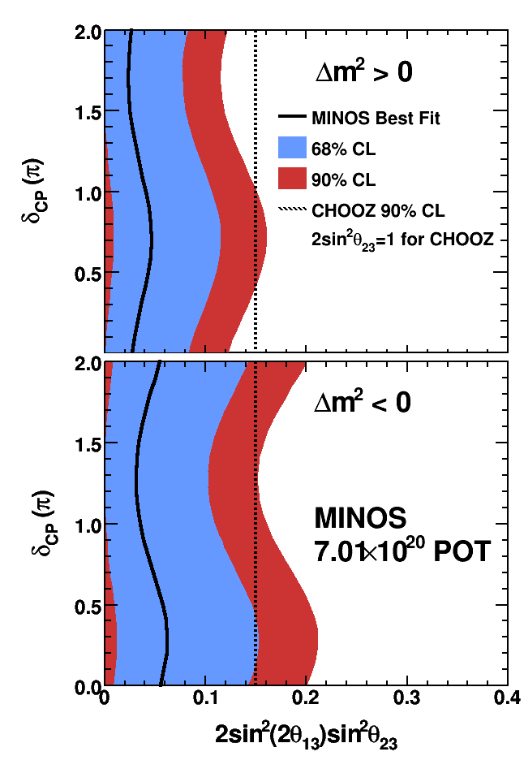
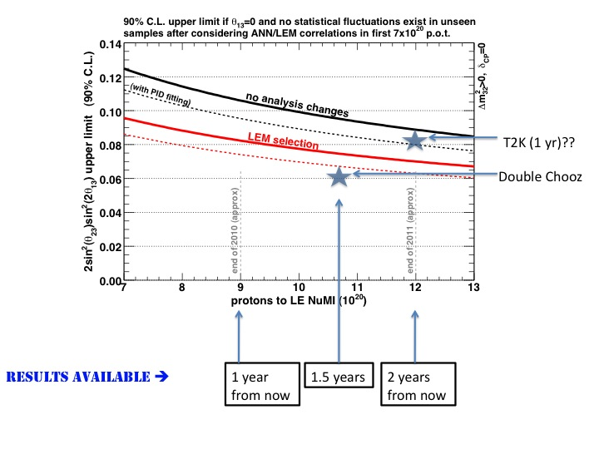
ν_{e} Appearance Results
Expect: 49.1±7.0(stat.)±2.7(syst.)
Observe: 54 events ( 0.7σ excess)
At δ_{cp}=0: sin²θ₁₃<0.12, with normal mass hierarchy
Improvements expected from analysis improvement , additional running.

Slide 7
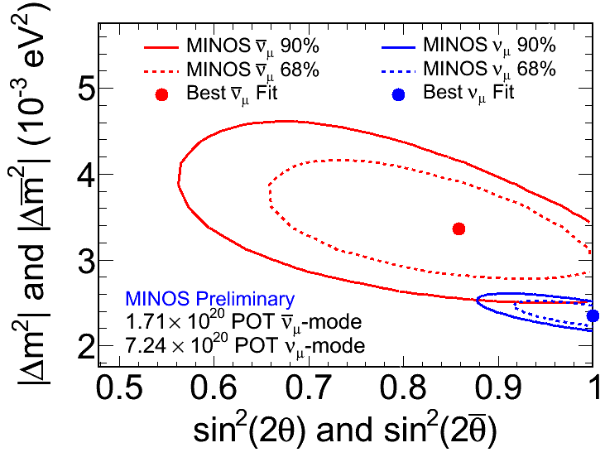
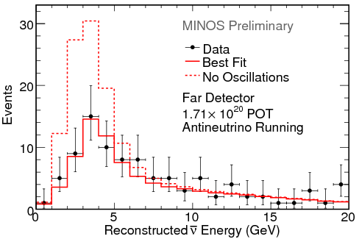
MINOS Anti-neutrino Run
No oscillation Prediction: 155
Observe: 97
No oscillations disfavored at 6.3σ
Some tension with neutrino result.
More running expected in 2011

Slide 8
MINOS Fermilab Research FTE
Budgeted Research FTE for MINOS
4.5 in FY 2010, decreasing to 1.9 in FY2011
All numbers are Ph.D. scientists – about 8 people.
Most recent estimates show about 2.8 FTE active in research.
Difference largely because of post-doc promotion without replacement.
Leadership roles (Co-spokesperson, publication chair, analysis group convenors)
Expect to require 2.5 in FY 2011
Attempting to increase post-doc contribution through joint work on new experiments, analysis on MINOS.
Important liaison with Indian institutions growing.
Currently 1 graduate student active (not shown in 2.8 above). Expect another in FY2011

Slide 9
Further Discussion
Computing support
Adequate personnel working mostly on MINOS in FY2010, but will be under pressure to split time more.
Experiments, CD share tools as much as they can.
Collaboration handling main burden of legacy package support and MC production.
CD procurement process has proved lengthy, but staff help if there are problems (mostly disk).
Guests and Visitors
Critical for MINOS, both for operations and analysis.
Helping ameliorate UK funding crisis. Win-win for UK, Fermilab.
Seeding emerging collaboration with Indian groups.
Notes:
xp

Slide 10
Summary
Extremely productive year for MINOS experiment, with results figuring prominently at principal international conferences.
Fermilab research FTE contribution has evolved because of promotions, time-sharing on new experiments. AD contributions and now graduate students are important.
Active guest and visitor program.
Plans for 2011 include taking final data set for “conventional” oscillation measurements and significantly improving statistical accuracy of antineutrino measurements.

Slide 11
Additional Slides

Slide 12
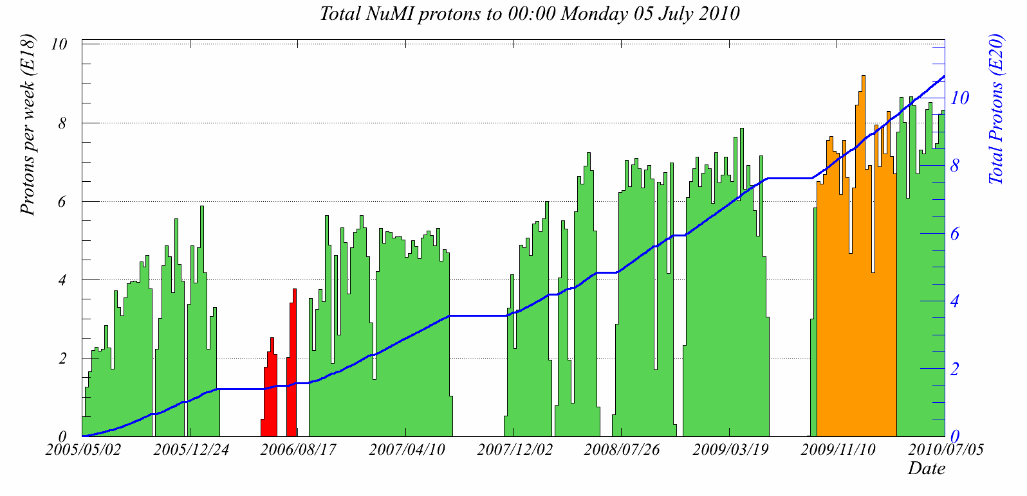
NuMI
Numi has delivered exceptional running the last year (orange = anti-ν)=special runs)
Hopefully it will last for the next year!

Slide 13
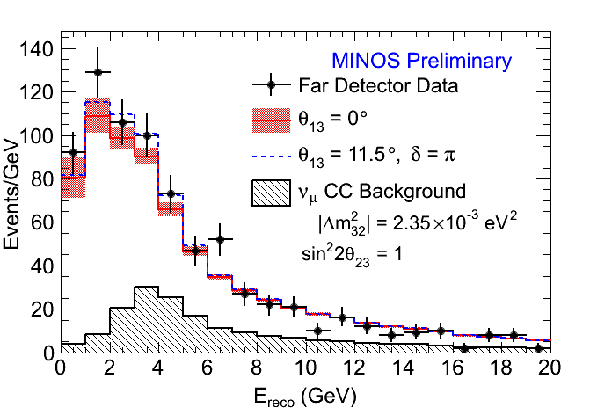
Neutral Currents in the Far Detector
Expect: 757 events
Observe: 802 events
No deficit of NC events
no (with) ν_{e} appearance

Slide 14
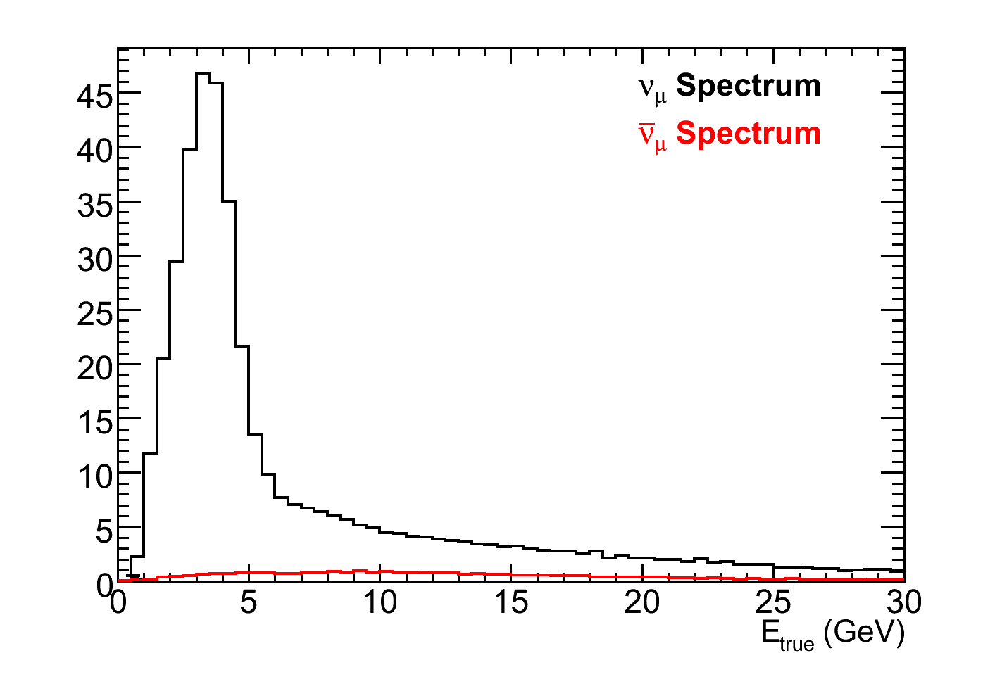
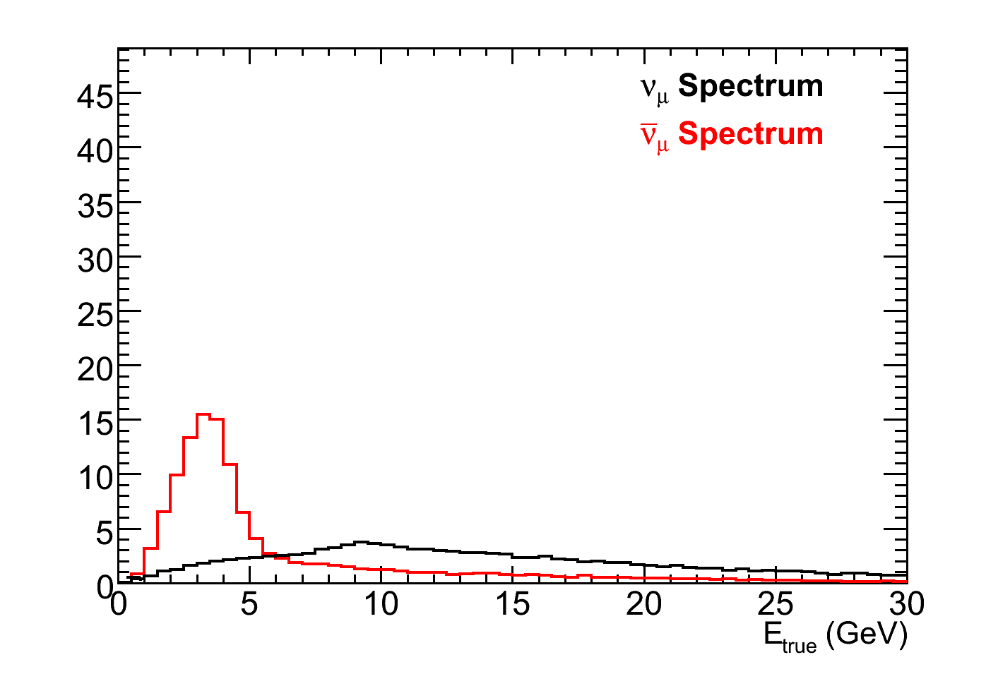
Making an anti-neutrino beam
Neutrino mode
Horns focus π⁺, K⁺
Anti-neutrino Mode
Horns focus π⁻, K⁻
Events
ν_{μ}= 91.7%
ν_{μ}= 7.0%
ν_{e}+ν_{e} = 1.3%
Events
ν_{μ}= 39.9%
ν_{μ}= 58.1%
ν_{e}+ν_{e} = 2.0%
Target
Focusing Horns
π⁺
2 m
ν_{μ}
120 GeV p’s from MI
π⁻
ν_{μ}
15 m
30 m
675 m

Slide 15
MINOS Collaboration FTE Statistics
5 publications in the last year
60 FTEs in total on MINOS but reducing /~120 total collaborators
20 FNAL personnel
A.Kreymer and R. Hatcher (CS)
D.Toretta (DAQ)
R.Plunkett (Co-Spoke)
P.Adamson, S. Childress, R. Zwaska (beam)
Brian Rebel (Publications chair)

