Slide 1
Particle Accelerators
Part 1
Eric Prebys
FNAL Accelerator Physics Center

Slide 2

My (main) Job: LARP
I’m the head of the US LHC Accelerator Research Program (LARP), which coordinates US R&D related to the LHC accelerator and
injector chain at Fermilab, Brookhaven,
SLAC, and Berkeley (with a little at
Jefferson Lab and UT Austin)
LARP consists of
  Accelerator Systems
    Instrumentation
    Beam Physics
    Collimation
  Magnet Systems
    Demonstrate the viability of high
    gradient quadrupoles based on Nb₃Sn
    superconductor, rather than NbTi
  Programmatic activities
    Management and travel
    Toohig Fellowship
    Support for Long Term Visitors at CERN
NOT to be confused with this “LARP” (Live-Action Role Play), which has led to some interesting emails

Slide 3
Outline
Today
  History and movitation for accelerators
  Basic accelerator physics concepts
Tomorrow
  Some “tricks of the trade”
    Accelerator techniques
    Instrumentation
  Case study: The LHC
    Motivation and choices
    A few words about “the incident”
    Future upgrades
  Overview of other accelerators

Slide 4
Discovery: It’s all about energy and collision rate
To probe smaller scales, we must go to higher energy
To discover new particles, we need enough energy available to create them
The rarer a process is, the more collisions (luminosity) we need to observe it.
1 fm = 10⁻¹⁵ m
(Roughly the size of a proton)

Slide 5
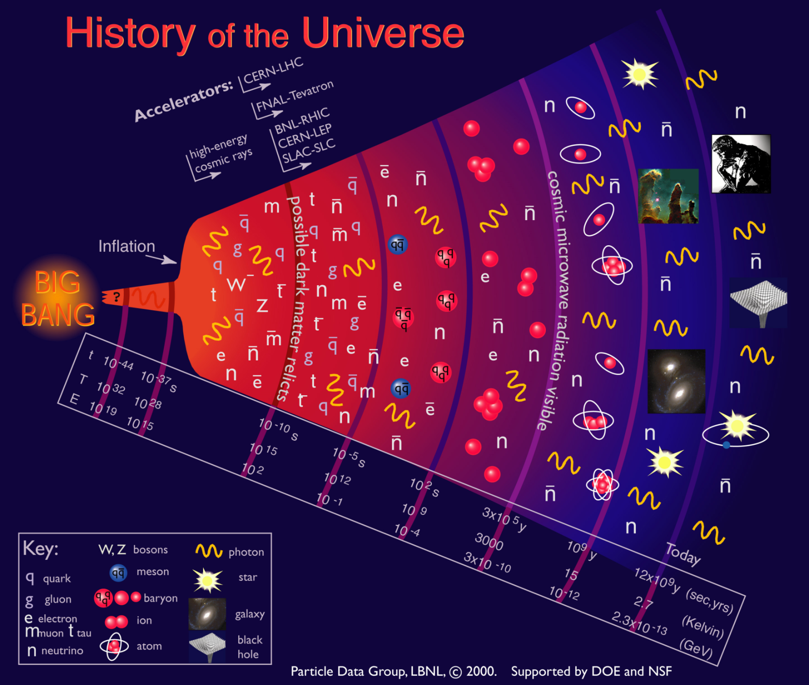
Another way to look at it: a window back in time
Accelerators allow us to probe down to a few picoseconds after the Big Bang!

Slide 6
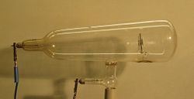
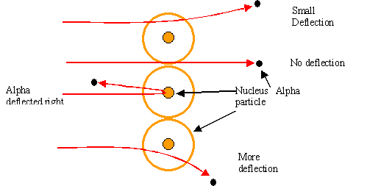
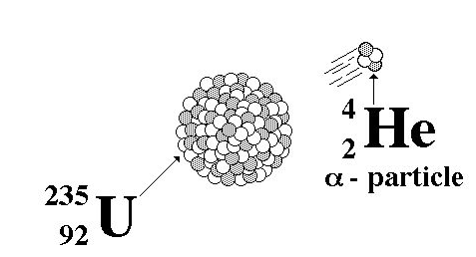
Some pre-history
The first artificial acceleration of particles
was done using “Crookes tubes”, in the
latter half of the 19th century
  These were used to produce the first X-rays (1875)
  But at the time no one understood what was going on
The first “particle physics experiment” told Ernest Rutherford the structure of the atom (1911)
In this case, the “accelerator” was a
naturally decaying ²³⁵U nucleus
Study the way radioactive particles “scatter” off of atoms

Slide 7
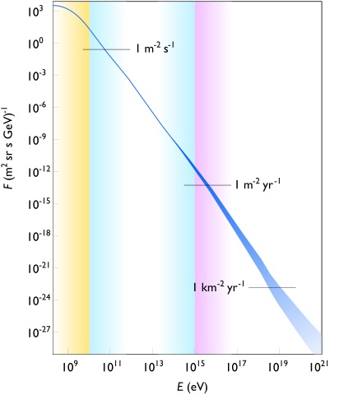
Natural particle acceleration
Max LHC energy
Radioactive sources produce maximum energies of a few million electron volts (MeV)
Cosmic rays reach energies of ~1,000,000,000 x LHC but the rates are too low to be useful as a study tool
  Remember what I said about luminosity.
On the other hand, low energy cosmic rays are extremely useful
  But that’s another talk

Slide 8
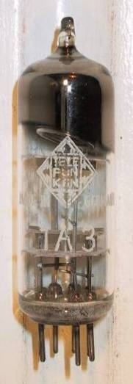
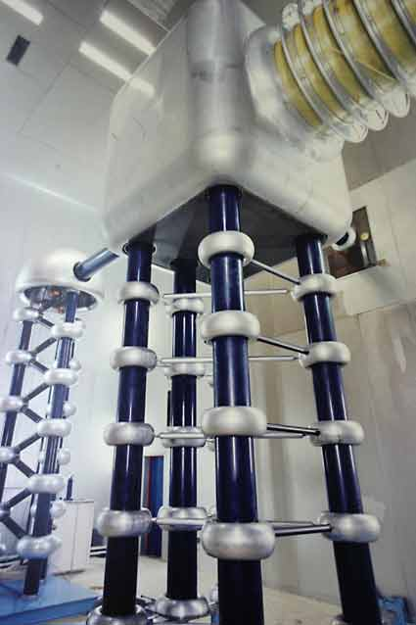
Man-made particle acceleration
The simplest accelerators accelerate charged particles through a static electric field. Example: vacuum tubes (or CRT TV’s)
Cathode
Anode
Limited by magnitude of static field:
  - TV Picture tube ~keV
  - X-ray tube ~10’s of keV
  - Van de Graaf ~MeV’s
Solutions:
  Alternate fields to keep particles in
  accelerating fields -> RF acceleration
  Bend particles so they see the same accelerating field over and over -> cyclotrons, synchrotrons
FNAL Cockroft-Walton = 750 kV

Slide 9
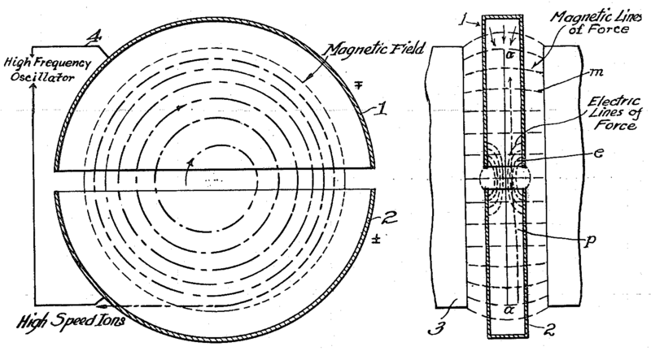
The Cyclotron (1930’s)
side view
top view
A charged particle in a uniform magnetic field will follow a circular path of radius
non-relativistic
“Cyclotron Frequency”
For a proton:
Accelerating “DEES”

Slide 10
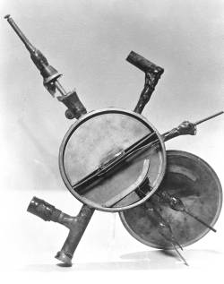
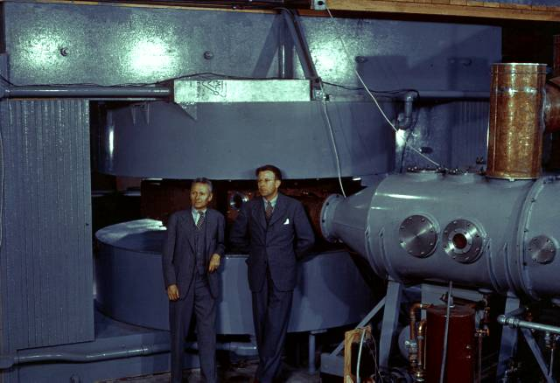
Round we go: the first cyclotrons
~1930 (Berkeley)
  Lawrence and Livingston
  K=80KeV
1935 - 60” Cyclotron
  Lawrence, et al. (LBL)
  ~19 MeV (D2)
  Prototype for many

Slide 11
Synchrocyclotron
Cyclotrons only worked up to about 20% of the speed of light (proton energies of ~15 MeV).
Beyond that
As energy increases, the driving frequency must decrease.
Higher energy particles take longer to go around. This has big benefits.
Particles with lower E arrive earlier and see greater V.
Phase stability!
Nominal Energy
(more about that shortly)

Slide 12
Synchrotrons and beam “stiffness”
The relativistic form of Newton’s Laws for a particle in a magnetic
field is:
A particle in a uniform magnetic
field will move in a circle of radius
In a “synchrotron”, the magnetic fields are varied as the beam accelerates such that at all points , and beam motion can be analyzed in a momentum independent way.
It is usual to talk about he beam “stiffness” in T-m
Thus if at all points , then the local bend radius (and therefore the trajectory) will remain constant.
Singly charged particles
Booster: (Bρ)~30 Tm
LHC : (Bρ)~23000 Tm

Slide 13
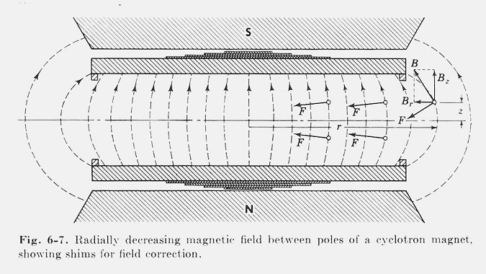
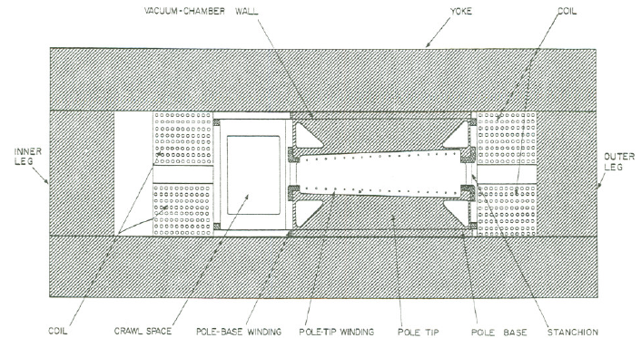
Weak focusing
Cyclotrons relied on the fact that
magnetic fields between two pole
faces are never perfectly uniform.
This prevents the particles from
spiraling out of the pole gap.
In early synchrotrons, radial field
profiles were optimized to take advantage of this effect, but in
any weak focused beams, the beam size grows with energy.
The highest energy weak
focusing accelerator was the
Berkeley Bevatron, which had
a kinetic energy of 6 GeV
  High enough to make antiprotons
  (and win a Nobel Prize)
  It had an aperture 12”x48”!

Slide 14
Strong focusing
Strong focusing utilizes alternating magnetic gradients to precisely control the focusing of a beam of particles
  The principle was first developed in 1949 by Nicholas Christophilos, a Greek-American engineer, who was working for an elevator company in Athens at the time.
  Rather than publish the idea, he applied for a patent, and it went largely ignored.
  The idea was independently invented in 1952 by Courant, Livingston and Snyder, who later acknowledged the priority of Christophilos’ work.
Although the technique was originally formulated in terms of magnetic gradients, it’s much easier to understand in terms of the separate funcntions of dipole and quadrupole magnets.

Slide 15
Thin lens approximation and magnetic “kick”
If the path length through a
transverse magnetic field is short
compared to the bend radius
of the particle, then we can think of
the particle receiving a transverse “kick”
and it will be bent through small angle
In this “thin lens approximation”, a
dipole is the equivalent of a prism in
classical optics.

Slide 16
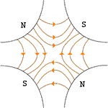
Quadrupole magnets*
A positive particle coming out of the page off center in the horizontal plane will experience a restoring kick
*or quadrupole term in a gradient magnet

Slide 17
What about the other plane?
Defocusing!
Luckily, if we place equal and opposite pairs of lenses, there will be a net focusing regardless of the order.
⇒pairs give net focusing in both planes -> “FODO cell”

Slide 18
Trajectories and phase space
In general, we assume the dipoles define the nominal particle trajectory, and we solve for
lateral deviations from that
trajectory.
At any point along the
trajectory, each particle
can be represented by
its position in “phase space”
Lateral deviation
s
x
Position along trajectory
We would like to solve for x(s)
We will assume:
  Both transverse planes are independent
    No “coupling”
  All particles independent from each other
    No space charge effects

Slide 19
Transfer matrices
The simplest magnetic lattice consists of quadrupoles and the spaces in between them (drifts). We can express each of these as a linear operation in phase space.
By combining these elements, we can represent an arbitrarily complex ring or line as the product of matrices.
Quadrupole:
Drift:

Slide 20
Example: FODO cell
At the heart of every beam line or ring is the “FODO” cell, consisting of a focusing and a defocusing element, separated by drifts:
The transfer matrix is then
We can build a ring out of N of these, and the overall transfer matrix will be
L
-L
f
-f

Slide 21
Betatron motion
Skipping a lot of math, we find that we can describe particle motion in terms of initial conditions and a “beta function” β(s), which is only a function of location in the nominal path.
Minor but important note: we need constraints to define β(s)
  For a ring, we require periodicity (of β, NOT motion): β(s+C) = β(s)
  For beam line: matched to ring or source
x
Lateral deviation in one plane
s
The “betatron function” β(s) is effectively the local wavenumber and also defines the beam envelope.
Phase advance
Closely spaced strong quads -> small β -> small aperture, lots of wiggles
Sparsely spaced weak quads -> large β -> large aperture, few wiggles

Slide 22
Betatron tune
Particle trajectory
As particles go around a ring, they will undergo a number of betatrons oscillations ν (sometimes Q) given by
This is referred to as the “tune”
Ideal orbit
We can generally think of the tune in two parts:
6.7
Integer : magnet/aperture optimization
Fraction: Beam Stability

Slide 23
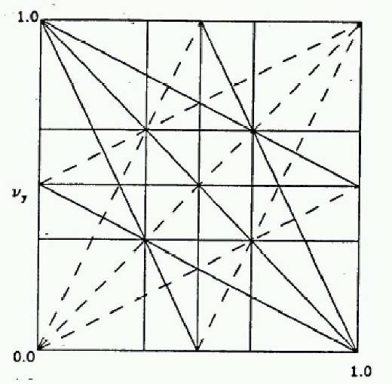
Tune, stability, and the tune plane
If the tune is an integer, or low order rational number, then the effect of any imperfection or perturbation will tend be reinforced on subsequent orbits.
When we add the effects of coupling between the planes, we find this is also true for combinations of the tunes from both planes, so in general, we want to avoid
Many instabilities occur when something perturbs the tune of the beam, or part of the beam, until it falls onto a resonance, thus you will often hear effects characterized by the “tune shift” they produce.
“small” integers
⇒Avoid lines in the “tune plane”
fract. part of Y tune
fract. part of X tune

Slide 24
Twiss parameters: α, β, and γ
As a particle returns to the same point s on
subsequent revolutions, it will map out an
ellipse in phase space, defined by
As we examine different locations on the
ring, the parameters will change, but the
area (Aπ) remains constant.
Twiss Parameters

Slide 25
Emittance
If each particle is described by an ellipse with a particular amplitude, then an ensemble of particles will always remain within a bounding ellipse of a particular area:
Area = ε
Since these distributions often have long tails, we typically define the “emittance” as an area which contains some specific fraction of the particles. Typical conventions:
Electron machines, CERN:
Contains 39% of Gaussian particles
Usually leave π as a unit, e.g. E=12 π-mm-mrad
FNAL:
Contains 95% of Gaussian particles

Slide 26
Normalized emittance
As the beam accelerates, “adiabatic damping” will reduce the emittance as:
The usual relativistic γ and β
So the “normalized emittance” will be constant:
We can calculate the size of the beam at any time and with:
Example:
Fermilab Booster

Slide 27
Interpreting the twiss parameters
As particles go through the lattice, the Twiss parameters will vary periodically:
= max
α = 0
⇒maximum
= decreasing
α >0
⇒focusing
= min
α = 0
⇒minimum
= increasing
α < 0
⇒defocusing

Slide 28
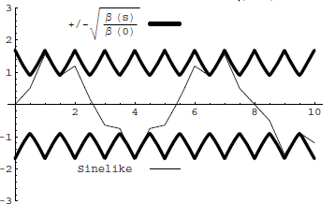
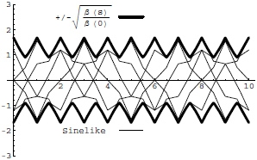
Conceptual understanding of β and ε
In this representation, we have separated the properties of the accelerator itself (Twiss Parameters) from the properties of the ensemble (emittance). At any point, we can calculate the size of the beam by
It’s important to remember that the betatron function represents a bounding envelope to the beam motion, not the beam motion itself
Normalized particle trajectory
Trajectories over multiple turns

Slide 29
Steering errors (or corrections)
A dipole magnet will perturb the trajectory of a beam as
A dipole perturbation in a ring will cause a “closed orbit distortion” given by
We can create a localized distortion by
introducing three angular kicks with
ratios
These “three bumps” are a very powerful tool for beam
control and tuning

Slide 30
Quadrupole errors
A single quadrupole of focal length f will introduce a tune shift given by
Studying these tune shifts turn out to be one very good way to measure β(s) at quadrupole locations (more about that tomorrow).
In addition, a small quadrupole purturbation will cause a “beta wave” distortion of the betatron function around the ring given by

Slide 31
Dispersion and chromaticity
Up until now, we have assumed that momentum is constant.
Real beams will have a distribution of momenta.
The two most important parameters describing the behavior of off-momentum particles are
  “Dispersion”: describes the position dependence on momentum
    Most important in the bend plane
  Chromaticity: describes the tune dependence on momentum.
    Often expressed in “units” of 10⁻⁴

Slide 32
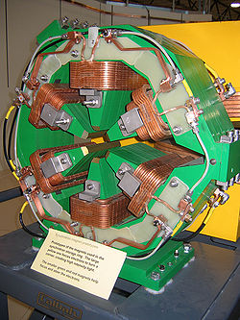
Sextupoles
Sextupole magnets have a field
(on the principle axis) given by
If the magnet is put in a sufficiently dispersive
region, the momentum-dependent motion will be large compared to the betatron motion,
The important effect will then be slope, which is effectively like adding a quadrupole of strength
The resulting tune shift will be
p=p₀+Δp
Nominal momentum
chromaticity

Slide 33
Transition
We showed earlier that in a synchro-cyclotron, high momentum particles take longer to go around.
  This led to the initial understanding of phase stability during acceleration.
In a synchrotron, two effects compete
This means that at the slip factor will change sign for
Path length
Velocity
“momentum compaction factor”: a constant of the lattice. Usually positive
Momentum dependent “slip factor”
“transition” gamma

Slide 34
Transition and phase stability
The sign of the slip factor determines the stable region on the RF curve.
Somwhat complicated phase manpulation at transition, which can result in losses, emittance growth, and instability
For a simple FODO ring, we can show that
  Never a factor for electrons!
Rings have been designed (but never built) with α<0⇒γ_{t} imaginary
Below γ_{t}: velocity dominates
Above γ_{t} : path length dominates
“bunch”
Particles with lower E arrive earlier and see greater V.
Particles with lower E arrive later and see greater V.
Nominal Energy
Nominal Energy

Slide 35
Digression: Floquet transformation
Recall that particles in an accelerator undergo “pseudo-harmonic” motion
Introducing the following
transformation
allows the representation a lattice as a harmonic oscillator
Essentially all analytical calculations of accelerator dynamics are done in this way
  But we won’t do any
Driving terms
Ideal, linear lattice

Slide 36
Longitudinal motion
We will generally accelerate particles using structures that generate time-varying electric fields (RF cavities), either in a linear arrangement
or located within a circulating ring
In both cases, we want to phase the RF so a nominal
arriving particle will see the same accelerating voltage
and therefore get the same boost in energy
cavity 0
cavity 1
cavity N
Nominal Energy

Slide 37
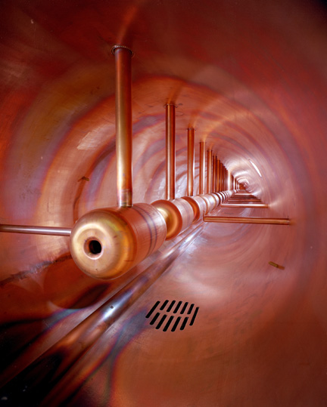
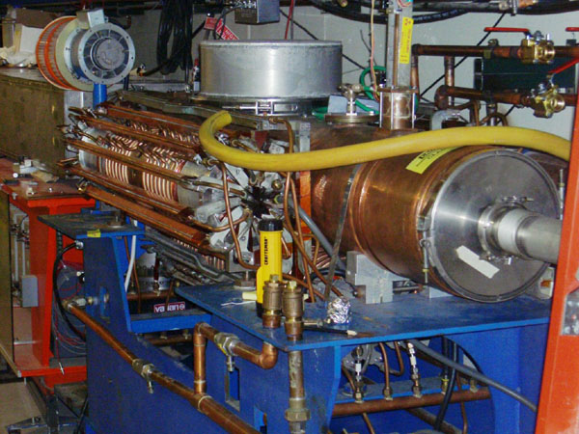
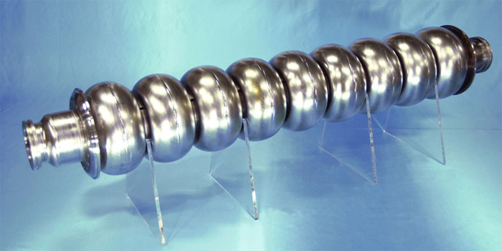
Examples of accelerating RF structures
37->53MHz Fermilab Booster cavity
Biased ferrite frequency tuner
Fermilab Drift Tube Linac (200MHz): oscillating field uniform along length
ILC prototype elipical cell “π-cavity” (1.3 GHz): field alternates with each cell

Slide 38
Phase stability
A particle with a slightly different energy will arrive at a slightly different time, and experience a slightly different acceleration
If then particles will stably oscillate around this equilibrium energy with a “synchrotron frequency” and “synchrotron tune”
Off Energy
Nominal Energy

Slide 39
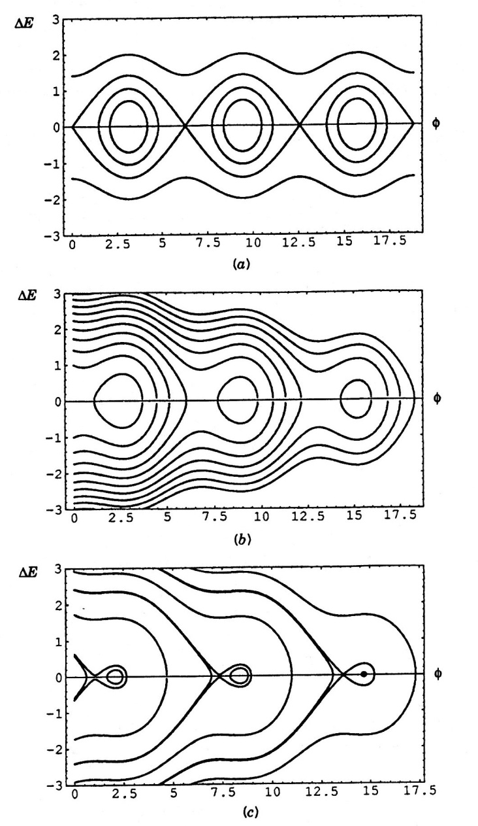
Accelerating phase and stability
The accelerating voltage grows as
sinφ_{s}, but the stable bucket area
shrinks
Just as in the transverse plane, we
can define a phase space, this time in the Δt-ΔE plane
As particles accelerate or accelerating voltage changes
Area = “longitudinal emittance” (usually in eV-s)

Slide 40
The Case for Colliding Beams
For a relativistic beam hitting a fixed target, the center of mass energy is:
On the other hand, for colliding beams (of equal mass and energy):
To get the 14 TeV CM design energy of the LHC with a single beam on a fixed target would require that beam to have an energy of 100,000 TeV!
  Would require a ring 10 times the diameter of the Earth!!

Slide 41
Luminosity
The relationship of the beam to the rate of observed physics processes is given by the “Luminosity”
Rate
Cross-section (“physics”)
“Luminosity”
Standard unit for Luminosity is cm⁻²s⁻¹
For fixed (thin) target:
Target thickness
Example: MiniBooNe primary target:
Incident rate
Target number density

Slide 42
Colliding Beam Luminosity
Circulating beams typically “bunched”
(number of interactions)
Cross-sectional area of beam
Total Luminosity:
Circumference of machine
Number of bunches
Record e+e- Luminosity (KEK-B): 1.71E34 cm⁻²s⁻¹ Record Hadronic Luminosity (Tevatron): 4.03E32 cm⁻²s⁻¹
LHC Design Luminosity: 1.00E34 cm⁻²s⁻¹

Slide 43
Luminosity: cont’d
For equally intense Gaussian beams
Expressing this in terms of our usual beam parameters
Particles in a bunch
Collision frequency
Geometrical factor:
- crossing angle
- hourglass effect
Transverse size (RMS)
Revolution frequency
Normalized emittance
Number of bunches
Betatron function at collision point

Slide 44
Beam-beam Effects (NOTE correction)
It seems like we want to get the beam as small and intense as possible, but we have to remember that the beams influence each other.
A beam passing through another beam will see either a focusing (pBar-p) or defocusing (p-p) field, resulting in a tune spread on a scale
Keep in mind, this is the maximum of a spread of tunes, so it they can’t be simply compensated
Typical maximum values are ~.02
This limits the beam “brightness” (N_{b}/ε_{Ν}) to
p
p
Number of collisions per bunch
Classical electron radius
Particles in a bunch

Slide 45
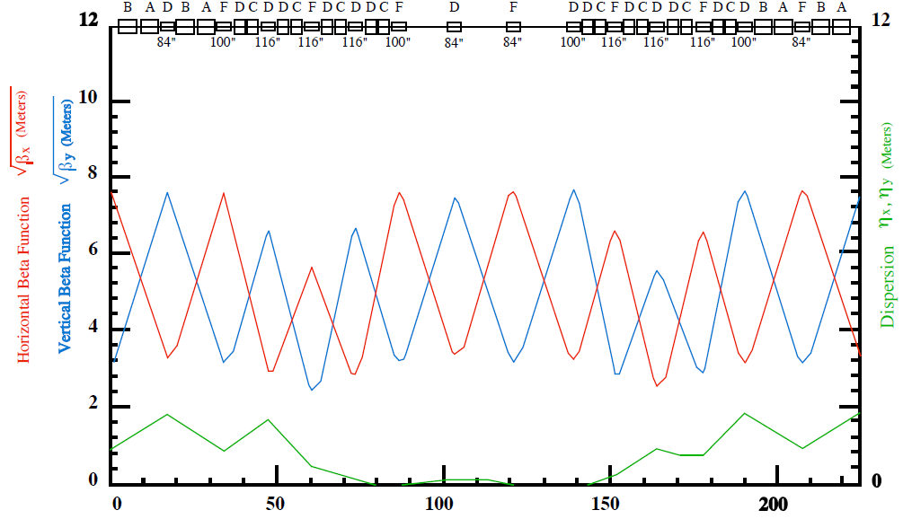
Limits to β*
An ordinary synchrotron lattice is characterized by FODO cells, in which vertical maxima correspond to horizontal minima, and vice versa
Creating a minimum in both planes can in general be solved by putting a triplet of quads on either side of the interaction region
  Low beta “insertion”
  Constrain lattice functions and phase advance to match “missing” period.
Lattice of the Fermilab Main Injector

Slide 46
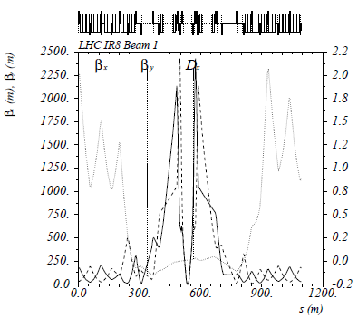
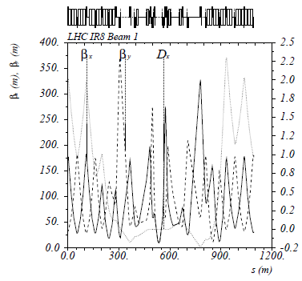
Optics near an interaction region
Near a beam waist, the beta function will evolve quadratically
Since there is a limit to how close we can put the focusing triplets, the smaller the β*, the larger the β (aperture) at the focusing triplet, and the stronger that triplet must be, which is limited by magnet technology
LHC collision region at 7 TeV region (β*=55cm)
At 450 GeV (β*=10m)
Must relax optics at injection so particles can clear triplets, then “squeeze” later.

Slide 47
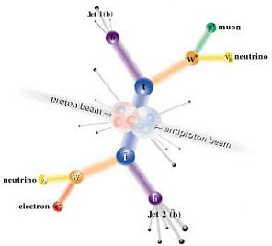
Electrons (leptons) vs. Protons (hadrons)
Electrons are point-like
  Well-defined initial state
  Full energy available to interaction
  Can calculate from first principles
  Can use energy/momentum conservation to find “invisible” particles.
Protons are made of quarks and gluons
  Interaction take place between these consituents.
  At high energies, virtual “sea” particles dominate
  Only a small fraction of energy available, not well-defined.
  Rest of particle fragments -> big mess!
So why don’t we stick to electrons??

Slide 48
Synchrotron Radiation: a blessing and a curse
As the trajectory of a charged particle is deflected, it emits “synchrotron radiation”
Radius of curvature
An electron will radiate about 10¹³ times more power than a proton of the same energy!!!!
Protons: Synchrotron radiation does not affect kinematics very much
Electrons: Beyond a few MeV, synchrotron radiation becomes very important, and by a few GeV, it dominates kinematics
- Good Effects:
- Naturally “cools” beam in all dimensions
- Basis for light sources, FEL’s, etc.
- Bad Effects:
- Beam pipe heating
- Exacerbates beam-beam effects
- Energy loss ultimately limits circular accelerators

Slide 49
Practical consequences of synchrotron radiation
Proton accelerators
  Synchrotron radiation not an issue to first order
  Energy limited by the maximum feasible size and magnetic field.
Electron accelerators
  Recall
  To keep power loss constant, radius must go up as the square of the energy (weak magnets, BIG rings):
    The LHC tunnel was built for LEP, and e⁺e⁻ collider which used the 27 km tunnel to contain 100 GeV beams (1/70th of the LHC energy!!)
    Beyond LEP energy, circular synchrotrons have no advantage for e⁺e⁻
      -> International Linear Collider (but that’s another talk)

Slide 50
Review: glossary of terms
“RF cavity”: resonant electromagnetic structure, used to accelerate or deflect the beam.
“Bunch”: a cluster of particles which is stable with respect to the accelerating RF
“Dipole”: magnet with a uniform magnetic field, used to bend particles
“Quadrupole”: magnet with a field that is ~linear near the center, used to focus particles
“Lattice”: the magnetic configuration of a ring or beam line
“Beta function (β)”: a function of the beam lattice used to characterize the beam size.
“Emittance (ε)”: a measure of the spatial and angular spread of the beam
“Tune”: number of times the beam “wiggles” when it goes around a ring. Fractional part related to beam stability.
“Longitudinal Emittance”: area of the beam in the Δt-ΔE plane. Constant with energy and adiabatic RF voltage change
“Luminosity”: rate at which particles “hit each other”. Constant of proportionality between cross-section and rate.

Slide 51
Some further reading
The definitive book on basic accelerator physics is
  Syphers and Edwards, “An Introduction to the Physics of High Energy Accelerators”
Other good books are:
  S.Y. Lee, “Accelerator Physics”
  Helmut Weideman, “Particle Accelerator Physics”
Some good web resources:
  Bill Barletta’s notes from the undergraduate USPAS course
    http://uspas.fnal.gov/materials/09UNM/UNMFund.html
  Gerry Dugan’s notes from the graduate USPAS course
    http://www.lns.cornell.edu/~dugan/USPAS/
Of course, you could always take the USPAS course
  http://uspas.fnal.gov/

