Slide 1
Integrable nonlinear accelerators
Sergei Nagaitsev (FNAL)
Aug 10, 2010

Slide 2
Acknowledgements
This work has been done in collaboration with Slava Danilov (SNS) and Sasha Valishev (FNAL)

Slide 3
Preliminaries
I will discuss the 2-D transverse beam dynamics. I’ll ignore energy spread effects, but it can be included.
The longitudinal coordinate, s, is equivalent to the time coordinate.
A 2-D Hamiltonian
will be called “integrable” if it has at least two conserved functionally-independent quantities (analytic functions of x, y, p_{x}, p_{y}, s) in involution.
A 1-D time-independent Hamiltonian is integrable.

Slide 4
Some history…
In 1957 theре were 2 major scientific breakthroughs in the USSR

Slide 5
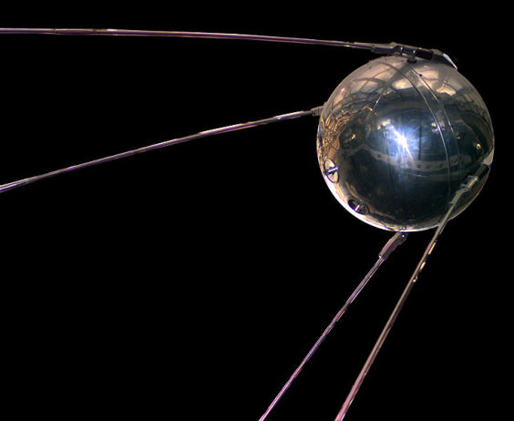
Some history…
In 1957 theре were 2 major scientific breakthroughs in the USSR
  First earth orbiting satellite “Спутник-1”

Slide 6
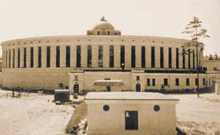
Some history…
In 1957 theре were 2 major scientific breakthroughs in the USSR
  First earth orbiting satellite “Спутник-1”
  Start of operations at “Синхрофазотрон” (Дубна)
    Accelerated protons to 10 GeV – world
    highest energy accelerator until 1959

Slide 7
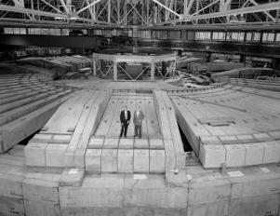
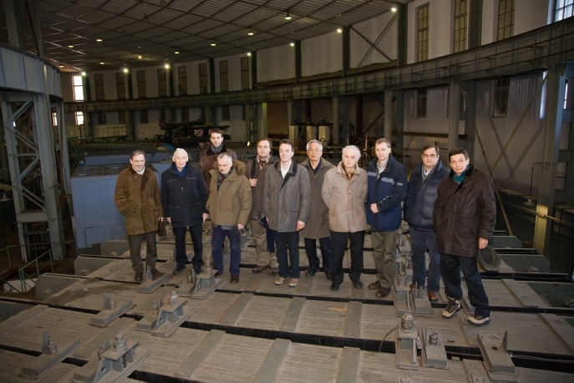
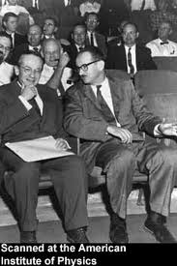
Bevatron and Synchrophasatron
Bevatron (Berkeley) – 6.3 GeV weak-focusing proton synchrotron
  Discovery of antiproton in 1955
Synchrophasatron – 10 GeV weak-
focusing synchrotoron
            Both were based on a discovery of
phase focusing by Veksler (JINR) and
McMillan (Berkeley)

Slide 8
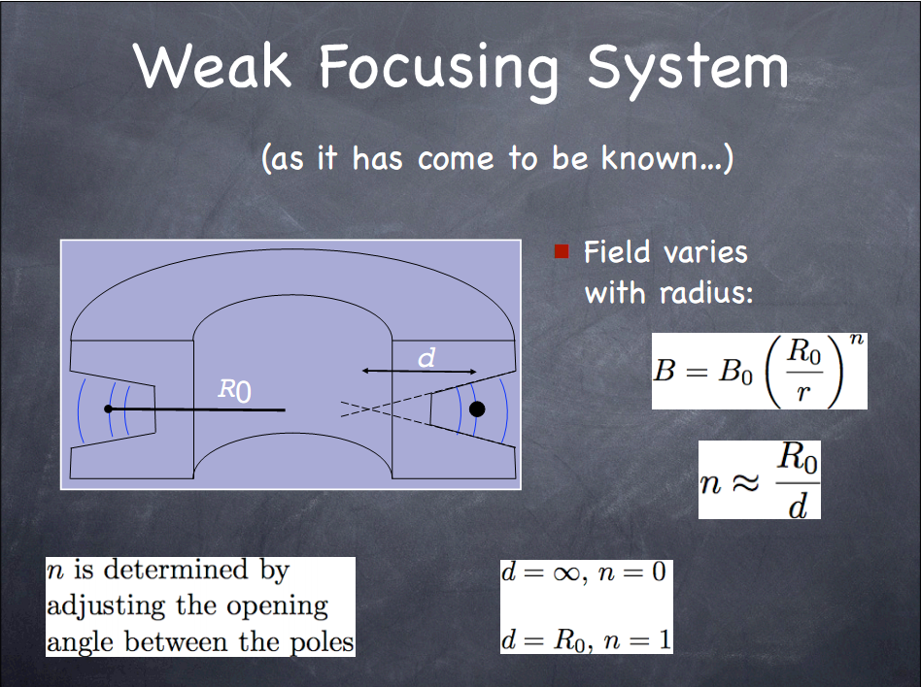
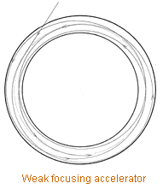
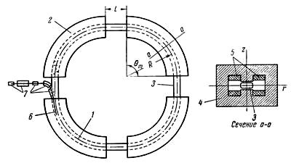

Slide 9
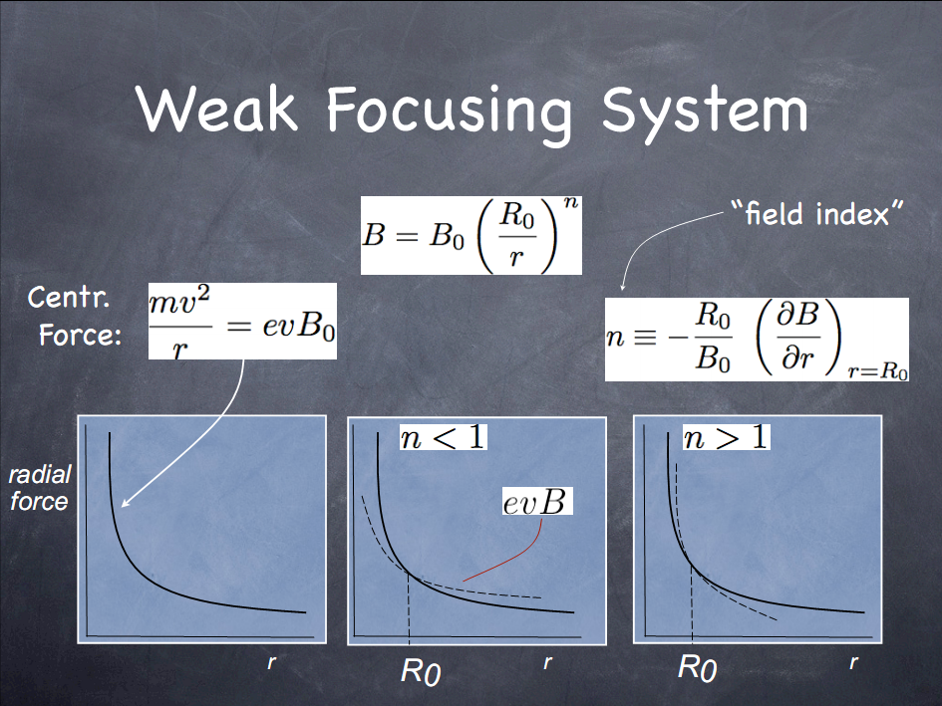

Slide 10
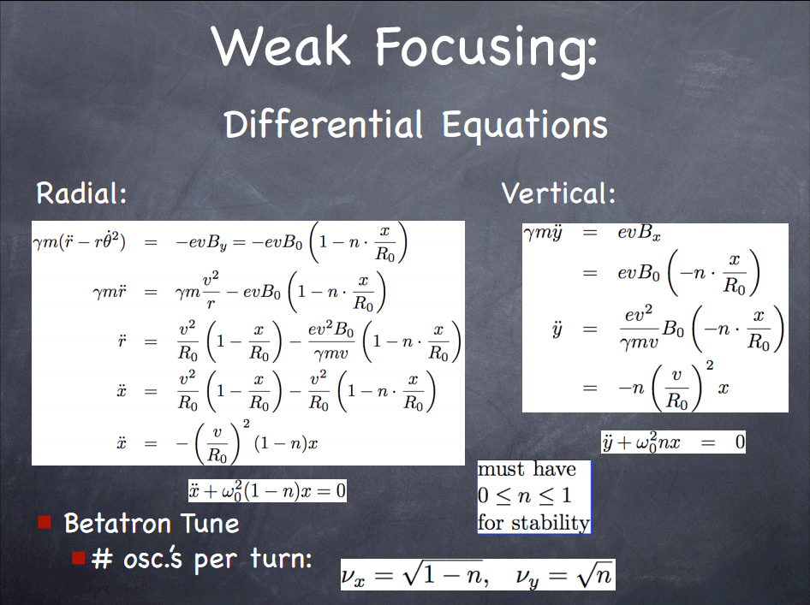
y
y
y

Slide 11
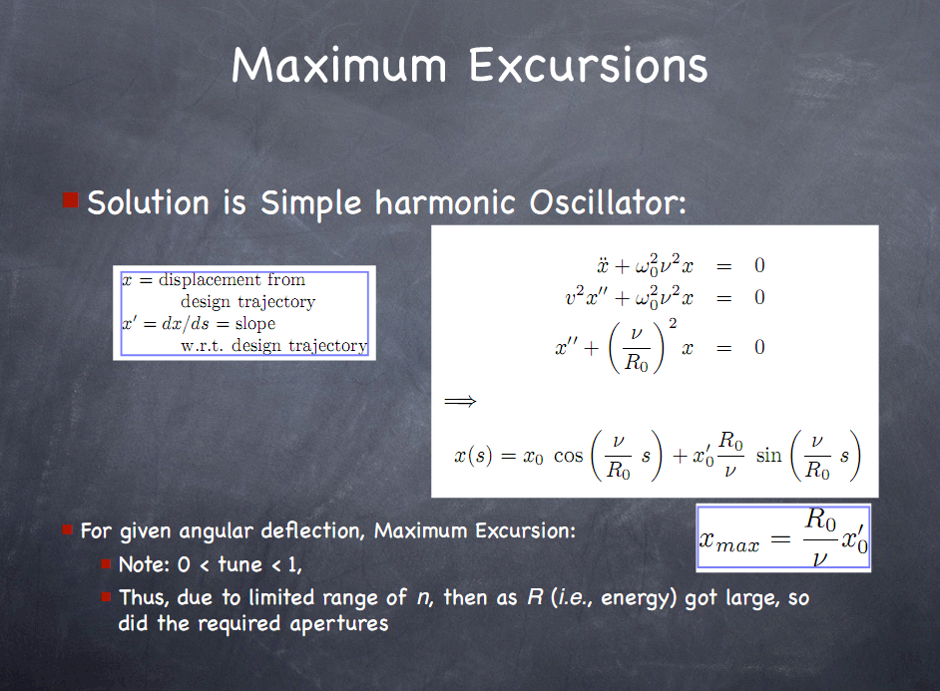

Slide 12



Weak focusing
Hamiltonian description
Action-angle variables
s – coordinate along the orbit (time equivalent)
-- are integrals of motion

Slide 13
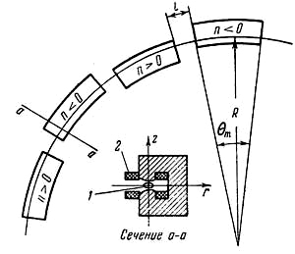
PS at CERN
In 1959 a 28-GeV Proton Synchrotron started to operate at CERN
  3 times longer than the Synchrophasatron but its magnets (together) are 10 times smaller (by weight)

Slide 14
Strong focusing (history)
Strong focusing or alternating-gradient focusing was first conceived by Christofilos in 1949 but not published , and was later independently invented in 1952 at BNL (Courant, Livingston, Snyder).
  they discovered that the frequency of the particle oscillations about the central orbit was higher, and the wavelengths were shorter than in the previous constant-gradient (weak) focusing magnets. The amplitude of particle oscillations about the central orbit was thus correspondingly smaller, and the magnets and the synchrotron vacuum chambers could be made smaller—a savings in cost and accelerator size.

Slide 15
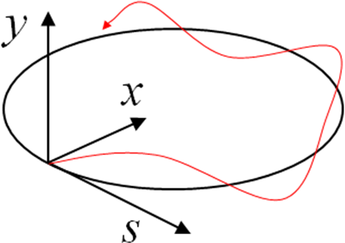
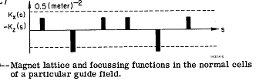
Strong focusing
Also applicable
to Linacs
-- piecewise constant
alternating-sign functions
s is “time”

Slide 16
Courant-Snyder Invariant
Equation of motion for
betatron oscillations
Courant and Snyder found a conserved quantity:
-- auxiliary (Ermakov)equation

Slide 17
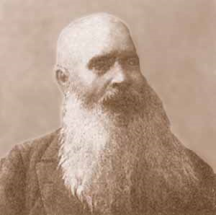
Vasily P. Ermakov (1845-1922)
Professor of Mathematics, Kiev university
“Second order diﬀerential equations: Conditions of complete integrability”, Universita Izvestia Kiev, Series III 9 (1880) 1–25.
Found a solution to the equation:
Ermakov invariant is what we now call Courant-Snyder invariant in accelerator physics

Slide 18
Normalized variables
Start with a time-dependent Hamilatonian:
Introduce new (canonical) variables:
-- new “time”
Time-independent Hamiltonian:
Thus, betatron oscillations are linear; all particles oscillate with the same frequency!
betatron tunes

Slide 19
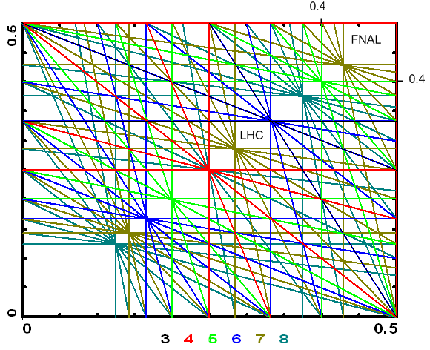
Resonances
The motion in accelerator is periodic in s (time).
  There are weak periodic kicks due to imperfections in magnets
  The linear betatron motion is unstable to such imperfections when
ν_{y}
ν_{x}

Slide 20
First synchrotrons
In late 1953 R. Wilson has constructed the first electron AG synchrotron at Cornell (by re-machining the pole pieces of a weakly-focusing synchrotron).
In 1955 CERN and BNL started construction of PS and AGS.
1954: ITEP (Moscow) decides to build a strong-focusing 7-GeV proton synchrotron.
  Yuri F. Orlov recalls: “In 1954 G. Budker gave several seminars there. At these seminars he predicted that the combination of a big betatron frequency with even a small nonlinearity would result in stochasticity of betatron oscillations. ”

Slide 21
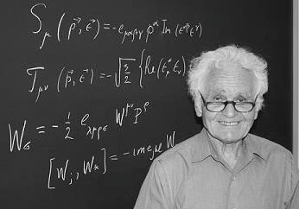
Yuri Orlov
Professor of Physics, Cornell
In 1954 he was asked to check Budker’s serious predictions.
He writes: “… I analyzed all reasonable linear and nonlinear resonances with tune-shifting nonlinearities and obtained well-defined areas of stability between and below resonances and the corresponding tolerances.”
Work published in 1955.

Slide 22
Concerns about resonances
So, at the time of AGS and CERN PS construction (1955-60) the danger of linear betatron oscillations were appreciated but not yet fully understood.
  Installed (~10) octupoles to “detune” particles from resonances. Octupoles were never used for this purpose.
Initial research on non-linear resonances (Chirikov, 1959) indicated that non-linear oscillations could remain stable under the influence of periodic external force perturbation:

Slide 23
Non-linear oscillator (example)
Cubic oscillator:
Such a system is insensitive to resonances!
We still do not know how to realize such a system in accelerators.
-- nonlinear integrable 2D Hamiltonian

Slide 24
Specific problem of particle accelerators
Focusing fields must satisfy Maxwell equations in vacuum
For stationary fields: focusing in one plane while defocusing in another
  quadrupole:
  Alternating “strong” focusing results in

Slide 25
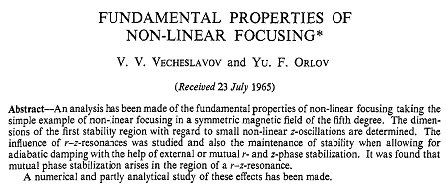
First non-linear accelerator proposals
In a series of reports 1962-65 Yuri Orlov has proposed to use non-linear focusing as an alternative to strong (linear) focusing.
  Final report (1965):

Slide 26
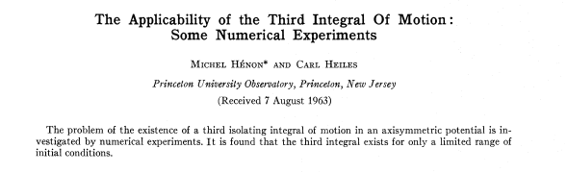
Henon-Heiles paper (1964)
First general paper on appearance of chaos in a 2-d Hamiltonian system.

Slide 27
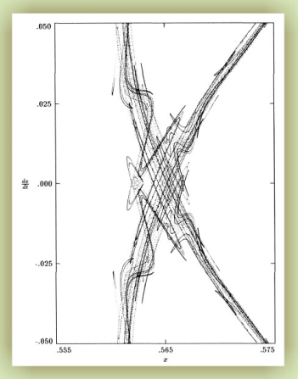
Henon-Heiles model
Considered a simple 2-d potential (linear focusing plus a sextupole):
There exists one conserved quantity (the total energy):
For energies E > 0.125 trajectories become chaotic
Same nature as Poincare’s “homoclinic tangle”

Slide 28
KAM theory
Deals with the time evolution of a conservative dynamical system under a small perturbation.
Developed by Kolmogorov, Arnold, Moser (1954-63).
Suppose one starts with an integrable 2-d Hamiltonian, eg.:
It has two conserved quantities (integrals of motion), E_{x} and E_{y} .
The KAM theory states that if the system is subjected to a weak nonlinear perturbation, some of periodic orbits survive, while others are destroyed. The ones that survive are those that have “sufficiently irrational” frequencies (this is known as the non-resonance condition). The KAM theory specifies quantitatively what level of perturbation can be applied for this to be true. An important consequence of the KAM theory is that for a large set of initial conditions the motion remains perpetually quasiperiodic.

Slide 29
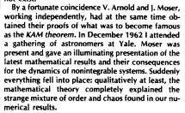
KAM theory
M. Henon writes (in 1988):
It explained the results Orlov obtained in 1955.
And it also explained why Orlov’s nonlinear focusing can not work.

Slide 30
KAM for Henon-Heiles potential
This potential can be viewed as resulting from adding a perturbation to the separable (integrable) harmonic potential. It is non-integrable.
All trajectories with total energies
are bound.
However, for E > 0.125 trajectories become chaotic.

Slide 31
E = 0.113, trajectory projections
x - p_{x}
y - p_{y}
x – y

Slide 32
E = 0.144, trajectory projections
x - p_{x}
y - p_{y}
x – y

Slide 33
Accelerators and KAM theory
Unlike Henon-Heiles potential, the nonlinearities in accelerators are not distributed uniformly around the ring. They are s-(time)-dependent and periodic (in rings)! … And non-integrable (in general).
Luckily, an ideal accelerator is an integrable system and small enough non-linearities still leave
enough tune space to operate it.
However, it was still not fully understood at the time of the first colliders (1960)…
octupole

Slide 34
Octupoles and sextupoles enter
1965, Priceton-Stanford CBX: First mention of an 8-pole magnet
  Observed vertical resistive wall instability
  With octupoles, increased beam current from ~5 mA to 500 mA
CERN PS: In 1959 had 10 octupoles; not used until 1968
  At 10¹² protons/pulse observed (1st time) head-tail instability. Octupoles helped.
  Once understood, chromaticity jump at transition was developed using sextupoles.
  More instabilities were discovered; helped by octupoles and by feedback.

Slide 35
Tune spread from an octupole potential
In a 1-D system:
Tune spread is unlimited
-----------------------------------------
In a 2-D system:
Tune spread (in both x and y) is limited to ~12%
1-D freq.

Slide 36
Tune spread from a single octupole in a linear latice
  Tune spread depends on a linear tune location
1-D system:
  Theoretical max. spread is 0.125
2-D system:
  Max. spread < 0.05
octupole

Slide 37
1 octupole in a linear 2-D lattice
Typical phase space portrait:
1. Regular orbits at small amplitudes
2. Resonant islands + chaos at larger amplitudes;
Are there “magic” nonlinearities that
create large spread and zero resonance strength?
The answer is – yes
(we call them “integrable”)

Slide 38
New approach
See: http://arxiv.org/abs/1003.0644
The new approach is based on using the time-independent potentials.
Start with a round axially-symmetric beam (FOFO)
V(x,y,s)
V(x,y,s)
V(x,y,s)
V(x,y,s)
V(x,y,s)

Slide 39
Special time-dependent potential
Let’s consider a Hamiltonian
where V(x,y,s) satisfies the Laplace equation in 2d:
In normalized variables we will have:
Where new “time” variable is

Slide 40
Three main ideas
Chose the potential to be time-independent in new variables
Element of periodicity
Find potentials U(x, y) with the second integral of motion

Slide 41
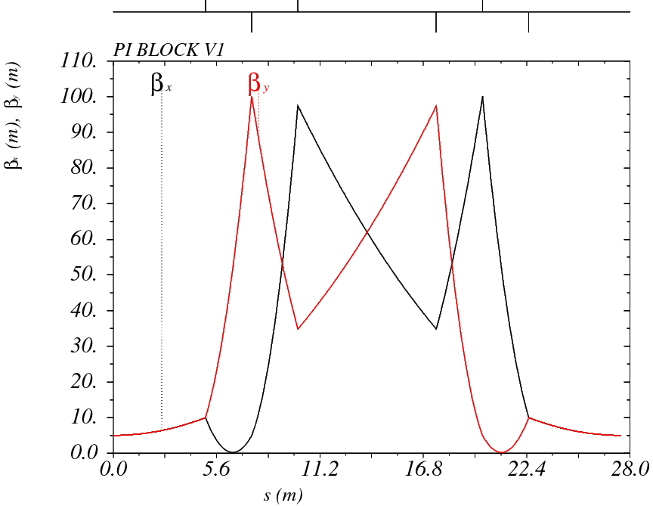
Test lattice (for an 8-GeV beam)
Six quadrupoles
provide a phase advance
of π
Linear tune: 0.5 – 1.0

Slide 42
Examples of time-independent
Hamiltonians
Quadrupole
quadrupole
amplitude
Tunes:
β(s)
Tune spread: zero
L

Slide 43
Examples of time-independent
Hamiltonians
This Hamiltonian is NOT integrable
Tune spread (in both x and y) is limited to ~12%
Octupole

Slide 44
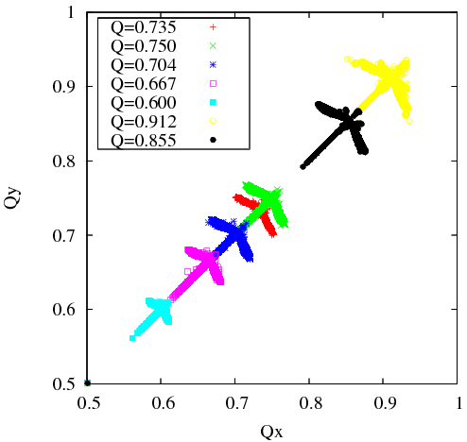
Tracking with octupoles
Tracking with a test lattice
10,000 particles for 10,000 turns
No lost particles.
50 octupoles in a 10-m long drift space
Courtesy of A. Valishev

Slide 45
Integrable 2-D Hamiltonians
Look for second integrals quadratic in momentum
  All such potentials are separable in some variables (cartesian, polar, elliptic, parabolic)
  First comprehensive study by Gaston Darboux (1901)
So, we are looking for integrable potentials such that
Second integral:

Slide 46
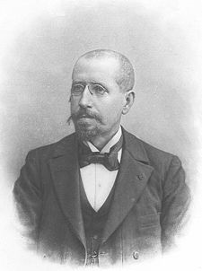
Darboux equation (1901)
Let a ≠ 0 and c ≠ 0, then we will take a = 1
General solution
ξ : [1, ∞], η : [-1, 1], f and g arbitrary functions

Slide 47
The second integral
The 2nd integral
Example:

Slide 48
Laplace equation
Now we look for potentials that also satisfy the Laplace equation (in addition to the Darboux equation):
We found a family with 4 free parameters (b, c, d, t):

Slide 49
The Hamiltonian
So, we found the integrable Laplace potentials…
→ 1 at x,y → ∞
→ 0 at x,y → ∞
→ ln(r) at x,y → ∞
c=1, d=1, b=t=0
c=1, b=1, d=t=0
c=1, t=1, d=b=0

Slide 50
The integrable Hamiltonian (elliptic coordinates)
Multipole expansion
U(x,y): c=1, t=1, d=0,
|k| < 0.5 to provide linear stability for small
amplitudes
Tune spread:
at small amplitudes
at large amplitudes
Max. ~100% in y and ~40% in x

Slide 51
Example of trajectories
25 nonlinear lenses in a drift space
Small amplitude trajectories
y
bare tune
x

Slide 52
Large amplitudes
bare tune
y
x

Slide 53
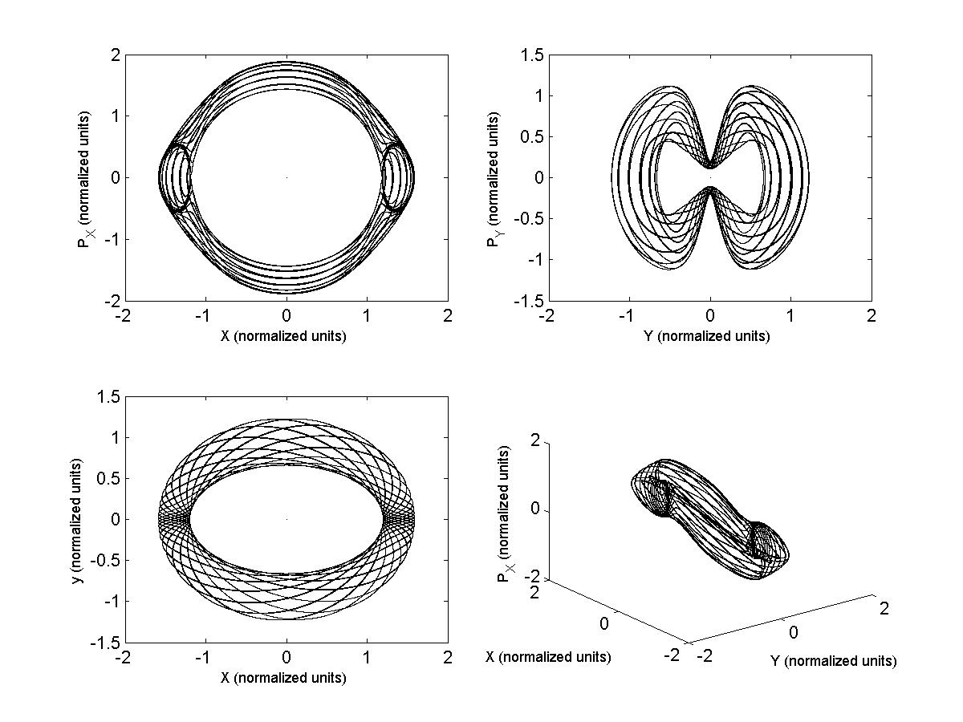
More examples of trajectories
c=1, d=1, b=t=0
Normalized coordinates:
Trajectory encircles the singularities (y=0, x=±1)

Slide 54
Polar coordinates
Let a ≠ 0 and c = 0

Slide 55
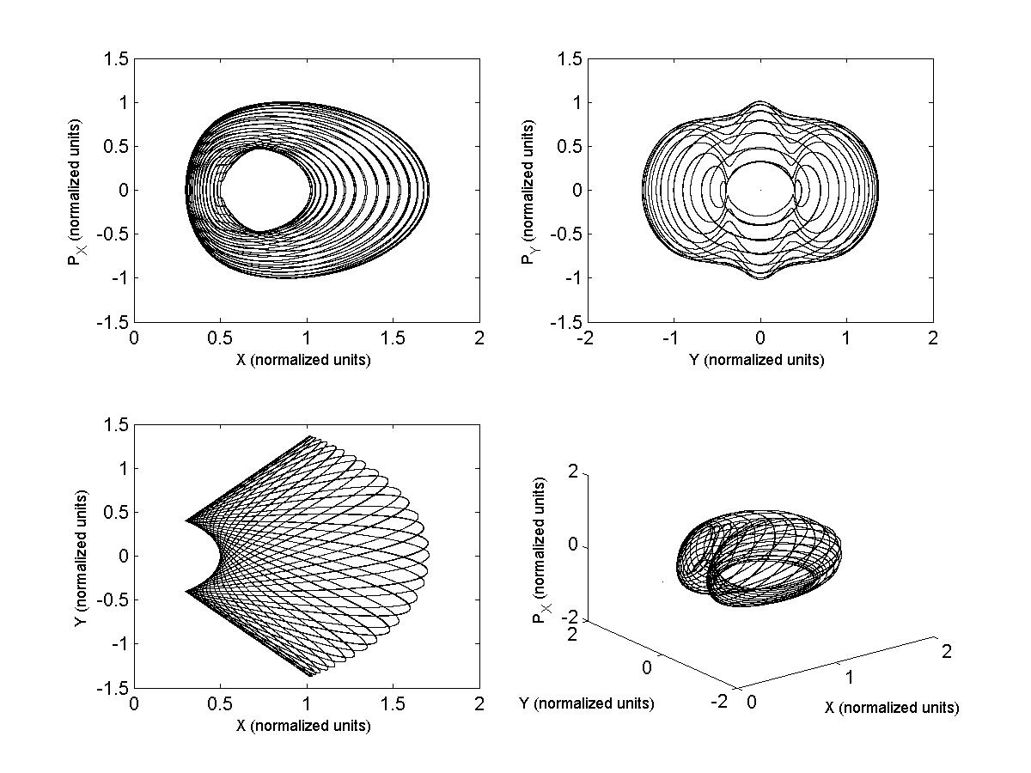
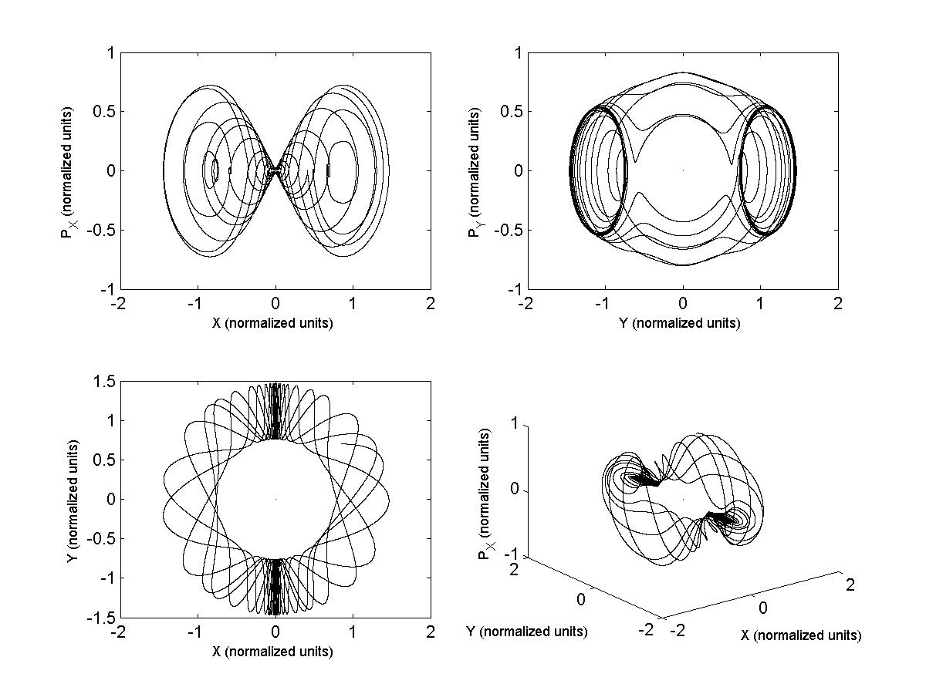
Two types of trajectories
d = -1, b = 0, and t = 0.1

Slide 56
Parabolic coordinates
a = 0
Not considered by Darboux (but considered by Landau)
Equation for potential:

Slide 57
Parabolic coordinates
Solution
The only parabolic solution is y² + 4x²
Potentials that satisfy the Laplace equation

Slide 58
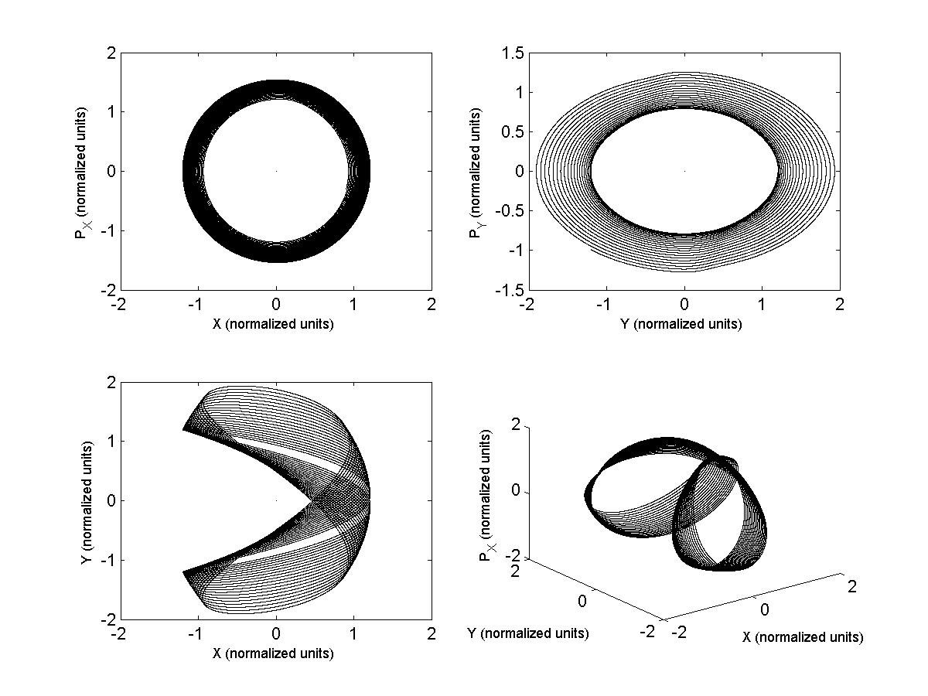
Example of trajectories
Trajectories never encircle the singularity

Slide 59
Summary
The lattice can be realized by both
and
Found nonlinear lattices (e.g. octupoles) with one integral of motion and no resonances that come from time-dependent force. Tune spread 5-10% possible.
Found first examples of completely integrable non-linear optics.
  Betatron tune spreads of 50% are possible.
  We used quadratic integrals but there are might be other functions.
Beyond integrable optics: possibly there exist realizable lattices with bound but ergodic trajectories

Slide 60
Conclusions
Nonlinear “integrable” accelerator optics has advanced to possible practical implementations
  Provides “infinite” Landau damping
  Potential to make an order of magnitude jump in beam brightness and intensity
Fermilab is in a good position to use of all these developments for next accelerator projects
  Rings or linacs
Could be retrofitted into existing machines

Slide 61
Extra slides

Slide 62
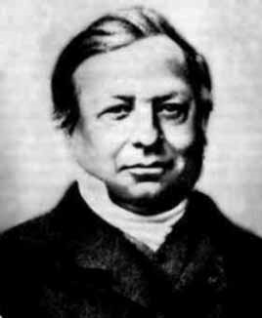
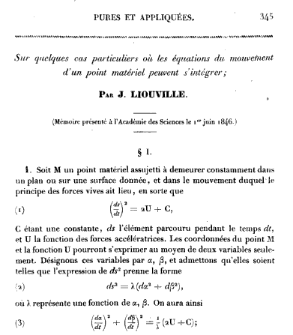

Joseph Liouville (1809-1882)
Liouville (1846) observed that if the Hamiltonian function admitted a special form
in some system of coordinates (u, v), the Hamiltonian system could be solved in quadratures. The form of the Hamiltonian function also implies additive separation of variables
for the associated Hamilton-Jacobi equation.

Slide 63
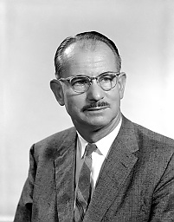
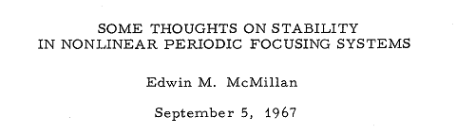
McMillan nonlinear optics
In 1967 E. McMillan published a paper
Final report in 1971. This is what later became known as the “McMillan mapping”:
If A = B = 0 one obtains the Courant-Snyder invariant

Slide 64
McMillan 1D mapping
At small x:
Linear matrix: Bare tune:
At large x:
Linear matrix: Tune: 0.25
Thus, a tune spread of 50-100% is
possible!
A=1, B = 0, C = 1, D = 2

Slide 65
What about 2D optics?
How to extend McMillan mapping into 2-D?
Danilov, Perevedentsev found two 2-D examples:
  Round beam: xp_{y} - yp_{x} = const
  Radial McMillan kick: r/(1 + r²) -- Can be realized with an “Electron lens” or in beam-beam head-on collisions
  Radial McMillan kick: r/(1 - r²) -- Can be realized with solenoids (may be useful for linacs)
In general, the problem is that the Laplace equation couples x and y fields of the non-linear thin lens

Slide 66
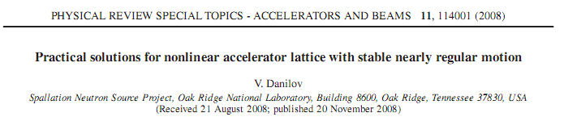
Danilov’s approximate solution
McMillan 1-D kick can be obtained by using
Then,
Make beam size small in one direction in the non-linear lens (by making large ratio of beta-functions)

Slide 67
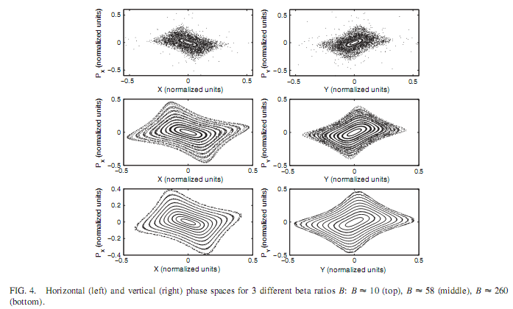
Danilov’s approximate solution
FODO lattice, 0.25,0.75 bare tunes
2 nonlinear, 4 linear lenses.
For beta ratio > 50,
nearly regular decoupled motion
Tune spread is around 30% .

