Slide 1
Electron Cloud
Measurements and Plans
Bob Zwaska
September 9, 2010
APC Seminar

Slide 2
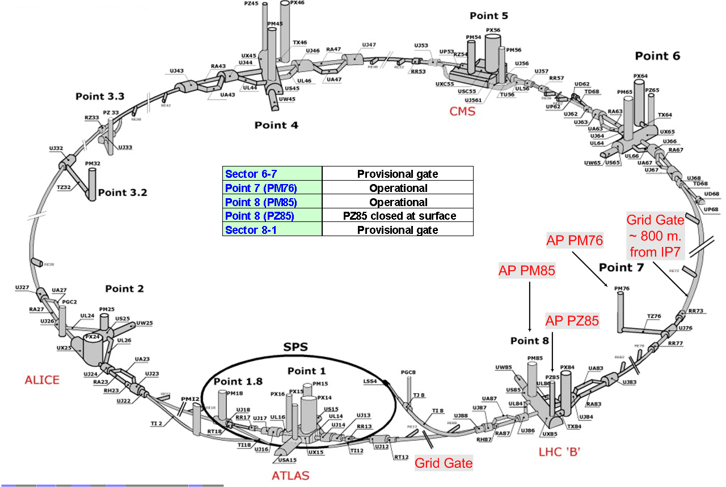

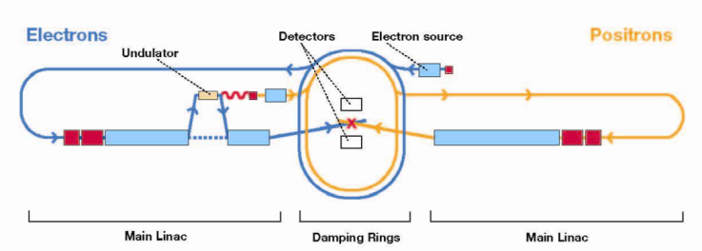
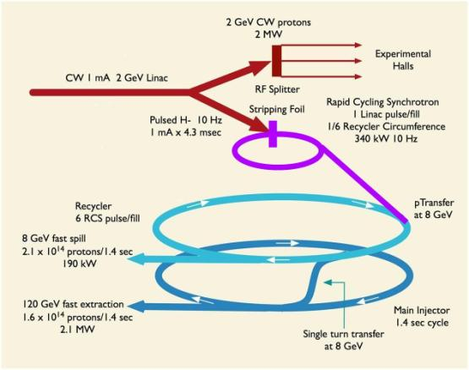
Introduction
New accelerators / brighter beams
  LHC/ILC/PrX
Collective effects scale strongly
  Space Charge, Impedance
  Electron Cloud
ECloud is a mostly new instability
  Doesn’t form at all for low-intensities
  No obvious signature in conventional beam instrumentation
  Generally, with any intense positive beam, a plasma of electrons can form within the vacuum vessel – degrading the performance

Slide 3
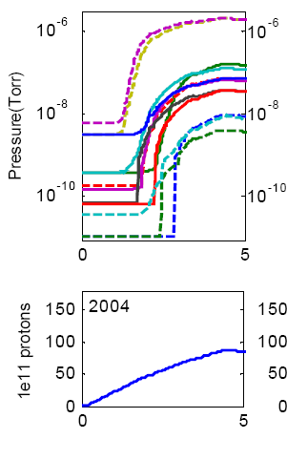
An Example: RHIC
Experienced substantial pressure rises as beam was injected
  Residual gas caused significant backgrounds in the detectors
  Sometimes even shut off the machine
Electron cloud was causing the rise
  Bombardment of vessel materials with electrons desorbed gas
Extensive effort to mitigate the cloud
  Replacement of beam pipes
  Beamline inserts
  Solenoids
Performance has improved, but the cloud was never completely excised
Time (Minutes)
Zhang et al. EPAC 2006

Slide 4
Electron Cloud Model at Fermilab
Considering the Main Injector beam
  1-8 ns long bunches every 19 ns
  1-5 mm transverse sigma
  Bunch intensities of ~10¹¹ protons
Produce a few initial/primary electrons
  Residual gas ionization
    O( e⁻ / m / torr / proton)
  Lost protons
    Can produce 100’s in beam pipe
Beam produces strong potential
  Nonadiabatic appearance
  Electrons Accelerate
Beam disappears
  Electrons collide with wall
  Produce more electrons through secondary emission
e⁻
e⁻
e⁻
+
e⁻
e⁻
e⁻
V
e⁻
~ kV
e⁻

Slide 5
Secondary Emission
Electrons produced upon collision with wall
  Conversion of energy to multiplicity
On average, 2 electrons produced per incident 400 eV electron on unconditioned MI pipe
  Over time, this number decreases
Secondary electron yield (SEY) depends on incident electron’s energy
Different materials and geometries can have different SEYs
Produced electrons have much lower energies, typically 1-10 eV

Slide 6
Secondary Electrons Reheated
Secondaries are reheated in the same way as the primaries
  Bunches must reappear before secondaries are reabsorbed
  Potential for exponential growth
Collective electron charge can increase heating effect
Eventually, electrons will screen the proton’s charge leading to a saturation density
  Peak electron linear density significant fraction of peak proton density
e⁻
e⁻
e⁻
+
e⁻
e⁻
e⁻
V
e⁻
few kV
e⁻

Slide 7
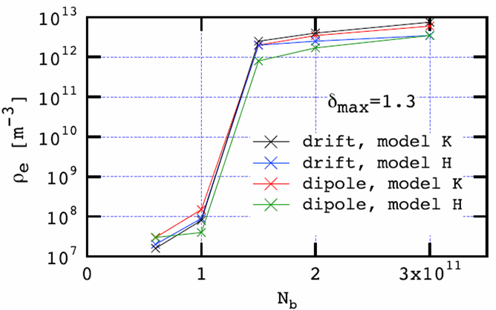
The Cloud at the Main Injector
Simulations suggest that MI might be near a threshold
  4-5 orders or magnitude increase of cloud density with a doubling of bunch intensity
Not yet established:
  How well the simulation pertains to Main Injector (question of SEY)
  What the effects of electron neutralization will be on the beam
There is an imperfect record for the correspondence of data and simulation
M. Furman (LBL) FERMILAB-PUB-05-258-AD
Bill Ng (FNAL)

Slide 8
Early Data - Threshold
Installed a single Argonne RFA in straight section
Large number of cycles sampled at maximum current
Clear turn-on at higher intensities
  Threshold at ~ 26e12 protons
  Threshold later moved higher
Allowed fitting of simulation to data, giving an SEY
  Furman’s results

Slide 9
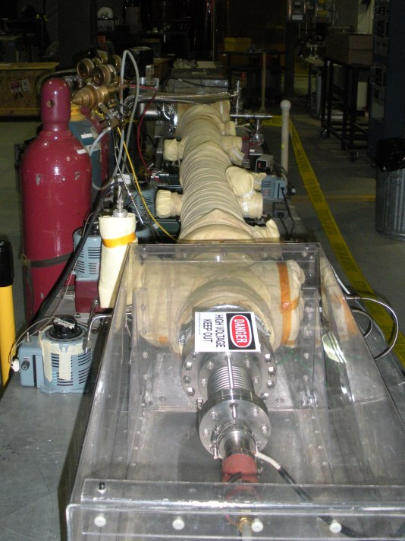
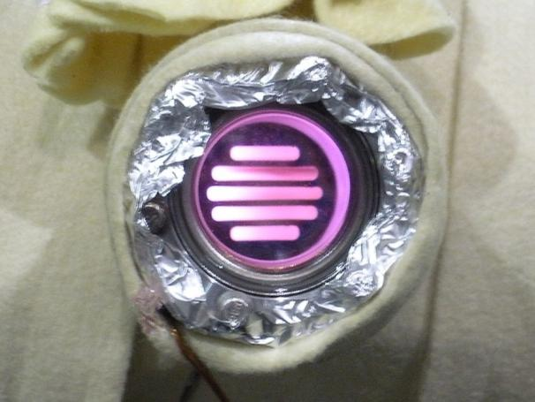
TiN Coating
TiN is a standard coating for Ecloud mitigation
  Lower SEY than stainless
  Good material properties
Coating of test chambers performed at BNL
Will need to adapt this procedure for in situ coating of 3000 m of Main Injector

Slide 10
Electron Cloud Experimental Upgrade - 2009
Major upgrade installed summer 2009
2 New experimental Chambers
  Identical 1 m SS sections, except that one is coated with TiN
4 RFAs (3 Fermilab & 1 Argonne)
3 microwave antennas and 2 absorbers
  Measure ECloud density by phase delay of microwaves
Primary Goal: validate TiN as a potential solution for Project X
Secondary Goals:
  Remeasure threshold and conditioning
  Further investigate energy-dependence
  Measure energy spectrum of electrons
  Test new instrumentation
  Directly compare RFA and Microwave
  Measure spatial extinction of ECloud
TiN Coated Chamber
Fermilab RFAs
Uncoated Chamber
E:CLOUD3
E:CLOUD1
E:CLOUD2
Beam
E:CLOUD4
Microwave Antennas
Argonne RFA
Microwave Absorbers

Slide 11
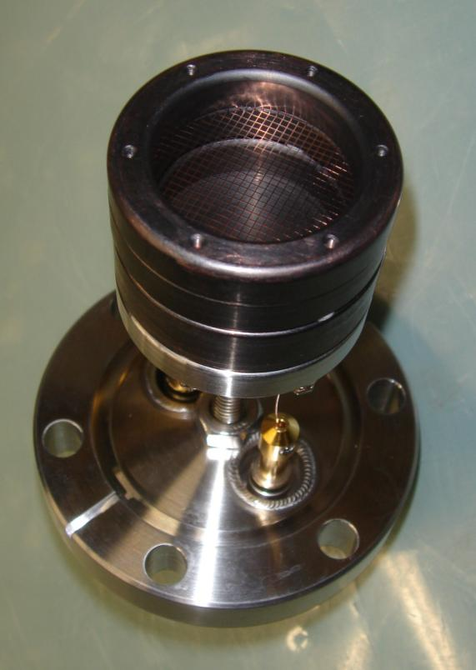
Electron Detectors
Retarding field analyzers
  Collect electron flux on chamber wall
  Electric field can filter out low-energy electrons
  Based on Argonne design
Maximize signal with enlarged area and by removing ground grid
  Ground is provided by the beam pipe
Shaping of electrodes optimizes energy filter performance
  Also, more hermetic
Amplifier/filter in tunnel
  Better-quality cables to surface

Slide 12
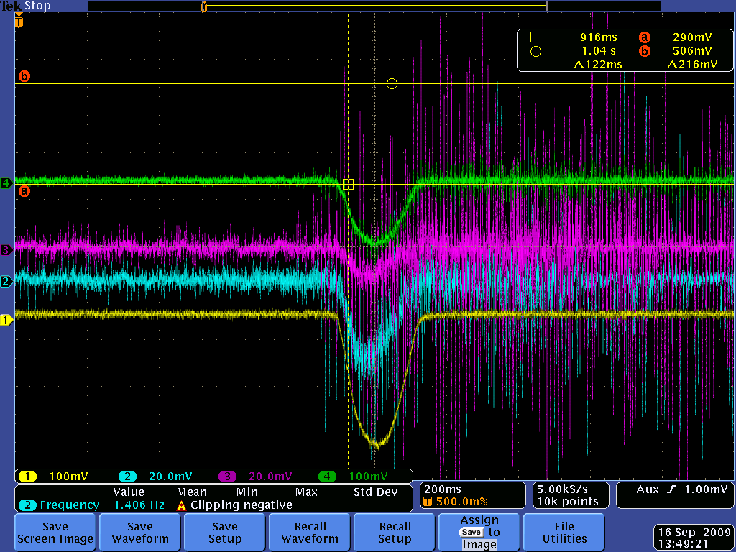
Early Data - 9/16/09: 12e12 on 6-batch
Uncoated (FNAL): 280 nA
Uncoated (ANL): 110 nA
Coated (5”): 25 nA
Coated (mid): 15 nA
FNAL/ANL ≈ 2.5
TiN Uncoated/Coated ≈ 18
Ratio may seem unremarkable, but it entirely depends on where you are with respect to a transition
MI Cycle

Slide 13
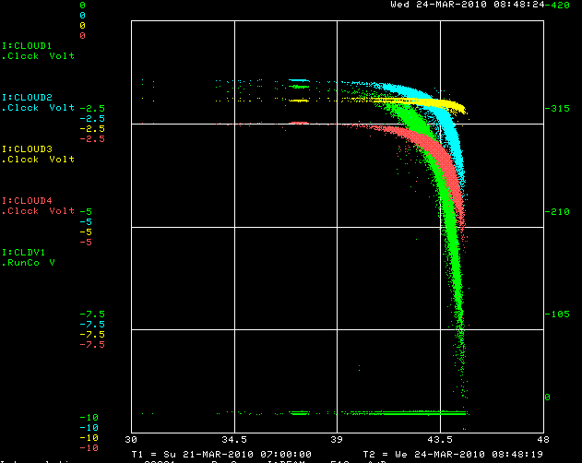
By datalogging our signals at a time that will give us a sample of the maximum signal achieved, and then plotting the data vs beam intensity we can see how the signal changes with an increase in beam intensity.

Slide 14
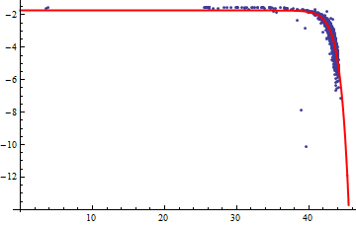
Threshold Measurement
Many cycles are sampled individually
  Data over 1 week shown here
  Cloud current compared to beam intensity
Strong threshold is found
  Fit to empirical formula
  Threshold evolution is monitored
Amplifier Current
Beam Intensity (e12)

Slide 15
Evolution of thresholds
Uncoated
Coated

Slide 16
Carbon Pipe
CERN is very interested in amorphous carbon
  See it as superior to TiN in not requiring as much conditioning
They built a chamber for us in short order and we installed it in MI this summer
Some early results here

Slide 17
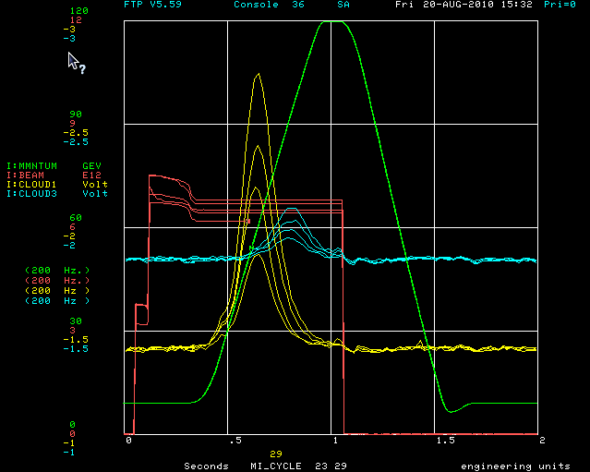
Early Carbon Measurements
Less signal on Carbon (x6)
Temporal shift is similar to before

Slide 18
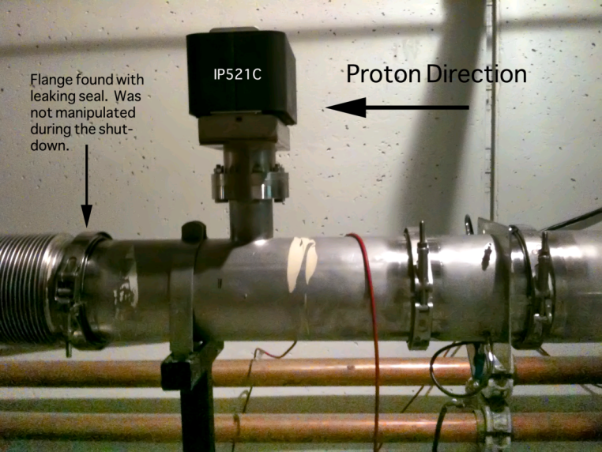
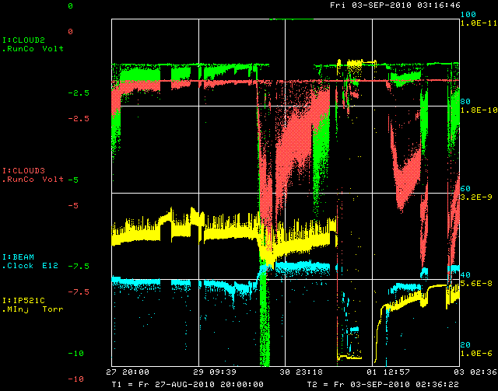
Vacuum
Vacuum leak started to effect measurements
Complicated correlation with Vacuum
  Reset material
  Still being understood

Slide 19
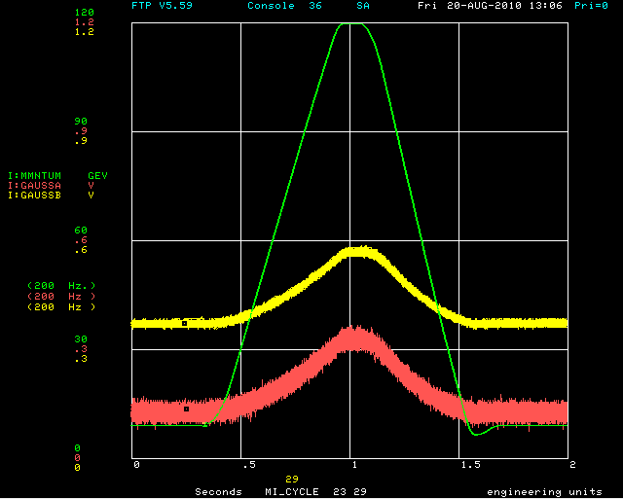
Magnetic Fields
Time-dependent field of ~ 3 Ga
  Static fields ~ 1 Ga

Slide 20
SEY Measurement
Developed SEY measurement station with Cornell
  Allows in situ measurement of SEY on samples
Place sample “buttons” of materials as portion of beampipe circumference
  Beampipe made of standard materials – for us: Stainless 416L
Directly measure the SEY of the sample
  SLAC did this by removing the button and testing in a surface physics lab
  At Cornell, it has been modified for in situ measurement
Will allow comparison between conditioning in electron/positron ring, and our proton ring
Other considerations:
  Change pieces without breaking vacuum
  Monitor electron flux
  Differential scrubbing can be factored out

Slide 21
In Situ SEY TestStand
Test Position
Isolation Valve
Linear Motion in vacuum
Sample
Electrical isolation
Electron Gun

Slide 22
Outlook
TiN and Carbon have been tested with present MI intensities
  TiN shows good conditioning over time with no obvious limit
    Better than SS
  Carbon, so far, appears similar to TiN
  Measurements will be refined and continued
SEY Test Stand built with Cornell
  Will be here at Fermilab this year and tested in lab
  Plan to install in MI next year
Need to be confident in an approach for Project X
  TiN appears to be an adequate approach
    But, it is still rather expensive
    Dipoles? Quads? Drifts? Recycler? RCS?
  Simulations are needed
    Too complicated for an analytical model
    Don’t fully understand buildup or beam effects

Slide 23
Electron Cloud
Measurements and Plans
Bob Zwaska
September 9, 2010
APC Seminar

Slide 24
Simple Model of Threshold
Electrons mostly start nearly at rest, near the beam pipe
Beam gives impulse to electrons
  Characteristic energy with characteristic SEY
At saturation SEY must be ~ 1
  No change in density
  Primary forcing is a much smaller effect at saturation
  Obviously, there may be multiple absorptions, so effective SEY curve may be lower
Electron cloud must screen beam impulse so that electron energy corresponds to SEY = 1
Threshold occurs when the characteristic SEY = 1
  Electron density increases rapidly above that to a sizeable fraction of proton density
I can come up with parameterizations that roughly match our thresholds, but more guidance from simulation would be nice

Slide 25
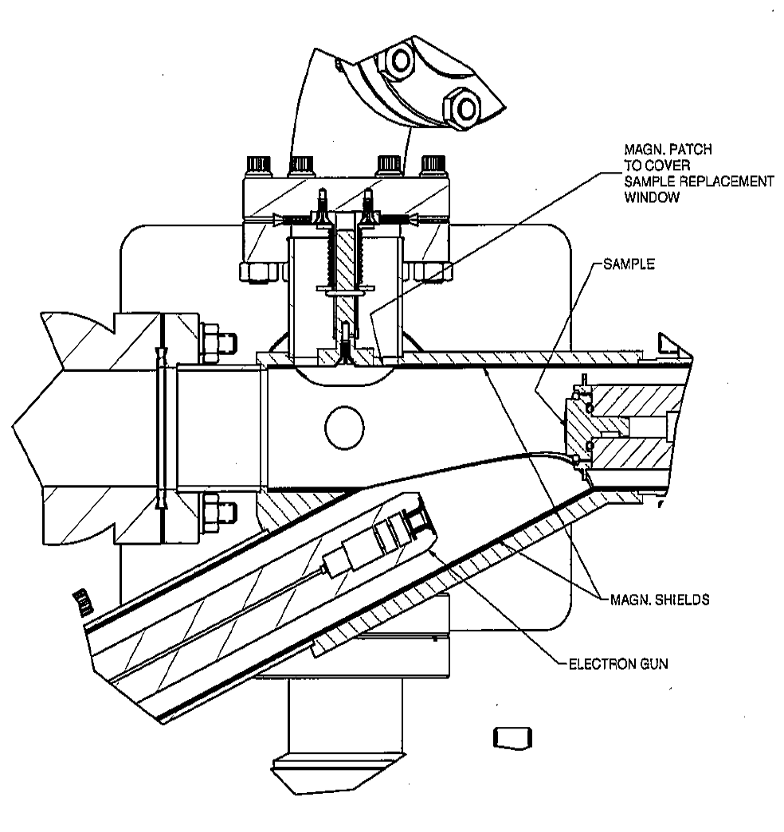
SEY Measurement
Sample is withdrawn from beampipe
Sample holder is electrically isolated from ground
  Attached to picoammeter
  Biased at -20 V to repel secondaries
Gun is permanently installed in setup
Power supply brought in for measurements
LabView controls the gun through the SEY scan
  Can include rastering across surface
  Picoammeter read out simultaneously
Scan should take ~ 30 minutes
  Still being optimized, could be longer or shorter
  Need to understand gun cathode heating time

Slide 26
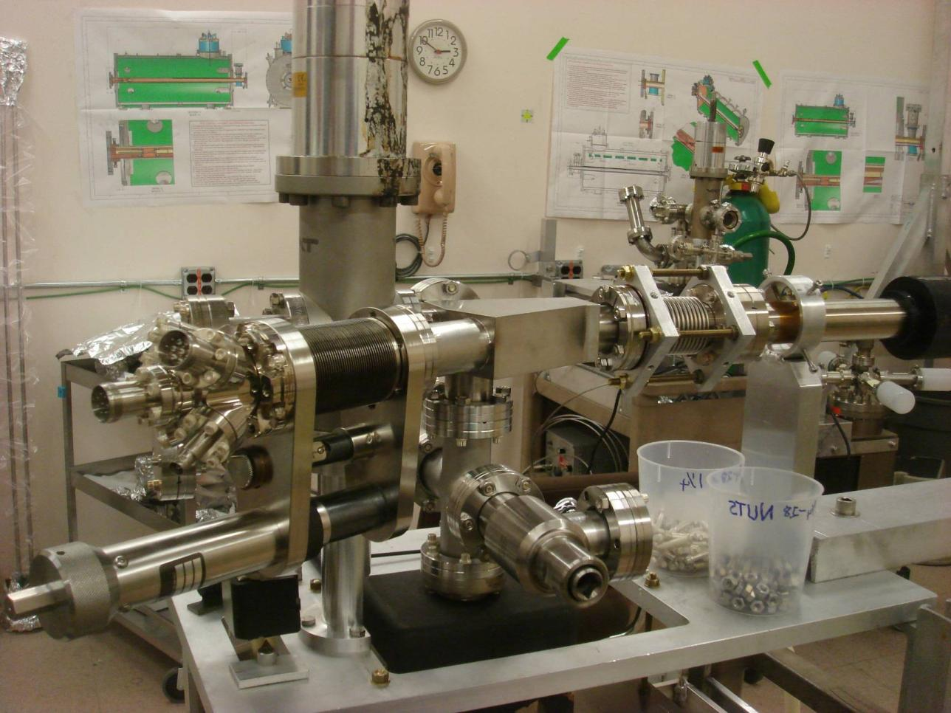
Prototype Pictures

Slide 27
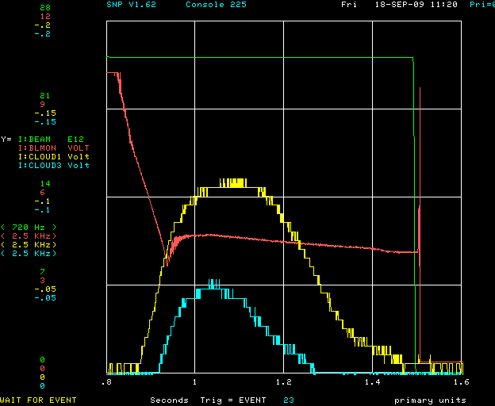
Example: Strong Signal
Unamplified signals
  Overloaded amplifier
Ratio is only ~ 2
  Uncoated / coated
Ratio changes with time, intensity
At the end of the run, we would see a small amount of cloud on the uncoated
  No cloud on the coated
  Infinite ratio

