Slide 1
Multilepton SUSY Search with 35 pb⁻¹ 2010 Data Richard Gray on behalf of the CMS Collaboration
SUSY11

Slide 2
Outline for today
Introduction
2010 35 pb⁻¹ analysis. Submitted to PRL
CMS public document.: SUS-10-008
SUSY Searches with Leptons and Jets or MET
Multi-Leptons ( ≥3 Leptons)
Conclusions.

Slide 3
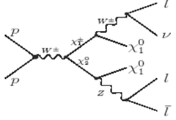
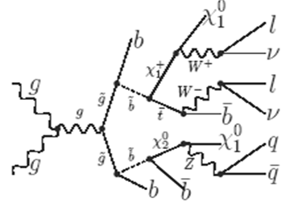
Multilepton SUSY Decays
Tevatron
Leptons produced at the end of a chain of susy decays.
Strongly coupled squarks and gluinos are generated in the proton collisions.
Some combination of charginos, neutralinos, and sleptons decay to leptons and LSP (dark matter)
Final state is ≥3 leptons with some combination of jets and MET
LHC

Slide 4
Searching for SUSY with Multi-Leptons
Isolated Leptons (not from jet) are rare.
SM events with ≥3 leptons are very rare!
Leptons isolated from jets come from gauge bosons γ*/Z⁰/ W±
Allow less stringent cuts on MET or Jets than other searches.
Many SUSY scenarios produce ≥3 leptons.
Also large hadronic energy, MET or both.
Reduce backgrounds with two variables:
MET: Missing transverse energy (neutrinos or LSP)
HT : Σ p_{T}(jet) with p_{T} > 40 GeV, |η|<2.4
Note: ≥3 leptons allow looser cuts on MET/H_{T} than ≥2
≥3 Leptons
(jets + MET )
e/μ/τ
e/μ/τ
Jet
e/μ/τ
MET

Slide 5
Background reduction variables
Even after requiring 3 or more leptons, there are still some SM backgrounds. These can be removed by cutting on missing transverse energy or H_{T} .
H_{T} is the total jet E_{T} for jets with E_{T}> 30 GeV

Slide 6
Background reduction variables
Beware, models vary. Not all of them have large H_{T,} not all have MET
Example:
slepton co-NLSP
scenario
m(q)=500

Slide 7
Event selection
Include 3 and ≥4 lepton combinations with ≤2 τ’s
Use single e and single μ Triggers
Veto events where M(l+l-) < 12 GeV ( J/ψ, Upsilon,Drell Yan)
Require ≥1 μ with pt > 15 GeV or ≥1 e with pt > 20 GeV
Divide remaining events into 5 bins defined by background reducing variables.
H_{T}>200 GeV
MET>50 GeV
75 GeV <M(l⁺l⁻)<105 GeV
Channels with Z’s or low MET and low HT are used to test background predictions.
MET (GeV)
×[Z, no Z]
50
×[Z, no Z]
200
H_{T} (GeV)

Slide 8
Lepton Selection (e, μ, τ)
Electrons and Muons:
p_{T} > 8 GeV, |η| < 2.1
Identification:
Electrons ~90-95% efficient for pT > 20 GeV
HoverE, track shower match, shower shape.
Muons ~95% efficient for pT
Minimum ionizing and good match between tracker and muon detectors.
Tau Leptons:
Tau are unstable and decay
Leptonic decays fall under e/μ
Single prong, no π^{ο}
Isolated track
Single Prong with π⁰ and 3 prong
“Shrinking Cone” algorithm (skinny jet)
Visible p_{T} > 8 GeV, |η| < 2.1
35%
11.61%
36.54%
15.19%

Slide 9
Removing Leptons from Jets
Isolated from jets.
Sum transverse energy in cone around lepton from tracks.
Require energy in cone to be small compared to the lepton.
Not displaced from collision.
Leptons from jets can start farther from interaction vertex
Require lepton to have small “impact parameter”

Slide 10
Background Predictions
Some are directly from Monte Carlo (MC)
Irreducible backgrounds: WZ+Jets, ZZ+Jets
Corrected to match efficiency measurements.
Small cross sections.
Some are from MC with Data Controls or Scale Factors
Including TTbar and FSR from dileptons
Correct MC to match efficiency measurements
The rest are completely “Data Driven”
Z+Jets, WW+Jets, W+Jets, QCD
No MC required.

Slide 11
TTbar Background
Obtained from Monte Carlo but validated in control data.
Compare MC to relevant distributions in data dominated by TTbar.
Compare non-isolated tracks in e⁺μ⁻ events (multiple entry)
Look at large and small impact parameter
Related to # of fake leptons, # of b-jets
e⁺μ⁻: p_{t} of Tracks with |d_{xy}(BS)| < 0.02 cm
e⁺μ⁻: p_{t} of Tracks with |d_{xy}(BS)| > 0.02 cm

Slide 12
Data Driven Background Predictions
Number e/μ from jets proportional to number k/π from jets.
Count isolated tracks to imply number of leptons from jets.
Determine conversion factor in di-jet data.
Use impact parameter distribution of tracks to understand systematic.
Use isolation side band for fake Tau background.
Use di-jet data to parameterize conversion factor.
Use region beyond sideband to understand systematic.

Slide 13
Data Driven Predictions
Use 2L data as a seed to predict ≥3L background
Example: 2e(SS) to predict 2e(SS)μ background
Apply background estimation procedures to seeds.
Predict e or μ from jet using isolated track (~40% systematic)
Predict fake Tau using isolation side band. (~30% systematic)
2μ_{Iso}
μ_{Iso}e_{Iso}
2e_{Iso}
2μ1T
3μ
2μ1e
1e1μ1Tau
2e1μ
3e
2e1Tau

Slide 14
Background Tests
μ⁺μ⁻μ± (MET < 50 GeV, H_{T} <200 GeV, with Z candidate)
μ⁺μ⁻e± (MET < 50 GeV, H_{T}<200 GeV, with Z Candidate)
μ⁺μ⁻T± (MET < 50 GeV, H_{T}<200 GeV, with Z Candidate)
Obs | SM Total | Data Driven | TTbar | WZ(ZZ)+Jets | FSR
2 | 1.8±0.3 | 1.1 | 0.01 | 0.7 | 0
Obs | SM Total | Data Driven | TTbar | WZ(ZZ)+Jets | FSR
2 | 1.4 ± 1.1 | 0.7 | 0.005 | 0.5 | 0.2
Obs | SM Total | Data Driven | TTbar | WZ(ZZ)+Jets | FSR
43 | 56 ± 12 | 55.8 | 0.02 | 0.25 | 0.3

Slide 15
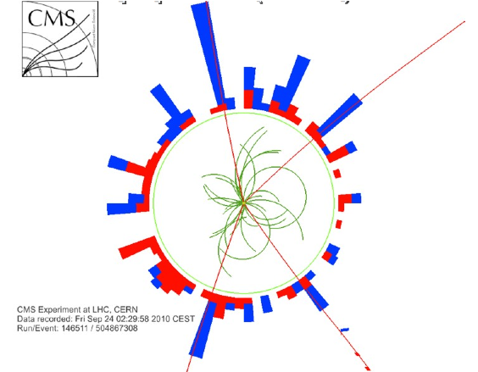
Observations and Backgrounds
Before MET cut | After MET cut
Observed and Predicted are Consistent
Famous ZZ(4μ) event here
(over 5,000 views on YouTube)
First saw it Sunday 10/10/2010

Slide 16
Multi-Lepton Summary Table
No statistically significant deviation from the standard Model.

Slide 17
95% Excluded Scenarios cMSSM tan(β)=3
cMSSM
Popular scenario that reduces SUSY parameters down to 5.
M0, M1/2, a0, sign(μ), tan(β)
Standard to compare experiments, but not realistic model.
Mass scenarios below solid black line are now excluded.

Slide 18
95% Excluded Scenarios (Other Signatures )
cMSSM
Mass scenarios below solid red line are now excluded.
So Why are we doing multileptons?
SUSY Scenario Examples | ≥3L | ≥2 Jets, 0 L, MET>200
Slepton co-NLSP | ~100% | 0%
Leptonic R-parity violating | ~100% | 0%
mSUGRA (Mo=60, M1/2=190) | ~23% | 11.4%
mSUGRA (Mo=200, M1/2=250) | ~1.8% | 35%
cMSSM isn’t friendly to multileptons, but other scenarios are.

Slide 19
95% Excluded Scenarios (Multi-Leptons)
Slepton co-NLSP
Sleptons have ~ the same mass, and are closest to the lightest SUSY particle which happens to be a gravitino.
At least 4 leptons produced per event.
Mass scenarios below solid line are now excluded.
Tevatron only excluded gluino mass < 400 GeV

Slide 20
95% Excluded Scenarios (Multi-Leptons)
R-parity violation
R-parity is conserved in most SUSY scenarios. But it might be violated.
If violated leptonically, can be 4 or more leptons produced per event.
Two curves for two different scenariois.
λ123 contains 2L+2Tau
λ122 contain no Tau.
Mass scenarios below solid line are now excluded.

Slide 21
Conclusions
Presented SUSY in multi-leptons with 35 pb⁻¹ 2010 CMS data.
Use combination of MC and data-driven SM background predictions
Make use of control objects to understand/control fake rate systematics.
Results consistent with the standard model.
Set new limits on slepton co-NLSP topology and R-Parity violating SUSY.
The 35 pb⁻¹ data consistent with the SM, and constrained the range of many SUSY possibilities beyond the reach of the Tevatron.
More data is here 2 fb⁻¹!!! The search continues.

