Slide 1
Indirect Searches for New Physics in Rare Kaon Decays
Francesca Bucci (INFN, Sezione di Firenze)
on behalf of the NA62 Collaboration
SUSY 2011
August 28 - September 02, 2011

Slide 2
Introduction
Precise measurements of FCNC processes in the B sector have severely restricted the parameter space of new-physics models
Experiments at the LHC have started a direct exploration of the physics in the TeV range
In this scenario, rare kaon decays are an outstanding opportunity to search for NP effects complementary to the high energy frontier and to the precision B physics

Slide 3
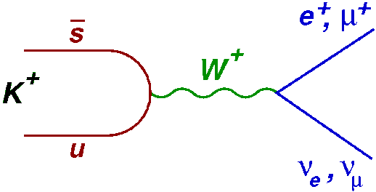
R_{K}=Γ(K→eν)/Γ(K→μν) in the SM
The decay K→eν is helicity suppressed
In the ratio R_{K} =Γ(K→eν/ K→μν) hadronic uncertainties cancel
The SM prediction of R_{K} has reached <0.1% precision
δR_{K} is the correction due to the Inner Bremsstrahlung part of the radiative K →eνγ process
[V. Cirigliano and I. Rosell Phys. Rev. Lett. 99 (2007) 231801]

Slide 4
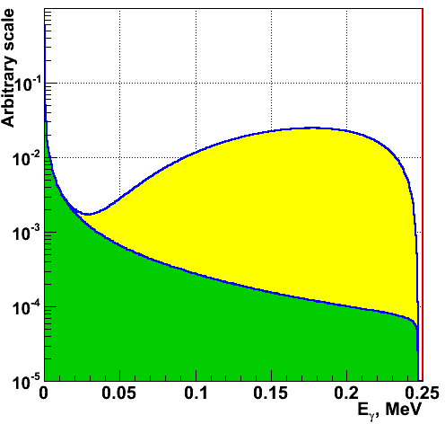
Radiative K→eν γ Decays
In K→eν γ (K_{e2γ}), γ can be produced via internal bremsstrahlung (IB) or direct-emission (SD)
By definition R_{K} is inclusive of IB radiation only
IB
γ
SD
γ
e±
e±
K±
K±
ν_{e}
ν_{e}
a.u.
SD
IB
E_{γ}^{CM} (GeV)

Slide 5
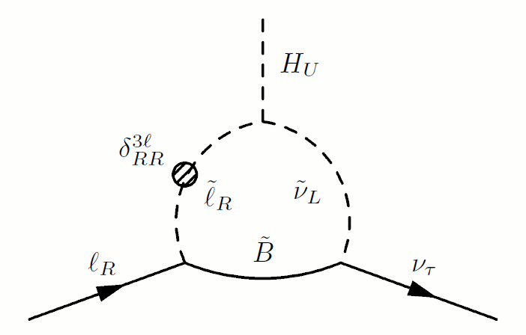
R_{K} beyond the SM
In MSSM, sizable sources of flavour violation in the lepton sector (Δ₁₃~10⁻⁴) can induce deviation from R_{K}SM at % level (e.g. tanβ=40, m_{H}=500 GeV/c²)
[A. Masiero, P. Paradisi, R. Petronzio Phys. Rev. D74 (2006) 011701]
u_{L}
s_{R}
Δ₁₃
Larger effects foreseen in B decays due to (m_{B}/m_{K})⁴~10⁴ but experimentally challenging

Slide 6
The NA62 experiment
A fixed target experiment at the CERN SPS
The SPS is needed as LHC proton
injector only part-time
For the remainder of the time it
can provide 400 GeV/c protons for
fixed target and neutrino experiments
NA48 NA62
Experience, infrastructures and (some) detectors from NA48 to NA62

Slide 7
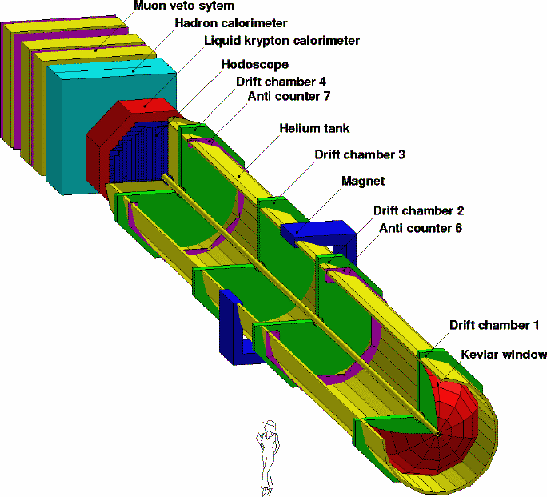
NA62-R_{K} Detector (inherited by NA48/2) and Data Taking
Magnetic spectrometer:
σ_{p}/p = (0.48 ⊕ 0.009 p)% (p in GeV/c)
Hodoscope:
Fast trigger for charged particle
and timing for the event (σ_{t}~ 150ps)
LKr electromagnetic calorimeter:
σ_{E}/E = (3.2/√E ⊕ 9.0/E ⊕ 0.42)% (E in GeV)
σ_{x} =σ_{y} ~ 1.5mm for E=10 GeV
NA62 data taking :
Four months in 2007 (mostly K⁺ only)
Two weeks in 2008 (special dataset for systematics uncertainties study)

Slide 8
R_{K} Measurement Strategy
K±→e±ν (K_{e2}), K±→μ±ν (K_{μ2}) collected simultaneously:
  No dependence on K flux
  Cancellation of several effects at first order
Analysis performed in bins of the reconstructed lepton momentum
# background events
acceptance
LKr trigger efficiency
downscaling factor of K_{μ2}
# signal events
measured PID efficiency
LKr readout efficiency
Notes:
Modificare i segni

Slide 9
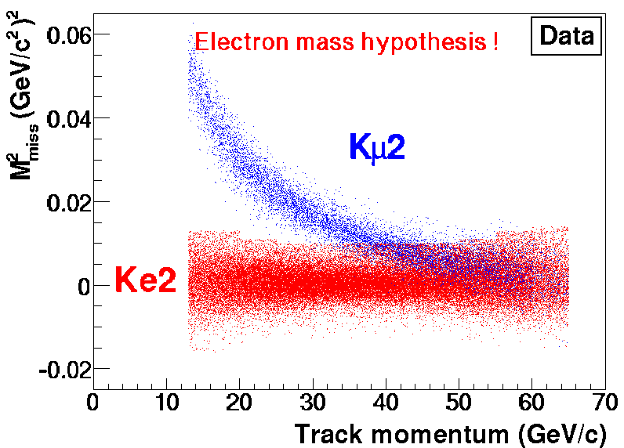
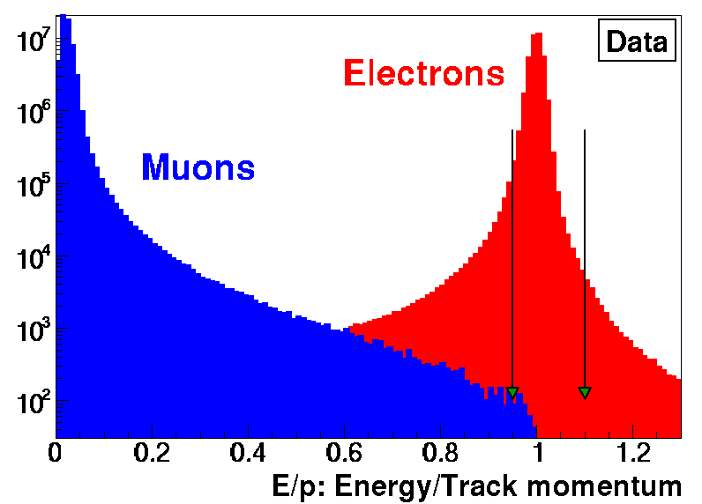
K_{e2} and K_{μ2} Selection
Geometry
  One reconstructed charged track
  13 < p < 65 [GeV/c]
  Geometrical acceptance cut
  Cut on K decay vertex position
  Photon veto using LKr
Kinematics
  Missing mass: M_{miss}²(l)=(P_{K}-P_{l})²
  -M₁²<M_{miss}²(l)< M₂²
Particle ID (E_{LKR}/p_{spectr})
  e ((E/p)_{min} < E/p < 1.1)
  μ (E/p < 0.85)

Slide 10
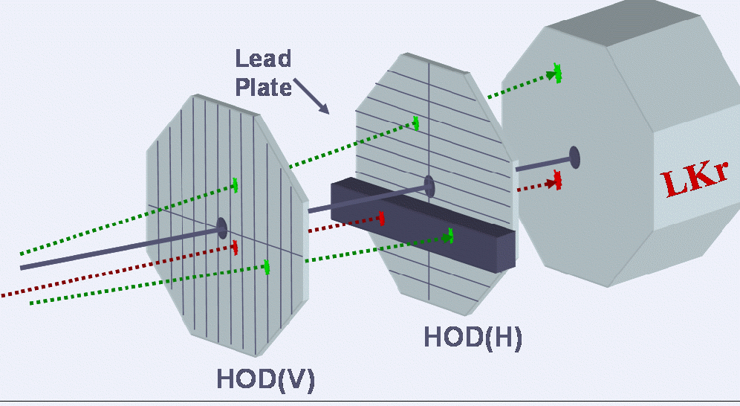
Background to K_{e2}
K_{μ2} decay is the largest background source
Catastrophic energy loss in or in front of the LKr
P_{μe}=P (μ→e) ~ 3×10⁻⁶⇒ P_{μe}/R_{K} ~ 10%
μ±→e±νν decays before the first DCH
(suppressed by muon polarization effects)
Need direct measurement of P_{μe}
To avoid electron contamination from muon decay (~10⁻⁴) a 9.2 X₀ thick lead wall covering 18% of the acceptance was installed between the HOD planes
μ
e
Notes:
Modificare i segni

Slide 11
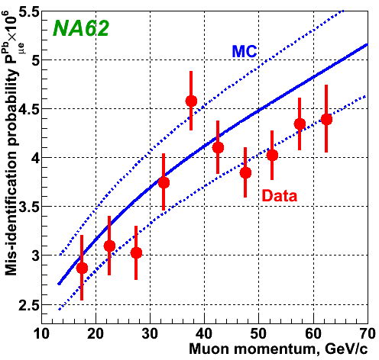
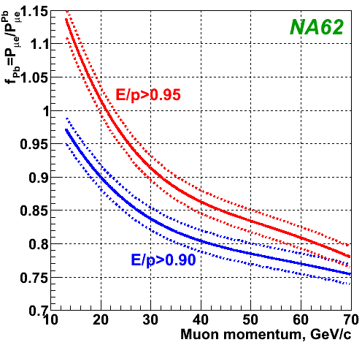
Background to K_{e2}
Muon catastrophic energy loss is the largest background source
P_{μe} is modified by the Pb wall
The correction f_{Pb}= P_{μe}/ P_{μe}^{Pb} evaluated with a dedicated Geant4-based simulation
Notes:
Km2

Slide 12
Background to K_{e2}
R_{K} is inclusive of IB radiation only ⇒
the SD contribution must be carefully estimated and subtracted
The structure-dependent (SD) K±→e±ν γ process has two components: SD⁺ (positive photon helicity) and SD⁻ (negative photon helicity)
SD⁻ decays and the interference between the IB and SD processes are negligible
The SD⁺ background contribution has been estimated by MC simulation using a recent measurement of the K±→e±νγ (SD⁺) differential decay rate
[J. Bijnens, G. Colangelo, G. Ecker, J. Gasser, arXiv:hep-ph/9411311]
[F. Ambrosino et al., Eur. Phys. J. C 65 (2010) 703]

Slide 13
Background to K_{e2}
Background from beam halo muons has been directly measured on data
K⁺ only sample used to measure background in K⁻ sample and vice-versa
K-less sample (both K⁺ and K⁻ beams blocked, only muon halos alllowed)
Control samples normalized to the data in the M_{miss}² region populated mainly by beam halo events.
Probability to reconstruct a K_{e2}± candidate due to a K⁺ decay with e± emission (~10⁻⁴ ) taken into account
Notes:
Muon halo

Slide 14
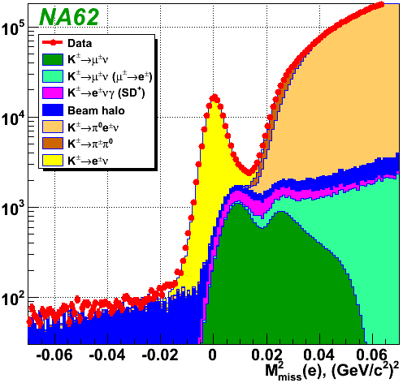
K_{e2} Sample
145,958 K±→e ± ν candidates
(99.28±0.05)% e± ID efficiency
Decay | B/(S+B)
K± → μ±ν | (5.64 ± 0.20)%
K± → μ±ν (μ → e) | (0.26 ± 0.03)%
K± → e±νγ (SD⁺) | (2.60 ± 0.11)%
K± → π⁰_{D}e±ν | (0.18 ± 0.09)%
K± → π±π⁰_{D} | (0.12 ± 0.06)%
Wrong sign K | (0.04 ± 0.02)%
Beam halo | (2.11 ± 0.09)%
Total | (10.95 ± 0.27)%

Slide 15
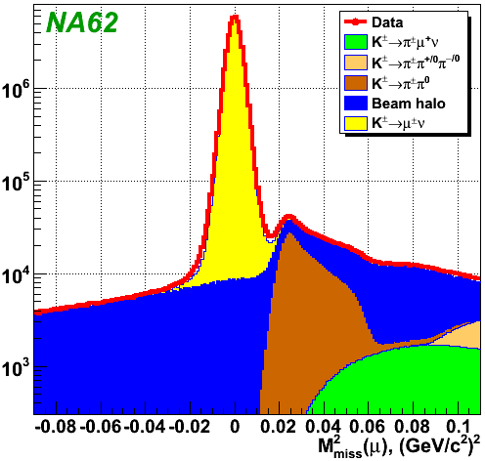
K_{μ2} Sample
The only significant background source in the K_{μ2} sample is the beam halo measured using the same technique as for the K_{e2} sample
42.817⋅ 10⁶ K±→μ ± ν candidates (collecting with downscaling factor D=50 or D=150)
B/(S+B) = (0.50 ± 0.01)%

Slide 16
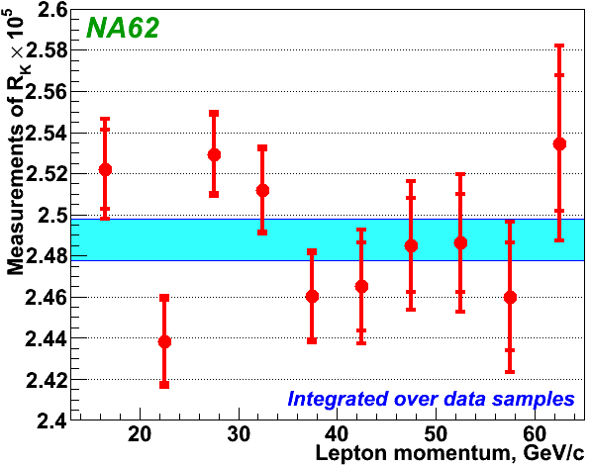
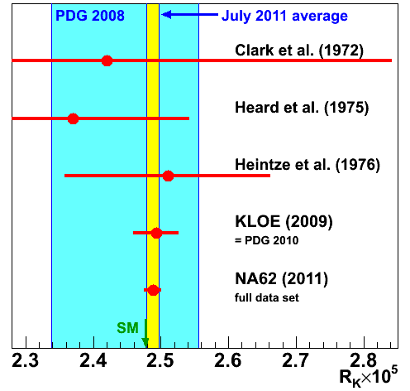
NA62 Result (full data set)
Fit over 40 R_{K} measurements (4 data samples × 10 momentum bins)
including correlations: χ²/ndf=47/39
July 2011
R_{K}=(2.488 ± 0.007_{stat} ±0.007_{syst} ) x 10⁻⁵=(2.488 ± 0.010) x10⁻⁵
July 2011 world average : R_{K}= (2.488 ± 0.009)× 10⁻⁵

Slide 17
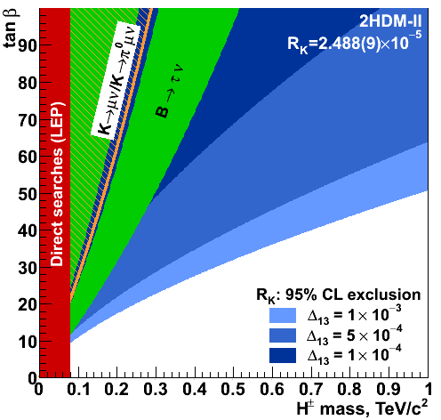
R_{K} Sensitivity to New Physics
For non-tiny values of the LFV s-lepton mixing Δ₁₃
the sensitivity to H± in R_{K} is strong
b→s γ
excluded

Slide 18
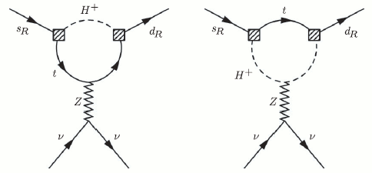
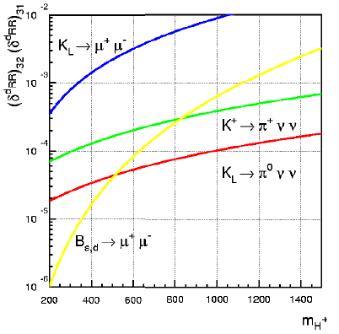
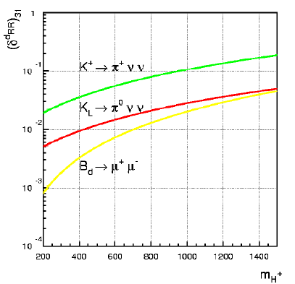
K→ πνν in MSSM
Charged Higgs/top quark loops at large tanβ and with
non-MFV right-right breaking terms
can induce sizable modifications of K→πνν amplitudes
[G. Isidori and P. Paradisi, Phys. Rev. D73 (2006) 055017]

Slide 19
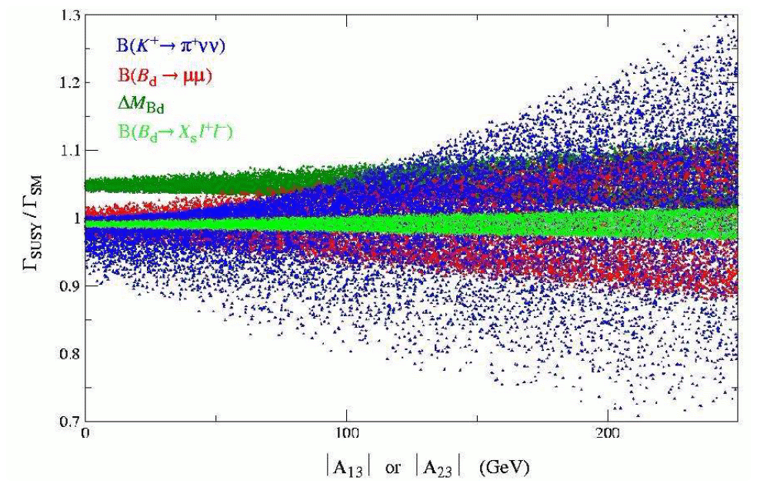
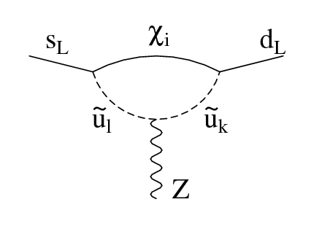
K→ πνν in MSSM
Non-standard model effects induced by chargino-squarks loop in the presence of non-MFV up-type trilinear terms are maximal in the K→ πνν decays
[G. Isidori et al. JHEP 0608:064 (2006) ]

Slide 20
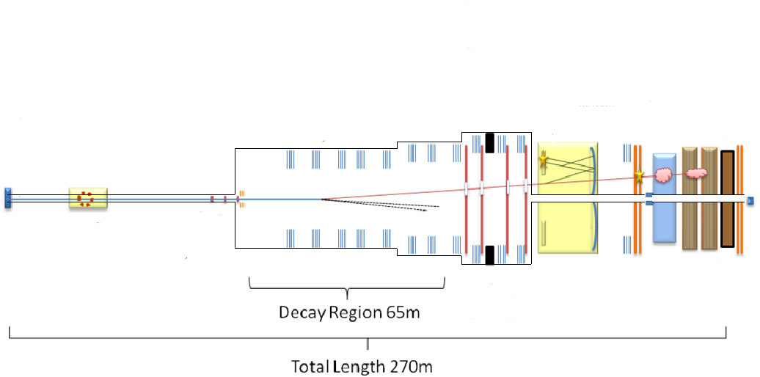
NA62
Branching ratio measurement of K⁺→π⁺νν with 10% accuracy
O(100) K⁺→π⁺νν events (2 years of data taking)
10/1 signal to background ratio
LAV
SAC
MUV
Target
CHANTI
Vacuum <10⁻⁵ mbar
CEDAR
protons
GTK
LKr
hadron beam
75 GeV/c
RICH
Straw
CHOD
Giuseppe Ruggiero - FPCP 2011
End 2012: first technical run
Physics data taking driven by CERN accelerator schedule

Slide 21
Conclusions
R_{K} measurement:
  The analysis of the full data sample taken by NA62 completed
  The measured value is R_{K}=(2.488 ± 0.010) x10⁻⁵
  The precision achieved is 0.4%
  The NA62 could improve the precision down to 0.2%
B(K⁺→π⁺νν) measurement with NA62:
  High sensitivity to New Physics
  10% precision BR measurement expected in two years of data taking
  Experiment under construction

Slide 22
Backup Slides

Slide 23
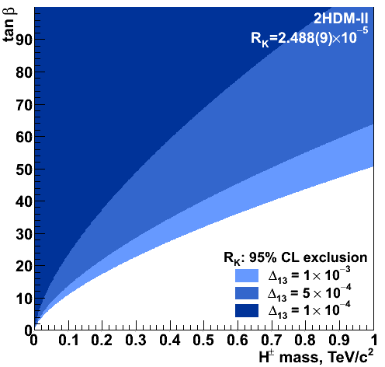
R_{K} Sensitivity to New Physics
For non-tiny values of the LFV s-lepton mixing Δ₁₃
the sensitivity to H± in R_{K} is strong

Slide 24
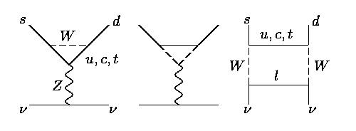
K→πνν Decays
FCNC decays mediated by Z penguins and box diagrams → strongly suppressed in the SM (<10⁻¹⁰)
Calculable with excellent precision [Phys.Rev. D83 (2011) 034030]
Notes:
Chargino-up-squark penguin diagrams contributing to the Zsd effective vertex

Slide 25
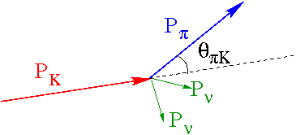
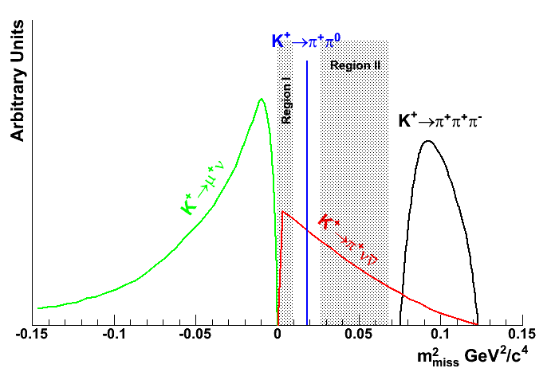
Background Rejection
Signal signature:
Incoming high momentum(75 GeV/c) K⁺
Outgoing low momentum(<35 GeV/c) π⁺ in time with the incoming K⁺
Decay | BR
K⁺→μ⁺ν(K_{μ2}) | 0.64
K⁺→π⁺π⁰(K_{π2}) | 0.21
K⁺→π⁺π⁺π⁻K⁺→π⁺π⁰π⁰ | 0.07
~92% of kaon decays kinematically constrained

Slide 26
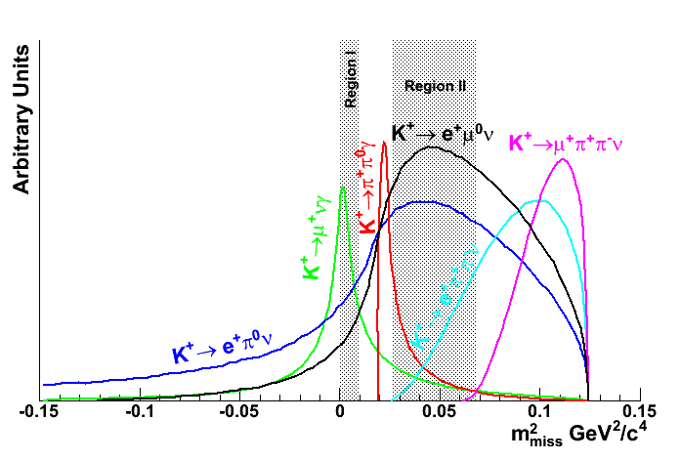
Particle Identification
K⁺ positive identification (CEDAR)
π/μ separation (RICH)
π/e separation (E/p)
Decay | BR
K⁺→π⁰e⁺ν(K_{e3}) | 0.051
K⁺→π⁰μ⁺ν(K_{μ3}) | 0.034
K⁺→μ⁺νγ(K_{μ2γ}) | 6.2×10⁻³
K⁺→π⁺π⁻e⁺ν (K_{e4}) | 4.1×10⁻⁵
K⁺→π⁺π⁻μ⁺ν (K_{μ4}) | 1.4 ×10⁻⁵
K⁺→μ⁺π⁰ν
m²_{miss} GeV²/c⁴

Slide 27
Sensitivity
Definition of “year” and running efficiencies based on NA48 experience:
~100 days/year and 60% overall efficiency

Slide 28
Techniques for K⁺→π⁺νν
Stopped
Work in kaon frame
High kaon purity
Compact detectors
In-Flight
Decays in vacuum
RF separated or not separated beams
Extended decay regions
Exp | Machine | Meas. or UL 90% CL | Notes
 | Argonne | <5.7×10⁻⁵ | Stopped; HL Bubble Chamber
 | Bevatron | <5.6×10⁻⁷ | Stopped; Spark Chambers
 | KEK | <1.4×10⁻⁷ | Stopped; π⁺→ μ⁺ → e⁺
E787/E949 | AGS | (1.73^{+1.15}_{-1.05})×10⁻¹⁰ | Stopped
NA62 | SPS |  | In Flight; Unseparated
P996 | FNAL |  | Stopped; Tevatron as strecher ring?

Slide 29
K_{L}⁰→π⁰νν
The charm contribution can be fully neglected since it proceeds in the
SM almost entirely through direct CP violation → determination of η
Exp | Machine | Meas. or UL 90% CL | Notes
KTeV | Tevatron | <5.7×10⁻⁷(π⁰→eeγ)
E391a | KEK-PS | <2.6×10⁻⁸
KOTO | J-PARC |  | Aim at 2.7 SM evts/3y
KOPIO |  |  | Opportunity at Project X ?
Need a huge number of K_{L} decays
NA48 K_{L} flux corresponding to 3×10¹⁰/year
NA62 possible K_{L} flux 5-10 times NA48 one
After SPS upgrade 100 times more

