Slide 1
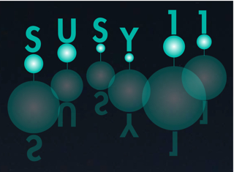
Tevatron
Perspectives and Legacy
Stefan Söldner-Rembold
Stefan Söldner-Rembold
dlobmeR-rendlöS nafetS

Slide 2
The Beginning

Slide 3
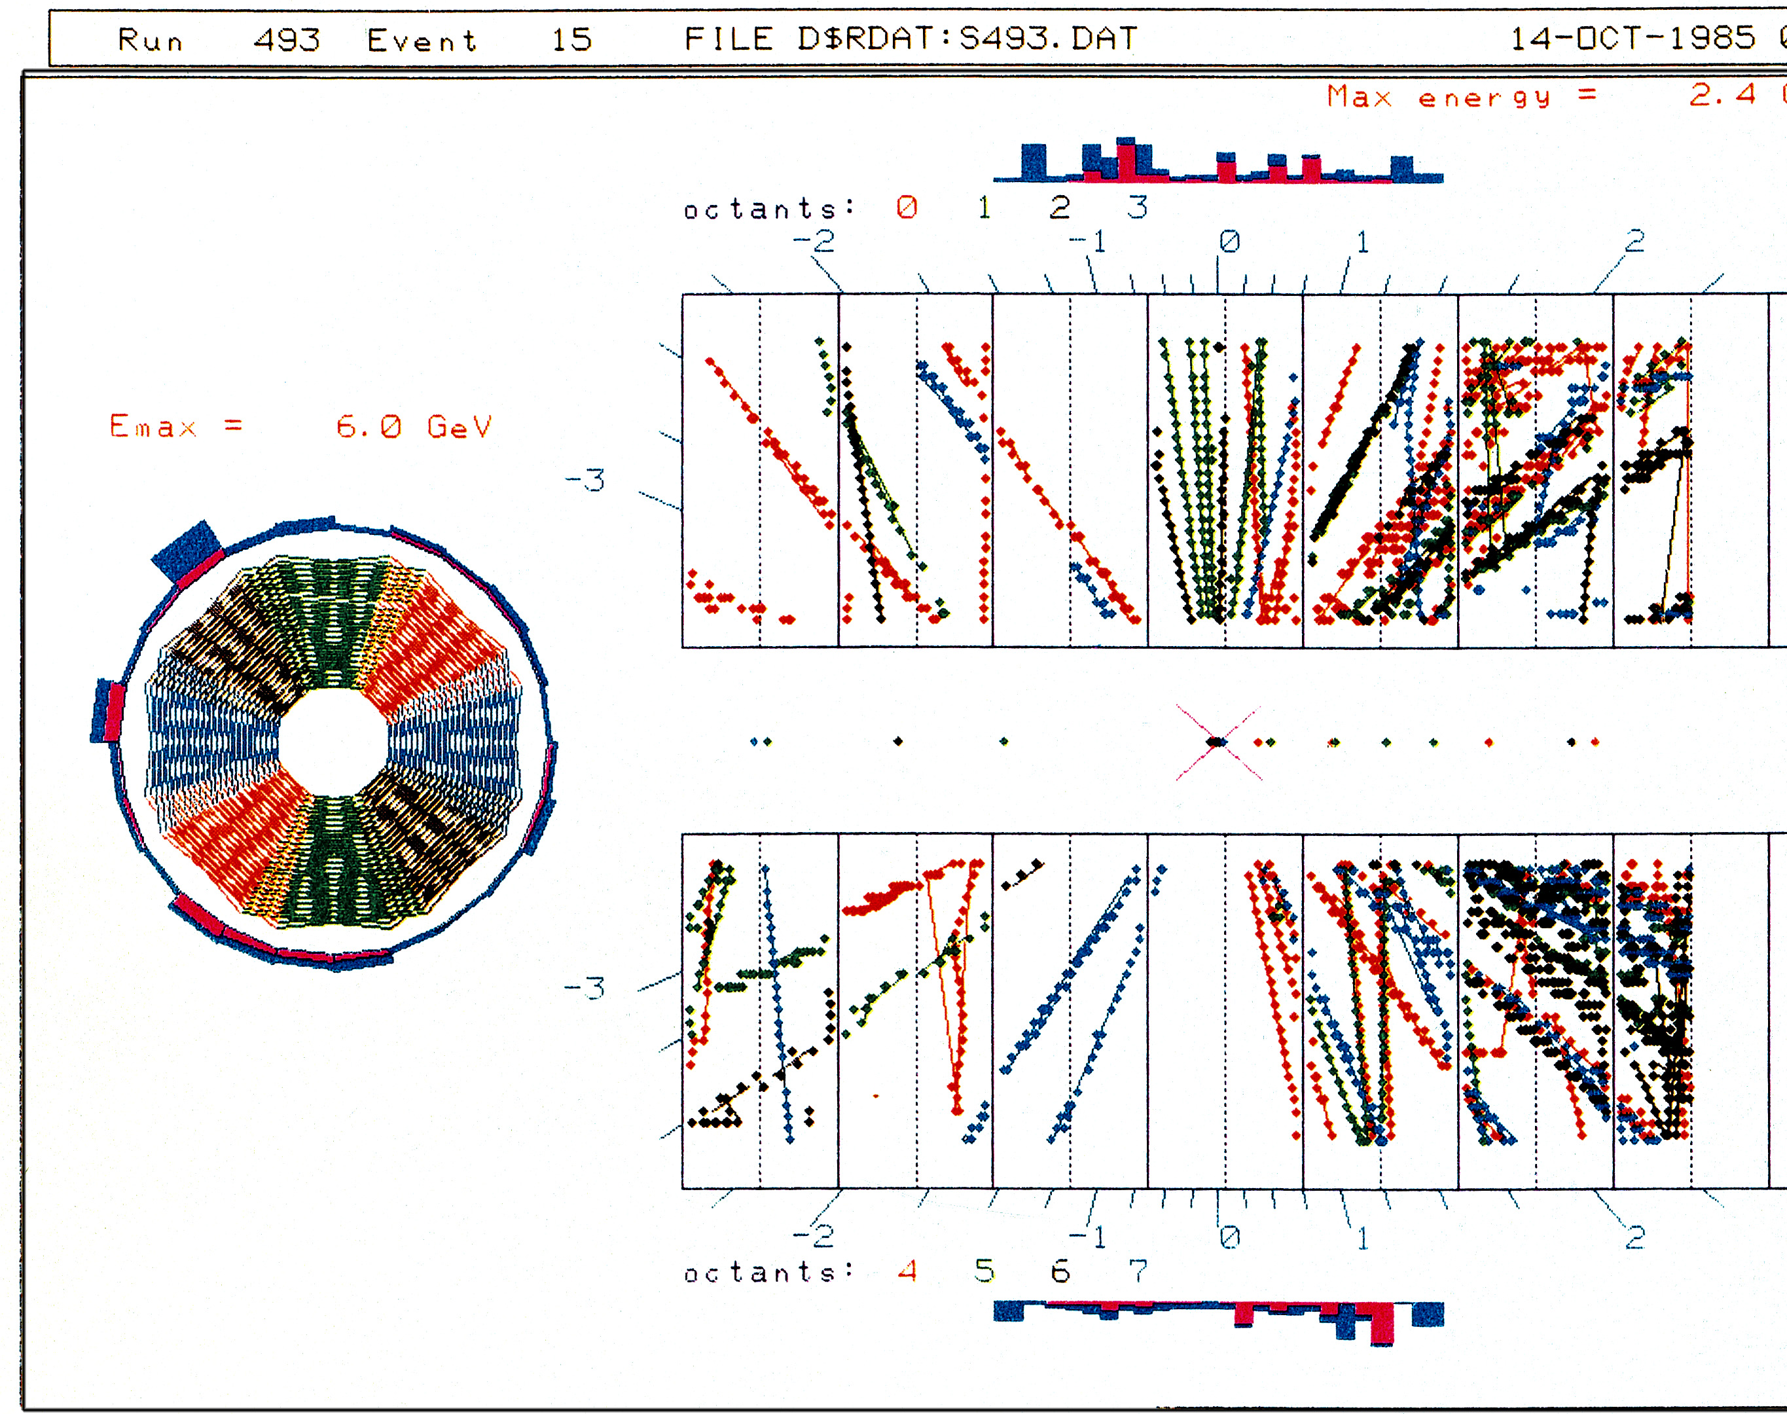
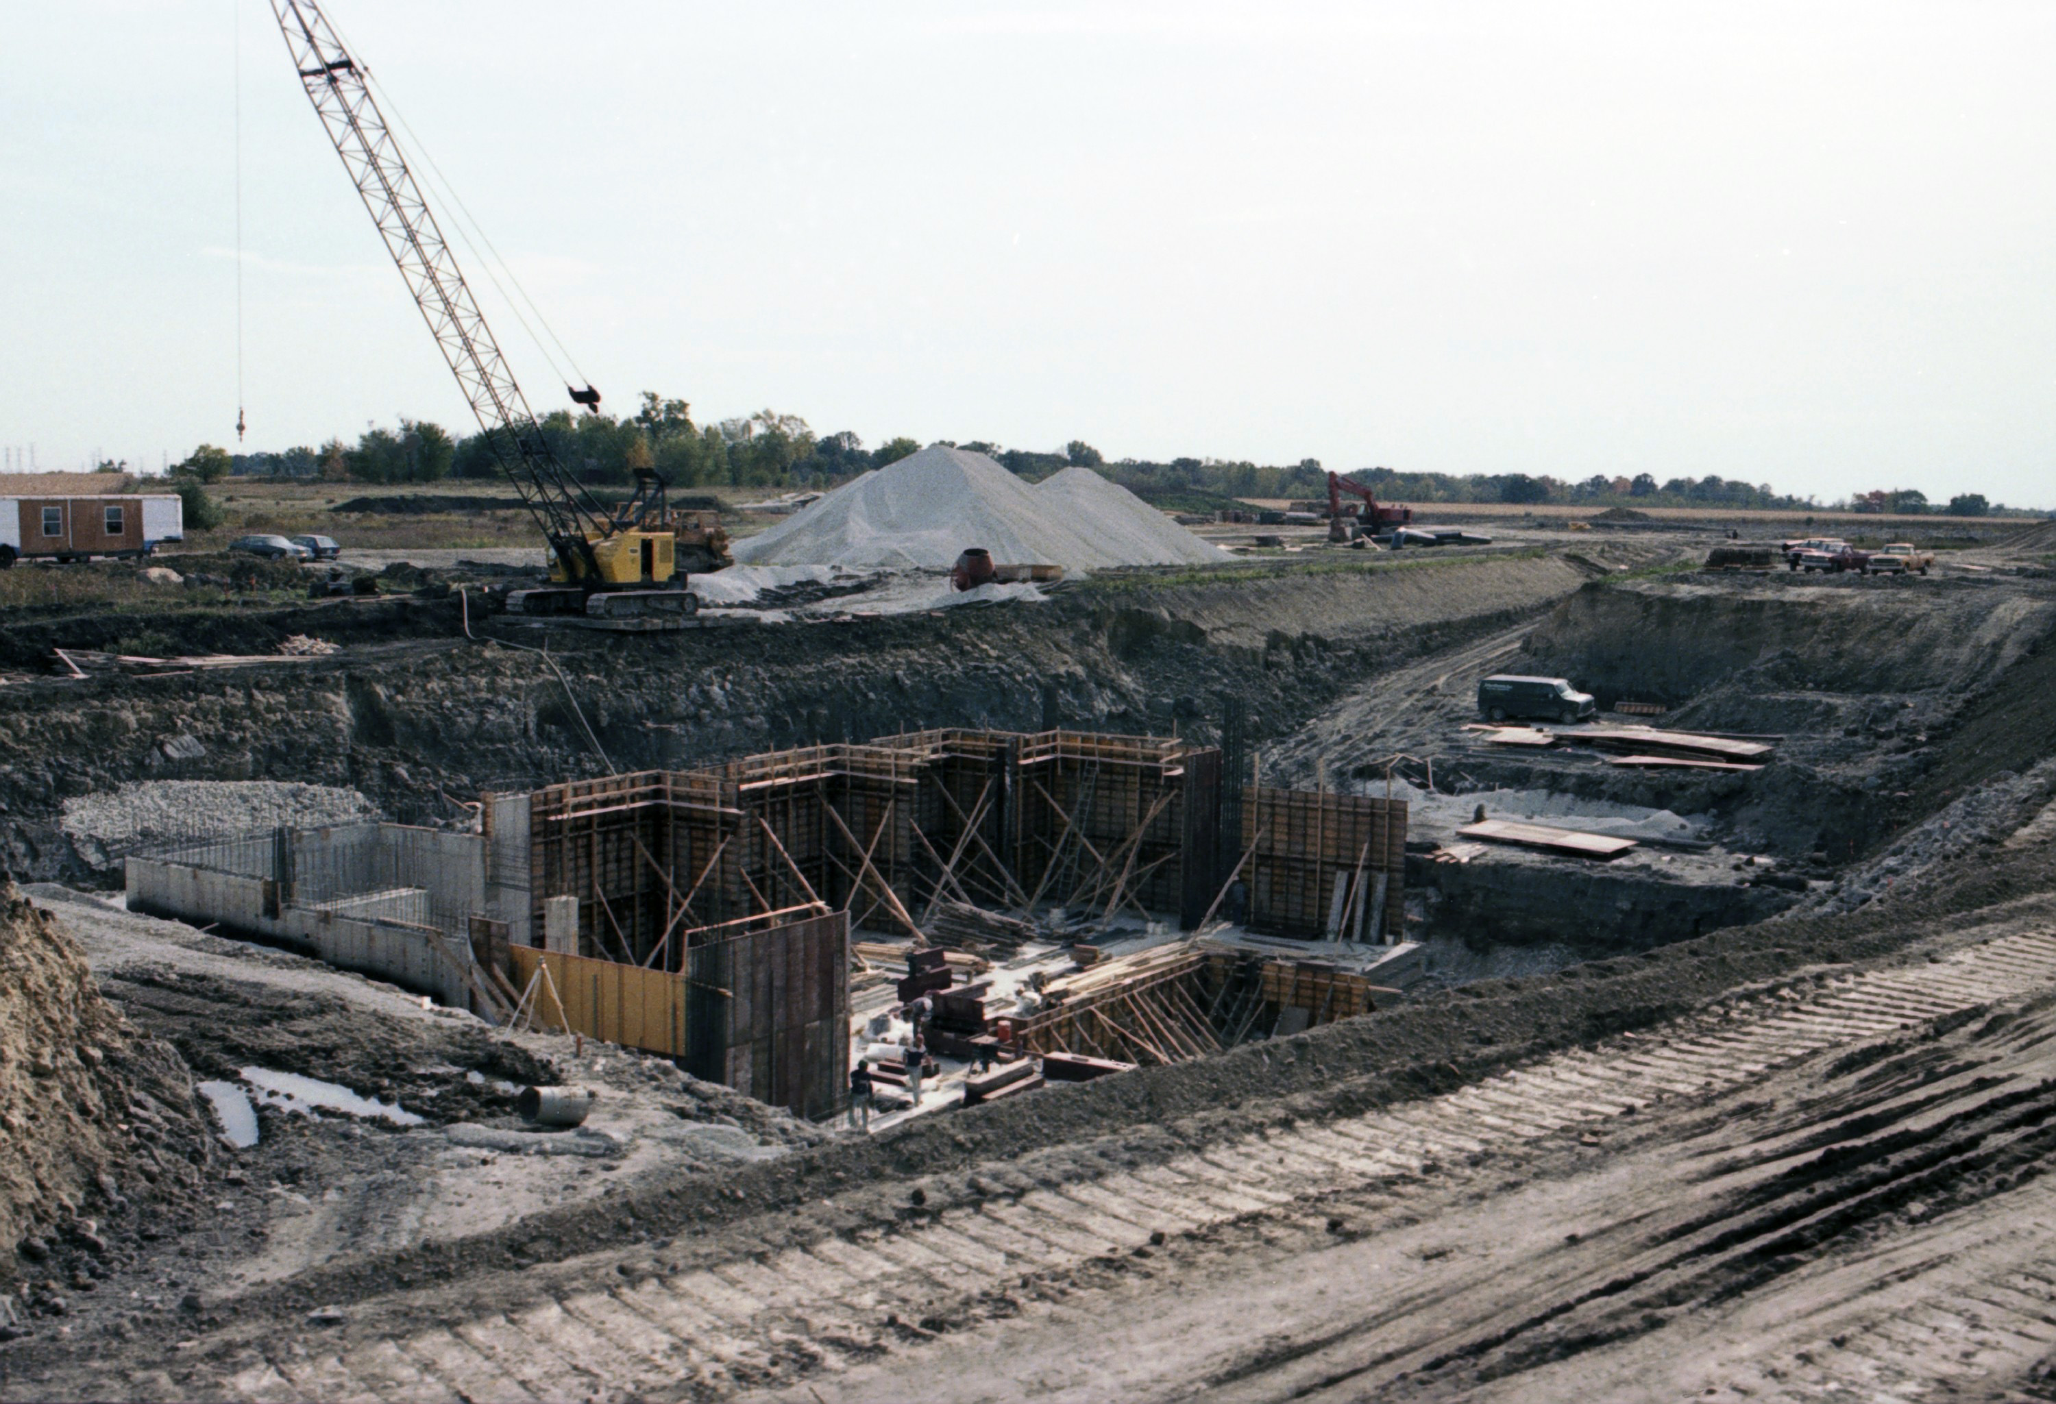
25 Years ago
First CDF collision 25 years ago
(no magnetic field yet – like DØ)
CDF more focused on tracking.
DØ more focused on calorimetry.
DØ in October 1985
Upgrades for Run II (2001-2011) make
them more similar:
CDF: new tracker, new silicon vertex detector
upgraded forward calorimeter and muons
DØ: solenoid, fiber tracker and silicon vertex
detectors, preshower detectors, new forward muon detectors.

Slide 4
Present

Slide 5
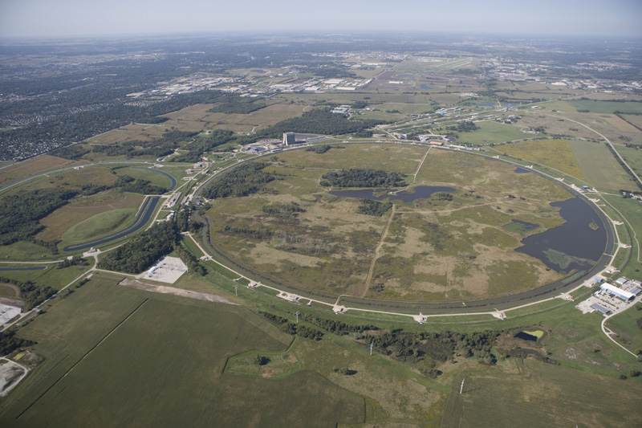
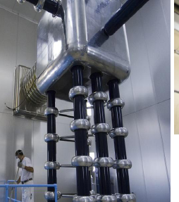
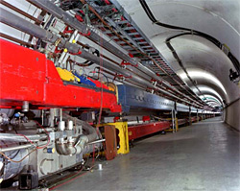
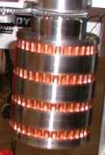
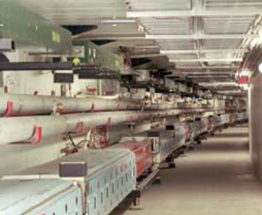
Highest energy proton-antiproton collider, cms energy ≈ 2 TeV
anti-proton
source
proton source
Protons
Recycler (anti-π @ 8 GeV)
Tevatron (150-1000 GeV)
Anti-protons
Main Injector (8-150 GeV)
We thank Fermilab’s Accelerator Division for building
this amazing machine and for operating it so successfully.

Slide 6
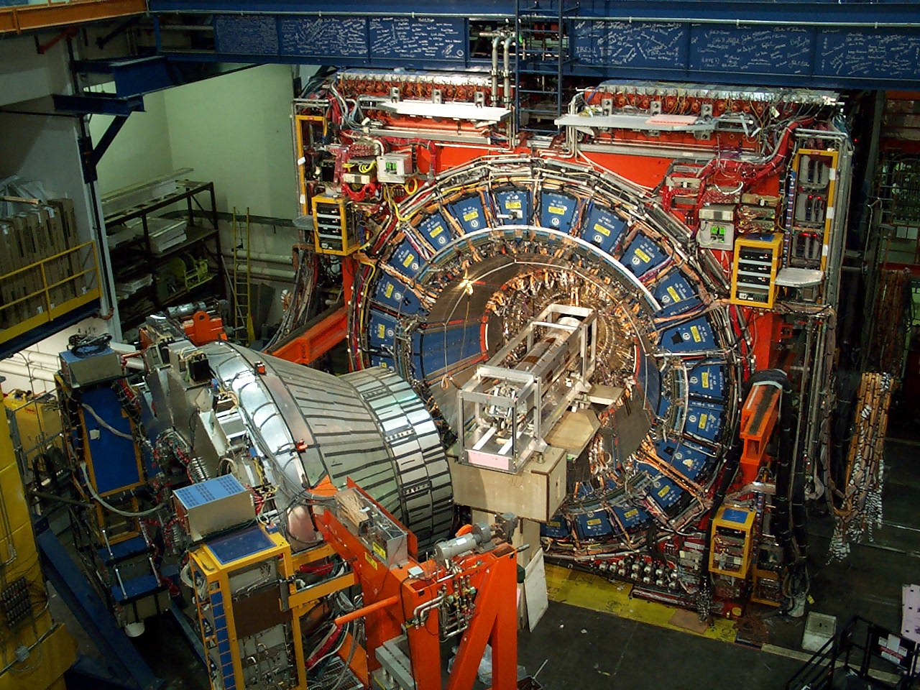
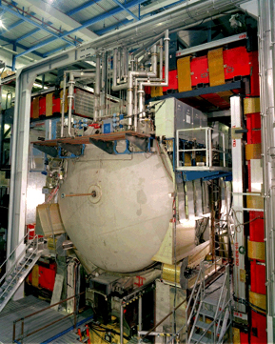
CDF
DØ

Slide 7
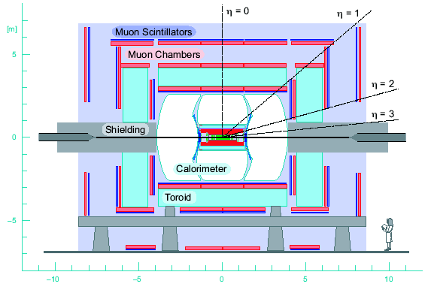
The DØ Detector
Tracking:
Silicon Microstrip Tracker
Central Fiber Tracker
2 T Solenoid
Calorimeter:
Liquid Argon Calorimeter
Scintillator Pre-shower
Muon:
Drift Tubes
Scintillators
1.8 T Toroid

Slide 8
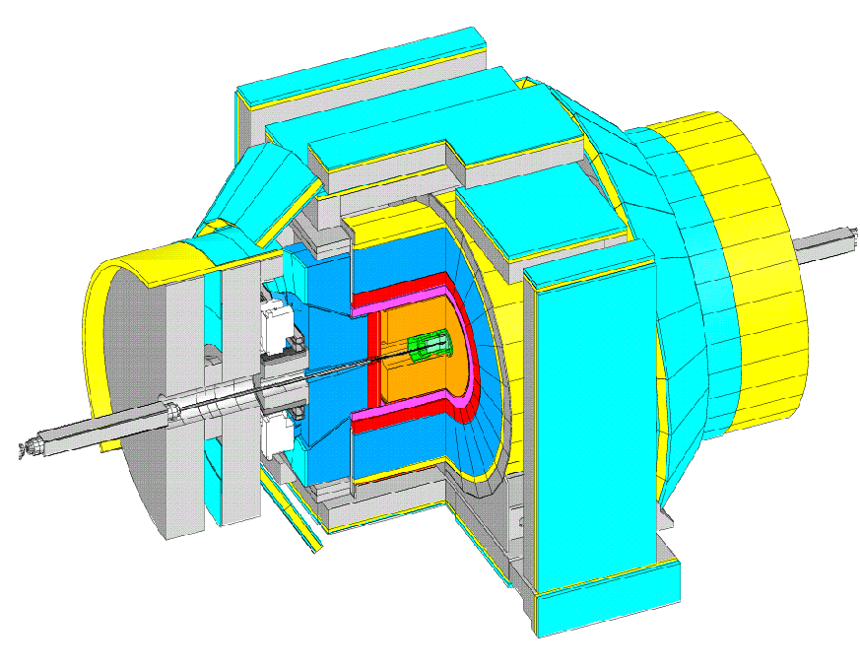
The CDF Detector
Tracking:
Silicon Vertex Tracker
Central Tracker
1.4 T Solenoid
Calorimeter:
EM Calorimeter
(lead/scintillator)
HAD Calorimeter
(iron/scintillator)
Muon:
Drift Chambers
Scintillators
Both experiments will become exhibits after data taking ends.

Slide 9

Spanning the Globe

Slide 10
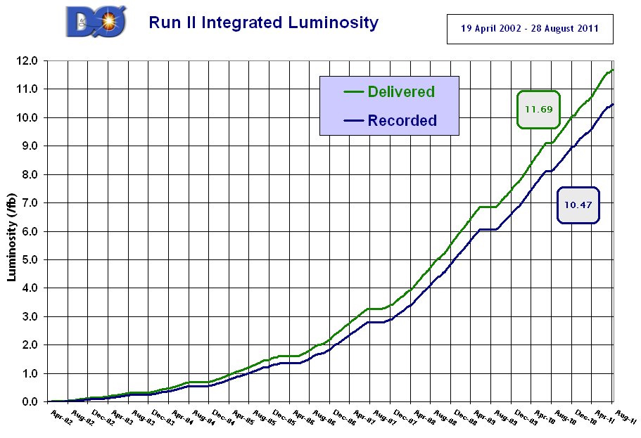
Integrated Luminosity
~90% recording efficiency.
Data taking will end on September 30.
>10 fb⁻¹ will be available for analysis
for each experiment.
This is about 100 times Run I !

Slide 11
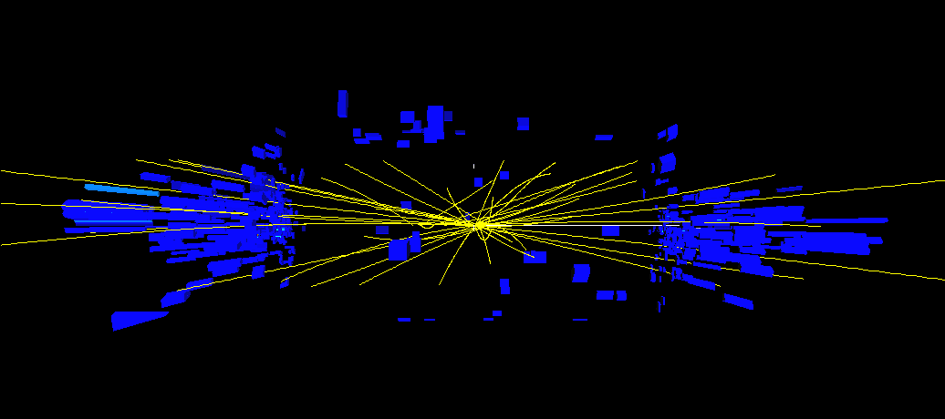
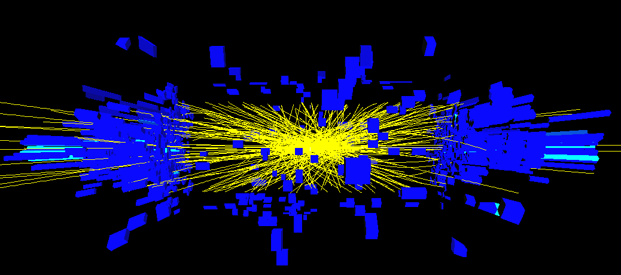
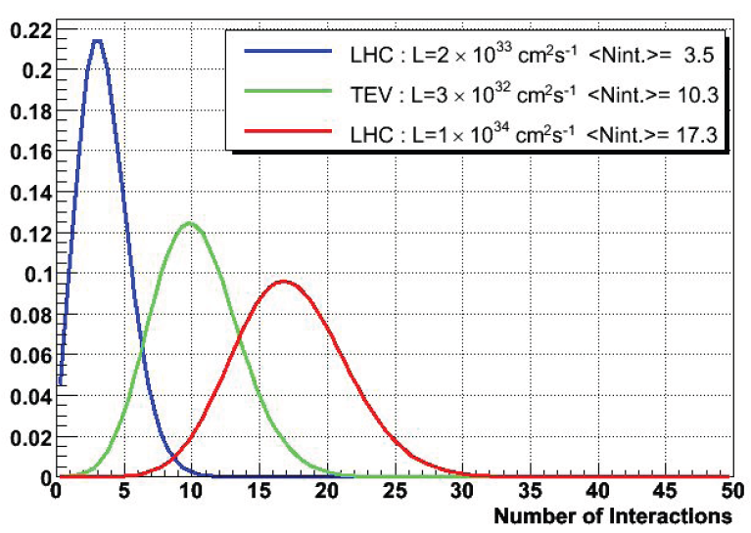
A Challenging Environment
A zero_bias data event at 60x10³⁰ cm⁻²s⁻¹ ... and at 240x10³⁰ cm⁻²s⁻¹
Significantly more than what the detectors were originally designed for.
We now reach 400x10³⁰ cm⁻²s⁻¹

Slide 12
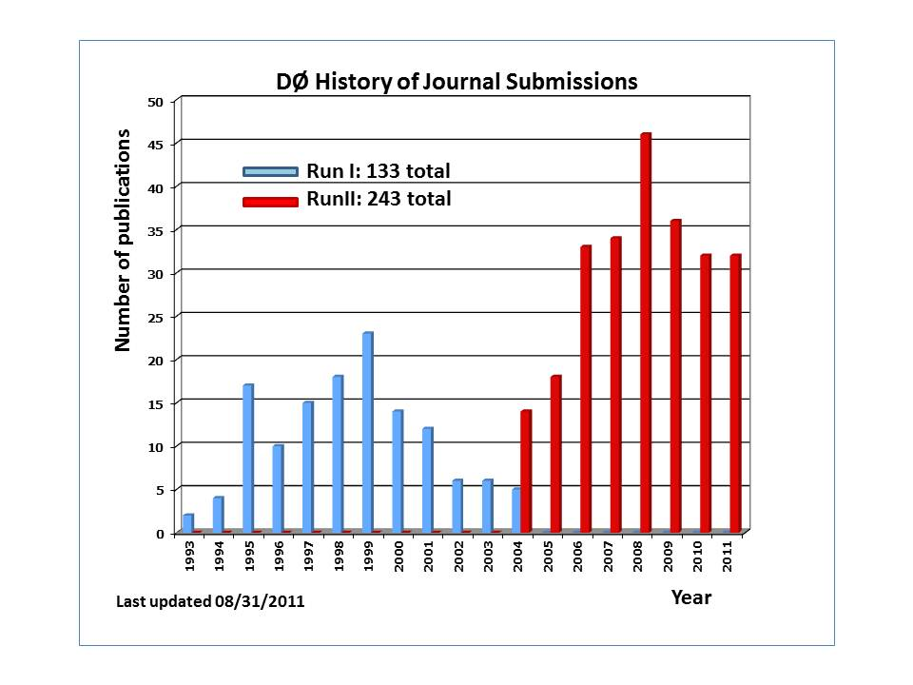
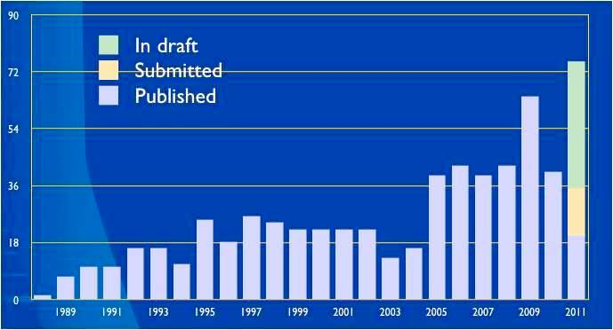
Publications
Most cited DØ papers:
Observation of Top Quark (1804)
Observation of X(3872) (297)
Two-sided bound on B_{s} oscillations (285)
Search for the Top Quark (255)
Most cited CDF papers:
Observation of Top Quark (1859)
Evidence of Top Quark (798/655)
J/ψ and b-hadron cross section (529)
Observation of B_{s} oscillations (395)

Slide 13
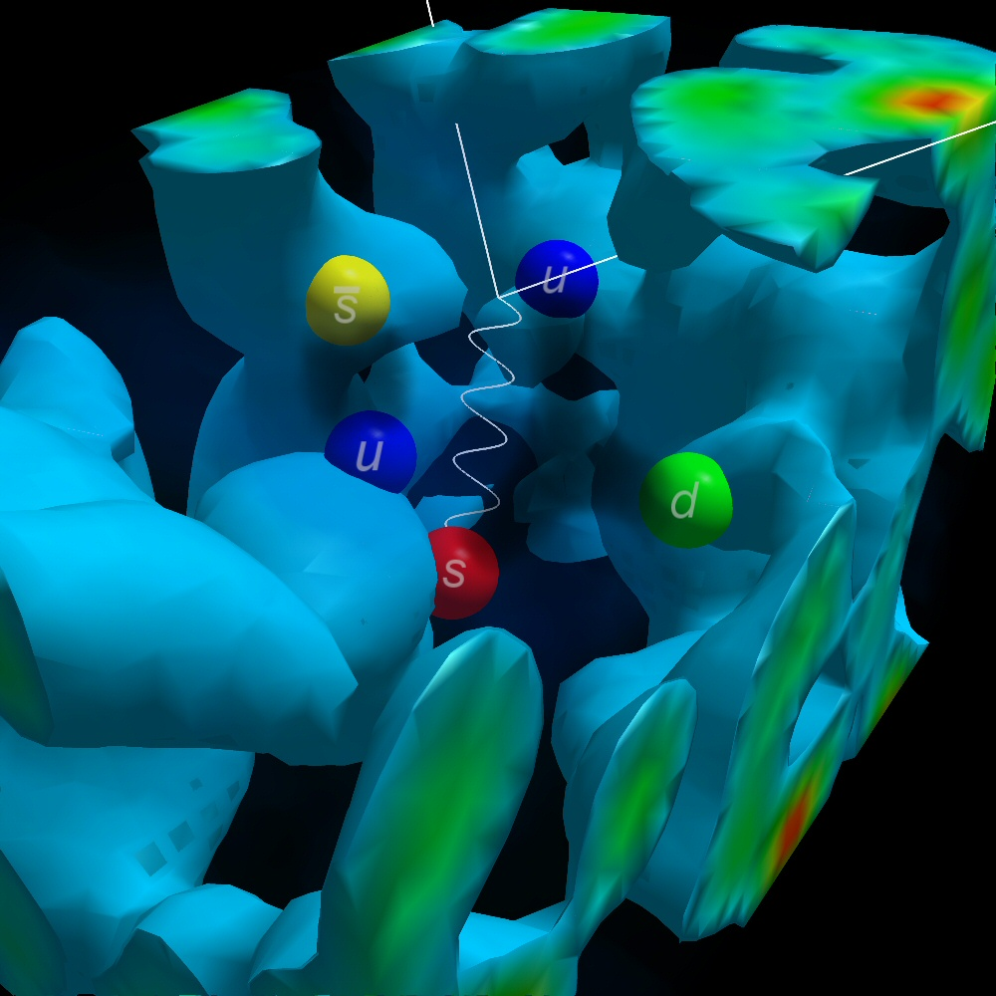
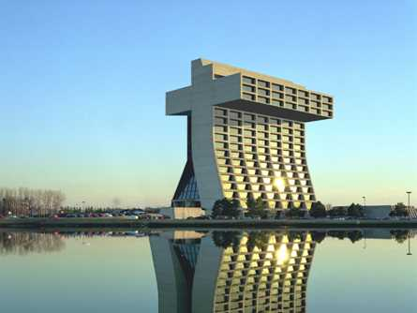


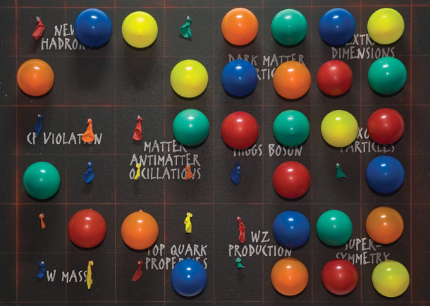
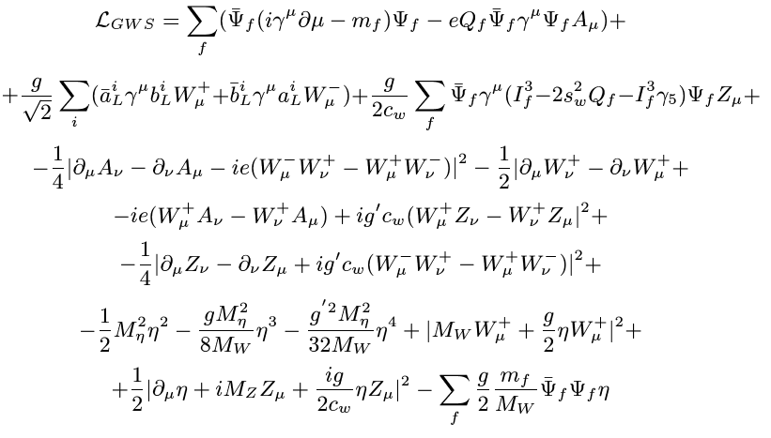
A Personal Selection of Highlights
QCD
Top
B physics
New Phenomena
Electroweak
Higgs

Slide 14
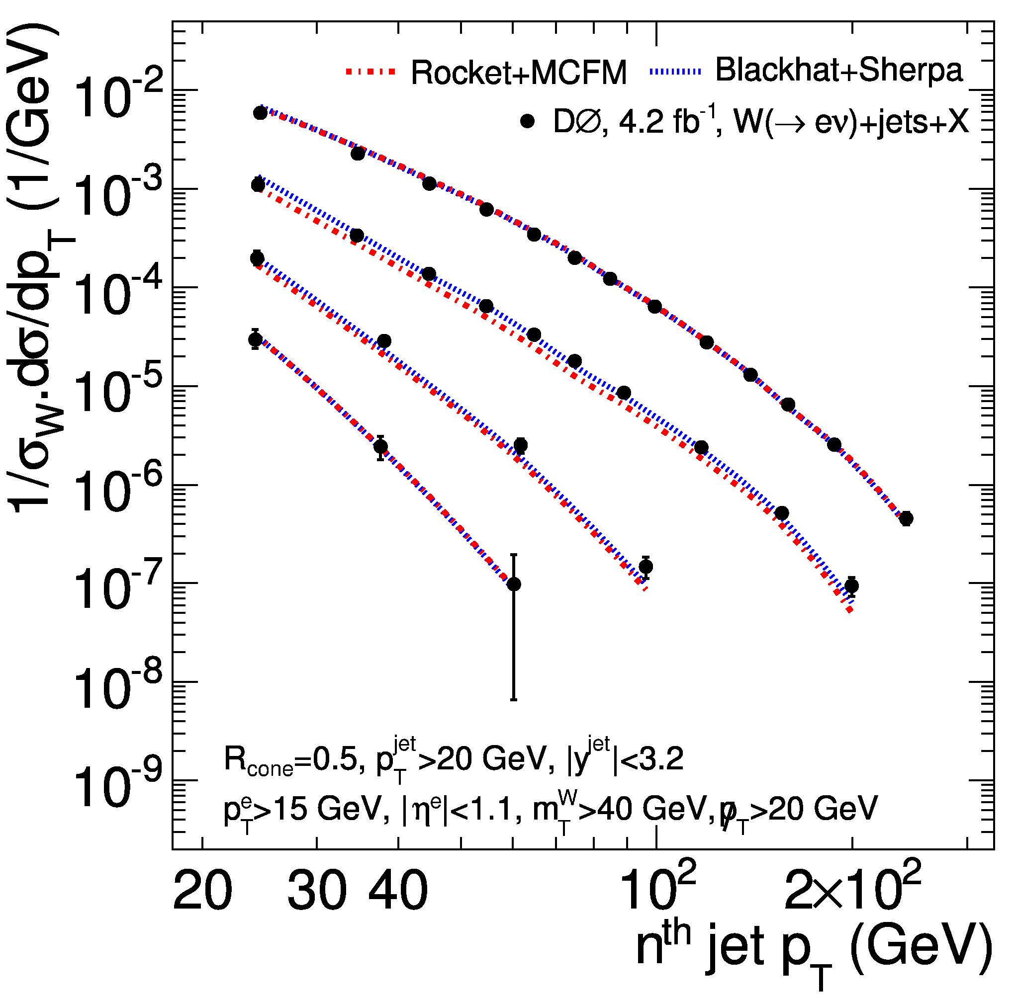
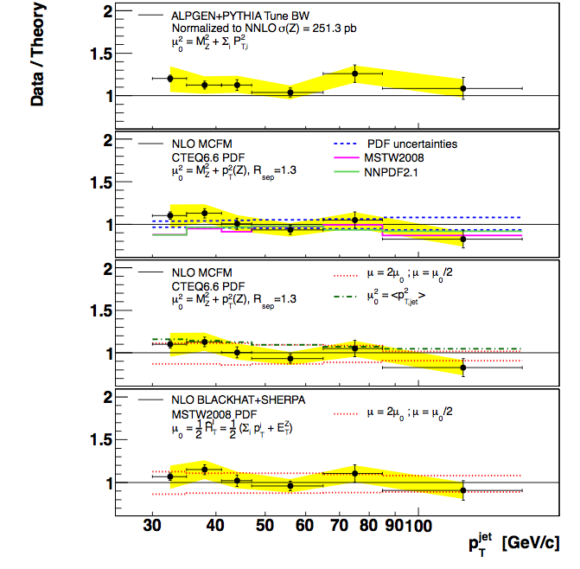
More than bread and butter
Panel Discussion on Monday:
Rob Roser, Gregorio Bernardi, Sally Dawson, Gordon Kane, Bogdan Dobrescu.
“The Tevatron legacy will be the top mass, the W mass, and measurements of
V+jets/QCD processes”. (quoted from memory).
CDF
W+jets
Z+2 jets

Slide 15
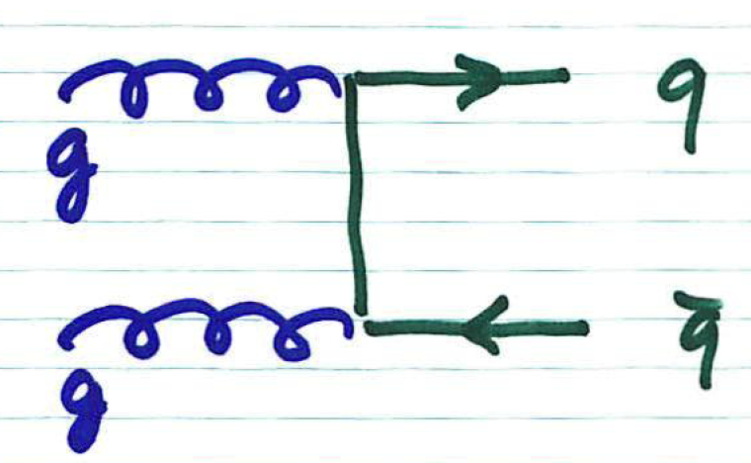
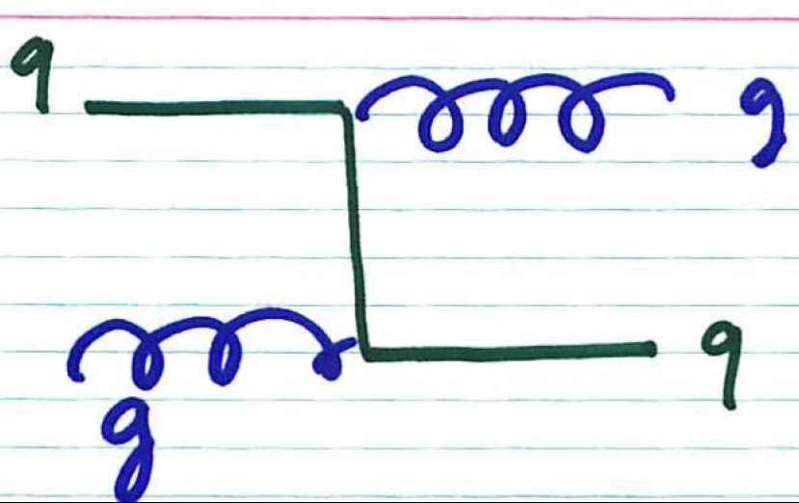
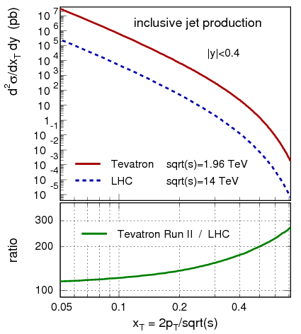
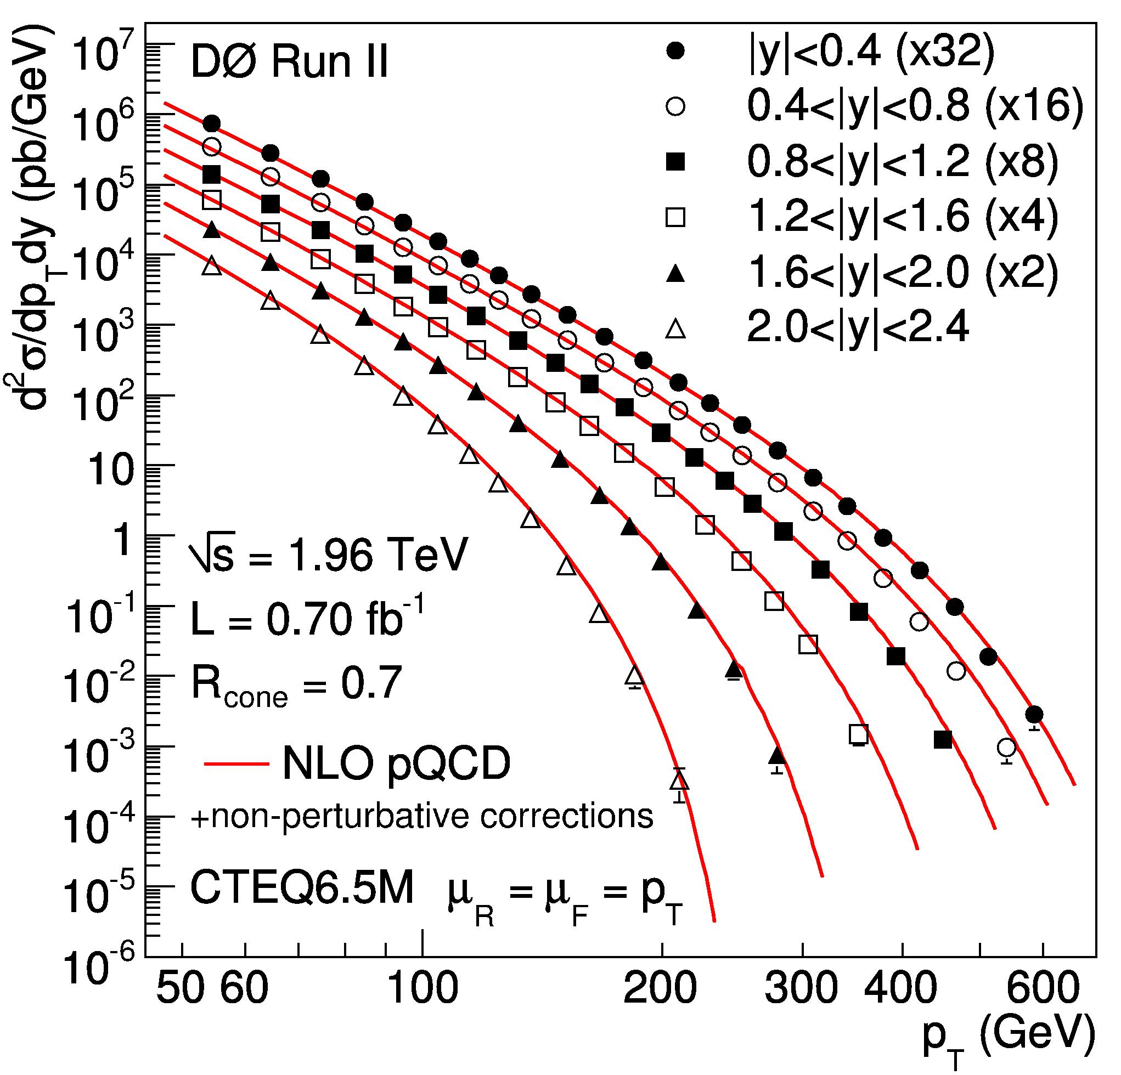
QCD and PDFs
M. Wobisch
Tevatron will continue to dominate
high-x gluon.
Important for searches (Higgs)

Slide 16
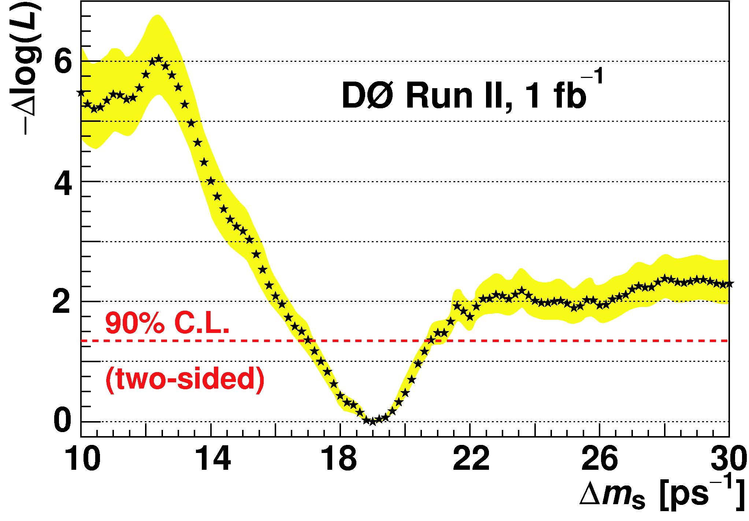
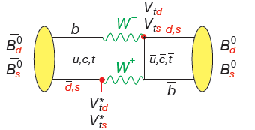
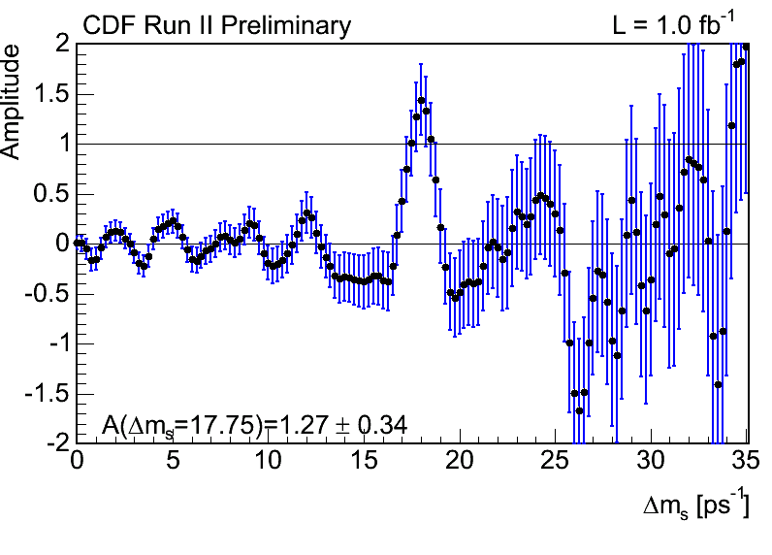
B Physics: B_{s} Oscillations
First observation of B_{s} oscillations
An experimental challenge: τ_{osc}≈ 0.3 ps
In agreement with SM expectations
confirmed by LHCb

Slide 17
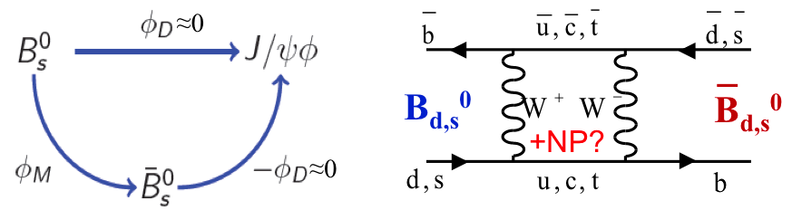
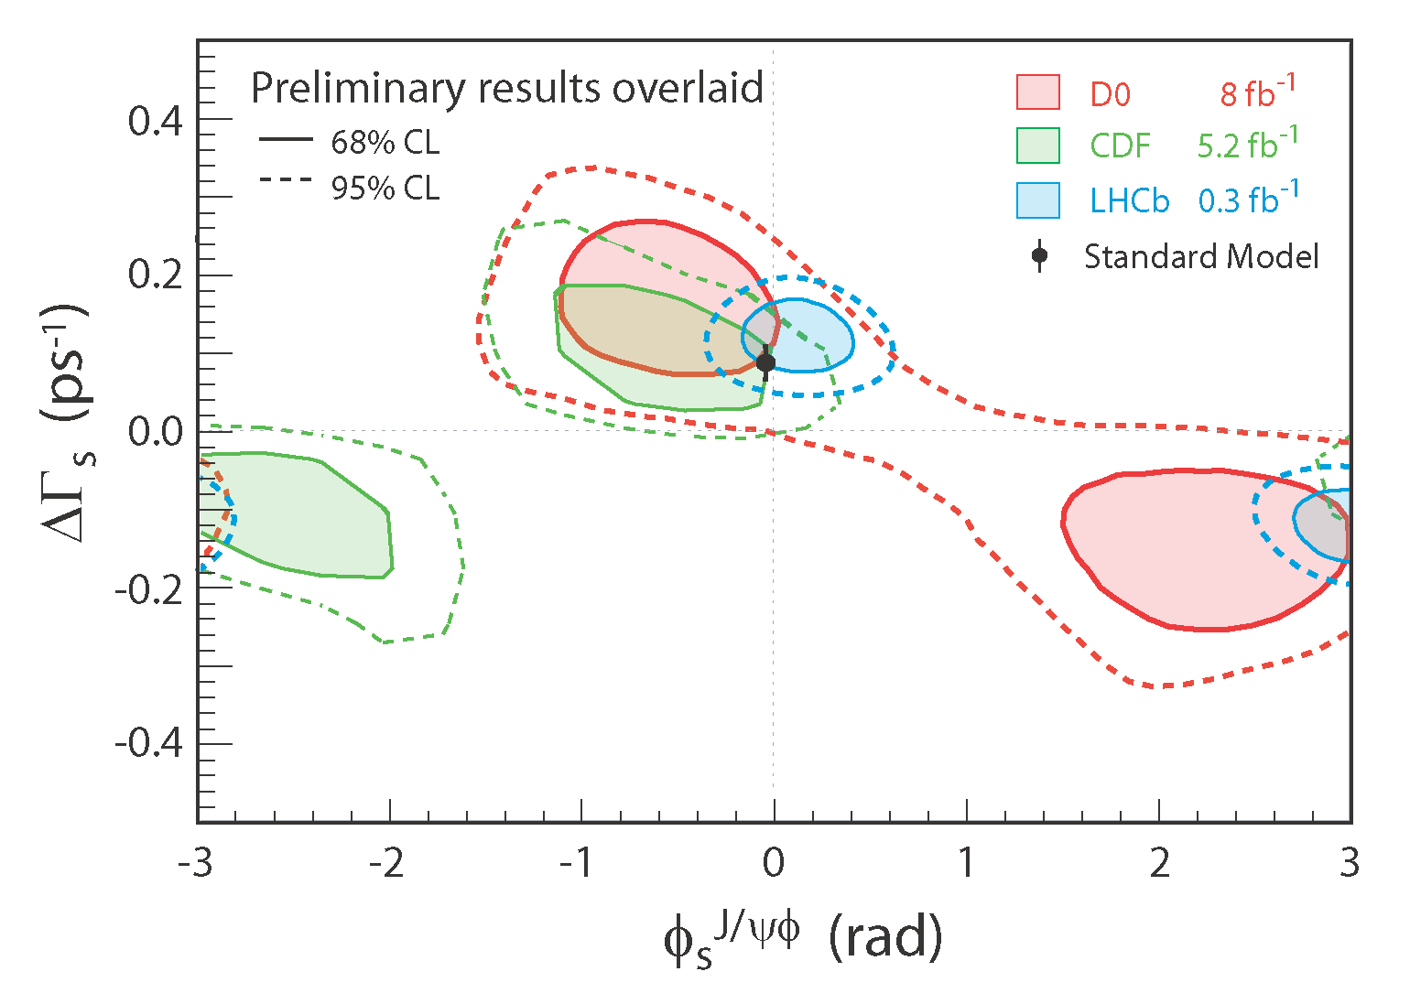
B Mesons as Window to New Physics
Interference between mixing
and decay gives rise to CP
violating phase φ_{s}.
Very sensitive to new physics.
LHCb results consistent with
Tevatron, but do not add to
tension with SM.
, Bolek Pietrzyk

Slide 18
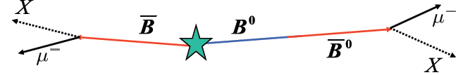
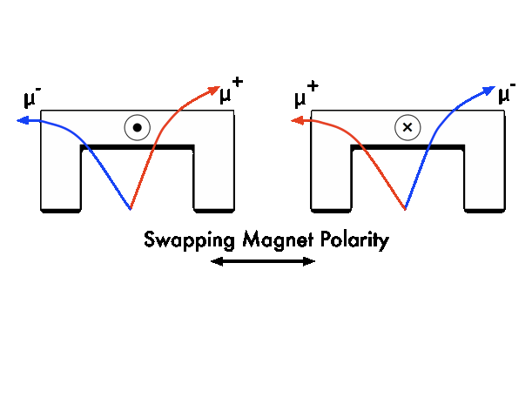
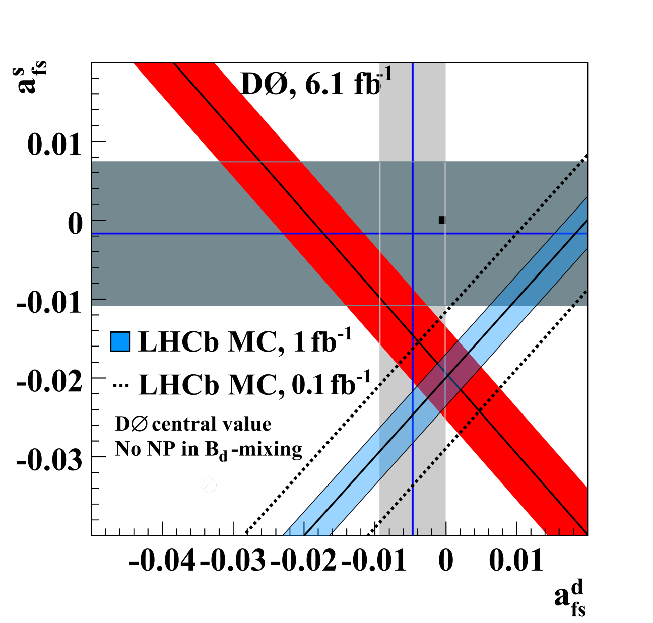
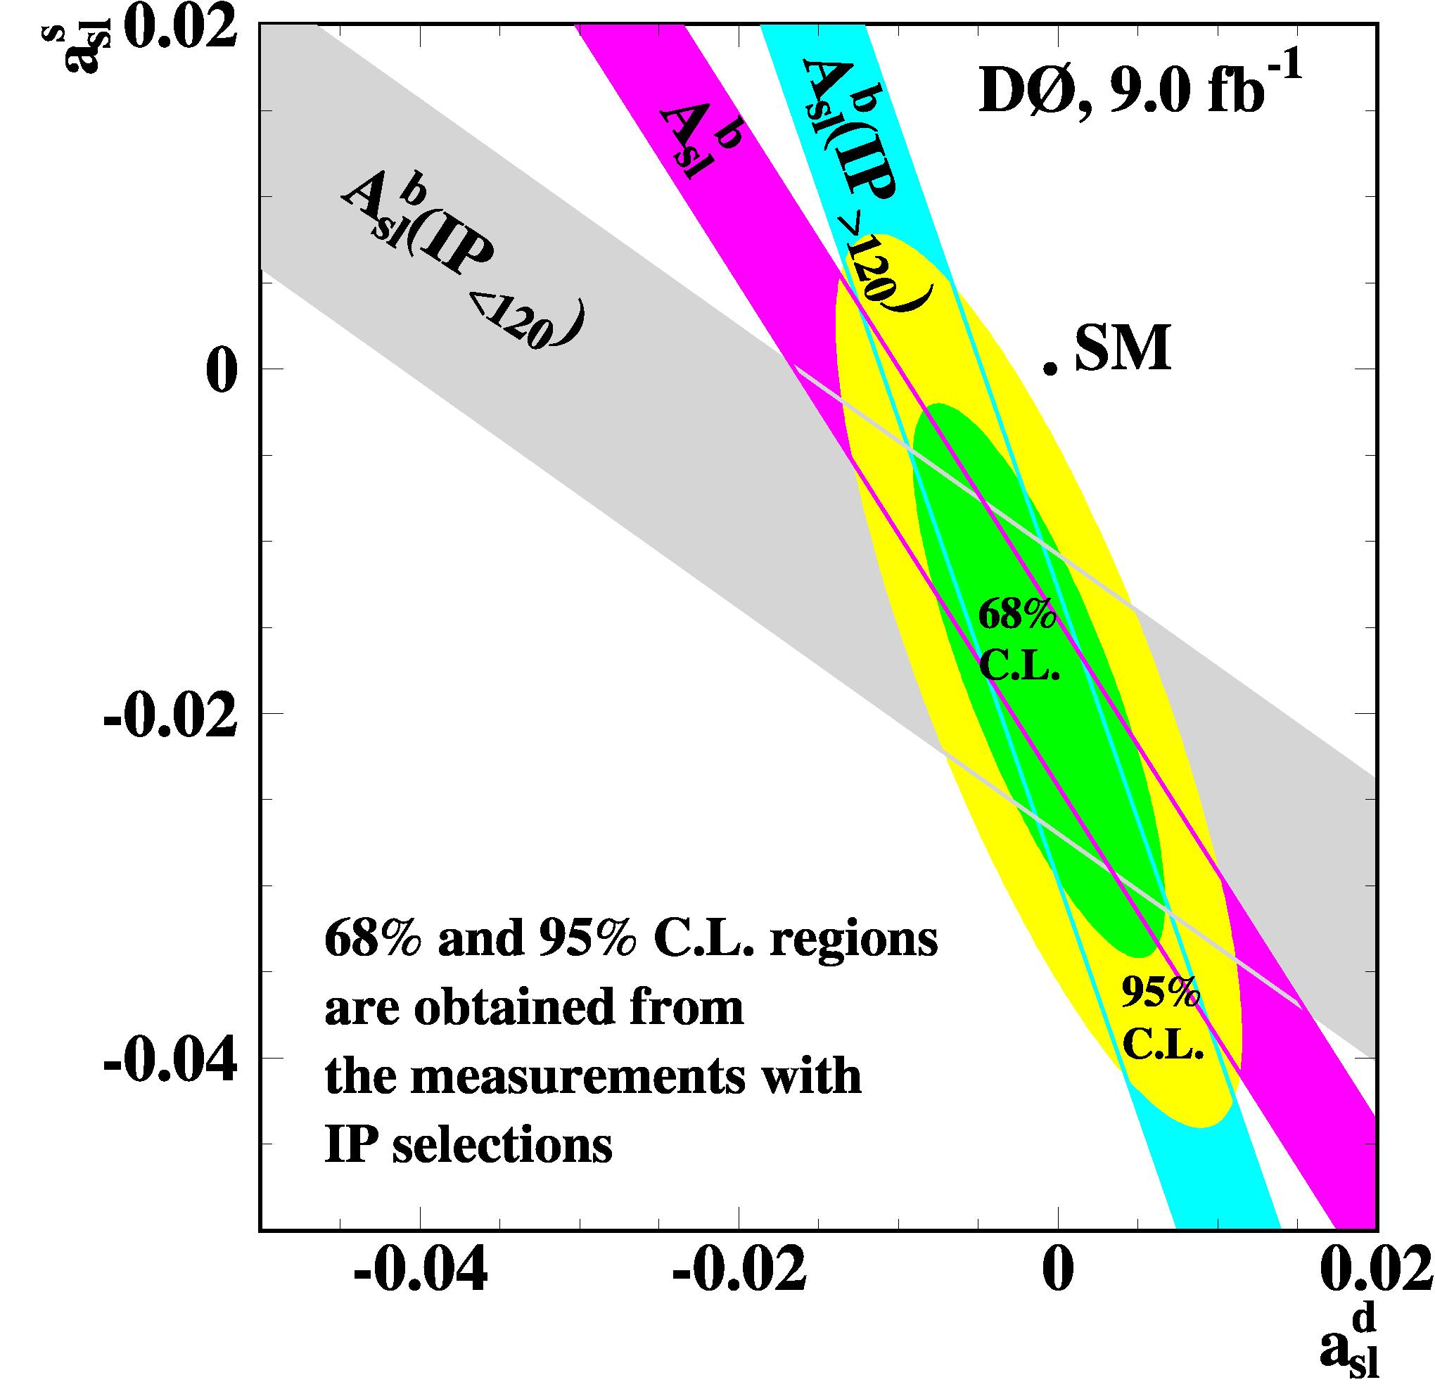
B Mesons as Window to New Physics
Di-muon charge asymmetry

Slide 19
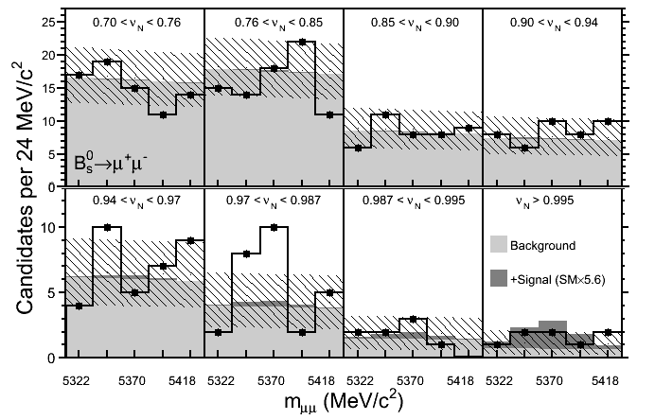
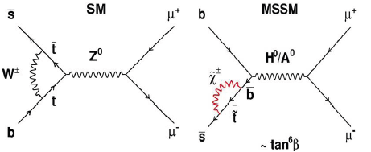
B Mesons as Window to New Physics
LHC experiments start to
challenge the Tevatron
measurements.

Slide 20
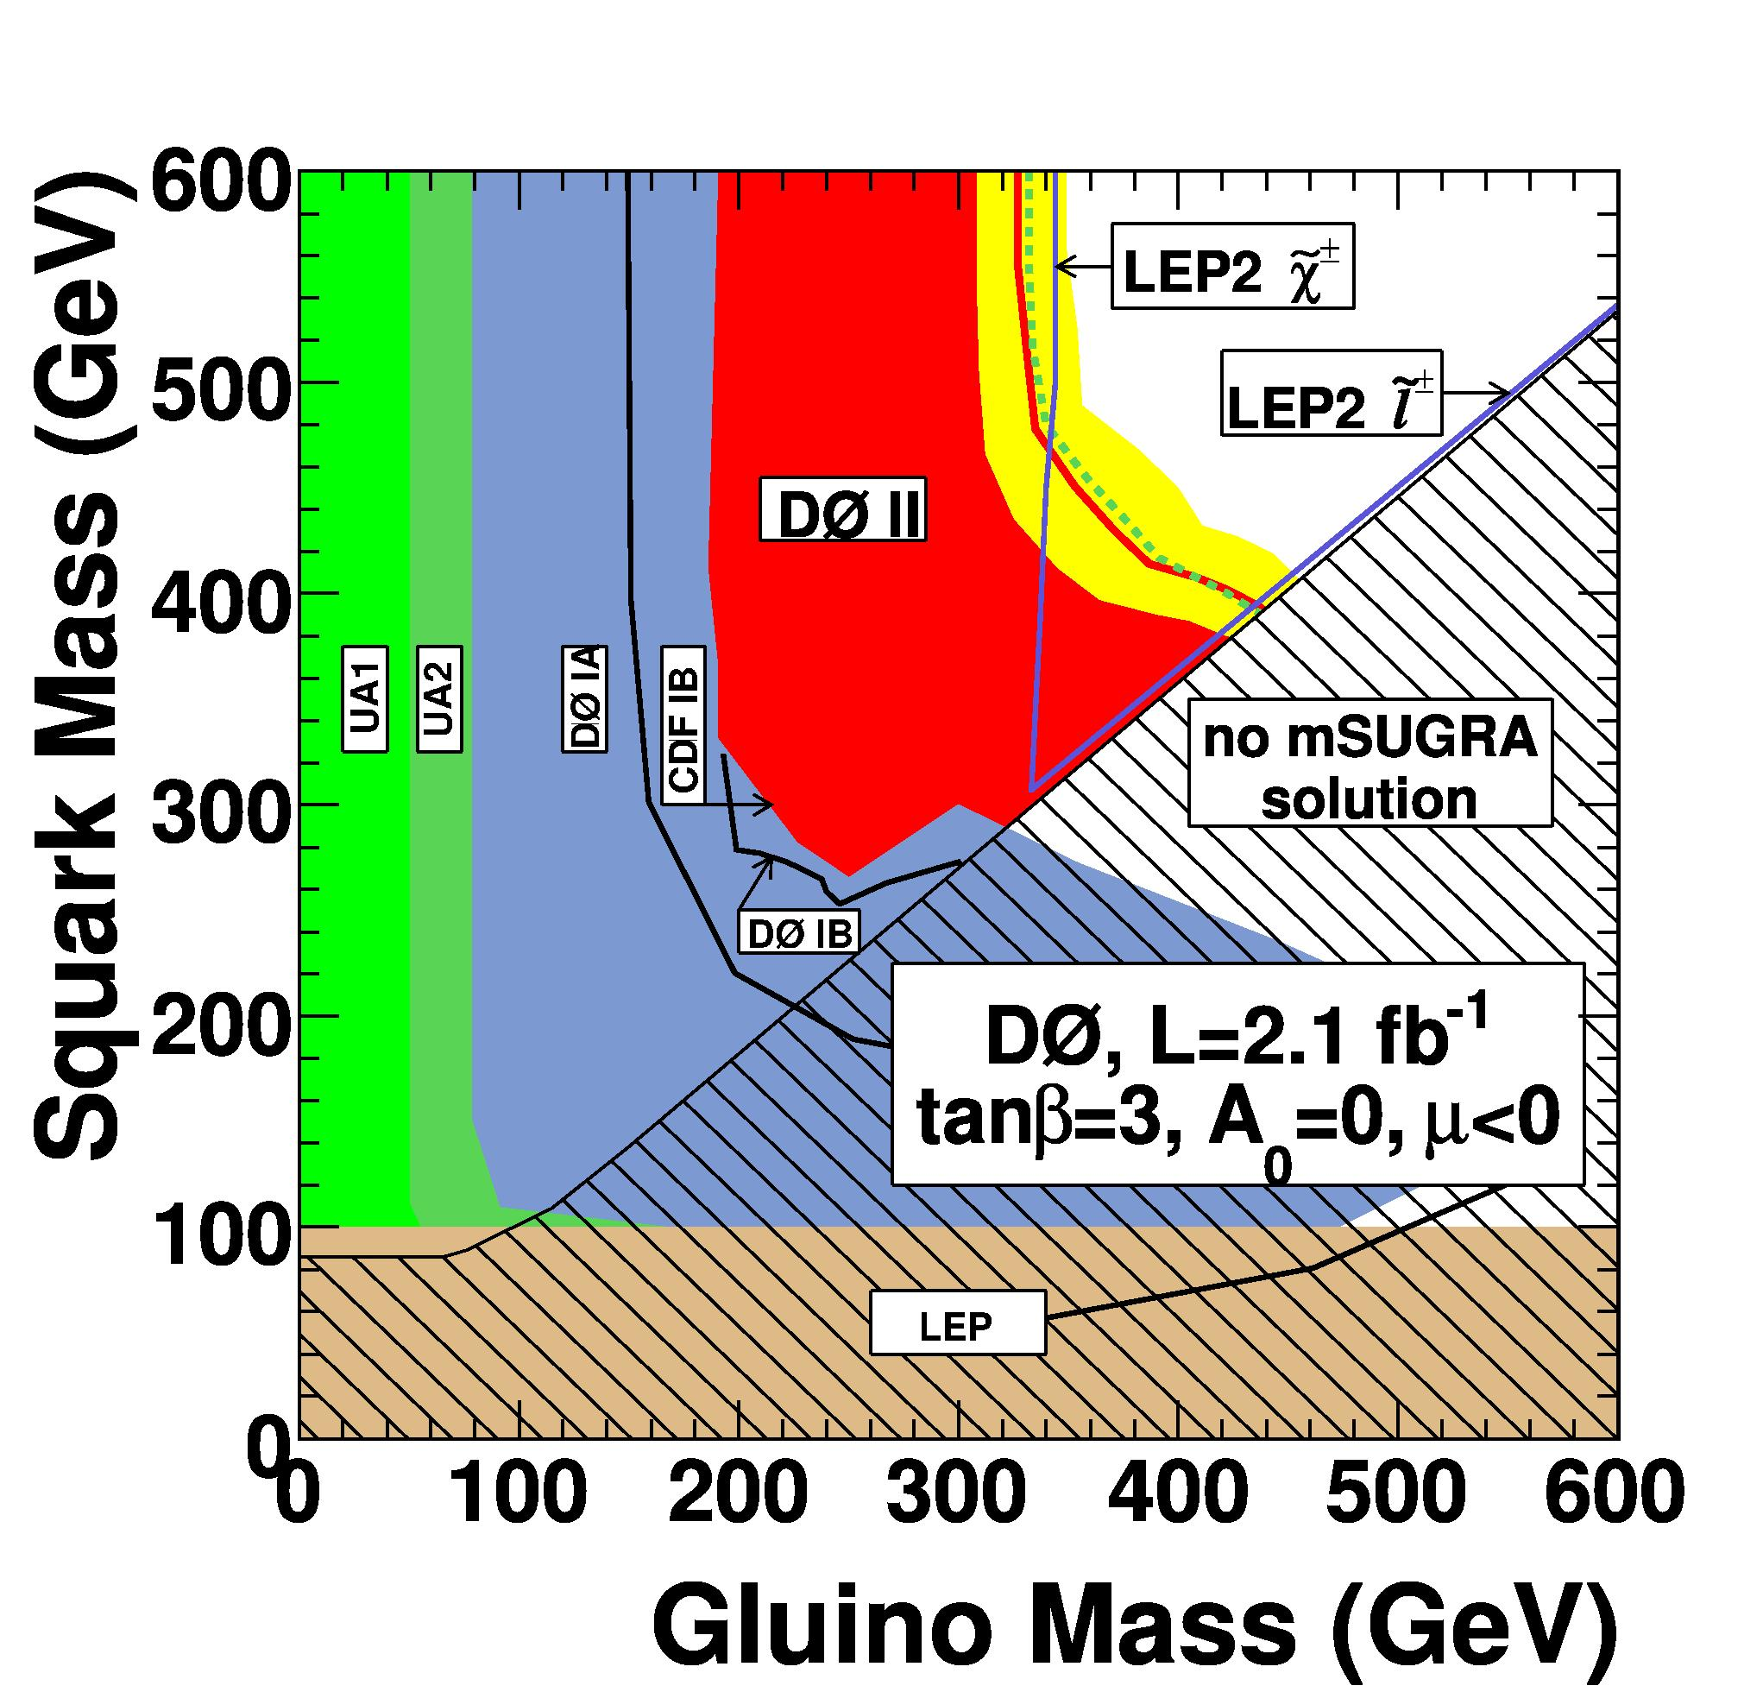
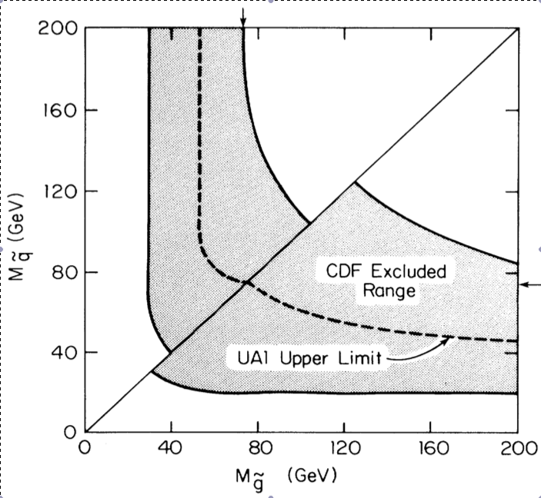
Direct Searches for New Physics
Squarks and Gluinos
abundantly produced in
strong interactions
100 times more luminosity
than for first results, plus
more sophisticated techniques:
- limit setting
- multivariate techniques
- better MC generators
- data driven background models
Leo Bellantoni
CDF, 25 nb⁻¹, 1989

Slide 21
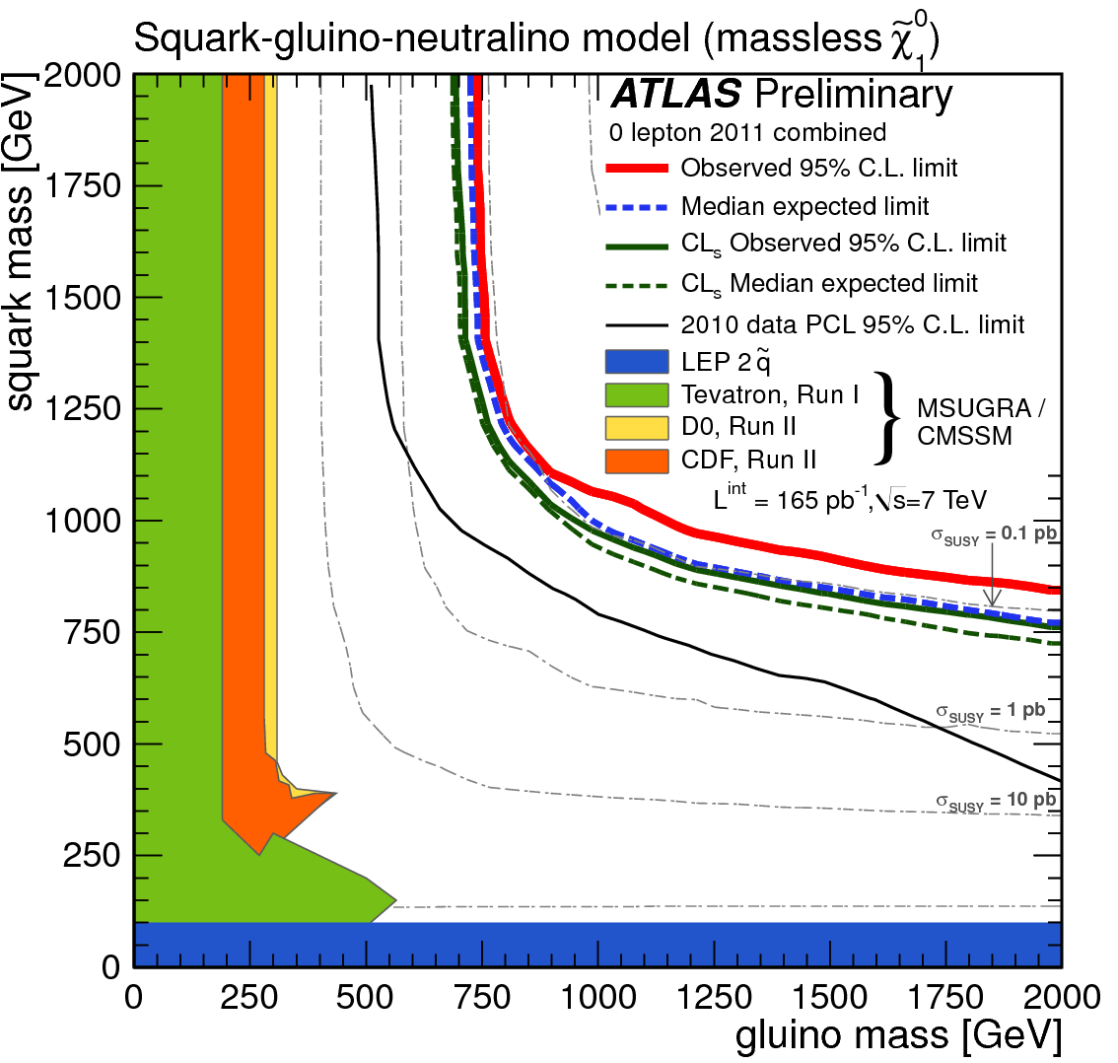
From Tevatron to LHC
“The power of energy”
(As an aside: we should
really not interpret the
size of the excluded area
in a way that makes no
sense in a statistical
interpretation. Still, we do.)

Slide 22

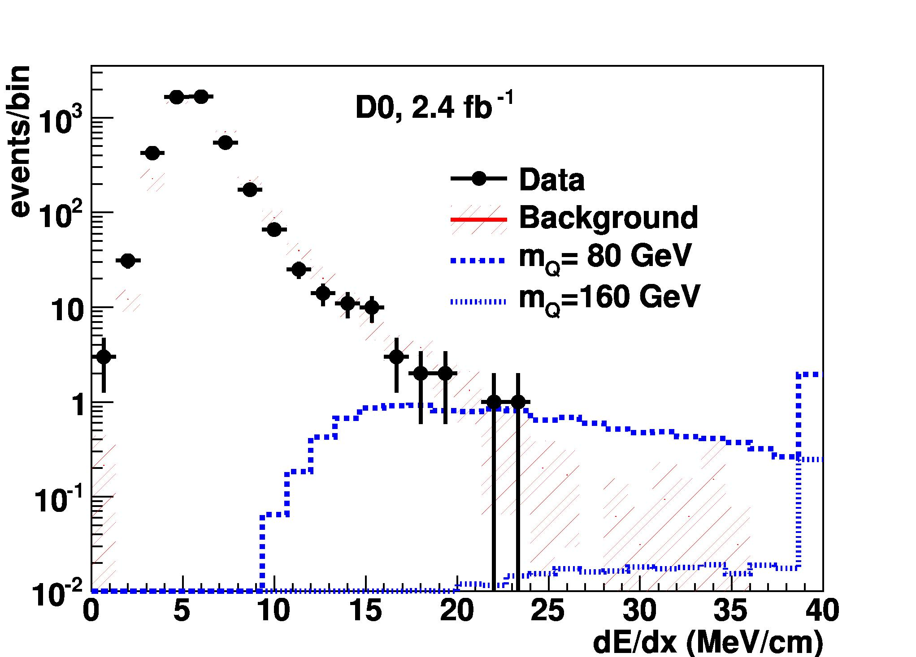
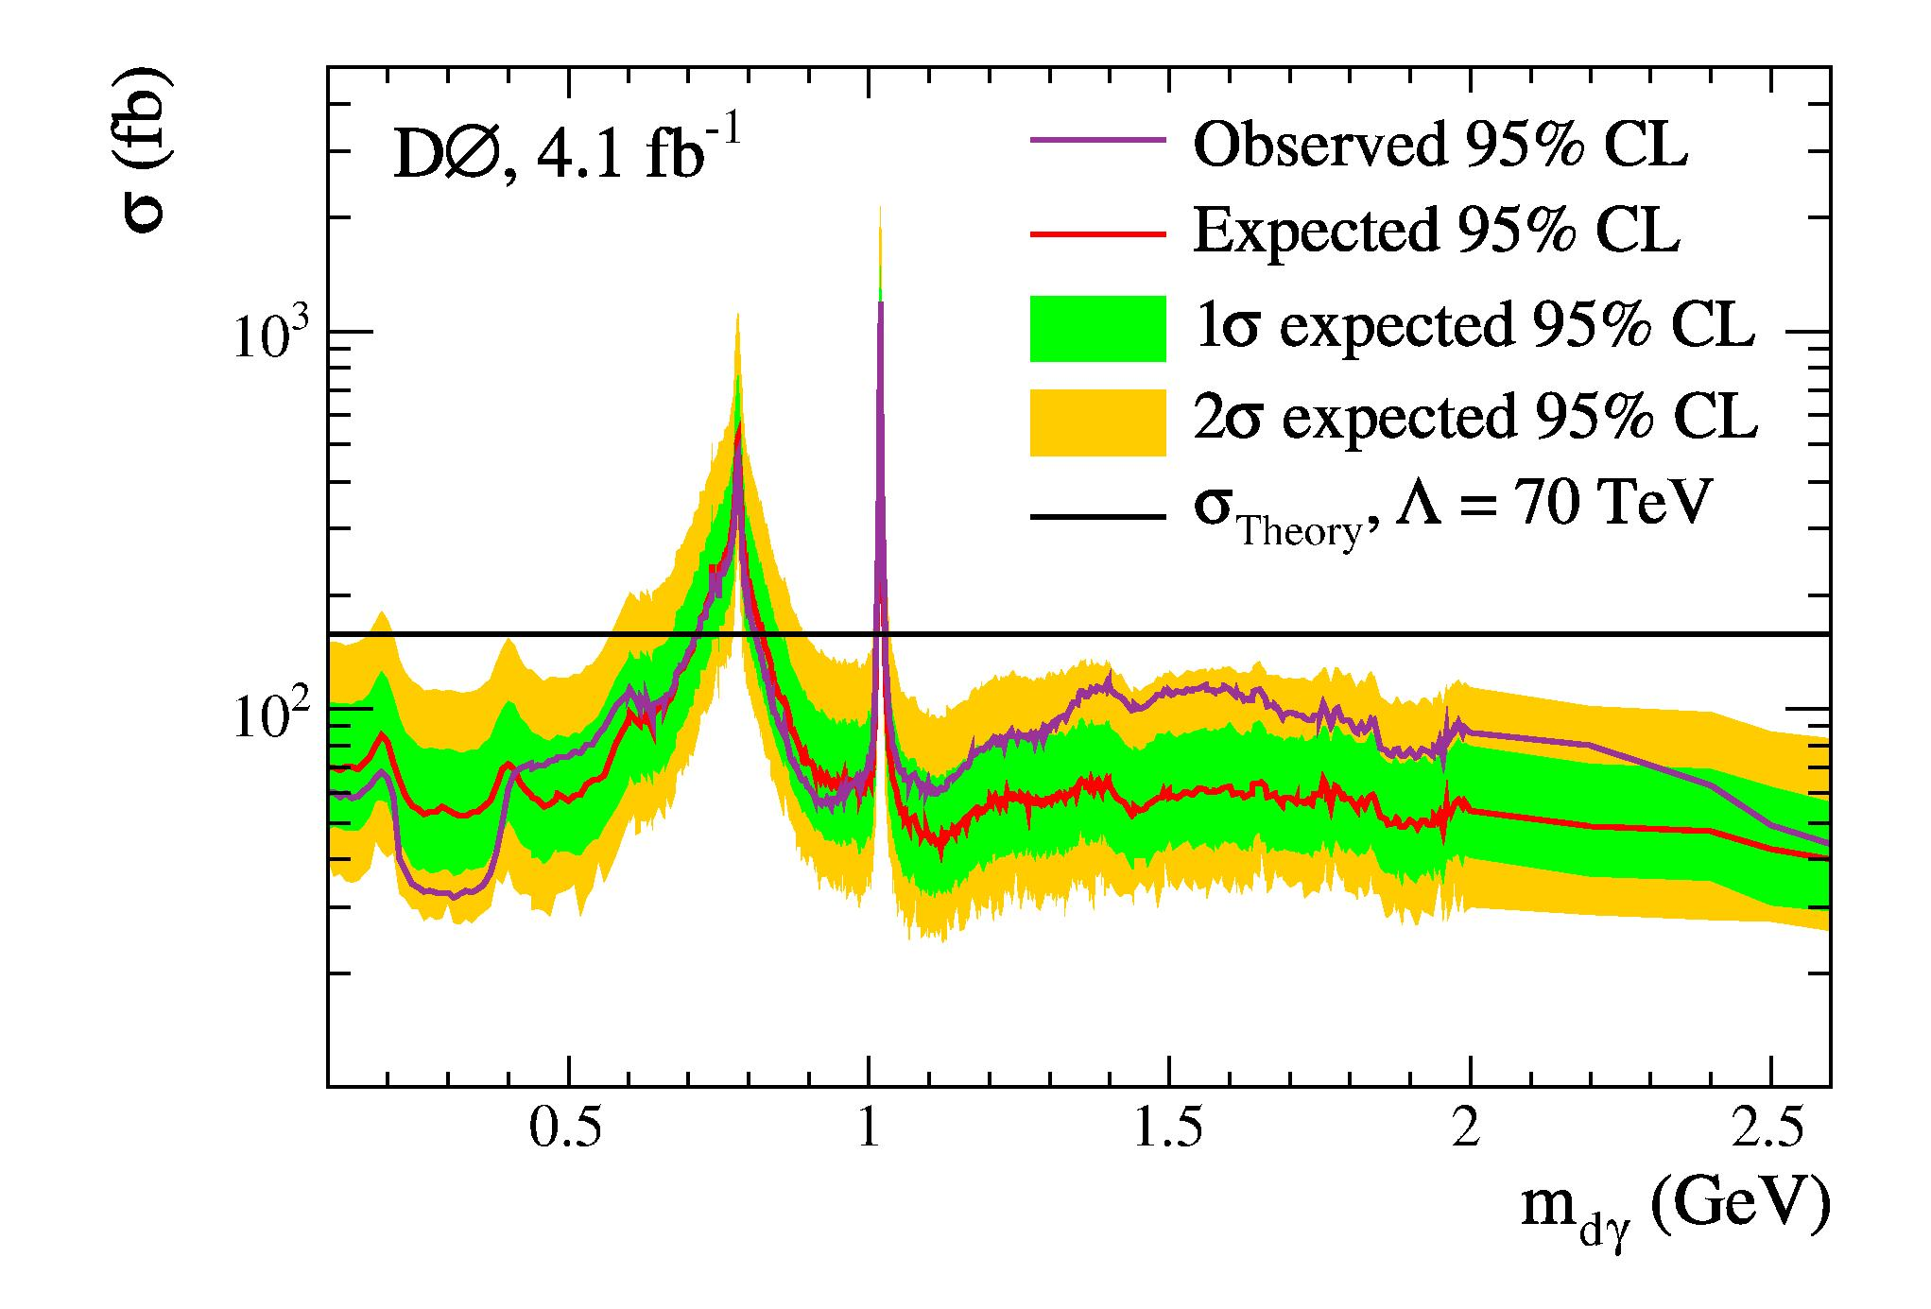
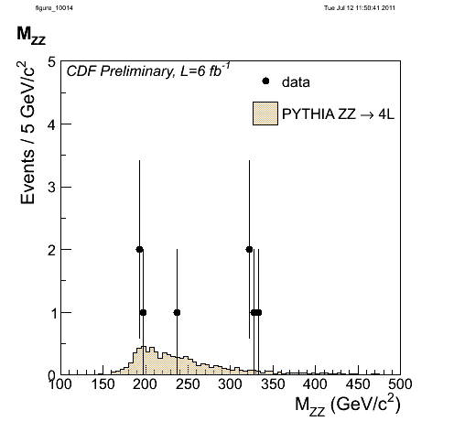
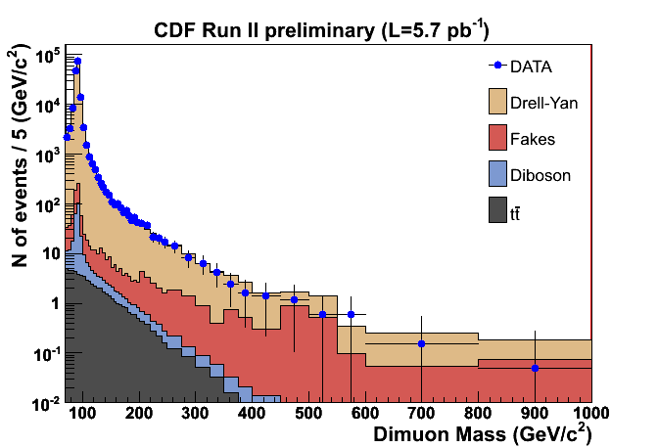
Exotics
Quirks
dark photons
G* to ZZ
RS gravitons
Many new models tested
for the first time by
Tevatron data.
Wealth of results on
SUSY, leptoquarks, large extra dimensions, excited quarks,
t’, W’, Z’, quirks, hidden valleys, new heavy gauge bosons,
compositeness, Randall-Sundrum gravitons, long-lived
particles, FCNC and model-independent searches.
Qiuguang Liu

Slide 23
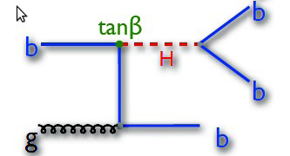
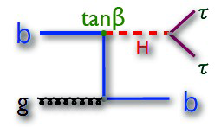
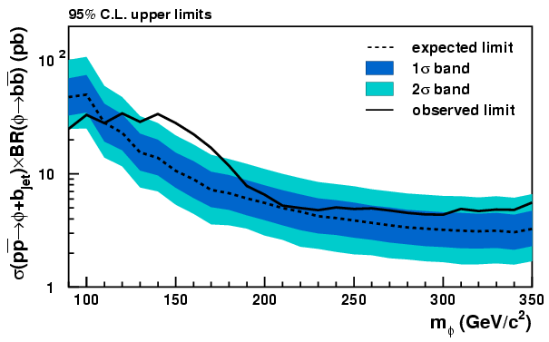
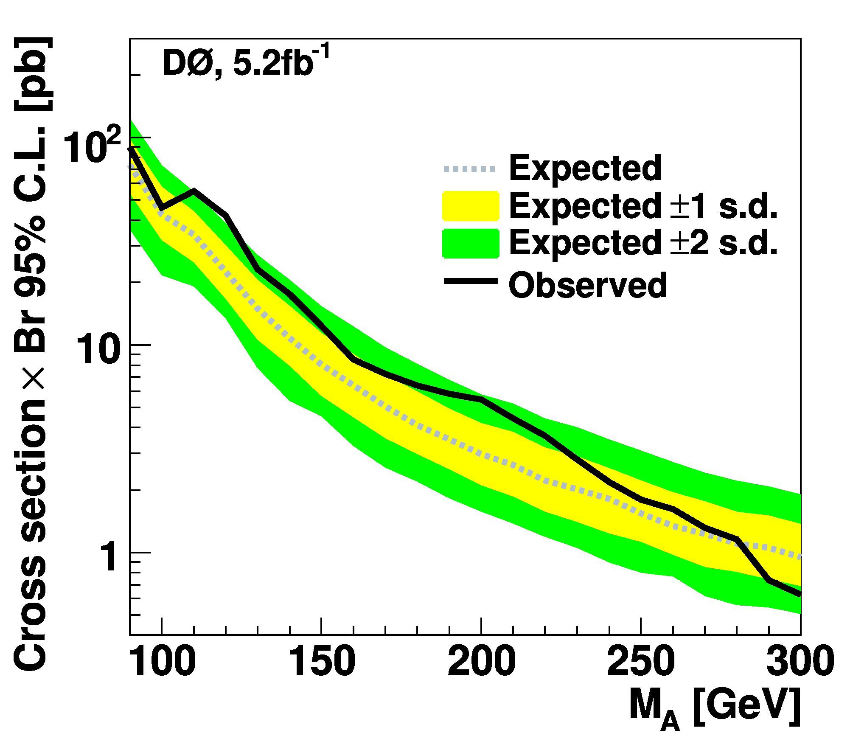

Supersymmetric Higgs
MSSM:
- two neutral CP-even Higgs (h,H)
- one neutral CP-odd Higgs (A)
- two charged (H±)
90%
10%
kills Z to ττ
Significantly extended excluded parameter space.
bbb channel unique to Tevatron
Only one example of non-standard Higgs searches
(fermiophobic, 4th generation, H⁺⁺ etc.)
T. Wright

Slide 24


Fermiophobic Higgs
Production through
associated production (VH_{f}) and
Vector Boson Fusion (VBF).
Decays into WW and γγ.
M(H_{f}) > 119 GeV
World’s best limit –
New Tevatron combination approved yesterday

Slide 25




The need for two experiments..
W+jj
DØ excludes ``bump” previously observed by CDF
- probably an experimental effect

Slide 26



The TevatrOn Particle
“The history of the top search over
the final two years shows evidence
of [..] competitiveness and friendly
rivalry at work.”
B. Carithers & P. Grannis, 1995
17 events
19 events
March 2, 1995:
Announcement of top
quark discovery in this auditorium

Slide 27

The TevatrOn Particle
Today, the Tevatron experiments each have
of order 1000s of top quark events which are
used as a precision laboratory to test the SM.
17 events
lepton+jets
19 events
"This monster, compared with all the other quarks, is like a big cowbird's egg in a nest of little sparrow eggs. It's so peculiar it must hold clues to some important new physics. ”
P. Grannis 1994 in the New York Times.
all-hadronic

Slide 28

Top Pair Production
Tevatron has taught us all we know about the properties of the top quark
Top mass
Top mass difference
Top charge
Lifetime
Top width
Branching ratios
|V_{tb}|
Anomalous coupling
New/Rare decays
Spin correlation
Charge asymmetry
Colour Flow
Production cross section
Production kinematics
Production via resonance
New particles
W helicity
Charged Higgs

Slide 29





Forward-Backward Top Asymmetry
Complementarity:
LHC: smaller qq fraction

Slide 30

Forward-Backward Top Asymmetry
Effects of p_{T}^{tt} modeling
need to be understood.

Slide 31



Single Top Observation
Electroweak process, sensitive to V_{tb}
s-channel t-channel
Cross section about half of top pair cross section
but it took more than a decade longer.
Much higher backgrounds (e.g. W+jets)

Slide 32







Single Top Observation
Boosted Decision Tree
Bayesian Neural Network
97 variables
24 channels
CDF, 3.2 fb⁻¹
5 multivariate analysis combined
to a ``Superdiscriminant”

Slide 33

Single Top Observation
Electroweak process, sensitive to V_{tb}
s-channel t-channel
Cross section about half of top pair cross section
but it took more than a decade longer.
Much higher backgrounds (e.g. W+jets)
Another example of
of pp/pp complementarity

Slide 34


EW: It is all connected
Need to measure
- Top quark mass
- W boson mass
to constrain remaining
SM parameter, M_{H}
Brout–Englert–Higgs-Guralnik–Hagen–Kibble

Slide 35




W Boson Mass
``Templates’’
LEP Z mass precision: 0.002%
Use Z mass to calibrate electron energy -
dominates uncertainty
Tevatron W mass precision: 0.04 %

Slide 36




Top quark mass
lepton+jets: 34%
di-leptons: 6%
all-jets: 60%
Use W mass to fit
jet energy scale.
Tevatron top mass precision: 0.6 %

Slide 37

EW: It is all connected
Brout–Englert–Higgs-Guralnik–Hagen–Kibble

Slide 38



Direct Higgs Search
WH or ZH

Slide 39



Example: Low Mass
1 b-tag
2 b-tags
Neutral Network
b tagging

Slide 40


Tevatron – LHC Complementarity
‘Tevatron’
Associated production is
dominant mode for Higgs
masses below 135 GeV
at the Tevatron. Significantly better S/B than at LHC.
Gluon fusion into di-photons
dominates Higgs sensitivity at LHC.
Gluon Fusion is also used
for high mass exclusion
in WW decays (direct coupling !).
Tree level coupling to b quark and W boson
‘LHC’
γ
γ
Higgs couples to massless particles via loops
with top and W, plus possibly new physics particles

Slide 41




Example: Medium/High Mass
Main background
Higgs is a scalar
– use angular correlation

Slide 42


Multivariate Techniques
MV techniques Improve
sensitivity by ~20%.
Have become standard in
most analyses.
Need to measure/cross check
background using control regions

Slide 43

Combination of channels
Increases sensitivity –
result still driven by a few
topologies.

Slide 44



SM Higgs Combination
observed exclusion:
< 109 GeV and 156 < m_{H} < 177 GeV
expected exclusion:
< 108 GeV and 148 < m_{H} < 181 GeV
exclusion confirmed by LHC
G. Bernardi

Slide 45

S+B versus B-only Hypotheses

Slide 46


Competition and Cooperation
First Joint CDF-DØ Publications in Run II
We should have more in the future
(and combinations with the LHC experiments)
Progress also driven by close collaboration with
theory community on signal cross sections,
uncertainties, Monte Carlo modeling of backgrounds..

Slide 47

The Future

Slide 48


SM Higgs Search Projections
Data taking will end on September 30, each experiment will have about 10 fb-1
to analyse, compared to about 8 fb-1 used for current results.
Including analysis improvements, Tevatron will have sensitivity over entire
allowed SM Higgs mass range.
- Tevatron remains unique in its sensitivity to Higgs to bb decays.

Slide 49


We are still getting smarter
Of course, running a couple of more years would have helped !

Slide 50


Top mass
W mass
Current Tevatron precision: 0.9 GeV
Current Tevatron precision: 31 MeV,
expect to get ~ 15 MeV
It will take the LHC a while to match this precision.
Indirect constraint on self-consistency of SM .

Slide 51
Self-consistency of SM
Expected precision:
- 1 GeV for the top mass
- 15 MeV for W boson mass:
upper limit on m_{H} at 95% CL
at approximately 120 GeV
for current minimum.

Slide 52






What have we learned this week ?
``The rumours of SUSY’s and the Tevatron’s
death are greatly exaggerated”

Slide 53
Conclusions
Only a tiny fraction of Tevatron results covered.
Many NP searches pioneered by Tevatron –now being taken over by the LHC.
In other areas Tevatron is complementary or unique.
Tevatron will test self-consistency of SM through direct versus indirect Higgs mass constraints.

