Slide 1
Nonlinear Optics as a Path to High-Intensity Circular Machines
S. Nagaitsev, A. Valishev (Fermilab), and V. Danilov (ORNL)
Draft talk for HB2010 Sep 23, 2010

Slide 2
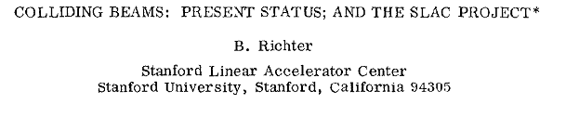
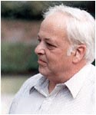
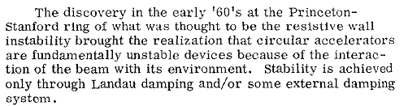
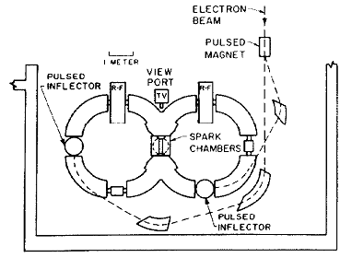
Report at HEAC 1971
1965, Priceton-Stanford CBX: First mention of an 8-pole magnet
  Observed vertical resistive wall instability
  With octupoles, increased beam current from ~5 to 500 mA
CERN PS: In 1959 had 10 octupoles; not used until 1968
  At 10¹² protons/pulse observed (1st time) head-tail instability.
  Octupoles helped.
  Once understood, chromaticity jump at transition
  was developed using sextupoles.
  More instabilities were discovered; helped by octupoles
  and by feedback.
CBX layout (1962)

Slide 3
How to make a high-intensity machine?
(OR, how to make a high-intensity beam stable?)
Landau damping – the beam’s “immune system”. It is related to the spread of betatron oscillation frequencies. The larger the spread, the more stable the beam is against collective instabilities.
External damping (feed-back) system – presently the most commonly used mechanism to keep the beam stable.
  Can not be used for some instabilities (head-tail)
  Noise
  Difficult in linacs

Slide 4
Most accelerators rely on both
LHC
  Has a transverse feedback system
  Has 336 Landau Damping Octupoles
  Provide tune spread of 0.001 at 1-sigma at injection
In all machines there is a trade-off between
Landau damping and dynamic aperture.
  …But it does not have to be.

Slide 5
Today’s talk will be about…
… How to improve beam’s immune system (Landau damping through betatron frequency spread)
  Tune spread not ~0.001 but 10-50%
What can be wrong with the immune system?
  The main feature of all present accelerators – particles have nearly identical betatron frequencies (tunes) by design. This results in two problems:
    Single particle motion can be unstable due to resonant perturbations (magnet imperfections and non-linear elements);
    Landau damping of instabilities is suppressed because the frequency spread is small.

Slide 6
Courant-Snyder Invariant
Equation of motion for
betatron oscillations
Courant and Snyder found a conserved quantity:
-- auxiliary equation
-- are Courant-Snyder integrals of motion
-- betatron frequencies

Slide 7
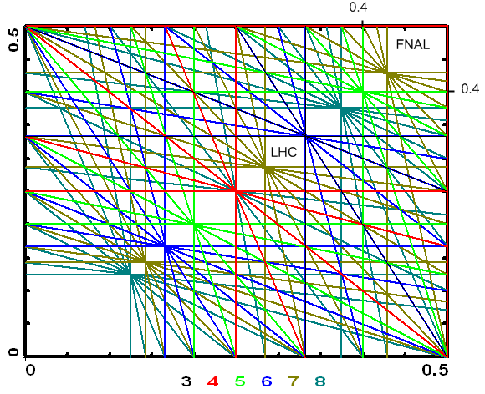
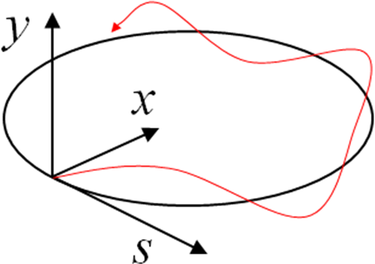
Linear function of actions: good or bad?
It is convenient (to have linear optics), easy to model, …but it is NOT good for stability.
We did not know (until now) how to make it any other way!
To create the tune spread, we add non-linear elements (octupoles) as best we can
  Destroys integrability!
octupole
  Tune spread depends on
  a linear tune location
1-D system:
  Theoretical max.
  spread is 0.125
2-D system:
  Max. spread < 0.05

Slide 8
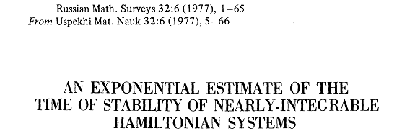
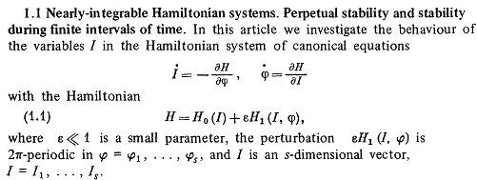

Long-term stability
The first paper on the subject was written by Nikolay Nekhoroshev in 1971
He proved that for sufficiently small ε
provided that H₀(I) meets certain conditions know as steepness
  Convex and quasi-convex functions H₀(I) are the steepest
An example of a NON-STEEP function is a linear function
Another example of a NON-STEEP function is

Slide 9
Non-linear Hamiltonians
We were looking for (and found) non-linear 2-D steep Hamiltonians that can be implemented in an accelerator
Other authors worked on this subject: Yu. Orlov (1962-65), E. McMillan (1967-71), and recently, J. Carry et al., S. Danilov, E. Perevedentsev
  The problem in 2-D is that the fields of non-linear elements are coupled by the Laplace equation.
  An example of a steep (convex) Hamiltonian is
  but we DO NOT know how to implement it with magnetic fields…

Slide 10
What are we looking for?
We are looking for a 2-D integrable convex non-linear Hamiltonian,
  -- convex curves
I₂
I₁

Slide 11
Our approach
See: Phys. Rev. ST Accel. Beams 13, 084002
Start with a round axially-symmetric LINEAR focusing lattice (FOFO)
  Add special non-linear potential V(x,y,s) such that
V(x,y,s)
V(x,y,s)
V(x,y,s)
V(x,y,s)
V(x,y,s)

Slide 12
Special time-dependent potential
Let’s consider a Hamiltonian
where V(x,y,s) satisfies the Laplace equation in 2d:
In normalized variables we will have:
Where new “time” variable is

Slide 13
Four main ideas
Chose the potential to be time-independent in new variables
Element of periodicity
Find potentials U(x, y) with the second integral of motion
Convert Hamiltonian to action variables
and check it for steepness

Slide 14
Integrable 2-D Hamiltonians
Look for second integrals quadratic in momentum
  All such potentials are separable in some variables (cartesian, polar, elliptic, parabolic)
  First comprehensive study by Gaston Darboux (1901)
So, we are looking for integrable potentials such that
Second integral:

Slide 15
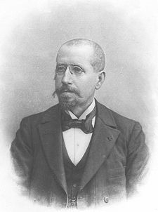
Darboux equation (1901)
Let a ≠ 0 and c ≠ 0, then we will take a = 1
General solution
ξ : [1, ∞], η : [-1, 1], f and g arbitrary functions

Slide 16
The second integral
The 2nd integral
Example:

Slide 17
Laplace equation
Now we look for potentials that also satisfy the Laplace equation (in addition to the Darboux equation):
We found a family with 4 free parameters (b, c, d, t):
The most interesting: c=1, t=1, d=0,

Slide 18
The integrable Hamiltonian
Multipole expansion
|k| < 0.5 to provide linear stability for small
amplitudes
For k > 0 adds focusing in x
Small-amplitude tune s:

Slide 19
Convex Hamiltonian
This Hamiltonian is convex (steep)
Example of tunes for k = 0.4
ν₁(J₁, 0)
ν₂(0, J₂)
For k -> 0.5 tune spreads of ~ 100% is possible

Slide 20
How to realize it?
Need to create an element
of periodicity.
  The T-insert can also be
  which results in a phase advance 0.5 (180 degrees) for the T-insert.
  The drift space L can give the phase advance of at most 0.5 (180 degrees).

Slide 21
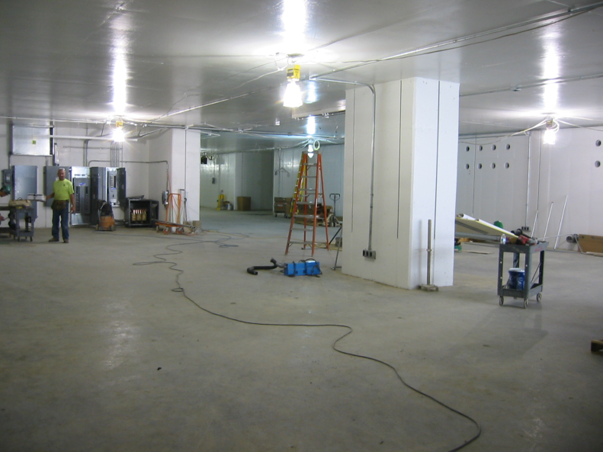
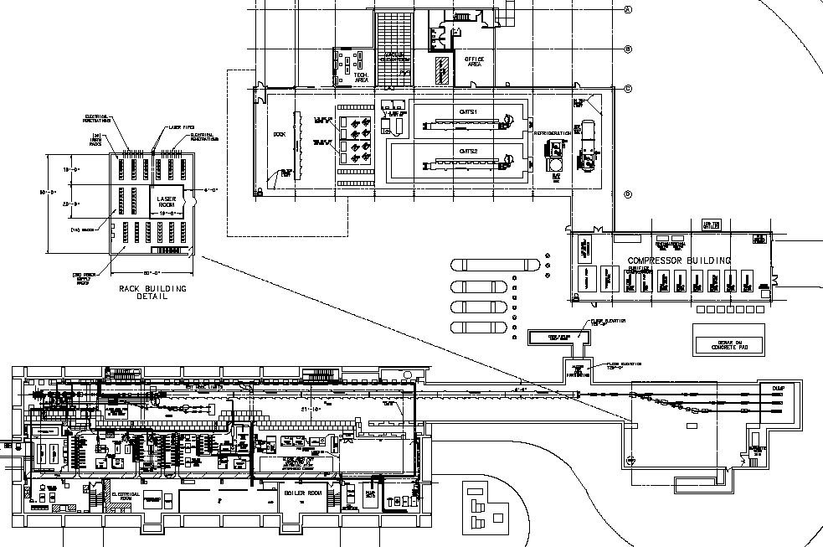
Location: New Muon Lab
New cryoplant and horizontal cryomodule test stands
Existing NML building
Photoinjector and low energy test beamlines
up to 6 cryomodules
High energy test beamlines
Possible 10m storage ring
New tunnel extension
75 meters

Slide 22
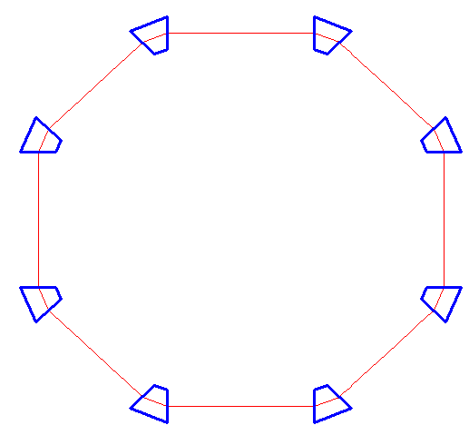
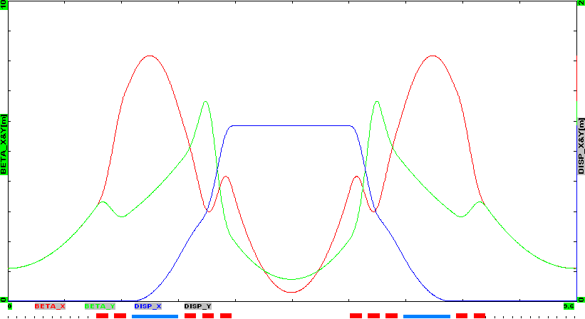
e- Energy | 150 MeV
Circumference | 38 m
Dipole field | 0.5 T
Betatron tunes | Qx=Qy=3.2 (2.4 to 3.6)
Radiation damping time | 1-2 s (10⁷ turns)
Equilibrium emittance, rms, non-norm | 0.06 μm
13 m
Nonlinear
Lens Block
Nonlinear lens block
Length | 2.5 m
Number of elements | 20
Element length | 0.1 m
Max. gradient | 1 T/m
Pole-to-pole distance (min) | ~ 2 cm
μ_{x},μ_{y}=0.5
βx
βy
Dx

Slide 23
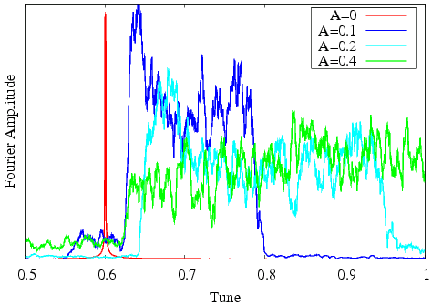
Current and Proposed Studies
Numerical Simulations
Possible Experiments at Test Ring
Nonlinear lenses implemented in a multi-particle tracking code (thin kick)
Studied particle stability
  Effects of imperfections (phase advance, beta-functions, etc.) - acceptable
  Synchrotron motion - acceptable
  Number of nonlinear lenses - 20
Simulated observable tune spread
To Do:
  Ring nonlinearities
  Chromaticity
Demonstrate large betatron tune spread
Demonstrate part of the beam crossing integer resonance
Map phase space with pencil beam by varying an injection error
All particles
are stable!
Spectrum of horizontal dipole moment
Q₀=0.9x4=3.6
5000 particles
8000 revolutions
But up to 10⁶ revolutions simulated

Slide 24
Conclusions
We found first examples of completely integrable non-linear optics.
  Tune spreads of 50% are possible. In our Test Ring simulation we achieved tune spread of about 1.5 (out of 3.6);
Nonlinear “integrable” accelerator optics has advanced to possible practical implementations
  Provides “infinite” Landau damping
  Potential to make an order of magnitude jump in beam brightness and intensity
Fermilab is in a good position to use of all these developments for next accelerator projects
  Rings or linacs

Slide 25
Extra slides

Slide 26
Examples of time-independent
Hamiltonians
Quadrupole
Integrable but still linear…
quadrupole
amplitude
Tunes:
β(s)
Tune spread: zero
L

Slide 27
Examples of time-independent
Hamiltonians
This Hamiltonian is NOT integrable
Tune spread (in both x and y) is limited to ~12%
Octupole

Slide 28
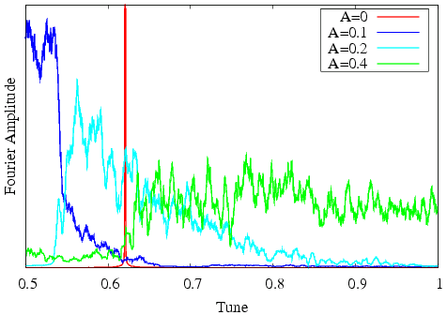
Spectrum of vertical dipole moment. Q₀=0.905x4=3.62

