Slide 2
Tube Hydroforming
a
b
c
d
e
f
F_{axial}
F_{axial}
P

Slide 3
TUBE BENDING

Slide 5
500 TON PREFORMING PRESS

Slide 6
4,000 TON HYDROFORM PRESS

Slide 7
PREFILLING

Slide 8
REMOVING HYDROFORMED PART

Slide 9
DRAINING COMPLETED PARTS

Slide 10
LASER TRIMMING

Slide 11
LASER TRIMMING

Slide 12
QC CHECK

Slide 13
Prototype Die and Raw Tube

Slide 15
Die Closing

Slide 16
Die Closed – Part Forming

Slide 17
Process Complete, Formed Part

Slide 18
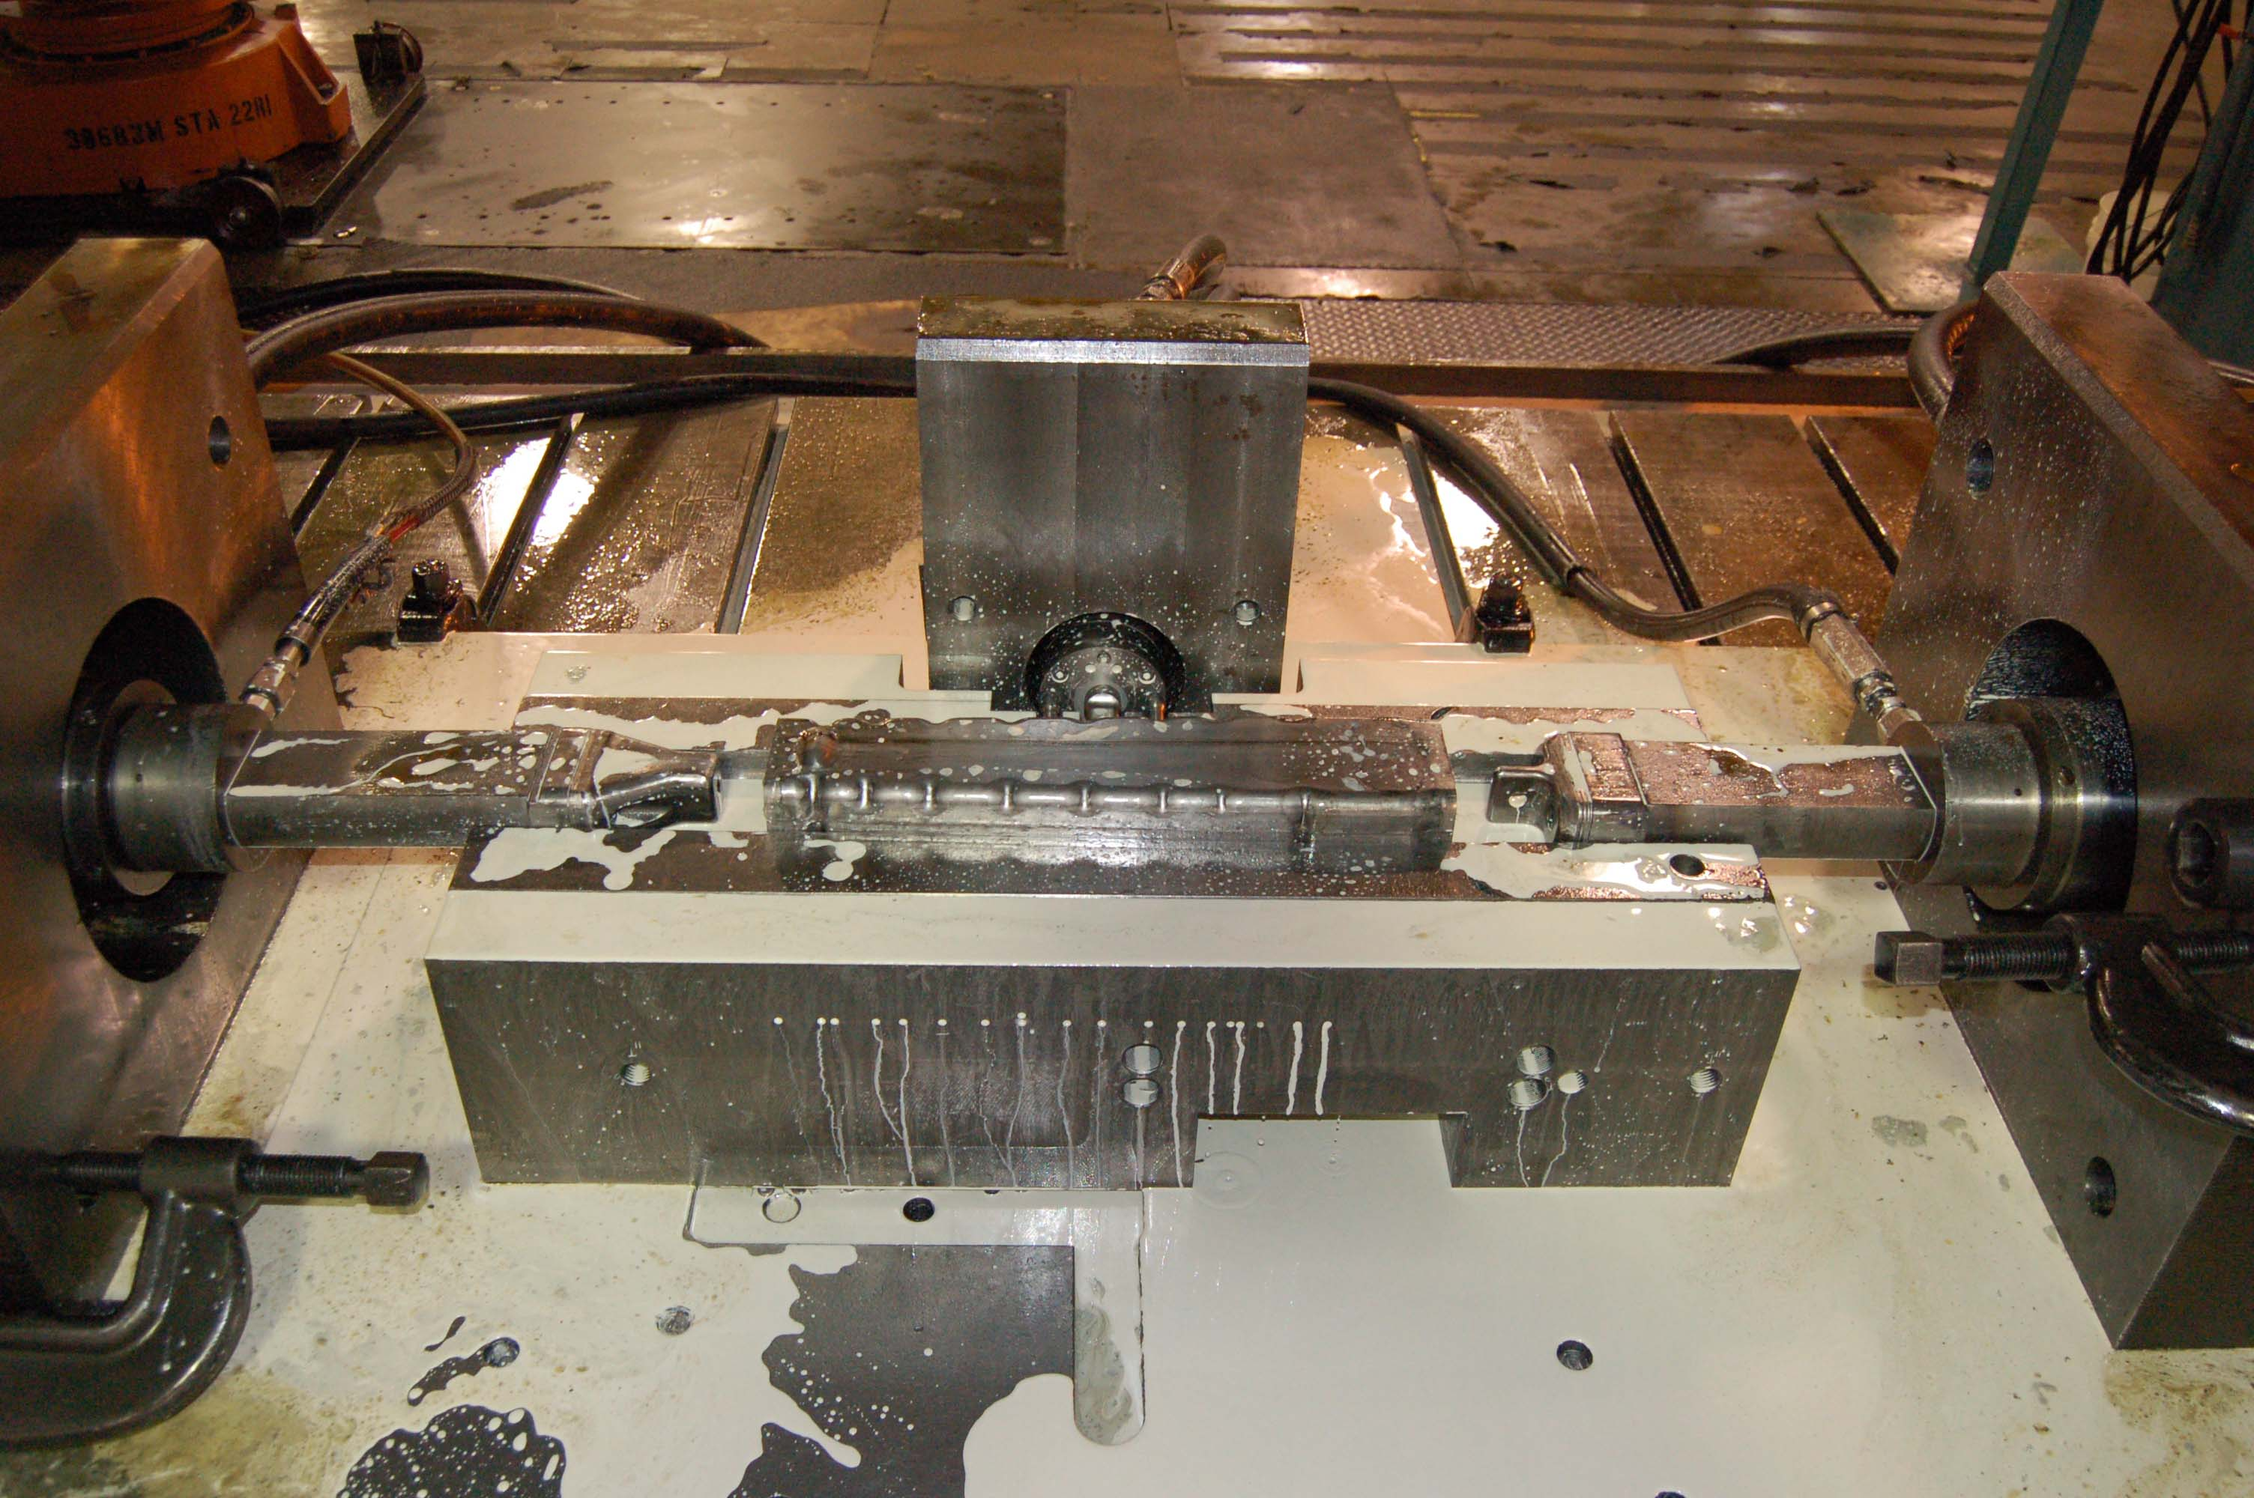

Slide 19
Final Laser Trimming

Slide 20
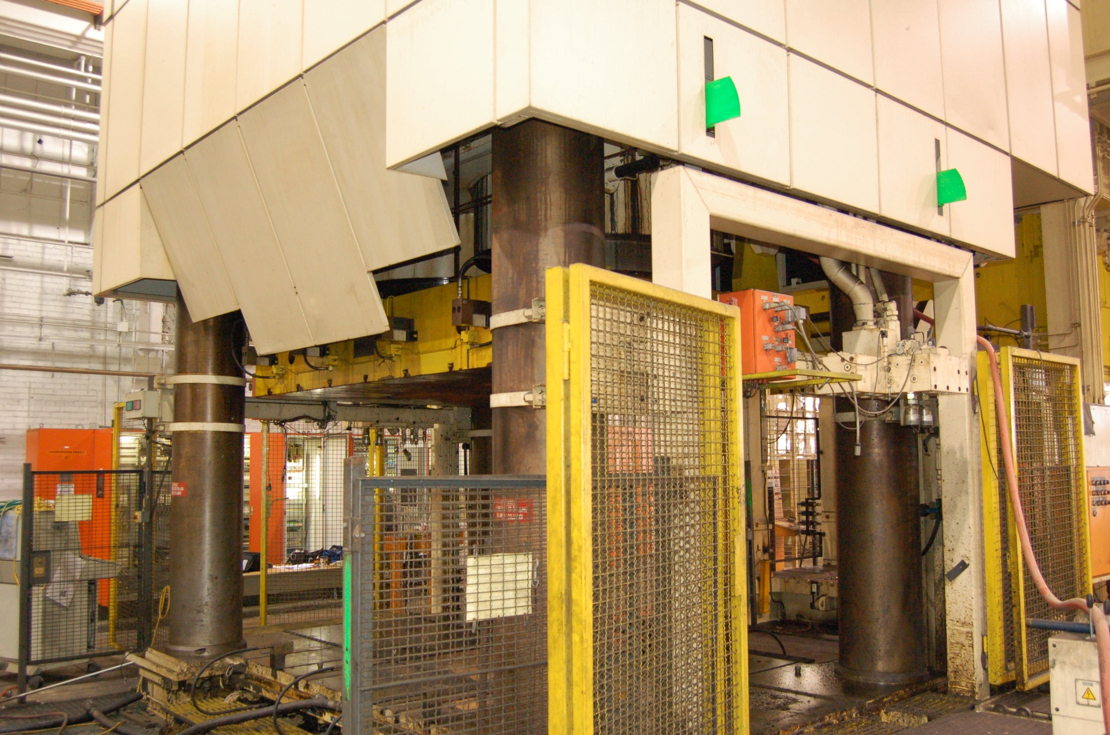
New Shuler 5500 Ton Hydroformer

Slide 21
Finite Element Analysis of Parts
( Result for SS 304 tubing)
Results obtained by SF technique
Max %th = 41%
Alpha = 2.75

Slide 23
Internal Pressure – End Feed Relationship
Number of simulation runs = 10
(determined by SF technique)

Slide 24
Generalety Project Report Cryomodule Hydroforming Simulation -Preliminary Report
May. 30, 2008
Prepared for
Prepared by
Mr. Mark Blasi
General Manager
American Hydroformers
Dr. Shengdong Liu
Generalety, LLC
BY ACCEPTING THE ABOVE GENERALETY REPORT, IT IS ACKNOWLEDGED THAT, ALTHOUGH STATE OF THE ART ANALYTICAL METHODS WERE APPLIED, GENERALETY DOES NOT IN ANY WAY WARRANT THE ADEQUACY OR THE APPROPRIATENESS OF TH METHOD OR PROCEDURE EMPLOYED IN PREPARING THIS REPORT, NOR DOES GENERALETY GUARANTEES THE ACCURACY OF ANY RESULTS OR CONCLUSIONS INDICATED IN THIS REPORT. YOU HEREBY AGREE TO INDEMNIFY AND HOLD GENERALETY HARMLESS FROM ANY CLAIM, ACTION, DAMAGES OR LIABILITY WHICH MAY BE ASSERTED BY ANY THIRD PARTY AND WHICH ARISES OUT OF THIS REPORT.

Slide 25
Objective
To conduct FEA simulation on pure Copper hydroforming process, feeding from one end only and to identify an optimum pressure-end feed relationship that produces the target expansion.

Slide 26
Hydroforming Simulation Model
Upper die
pad
Lower die

Slide 27
Illustration of Hydroforming Die

Slide 28
Hydroforming Pressure & Time Curves
*User-defined – Generalety created curve

Slide 29
Hydroforming Displacement & Time Curves
*User-defined – Generalety created curve

Slide 30
Copper hydro Diameter Expanded Size
Initial Tube Diameter: 52.7mm
Target Diameter : 160mm

Slide 31
Blank Material
Material: Copper
Thickness 1.27mm
Yield(Mpa) | Tensile(Mpa) | N-value | R-Bar | K-value
33.3 | 210 | 0.54 | 0. 7 | 502.63

Slide 32
FLD (Curve Ref)
Red color - Cracks

Slide 33
Thickness (Curve Ref)

Slide 34
Thickness Strain (Curve Ref)

Slide 35
Maximum Diameter without Material Failure - Copper
*User-def – Generalety created curve.

Slide 36
Remarks
FEA simulation was conducted on pure copper tube hydroforming process
The results indicate that the tube fails at very early expansion stage using the pressure-displacement curves obtained from the client
Generalety has created and tried many different pressure-displacement curves.
The best expansion result obtained is 112mm in diameter, which is 48mm short from the target expansion.

Slide 37
Single Cell, One Way Feed Die Segments

Slide 38
Single Cell Die In Press

Slide 39
Expanded Copper Tube – Asymmetric Expansion

Slide 40
Experiments with 304 Stainless Steel Tube

Slide 41
What Might Work?
Pure Expansion is not the answer – too much expansion is required.
Procedure of first stage reduction for the iris and hydroforming expansion of the equator looks promising.
Multistep series of expansions, reductions and anneals.

Slide 42
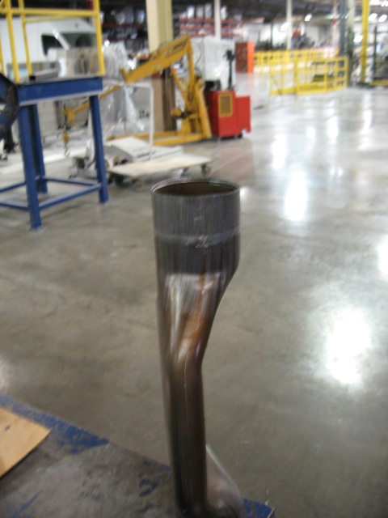
A Part Made With Stage 1 Expansion, Crush, Anneal, Stage 2 Expansion

