Slide 1
The DYNES Architecture & LHC Data Movement
Shawn McKee/University of Michigan
For the DYNES collaboration
Contributions from Artur Barczyk, Eric Boyd, Tom Lehman, Harvey Newman and Jason Zurawski
OSG All-hands Meeting
March 8th 2011, Harvard Medical School

Slide 2
DYNES Summary
NSF MRI-R2: DYnamic NEtwork System (DYNES, NSF #0958998)
What is it?:
A nationwide cyber-instrument spanning up to ~40 US universities and ~14 Internet2 connectors
Extends Internet2s ION service into regional networks and campuses, based on OSCARS implementation of IDC protocol (developed in partnership with ESnet)
Who is it?
A collaborative team including Internet2, Caltech, University of Michigan, and Vanderbilt University
Community of regional networks and campuses
LHC, astrophysics community, OSG, WLCG, other virtual organizations
What are the goals?
Support large, long-distance scientific data flows in the LHC, other leading programs in data intensive science (such as LIGO, Virtual Observatory, and other large scale sky surveys), and the broader scientific community
Build a distributed virtual instrument at sites of interest to the LHC but available to R&E community generally

Slide 3
DYNES and LHC: The Problem to be Addressed
The LHC experiments’ “Tiered” computing and storage system already encompasses more than 140 sites
Each hosting from tens of terabytes (Tier3) to hundreds of terabytes (Tier2) to petabytes (Tier1)
Sustained throughputs at 1-10 Gbps (and some > 10 Gbps) are in production use today by some Tier2s as well as Tier1s, particularly in US
LHC data volumes and transfer rates are expected to expand by an order of magnitude over the next several years
As higher capacity storage and regional, national and transoceanic network links of 40 and 100 Gbps become available and affordable.
US LHCNet, for example, is expected to reach 280-400 Gbps by 2014 between its points of presence in NYC, Chicago, CERN and Amsterdam
Network usage on this scale can only be accommodated with planning, an appropriate architecture, and nationwide community involvement
By the LHC groups at universities and labs
By campuses, regional and state networks connecting to Internet2
By ESnet, US LHCNet, NSF/IRNC, major networks in US & Europe

Slide 4
DYNES: Addressing the Problem with Dynamic Network Circuits (1/2)
DYNES will deliver the needed capabilities to the LHC, and to the broader scientific community at all the campuses served, by coupling to their analysis systems:
Dynamic network circuit provisioning: IDC Controller
Data transport: Low-cost IDC-capable Ethernet switch;
FDT server for high throughput, Low-cost storage array
End-to-end monitoring services

Slide 5
DYNES: Addressing the Problem with Dynamic Network Circuits(2/2)
DYNES does not fund more bandwidth, but provides access to Internet2’s dynamic circuit network (“ION”), plus the standard mechanisms, tools and equipment needed
To build circuits with bandwidth guarantees across multiple network domains, across the U.S. and to Europe
In a manageable way, with fair-sharing
Will require scheduling services at some stage
To build a community with high throughput capability using standardized, common methods

Slide 6
DYNES: Why Dynamic Circuits(1/2)?
To meet the science requirements, Internet2 and ESnet, along with several US regional networks, US LHCNet, and in GEANT in Europe, have developed a strategy (starting with a meeting at CERN, March 2004) based on a ‘hybrid’ network architecture utilizing both routed and circuit based paths.
The traditional IP network backbone is paralleled by a circuit-oriented core network reserved for large-scale science traffic.

Slide 7
DYNES: Why Dynamic Circuits(2/2)?
Exiting examples are Internet2’s Dynamic Circuit Network (Its “ION Service”) and ESnet’s Science Data Network (SDN), each of which provides:
Increased effective bandwidth capacity, and reliability of network access, by mutually isolating the large long-lasting flows (on ION and/or the SDN) and the traditional IP mix of many small flows
Guaranteed bandwidth as a service by building a system to automatically schedule and implement virtual circuits traversing the network backbone, and
Improved ability of scientists to access network measurement data for all the network segments end-to-end via the perfSONAR monitoring infrastructure.

Slide 8
DYNES: Why Not Static Circuits or Traditional, General Purpose Networks ?
Separation (physical or logical) of the dynamic circuit-oriented network from the IP backbone is driven by the need to meet different functional, security, and architectural needs:
Static “nailed-up” circuits will not scale.
GP network firewalls incompatible with enabling large-scale science network dataflows
Implementing many high capacity ports on traditional routers would be very expensive
Price balance: Worse in the next generation: 40G and 100G general purpose router ports are several hundred k$ each.

Slide 9
DYNES Project Schedule
All applications has been reviewed.
Clarifications are needed for some. This could require some changes to the proposed configuration
Teleconferences with individual sites will be arranged
A draft DYNES Program Plan document is available with additional details on the project plan and schedule:
http://www.internet2.edu/dynes

Slide 10
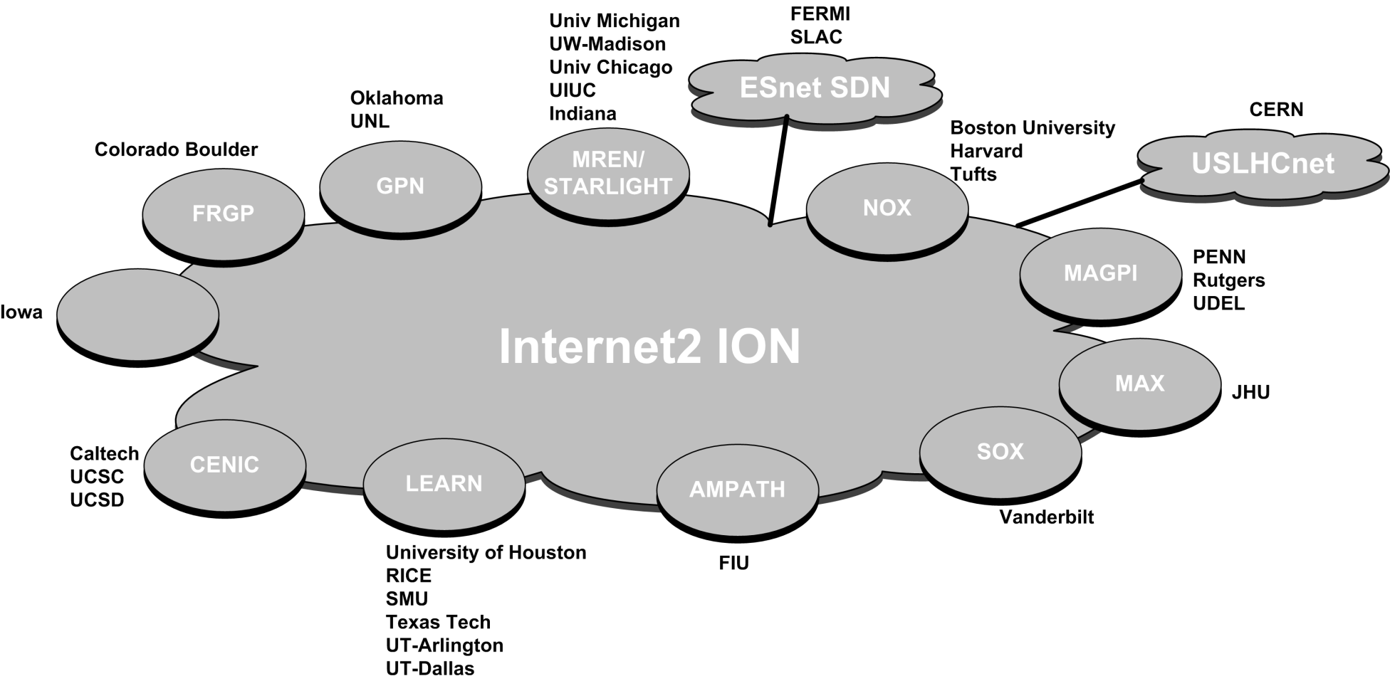
DYNES Infrastructure Overview
DYNES Topology
Based on Applications received
Plus existing peering wide area Dynamic Circuit Connections (DCN)

Slide 11
NSF proposal defined four project phases
Phase 1: Site Selection and Planning (4 months) (Sep-Dec 2010)
Participant Selection Announcement: February 1, 2011
33 Total Applications
8 Regional Networks
25 Site Networks
Phase 2: Initial Development and Deployment (6 months) (Jan 1-Jun 30, 2011)
Development of DYNES at a limited number of sites (February 28, 2011)
Caltech, Vanderbilt, University of Michigan, Internet2, USLHCnet
Regional networks as needed
Initial Site Systems Testing and Evaluation Complete: end of March, 2011
Phase 3-Group A Deployment (10 Sites) (March -July, 2011)
Phase 3-Group A Deployment (10 Sites) (March-July, 2011)
Receive DYNES Equipment: April, 2011
Ship Configured Phase 3-Group A Equipment to sites: May 2011
Deploy and Test at Phase 3-Group A Sites: May-June, 2011

Slide 12
DYNES Phase 3 & 4 Project Schedule
Phase 3: Scale Up to Full-scale System Development (14 months) (July, 2011-August , 2012)
Phase 3-Group A Deployment (10 Sites): Moved to Phase 2
Moving this to Phase 2 represents a more ambitious schedule then the original proposal plan. This will allow for some buffer in case unexpected issues are uncovered as part of the initial deployment and testing.
Phase 3-Group B Deployment (10 Sites): July -September, 2011
Phase 3-Group C Deployment (15 Sites): October-November, 2011
Full-scale System Development, Testing, and Evaluation (November 2011- August, 2012)
Phase 4: Full-Scale Integration At-Scale; Transition to Routine O&M (12 months) (September , 2012-August , 2013)
DYNES will be operated, tested, integrated and optimized at scale, transitioning to routine operations and maintenance as soon as this phase is completed

Slide 13
DYNES Standard Equipment
Inter-domain Controller (IDC) Server and Software
IDC creates virtual LANs (VLANs) dynamically between the FDT server, local campus, and wide area network
IDC software is based on the OSCARS and DRAGON software which is packaged together as the DCN Software Suite (DCNSS)
DCNSS version correlates to stable tested versions of OSCARS. The current version of DCNSS is v0.5.3.
It expected that DCNSSv0.6 will be utilized for Phase 3-Group B deployments and beyond. DCNSSv0.6 will be fully backward compatible with v0.5.3. This will allow us to have a mixed environment as may result depending on actual deployment schedules.
The IDC server will be a Dell R610 1U machine.

Slide 14
DYNES Standard Equipment
Fast Data Transfer (FDT) server
Fast Data Transfer (FDT) server connects to the disk array via the SAS controller and runs the FDT software
FDT server also hosts the DYNES Agent (DA) Software
The standards FDT server will be a Dell 510 server with dual-port Intel X520 DA NIC. This server will a PCIe Gen2.0 card x8 card along with 12 disks for storage.
DYNES Ethernet switch options:
Dell PC6248 (48 1GE ports, 4 10GE capable ports (SFP+, CX4 or optical)
Dell PC8024F (24 10GE SFP+ ports, 4 “combo” ports supporting CX4 or optical)

Slide 15
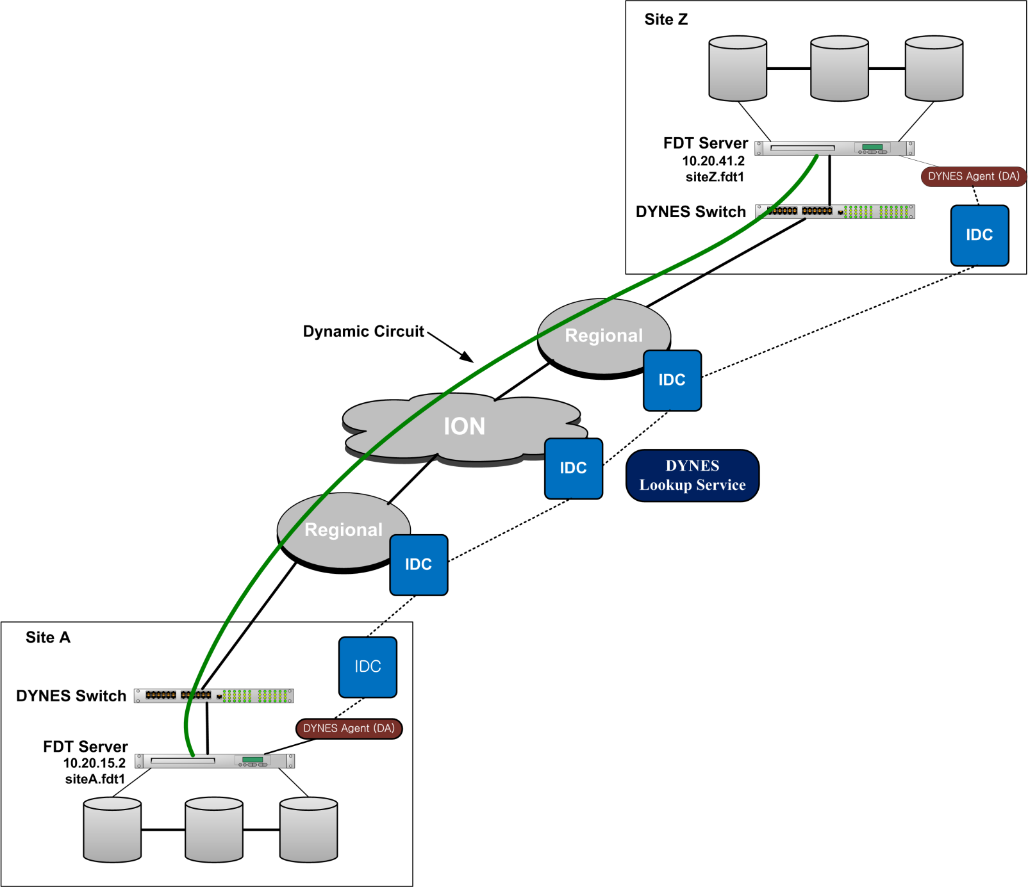
DYNES Data Flow Overview
Each DYNES Sites will be assigned DYNES Project private address space (10.20/16) and an EndPoint Name (siteZ.fdt1)
Transfers via DYNES
transfer URL sent
to transfer agent
Notes:
Each DYNES Sites will be assigned DYNES Project private address space (10.20/16) and an EndPoint Name (siteZ.fdt1)
The DYNES FDT Server will include a data storage and reference structure to allow user to identify and indicate the data to be moved via DYNES. This data storage and reference structure will be project dependent. This will allow users to specify the desired data in the form of a DYNES Data Id.
The combination of the DYNES EndPoint Name and DYNES Data ID will form a "DYNES Transfer URL" (siteZ.fdt.1/datalocationref30)
Users will need to present a "DYNES Transfer URL" to their local DYNES Agent to initiate the data transfer.
The DYNES Agent (DA) will provide the functionality to request the circuit instantiation, initiate and manage the data transfer, and terminate the dynamically provisioned resources. Specifically the DA will do the following:
Accept user request in the form of a DYNES Transfer URLs indicating the data location and ID
Locates the remote side DYNES EndPoint Name embedded in the Transfer URL
Submits a dynamic circuit request to its home InterDomain Controller (IDC) utilizing its local DYNES EndPoint Name as source and DYNES EndPoint Name from Transfer URL as the destination
Wait for confirmation that dynamic circuit has been established
Starts and manages Data Transfer using the appropriate DYNES Project IP addresses
Initiate release of dynamic circuit upon completion
The dynamic circuit network infrastructures and control plane will provide for the multi-domain circuit instantiation. The high level workflow is as described below:
Upon receipt of a circuit request from a DYNES Agent, the IDC utilized the DYNES LookUp Service to translate the DYNES EndPoint Names into dynamic circuit source and destination URNs.
The initiating IDC then uses these URNs to set up the multi-domain dynamic circuit and notify the DYNES Agent when circuit is ready for use.
The IDC will also accept requests from the local DYNES Agent to tear down the dynamic circuit after data transfer is complete.
The FDT Servers can also have public IP addresses which can also be utilized for data transfers when dedicated circuits are not instantiated.
In this basic scenario, only the provided FDT server will be integrated into the DYNES instrument. However, other site servers can also be integrated into the DYNES infrastructure.

Slide 16
Dynes DataFlow Information
The DYNES Agent (DA) will provide the functionality to request the circuit instantiation, initiate and manage the data transfer, and terminate the dynamically provisioned resources. Specifically the DA will do the following:
Accept user requests as a DYNES Transfer URL
Locate the remote side DYNES
Submits a dynamic circuit
Confirm the circuit has been established
Starts and manages Data Transfer, logging progress
Initiate release of dynamic circuit upon completion
Finalize log transfer record

Slide 17
DYNES and LHC “Integration”
The DYNES collaboration is creating a distributed virtual instrument to create virtual circuits between DYNES sites
Collaborating with other efforts: OSCARS/DCN, ESCPS, StorNet, GLIF, etc.
Future work to enable support for operating in the context of the LHC collaborations existing data management infrastructures.
Future integration with LHCONE effort
Plans in both USATLAS and USCMS to integrate DYNES capabilities into production

Slide 18
DYNES References
DYNES
http://www.internet2.edu/dynes
OSCARS
http://www.es.net/oscars
DRAGON
http://dragon.east.isi.edu
DCN Software Suite (DCNSS)
http://wiki.internet2.edu/confluence/display/DCNSS/
FDT
http://monalisa.cern.ch/FDT/
REDDnet
http://www.reddnet.org

Slide 19
?Questions?

