Slide 1
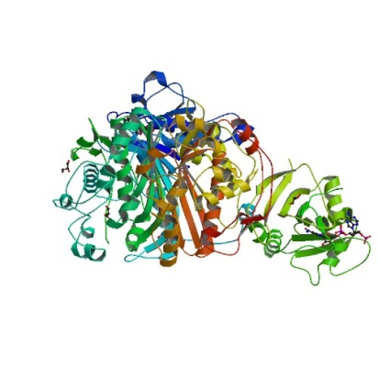
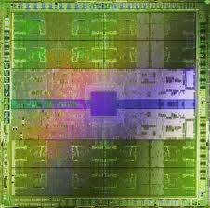
HTPMD
High Throughput Parallel Molecular Dynamics
Steve Cox
RENCI Engagement

Slide 2
Overview
High Throughput Parallel Computing
Molecular Dynamics
First User
Solution
Bigger Challenges
Workflow and Hybrid Computing

Slide 3
High Throughput Parallel Computing (HTPC)
Objectives
Exploit parallel processing OSG resources
Simplify submission to hide details (RSL/targeting)
Integrate with existing submission models
Explore MPI delivery and execution
Status
8-way jobs are the practical upper bound
About a half dozen sites are HTPC enabled
Implementing discoverable GIP configuration

Slide 4
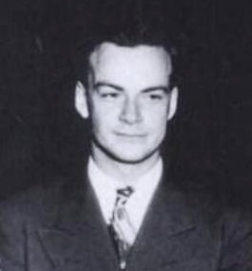
Molecular Dynamics (MD)
Molecular dynamics is computer simulation of physical movements by atoms and molecules.
- Wikipedia
“…everything that living things do can be understood in terms of the jigglings and wigglings of atoms.“
- Richard Feynman

Slide 5
Amber / PMEMD
Widely used for molecular simulation
Atomic motion modeled at nanosecond granularity
PMEMD: Particle Mesh Ewald Molecular Dynamics
Heavily reliant on message passing interface (MPI)
Works with MPICH / MPICH2 among others
Can be statically linked for portability
One researcher on Amber9, one on Amber10
Amber11 PMEMD is GPGPU accelerated

Slide 6
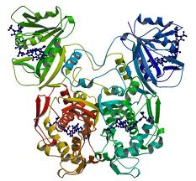
Case Study 1: DHFR Protein Dynamics & FDH
Dr. Laura Perissinotti of U. Iowa
Referral from SBGrid
Studying
(1) Dihydrofolate Reductase
Found on chromosome 5
Required for manufacture of purines
Catalyzes DNA components
(2) Formate Dehydrogenase – instrumental in
E. coli anaerobic respiration
Decomposition of compounds like methanol

Slide 7
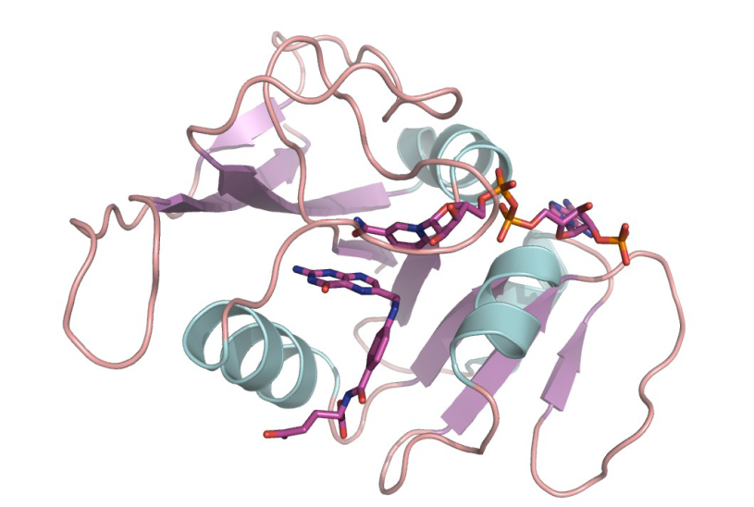
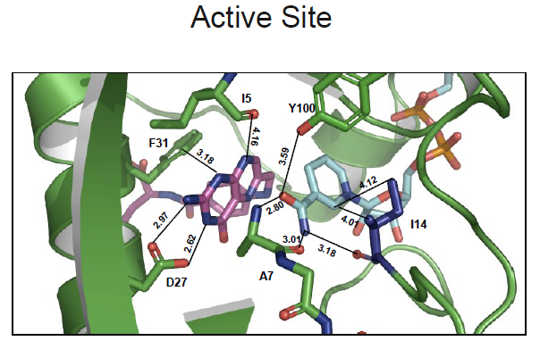
Case Study 1: DHFR Protein Dynamics & FDH
E. coli DHFR
NADP+
Folate
Low atom count relative to upcoming projects

Slide 8
Case Study 1: Simplify the Researcher-Grid Interface
CPMEMD packages
Amber PMEMD
MPI Libraries (MPICH, MPICH2)
OSG Adapter Scripts
RCI – Job Control
CPMEMD
job
common functions
job
Amber PMEMD 9
mpich-1.2.7p1
mpich2-1.1.1p1
RCI

Slide 9
Case Study 1: Simplify the Researcher-Grid Interface
All files are staged in and out for the user
job module
stage-in: globus-url-copy
run
The framework provides static executables, runs the specified experiment and tracks and reports exit status
stage-out: globus-url-copy
The framework provides an API to run PMEMD via MPI
OSG Worker Node ( VDT, Globus, … )

Slide 10
Case Study 1: Simplify the Researcher-Grid Interface
Researchers focus on the experiment - implement a standard entry point.
cpmemd_execute_experiment ()
Execute PMEMD with a template driven input file; inputs and outputs from and to standard locations
cpmemd_exec ()
API
API
cpmemd_mpi_exec ()
mpiexec
pmemd.mpich2
Execute PMEMD with complete control over all parameters while still allowing the framework to manage MPI launch

Slide 11
Case Study 1: Outcomes (a)
Laura is using it in production
OSG is “approximately 4 to 8 times faster”
Able to execute and extend it independently
Gratia statistics so far
WallDuration: 310,721
CpuDuration: 1,841,945
CpuSystemDuration: 19,645
Anticipating
100ns of DHFR simulation
FDH simulation
PAAD probe: 50ns
Mutants: 200ns
Approximately
35 jobs
WallDuration: 1,500,000

Slide 12
Case Study 1: Outcomes (b)
Shortcomings
Poor performance relative to (GPU) alternatives
Too much workflow management code
Too little platform independent meta-data
Experiments are monolithic programs
No abstract models of – well – anything, really
No semantic value without reading all the code
Wont scale to UNC CSB’s larger problems

Slide 13
Case Study 2: UNC Center for Structural Biology
Brenda Temple, PhD
Executive Director of the UNC CSB
Provides MD expertise to researchers
Uses Amber PMEMD extensively
Manages a variety of simultaneous MD projects
Projects are of widely varying complexity
Regularly runs 128-way jobs on a UNC cluster

Slide 14
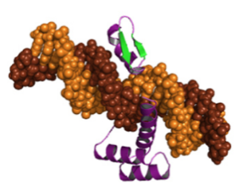
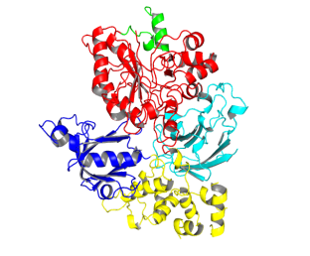
Case Study 2: UNC Center for Structural Biology
Brenda Temple, PhD.
Executive Director
Design of artificial transcription factors
Regulation of PLC-b2 Activity by Conserved Motions of the X-Y Linker
Pilar Blanquefort’s Lab
John Sondek’s Lab
complexity

Slide 15
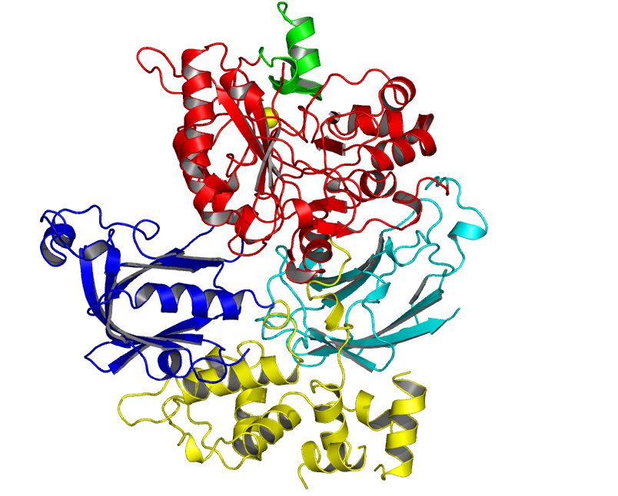
Phospholipase C-b2 Active Site is Occluded by X/Y Linker
Case Study 2: CSB and the Sondek Lab
Why Should We Use Molecular Dynamics to Study PLC-b2?
Working Hypothesis: Negative charges in the linker are critical for auto-inhibition of PLC activity
What is the Role of Electrostatics in X/Y Linker?
How Does the Presence of a Membrane Influence the Motions of the Linker?
Rate: 128 CPU/day x 1 ns/day = 65 ns / 65 days
Our Goal is 200ns simulations
X/Y Linker
TIM
C2
PH
R_{work}=22.1%
R_{free}=20.5%
EF

Slide 16
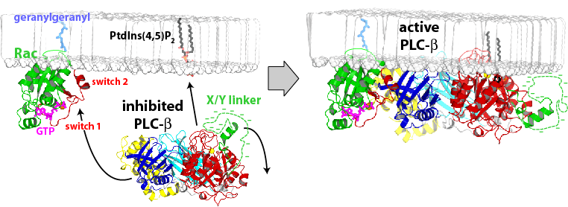
Case Study 2: CSB and the Sondek Lab
Proposed Mechanism for Release of Auto-inhibition of PLC

Slide 17
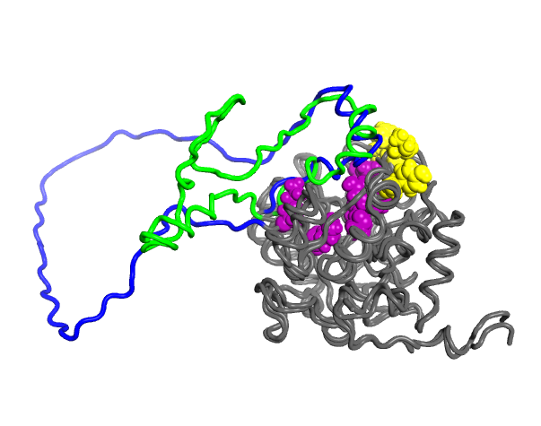
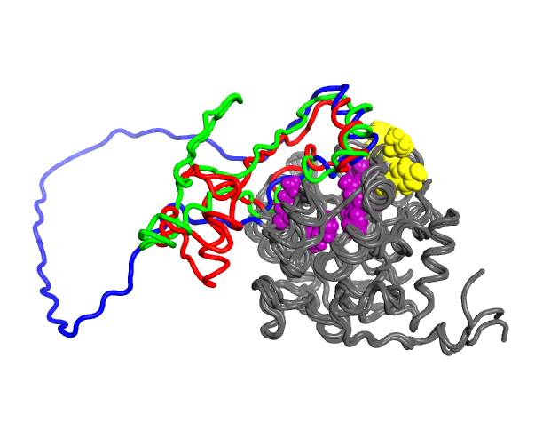
Case Study 2: CSB and the Sondek Lab
X/Y Linker
X/Y Linker
(50ns)
Hydrophobic Ridge
X/Y Linker
(50ns)
X/Y Linker
(starting)
X/Y Linker
(50ns)
Active
Site
X/Y Linker
(65ns)

Slide 18
Case Study 2: CSB and the Sondek Lab
Mechanism of Collapse
Run longer simulations with wt, K475M, and G530P PLC-b2 mutants to evaluate collapse of linker
Run simulations with linker mutated to Gln and Ala to further investigate importance of negative charge in motions of X/Y linker
Scope of Mechanism: Simulate X/Y linker motion for PLC-d
Experimentally address MD insights
Mutate K475 to eliminate/reverse charge and evaluate in vivo effects
Met, Ala, Ser, Asp
Mutate Glu & Asp residues in X/Y linker to Gln, Asn, or Gly and Ser
Historical note on in-silico molecular dynamics at the CSB:
3-5 years ago: 10 ns of simulation was average
Now: 50 ns of simulation is about average

Slide 19
Case Study 2: Observations
Better performance is vital
Current experiments
Have dozens of phases
Workflow semantics implemented as shell scripts
Structure is hidden from non-experts
Monolithic construction impedes reuse
The future is
More complex workflow
Greater demand for compute power
Scalable, semantically rich infrastructure needed

Slide 20
Second Generation: Performance and Workflow
GPGPU improves performance dramatically
General Purpose Graphics Processing Units
Amber11 for GPU on RENCI-Blueridge
Available via Blueridge OSG CE interface
Extending GIP to model GPGPU-HTPC
Need to reflect the GPU difference in accounting
New FERMI GPUs a significant advance over Tesla

Slide 21
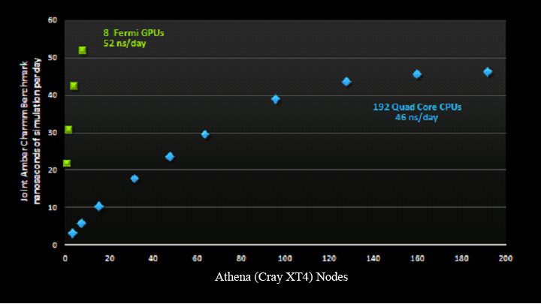
Are GPGPU’s worth the effort?
Yes. The GPU architecture makes a critical difference in the performance of parallel molecular dynamics simulations
Amber11 PMEMD on FERMI

Slide 22
Second Generation: Performance and Workflow
Pegasus for Workflow Management
An HTC differentiating advantage
Workflow framework simplifies development
Standards (XML) based workflow representation
Extensible via DAX APIs in Java, Python, Perl
Manages vital but tedious stage-in/out

Slide 23
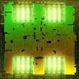
Second Generation: Changes to the Stack
Amber11 provides GPGPU support for PMEMD
Pegasus replaces various scripts (RCI)
HTPC in a hybrid CPU/GPU architecture
PMEMD minimization calculation is CPU only
Dynamic calculation is GPU enabled
pmemd
pmemd
Amber11
Amber9
Grayson
RCI
Pegasus
HTPC (CPU)
HTPC (C/GPU)
OSG - HTC
OSG - HTC

Slide 24
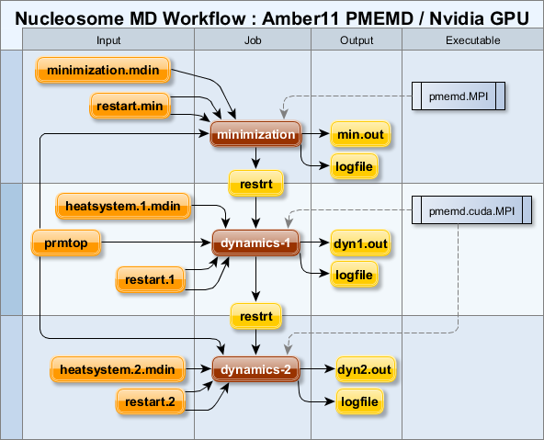
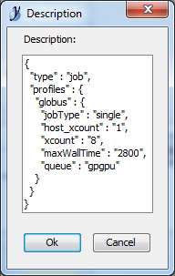
Introducing Grayson for Pegasus
Model Driven Architecture Applied to Workflow Management
GraphML with JSON annotation
Intuitive semantics with regard to
Input / Output
Order
Parallelism
Executable to job relationships
Portable, open standard representation
Execution environment independent
Semantically rich meta-data with JSON
Generates Pegasus DAX workflow format
Produces information-rich visual artifacts

Slide 25
Grayson for Pegasus
{
"type" : "executable",
"path":"/home/scox/gpu/bin/pmemd.MPI",
"site" : "TestCluster"
}
{
"type" : "job",
"profiles" : {
"globus" : {
"jobType" : "single",
"host_xcount" : "1",
"xcount" : "8",
"maxWallTime" : "2800"
}
}
}
{
"type" : "executable",
"path":"/home/scox/gpu/bin/pmemd.cuda.MPI",
"site" : "TestCluster"
}
{
"type" : "job",
"profiles" : {
"globus" : {
"jobType" : "single",
"host_xcount" : "1",
"xcount" : "8",
"maxWallTime" : "2800",
"queue" : "gpgpu"
}
}
}

Slide 26
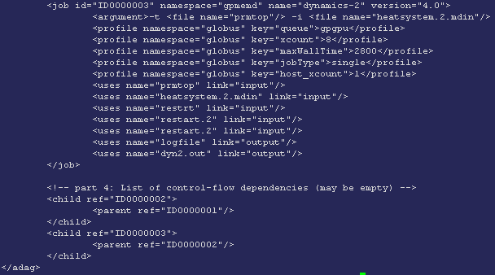
Grayson for Pegasus
{
"type" : "job",
"profiles" : {
"globus" : {
"jobType" : "single",
"host_xcount" : "1",
"xcount" : "8",
"maxWallTime" : "2800",
"queue" : "gpgpu"
}
}
}
Job input, outputs, executables and profile information are all translated to Pegasus DAX form.
Input and output chains model DAX parent->child relationships.

Slide 27
Grayson for Pegasus
Grayson 0.2
Increase workflow reusability
Simplify workflow creation
Remove execution environment details from the workflow model
Develop a context specific model reusable across workflows
Make workflows abstract process models
Key features
Model by Reference: refer to a component in another model
Properties: compose the application flexibly
Inheritance: sort of - technically closer to aggregation
Profile Inheritance: jobs aggregate executable requirements
Separate Compilation: compose systems from separate models

Slide 28
Grayson for Pegasus 0.2
{
"type" : "properties",
"map" : {
"pmemdMPI" : "/home/scox/gpu/bin/pmemd.MPI",
"pmemdCudaMPI" : "/home/scox/gpu/bin/pmemd.cuda.MPI",
"clusterId" : "TestCluster"
}
}
{
"type" : "executable",
"path" : "${pmemdCudaMPI}",
"profiles" : {
"globus" : {
"queue" : "gpgpu"
}
}
}
{
"type" : "abstract",
"profiles" : {
"globus" : {
"jobType" : "single",
"host_xcount" : "1",
"xcount" : "8",
"maxWallTime" : "2800"
}
},
"site" : "${clusterId}"
}

Slide 29
Grayson for Pegasus
Running Grayson
Compile one or more GraphML files depicting workflows
Emit a Pegasus DAX modeled by the workflow
Emit site catalog information
Execute pegasus-plan to submit the generated DAX
graysonc \
--model nucleosome.graphml \
--model blueridge-context.graphml \
--namespace=gpmemd \
--version=1.0 \
--output=gridpmemd.dax \
--site
pegasus-plan \
-D pegasus.user.properties=pegasusrc \
--sites TestCluster \
--dir work \
--output local \
--dax gridpmemd.dax \
--verbose \
--submit

Slide 30
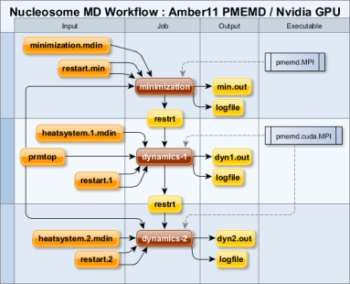
Grayson for Pegasus
Design
Compile / Plan / Submit
Monitor / Execute
yEd
*.graphml
graysonc
pegasus-plan
condor
globus
pbs
cpu
gpu

Slide 31
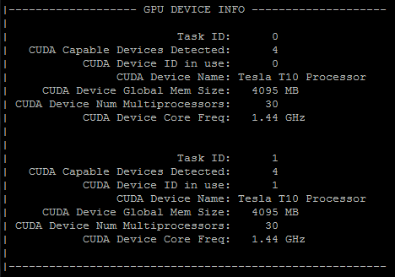
Second Generation: Grayson / Pegasus / GPGPU
From concept…
to silicon

Slide 32
Conclusion
HTPC MD on OSG ready for prime-time
GPGPU via OSG/HTPC is demonstrated
Accounting work needed to reflect benefit
Design ongoing for GIP discoverability
Grayson for Pegasus
Model Driven Architecture for Workflows
Semantically rich artifacts
Open standards and portability
Execution environment independent

Slide 33
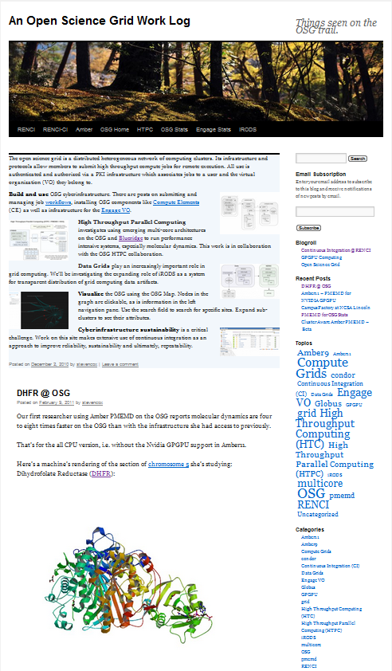
References
Steve’s OSG Blog
HTPC Wiki
Pegasus WMS
Amber PMEMD
NVIDIA CUDA
UNC CSB
John Sondek’s Lab

