Slide 1
Campus Grid Technology
Derek Weitzel
University of Nebraska – Lincoln
Holland Computing Center (HCC)
Home of the 2012 OSG AHM!

Slide 2
Motivation for a Campus Grid
Increase available resources by distributing jobs around the campus.
Offload single core jobs to idle resources, making room for specialized (MPI) jobs.
Independence from resource failures.

Slide 3
Campus Grids you may know
GLOW
Condor is Everywhere!
AFS for data
Purdue
Condor & PBS on nodes
Shared Home directories, Large clusters with share file systems, Condor file transfer between departmental clusters.

Slide 4
What changes do we want?
Prefer not installing condor on every worker node. Less intrusive for sysadmins.
PBS and Condor should coordinate job scheduling. We don’t want PBS to kill condor jobs if it doesn’t have to.

Slide 5
Campus Grid Technology
Condor + Glideins
Condor will handle job submission, job execution, and file transfer
Introducing Campus Grid Factory to handle on-demand glidein submissions.

Slide 6
Campus Grid Factory
Submit Condor worker nodes as jobs to PBS
Uses GlideinWMS libraries to manage glideins on the cluster.
Condor + GlideinWMS + BLAHp + Custom Glue
Provides virtual Condor pool for outside clients for Flocking.

Slide 7
Campus Factory Operation
Factory queries user queue
Submit to PBS (through Condor BLAHP)
PBS Starts the Glidein job.

Slide 8
Campus Factory Operation
Glidein reports to the factory’s collector
User queue requests idle slots from factory
Condor negotiates and starts the job.

Slide 9
Campus Grid Internals

Slide 10
Advantages of the Campus Factory
User is presented with an uniform Condor interface to resources.
Can create overlay network on any resource Condor (BLAHp) can submit to (PBS, LSF,…)
Uses well established technologies, Condor, BLAHp, and ideas, Condor, flocking.

Slide 11
Advantages for the Local Scheduler
Allows PBS to know and account for outside jobs.
Can co-schedule with local user priorities.
PBS can preempt grid jobs for local jobs.

Slide 12
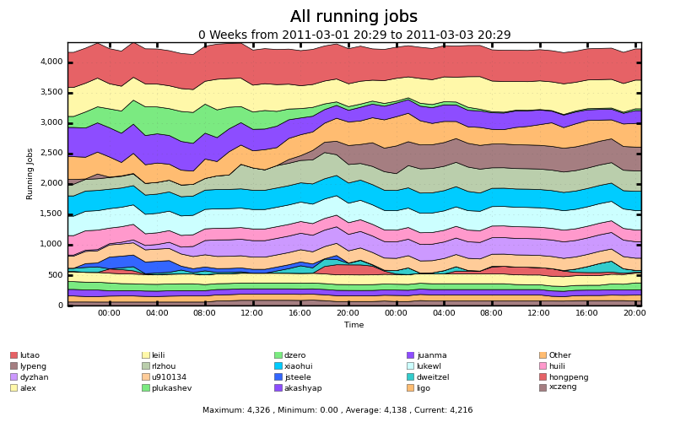
Getting outside the Campus
Campus resources are busy:
Running jobs on Firefly. ~4300 cores

Slide 13
Getting outside the Campus
Users will use whatever resources are available, usually to the max.
Have you had a user submit 50,000 - 1 core jobs to PBS? We have!
There are resources available out there, just need to get there.
Users want a smooth transition to other resources.

Slide 14
Getting outside the Campus: Flocking
User Schedd advertises idle jobs to resource.
Resource matches idle jobs with job slots
User schedd transfers data directly to worker node.

Slide 15
Getting outside the Campus: Flocking
Flocking
Need to have Condor on the other side.
Need to have mutual trust relationships. Not necessarily x509.
Nebraska is part of Diagrid, large Condor flock led by Purdue.

Slide 16
Getting outside the Campus: OSG Interface
Expand further with OSG Production Grid
GlideinWMS
GlideinWMS Frontend provides virtual Condor pool of grid worker nodes. Campus submit hosts can Flock to the GlideinWMS Frontend.
Submission at the Frontend can also flock to campus resources.
We don’t have to submit globus jobs; all Condor vanilla universe.
Factory is at UCSD submit globus jobs for us.

Slide 17
Ever-increasing circle of resources
Grid
Campus
Local
Me, my friends and everyone else

Slide 18
Campus Grid at Nebraska
Prairiefire PBS/Condor (Like Purdue)
Firefly – Only PBS
GlideinWMS interface to OSG
Flock to Purdue

Slide 19
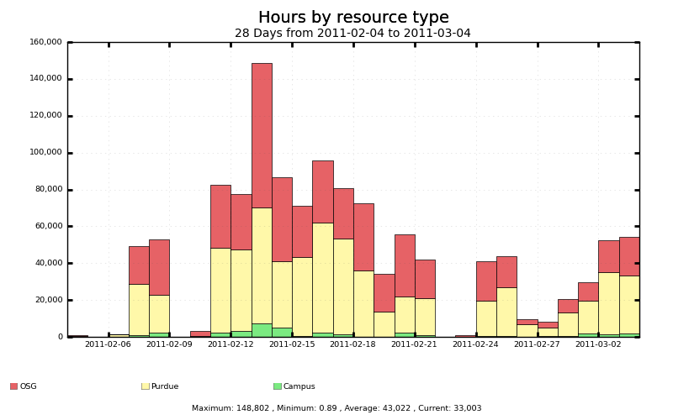
Usage of the Campus Grid
Bridging to Purdue provides a lot of time
OSG resources (through GlideinWMS)

Slide 20
Future Work
Accounting
Submission side accounting is easy, we already do it in the OSG.
To accurately get data, we need to account on the execute site (worker nodes).
Data
Is there a better way than Condor File Transfer?
What about the cache models being proposed by CMS/Atlas?

Slide 21
Bonus: HTPC on Campus
Specifying the right requirements, exactly the same as regular jobs.
Flocking HTPC to Campus factory exactly the same, just specify requirements.

Slide 22
Acknowledgements
Brian Bockelman (Technical consult)
Dan Fraser (Campus Grids Lead)
David Swanson (Advisor)
Igor Sfiligoi (GlideinWMS)
Jeff Dost (UCSD Factory Support)

