Slide 1
glideinWMS Plans and Roadmap
Burt Holzman
Fermilab Computing Division and CMS

Slide 2
Simplified glideinWMS overview
Collector
Worker Node
Worker Node
Worker Node
Glidein
Worker Node
Job
Submit node
Gatekeeper
Job
Site
Glidein
!
SBGrid Frontend
Peter and Ian submit jobs
SBGrid Frontend requests glideins
Factory sends glideins via condor-G
Glidein starts on worker
First job completes
Glidein starts first job
Second job starts

Slide 3
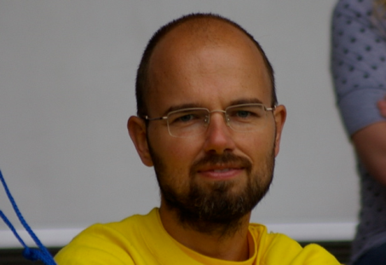
The team
UCSD
Students

Slide 4
glideinWMS is also subprojects
gLexec (inherited from FNAL/CD Auth. Services)
suexec analog for grid proxies
Developers @ NIKHEF; packaging/testing for OSG
WLCG requirement for multi-user pilot jobs
CEDPS (close-out: September 2011)
Increase reliability for stage-out data in glidein context
Collaborative effort with Globus / globus.org /Condor
CorralWMS
Integration project between ISI Corral (provisioned TeraGrid resources) and glideinWMS (opportunistic OSG resources)

Slide 5
Latest releases
V2.5.1
New (nearly) non-interactive installer
Dynamic glidein removal
Java support for glideins
Improved logging & monitoring
V2.5.0
CREAM CE support
Corral frontend support
Efficiency improvements in Condor communication
Improved signal handling
Auto-removal of held glideins
V2.4
Multi-VO support (see Jeff Dost’s talk)

Slide 6
New features
Short-term / next release
Native multicore/HTPC support
gLexec validation by pilot
Publication of known sites to end users
VOMS-only site selection
Better malformed match handling
Improved monitoring

Slide 7
New features (II)
Mid-term features
Multiple glideins per submission
Tool-assisted (and possibly automated) configuration changes based on dynamic information from information systems
Continued integration with Corral Frontend
Cloud support for Amazon EC2, Magellan
Overarching goals
Ease-of-use
User-friendliness

Slide 8
Corral Frontend
Simple frontend standalone users
Not tied to a VO
Glideins are submitted with the user’s credentials and the glideins can only serve that one user
Works well on TeraGrid and campus clusters
Multislot requests
1 glidein request – N slots
Users on OSG include LIGO, SCEC, and NASA IPAC Galactic Plane

Slide 9
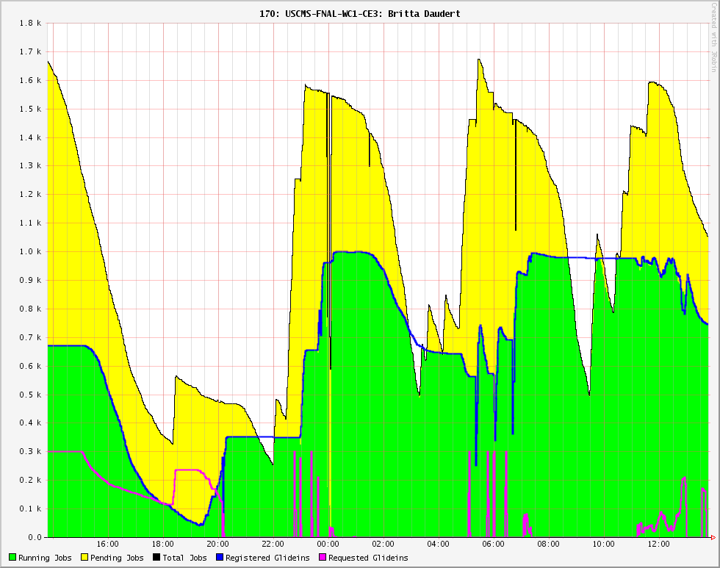
Corral Frontend – LIGO taskforce
The Corral frontend has been used to help LIGO Inspiral workflows perform better on OSG
Solves the problem of competing withLIGO Boinc jobs
1.8 kjobs
Pending
jobs
Running jobs

Slide 10
Life in the Cloud – in principle
Magellan
Collector
Worker Node
Worker Node
Worker Node
Glidein
Image
Job
Submit node
Cloud Interface
Job
Glidein
SBGrid Frontend

Slide 11
Life in the Cloud – reality Authentication
OSG is based on X.509 certificates
Clouds are not
Need to allow additional authentication mechanisms
E.g. passing the Amazon account keys to the factory
Need to specify trust domains
Amazon account keys don’t work on Magellan!
Requires protocol changes – in progress

Slide 12
Life in the Cloud – reality The “Worker Node”
Responsibility for the worker environment no longer belongs to the site – there is no “site”!
Some users want full control over the image
Some users want minimal control over the image
We will try to support both options
Provide a bare-bones image by default, but also
Allow VO-specific customizations
State-of-the-art tools (BoxGrinder, appliance-creator, others) under investigation

Slide 13
Outlook
Working on v2.5.2 features
Planning work for v3.0 (comprehensive cloud support)
We’d like more input from you, the stakeholders, on your cloud use cases
Does your VO need to (and want to) control the image?
What cloud providers are you considering?
How big a priority is this for your VO?

