Slide 1
Intelligent
Detector
Design
Norman Graf (SLAC)
(for the ALCPG Simulation & Reconstruction WG)
Muon Collider Simulation Technical Meeting
October 5, 2010

Slide 2
LCD Simulation Mission Statement
Provide full simulation capabilities for Lepton Collider physics program:
  Physics simulations
  Detector designs
  Reconstruction and analysis
Need flexibility for:
  New detector geometries/technologies
  Different reconstruction algorithms
  Different machine environments
Limited resources demand efficient solutions, focused effort.

Slide 3
Detector Performance Studies
The ILC community recently finished a very intensive round of detector performance and optimization studies, culminating in the submission of LOI’s and is engaged in preparing more detailed updates for the DBD in 2012.
The CLIC community is currently engaged in an aggressive effort to provide a CDR in 2011.
Provides an excellent opportunity for this community to benefit from the very large investment in software and the lessons learned.
  What worked
  What didn’t work

Slide 4
Options
You just heard about ILCRoot from C. Gatto.
In this talk, you will hear about the ALCPG simulation, reconstruction and analysis toolkit.
Also have available software developed by others in the ILC community.
ECFA-LC, vanilla C++
  Mokka (G4 full simulation)
  MarlinReco (reconstruction and analysis toolkit)
ACFA-LC, root-based C++
  Jupiter (G4 full simulation)
  Satellites (reconstruction and analysis)

Slide 5
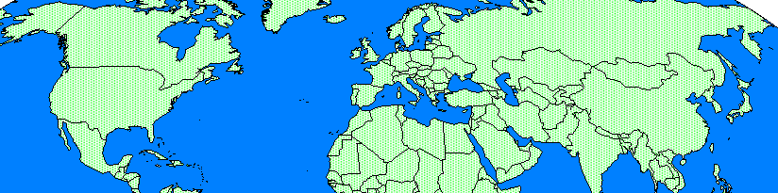
LCIO
ALCPG
SiD
ECFA-LC
LDC
ACFA-LC
GLD
slic
org.lcsim
Java
MOKKA
MarlinReco
C++
JUPITER
Satellites
root
LCIO
Common Data Model
Common IO Format

Slide 6
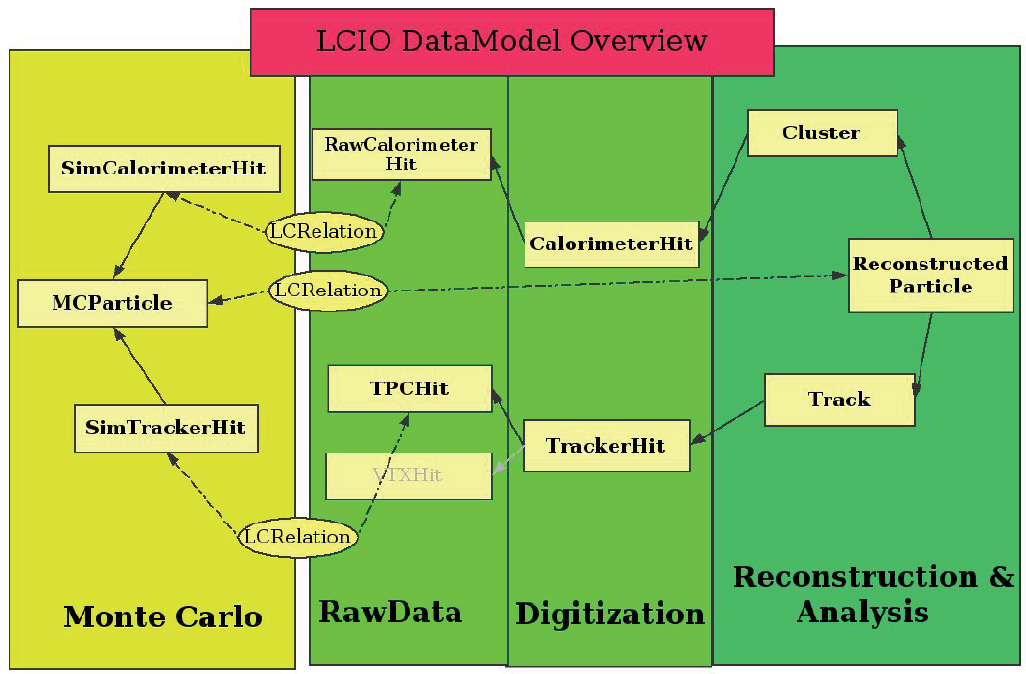
LCIO Overview
Object model and persistency format for HEP events
  MC simulation
  Test Beam data
  Reconstructed Objects
Multiple bindings (C++, Java, Fortran, python, root)

Slide 7
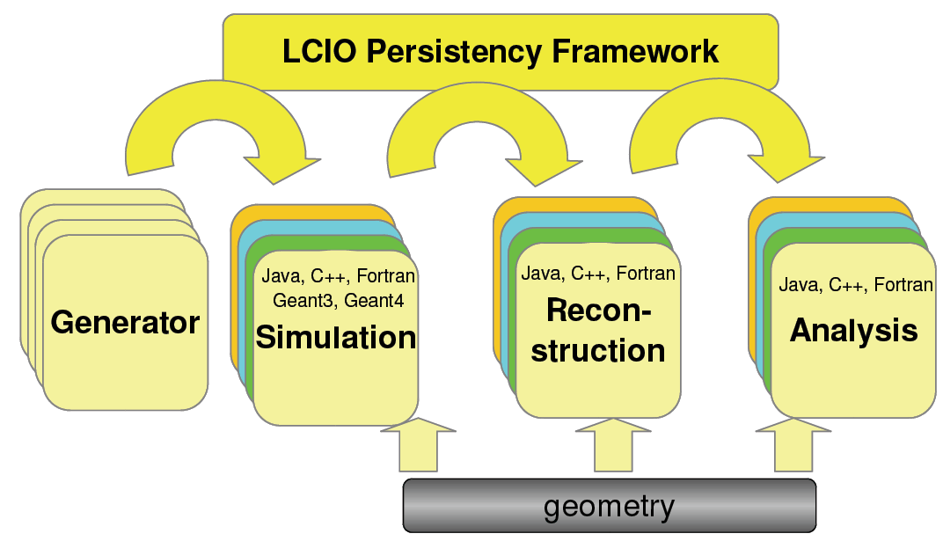
LCIO Overview
or
TestBeam

Slide 8
LCIO Interoperability
All three regional LCD simulators write LCIO
  Cross-checks between data from different simulators
  Read/write LCIO from
    Fast MC / Full Simulation / Test Beams
    Different detectors
    Different reconstruction tools
    Different frameworks, languages, operating systems
Reconstruction also targets LCIO
  Can run simulation or reconstruction in one framework, analysis in another.
    Generate events in Jupiter, analyze in MarlinReco.
    org.lcsim to find tracks in Java, LCFI flavor-tagging to find vertices using MarlinReco (C++) package.

Slide 9
Overview: Goals
Facilitate contribution from physicists in different locations with various amounts of time available.
Use standard data formats, when possible.
Provide a general-purpose framework for physics software development.
Develop a suite of reconstruction and analysis algorithms and sample codes.
Simulate benchmark physics processes on different full detector designs.

Slide 10
Fast Detector Response Simulation
Covariantly smear tracks with matrices derived from geometry, materials and point resolution using Billoir’s formulation.
  Analytically from geometry description.
Smear neutrals according to expected calorimeter resolution (EM for γ, HAD for neutral hadrons)
  Derived from full Geant4 simulations
Create reconstructed particles from tracks and clusters ( γ, e, μ from MC, π^{+/-}, K⁰_{L} for others)
Can also dial in arbitrary effective jet energy resolution.
  Derived from full simulation, reconstruction & analysis.
“Supersymmetry, the ILC, and the LHC inverse problem”

Slide 11
lelaps
Fast detector response package.
Handles decays in flight, multiple scattering and energy loss in trackers.
Parameterizes particle showers in calorimeters.
Produces detector data at the hit level.
  Feeds directly into full reconstruction.
Uses runtime geometry (compact.xml → godl).

Slide 12
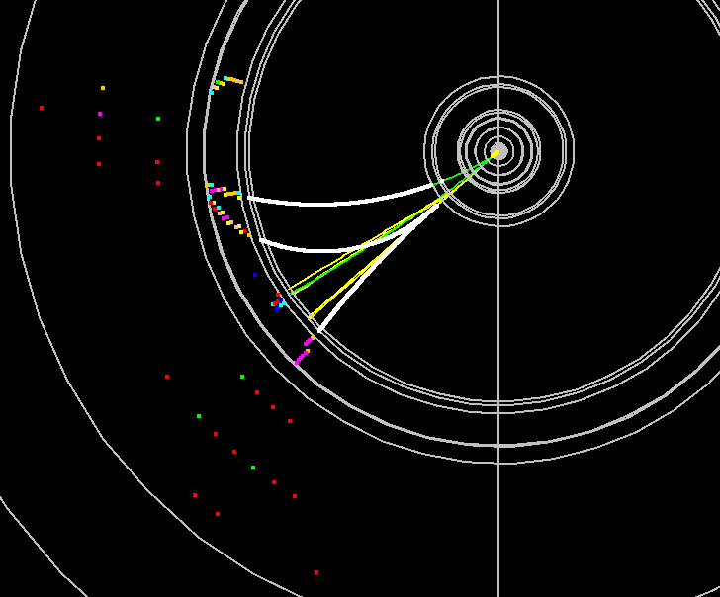
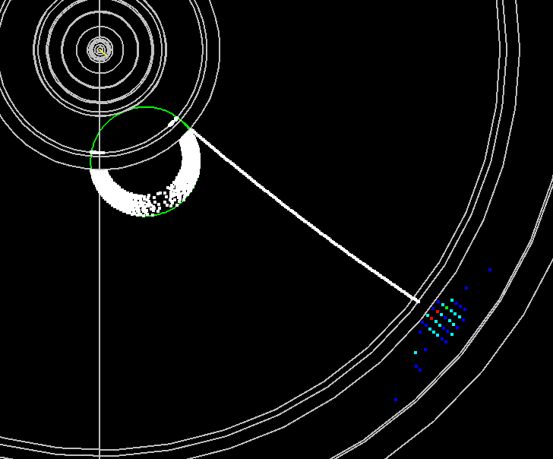
Lelaps: Decays, dE/dx, MCS
Ω⁻ → Ξ⁰ π⁻
Ξ⁰ → Λ π⁰
Λ → p π⁻
π⁰ → γ γ as simulated by Lelaps for the LDC model.
gamma conversion as simulated by Lelaps for the LDC model.
Note energy loss of electron.

Slide 13
Detector Design (GEANT 4)
Need to be able to flexibly, but believably simulate the detector response for various designs.
The daunting machine backgrounds expected at the Muon Collider will require detailed full detector simulations.
GEANT is the de facto standard for HEP physics simulations.
Use runtime configurable detector geometries
Write out “generic” hits to digitize later.

Slide 14
Full Detector Response Simulation
Use Geant4 toolkit to describe interaction of particles with matter and fields.
Thin layer of LC-specific C++ provides access to:
  Event Generator input ( binary stdhep format )
  Detector Geometry description ( XML )
  Detector Hits ( LCIO )
Geometries fully described at run-time!
  In principle, as fully detailed as desired.

Slide 15
Geometry Definition
Goal was to free the end user from having to write any C++ code or be expert in Geant4 to define the detector.
All of the detector properties should be definable at runtime with an easy-to-use format.
Selected xml, and extended the existing GDML format for pure geometry description.

Slide 16
Full Simulation History
Provide static binary to run full detector simulations using runtime xml detector descriptions.
    in-house lcdparm xml format (1998)
    collaboration with R. Chytracek on GDML (2000)
GISMO (C++ GHEISHA + EGS, lcdparm ) 1998
LCDRoot (Geant4 + Root, lcdparm ) 1999
LCDG4 (Geant4 + sio, lcdparm) 2002
LCS (Geant4 + lcio, lcdparm) 2004
slic (Geant4 + lcio, GDML) 2005

Slide 17
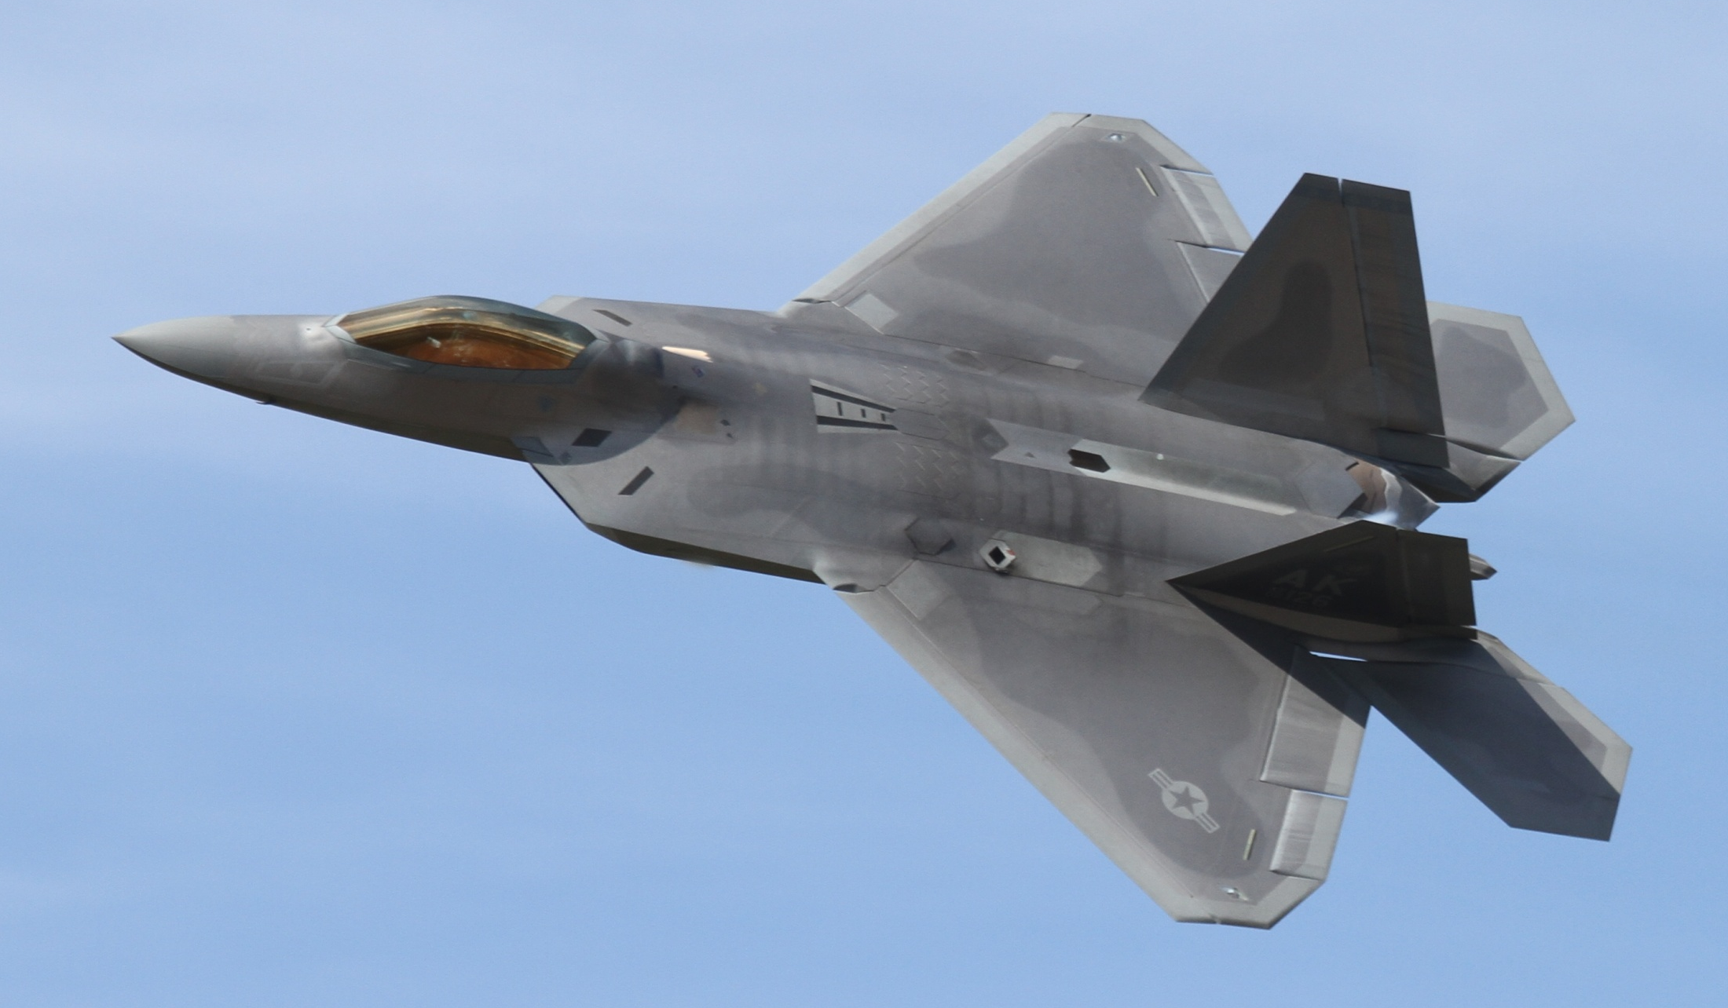
Fifth Generation
Lockheed-Martin F-22A Raptor
5th Generation Fighter

Slide 18
LC Detector Full Simulation
MC Event (stdhep)
slic
Raw Event (lcio)
Geometry (lcdd)
GEANT4
Compact Geometry Description
(compact.xml)
Reconstruction, Visualization, …

Slide 19
GeomConverter
Small Java program for converting from compact description to a variety of other formats
LCDD*
slic
lcio
GODL
lelaps
lcio
GeomConverter
Compact
Description
HEPREP
wired
*This is simply a convenience.
lcdd file can be created in many
ways, e.g. from survey database,
CAD models, or by hand.
org.lcsim
Analysis &
Reconstruction

Slide 20
Detector Variants
Runtime XML format allows variations in detector geometries to be easily set up and studied:
  Absorber materials and readout technologies for sampling calorimeters
    e.g. Steel, W, Cu, Pb + RPC vs. GEM vs. Scintillator readout
  Optical processes for dual-readout or crystal calorimeters
  Layering (radii, number, composition)
  Readout segmentation (size, projective vs. nonprojective)
  Tracking detector technologies & topologies
    TPC, Silicon microstrip, pixels, …
    “Wedding Cake” Nested Tracker vs. Barrel + Cap
  Far forward MDI variants, shielding, field strength, etc.

Slide 21
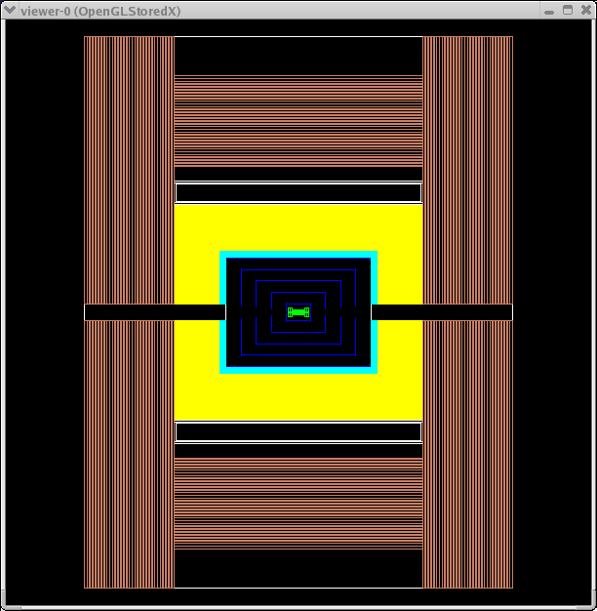
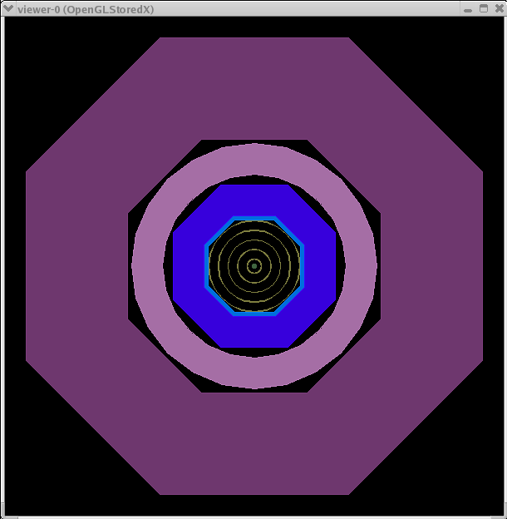
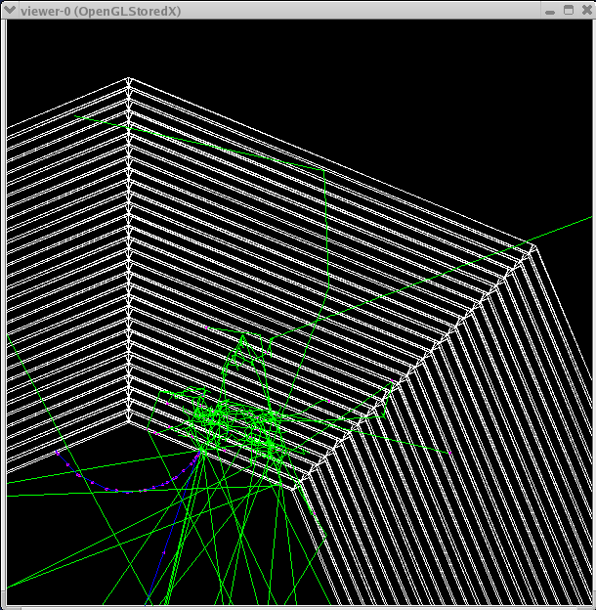
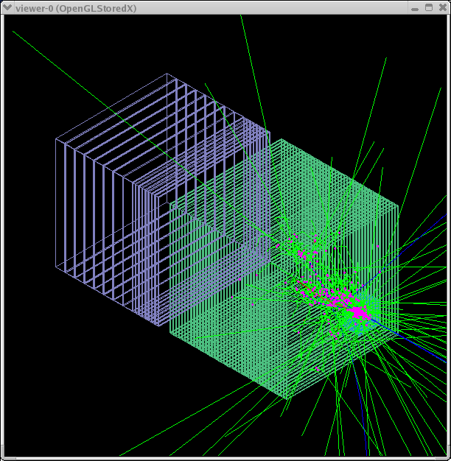
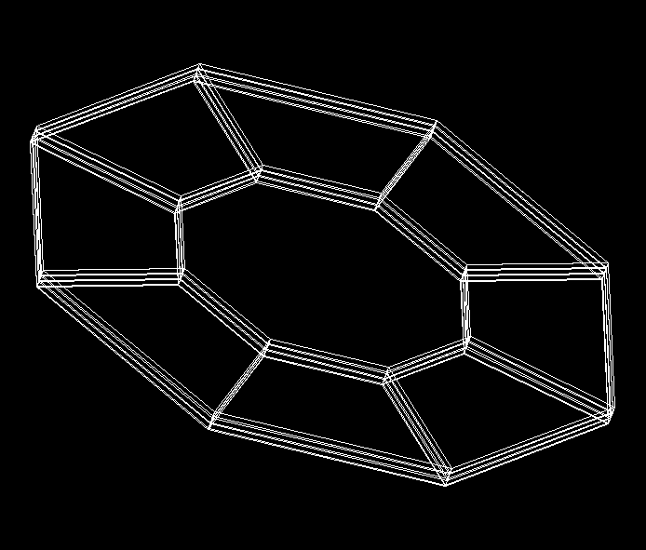
Example Geometries
Cal Barrel
SiD
SiD
Cal Endcap
MDI-BDS
Test Beam

Slide 22
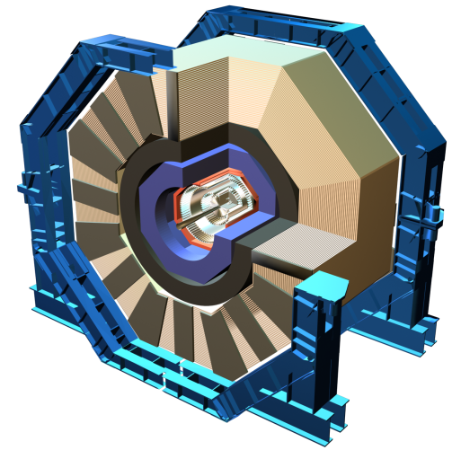
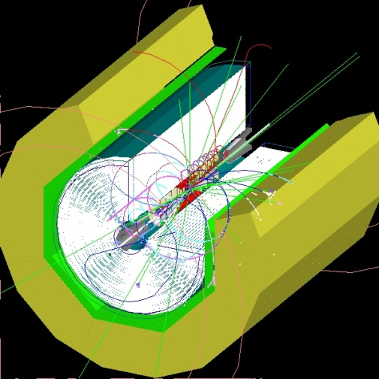
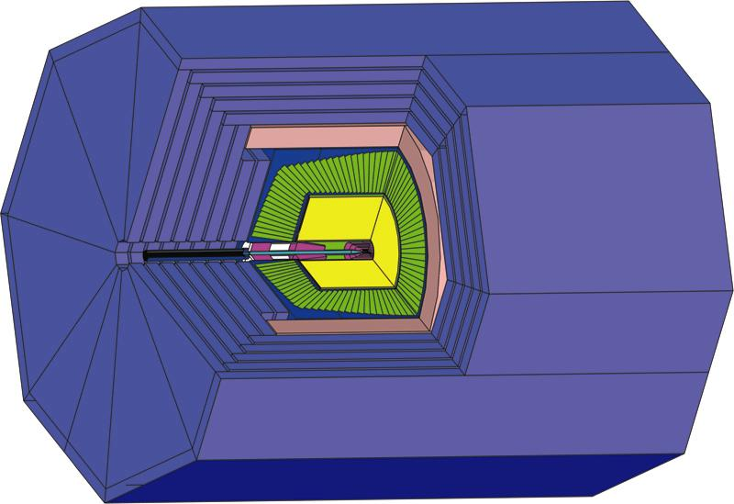
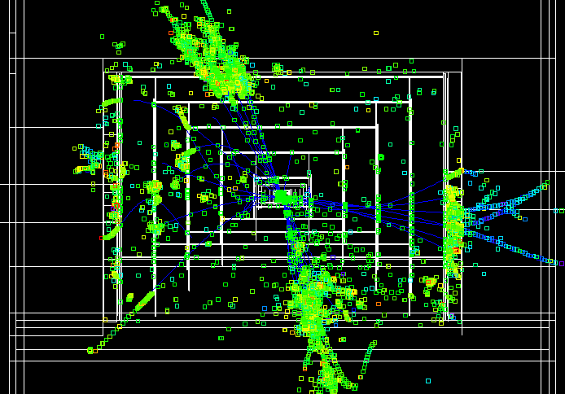
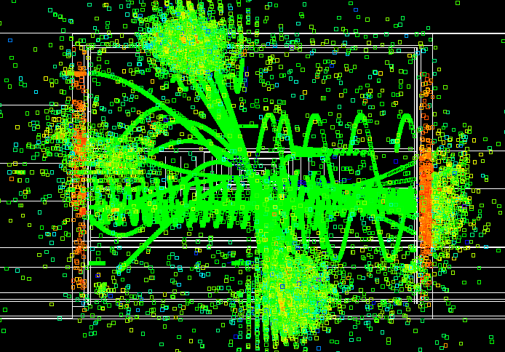
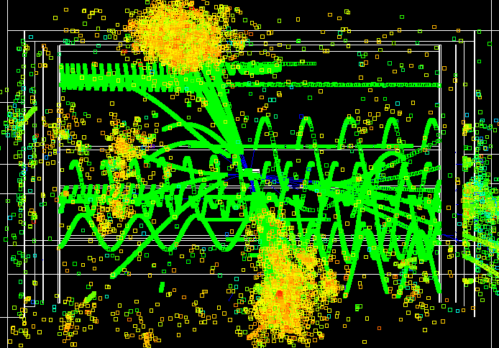
ILC Full Detector Concepts
SiD
GLD
LDC

Slide 23
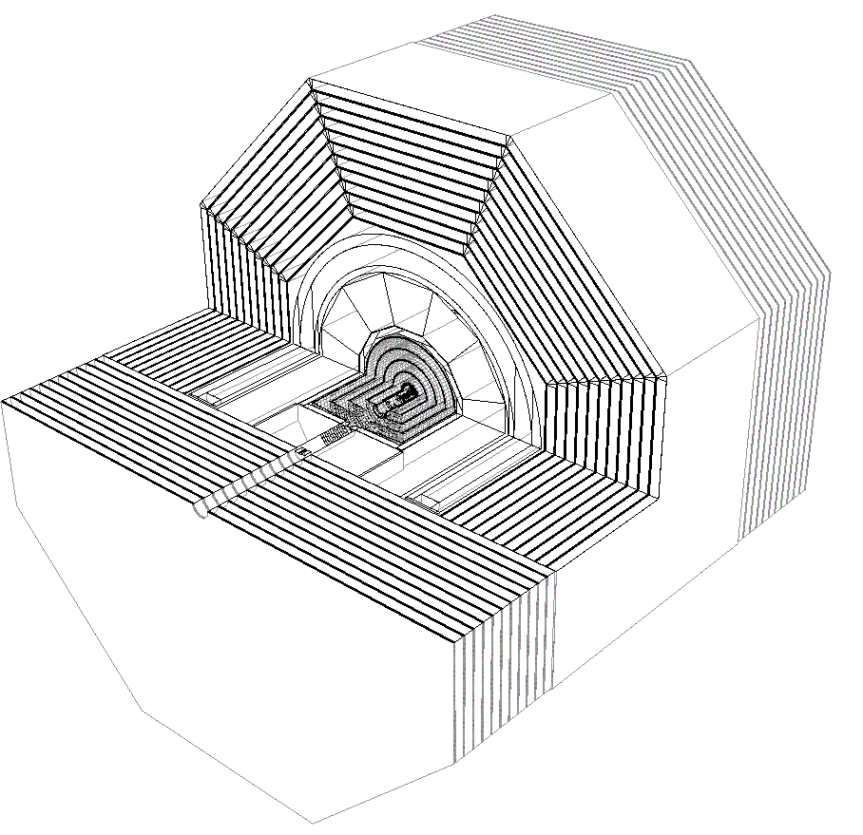
sidloi

Slide 24
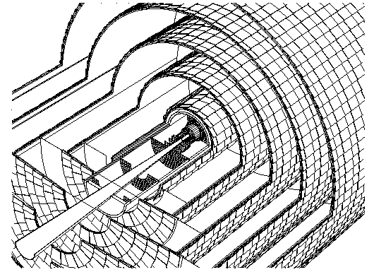
sidloi

Slide 25

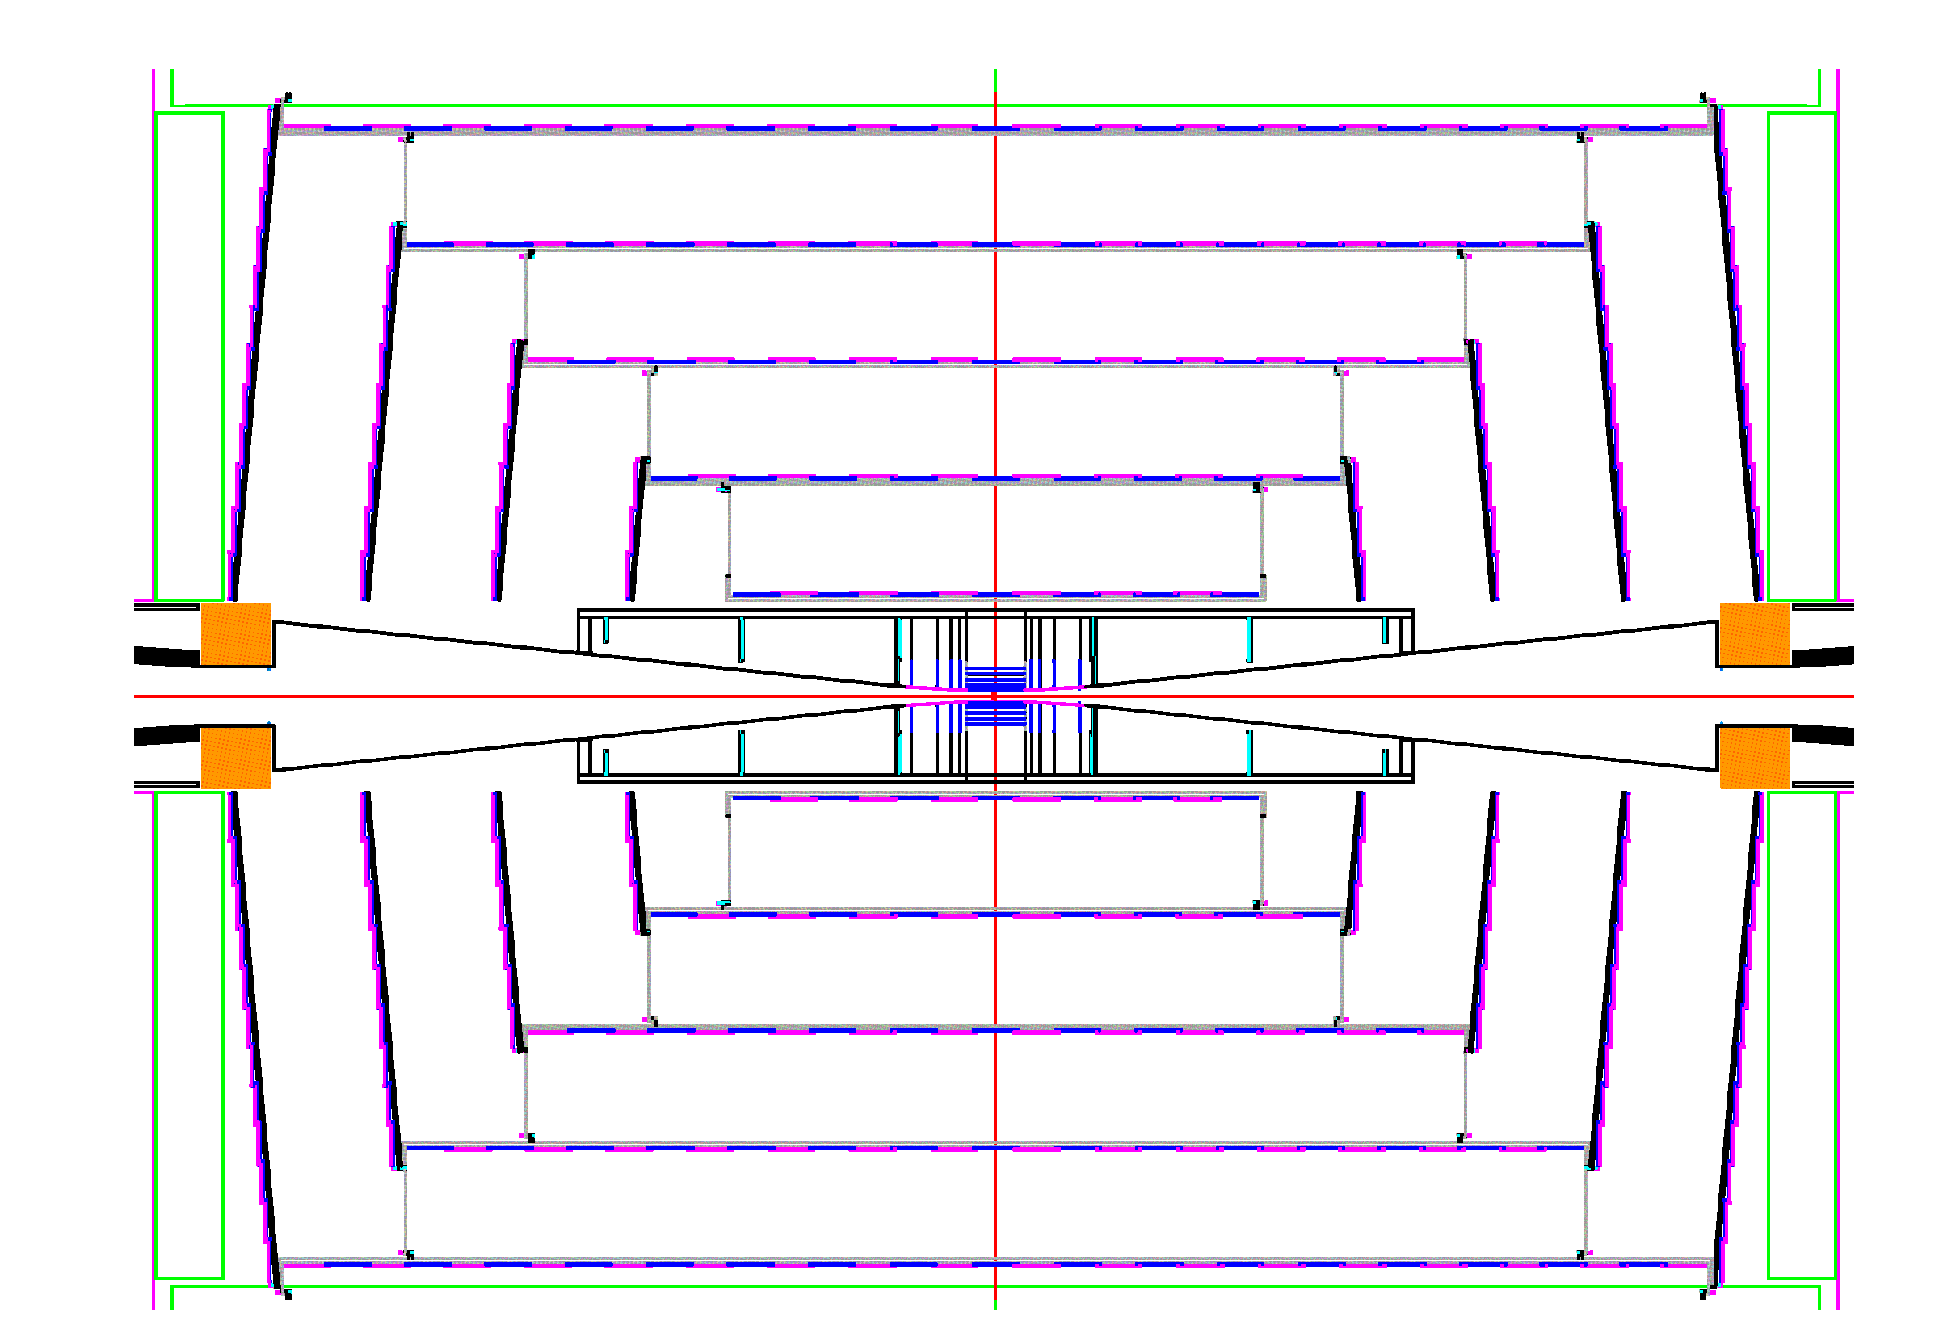
sidloi Tracker

Slide 26
slic: The Executable
26
Build static executables on Linux, Windows, Mac.
Commandline or G4 macro control.
Only dependence is local detector description file.
  Trivial Grid usage (no database call-backs, etc.)
  Grid ready, Condor and lsf scripts available.
Event input via stdhep, particle gun, …
Detector input via GDML, lcdd
Response output via LCIO using generic hits.
Fast (~30s/event for ILC)

Slide 27
Reconstruction/Analysis Overview
Java based reconstruction and analysis package
  Runs standalone or inside Java Analysis Studio (JAS)
  Fast MC → Smeared tracks and calorimetry clusters
  Full Event Reconstruction
    Beam background overlays at detector hit level, including time offsets.
    detector readout digitization (CCD pixels, Si μ-strips, TPC pad hits)
    ab initio track finding and fitting for ~arbitrary geometries
    multiple calorimeter clustering algorithms
    Individual Particle reconstruction (cluster-track association)
  Analysis Tools (including WIRED event display)
  Physics Tools (Jet Finding, Vertex Finding, Flavor Tagging)
Write once run, run anywhere
  Exact same libraries run on all platforms (Windows, Mac, Linux(es), Grid) using the Java Virtual Machine.

Slide 28
Tracking
Analytic covariance matrices available for fast MC smearing for each detector.
Track “cheater” available for studies of full detector simulation events. Assigns hits on basis of MC parentage.
Ab initio track finding packages.
Fitting code incorporating multiple scattering and energy loss via weight matrix or Kalman Filter available.

Slide 29
Tracking Detector Readout
Hits in Trackers record full MC information.
Module tiling and signal digitization is deferred to analysis stage.
  Used to rapidly study many possible solutions.
Fully-featured package to convert MC hits in silicon to pixel hits. Fully configurable at runtime.
MC Hits→ Pixel ID & ADC→ Clusters→ Hits (x ± δx)
Can correctly study occupancies, overlaps, ghost hits, etc.

Slide 30
Track Finding
Standalone pattern recognition code for 1D (e.g. Si μstrip) and 2D (e.g. Si pixel) hits.
  High efficiency, even in presence of backgrounds.
  Efficient at low momentum.
Conformal-mapping pattern recognition also available, applicable also to TPC.
MIP stubs in highly segmented calorimeters also provide track candidates, propagate inwards to pick up tracker hits.

Slide 31
Java Analysis Studio (JAS)
Integrated Development Environment (editor, compiler)
Cross-platform physics analysis environment with iterative, event-based analysis model
  quick development, debugging, ad hoc analysis
  additional functionality with plugins
Dynamically load / unload Java analysis drivers
  Supports distributed computing.
Plotting and fitting and analysis (cuts, scripting) engine
  1D, 2D histograms, clouds, profiles, dynamic scaling, cuts
  high-quality output to vector or raster formats
Integrated event browser and event display

Slide 32
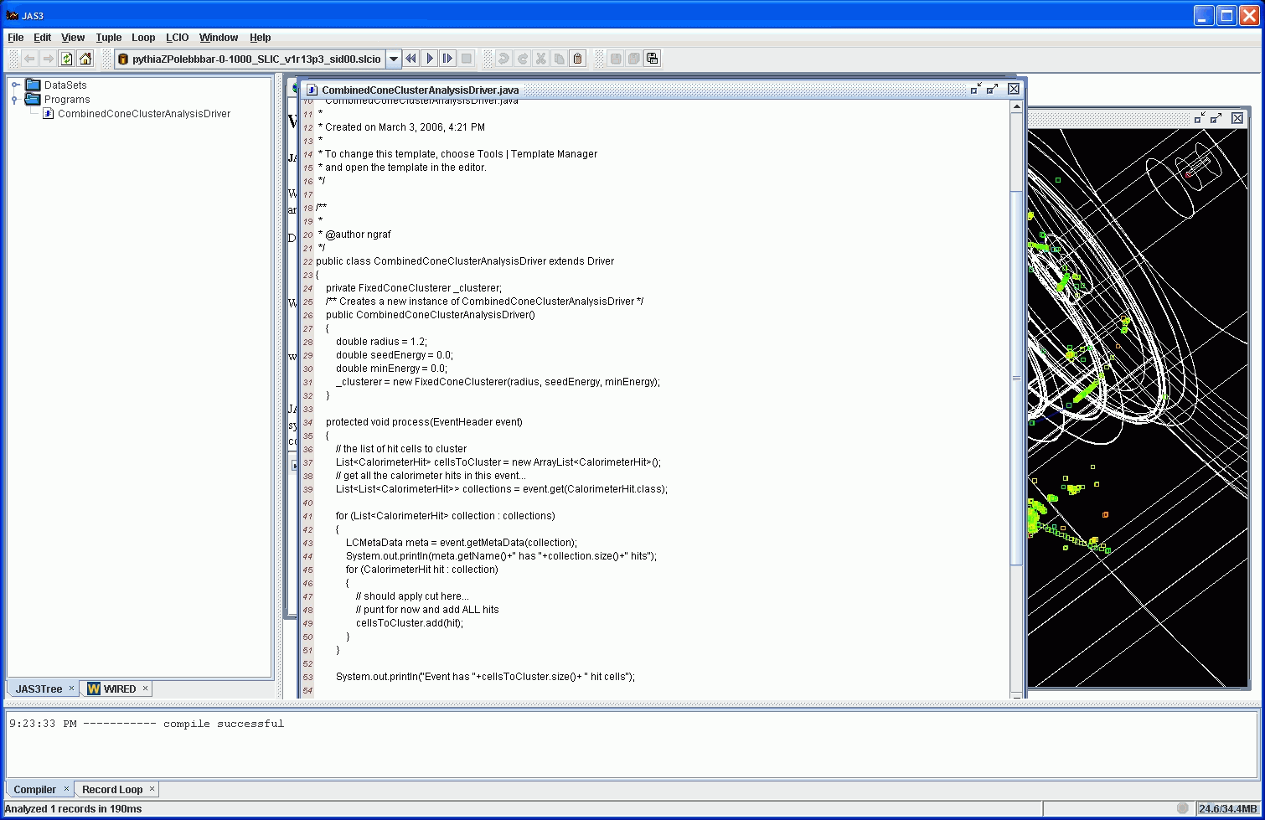
JAS editor/compiler

Slide 33
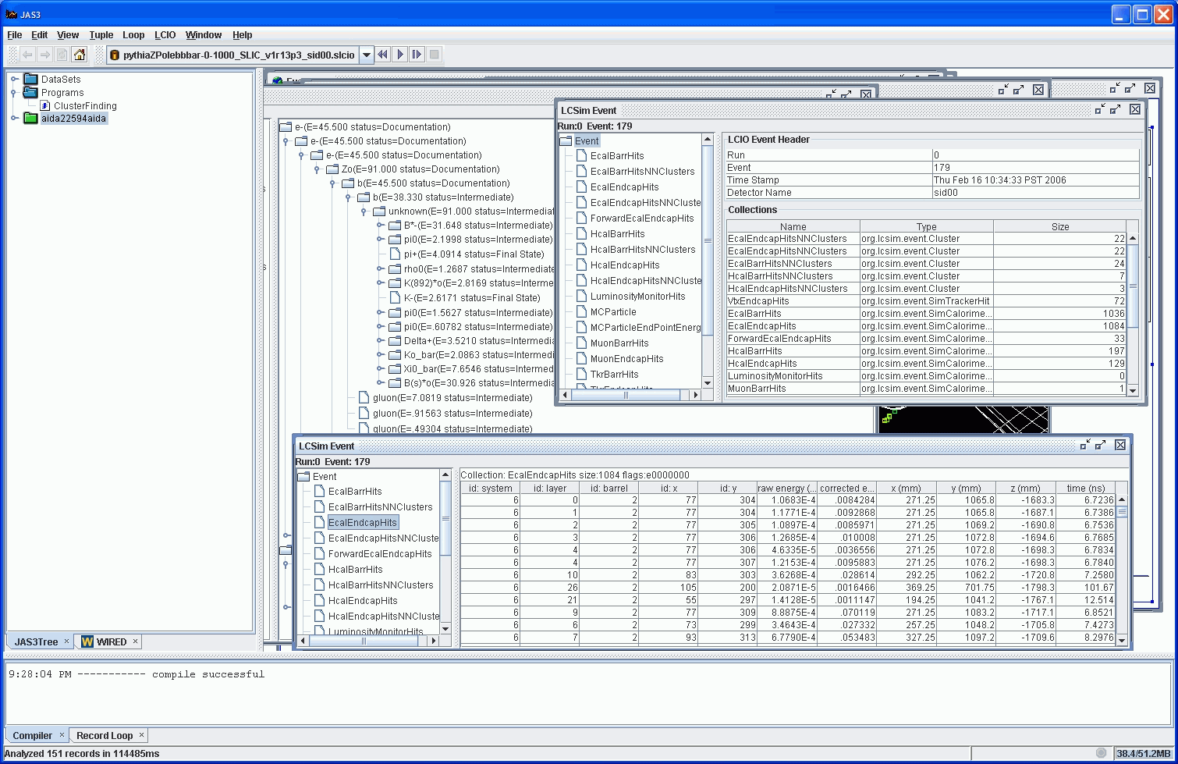
JAS event browser

Slide 34
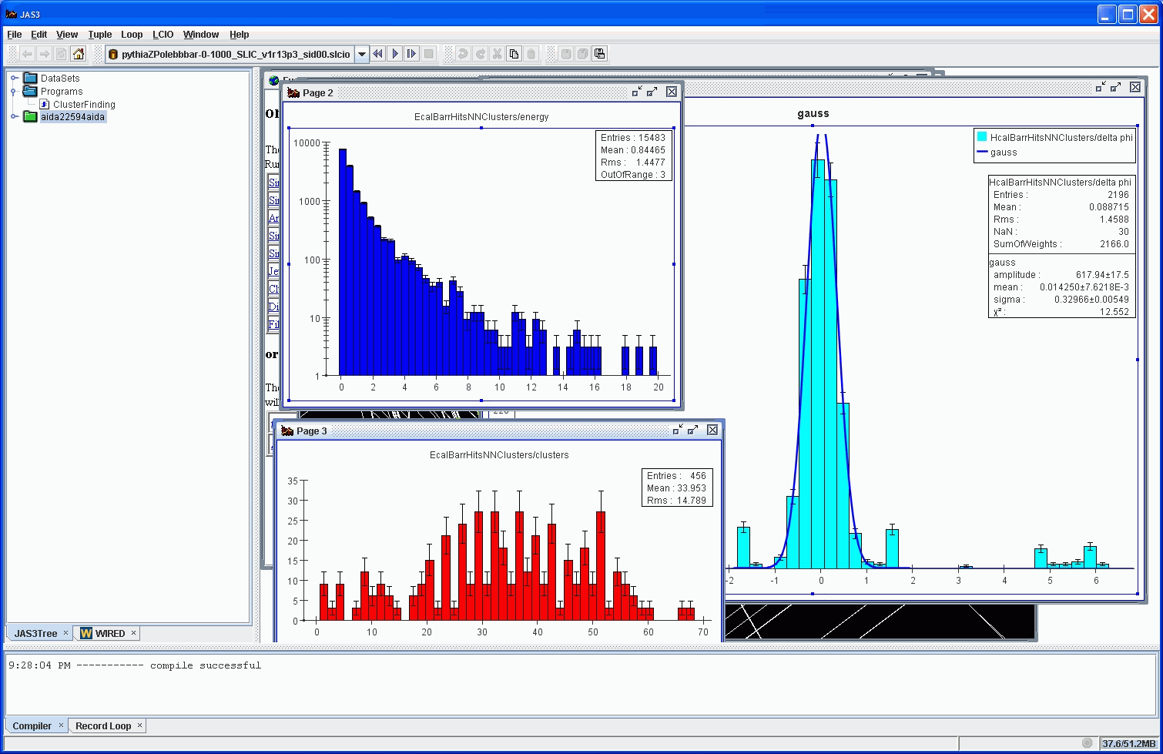
JAS histogramming/ fitting

Slide 35
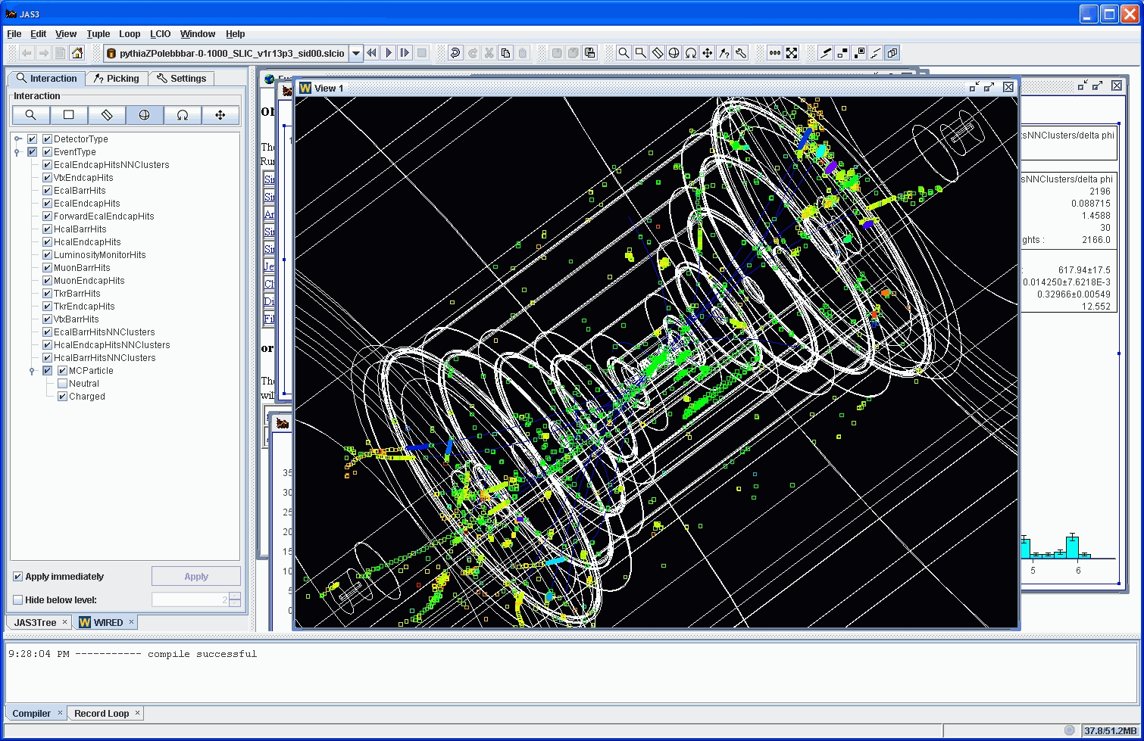
Wired LCD Event Display

Slide 36
Validated
This suite of software tools provides:
  Physics event generation & bindings to most legacy generators through the stdhep format.
  Full detector response simulation using precompiled binaries & runtime geometry definition (no coding!).
  Full detector digitization (x-talk, noise, diffusion, etc.)
  Hit-level overlay of arbitrary background events.
  Access to other LCIO-compliant software frameworks.
  Full ab-initio event reconstruction and analysis suites.
  Tested on hundreds of millions of events.
“From zero to analysis in 15 minutes.”

Slide 37
Using root
Can analyze output AIDA files using RAIDA.
  non-official root binding to AIDA
Can analyze output LCIO files two ways:
  Using root LCIO Dictionary
  Using rlcio files, LCIO event data model written as root files
    output files are larger
    read times are longer
Roll your own
  write out native root files yourself.
    neither recommended nor supported!

Slide 38
User base
ILC physics and detector community
  primarily US and UK members of SiD
CLIC physics and detector community
  CERN-based SiD’ studies
JLAB heavy-photon search proposals
  HPS: SLAC-based, fixed target, forward detector
  DarkLight: MIT-based, gas-jet, asymmetric detector.
FNAL dual-readout crystal calorimetry

Slide 39
Simulation Summary
ALCPG sim/reco supports an ambitious international detector simulation effort. Goal is flexibility and interoperability.
Provides a complete and flexible detector simulation package capable of simulating arbitrarily complex detectors with runtime detector description.
Reconstruction & analysis framework was used to characterize the Silicon Detector and was essential to that concept’s successful validation in the LOI process.
LCIO provides interoperability with tools developed in other regions (e.g. jet flavor tagging (LCFI), particle flow (Pandora)), other languages (FORTRAN, java, C++, python) and other analysis frameworks (e.g. Marlin, root).

Slide 40
Synergy
Learn from other’s experience (ILC & CLIC).
Use equivalent benchmarks.
Use existing standards.
Use what works.
Go with what has been successful.
WORK TOGETHER!

Slide 41
Additional Information
Wiki - http://confluence.slac.stanford.edu/display/ilc/Home
lcsim.org - http://www.lcsim.org
ILC Forum - http://forum.linearcollider.org
LCIO - http://lcio.desy.de
SLIC - http://www.lcsim.org/software/slic
LCDD - http://www.lcsim.org/software/lcdd
JAS3 - http://jas.freehep.org/jas3
AIDA - http://aida.freehep.org
WIRED - http://wired.freehep.org

