Slide 1
Indian Institutions and Fermilab Collaboration Meeting
Oct 26-30, 2010
Group A
650MHz Blade Tuner
Harry Carter
Fermilab

Slide 2
Cavity and Cryomodule Deliverables
(from S. Mishra’s talk)
650 MHz, β = 0.9 cavity and cryomodule design with RRCAT (finalize by end of 2011),
    650 MHz, β = 0.9 Cavity in collaboration with IUAC
      1-cell cavity Q4-2011
      1st 5-cell cavity in Q4-2012
    Helium Vessel design based on 1.3GHz blade tuner vessel
    Blade Tuner based on original INFN 1.3GHz design
    Cryomodule superconducting magnet, participation in design
    650 MHz Cryomodule design (Q4 2011)
      Here an important assumption is that modified TESLA will be the design for 650 MHz CM
      Design means a complete set of engineering drawings for the CM
        As an example, the complete set of ILC Type IV CM drawings contains over 750 individual drawings

Slide 3
650MHz Helium Vessel
POC is Tom Peterson. Technical design contact is Chuck Grimm
Design requirements
  Use on Beta=0.9 and 0.6 cavities
  Grade 2 titanium construction
  Minimal contribution to df/dP
  MAWPof 2 bar (warm) and 4 bar (cold)
  Designed to ASME B&PV Code or equivalent level of safety (10CFR851)
Design evaluation criteria
  Compatibility with T4CM–based cavity support system
  Reliability of complete system
  Tuning range of vessel (limited by vessel bellows stresses)
When will functional requirement specification (FRS) be available?
Schedule
  When is a 650 MHz helium vessel needed?
    Prototype
    Final design

Slide 4
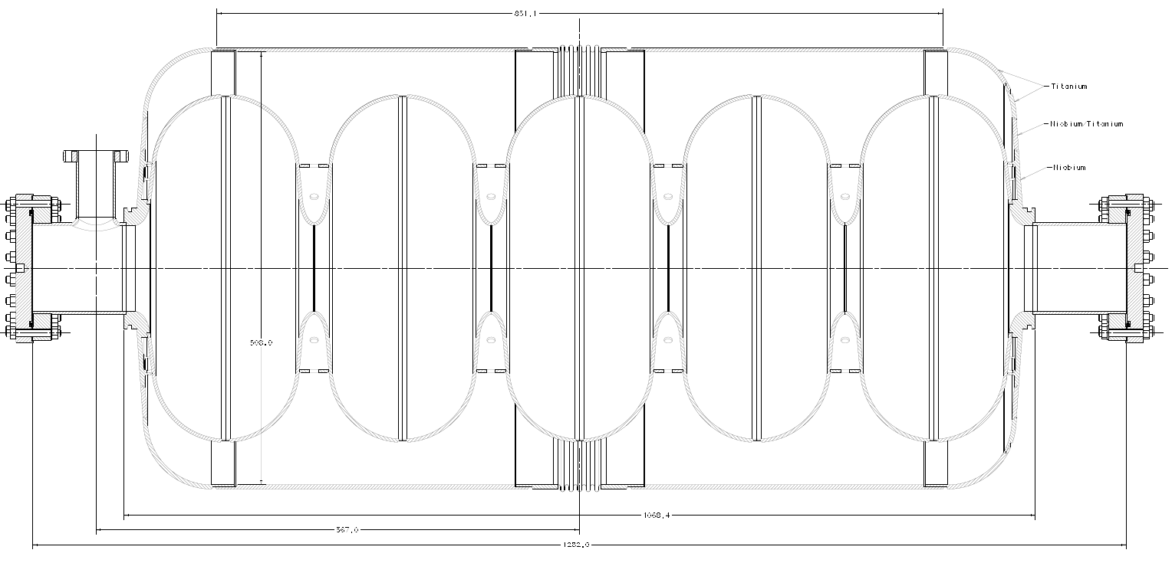
Proposed 650MHz Helium Vessel
Vessel Cross-Section

Slide 5
1.3GHz Blade Tuner

Slide 6
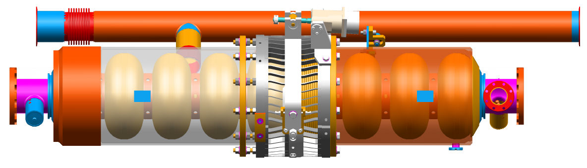
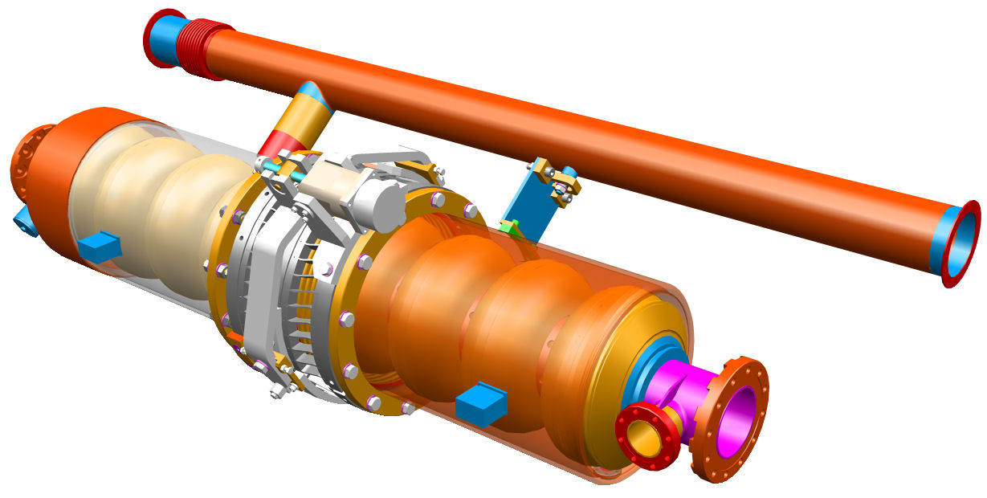
1.3GHz Dressed Cavity

Slide 7
650MHz Blade Tuner
FNAL technical expert is Serena Barbanotti
Design input and details
  Basis for design is INFN 1.3GHz cavity blade tuner
  Use on Beta=0.9 and 0.6 cavities
  Grade 2 titanium for all components except the blades
  Grade 5 titanium for the blades
Design evaluation criteria
  Compatibility with CM cavity support system
  Reliability of complete system
  Tuning range of device
When will functional requirement specification be available?
Schedule
  When is it needed?
    Prototype
    Final design

Slide 8
650MHz Blade Tuner
Alternatives
  Stainless steel helium vessel and stainless steel blade tuner
    We are currently working on a 1.3GHz SS design and have procured two tuners and two vessels. Have not yet identified a cavity to “dress” with them.
    Does it make sense to explore SS for 650 MHz vessels and tuners?
  India-developed wedge tuner
  Pneumatic actuation versus electro-mechanical drive
  Drive mechanism outside vacuum vessel
    Improved reliability at the cost of some complexity for vacuum vessel feed-thrus
Work that can be done now (while we prepare the FRS)
  Analytical---preliminary FEA of scaled up 1.3GHz has been completed. More work can be done here.
  Other studies?
  Survey of potential vendors
    We currently have two U.S. vendors building 1.3GHz blade tuners

Slide 9
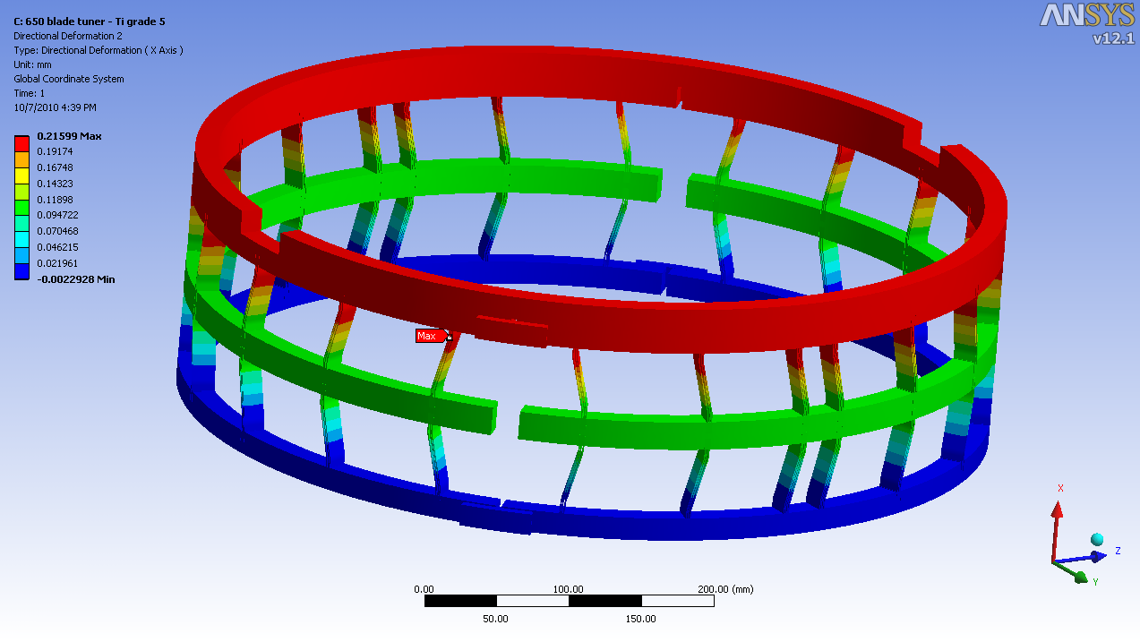
650 MHz Blade Tuner fEA
S. Barbanotti

Slide 10
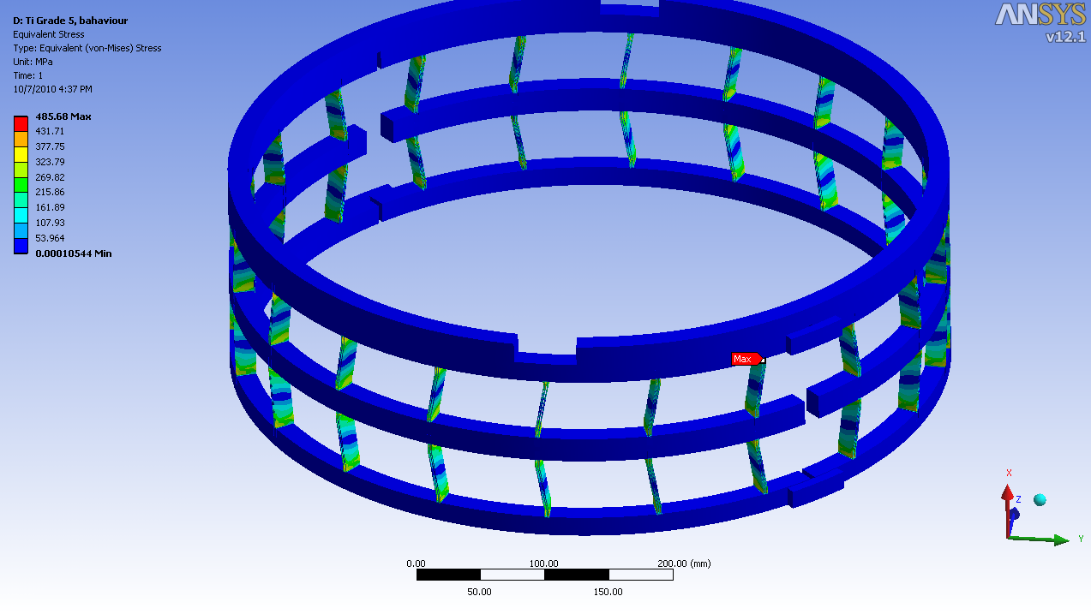
650 MHz blade Tuner fEA
S. Barbanotti

