Slide 1
Status of Fermilab Project X
IIFC Meeting
Oct 26, 2010
Steve Holmes
Project-X, Project Manager
Fermilab

Slide 2
Outline
Fermilab Strategic Plan
Project X Reference Design
Moving Project X through the U.S. Department of Energy Process
R&D Plan
Project X Collaboration and India’s Role
Our websites:
http://projectx.fnal.gov
http://projectx-docdb.fnal.gov

Slide 3
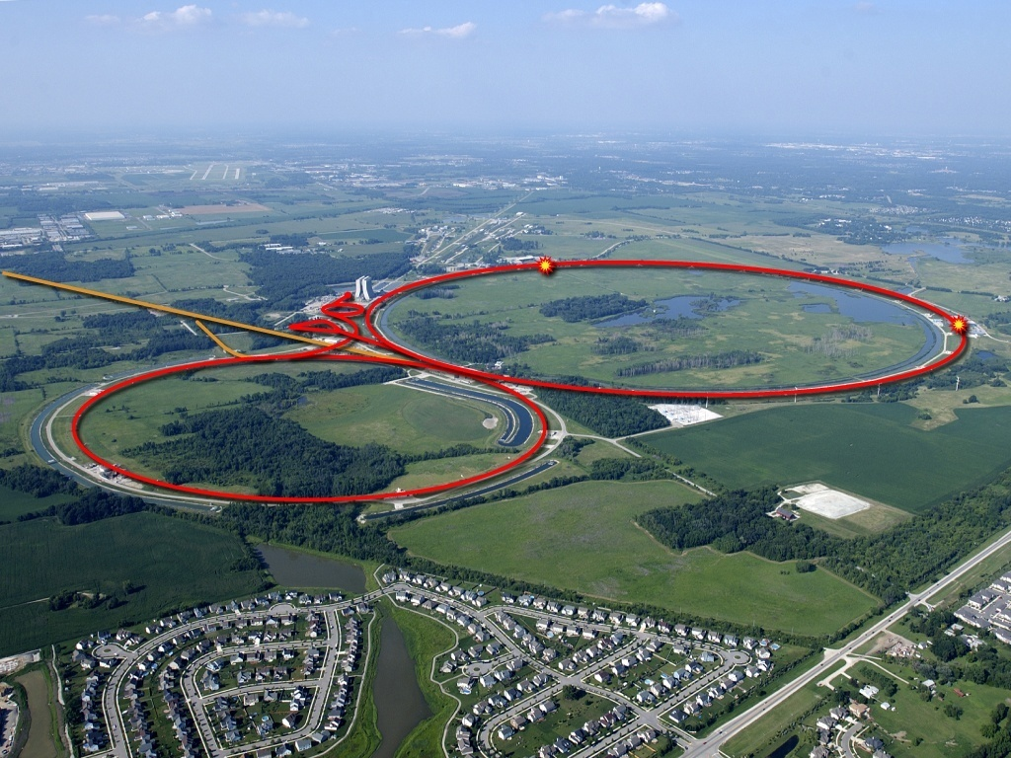
Strategic Context:
Fermilab and the World Program
Tevatron has passed the energy frontier to LHC, following 25 years as the highest energy particle collider in the world.
Highest power long baseline neutrino beam in the world, but will face stiff competition from J-PARC
To Soudan
Notes:
Different word than ceded

Slide 4
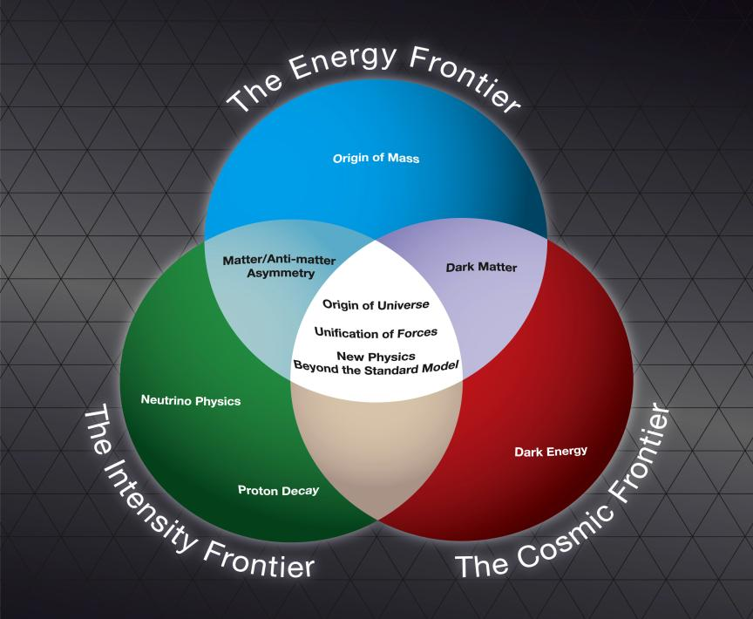
Fermilab Strategic Plan
The U.S. strategy for elementary particle physics has been developed by the DOE’s High Energy Physics Advisory Panel (HEPAP). Fermilab is fully aligned with this strategy.
The Fermilab strategy is to
mount a world-leading program
at the intensity frontier, while
using this program as a bridge
to an energy frontier facility
beyond LHC in the longer term.

Slide 5
Evolution of the Fermilab Accelerator Complex
A multi-MW Proton Source, Project X, is the key element of Fermilab’s strategy for future development of the accelerator complex.
Project X provides long term flexibility for achieving leadership on the intensity and energy frontiers
  Intensity Frontier:
  MINOS→ NOνA→ LBNE/mu2e→ Project X → Rare Processes → NuFact
    Continuously evolving world leading program in neutrino and rare processes physics;
    Opportunities for applications outside Elementary Particle Physics
  Energy Frontier:
  Tevatron → ILC or Muon Collider
    SRF Technology alignment
    Fermilab as host site for ILC or MC
Notes:
Different word than linchpin, other opportunities in sub bullet expand EPP, SRF Technology alignment

Slide 6

Mission
A neutrino beam for long baseline neutrino oscillation experiments
  2 MW proton source at 60-120 GeV
High intensity, low energy protons
for kaon and muon based precision
experiments
  Operations simultaneous with the
  neutrino program
A path toward a muon source for
possible future Neutrino Factory
and/or a Muon Collider
  Requires ~4 MW at ~5-15 GeV .
Possible non-HEP missions under consideration
  Nuclear Physics and Nuclear Energy applications
Notes:
Replace ADS Development with Nuclear Energy Application

Slide 7
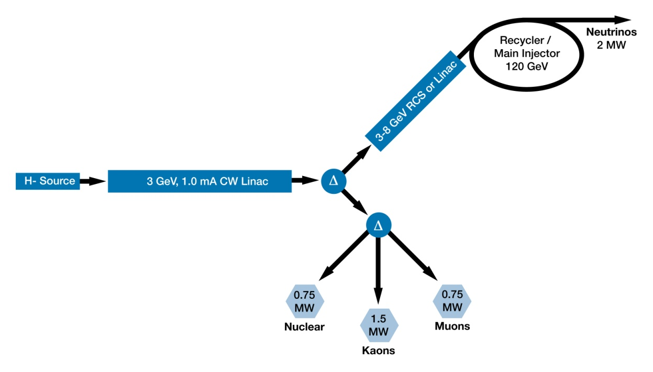
Reference Design
3 GeV CW linac; 3 MW beam power
  Flexible provision for beam requirements supporting multiple users
3-8 GeV acceleration via a (1.3 GHz) superconducting pulsed linac
Existing Recycler/Main Injector support the neutrino program
Reference Design Report to be released ~October 31

Slide 8
Project X Goals
Construct a 3 GeV continuous-wave superconducting H- linac, capable of delivering 1 mA of average beam current.
  Supports rare processes and nuclear physics programs
  Can support nuclear energy applications with beam energies <2 GeV
Construct a 3-8 GeV pulsed linac, utilizing an ILC-style RF system, with total beam power delivered to 8 GeV of 300 kW.
  Required for the neutrino program
  Establishes a path toward a muon based facility
Upgrade the Recycler and Main Injector to provide ≥ 2 MW to a neutrino production target at 60-120 GeV.
  Supports the long baseline neutrino program
Simultaneous operations of the rare processes and neutrino programs
Notes:
ADS Development with Nuclear Energy Applications

Slide 9
Functional Requirements
Requirement | Description | Value
L1 | Delivered Beam Energy, maximum | 3 GeV
L2 | Delivered Beam Power at 3 GeV | 3 MW
L3 | Average Beam Current (averaged over >1 μsec) | 1 mA
L4 | Maximum Beam Current (sustained for <1 μsec) | 10 mA
L5 | The 3 GeV linac must be capable of delivering correctly formatted beam to a pulsed linac, for acceleration to 8 GeV
L6 | Charge delivered to pulsed linac | 26 mA-msec in < 0.75 sec
L7 | Maximum Bunch Intensity | 1.9 x 10 ⁸
L8 | Minimum Bunch Spacing | 3.1 nsec (1/325 MHz)
L9 | Bunch Length | <50 psec (full-width half max)
L10 | Bunch Pattern | Programmable
L11 | RF Duty Factor | 100% (CW)
L12 | RF Frequency | 325 MHz and harmonics thereof
L13 | 3 GeV Beam Split | Three-way
P1 | Maximum beam Energy | 8 GeV
P2 | The 3-8 GeV pulsed linac must be capable of delivering correctly formatted beam for injection into the recycler (or Main Injector).
P3 | Charge to fill Main Injector/cycle | 26 mA-msec in <0.75 sec
P4 | Maximum beam power delivered to 8 GeV | 300 kW
Notes:
May not want to explain all the details, You should highlight a few points. Same for next slide

Slide 10
Functional Requirements
Requirement | Description | Value
M1 | Delivered Beam Energy, maximum | 120 GeV
M2 | Delivered Beam Energy, minimum | 60 GeV
M3 | Minimum Injection Energy | 6 GeV
M4 | Beam Power (60-120 GeV) | > 2 MW
M5 | Beam Particles | Protons
M6 | Beam Intensity | 1.6 x 10 ¹⁴ protons per pulse
M7 | Beam Pulse Length | 9.5 μsec
M8 | Bunches per Pulse | 504
M9 | Bunch Spacing | 18.8 nsec (1/53.1 MHz)
M10 | Bunch Length | <2 nsec (fullwidth half max)
M11 | Pulse Repetition Rate (120 GeV) | 1.333 sec
M12 | Pulse Repetition Rate (60 GeV) | 0.75 sec
M13 | Max Momentum Spread at extraction | 2 × 10⁻³
I1 | The 3 GeV and neutrino programs must operate simultaneously
I2 | Residual Activation from Uncontrolled Beam Loss | <20 mrem/hour (average) <100 mrem/hour (peak) @ 1 ft
I3 | Scheduled Maintenance Weeks/Year | 4
I4 | 3 GeV Linac Operational Reliability | 90%
I5 | 60-120 GeV Operational Reliabiltiy | 85%
I6 | Facility Lifetime | 40 years
U1 | Provisions should be made to support an upgrade of the CW linac to support an average current of 4 mA.
U2 | Provisions should be made to support an upgrade of the Main Injector to support a delivered beam power of ~4 MW at 120 GeV.
U3 | Provisions should be made to deliver CW proton beams as low as 1 GeV
U4 | Provision should be made to support an upgrade to the CW linac such that it can accelerate Protons

Slide 11
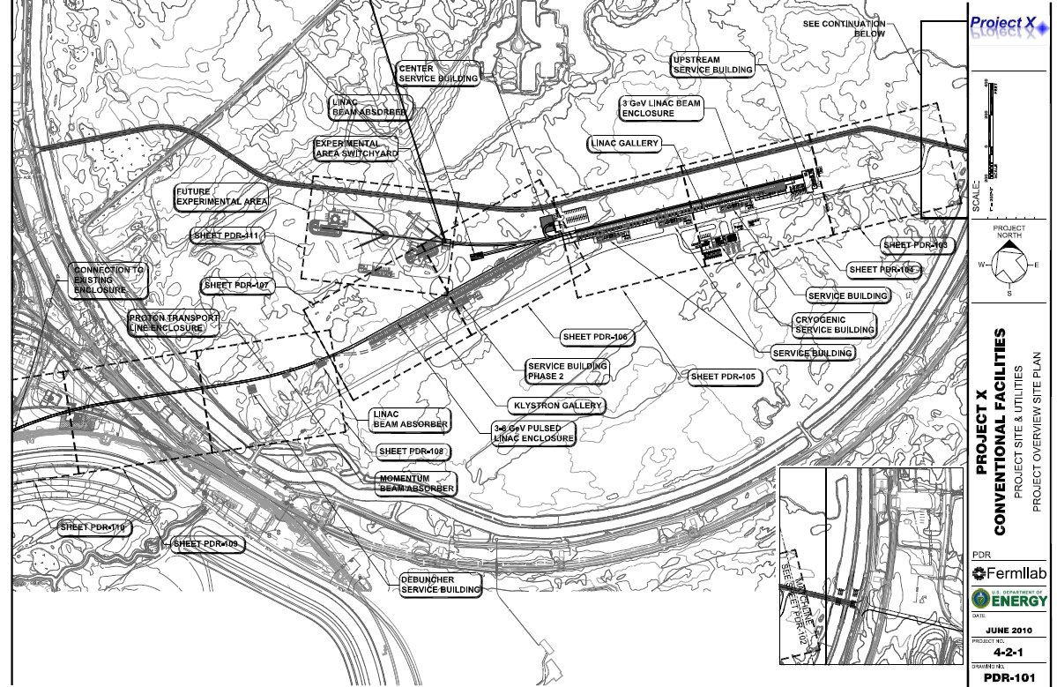
Reference Design
Provisional Siting

Slide 12
CW Linac Technologies
β=0.11
β=0.22
β=0.4
β=0.61
β=0.9
β=1.0
325 MHz SSR
2.5-160 MeV
650 MHz Elliptical 0.16-2 GeV
1.3 GHz Elliptical 2-3 GeV
Section | Freq | Energy (MeV) | Cav/mag/CM | Type
SSR0 (β_{G}=0.11) | 325 | 2.5-10 | 26 /26/1 | SSR, solenoid
SSR1 (β_{G}=0.22) | 325 | 10-32 | 18 /18/ 2 | SSR, solenoid
SSR2 (β_{G}=0.4) | 325 | 32-160 | 44 /22/4 | SSR, solenoid
LB 650 (β_{G}=0.61) | 650 | 160-520 | 42 /42/7 | 5-cell elliptical, doublet
HB 650 (β_{G}=0.9) | 650 | 520-2000 | 96 /24/12 | 5-cell elliptical, doublet
ILC 1.3 (β_{G}=1.0) | 1300 | 2000-3000 | 72 /9 /9 | 9-cell elliptical, quad
Notes:
I would suggest that you point out that Indian DAE labratories are already working on SSR1, 650 and ILC cavities.

Slide 13
Pulsed Linac
A superconducting pulsed linac will be used for acceleration from 3 to 8 GeV
  ILC style cavities and cryomodules
    1.3 GHZ, β=1.0
  ILC style rf system
    5 MW klystron
    Two cryomodules per rf source
  Must deliver 26 mA-msec to the Recycler every 0.75 sec. Options:
    2 mA x 2.2 msec pulses at 10 Hz
      Six pulses required to load Recycler/Main Injector
    1 mA x 2.2 msec pulses at 20 Hz
      Twelve pulses required to load Recycler/Main Injector
    1 mA x 4.4 msec pulses at 10 Hz
      Six pulses required to load Recycler/Main Injector
    1 mA x 26 msec pulses at 10 Hz
      One pulse required to load Main Injector

Slide 14
Department of Energy Process
The U.S. Department of Energy mandates a formal process for all projects with costs in excess of $10M
Process is governed by five “Critical Decisions”:
  CD-0: Approve Mission Need
  CD-1: Approve Alternative Selection and Cost Range
  CD-2: Approve Performance Baseline
  CD-3: Approve Start of Construction
  CD-4: Approve Start of Operations or Project Completion
Most projects undertaken in the last decade have take between 3 to 4 years to get from CD-0 to CD-3
Project X does not yet have CD-0
  Documentation is in preparation and we are currently anticipating in spring 2011
    DOE briefing November 16-17
  IIFC is a major factor in pushing this process forward
Notes:
Why IIFC statement is in ( ), You could mention that we are expecting CD-0 in Jan 2011 and we have a DOE briefing in Nov. So this meeting in India is timely to firm up our collaboration and present to DOE. Can you give a schedule if we get CD-0 in Jan 2011

Slide 15
Department of Energy Process
Planning for Project X, including all R&D activities, is undertaken within the CD framework:
  The process starts with the approval of the physics mission (CD-0); the accelerator design is less important at this stage
  Alternative implementations need to maintained through CD-0 and then analyzed prior to CD-1; a Conceptual Design Report is produced for CD-1
    The basic configuration is established at CD-1
  Formalized accounting and reporting requirements are initiated with CD-0, and come to full fruition at CD-2
  The performance baseline is established at CD-2
    Performance baseline = technical scope & performance goals, cost, and schedule
    The final configuration is established at CD-2
  Final (detailed) design is completed between CD-2 and CD-3
    All R&D is generally complete at the time of CD-3
  CD-3 authorizes the start of construction
There are no explicit provisions for integration of contributions from international partners within this DOE framework
  So we are inventing the path forward together
Notes:
The international partner will be by bilateral agreements. The Asia politics

Slide 16
RD&D Plan
Goals
RD&D = Research, Design, and Development
RD&D Plan corresponds to the Reference Design
  Most recent version available at:
  http://projectx-docdb.fnal.gov:8080/cgi-bin/ShowDocument?docid=628
Goals
  Complete design of the Project X facility including all technical and conventional construction elements
  Identification of key accelerator physics and engineering challenges and validation of performance of critical technology items
    Simulations, experimentation, and prototype construction as appropriate
  Development of an acquisition strategy for key technical elements, including development/qualification of vendors for critical components
  Development of a technical/cost/schedule baseline for construction
  Preliminary identification of performance upgrade paths

Slide 17
RD&D Plan
Scope/Deliverables
Scope
  All activities required to bring Project X from the Reference Design through final design (CD-3).
Deliverables
  All documentation required by the Department of Energy prior to authorizing construction
  Supporting technical R&D required to validate the design and establish fabrication methods
Assumed Critical Decision dates
  CD-0: January 2011 Approve Mission Need
  CD-1: July 2012 Approve Alternative Selection & Cost Range
  CD-2: August 2013 Approve Performance Baseline
  CD-3: September 2014 Approve Start of Construction
  CD-4: September 2019 Project Complete
Notes:
Almost same as slide 14. Can you combine the two. This one has dates that I was requesting on the slide 14.

Slide 18
SRF Development Plan
(see Supplement I to MOU Addendum III)
Notes:
You should mention that this plan is tied to Supplement 1 to Addendum MOU III with Indian laboratories.

Slide 19
Collaboration Plan
A multi-institutional collaboration has been established to execute the Project X RD&D Program.
  Organized as a “national project with international participation”.
    Fermilab as lead laboratory
    International participation via in-kind contributions, established through bi-lateral MOUs.
      IIFC is the first international agreement
  Collaboration MOUs for the RD&D phase outlines basic goals, and the means of organizing and executing the work. Signatories:
  ANL ORNL/SNS BARC/Mumbai
  BNL MSU IUAC/Delhi
  Cornell TJNAF RRCAT/Indore
  Fermilab SLAC VECC/Kolkata
  LBNL ILC/ART
  Collaborators to assume responsibility for components and sub-system design, development, cost estimating, and potentially construction.
Notes:
Spelling of Kolkata. Put IIFC as a sub-bullet

Slide 20
Current Institutional Responsibilities
 | Front End | Cav & CMs | RF | Cryo | Instru | Cntrls | MI/Recycler | Beam Trnspt | Accel Phys | Systm Integ | Test Facil
ANL |  | X | X |  |  |  |  |  | X
BNL |  | X |  |  |  |  |  | X
Cornell |  | X |  |  |  |  | X
Fermilab | X | X | X | X | X | X | X | X | X | X | X
LBNL | X |  |  |  | X |  |  |  | X
SNS |  |  |  |  | X
MSU |  | X
TJNAF |  | X
SLAC | X |  | X |  |  |  | X |  | X |  | X
ILC/ART |  | X
BARC | X | X | X | X | X |  |  |  |  |  | X
IUAC |  | X |  | X
RRCAT |  | X | X | X |  |  |  |  |  |  | X
VECC |  | X |  | X

Slide 21
Indian Institutes & Fermilab Collaboration (IIFC)
Goals:
  India Institutions to assist Fermilab in the realization of Project X at Fermilab;
    Input into performance goals
  Indian Institutions to acquire technical capabilities in the design and construction of high intensity proton accelerators;
  Indian researchers to participate in the Project X physics program
    Elementary Particle Physics: neutrino/muon/kaon
    Nuclear: Nuclear physics and Nuclear energy applications
Framework
  Establish Indian contributions during the R&D phase
    Alignment with Indian technology goals
  Construction phase is under discussion, but…
    Expectation that R&D areas carryover into construction
  Indian participation in the commissioning phase
  Fermilab holds ultimate responsibility for successful execution of the RD&D, construction, and commissioning phase
Notes:
India should be replaced by Indian Institutions. Replace ADS with Nuclear Energy

Slide 22
Indian Institutes & Fermilab Collaboration (IIFC)
Strategy
  Full integration of Indian activities within the Project X RD&D Plan
    Clear definition and common understanding of functional requirements, deliverables, and responsible managers
  Formally established points of contact at Fermilab and Indian Institutions to manage R&D sub-projects
    IIFC oversight structures in place
    Fermilab management plan in place; reviewed by IC-IIFC
  Continuous communication so that Indian participants remain fully informed of Project X technical and political status
    Includes making clear what technical configurations are fixed and which are still open for modification, for example:
      650 MHz to 3 GeV?
      Eliminate Recycler and drop pulsed linac energy to 6 GeV?
      Replace SSR2 with TSR?
      RF power sources are to be determined
  Long term Indian visitors in residence at Fermilab
    Direct integration into Fermilab teams
Notes:
India with Indian Institutions

Slide 23
Strategy/Timeline
Next month: Complete all preliminary design, configuration, and cost range documentation for CD-0.
  Functional Requirements Specification
  Reference Design Report
  RD&D Plan
  Cost estimate/range
  Resource Loaded Schedule
  Department of Energy briefing on November 16-17
Continue conceptual development on outstanding technical questions
  Baseline concept for the chopper
  Concepts for marrying the 3-8 GeV pulsed linac to CW front end
  Injection into the Recycler/Main Injector
  Emphasis of srf development at all relevant frequencies
The DOE has advised that the earliest possible construction start is FY2015
  We are receiving very significant R&D support for Project X and SRF development (~$40M in FY11, not including ARRA (stimulus))
Planning for a five year construction schedule
Project X could be up and running in ~2020
Notes:
You should verbally say how much is the total expense in Project-X and SRF R&D. If I add everything up it will be close to $0.5B (2005-2015)

Slide 24
Summary
Project X is central to Fermilab’s strategy for development of the accelerator complex over the coming decade
  World leading programs in neutrinos and rare processes;
  Potential applications beyond elementary particle physics;
  Aligned with ILC, Muon Accelerators, and Nuclear Energy
Project X design concept is well developed and well aligned with the requirements of the physics program:
  3 GeV CW linac operating at 1 mA: 3 MW beam power
  3-8 GeV pulsed linac injecting into the Recycler/Main Injector complex
The IIFC is a key element in moving Project X forward
  International participation in an accelerator developmen/construction project is new to us:
    Patience and goodwill on both sides are necessary to make this work
We are expecting CD-0 for Project X in early 2011
Project X could be constructed over the period ~2015 – 2019

Slide 25
Backup Slides

Slide 26
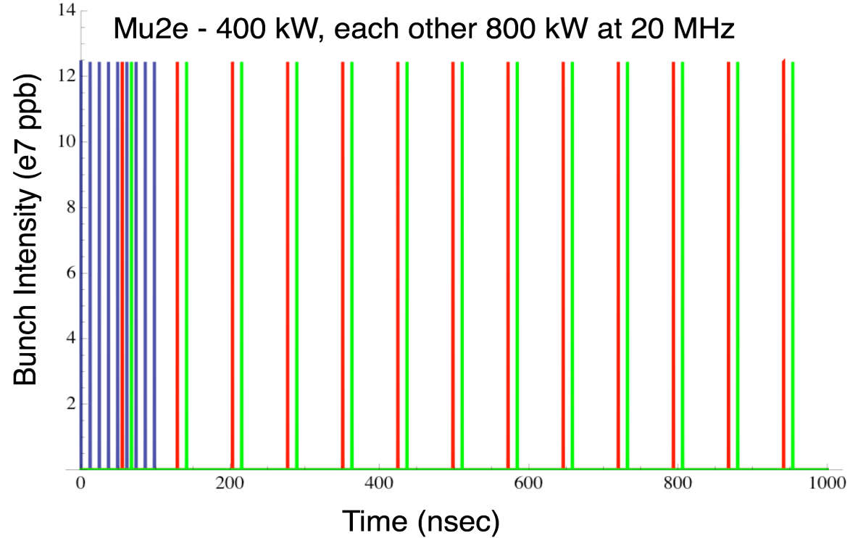
Initial Configuration-2
Operating Scenario
1 μsec period at 3 GeV
mu2e pulse (9e7) 162.5 MHz, 100 nsec 400 kW
Kaon pulse (9e7) 27 MHz 800 kW
Other pulse (9e7) 27 MHz 800 kW
Separation scheme

