Slide 1
Overview of the IIFC Collaboration Program: Present and Future
Shekhar Mishra
Project-X,
International Collaboration Coordinator
IIFC-Fermilab Coordinator

Slide 2
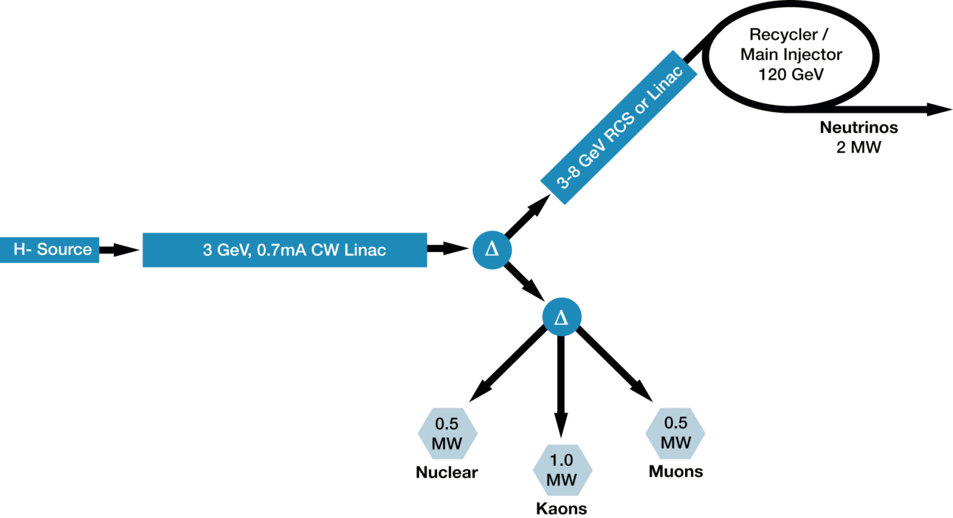
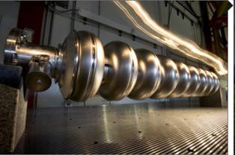
Fermilab’s Next 10 yrs Strategy
A multi-MW proton source, Project-X, is the key element of Fermilab’s strategy for future development of the accelerator complex.
  Project-X is designed to provide flexibility in evolving Fermilab physics program in response to research results from the LHC
  Fermilab is diversifying in the areas of Nuclear Physics and Energy
2
Notes:
2

Slide 3
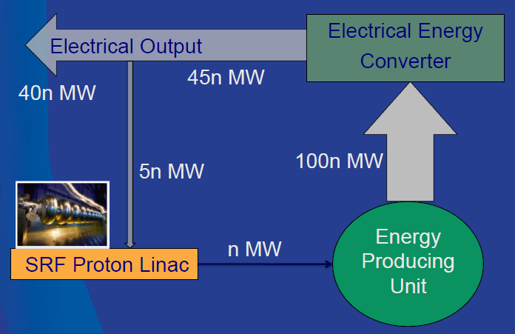
Indian DAE Next 10-15 yrs Strategy
A multi-MW proton source is the key element of the 3rd stage Indian Nuclear Energy program, including transmutation and accelerator driven subcritical (ADS) system
  Multi MW CW beam at 1-2 GeV (similar to Fermilab Project-X) could be the accelerator technology demonstration project.
Indian Institutions and Fermilab Collaboration is also interest in developing the technical expertise and Indian industrial capabilities.
3
Notes:
3

Slide 4
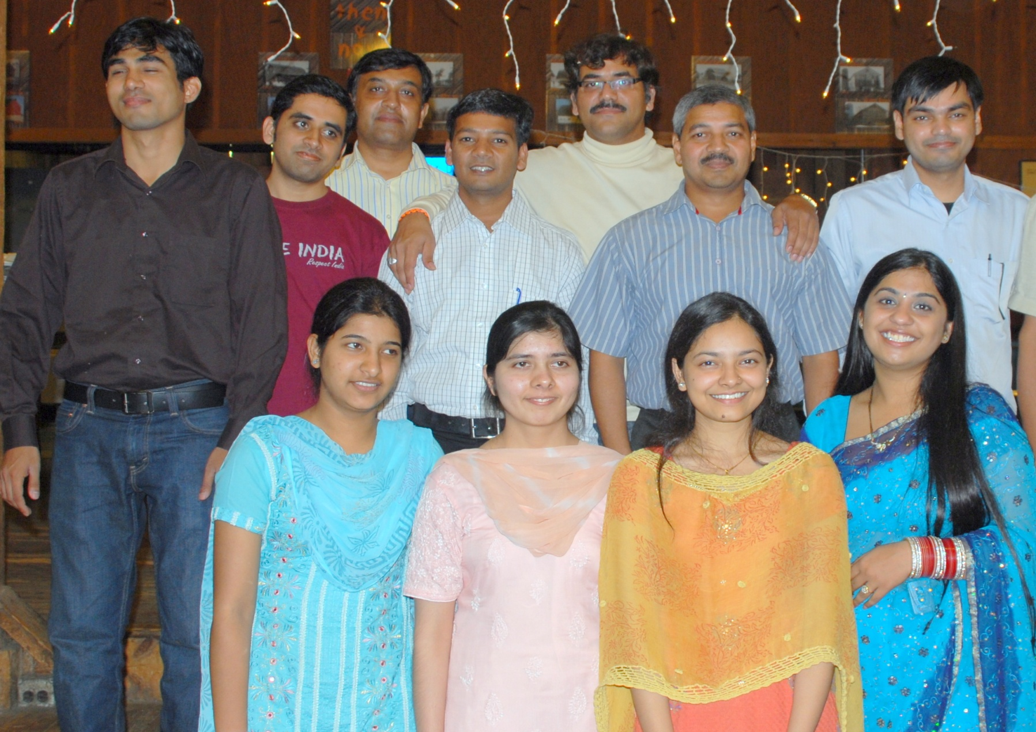
Colleagues at Fermilab under IIFC
Accelerator: 5+1 (1 Student), HEP: 6+2 (5+2 Students)

Slide 5
MOU: US and Indian Laboratories
On Jan 9, 2006, US (Fermilab, SLAC, Jlab, Cornell) and Indian Institutions (BARC, RRCAT, VECC, IUAC, DU) signed an MOU to collaborate on Accelerator and High Energy Physics
We are collaborating under four addendums to the MOU (http://iifc.fnal.gov)
  Fermilab, RRCAT, BARC, IUAC and VECC Collaboration on ILC Main Linac SRF Accelerator Technology R&D
  SLAC, RRCAT, BARC, IUAC and VECC Collaboration on ILC RF Power Sources and Beam Dump Design R&D
  Fermilab and Indian Accelerator Laboratories Collaboration on High Intensity Proton Accelerator and SRF Infrastructure Development (Phase I)
  US and Indian Institutions Collaboration on Neutrino Physics, Related Experiments and Detector Development.

Slide 6
It takes time
In Jan 2006 we established an umbrella MOU and in 2007 1st Addendum.
  Initial Interaction and visit by Indian
  Initial focus on ILC R&D
  Project-X
Jan 2008 to Jan 2009: We worked on aligning the Fermilab and Indian DAE accelerator programs; that resulted in Addendum MOU III (Phase 1).
  Fermilab
  Indian Laboratories
  DOE & DAE
  Management structure
  Funding
    No $ leaving boundaries
  Laws of both countries
    Export Controls
    IPR
    Sensitive Country
  US Industries
June 2010: Established Supplement 1
  New Project-X configuration
  With detailed deliverables and schedule

Slide 7
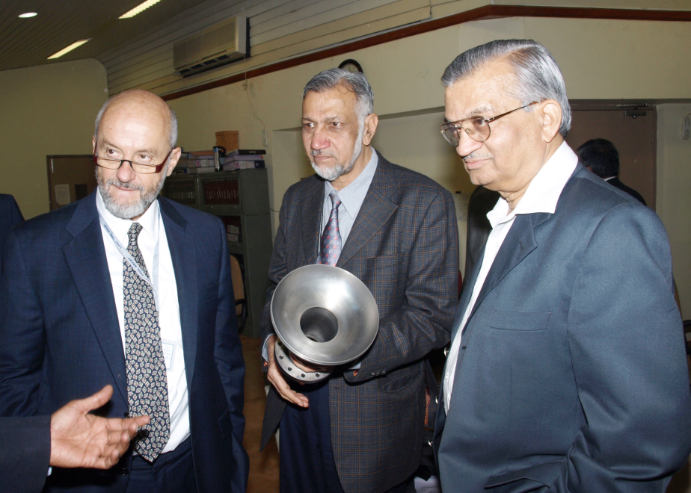
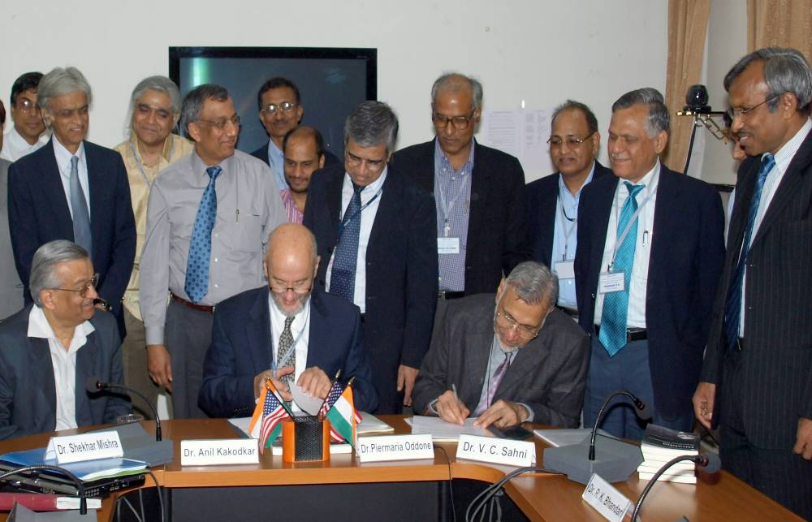
Jan 2009: Addendum MOU III
Addendum III includes all SRF aspects of
  High Intensity Proton Accelerator.
  SRF infrastructure
  Personnel exchange and Training of manpower
  Indian Industries involvement

Slide 8
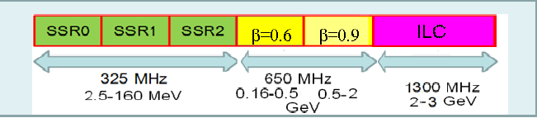
Phase I: SRF R&D
Fermilab is developing HIPA (Project-X) as a national project with International participation.
  Indian DAE laboratories are 1st international partner.
Indian Accelerator Program for Nuclear Energy and Fermilab High Intensity Proton Accelerator program are aligned in design.
Indian Institution

Slide 9
Phase 1: R&D Collaboration
Project-X Accelerator Physics
  Project-X Lattice design
SSR1 Cavity prototype and fabrication
1300 MHz → 650 MHz, β = 0.9 & 0.6 cavity design, prototype and fabrication
1300 MHz → 650 MHz Cryomodule design
  He Vessel
  Blade Tuner
SRF Infrastructure
  Vertical Test Stand design
  Horizontal Test Stand design and cryostat
  Cryomodule Test Stand design and cryostat

Slide 10
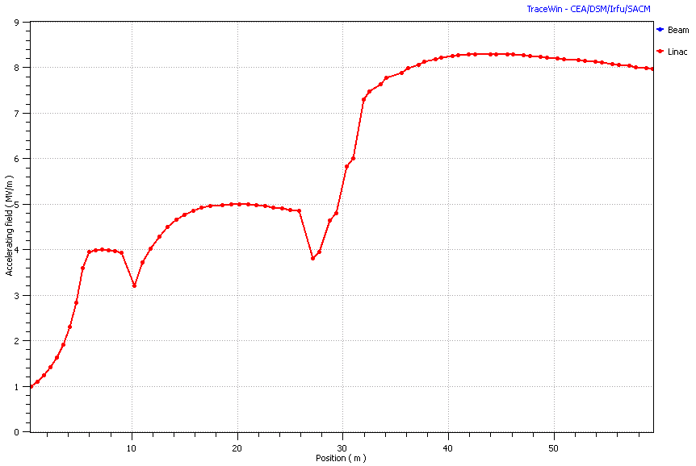
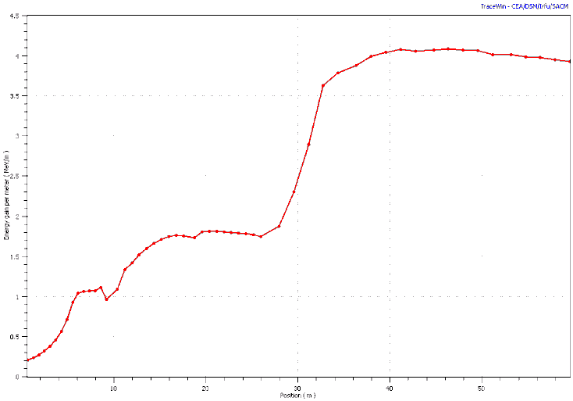
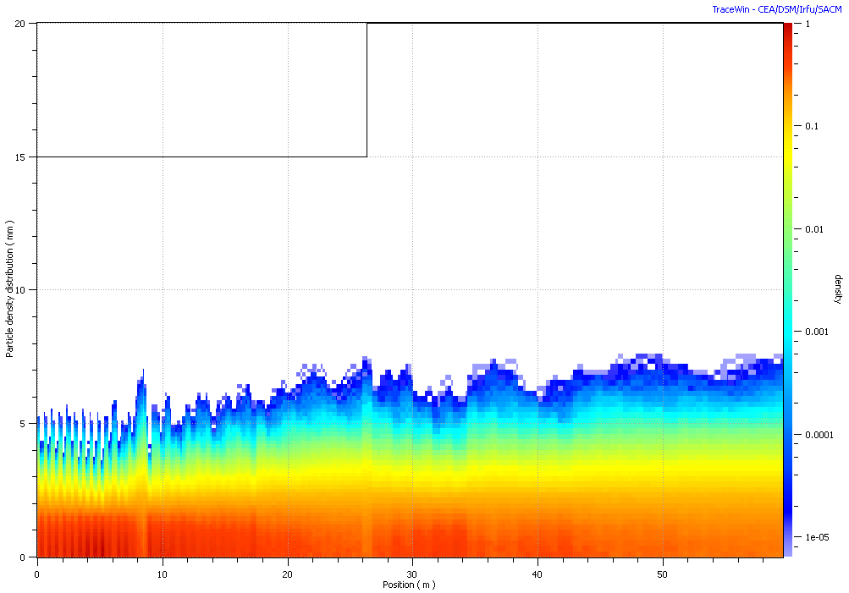
Optimizing Accelerator Layout
To design the new alternative of Front End of CW linac with new no. of cavities per cryomodule & new length of Cryomodule.
To study the beam dynamics with new lattice.
  The Tracking is done with 100 k macro particles.
  The Longitudinal and Transverse acceptance are calculated.
Accelerating Field
Energy Gain
Transverse Distribution of particles along linac

Slide 11
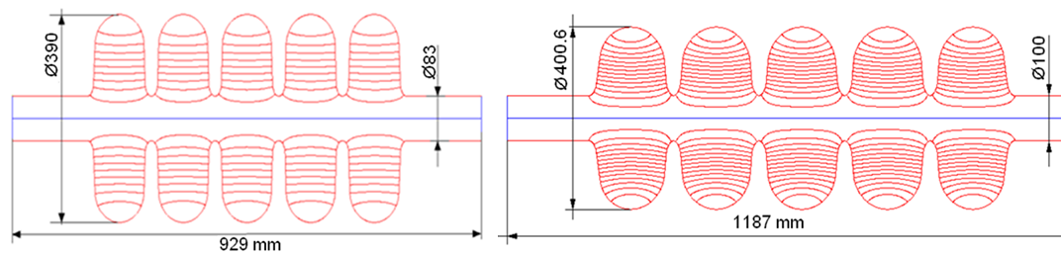
RF parameters of the 650 MHz cavities
High energy SC Linac (160 – 2000 MeV)
Parameter | LE650 | HE650
Beta_G | 0.61 | 0.9
R/Q, Ohm | 378 | 638
G-factor, Ohm | 191 | 255
Max. gain per cavity, MeV(on crest) | 11.7 | 19.3
Gradient, MeV/m | 16.6 | 18.7
Max. Surface electric field, MV/m | 37.5 | 37.3
E_{pk}/E_{acc} | 2.26 | 2
Max surf magnetic field, mT | 70 | 70
B_{pk}/E_{acc} | 4.21 | 3.75
Q_{0,2K,} ×10¹⁰ | 1.5 | 2.0
P_{2K} [W] max | 24 | 29

Slide 12
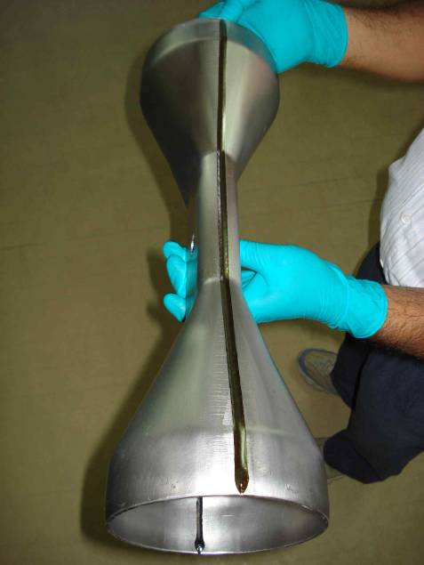
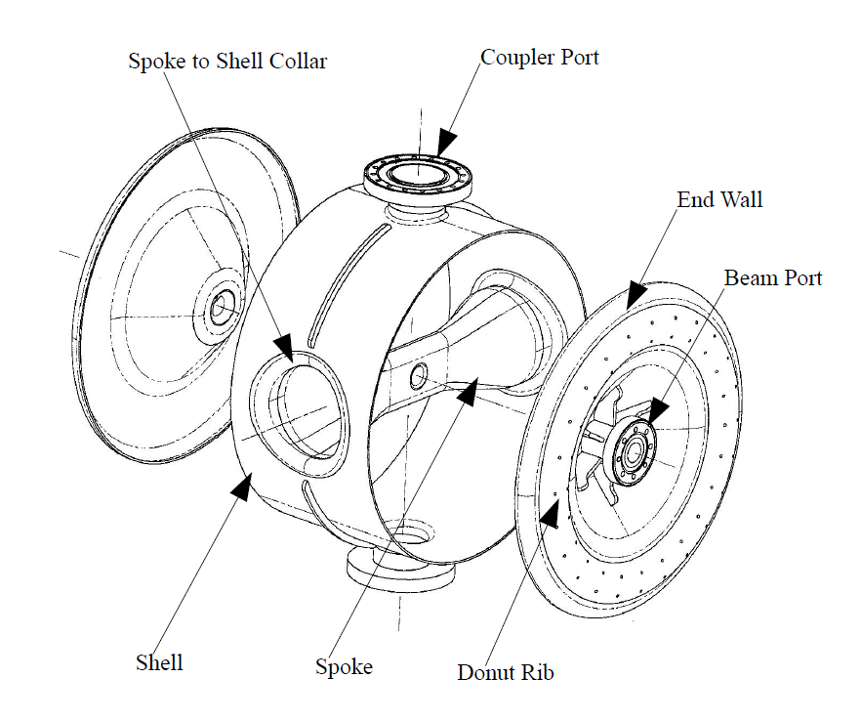
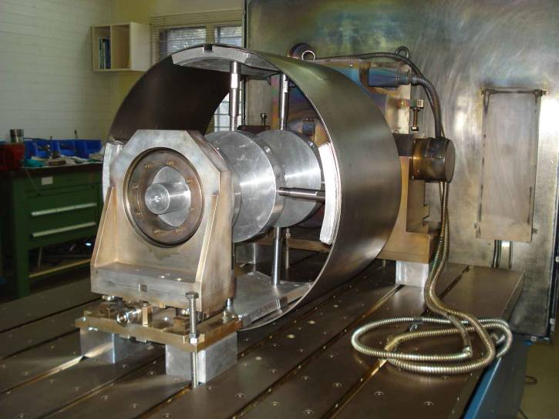
Fabrication of SSR1
Two SSR1 cavities are under fabrication at IUAC
Major components of SSR1 – β = 0.22,
f = 325 MHz

Slide 13
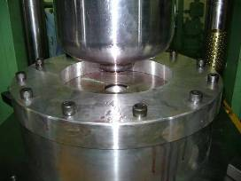
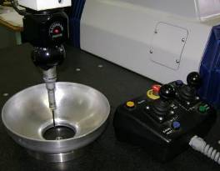
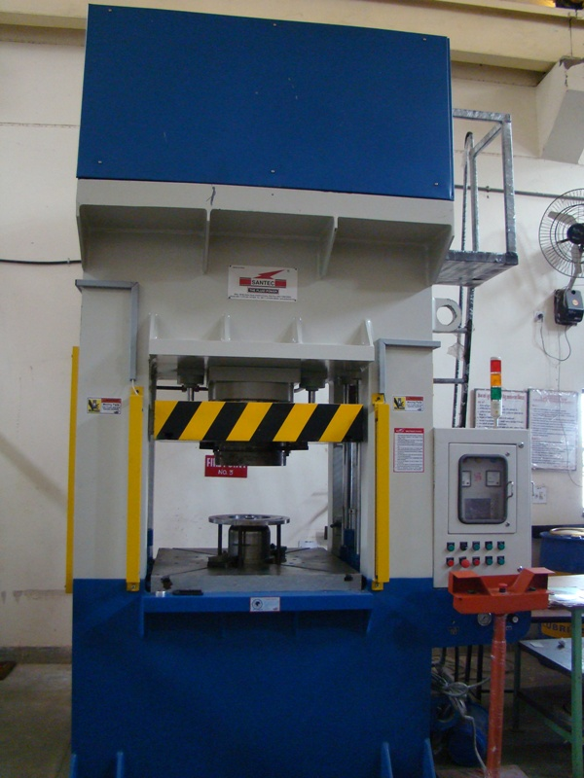
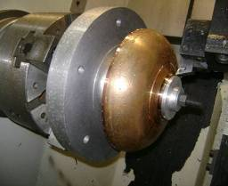
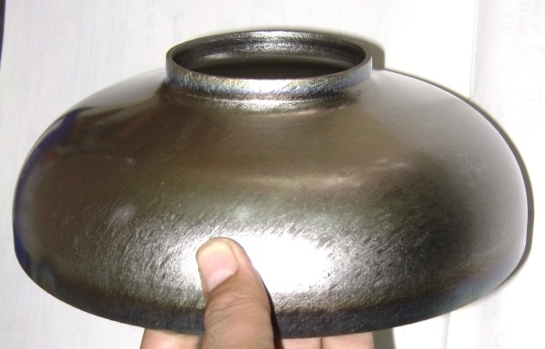
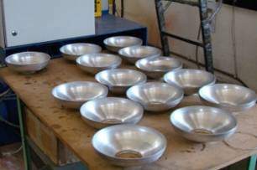
1300 MHz Cavity: Forming and Machining
RRCAT: Developed forming tooling & process for 1.3 GHz SCRF cavity.
120 T - HYDRAULIC PRESS
Forming
Inspection
Machining
Formed Niobium Half cell
Notes:
13

Slide 14
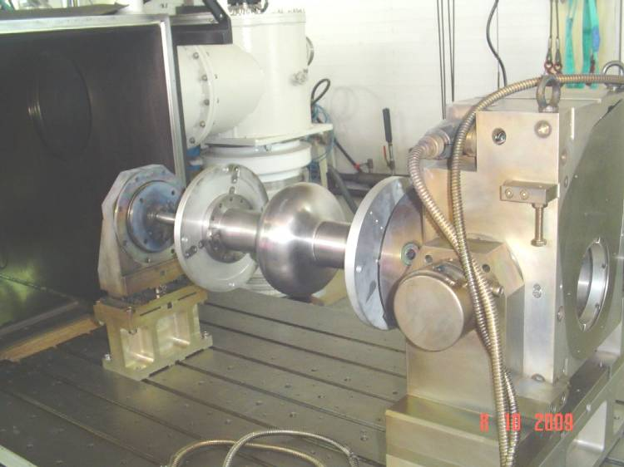
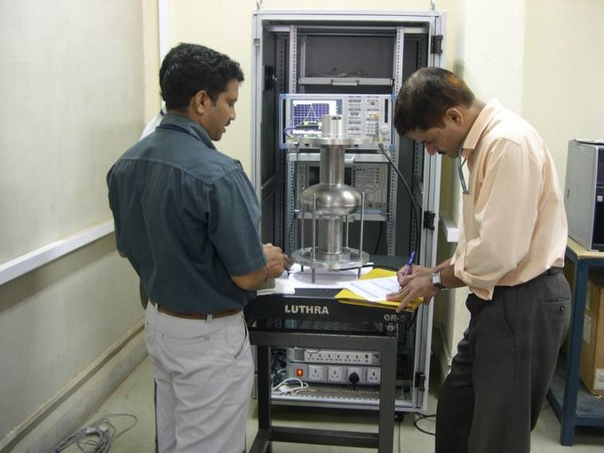
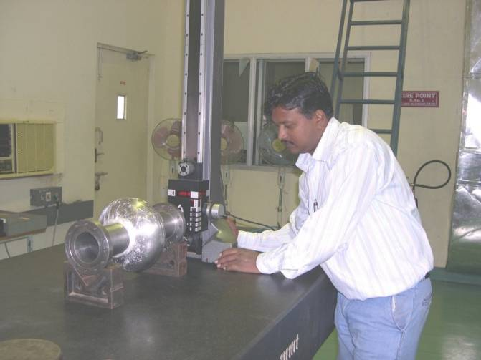
Equator Welding
Setting inside IUAC EBW Chamber
Frequency measurement
This work was carried out by RRCAT in collaboration with Fermilab and IUAC.
Significant input was provided by DESY and US Company AES
Mechanical inspection

Slide 15
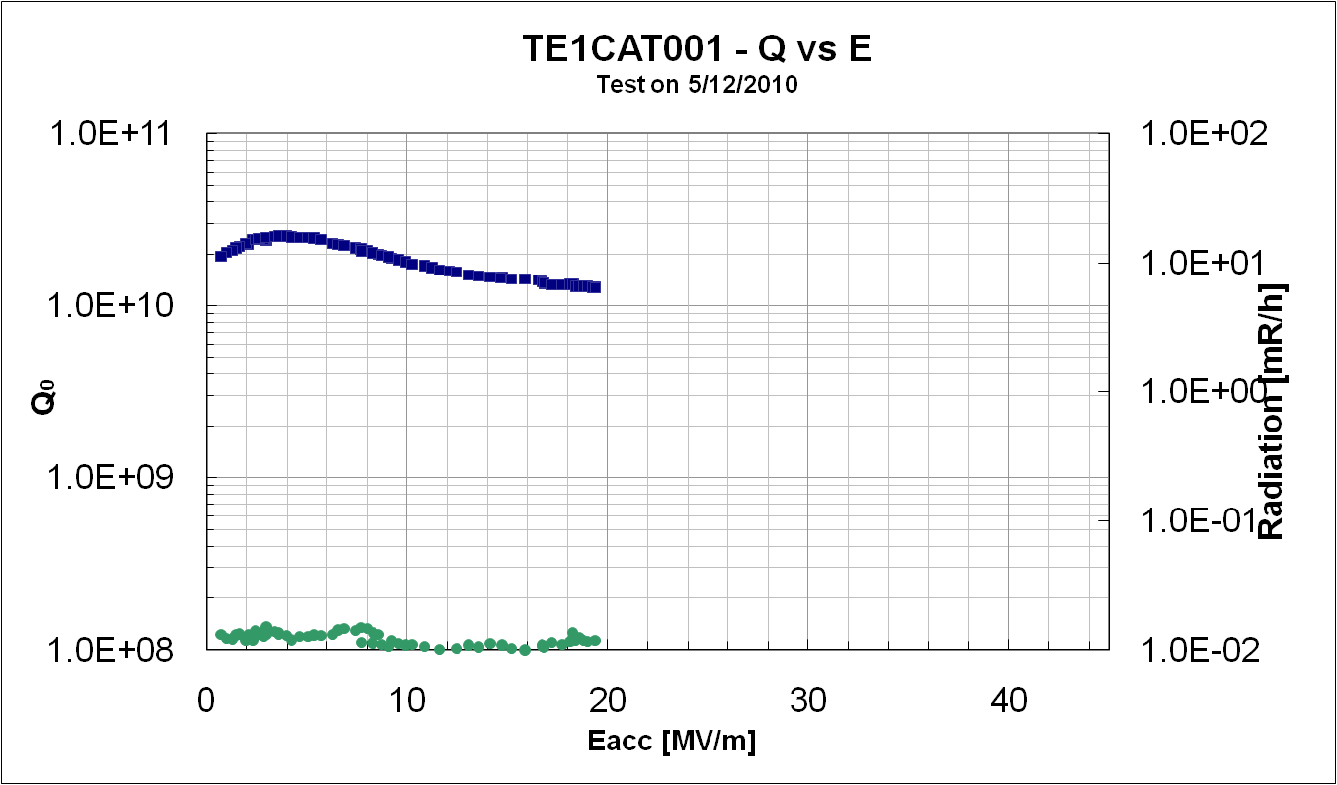
1-cell Cavity 2 K VTS test result
No Field Emission
Quench at Equator
The equator weld is a suspect. Welding procedure.
These cavities have been barrel polished at Fermilab and awaits further processing and testing.
RRCAT in collaboration with IUAC will fabricate 2, 7 cell, 1300 MHz cavities to validate their procedure and infrastructure.

Slide 16
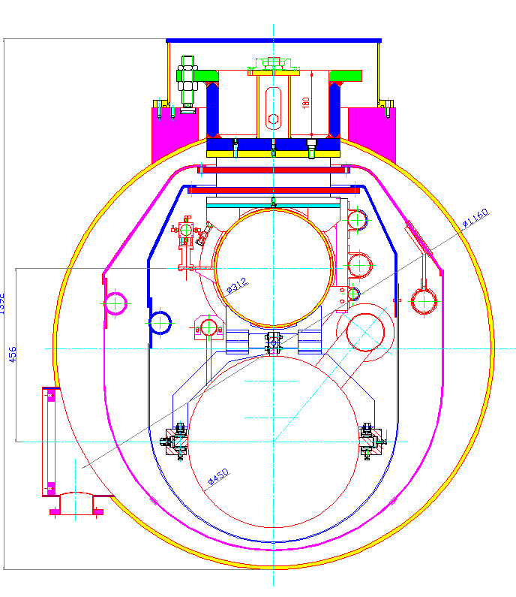
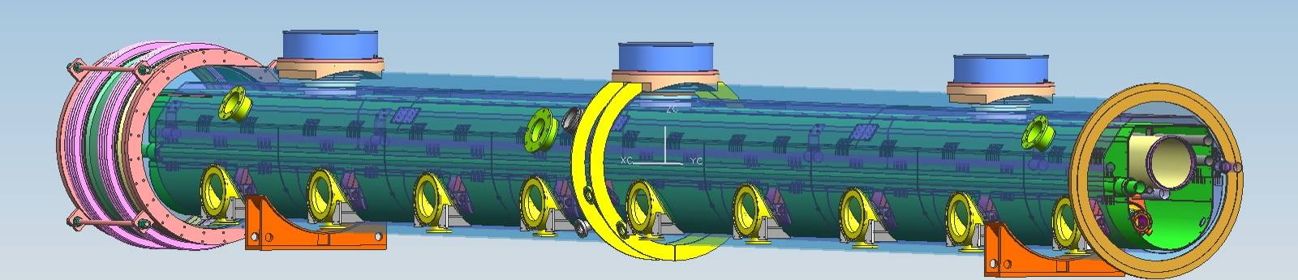
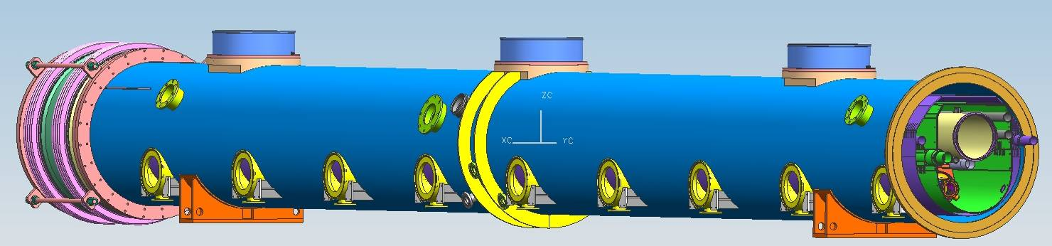
1300 → 650 MHz Cryomodule Design
Option E-
Vacuum Vessel with Diameter 46 inches.
Retaining essential features of T4CM design.
But incorporating Value Engineering Changes.
The Cross section
The 3-D Model (Under designing)
The 3-D Model
RRCAT-FNAL CRYOMODULE
RRCAT-FNAL CRYOMODULE
Notes:
16

Slide 17
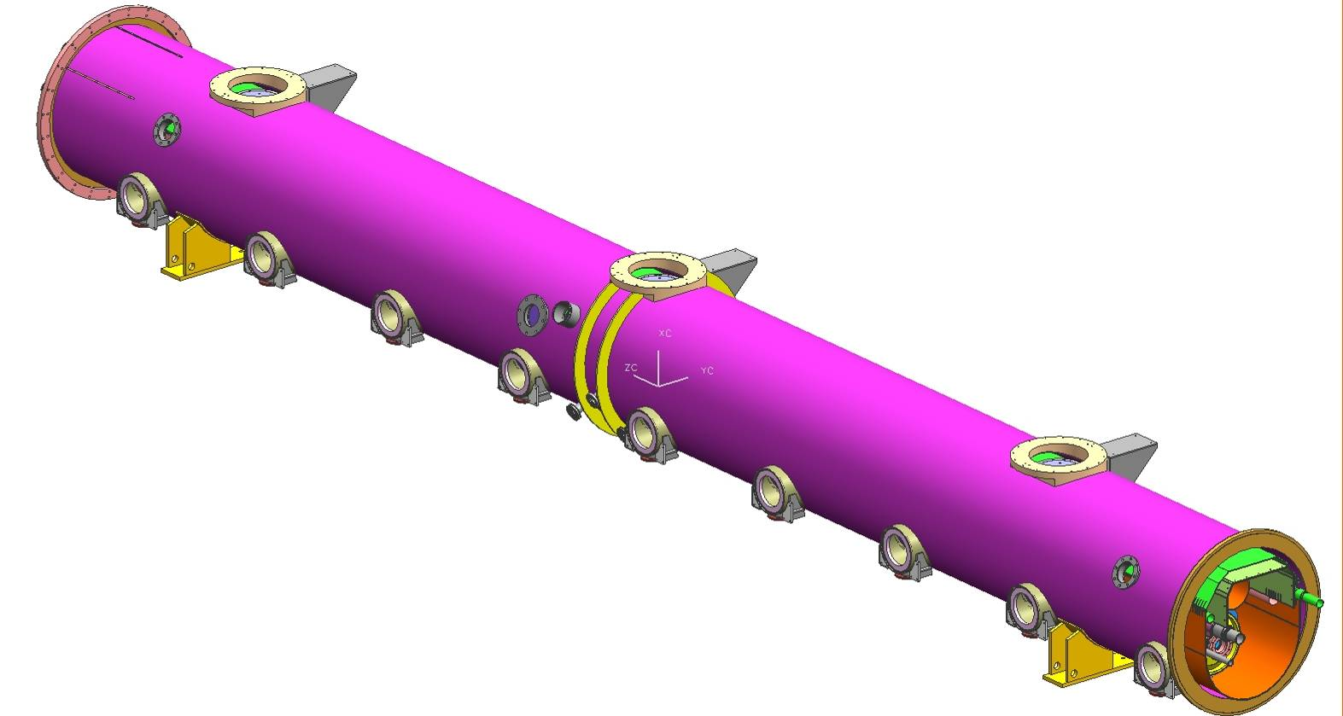
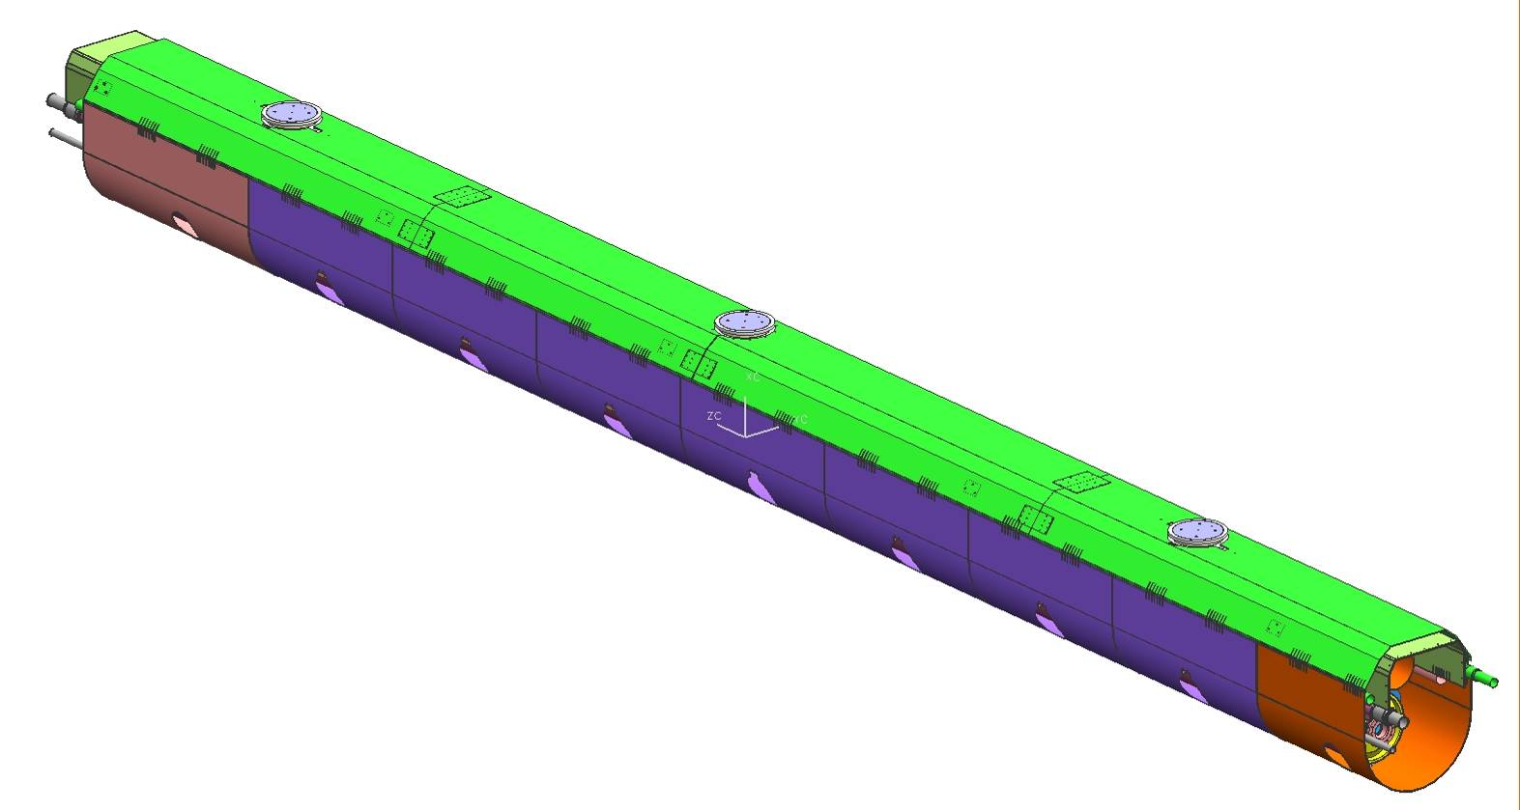
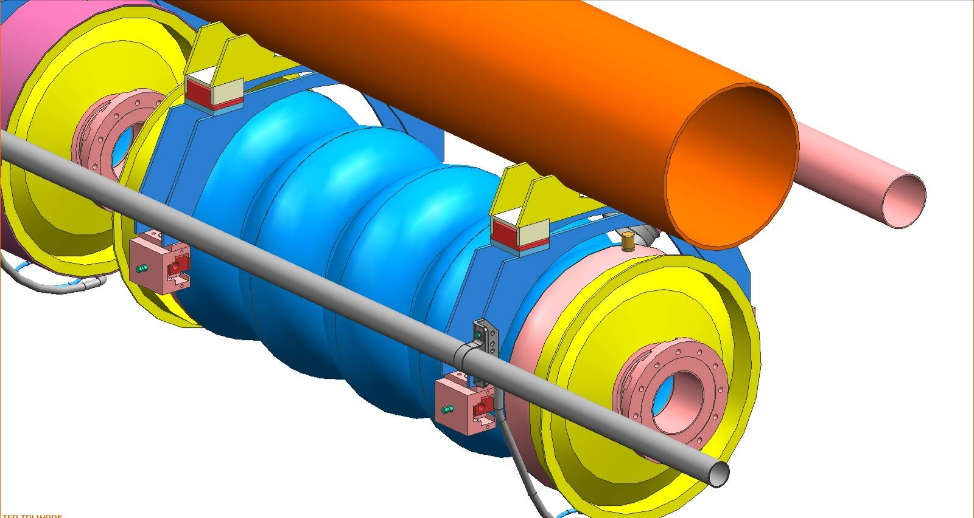
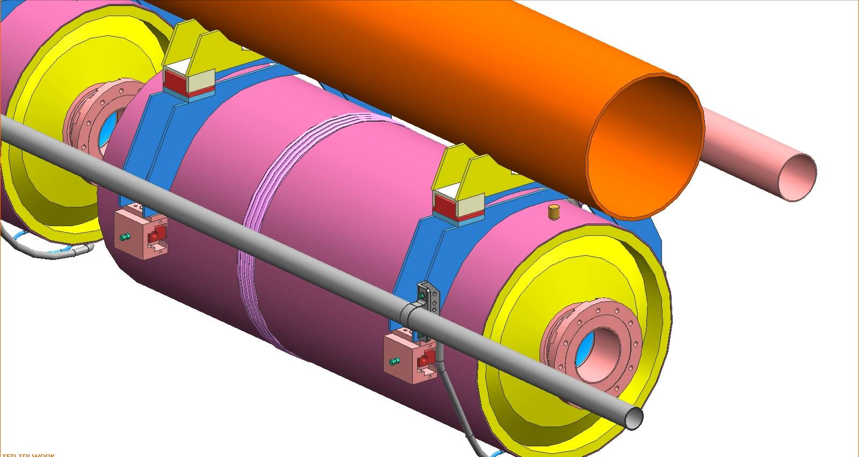
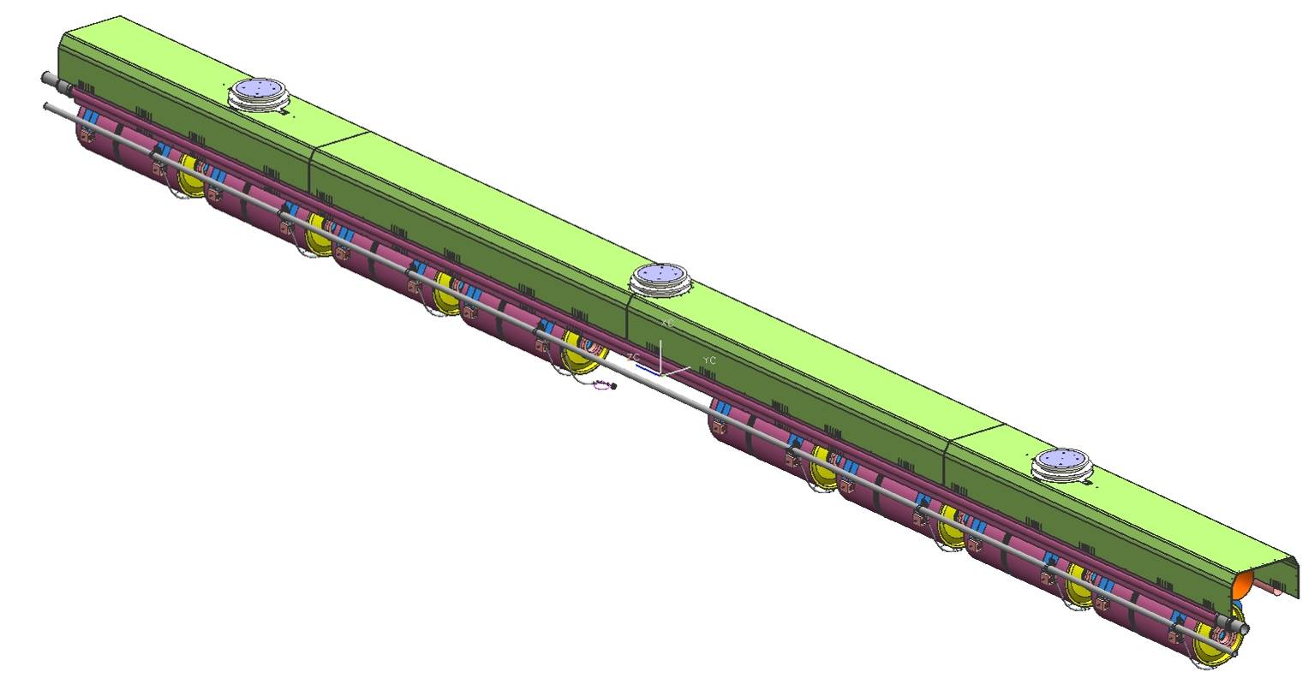
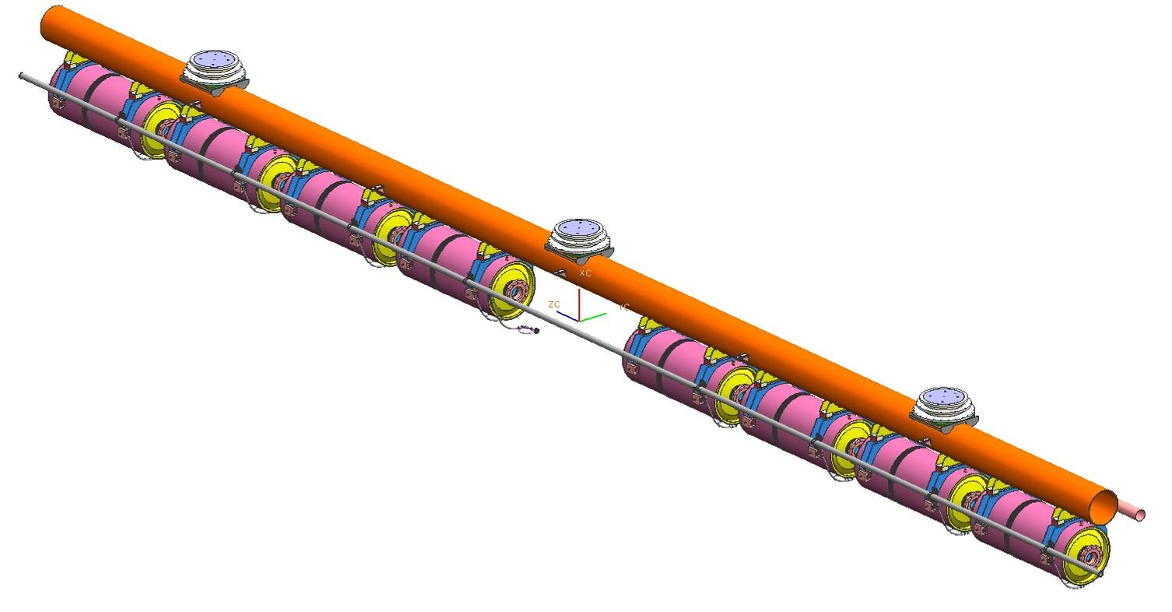
The Final Model –External View
The 80K Thermal Shield
Cavity Support System
(With Cavity of 650MHz)
The 650MHz cavity
The 5K Thermal Shield
(only Upper segment)
The 650MHz cavity with helium Vessel
Notes:
17

Slide 18
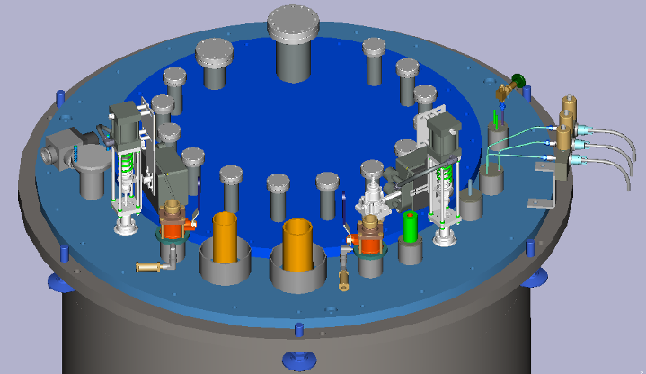
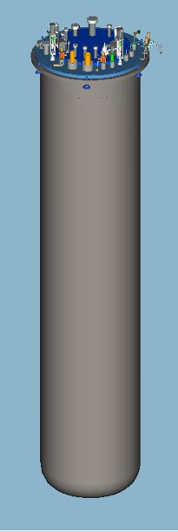
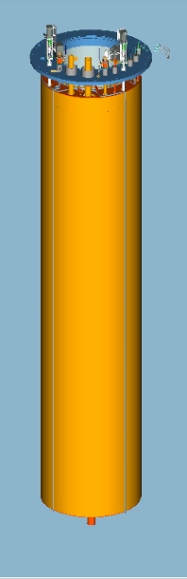
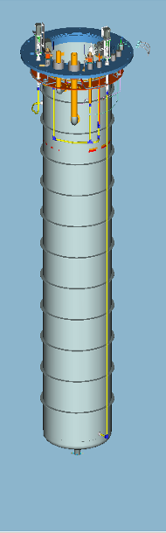
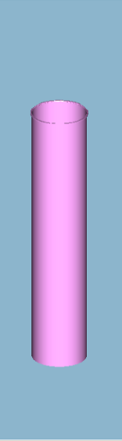
Vertical Test Stand Design
Indian Institutions have provided engineering resources to design an upgraded Vertical Test Stand for Fermilab.
  It is being fabricated by a US vendor
  using ARRA funds
  RRCAT also purchased one
RRCAT has carried out design of the following:
  Liquid Helium Vessel Shell
  Liquid Helium Vessel Top Flange
  Vacuum Vessel Shell
  Vacuum Vessel Flange
  Top Insert Plate
RRCAT has also verified the design of following by Analysis
  Assembly of LHe Vessel Top Flange, Weld Rim
  Top Insert Plate
  Assembly of Vacuum Vessel Flange, LHe Vessel Flange, Top Plate, Support Pads
  Magnetic Shield design – 300K & 2K
VTS-2 TOP PLATE – CRYOGENIC & VACUUM INSERTS
VACUUM VESSEL
80K SHIELD
LIQUID HELIUM VESSEL
2K MAGNETIC SHIELD
3-D MODELS OF VTS-2 VESSELS

Slide 19
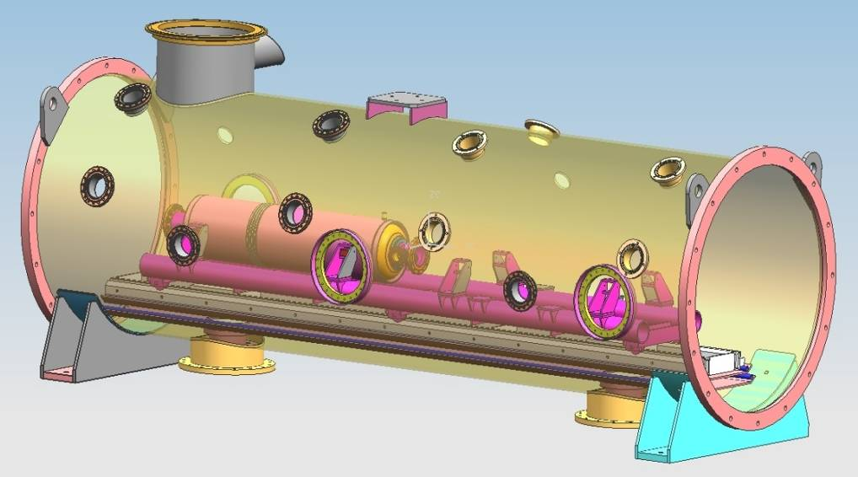
Horizontal Test Stand (HTS-2)
Fermilab has fabricated and is operating the first US Horizontal Test Stand for 1.3 GHz elliptical cavities.
Indian collaboration is designing an upgraded Horizontal Test Stand for Fermilab and RRCAT.
  Test a combination of two cavities and/or magnet
  650 MHz and 1300 MHz cavities
  CW or pulse mode testing of cavities
  Incorporating modifications based on operational experience of HTS-1
A 3-D model of the HTS-2 being designed

Slide 20
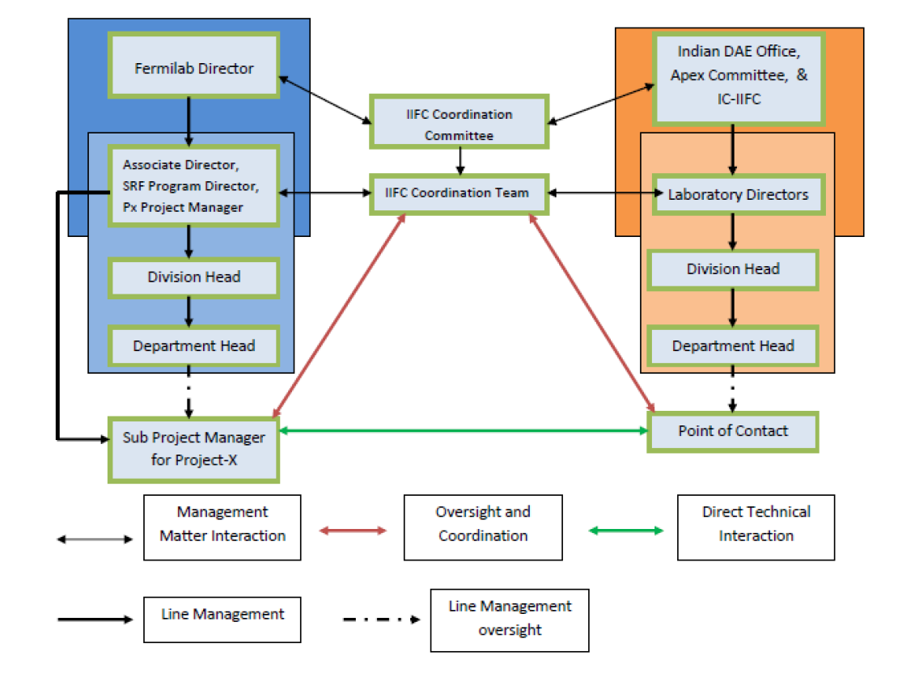
IIFC Management: Overview
Fermilab Director and Indian DAE need to nominate member for IIFC Coordination Committee and Coordination Team

Slide 21
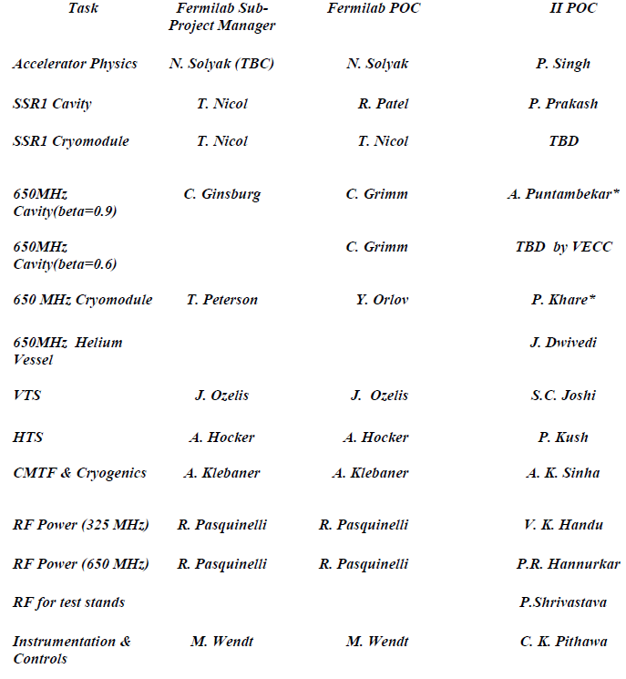
IIFC Management: Communication
Fermilab IIFC Sub-Project Managers hold the overall responsibility for the development and execution of the approved plan and deliverables as agreed upon with the Fermilab Project Management Teams.
The SPMs will interface with their respective Indian Counterparts to.
  Develop the detailed scope of work, plan deliverables, based on higher level guidance provided by the FPMT/IIFC-CC, and in consultation with the Indian Institutes POC and the IIFC-CT;
  Manage the supporting technical program;
  Integrate the work being done in Indian Institutions into the overall program;
  Maintain contact with the appropriate Indian POC
  Communicate to the FPMT requests for changes – either in scope of work or schedule;
  Keep the IIFC-CT and Fermilab Project Management Team informed about technical, cost, or schedule issues and risks, and/or anticipated resource needs;
  Provide technical progress reports
The SPM may delegate to a Point of Contact (POC) the primary responsibility for serving as the direct liaison to the Indian Institutes engaged in his/her sub-project.
* Indian POC for Fermilab POC. All information flow through this person.

Slide 22
Phase II: R&D
The Phase II of this collaboration would expand the present R&D collaboration to all non SRF areas of Project-X
Elements of Phase II: R&D
  Front End: Source and RFQ
  325 MHz RF Power
  650 MHz RF Power
  Power Coupler
  Instrumentations and Controls
  Superconducting Magnet
  Cryogenics
The technical discussions have already started
  This meeting will outline these areas of collaboration

Slide 23
Phase III: Project-X
Fermilab and DAE accelerator laboratories have proposed to jointly work
  On the construction and commissioning of the Project-X accelerator at Fermilab
  Development of Indian capabilities and industrial infrastructure that could lead the construction of HIPA in India.
India is expected to make significant In-Kind contributions
  US will share accelerator technology and knowledge
The Accelerator collaboration started in 2006 and has now gone into the 3rd stage
  Component level → Scientists to Scientists
  System Level → Laboratories to Laboratories
  Facility Level → Agency to Agency
    Fermilab has worked with US DOE in developing a DOE-DAE agreement based on IIFC discussion to date)
    At present the US-DOE and DAE are working to negotiate the language and high level details of DOE-DAE agreement.

Slide 24
Collaboration on High Energy Physics
Indian institutions have been collaborating on Fermilab based High Energy Physics experiments since 1986.
  Several students have received PhD from Indian universities while working on Fermilab experiments.
Recently we have established a Neutrino Physics collaboration with India
  Indian Institutions have joined MINOS, MIPP and LBNE
  Students and faculties are contributing to the analysis
    Several PhD thesis
  Faculty and engineering staff are getting involved in design of future experiments.
We are holding a joint workshop in Jan 2011 to discuss collaboration on all aspect of High Energy Physics, Nuclear Physics and Energy

Slide 25
Overall Planning and Goals
In general the discussions on Oct 27th and 28th should be focused on technical overview, questions, resources etc. Oct 29th and 30th should be devoted to detailed technical planning, integrated schedule, milestones, needed reviews, agreement on detailed deliverables and a schedule of future face to face interaction.
We need to
  Establish good one on one contact. Make sure there is time to sit and discuss the project and the functional requirements.
  Agree on how communications (at the one on one level) will occur.
  Understand the capabilities as well as any constraints of the groups involved.
  Make sure that we understand - for each specific project/deliverable, what the risks and technical challenges are and where one can look for examples of similar work done by other projects.
  Discuss the criteria under which any new designs would be evaluated. This might vary a little depending upon the specific deliverable.
  Talk about the schedule and what needs to happen by when. If the schedule is not correct, suggest changes.
  Develop a list of questions that need to be answered in order to make progress on each deliverable.
  If there is some study or analysis that can be done now (while we prepare the Functional Requirement Specification) we could agree to start that work immediately.
In the end, our Indian colleagues need to feel connected into this work and Fermilab, and ready to take ownership for the success of the Indian deliverables for which they are responsible.
This work should also advance the Indian HIPA project.

Slide 26
Summary
Indian Institutions and Fermilab have established an excellent working relationship and are collaborating on SRF part of the High Power Linac for HIPA.
  Progress is being made on several fronts.
We are proceeding to expand this R&D collaboration to all non-SRF aspect of the accelerator.
Fermilab has proposed to build a 3 GeV CW, ~3 MW SRF linac (followed by 3-8 GeV Pulsed SRF Linac) for its High Energy Physics program.
  The design of this SRF linac is aligned with Indian 3rd Stage Nuclear program.
This is an unprecedented opportunity for both Indian and US Institutions, and agencies to collaborate on jointly developing accelerators for its domestic program.
During this meeting
  we need to make significant technical progress on Phase I and II
  Discuss steps that could be taken to make a plan for Phase III

