Slide 1
IIFC Instrumentation R&D for Project X at BARC
C.K. Pithawa – BARC Manfred Wendt – Fermilab

Slide 2
BARC Collaboration
Proposed Project X instrumentation R&D activities:
LLRF system
BPM system
RF interlock system

Slide 3
BARC Experience on the Instrumentation for Accelerators
LLRF system: Our systems are in use in Super-conducting linacs at TIFR and IUAC. Also supplied to Australian National University.
Prototype digital version of the LLRF already designed and tested at TIFR Linac.
Beam Position Monitor: Under design for SPIRAL2, GANIL, France and LEHIPA, BARC
Accelerator Control Systems: Developed for FOTIA – DC 6MV tandem Heavy Ion Linac and TIFR super-conducting linac, 150 MHz, Heavy Ion Linac. For LEHIPA – 352 MHz, 20 MeV, Proton Linac, this is being designed as a distributed control system.

Slide 4
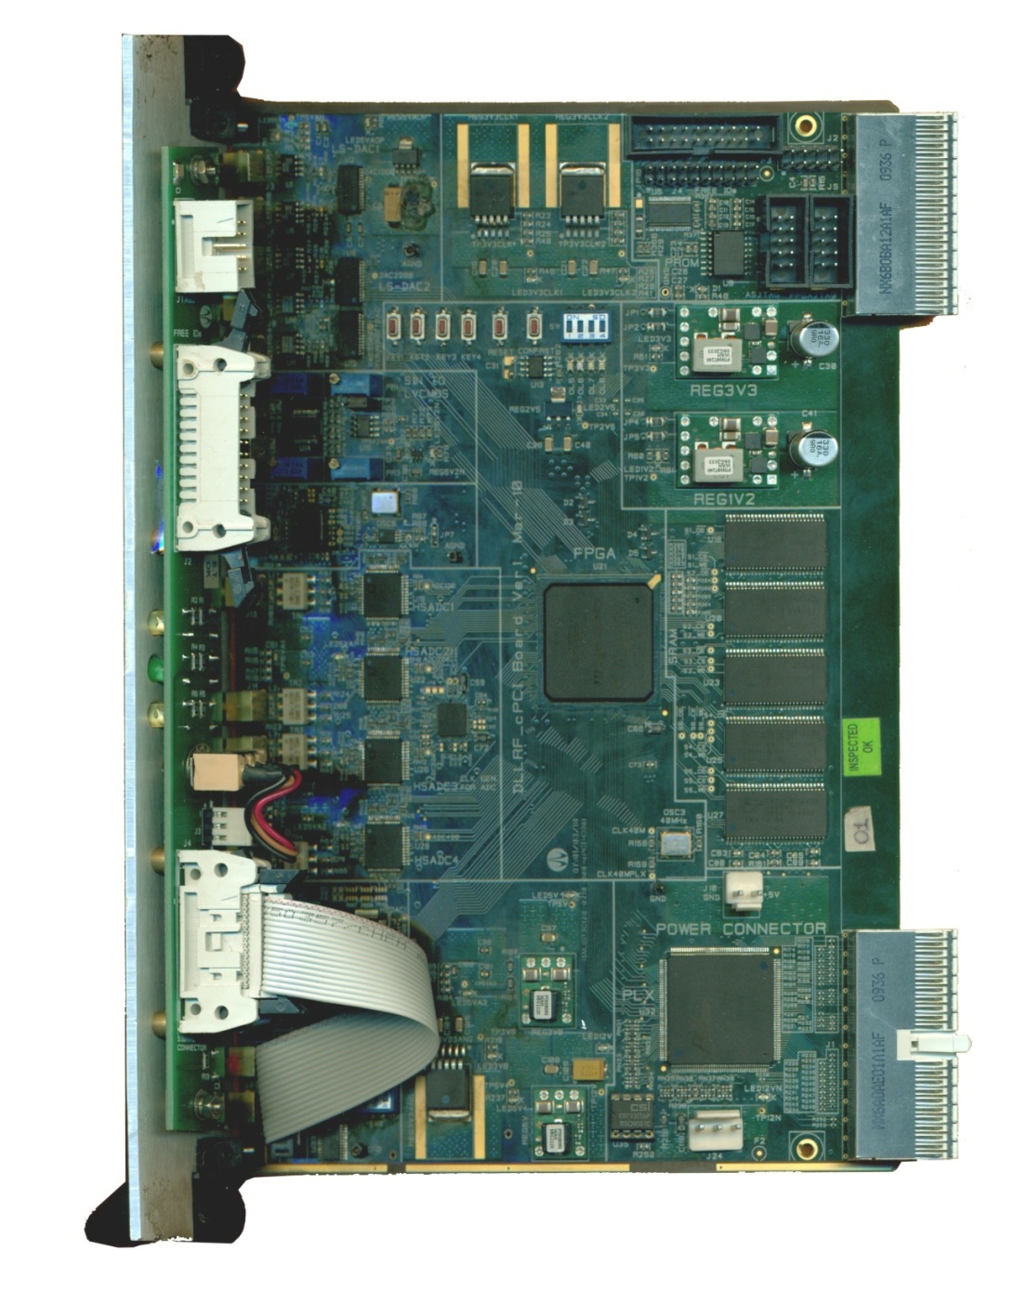
Four Channel System: Digital Processing Card
Features:
High speed High Density FPGA
Fast ADC –14 bits,105 MSPS, 4 nos
.
Fast DACs –14 bits, 300 MSPS, 2 nos
Slow DACs –Dual,40 MSPS,10 bits,
3 nos.
Clock Generation – PLL synthesizer
Memory – 1 MB, 6 nos.
cPCI Interface

Slide 5
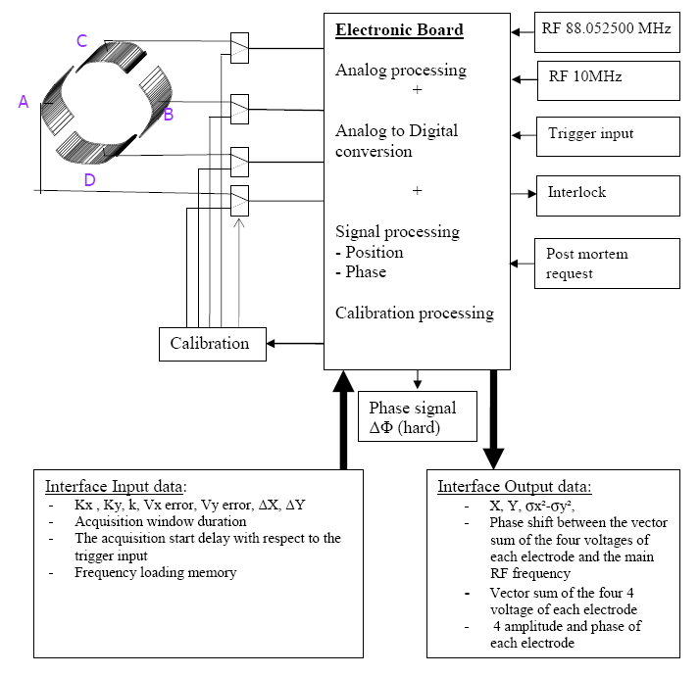
BPM for the SPIRAL2 LINAC GANIL (Grand Accelerateur National d’Ions Lourds) in Caen, France
BPM Electronics based on VME Board (22 units to be supplied)
MVME5500 , VxWorks6.8 , Spiral2 EPICS IOC, EDM GUI

Slide 6
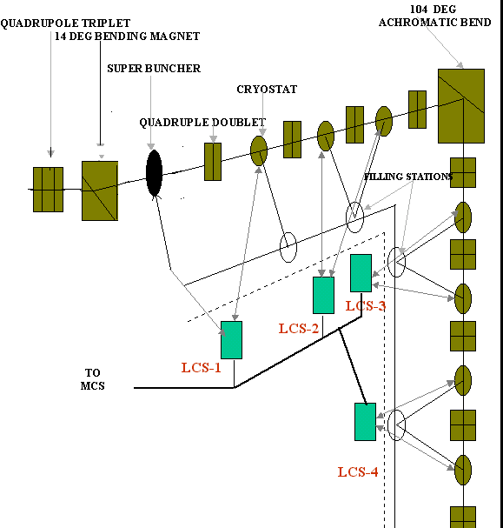
BARC-TIFR Linac - Beam Hall Layout

Slide 7
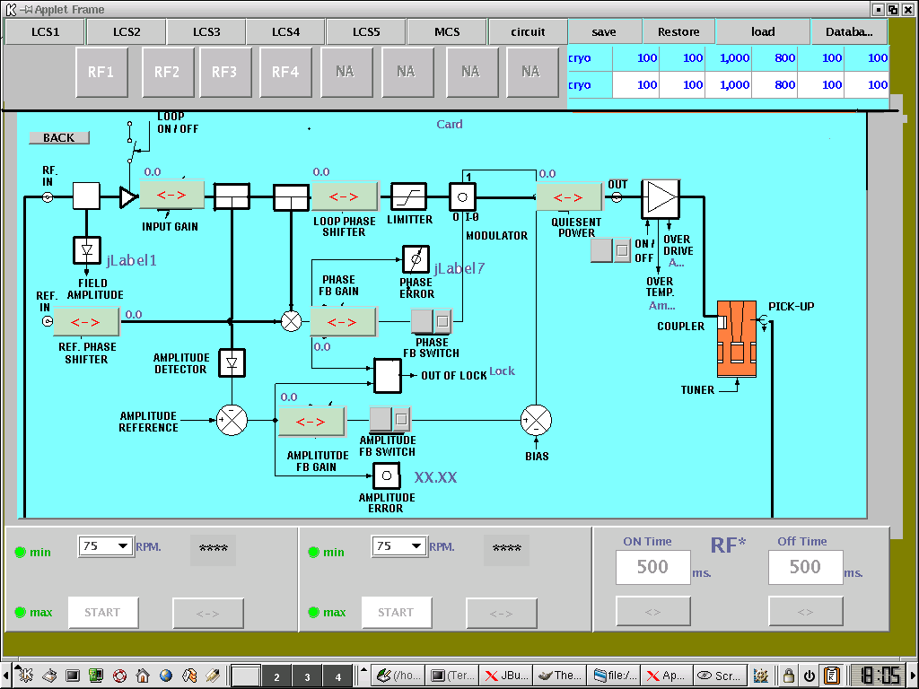

Slide 8
CMTF Proposal
Already Discussed within IIFC
CMTSs → BARC CDM
1→ 1300 MHz stand
2 → 650 MHz stand
Cryogenic → VECC/BARC
650 MHz RF Power → RRCAT
RF Interlock and protection system → BARC
LLRF System → BARC
New Proposal is for BARC/ED to take responsibility of full integration of the CMTS system, including controls for CMTS
Indian Institutions would participate in the development of the CMTS1 (1300 MHz) at Fermilab, while developing the CMTS2 (650 MHz) in India for delivery and integration at Fermilab.

Slide 9
BARC Collaboration
First steps to initiate the collaboration
Fermilab needs to transfer technical information to BARC
Presentations, write-ups, schematics, layouts, etc.
Inform Fermilab colleagues about the collaboration details
On its way…
Draft R&D scope and deliverables
Agreed to use HINS as test bed for BPM instrumentation.
CMTF as target for the IIFC proposals, including instrumentation e.g. LLRF, RF protection interlocks and control systems.
My visit of Fermilab:
I met with Brian Chase (LLRF), Peter Prieto (BPMs & RF protection), Jim Patrick (Controls), and many others.
Visit of accelerator test facilities at NML and MDB.
Evaluate plans and scope for BPM, RF protection & LLRF systems.
Draft of a schedule (on its way…)

Slide 10
BARC Collaboration
Next steps…
Fermilab needs to define specifications and requirements for all three projects.
Requirement Specifications, scope of work and deliverables, including calibration and test set-up and time schedule to be jointly worked out.
The application software requirements and interface details need to be worked out in discussion with colleagues at Fermilab.
Send 2+ BARC engineers for 3-6 month to Fermilab
Work as member of the Fermilab instrumentation team
Receive detailed technical information, get used to tools, procedures, tricks, hands-on activities, trouble-shooting, and the day-to-day engineering struggle.
Finalized all definitions and interfaces on the R&D deliverables.

Slide 11
BARC Collaboration
Opens questions
BARC want to initiate the collaboration on all three systems simultaneously! It might be preferable to start with one activity, e.g. a BPM system for HINS?!
BARC proposed participation in development of the Global Project X Control System. Fermilab would respond later.
At this moment Fermilab would limit control activities to drivers, interfaces, ACNet-in-a Box, etc.
Management and work distribution on CMTF needs to be discussed and specified.

