Slide 1
Development of SCRF Infrastructure at RRCAT
Satish Chandra Joshi
Proton Linac & Superconducting Cavity Division
Raja Ramanna Centre for Advanced Technology, Indore, India
October 28, 2010

Slide 2
SCRF Infrastructure at RRCAT
Started in December 2007 under funding received from DAE for XI Plan Program
Motivation: Domestic & International Programs
Indian participation in ILC & Proton Driver.
Superconducting Materials R & D for SCRF
Development of SCRF Cavity Science and Technology including setting up a facilities that would be useful for development of cavities for HIPA.
Application of SCRF including development of an infrared source to give coherent radiation using a superconducting post-accelerator.

Slide 3
SCRF Infrastructure Facility
During planning stage of SCRF Cavity Infrastructure Facility at RRCAT, important inputs were also received from SCRF facilities planned at Fermi National Accelerator Lab:
  Clean room facility
  Cavity RF Measurement techniques
  Chemical Polishing of cavity (ANL)
  Vertical test stand facility
  Electron beam welding machine specifications
  Experience & exposure received during visit to Fermi lab
Special thanks to colleagues at FNAL: Robert Kephart, Shekhar Mishra, Rich Stanek, Harry Carter, Tom Peterson, Mark Champion, Ruben Carcagno, Joe Ozalis, Camille Ginsburg, Cosmore Sylvester, Tug Arkan, Mike Foley, Charlie Cooper,

Slide 4
Outline
SCRF Cavity Infrastructure Facilities Planned:
  SCRF cavity fabrication
  Cavity Processing
  Building for Cavity Fabrication and Processing
  Development of Test Facilities
    VTS
    HTS

Slide 5
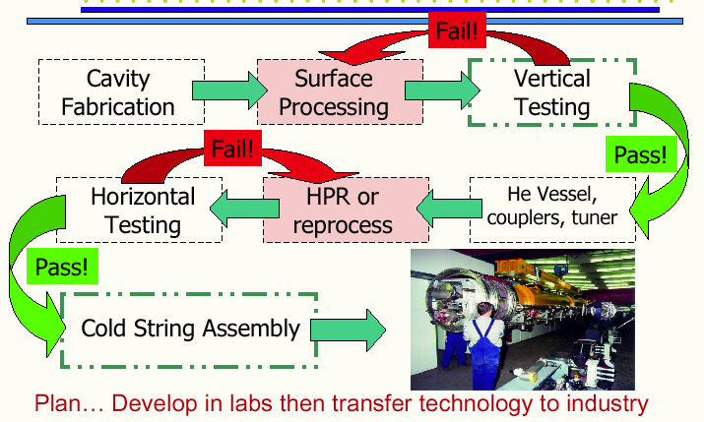
Cavity Manufacturing, Processing & Testing

Slide 6
New Facilities Planned at RRCAT
SCRF cavity fabrication Facilities:
120 Ton Hydraulic Press, Nb machining, EBW Machine etc.
Chemical & thermal processing facilities
EP/BCP/CBP, HPR & Annealing Furnaces etc.,
Cavity Inspection Facilities
3-D CMM, UTM, Optical inspection bench, 3-D confocal microscope, SIMS
Cavity RF Measurement & Tuning Facility
Half Cell, dumbell and multi-cell cavity frequency measurement
Cavity Frequency & field tuning machine (under planing)
Assembly & testing set up.
Clean-room, Test cryostats, RF sources etc.

Slide 7
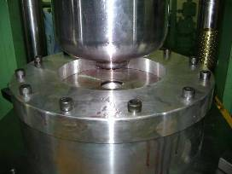
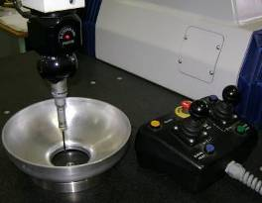
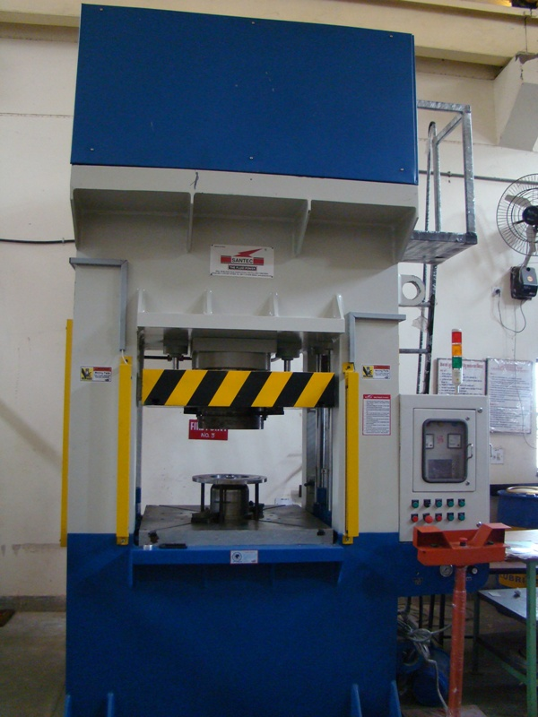
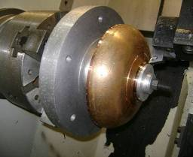
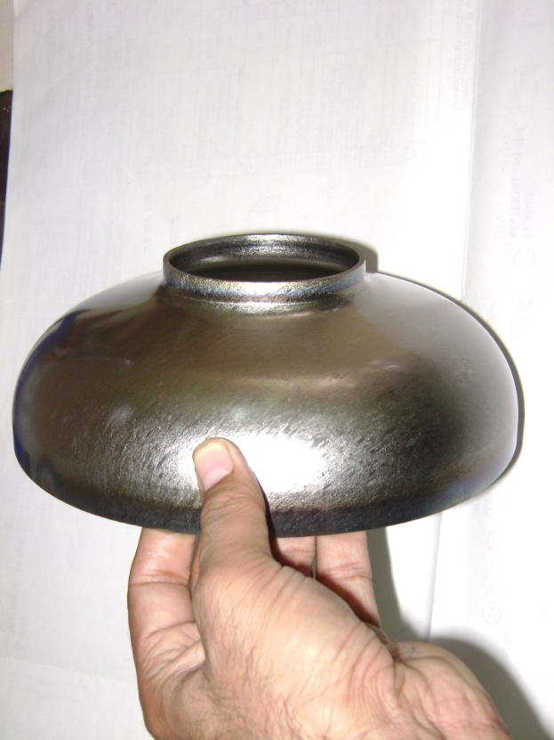
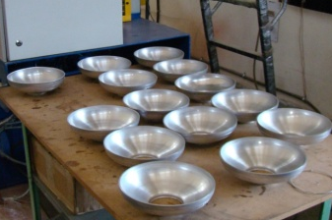
Development work done on Forming & Machining
Developed forming tooling & process for 1.3 GHz SCRF cavity.
120 T - HYDRAULIC PRESS
Forming
Inspection
Machining
Formed Niobium Half cell

Slide 8
Procurement of Electron Beam Welding Machine
Electron Beam welding machine is being procured for development and manufacturing of SCRF cavities (including low to high β range) made from high RRR Niobium for high energy accelerators and high power proton linac for Indian programs and also for participation in International collaboration projects like ILC/ProjectX.

Slide 9
Major specifications of EBW Machine
Beam power | 15 kW
Gun Voltage | 90 to 150 kV
Duty cycle | 100%
Beam current range | 0 - 100 mA or wider
Beam current setting resolution | 0.1 mA
Beam oscillations | 1 – 1000 Hz or more
Beam deflection | ± 2.5º min
Focus range | Ceiling to bottom of chamber, programmable
Beam focus diameter | 0.25 mm or less
Inner size of chamber | 3650 x 1500 x 1800 LxBxH mm³ (min)
X-Y table size | 1780 mm x 710 mm (nearest standard)
Travel of X Y table | 1780 mm x 660 mm
Linear speed | 1-2500 mm per minute
Vacuum ready pressure | < 1x10⁻⁴ mbar in 15 minutes
Ready for welding pressure | < 1x10⁻⁶ mbar in 60 minutes
Load Capacity | 2500 kg
X – radiation leakage limit | less than 0.1 mR/hr at full accelerating voltage
Online optics | With CCD camera and suitable illumination system

Slide 10
Cavity Processing
Cavity Washing, degreasing
CBP
EP/BCP
Thermal Processing @ 600⁰-800⁰ C
Cavity Tuning
HPR
Drying & evacuation.
Thermal Processing~120⁰C

Slide 11
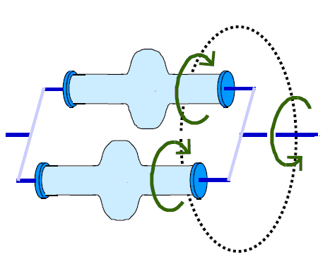
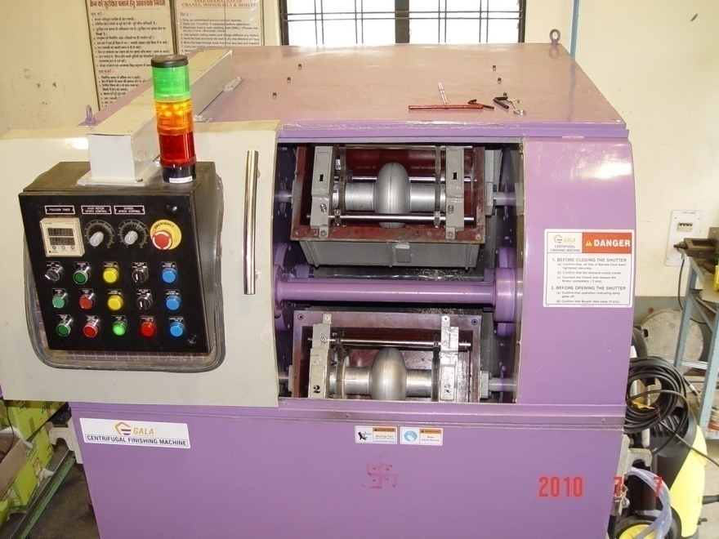
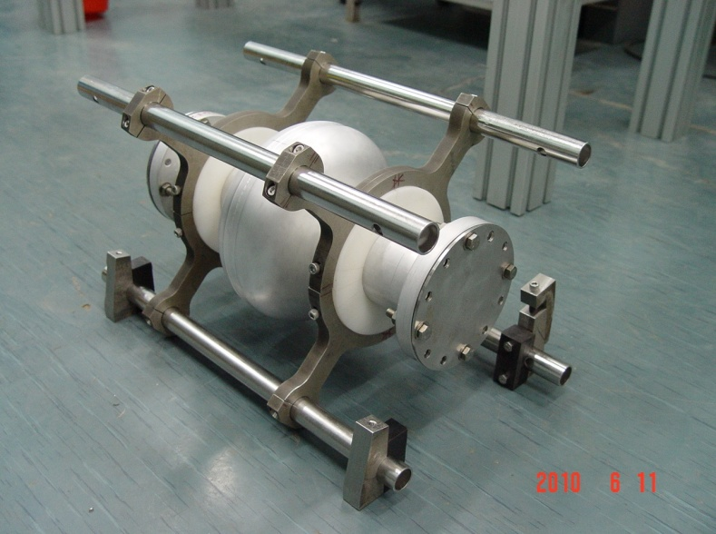
Centrifugal Barrel Polishing (single Cell)
Main features of CBP machine
Turret and Barrel rotate in opposite direction
Turret speed – 0 – 200 rpm ( variable )
Barrel speed – 0 – 200 rpm ( variable )
Barrel size – 320 X 320 X 500 mm
Cavity rotation
direction
SCRF cavity
Turret rotation
direction
Requirement of CBP machine
Reduction of EB weld bead contour from inside surface of SCRF cavity
Removal of the inside damaged surface layer during forming
– thickness approx. 150 μm
Polishing of inner surface of cavity to get surface finish up to 200 nm
Working principle of CBP
Cavity ready for mounting in CBP m/c
Cavities mounted in CBP machine

Slide 12
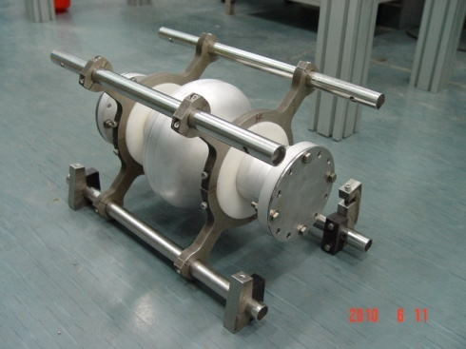
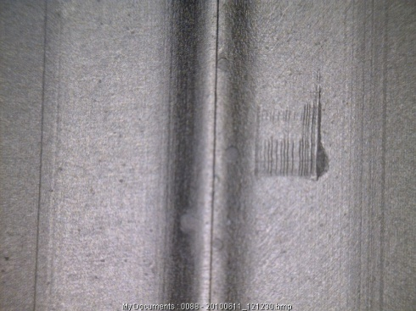
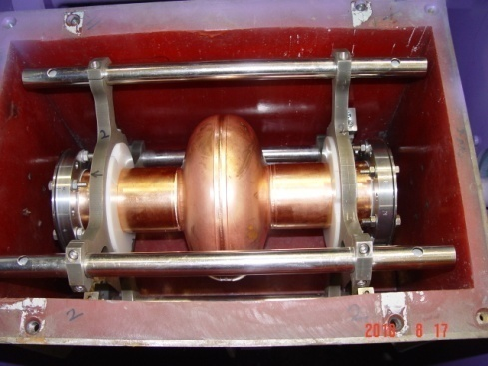
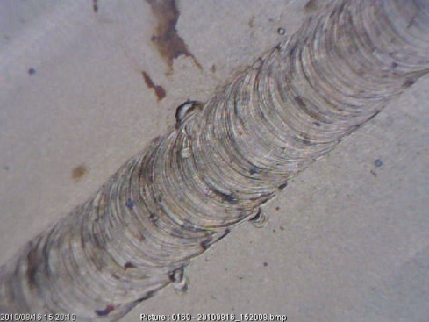
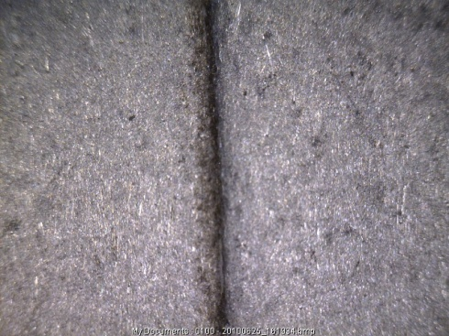
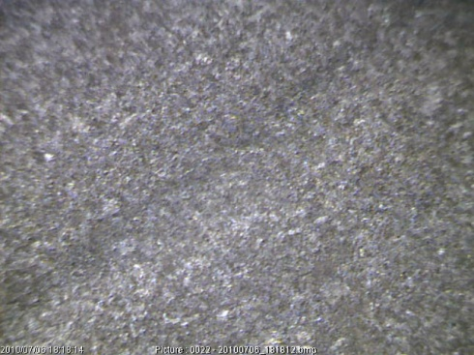
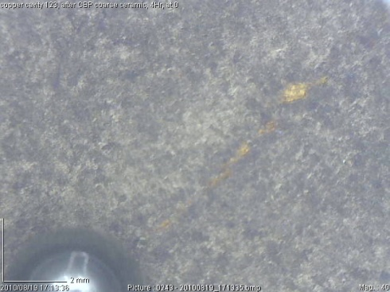
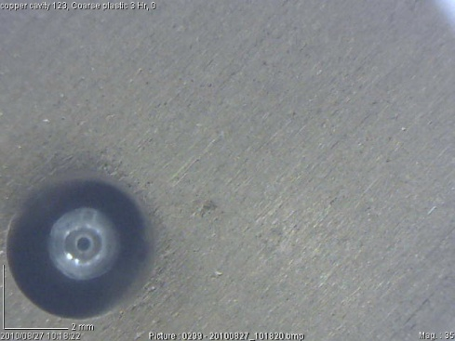
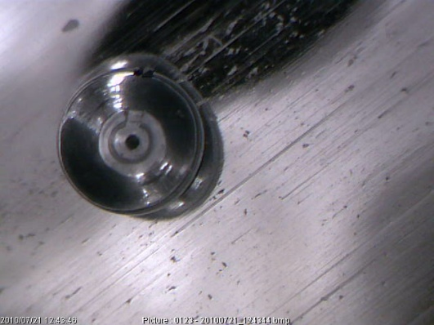
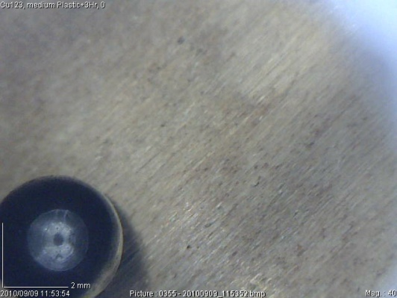
Initial Trial Results of CBP
Aluminum Cavity
Copper Cavity

Slide 13
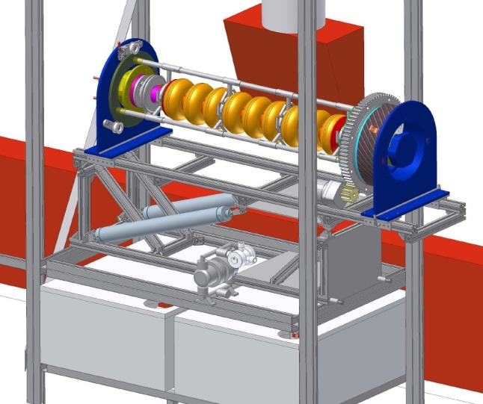
Plan for EP Setup
Electro polishing Bench (Single cell / Multi cell)
Acid Storage, refrigerator and handling system
Heat Exchanger for EP solution
Scrubber Unit (Acid fumes from EP)
Chemistry Lab support for EP,BCP
Used Acid and affluent Collection & neutralization
PLC Control Power supply ( 0-25 V, 1000 A)
Current density: ~ 50 – 100 mA/cm²
Material removal rate ~ 0.5 μm/min
Rotational speed~ 0.2 -1 rpm

Slide 14
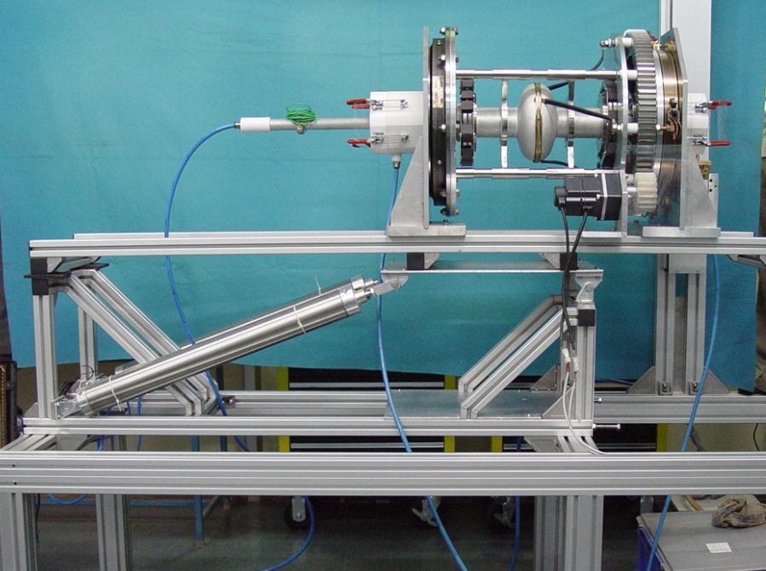
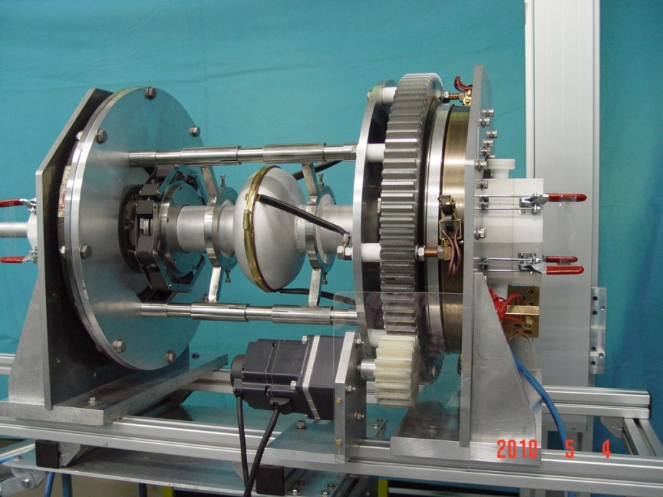
Development of Electro polishing setup
  Bench for electro-polishing of SCRF cavity has been developed, it can process up to nine cell cavity. The stand is capable of :
  Rotating the cavity at 2-10 rpm.
  Holding the cavity in horizontal position during processing & in vertical position during draining/ rinsing and for loading the cathode
  Slip ring with 4 carbon brushes to connect power supply.
  The flow circuit has been tested with water.
  Acid pumps, valves & plumbing have been procured.
  25V – 1000A DC Power supply has been procured.

Slide 15
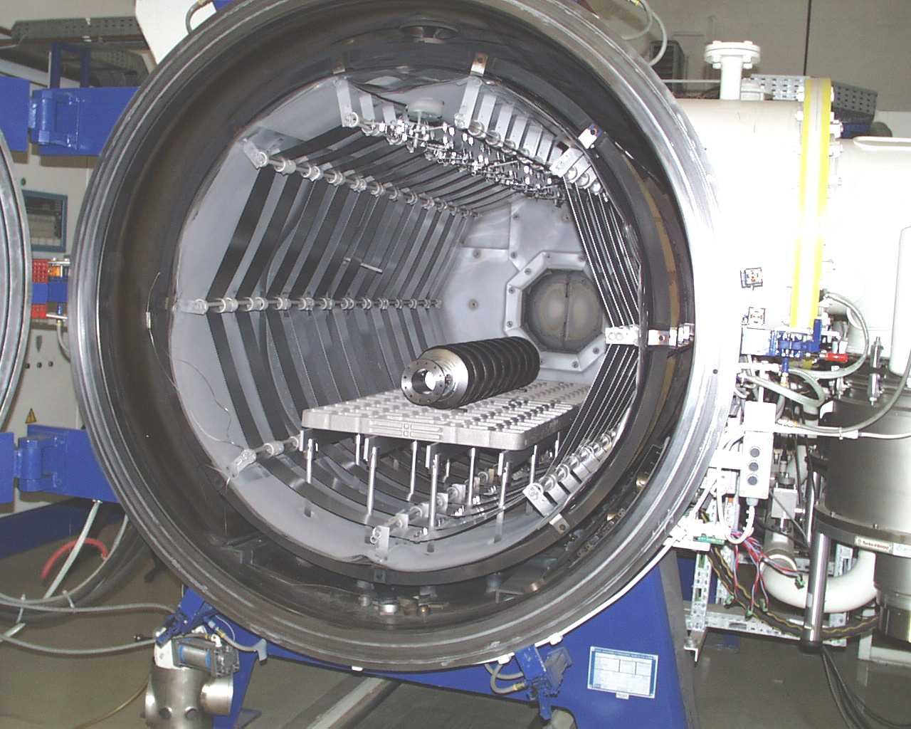
THERMAL PROCESSING OF CAVITIES
Specification of High Vacuum Furnace
Orientation | Horizontal
Temperature range | Option-1 1000°C Max
Working Vacuum | <1 x 10⁻⁷ mbar (600°C -1000°C ) <1 x 10⁻⁶ mbar (> 1000°C)
Working Volume | Diameter 800mm Depth 1500mm
Indent for a Horizontal High Vacuum Annealing Furnace has been initiated.
The furnace is expected to be delivered by March 2012.

Slide 16
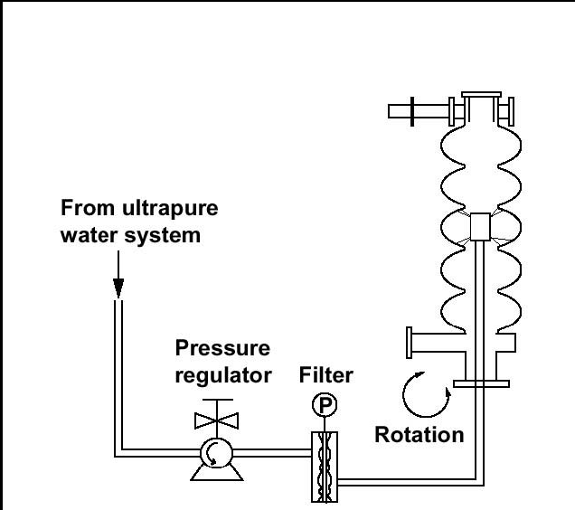
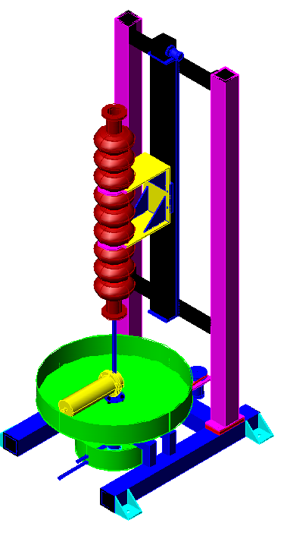
High Pressure Rinsing Stand
Features:
Material of Construction: SS 316
Cavity / wand Rotational speed: 2-20 RPM
Vertical Stroke: 1300 mm
Vertical movement speed:
~60 mm/min
Ultra-pure water jet pressure: 80 – 100 bar
Water Filter: 0.05 micron
Installed in Class 100 clean room

Slide 17
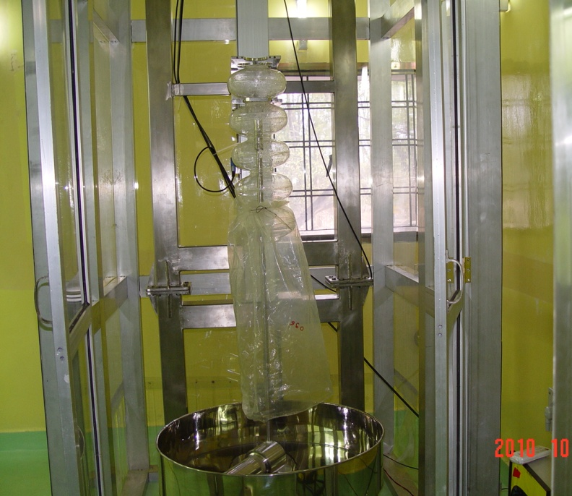
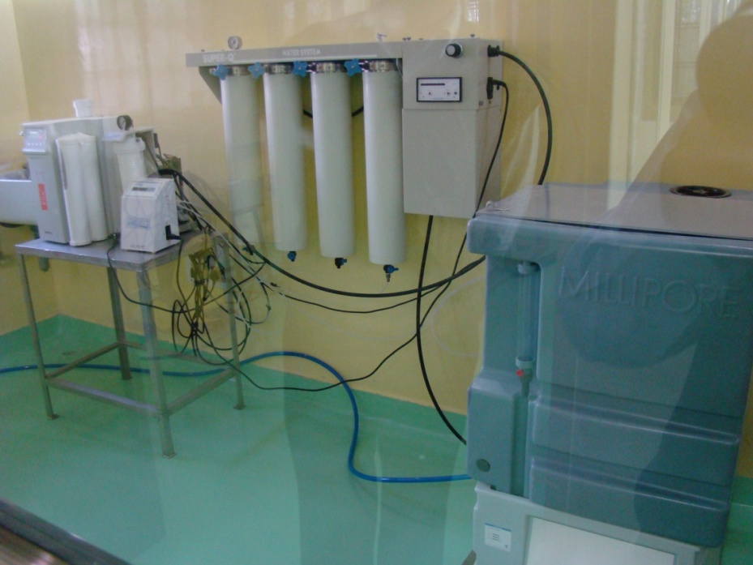
High Pressure Rinsing Setup
Ultra Pure Water Plant
High Pressure Rinsing Set up in Clean enclosure (Class 100)

Slide 18
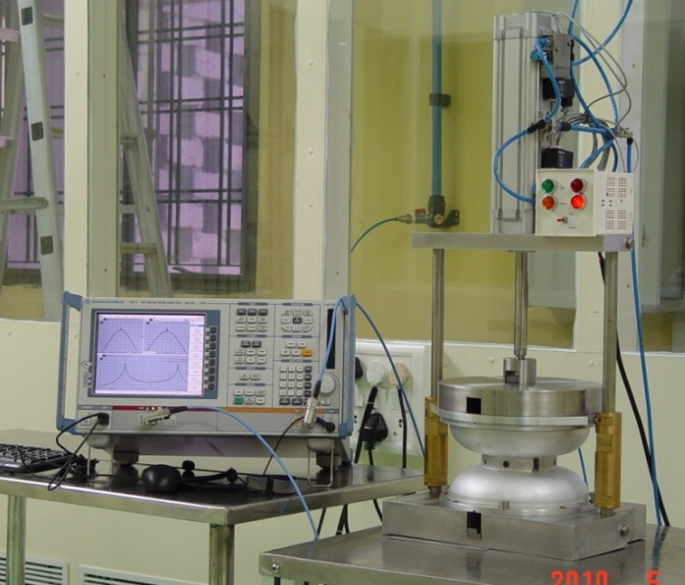
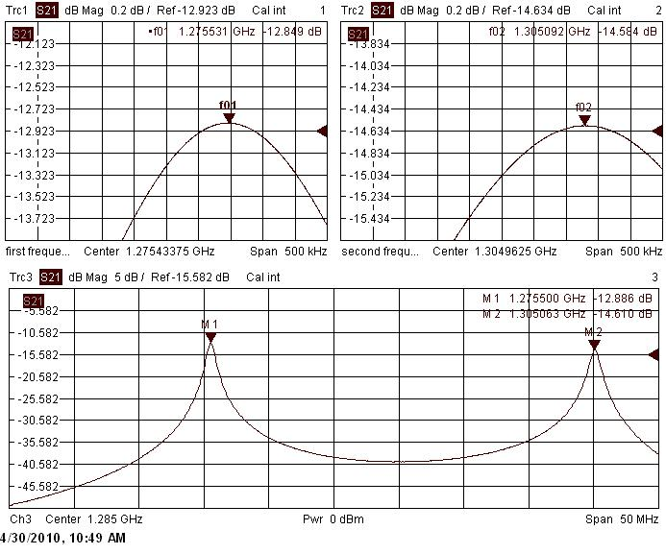
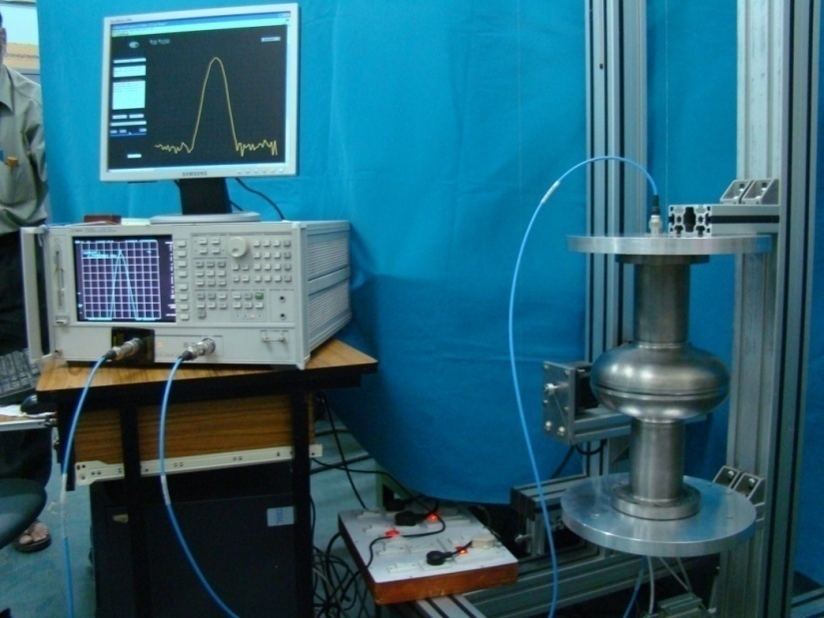
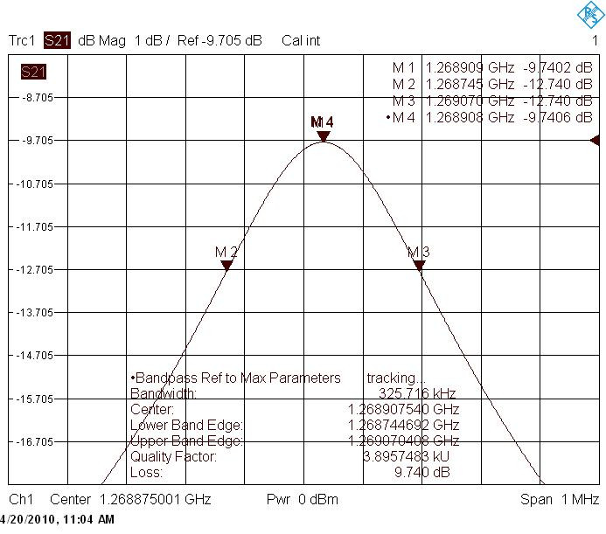
RF MEASUREMENT SETUP
RF FREQUENCY MEASUREMENT SETUP
RF FREQUENCY PEAKS OF DUMB-BELL
RF MEASUREMENT SET UP FOR FREQUENCY AND FIELD DISTRIBUTION
RF FREQUENCY PEAKS OF SINGLE CELL CAVITY

Slide 19
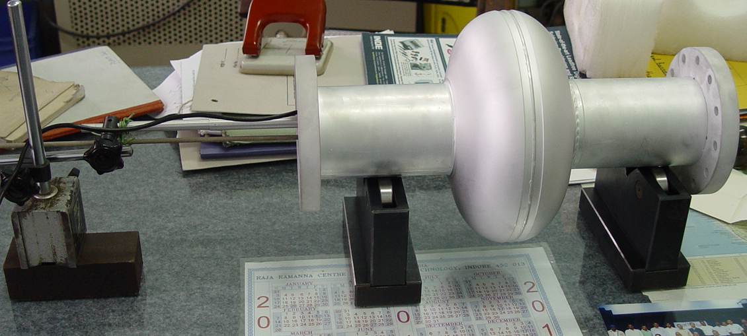
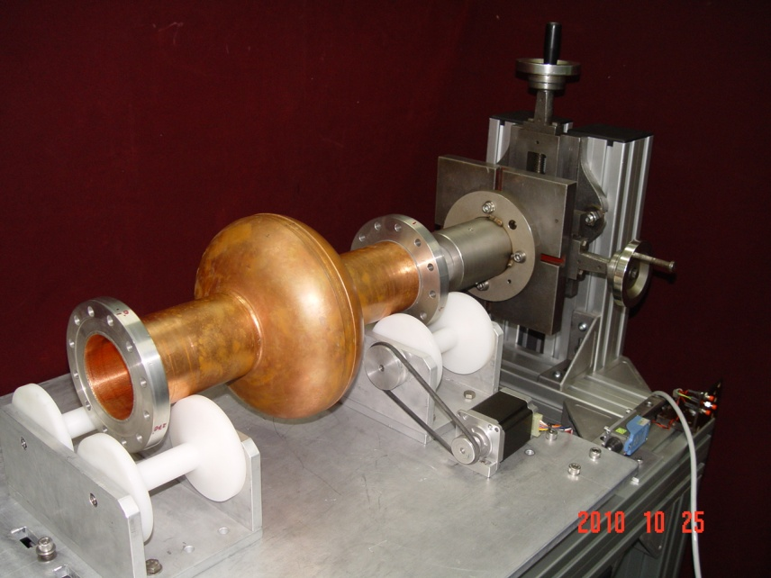
Cavity Optical Inspection
Cavity internal surface measurement using a small digital CCD camera with magnification 10X-200X
Motorized Optical inspection bench for cavity internal inspection (under development), it can accommodate 9 cell cavity

Slide 20
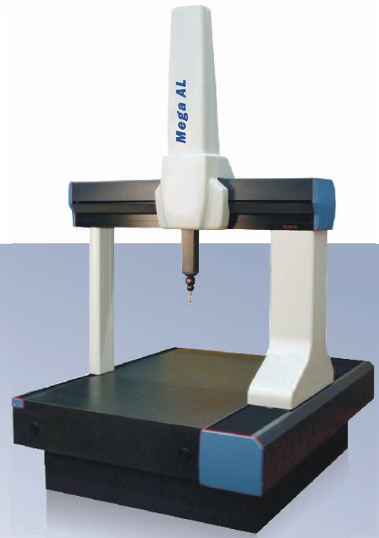
Procurement of High Precision 3D CMM
Measuring Range X axis Y axis Z axis | 1200 mm 2000 mm 1000 mm
Accuracy | 1.6 + L/400 μm
Resolution | 0.1 μm
Measuring Table | Granite Surface Plate (Grade 0)
Probing Systems | TP 20, SP 80, Laser Scanner
Z
Purchase Order placed on Aug 2010
Expected Delivery – March - 2011
Y
X

Slide 21
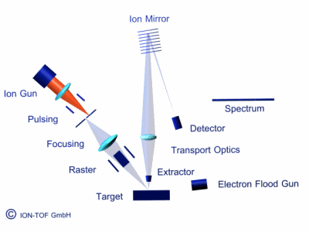
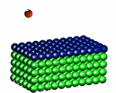
Secondary Ion Mass Spectrometer (SIMS)
To develop understanding of impurity distribution near the top layer (~100 -200 nm) of niobium by 2-D, 3-D ion mapping of the impurities.
During Electro-polishing, CBP, HPR, low & high temperature baking & annealing of SCRR Cavities
Quantification of the elemental impurity distribution using niobium standards.
Red ball : Primary ion
Blue ball : First atomic monolayer of the sample
Green balls : Inner layers
1- 30 KeV
1- 100 eV

Slide 22
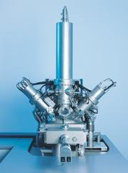
TOF SIMS 5 Specifications
Mass analyser | energy focussing reflectron time-of-flight (TOF) analyser
Detector type | A combination of microchannel plate (MCP), scintillator, and photomultiplier for secondary ions detection.
Ion sources | Analysis source: Field emission cluster ion bismuth source Sputter source : Thermal ionization Cesium source & Electron impact gas ion source
Mass range | 1 – 10000 amu
Mass resolution | Better than 10000 at mass 29 amu
Detection limit | Better than 1 ppm
Depth resolution | 1 nm or better
Depth profiling range | 1 nm – 10 micron
Minimum Lateral resolution | 150 nm or better with primary ion analysis gun
Base pressure reached after bakeout | < 5 x 10 ⁻¹⁰ torr
Sample size | 100 mm x 80 mm or smaller sized samples
Specimen holder/manipulator | Sample heating and cooling (computer controlled, -150 °C to 600 °C) in the analysis chamber.

Slide 23
Universal testing machine for evaluation of mechanical properties
Specifications
Load: ± 50 kN
Testing speed: 0.001 – 500 mm/min
Accuracy of Load: ± 0.5% for 0.5 – 50 kN
Strain measurement Accuracy: ASTM E 83 Class B or better
Total cross head travel: 1500 mm
Following measurements can be done
Yield strength, ultimate tensile strength
Elongation
Plastic strain ratio, Strain hardening exponent.
Compressive strength.
Cavity Stiffness measurement

Slide 24
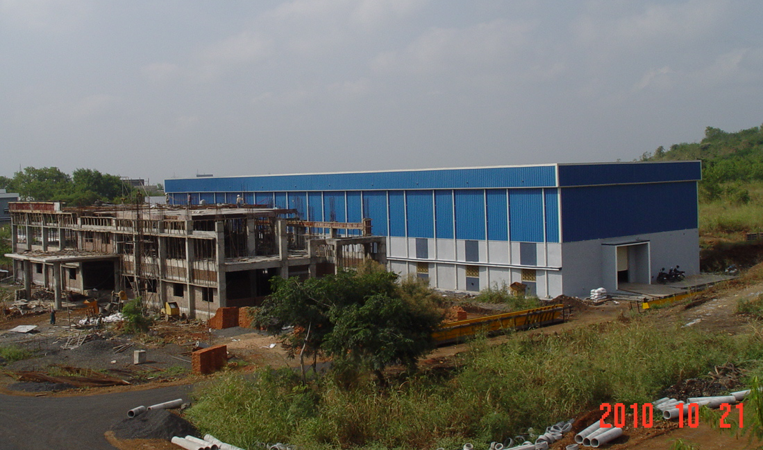
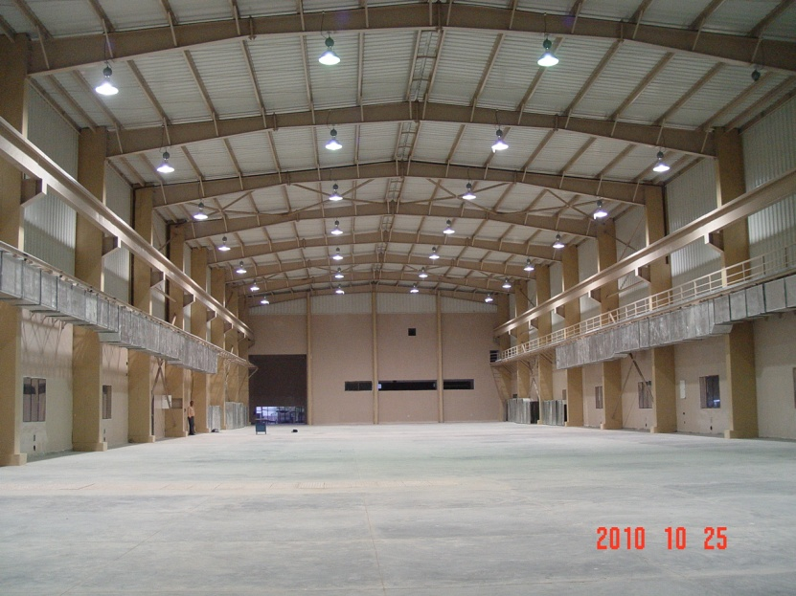
Building for SCRF Cavity Development
Cavity Processing Building
Expected to be ready by March 2011
The building will house clean rooms, Electron Beam welding machine. High Vacuum Annealing Furnace, Electro-polishing setup, Centrifugal barrel polishing machine etc.
Clean Rooms
Clean Rooms of Class 10 to Class 10000.
Procurement has been initiated & expected to be installed by Dec’11
SCRF Lab Building
Expected to be ready by March’11
The building will house Cavity forming facility, machining facilities, CMM, SIMS, material testing facility etc

Slide 25
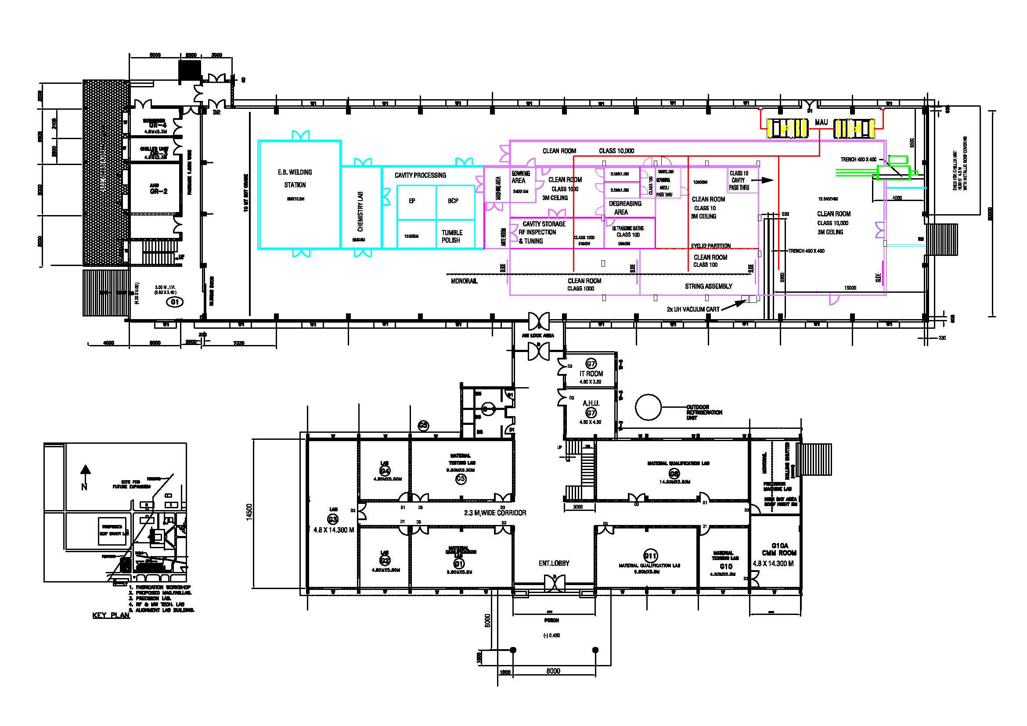
Building Plan for SCRF Facility

Slide 26
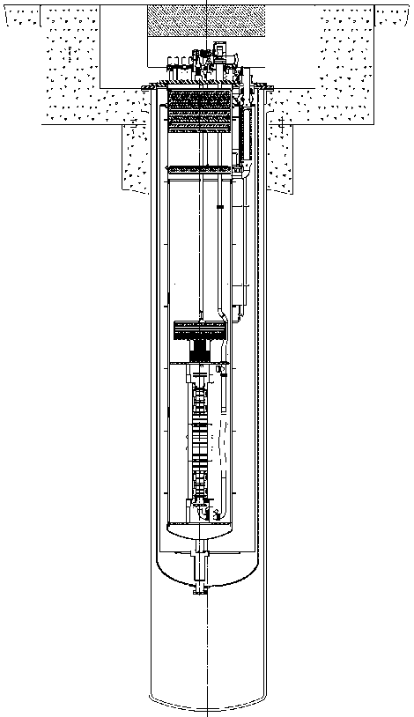
Development of VTS-2 in collaboration with FNAL
Single & 9-cell Tesla-style cavities (2 – 6 cavities)
Single Spoke Resonator cavity 325 MHz
Triple Spoke Resonator Cavity 325 MHz
  Measure Q vs. T (T_{min}~1.5 K)
  Measure Q vs. E_{acc} at 2 K
cryogenic capacity ~250 W at 2 K
Magnetically shielded cryostat
  External (room-temperature) Amumetal® (80% Ni alloy) and internal Cryoperm 10® magnetic shield, designed to attenuate field to <10 mG at cavity
Radiation shielding to maintain “Controlled Area” status
  < 5 mrem in an hour immediately outside the shielding
vacuum vessel φ=58”
radiation shielding
cavity
helium vessel 34”
Notes:
26

Slide 27
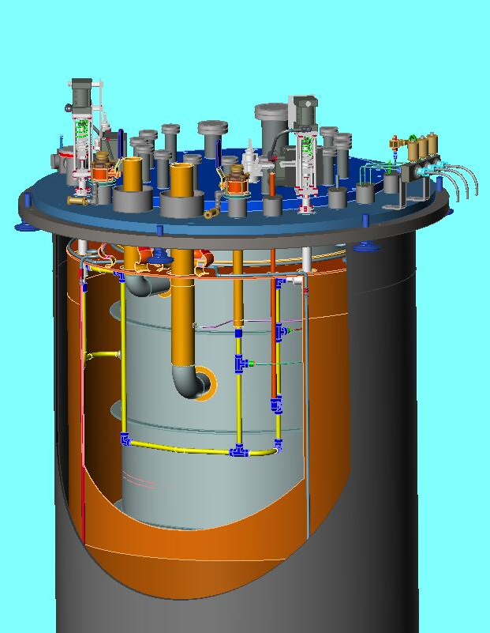
Dimensional Envelope for VTS-2
Outside diameter of Vacuum Vessel + outside magnetic shield | ≤ 58 inches
Length of Vacuum Vessel (from top flange to crown of head) | 211.375 inches
Clear aperture of the Helium Vessel | 34 inches
Length of Helium Vessel (from top flange to crown of head) | 191.35 inches
80K Shield sits in space between Helium Vessel OD & Vacuum Vessel ID

Slide 28
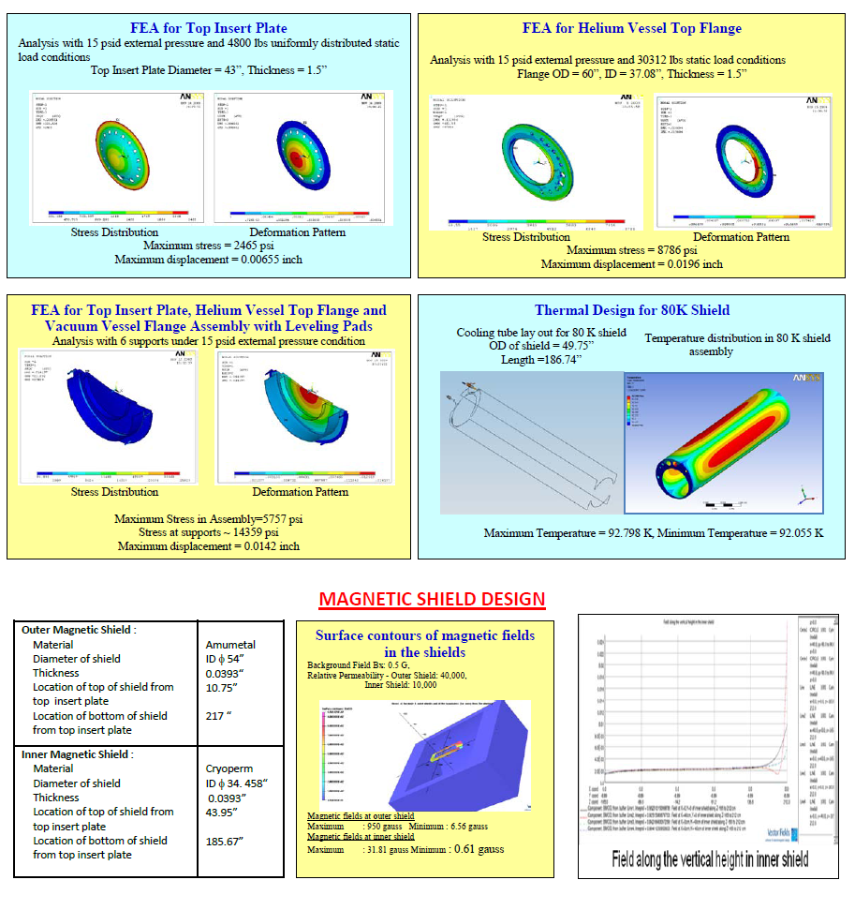
Engineering Design & Analysis of VTS Cryostat

Slide 29
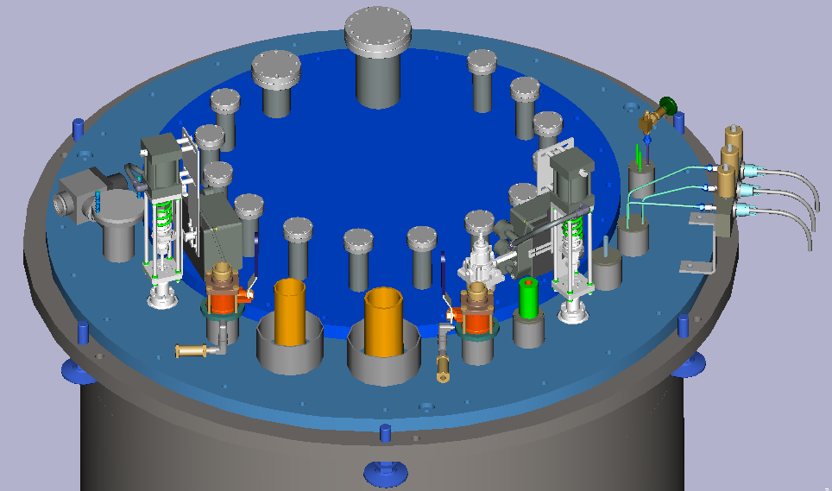
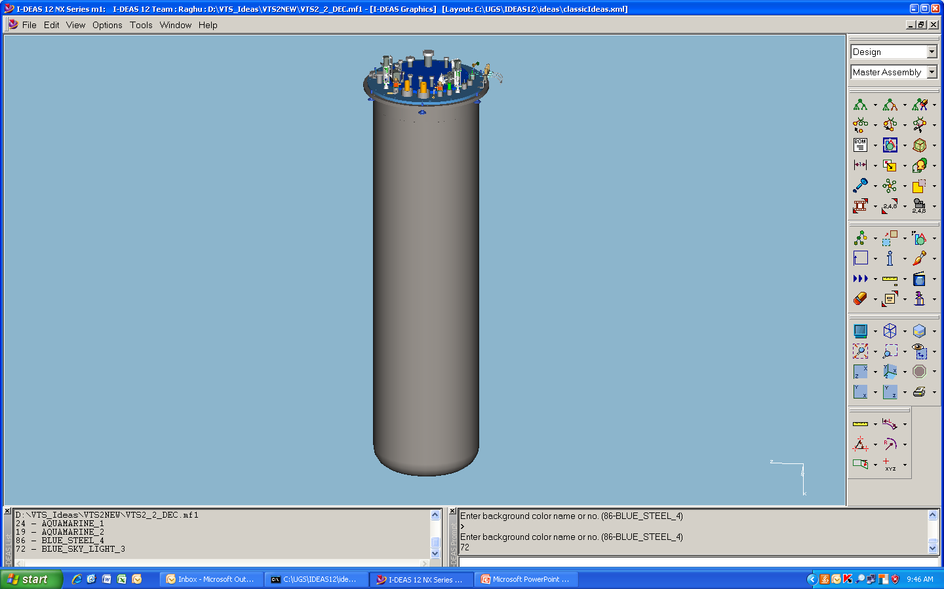
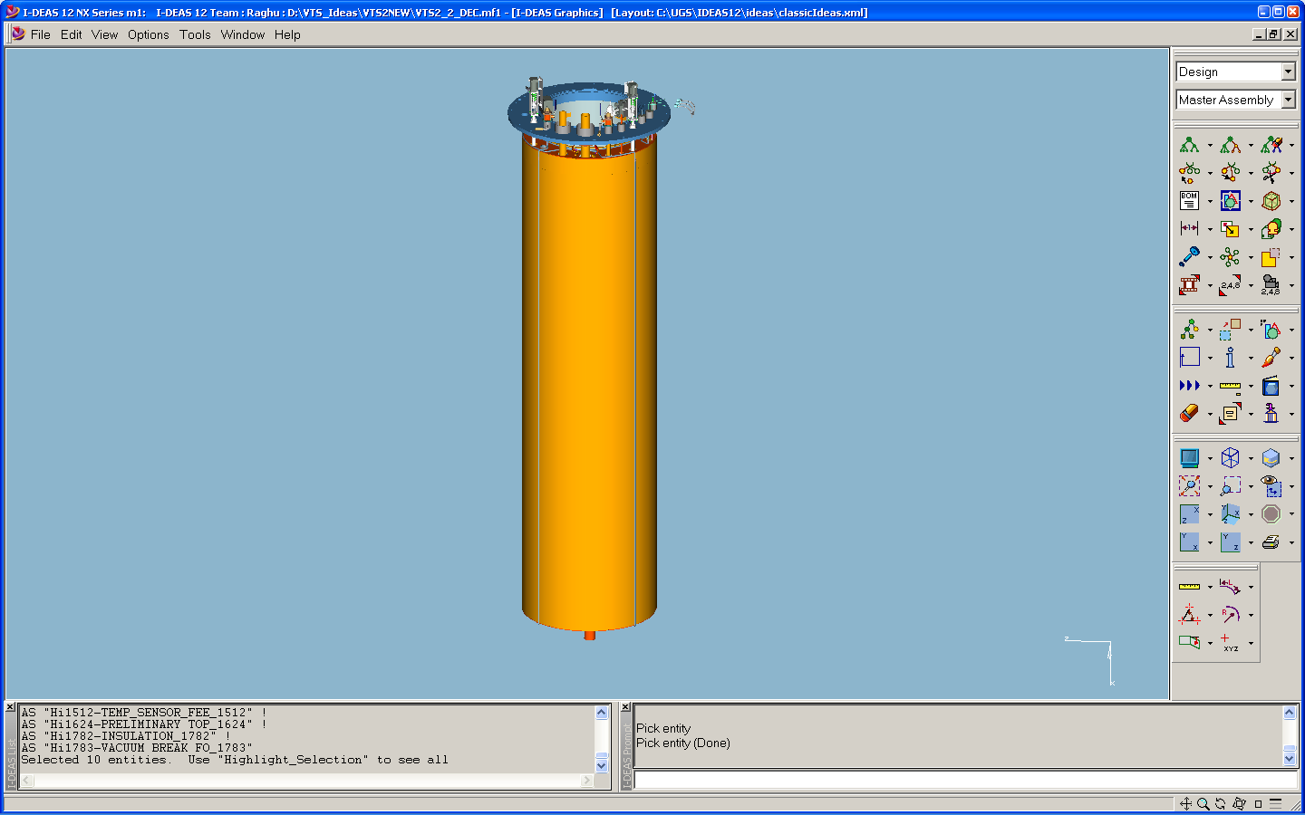
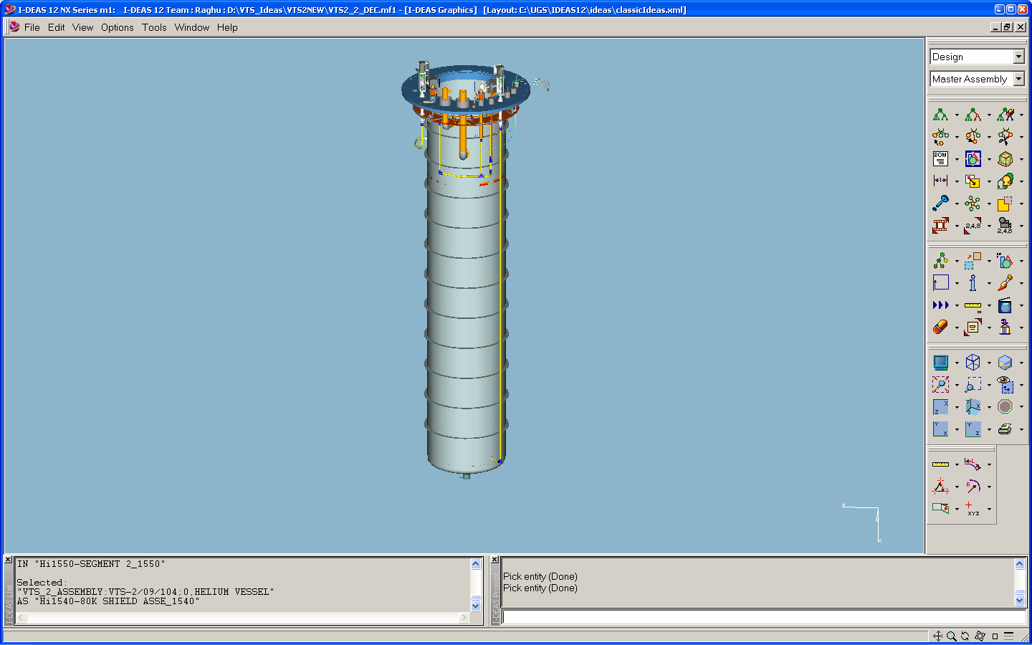
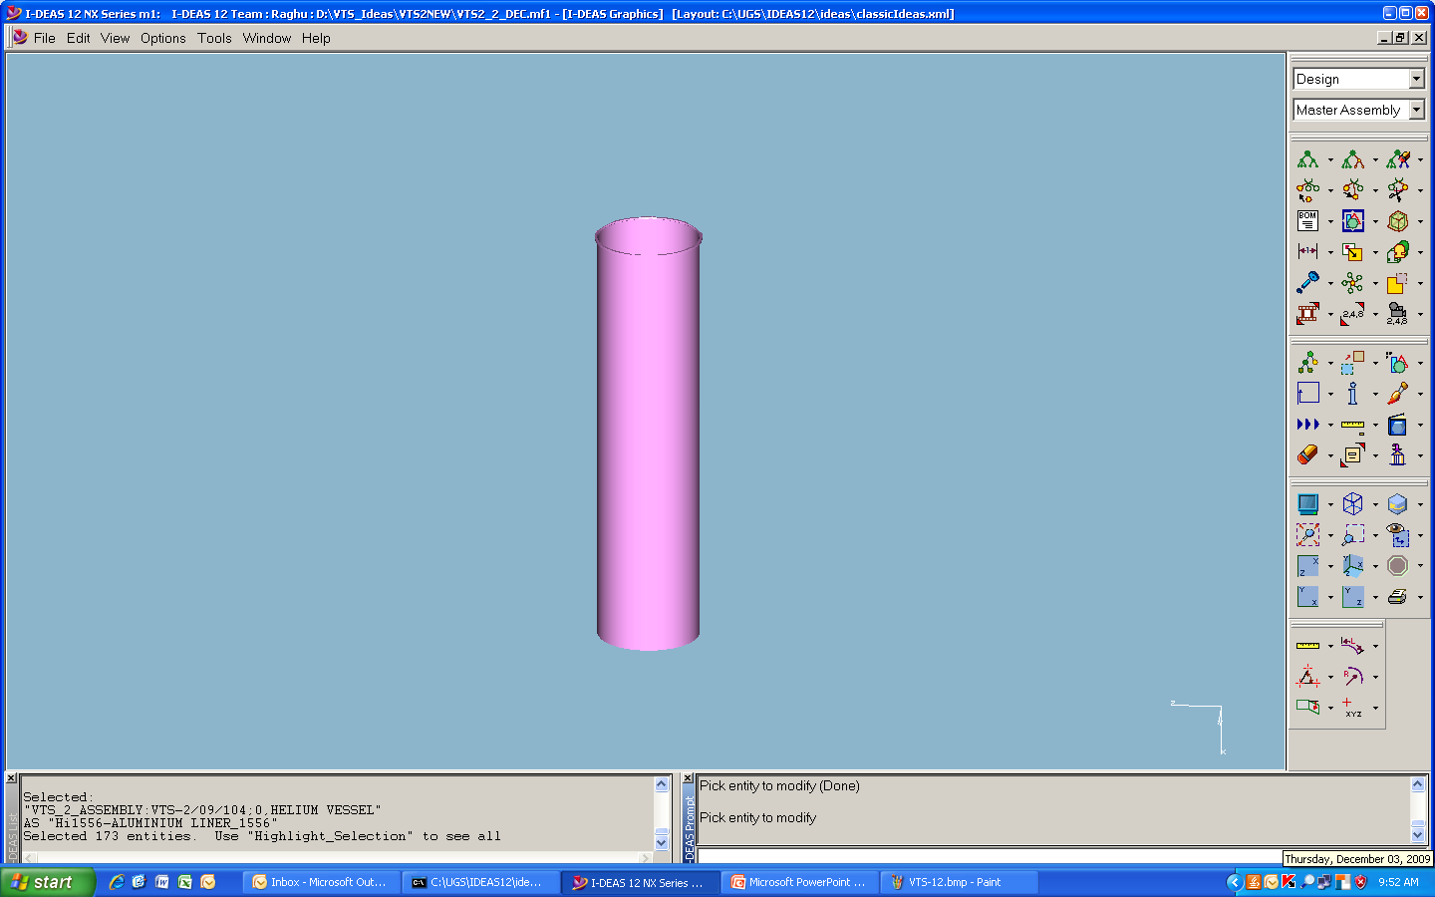
Development of Vertical Test Stand
RRCAT & Fermi Lab jointly carried out design of design of various components of 2K VTS Cryostat:
Liquid Helium Vessel
80K shield
Vacuum Vessel
Top Insert Plate
Magnetic shielding (2K + room temperature)
Piping layout for liquid helium
3-D model of the complete VTS-2 assembly
Three VTS cryostats are under fabrication at US vendor under joint supervision of engineers from Fermi Lab and RRCAT.
Expected delivery schedule : Nov 2010 – Feb 2011.
Building to house VTS at RRCAT is under construction and expected to be ready by Mid of 2011
Cryogenics system under process (P K Kush &Team)
Components of RF and DAQ system fro RRCAT VTS is under process and expected to be ready by Dec 2011.
(P Shrivastava & Team – RF and T A Puntambekar & Team – DAQ)
VTS-2 TOP PLATE – CRYOGENIC & VACUUM INSERTS
VACUUM VESSEL
80K SHIELD
LIQUID HELIUM VESSEL
2K MAGNETIC SHIELD
3-D MODELS OF VTS-2 VESSELS

Slide 30
Tuning of SCRF Cavity
A multicell elliptical accelerating cavity requires a “flat” electrical field profile at the target π-mode frequency
Emin/Emax>0.98
Cavity requires cell to cell tuning due to shape deformation during fabrication, material removal at various stages of polishing & also deformation during thermal processing.
Cavity must be straight & requires an alignment

Slide 31
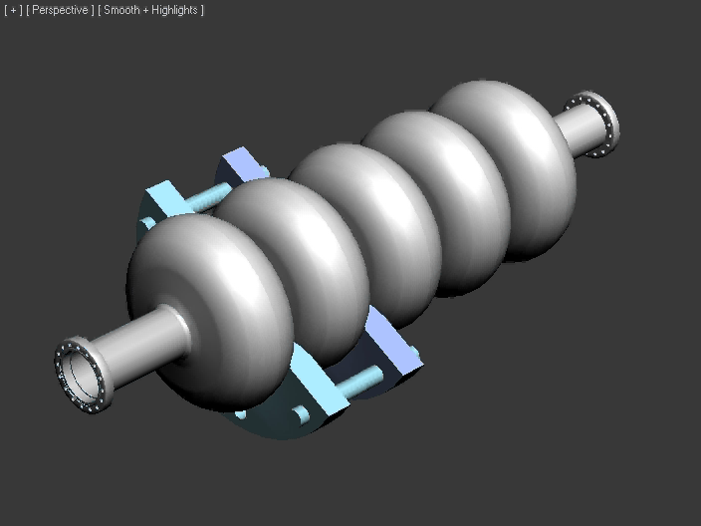

Tuning Machine is needed for 650 MHz cavity
A semi automatic tuning machine for 650 MHZ cavity is being planed at RRCAT
.
Fermi Lab has developed Instrumentation, software and integration for 1.3 GHz Automatic Tuning Machine (DESY, FNAL & KEK Collaboration). This expertise will be beneficial for IIFC to develop a tuning machine for 650 MHz.

Slide 32
Acknowledgement
Dr S Banerjee, Chairman, AEC, Dr Anil Kakodkar, Former Chairman, AEC, Dr V C Sahni, Chairman Specialist Group, Dr R Bhandari, IIFC Management for their support to SCRF Facility during project planning, review and execution.
Dr PD Gupta, Director RRCAT for continuous support and encouragement in speeding up of the activities.
Chairman & Members of Scientific Committee, Accelerator Group Board, Program Implementation Committee, RRCAT
Construction & Services Division, Fabrication Facility, Purchase, Stores, Accounts & Administration Division, RRCAT
Project Sub-Coordinators Dr S B Roy, P K Kush, KK Pant

Slide 33

Thank you

