Slide 1
Overall Summary of the IIFC meeting and plan for near term
Shekhar Mishra
Fermilab

Slide 2
Management Discussions
Participants
DAE: S. Banerjee, A. Kakodkar, R. Bhandari, P.D. Gupta, S. Kailas, D. Kanjilal, V. Sahni, P. Singh
Fermilab: S. Mishra, S. Holmes, S. Henderson, R. Kephart
Discussion
DAE-DOE agreement
Phases 1, 2 and 3 of the collaboration
Action Items
DAE-DOE to work on agency level agreement for this collaboration
Drs. Mishra and Bhandari to modify the Phase 3 document currently under development to include a ~0.65-1 GeV facility in India in parallel with the Project X CW linac. This document should identify the areas of overlap between Project X and the Indian facility in a manner that can couple the two projects under the DAE-DOE agreement. Also need to establish Indian participation in Project X physics program in this document.
Dr. Gupta to initiate a planning exercise for a ~0.65-1 GeV spallation neutron source at RRCAT. This will be an Indian project.

Slide 3
Management Discussion…
We had management discussions with the directors of IUAC, RRCAT, BARC and VECC.
Overall all very supportive of this collaboration program
Happy to see that a parallel Indian program is developing
Fermilab IIFC Management plan that have been submitted to DAE management.
IIFC-CC, IIFC-CT will provide oversight
Sub-Project Managers
Point of Contacts
One and one communication
Putting a mechanism to agree on the issues
POC responsible for resolving these issues in a timely manner

Slide 4
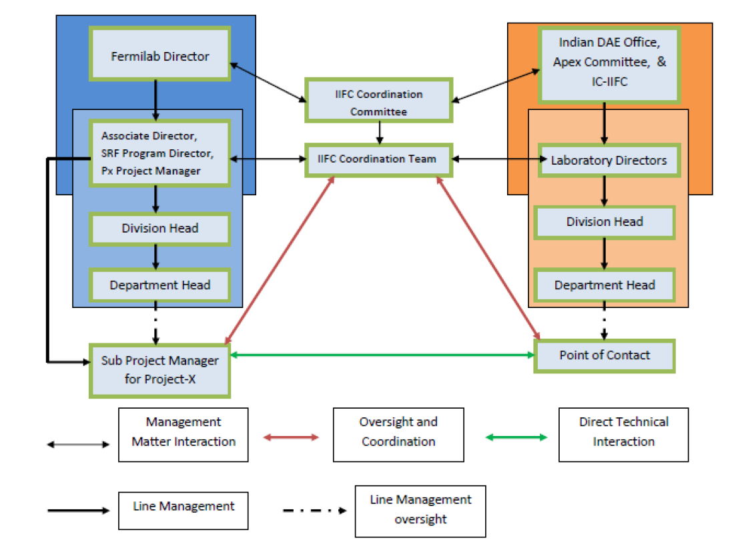
IIFC Management: Overview
Fermilab Director and Indian DAE need to nominate member for IIFC Coordination Committee and Coordination Team

Slide 5
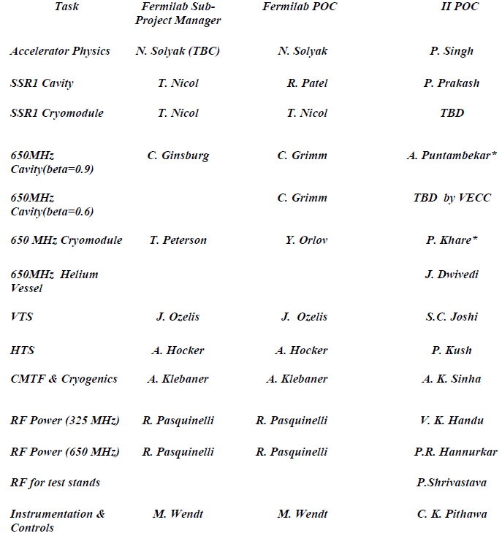
IIFC Management: Communication
Fermilab IIFC Sub-Project Managers hold the overall responsibility for the development and execution of the approved plan and deliverables as agreed upon with the Fermilab Project Management Teams.
The SPMs will interface with their respective Indian Counterparts to.
Develop the detailed scope of work, plan deliverables, based on higher level guidance provided by the FPMT/IIFC-CC, and in consultation with the Indian Institutes POC and the IIFC-CT;
Manage the supporting technical program;
Integrate the work being done in Indian Institutions into the overall program;
Maintain contact with the appropriate Indian POC
Communicate to the FPMT requests for changes – either in scope of work or schedule;
Keep the IIFC-CT and Fermilab Project Management Team informed about technical, cost, or schedule issues and risks, and/or anticipated resource needs;
Provide technical progress reports
The SPM may delegate to a Point of Contact (POC) the primary responsibility for serving as the direct liaison to the Indian Institutes engaged in his/her sub-project.
* Indian POC for Fermilab POC. All information flow through this person.

Slide 6
Phase 1: R&D Collaboration
Project-X Accelerator Physics
Project-X Lattice design
SSR1 Cavity prototype and fabrication
1300 MHz → 650 MHz, β = 0.9 & 0.6 cavity design, prototype and fabrication
1300 MHz → 650 MHz Cryomodule design
He Vessel
Blade Tuner
SRF Infrastructure
Vertical Test Stand design
Horizontal Test Stand design and cryostat
Cryomodule Test Stand design and cryostat

Slide 7
Phase II: R&D
The Phase II of this collaboration would expand the present R&D collaboration to all non SRF areas of Project-X
Elements of Phase II: R&D
Front End: Source and RFQ
325 MHz RF Power
650 MHz RF Power
Power Coupler
Instrumentations and Controls
Superconducting Magnet
Cryogenics
The technical discussions have already started
This meeting will outline these areas of collaboration

Slide 8
Phase III: Project-X
Fermilab and DAE accelerator laboratories have proposed to jointly work
On the construction and commissioning of the Project-X accelerator at Fermilab
Development of Indian capabilities and industrial infrastructure that could lead the construction of HIPA in India.
India is expected to make significant In-Kind contributions
US will share accelerator technology and knowledge
The Accelerator collaboration started in 2006 and has now gone into the 3rd stage
Component level → Scientists to Scientists
System Level → Laboratories to Laboratories
Facility Level → Agency to Agency
Fermilab has worked with US DOE in developing a DOE-DAE agreement based on IIFC discussion to date)
At present the US-DOE and DAE are working to negotiate the language and high level details of DOE-DAE agreement.

