Slide 1
Group B Summary IIFC
Rich Stanek
October 28, 2010

Slide 2
Parallel Session B
Several talks in Parallel Session B
“325 MHz RF Power Development at BARC for IIFC” by V.K. Handu and Manjiri Pande
“650 MHz RF Power Development at RRCAT for IIFC” by P.R. Hannurkar
“Instrumentation and Controls Development at BARC for IIFC” by C.K. Pithawa
The fourth talk, “BARC CW Power Coupler for 325 MHz for IIFC” by Rajesh Kumar was given in a joint session and so is not part of this summary
“IIFC Instrumentation R&D for Project X at BARC” by C.K. Pithawa, Manfred Wendt, et. al. a summary of discussions
“RF Power for VTS and HTS” by P. Shrivastava
Each talk combined a review of current projects, accomplishments and capabilities along with a look into what has already been done for the new frequencies 325 and 650 MHz

Slide 3
Outline – BARC presentation
1. Technical capabilities of the Technical Physics Division
2. High power Radio Frequency source development for Accelerator applications
3. Solid state RF amplifier development
Courtesy
V.K. Handu and Manjiri Pande

Slide 4
Development of high power RF sources
RF power development activity at TPD, BARC:
For accelerator application:
1. 100 MHz, 200 Watt RF source for 14 MeV Neutron Generator
2. 350 MHz, 60 kW RF system for deuterium 400 KeV RFQ accelerator
3. 350 MHz, 2.5 kW (CW and pulse mode) driver for 60 kW RF system
4. 352.21 MHz Klystron based RF system for LEHIPA
5. 75 MHz, 1 kW RF system for Heavy ion RFQ
350 MHz solid state RF power amplifier development
For Mass Spectrometer:
1. 27.12 MHz, 1.5 kW RF Generator for ICP-MS
2. 1.2 MHz, 4 kVpp RF source for Quadrupole Mass Spectrometer (QMS)
Courtesy
V.K. Handu and Manjiri Pande

Slide 5
Solid state RF amplifier development
Experience on Solid-state driver for Klystron
2. Indigenous development of solid-state power amplifier at 350 MHz
a. Amplifier modules
b. Power combiners design & analysis
c. 700 W Amplifier development
3. Proposal of 5 kW, 325 MHz Amplifier development
a. Options
b. Schedules
Courtesy
V.K. Handu and Manjiri Pande

Slide 6
3. Proposed Specification of 5 kW SSPA
Center frequency : 325 MHz
Bandwidth (3 dB) : 10 MHz
Power output (1 dB), CW : 5 kW
Gain (1 dB), minimum : 50 dB
Gain Stability : +/-0.5 dB
Stability : Un conditionally Stable
Cooling : Water Cooled
Input & Output VSWR : 1: 1.2
Harmonics & Spurious : <30 dBc
Efficiency (Total) : > 40%
Courtesy
V.K. Handu and Manjiri Pande

Slide 7
5 kW Amplifier Line-UP, option-1
Courtesy
V.K. Handu and Manjiri Pande
RF input 0 dBm
BGY 888
MRF6V2300
>5 kW @ 350 MHz
1 W , 30 dB
100 W, 20 dB
1:8 Divider
Micro strip
8:1 Combiner
Coaxial
8 × 800 W
19 dB

Slide 8
Proposed Schedule
High Power solid-state amplifier of 1000 W at 350 MHz will be ready by 2011
High Power solid-state amplifier of 2.5 kW at 350 MHz will be ready by December 2011
Based on earlier experience @ 350 MHz:
1 kW , 325 MHz - two such modules ready by 2013
5 kW SSPA - one module ready by 2013
Courtesy
V.K. Handu and Manjiri Pande

Slide 9
BARC- Fermilab Webex Meeting on 16/09/2010 on I&C Collaboration
Instrumentation and Controls
Presentation by BARC on Proposed collaboration
Presentation by Dr. Manfred Wendt
Three systems were identified
Low Level RF Control
Beam Position Monitor
RF Protection Interlock
However, our offer for Integrated Control System (primarily a software activity) for Project X stands
Courtesy
C.K. Pithawa

Slide 10
BARC Experience on the Proposed Systems
LLRF system: Our systems are in use in Super-conducting linacs at TIFR and IUAC and also supplied to Australian National University
Prototype digital version of the LLRF already designed and tested at TIFR Linac
Beam Position Monitor: Under design for SPIRAL2, GANIL, France and LEHIPA, BARC
Accelerator Control Systems: Developed for FOTIA – DC 6MV tandem Heavy Ion Linac and TIFR super-conducting linac, 150 MHz, Heavy Ion Linac. For LEHIPA – 352 MHz, 20 MeV, Proton Linac, this is being designed as a distributed control system.
Courtesy
C.K. Pithawa

Slide 11
RF sub-systems BARC-TIFR Super-conducting Linac
RF Electronics for Super Conducting Resonators
a) Resonator Controller : Based on Self-excited-Loop architecture.
b) RF Power Amplifiers : Solid-state, 150 MHz, 150W.
RF Electronics for Normal Conducting Resonators
a) Dynamic Phase Reference Generation: Provides stable Phase References to all the RF systems of the linac.
b) Resonator Controller: Based on Generator Driven Resonator architecture
Courtesy
C.K. Pithawa

Slide 12
Digital Low Level RF for 20 MeV Linac
Development in stages:
In the Initial Phase single channel system has been developed
Has only one input and one output channel
Incorporates the main feedback algorithm of amplitude and phase control
Uses high speed, high density FPGA
System working
Courtesy
C.K. Pithawa

Slide 13
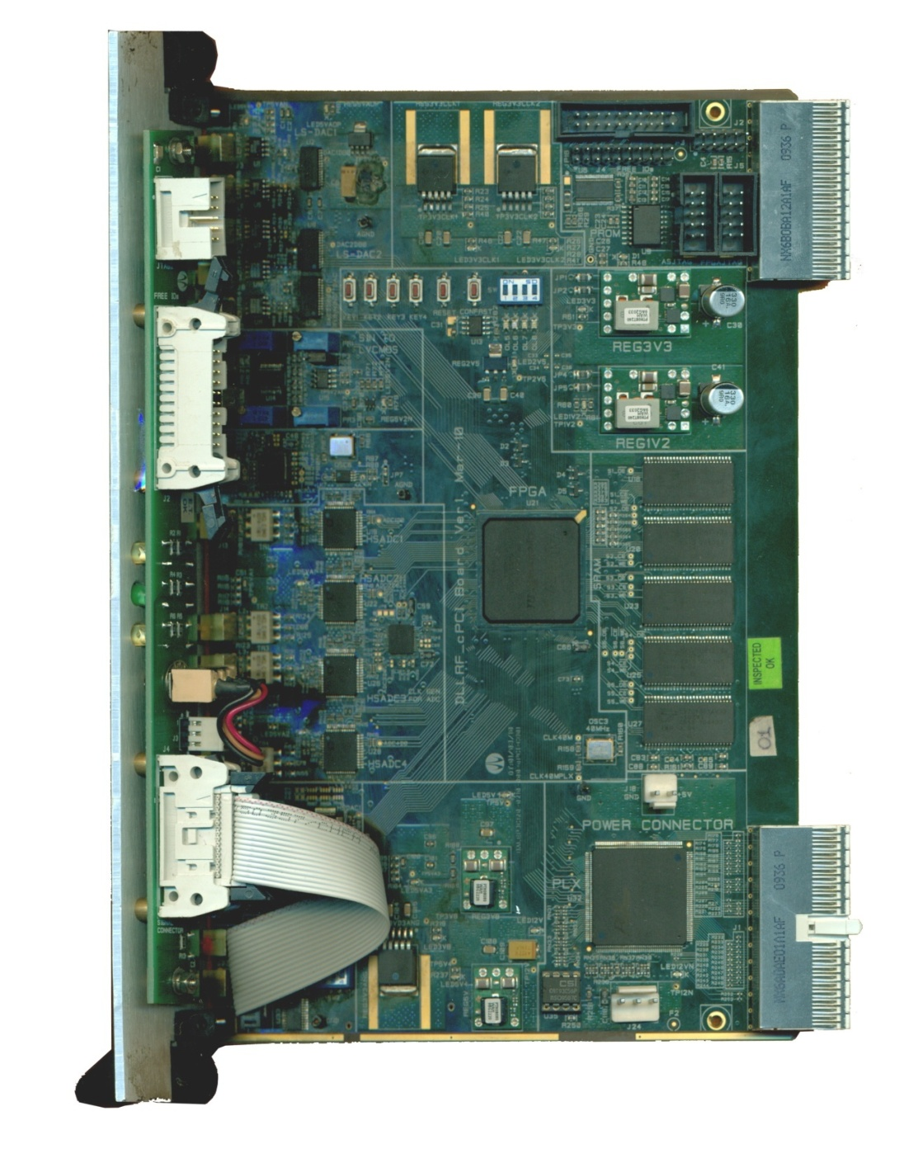
Four Channel System: Digital Processing Card
Features:
High speed High Density FPGA
Fast ADC –14 bits,105 MSPS, 4 nos
.
Fast DACs –14 bits, 300 MSPS, 2 nos
Slow DACs –Dual,40 MSPS,10 bits,
3 nos.
Clock Generation – PLL synthesizer
Memory – 1 MB, 6 nos.
cPCI Interface
Courtesy
C.K. Pithawa

Slide 14
IIFC Proposal-2 : BPM
Used primarily for determining position of bunched beam in the accelerator
Can provide several other parameters – phase, intensity, energy
BPM under development at BARC for:
Our own accelerator programs – LEHIPA
SPIRAL2, GANIL, France
Courtesy
C.K. Pithawa

Slide 15
BPM for the SPIRAL2 LINAC GANIL (Grand Accelerateur National d’Ions Lourds) in Caen, France
BPM Electronics based on VME Board (22 units to be supplied)
MVME5500 , VxWorks6.8 , Spiral2 EPICS IOC, EDM GUI
Courtesy
C.K. Pithawa

Slide 16
Software Development for BPM of SPIRAL2 GANIL
Instrument Front End :
VME with MVME 5500CPU
Software Environment at Instrument front-End:
EPICS IOC on VxWorks
Operator Front End:
EPICS over Linux, EPICS Extendible Display Manager (EDM) GUI
Epics Client Access server on VxWorks to access VME Hardware
Epics Client Access:
client on Linux to read the data from VME
Courtesy
C.K. Pithawa

Slide 17
IIFC Proposal-3: RF Protection Interlock System
Part of machine protection system -prevents power mismatch, sparks, over-voltages, etc. in the high power RF distribution system between klystron and cavity input coupler.
This is of interest to us
More details required, especially regarding sensors
Hardware and Software can be easily tested with simulators. But sensors design, fabrication, testing issues have to be sorted out.
Courtesy
C.K. Pithawa

Slide 18
650 MHz at RRCAT
Courtesy
P. R. Hannurkar

Slide 19
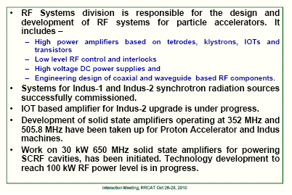
RF Systems Division
Courtesy
P. R. Hannurkar

Slide 20
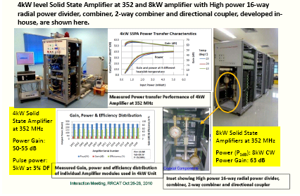
Courtesy
P. R. Hannurkar

Slide 21
Courtesy
P. R. Hannurkar

Slide 22
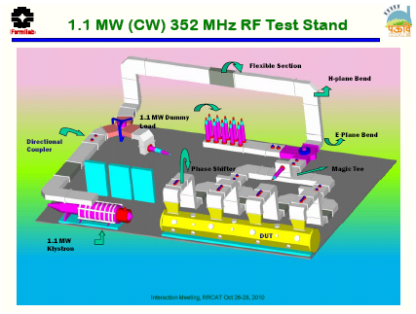
sss
Courtesy
P. R. Hannurkar

Slide 23
650 MHz RF Power at RRCAT
Courtesy
P. R. Hannurkar

Slide 24
RF Power for VTS
Group has a lot of experience in pulsed RF power
Designed and successfully tested long pulse, Solid State Bouncer modulator for LEP 1 MW Klystrons
Wave guide components
Also, 1.3 MW Pulsed 352.2 MHz Test Stand at RRCAT
Responsible for 1.3 GHz cavity frequency measurements (consistent with FNAL results)
Indian VTS RF power system will be based on Fermilab’s existing VTS
Most components are on order
Some issue with availability of parts that are a little dated and becoming obsolete

Slide 25
Visit to BARC
FNAL contingent
Group B members ➔ Mark, Arkadiy, Manfred and myself
Management team ➔ Steve, Stuart, Bob and Shekhar
First day ➔ tours of BARC facilities/infrastructure and meet with BARC director
RF Division, Instrumentation/Controls, CDM
Mostly positive experience
Once again demonstrated capabilities to contribute
Second day ➔ Group B meets in breakout sessions to discuss details
Instrumentation & controls
RF power
CMTS cryogenic components
Teamcenter

Slide 26
Teamcenter
Plan is to create a hub in India at BARC
Outside tightest security area ➔ “new” computing area tied to training facility
All Indian Labs tie into this Multi-Site hub via secure network
This already exists
Still there are many issues that have to be addressed
See Action Items
Trying to get IIFC institutions to adopt UG NX
Need to decide how ECAD will be done (look for consistency)
Best chance to do concurrent engineering
Best estimate ➔ go into production with Teamcenter March 2011

Slide 27
Teamcenter Fermilab Action Items

Slide 28
Teamcenter BARC/RRCAT Action Items

Slide 29
My Thoughts BARC
BARC has the capabilities
Design and build nuclear reactors
Do some control work from scratch
CDM facilities are impressive
Cryogenic component fabrication might require additional collaboration but capabilities are there
Once again in the area of RF power their interests and ours match up well
In some areas they will definitely draw benefits from exposure to what we have in our plans
LEHIPA project creates synergy with our work
For Project X ➔ Need to be careful to give a clear indication of what is and what is not open for original design
Security and access to BARC could be an issue

Slide 30
My Thoughts - Instrumentation
Plans seem to be forming
How to do the work
Visits to Fermilab
Need to develop written specifications (FRS and TRS) for each project including what are the fixed parameters and what can be improved
Opens questions (from Instrumentation WG)
BARC want to initiate the collaboration on all three systems simultaneously! It might be preferable to start with one activity, e.g. a BPM system for HINS?!
Should we send a senior BARC engineer for 1-2 weeks?
BARC proposed participation in development of the Global Project X Control System. Fermilab would respond later.
At this moment Fermilab would limit control activities to drivers, interfaces, ACNet-in-a Box, etc.

Slide 31
My Thoughts RF
Fermilab RF System Subproject Manager needs to
Prepare and fully approve FRS and TRS documents for 325 and 650 RF Power Systems to precisely define the scope of work, constraints, and expectations
Even in the R&D stage it is important to have a focused and consistent view of what we are trying to build
It is possible to design to a range and have adjustability in the final parameters when requirements are fixed.
My sense is that if we blink our eyes we’ll find real work has been done at BARC and RRCAT on 325 and 650 RF systems
It would be valuable to schedule a workshop focusing on RF power at Fermilab to help align all the groups involved in these systems
Schedule a in time between PAC and Project X Collaboration Meeting at SNS Oak Ridge, TN, or sooner if possible

Slide 32
Additional Thoughts
Availability of critical parts
Philosophy should be to design the very best system and then determine a Fabrication Plan that delivers that design
To the extent possible, Indian Labs can order from same vendor (used by Fermilab)
It may be beneficial to purchase certain critical components in US and send them to BARC/RRCAT for integration into the final product ➔ to assure QC and proper availability
This must be done in a way consistent with all applicable export control rules and customs requirements
Need to look forward with respect to RF power design
In the area of SSA things are constantly changing
Improvements in power capability and cost ratio
Want to assure that when Project X is given the go ahead we are designed to the state of the art and not stuck at five year old technologies
More work needs to be done but it looks promising

Slide 33
Summary
Addendums to the IIFC MOU that deal with RF systems and Instrumentation need to be finalized
To allow BARC and RRCAT to “officially” work on these items
Capabilities and expertise of Indian Institutions in areas of RF Power systems/Instrumentation are impressive
The Instrumentation side of the IIFC seem to be coming to agreement on initial scope of projects.
Appears to be mutual interest and expertise in areas of LLRF, RF protection systems and fabrication of BPMs
Working on getting an extended visit by BARC engineer at Fermilab to learn more about our systems
For RF Power, Fermilab really needs to define in writing the specifications and requirements (FRS and TRS)
Emphasis on Solid State Amplifiers is aligned with current FNAL initiatives

