Slide 1
Coherent Synchrotron Radiation studies at the A0 photoinjector
Jayakar Charles Tobin Thangaraj
& the A0 team

Slide 2
Outline of the talk
Introduction
Coherent Synchrotron Radiation
Experimental results
Work in progress

Slide 3
Coherent Synchrotron Radiation
Synchrotron radiation is the result of individual electrons that randomly emit photons when passing through a bend.
Coherent synchrotron radiation (CSR) is produced when a group of electrons collectively emit photons in phase. This can occur when bunch length is shorter than radiation wavelength.

Slide 4
Why is it important?
CSR induces an energy redistribution along the bunch.
This energy modulation inside the dipole may result in modulation of the transverse slopes which may increase the projected emittance in the bend plane
λ_{r}
R
Coherent radiation for λ_{r} > σ_{z}
θ
R=L_{o}/θ

Slide 5
Condition for coherent radiation
For A0 at the third dipole: CSR expected above λ=0.3mm

Slide 6
Long wavelength cutoff due to vacuum chamber
For A0 at the third dipole: CSR expected 0.3mm < λ < 20mm

Slide 7
CSR effect on the bunch is….

Slide 8
CSR effect on the bunch is….
Particles get deflected differently due to the energy spread induced
by CSR leading to an angular spread which shows up as emittance growth

Slide 9
Experimental Setup

Slide 10
Intensity Vs Charge Vs Phase measurement
3.9 GHz cavity (off)
D4
D2
D3
XS4
1.3 GHz booster cavity
D1
Collecting
Optics
Coherent
Synchrotron light
Pyrometer
=quadrupole =dipoles =diagnostics

Slide 11
What is out there?
Pyro-detector
connected to digitizer
PORT: : BEAMPIPE
Polarizer
Focusing optics

Slide 12
RF chirp

Slide 13
Chirp maths:
So we expect maximum CSR power around 40 deg off crest.

Slide 14
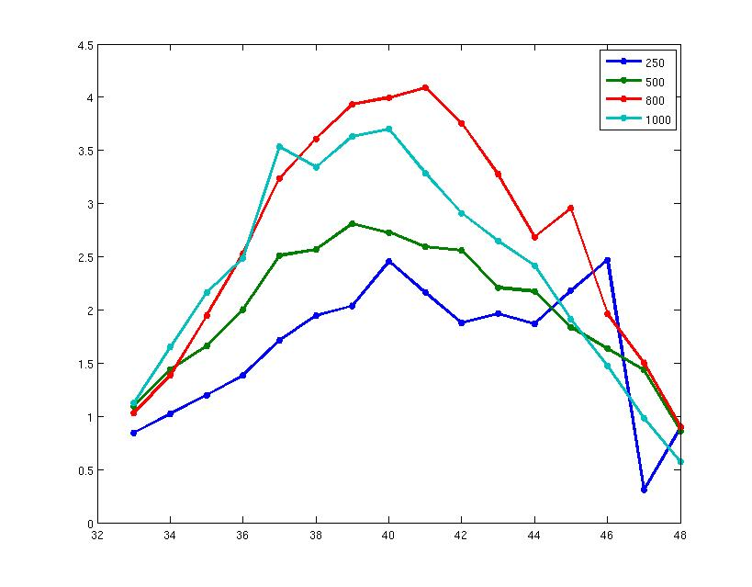
CSR Power Vs RF Phase (bunchlength)
Power (mV)
RF Phase (degrees)

Slide 15
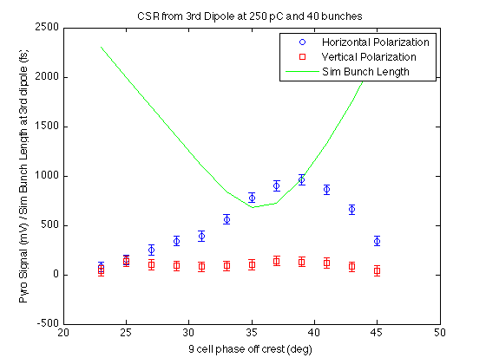
Experimental : Polarization vs CSR

Slide 16
Bunch length measurement: Experimental Setup
3.9 GHz cavity (off)
D4
D2
D3
XS4
1.3 GHz booster cavity
D1
Collecting
Optics
Synchrotron light
Interferometer
=quadrupole =dipoles =diagnostics

Slide 17
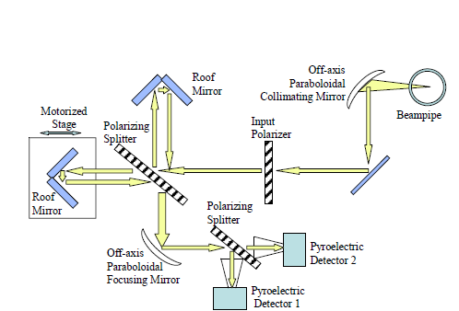
Martin – Puplett interferometer

Slide 18
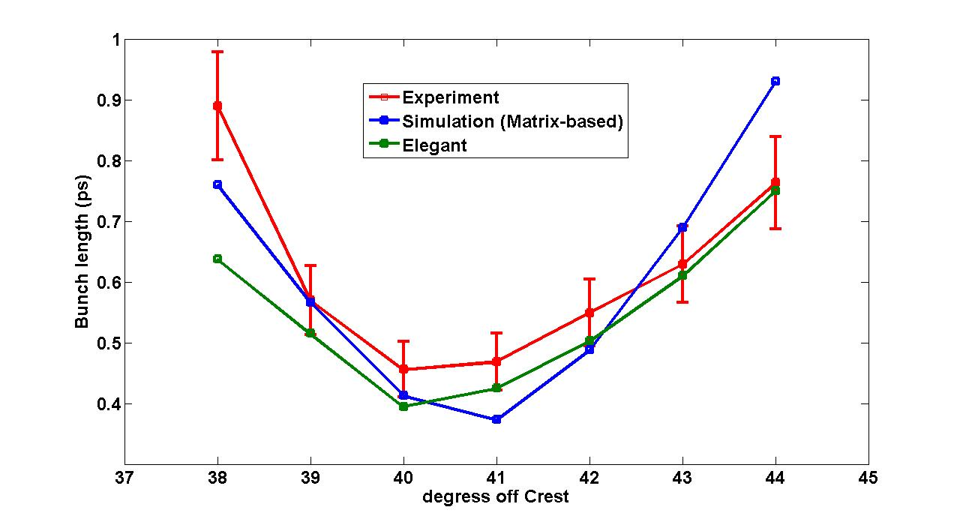
Bunch length measurement: Simulation Vs Experiment

Slide 19
Studying the effects of CSR on the beam
D4
D2
D3
D1
screen
Skew quad
=quadrupole =dipoles =diagnostics

Slide 20
“Skewed” maths

Slide 21
“Skewed” maths

Slide 22
Experimental work in progress
So, with skew quad on, (after cancelling x-dispersion), what we see on the screen is,
X_{out} VS Z_{in}

Slide 23
Summary
Coherent synchrotron radiation has been measured at A0 for various different charges
We have measured the bunchlength using CSR radiation
Experiments underway to study measuring CSR effects using “skewquad”

