Slide 1
Preliminary result of Box cavity and Compare with HPRF test
K. Yonehara

Slide 2
Caution
I’m not a collaborator for this experiment
Al gave me a permission to look at some results
I show preliminary analysis data
Full analysis will be done by Yagmur (or someone)

Slide 3
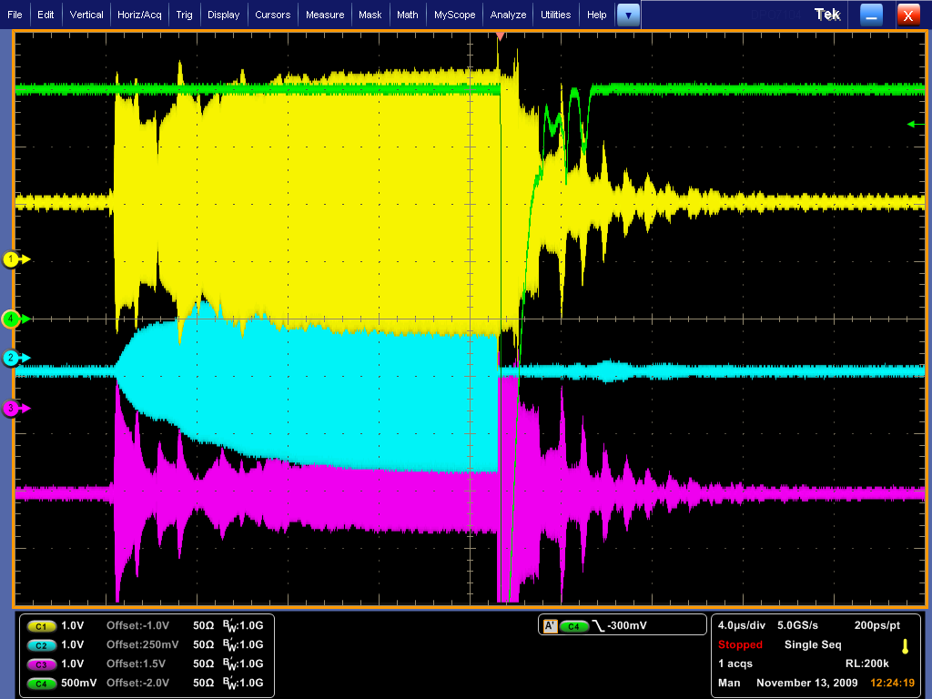
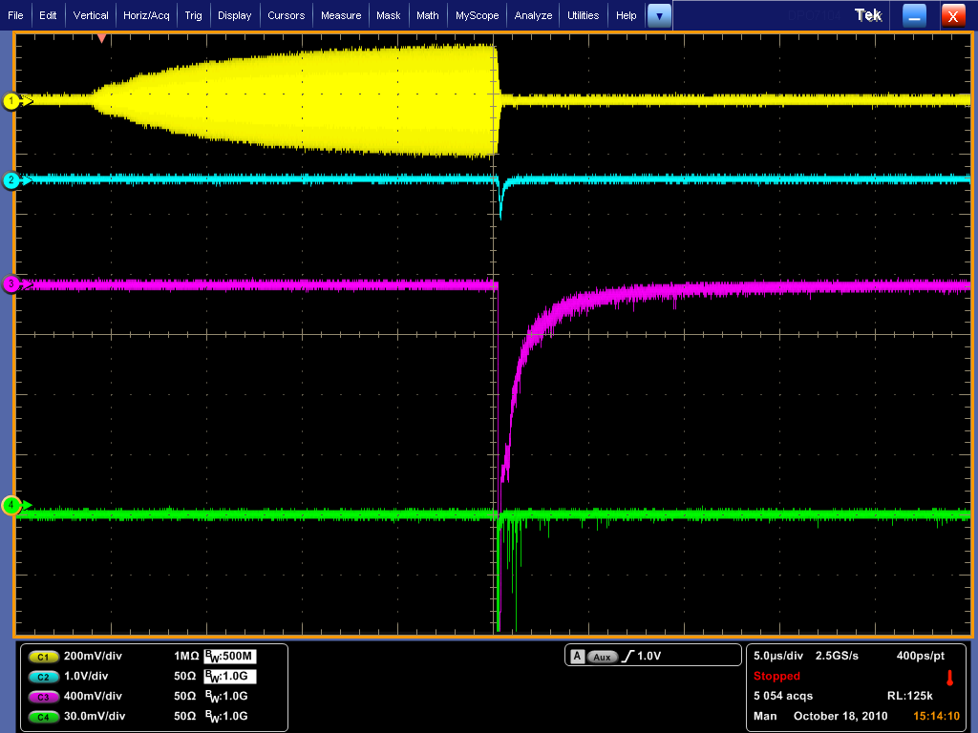
HPRF (1540 psi, 11/13/09)
Box cavity (0T, 0degree, 10/08/10)
RF pickup
Trig light
Trig light
RF pickup
X-ray
Spec light (515.3 nm)
Caution: Scale is different
Decay slope in RF pickup signal in HPRF is faster (10 ~ 20 ns) than
Box cavity result (100~300 ns).

Slide 4
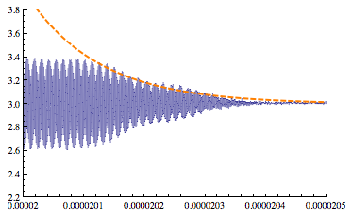
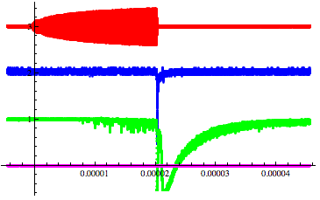
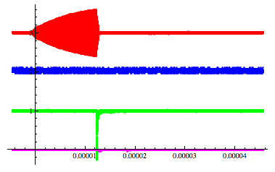
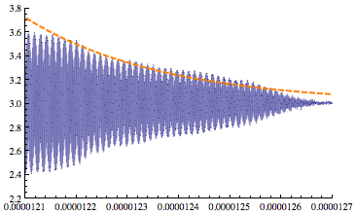
0 T, 0 degree (2010, 0927)
τ =120 ns
1 T, 0 degree (2010, 0922)
τ =270 ns

Slide 5
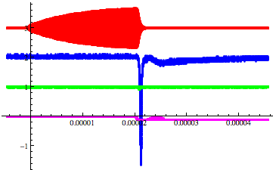
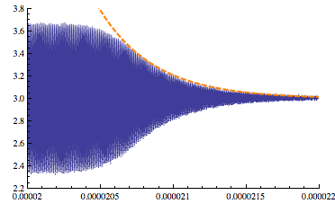
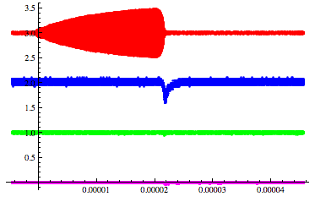
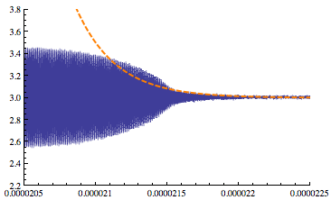
2 T, 0 degree (2010, 0921)
τ =380 ns
3 T, 0 degree (2010, 0820)
τ =280 ns
X-ray disappears

Slide 6
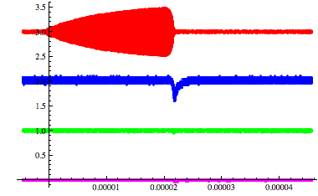
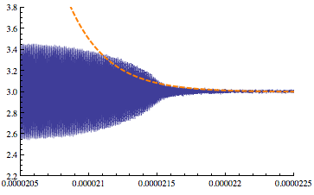
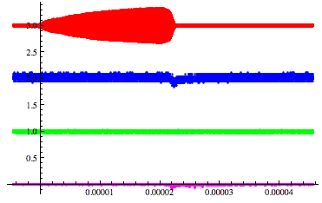
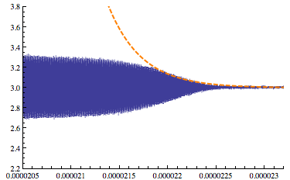
3 T, 1 degree (2010, 0715)
τ =280 ns
3 T, 4 degree (2010, 0719)
τ =345 ns

Slide 7
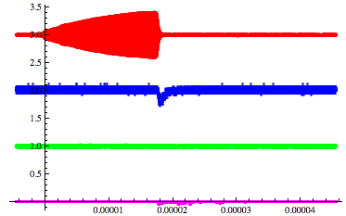
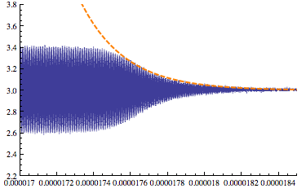
3 T, -1 degree (2010, 0810)
τ =240 ns

Slide 8
Decay τ in RF pickup signal
Breakdown τ in HPRF (various gas pressures)
Breakdown τ in box cavity
09/24/2008

Slide 9
RF modulation
RF modulation in HPRF
RF signal in box cavity (0 T, 0 degree)
RF signal in stable condition
Clear phase shift in decay signal
RF signal in breakdown
No RF modulation!

Slide 10
RF modulation
RF signal in box cavity (3 T, 0 degree)
No RF modulation in decay signal in box cavity
It seems that box cavity does not have a dense
plasma that we saw in the HPRF
RF signal in stable condition
RF signal in breakdown
No RF modulation!

Slide 11
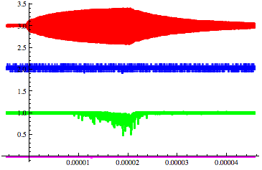
Test Fowler-Nordheim model
0 T, 0 degree (2010, 0927)
Orange circle represents the X-ray
emission at the stable RF condition
It happens only in 0 T
The intensity can follow Fowler-
Nordheim model (mechanism of
field emission electrons)
I have currently 12 shots of analyzed
x-ray emission
Here, I show one typical shot and one
interesting shot that does not have
any breakdown but strong x-ray emission
Analysis has been made in bottom shot
Result is shown in next slide
RF pickup
X-ray
0 T, 0 degree (2010, 0927)

Slide 12
X-ray emission vs E
(Top left) Average x-ray intensity
(Bottom left) Average RF amplitude
(Top right) Normalized both signals by its maximum signal
RF amplitude ramps up up to 20 μs and goes down
X-ray intensity follows the RF amplitude curve
The growth in RF amplitude is an inverse- exp function
while x-ray growth is a simple exp function
It seems the Fowler-Noldheim model is suggested
However, intensity is changed after 20 μs (orange box
in top right plot), i.e. x-ray signal becomes higher even
at the same RF amplitude

Slide 13
Summary
Box cavity shows quite different signals from HPRF cavity
Longer time structure of breakdown in box cavity
Longer time constant in stronger magnetic field in box cavity
X-ray signal disappears in 0 degree strong magnetic fields
No or less high energy electron is generated in E×B cavity due to field insulation effect
However, we still see the breakdown probability reduction in strong magnetic fields
Some breakdown physics process becomes dominant in box cavity
No RF modulation is observed in box cavity in any B fields (even no B condition)
This means there is no or thin density plasma
Test FN model
X-ray intensity becomes higher at lower RF amplitude after RF power feeding is stopped

