Slide 1
CD Networking, Middleware,
& Computer Security
Applied R&D Workshop
Nov. 5, 2010

Slide 2
Workshop Goals
Discuss & ensure concordance between our science needs, and our network/middleware/ computer security applied R&D efforts
Generate input to DOE/SC’s strategic planning for ASCR’s network/middleware R&D program
Establish framework for developing grant proposal ideas consistent with bullet 1
Anything else?

Slide 3
Workshop Deliverable(s)
White paper providing the FNAL perspective on:
  What are the major (computing) challenges facing the DOE science community?
  What has been accomplished to meet these challenges?
  What is the current state of the art relative to these challenges?
  What new questions have been raised, based on the current state of the art?
Other deliverable(s)?

Slide 4
DOE/SC/ASCR Strategic Directions (I)
Workshop in Feb time frame targeted at DOE science needs
Current strategic emphasis:
  Exascale computing
  Terabit networking
Current tactical emphasis:
  ESnet ANI 100 Gb/s backbone & test bed
  Leadership computing facilities (ANL & ORNL)
  DOE looking at other poster children besides LHC

Slide 5
DOE/SC/ASCR Strategic Directions (II)
3-5yr horizon questions ASCR is asking themselves:
  What will the network infrastructure look like?
    Bundled channels or 100GE/1TE lambdas
    Continuation of parallel circuit (SDN) & shared IP links
  What will the end hosts look like?
    Physical interconnects & interfaces
    Protocols & services

Slide 6
DOE/SC/ASCR Strategic Directions (III)
3-5yr horizon questions ASCR is asking (cont.):
  What will the traffic flows look like?
    Individual flows >10Gb/s
    Highly parallelized flows at <10Gb/s each
    Mix of large & small flows
    Mix of real-time and bulk-xfer flows
  What’s needed for management & operational support?
    Determining infrastructure is operating properly
    Determining what problems exist, and where
    Setting & communicating realistic expectations

Slide 7
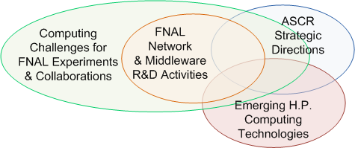
Desired Intersections

