Slide 1
Project X Accelerator Overview
Steve Holmes
Presentation to DOE/Office of High Energy Physics
November 17, 2010

Slide 2
Outline
Project X Reference Design
  Mission & Goals
  Reference Design Overview
  Collaboration
  Strategy/Timeline
Project X Cost Range

Slide 3
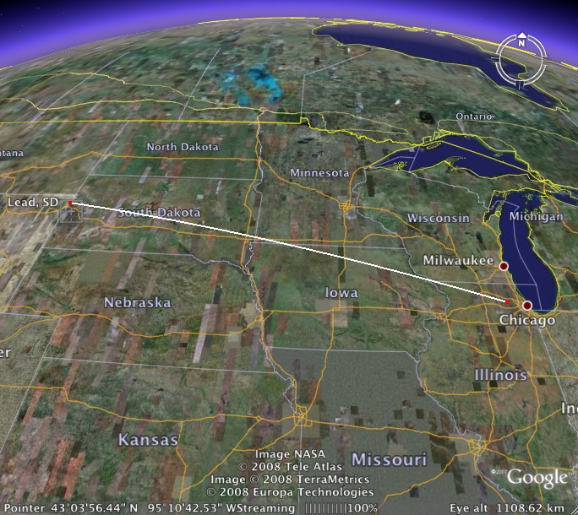
Project X Mission
A neutrino beam for long baseline neutrino oscillation experiments
  2 MW proton source at 60-120 GeV
High intensity, low energy protons
for kaon and muon based precision
experiments
  Operations simultaneous with the
  neutrino program
A path toward a muon source for
possible future Neutrino Factory
and/or a Muon Collider
  Requires ~4 MW at ~5-15 GeV .
Possible missions beyond P5
  Standard Model Tests with nuclei and energy applications
Notes:
Replace ADS Development with Nuclear Energy Application

Slide 4
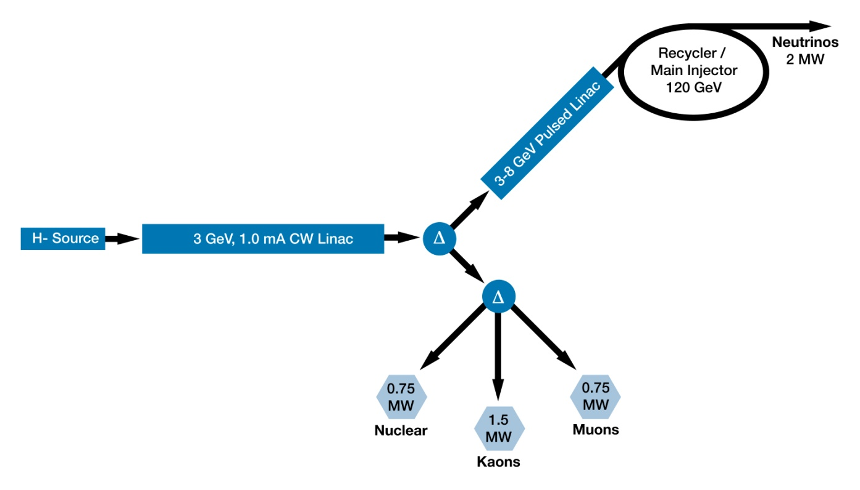
Project X Reference Design

Slide 5
Project X Scope
3 GeV CW superconducting H- linac, capable of delivering 1 mA average beam current.
  Flexible provision for variable beam structures to multiple users
  Starts at ion source; ends at 3-way split (with stubs)
  Supports rare processes programs
3-8 GeV pulsed linac capable of delivering 300 kW at 8 GeV
  Supports the neutrino program
  Establishes a path toward a muon based facility
  Provision for 1 GeV extraction for nuclear energy program
Upgrades to the Recycler and Main Injector to provide ≥ 2 MW to the neutrino production target at 60-120 GeV.
  Ends at MI extraction kicker
  Supports the long baseline neutrino program
All interconnecting beamlines
Notes:
ADS Development with Nuclear Energy Applications

Slide 6
Project X Capabilities
> 2 MW delivered to a neutrino target at any energy between 60 – 120 GeV
Simultaneous delivery of ~3 MW of high duty factor beam power to the 3 GeV program
  Variable beam formats to multiple users
  CW beam at time scales >1 μsec
  10% duty factor on time scales < 1 μsec
Potential for development of additional programs at:
  1 GeV for nuclear energy experimentation
  8 GeV for neutrino or muon experimentation
The utilization of a CW linac creates a facility that is unique in the world, with performance that is unlikely to be duplicated in any synchrotron-based facility

Slide 7
Project X Reference Design
Operating scenario
1 μsec period at 3 GeV
Muon pulses (12e7) 162.5 MHz, 80 nsec 750 kW
Kaon pulses (12e7) 27 MHz 1500 kW
Nuclear pulses (12e7) 13.5 MHz 750 kW
Ion source and RFQ operate at 6.2 mA
83% of bunches are chopped @ 2.5 MeV ⇒ maintain 1 mA over 1 μsec
Separation scheme
Transverse rf splitter

Slide 8
Project X Supporting Documentation http://projectx-docdb.fnal.gov/
Functional Requirements Specification
Reference Design Report
Research, Design, & Development Plan
Cost Estimate
Resource Loaded Schedule

Slide 9
Project X Functional Requirements
Requirement | Description | Value
L1 | Delivered Beam Energy, maximum | 3 GeV (kinetic)
L2 | Delivered Beam Power at 3 GeV | 3 MW
L3 | Average Beam Current (averaged over >1 μsec) | 1 mA
L4 | Maximum Beam Current (sustained for <1 μsec) | 10 mA
L5 | The 3 GeV linac must be capable of delivering correctly formatted beam to a pulsed linac, for acceleration to 8 GeV
L6 | Charge delivered to pulsed linac | 26 mA-msec in < 0.75 sec
L7 | Maximum Bunch Intensity | 1.9 x 10 ⁸
L8 | Minimum Bunch Spacing | 3.1 nsec (1/325 MHz)
L9 | Bunch Length | <50 psec (full-width half max)
L10 | Bunch Pattern | Programmable
L11 | RF Duty Factor | 100% (CW)
L12 | RF Frequency | 325 MHz and harmonics thereof
L13 | 3 GeV Beam Split | Three-way
P1 | Maximum Beam Energy | 8 GeV
P2 | The 3-8 GeV pulsed linac must be capable of delivering correctly formatted beam for injection into the Recycler Ring (or Main Injector).
P3 | Charge to fill Main Injector/cycle | 26 mA-msec in <0.75 sec
P4 | Maximum beam power delivered to 8 GeV | 300 kW
P5 | Duty Factor (initial) | < 4%
Notes:
May not want to explain all the details, You should highlight a few points. Same for next slide

Slide 10
Project X Functional Requirements
Requirement | Description | Value
M1 | Delivered Beam Energy, maximum | 120 GeV
M2 | Delivered Beam Energy, minimum | 60 GeV
M3 | Minimum Injection Energy | 6 GeV
M4 | Beam Power (60-120 GeV) | > 2 MW
M5 | Beam Particles | Protons
M6 | Beam Intensity | 1.6 x 10 ¹⁴ protons per pulse
M7 | Beam Pulse Length | ~10 μsec
M8 | Bunches per Pulse | ~550
M9 | Bunch Spacing | 18.8 nsec (1/53.1 MHz)
M10 | Bunch Length | <2 nsec (fullwidth half max)
M11 | Pulse Repetition Rate (120 GeV) | 1.2 sec
M12 | Pulse Repetition Rate (60 GeV) | 0.75 sec
M13 | Max Momentum Spread at extraction | 2 x 10⁻³
I1 | The 3 GeV and neutrino programs must operate simultaneously
I2 | Residual Activation from Uncontrolled Beam Loss in areas requiring hands on maintenance. | <20 mrem/hour (average) <100 mrem/hour (peak) @ 1 ft
I3 | Scheduled Maintenance Weeks/Year
I4 | 3 GeV Linac Operational Reliability
I5 | 60-120 GeV Operational Reliability
I6 | Facility Lifetime
U1 | Provisions should be made to support an upgrade of the CW linac to support an average current of 4 mA.
U2 | Provisions should be made to support an upgrade of the Main Injector to support a delivered beam power of ~4 MW at 120 GeV.
U3 | Provisions should be made to deliver CW proton beams as low as 1 GeV.
U4 | Provision should be made to support an upgrade to the CW linac such that it can accelerate Protons.

Slide 11
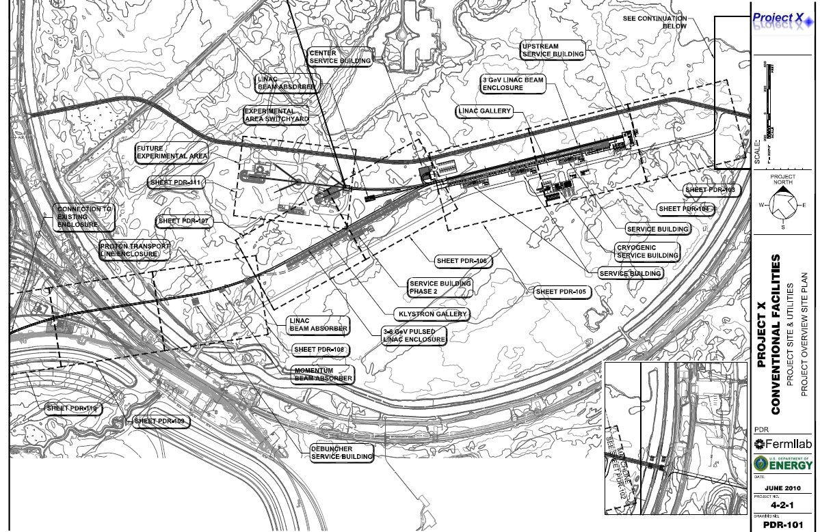
Project X Reference Design
Siting

Slide 12
Reference Design: CW Linac Technologies
β=0.11
β=0.22
β=0.4
β=0.61
β=0.9
β=1.0
325 MHz SSR
2.5-160 MeV
650 MHz Elliptical 0.16-2 GeV
1.3 GHz Elliptical 2-3 GeV
Section | Freq | Energy (MeV) | Cav/mag/CM | Type
SSR0 (β_{G}=0.11) | 325 | 2.5-10 | 26 /26/1 | SSR, solenoid
SSR1 (β_{G}=0.22) | 325 | 10-32 | 18 /18/ 2 | SSR, solenoid
SSR2 (β_{G}=0.4) | 325 | 32-160 | 44 /22/4 | SSR, solenoid
LB 650 (β_{G}=0.61) | 650 | 160-520 | 42 /42/7 | 5-cell elliptical, doublet
HB 650 (β_{G}=0.9) | 650 | 520-2000 | 96 /24/12 | 5-cell elliptical, doublet
ILC 1.3 (β_{G}=1.0) | 1300 | 2000-3000 | 72 /9 /9 | 9-cell elliptical, quad
Expect to continue with 650
Notes:
I would suggest that you point out that Indian DAE labratories are already working on SSR1, 650 and ILC cavities.

Slide 13
Pulsed Linac
Superconducting pulsed linac for acceleration from 3 to 8 GeV
ILC style cavities and cryomodules
  1.3 GHZ, β=1.0
ILC style rf system
  5 MW klystron
  Four cryomodules per rf source
Must deliver 26 mA-msec to the Recycler every 0.75 sec. Options:
  1 mA x 4.4 msec pulses at 10 Hz
    Six pulses required to load Recycler/Main Injector
  1 mA x 26 msec pulses at 10 Hz
    One pulse required to load Main Injector

Slide 14
Collaboration
A multi-institutional collaboration has been established to execute the Project X RD&D Program.
  Organized as a “national project with international participation”
    Fermilab as lead laboratory
    International participation via in-kind contributions, established through bi-lateral MOUs.
  Collaboration MOUs for the RD&D phase outlines basic goals, and the means of organizing and executing the work. Signatories:
  ANL ORNL/SNS BARC/Mumbai
  BNL MSU IUAC/Delhi
  Cornell TJNAF RRCAT/Indore
  Fermilab SLAC VECC/Kolkata
  LBNL ILC/ART
It would be natural for collaborators to continue their areas of responsibility into the construction phase.
Notes:
Spelling of Kolkata. Put IIFC as a sub-bullet

Slide 15
Current Institutional Responsibilities
 | Front End | Cav & CMs | RF | Cryo | Instru | Cntrls | MI/Recycler | Beam Trnspt | Accel Phys | Systm Integ | Test Facil
ANL |  | X | X |  |  |  |  |  | X
BNL |  | X |  |  |  |  |  | X
Cornell |  | X |  |  |  |  | X
Fermilab | X | X | X | X | X | X | X | X | X | X | X
LBNL | X |  |  |  | X |  |  |  | X
SNS |  |  |  |  | X
MSU |  | X
TJNAF |  | X
SLAC | X |  | X |  |  |  | X |  | X |  | X
ILC/ART |  | X
BARC | X | X | X | X | X |  |  |  | X |  | X
IUAC |  | X |  | X
RRCAT |  | X | X | X |  |  |  |  |  |  | X
VECC |  | X |  | X

Slide 16
RDR Cost Methodology
Same methodology as previous IC-1 and IC-2 estimates
  Base estimate of direct costs based on 2010 dollars
      Bottoms up estimates from technical leads
      Use or scale IC-1/2 estimates where appropriate
      Includes spare components
      Includes R&D
      FNAL labor rates (13 categories)
  Full estimate derived from base
      FNAL standard overhead rates
      Construction over FY15-19
      DOE Escalation rates
      Contingency (40% top down)
      Time phased RD&D + construction model in two ~500 line MS Projects
16
Notes:
16

Slide 17
Project X Base/Total Estimates
Full Estimate, $Then-year$
Three estimates, with differing scopes
  IC-1 $1,500M
    8 GeV pulsed linac + Recycler/MI
    Limited capabilities for rare processes
  IC-2 $1,600M
    2 GeV CW linac + 2-8 GeV RCS + Recycler/MI
    2 GeV too low for rare processes (Kaons)
    Ineffective platform for Neutrino Factory or Muon Collider
  RDR: $1,800M
    3 GeV CW linac + 3-8 pulsed linac + Recycler/MI
    Ameliorates above deficiencies
17
Notes:
17

Slide 18
Cost Comparisons
RDR is 20% higher than IC-1, 13% higher than IC-2
  3.4% is an additional year’s escalation
  7.3% is in the cryo systems
  3.0% is the rf systems
  4.7% is the R&D program
RDR full estimate in $FY10$ is ~$1.5B
18
Notes:
18

Slide 19
Cost Range
Cost of 3-8 GeV acceleration
  $302 M with RCS
  $420 M with pulsed linac
Direct injection into MI at 6 GeV
  3-6 GeV Pulsed linac
  Requires solution for injection of 26 msec H- pulse
  $305 M for pulsed linac (net Recycler)
Bottom Line: Could save ~$115M by either:
  Substitute RCS for 3-8 GeV pulsed linac; or
  Direct inject into Main Injector at 6 GeV with pulsed linac
Preference is to retain the pulsed linac as it provides much better platform for muon based facilities, and leverages world-wide technology development

Slide 20
Strategy/Timeline
November: Finalize all preliminary design, configuration, and cost range documentation for CD-0.
  Functional Requirements Specification
  Reference Design Report
  RD&D Plan
  Cost estimate/range
  Resource Loaded Schedulee
Deliverables: Next four years
  All documentation required by the Department of Energy prior to authorizing construction
  Supporting technical R&D required to validate the design and establish fabrication methods
Assumed Critical Decision dates
  CD-0: January 2011
  CD-1: July 2012
  CD-2: August 2013
  CD-3: September 2014
  CD-4: September 2019
Project X could be up and running in ~2020
Notes:
You should verbally say how much is the total expense in Project-X and SRF R&D. If I add everything up it will be close to $0.5B (2005-2015)

Slide 21
Summary
Project X will enable a world-leading accelerator based HEP program at Fermilab for decades
The Project X Reference Design as established over the last year provides capabilities that will be unique in the world
  2 MW to the neutrino program over 60-120 GeV
  3 MW to the rare processes program
  Flexible provision for variable beam formats to multiple users
  Technology aligned with ILC and NF/MC
The Reference Design cost range is $1.7-1.8B
  20% increase over IC-1
    Some of this is inflation
    Most is related to increased costs associated with a high power, CW linac
  Assumes construction over FY2015-2019
  Does not account for in-kind international contributions
We are ready for CD-0

Slide 22
Backup Slides

Slide 23
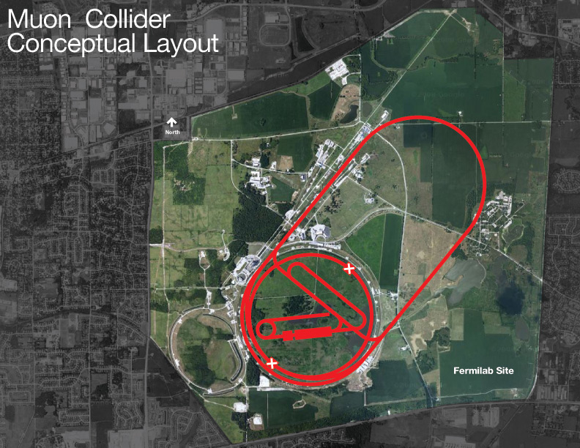
PX/NF/MC Strategy
Project X shares many features with the proton driver required for a Neutrino Factory or Muon Collider
  NF and MC require ~4 MW @
  10± 5 GeV
  Primary issues are related to
  beam “format”
    NF wants proton beam on
    target consolidated in a few
    bunches; Muon Collider requires
    single bunch
  Project X linac is not capable of
  delivering this format
It is inevitable that a new ring(s) will be required to produce the correct beam format for targeting.

Slide 24
Benchmarks
Cavity/Cryomodule costs
  JLab
  ILC R&D
Cryogenic costs
  SNS
  JLab
RF costs
  $/watt
Conventional
  Means + recent Fermilab experience

Slide 25
International Governance
Organizing Principles
DOE and Fermilab hold sole responsibility for delivery of the facility and subsequent operations.
  Supported by high level institutional board providing advice on establishing the international context, distribution of work, publicizing efforts, establishing operational modes, etc.
All international contributions should be in-kind.
All arrangements between Fermilab and international partners should be bi-lateral.
  Fermilab does not want to mediate interactions between foreign countries.
  Each deliverable should be the responsibility of a single country.
Each deliverable should have a Fermilab manager and a manager/point of contact from the corresponding country.
  Indian Institutes Fermilab Collaboration model
  No Fermilab sub-project manager should be coordinating with more than one country.

Slide 26
Loaded, Escalated, Contingency
FNAL Std OH on SWF and M&S, incl. large procurements (~24%)
DOE Escalation Rate for Lab(14.6%)
Budget profile
Top Down Contingency (40%)
26
PX Briefing to OHEP
Notes:
26

Slide 27
Opportunities (Loaded Estimate)
Review FNAL Overheads, negotiate for direct project costs vs. lab services / support
  Current OH ~24%; comparison 12GeV / 6%+support; NSLS-II (10%); FRIB 10%+MSU$+zero on some items
Review Contingency
  Currently top down at 40%; some technical leads note this is very conservative for components available off the shelf
  Compare base numbers w/ data from JLab, XFEL…..
  Integration, Civil construction require large uncertainties
Utilize International Collaborations
27
PX Briefing to OHEP
Notes:
27

Slide 28
Opportunities (base estimate)
Value engineering on all aspects of Conventional Facilities design requirements
Value engineering and consolidation of RF designs
Continued studies on HE Linac cavities and cryomodules
  IC-1 Review pointed out HE Linac cryomodules could be ~300/400k$ less in qty (-18M$ (IC1), -7M$ (IC2))
  Review pressure ratings, 5K shield, HOM couplers, piezo tuners, …
Review of LE Linac cryomodules and consolidation of HE / LE cryomodule technical design criteria
  LE Linac cryomodules should have a similar target as HE Linac (-9M$)
Review of uncertainties in component heat loads and effect on cryogenic system
Overall development of consolidated beamline and instrumentation scheme
28
PX Briefing to OHEP
Notes:
28

