Slide 1
Transfer line from RR to P1 line for Mu2e Project
Meiqin Xiao
Nov 17, 2010

Slide 2
Outline
Overview
Design 1
Cartoon of the transfer line
Lattice functions matching
Matching parameters
3D plot of the transfer line
Design 2
Cartoon of the transfer line
Lattice functions matching
Matching parameters
3D plot of the transfer line
Kicker @RR near Q520B
Aperture checking
Lambertson
Vertical bending dipole
Summary

Slide 3
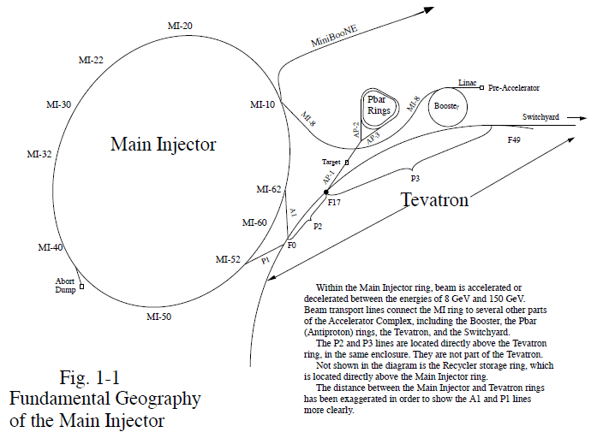
Overview the path of the beam transfer
--- The Mu2e project is planned to transfer the Booster beam not used by Nova into the Antiproton Source.

Slide 4
General thoughts of the design
The planes of injection/extraction
Horizontal kick and vertical bend: traditional kicker and Lambertson
Generic features for vertical bending
A: Only two bend centers needed but they
must be 360º apart.
Will be utilized for new transfer lines.
n*360
B: Procedure used for MI<-> Recycler transfers.
Requires 180º between two same sign bends
n*180
n*180
n = odd
Use Lambertson, Quads and bending magnets available in Nova’s infantry

Slide 5
Design 1: RR @Q522B→P150@Q705
Recycler
Q523
Q522
Q521
Q520
ODH Barrier
Q901
RRLAM
Q903
Q902
0.7364 m
HBend
Q904
P1 line
Q706
Q705
Q704
Q703
Q702
Q701
I:LAM52
Main Injector
VBend
C
B
A
Q527
Q526
Q525
Q524
Q523
V700
Q522
Q521
Q520
Twiss functions and the site coordinates
at the exit of Q522B in RR and at the entrance of Q705 in P150 line
 | α_{x} | β_{x} | D_{x} | dD_{x} | α_{y} | β_{y} | D_{y} | dD_{y}
Extraction point | 2.307 | 51.828 | 0.024 | 0.004 | -0.911 | 15.257 | 0 | 0
Injection point@150GeV | 0.530 | 11.699 | -0.398 | -0.021 | -1.858 | 47.591 | 0.589 | 0.024
 | x(East) [m] | y(North) [m] | z(Elevation) [m] | BRNG [deg] | PITCH [deg] | ROLL [deg]
Q522B | 31116.826516 | 29471.113031 | 219.575544 | 131.20636 | 0 | 0
SQ705U | 31064.68059 | 29529.47085 | 218.8391336 | 133.35518 | 0.24167 | 0

Slide 6
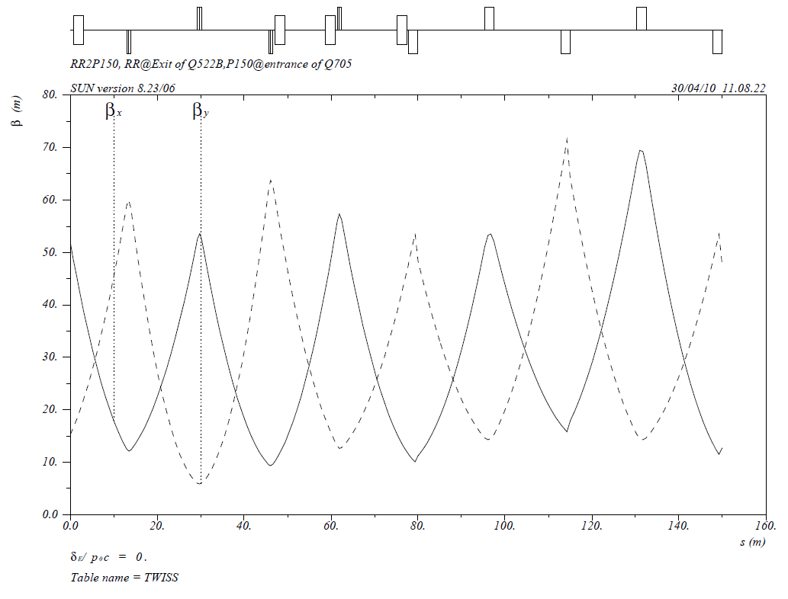
Design 1: Twiss functions match
HBEND
VUP2
RRLAM
Recycler
P150 Line

Slide 7
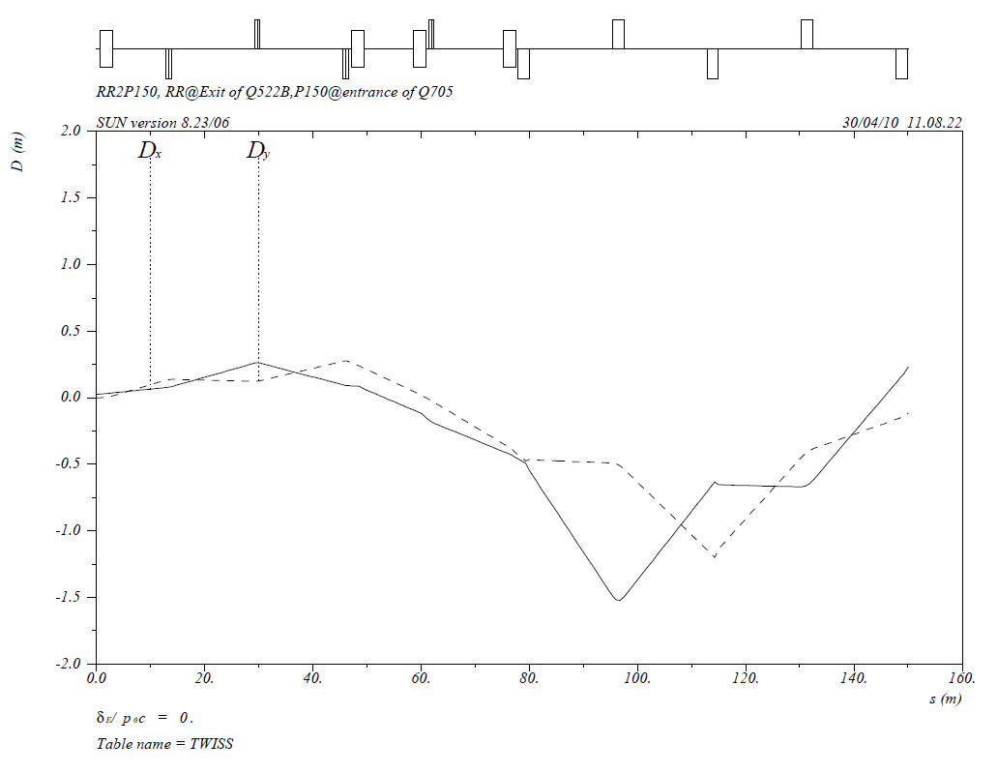
Design 1: Dispersion functions propagate
RRLAM
HBEND
VUP2
Recycler
P150 Line

Slide 8
Design 1: matching parameters

Slide 9
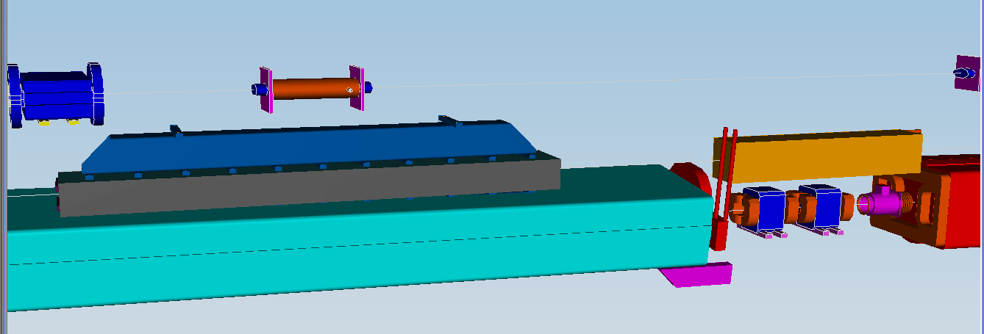
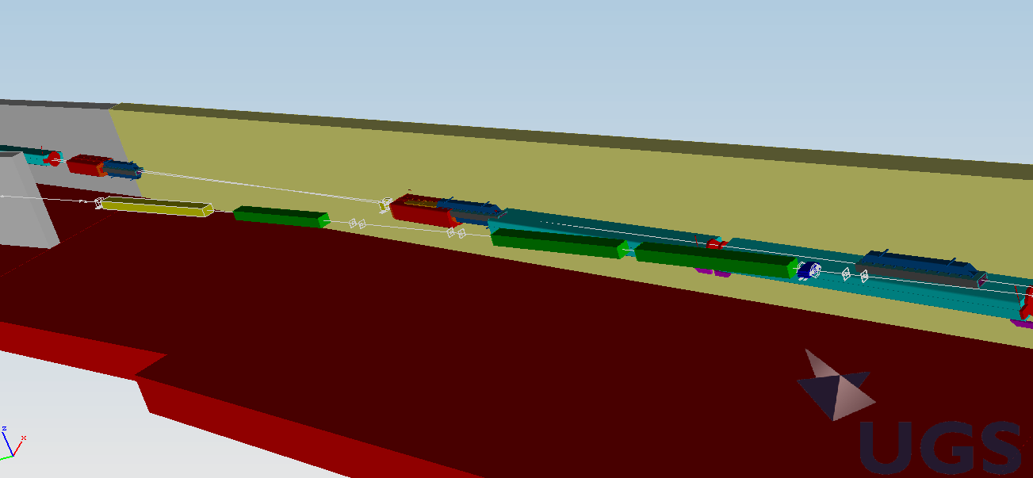
3D plot: RR to P150 line
RR Lamb @Q522B
Q901A,B
HBEND1
Q903A,B
Q705
VUP2
HBEND1
Q704

Slide 10
Design 2: : RR @Q522B→P150@Q703
Recycler
Q523
Q522
Q521
Q520
ODH Barrier
RRLAM
Q901
0.8242 m
Q902
P1 line
Q706
Q705
Q704
Q703
VUP2
Q702
Q701
I:LAM52
Main Injector
C
B
A
Q527
Q526
Q525
Q524
Q523
V700
Q522
Q521
Q520
Twiss functions and the site coordinates
at the exit of Q522B in RR and at the entrance of Q705 in P150 line
 | α_{x} | Β_{x}(m) | D_{x}(m) | dD_{x} | α_{y} | β_{y}(m) | D_{y}(m) | dD_{y}
Extraction point | 2.307 | 51.828 | 0.024 | 0.004 | -0.911 | 15.257 | 0 | 0
Injection point@150GeV | 0.618 | 11.115 | 0.013 | 0.001 | -2.915 | 66.278 | -0.043 | 0.007
 | x(East) [m] | y(North) [m] | z(Elevation) [m] | BRNG [deg] | PITCH [deg] | ROLL [deg]
Q522B | 31116.826516 | 29471.113031 | 219.575544 | 131.20636 | 0 | 0
SQ703U | 31088.24757 | 29503.6478 | 218.751311 | 131.20619 | 0.1885 | 0

Slide 11
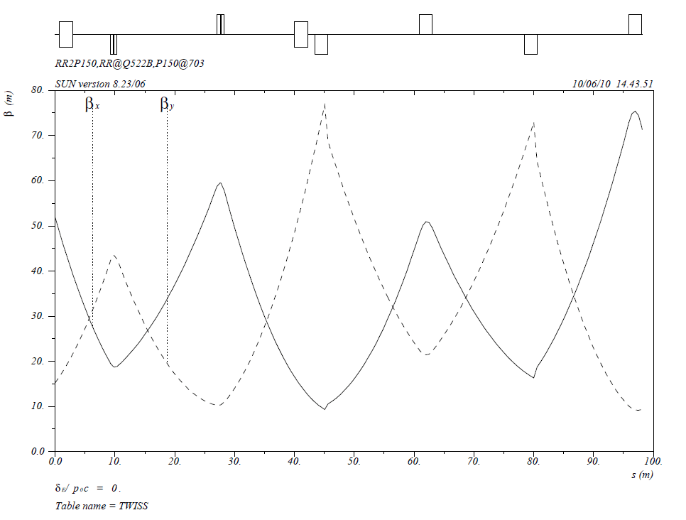
Design 2: Twiss functions match
RRLAM
VUP2
Q703
Q705
Q704
P150 Line

Slide 12
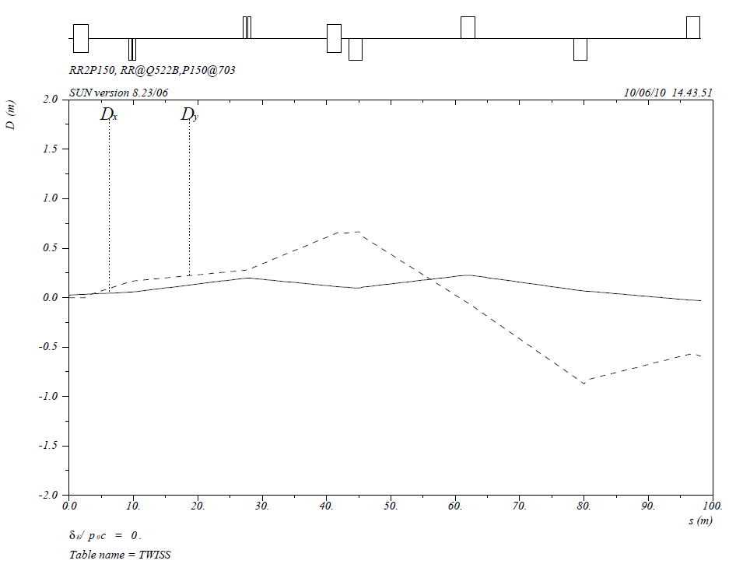
Design 1: Dispersion functions propagate
RRLAM
VUP2
Q703
Q705
Recycler
P150 Line
Q704

Slide 13
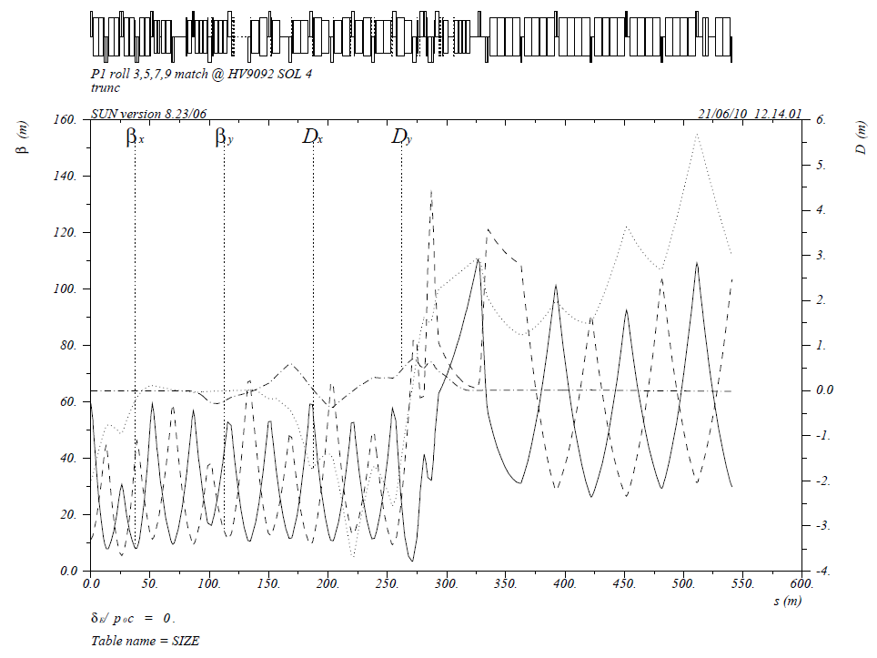
Lattice function @Existing P1 line@150GeV
Q703
Q705

Slide 14
Design 2: matching parameters

Slide 15
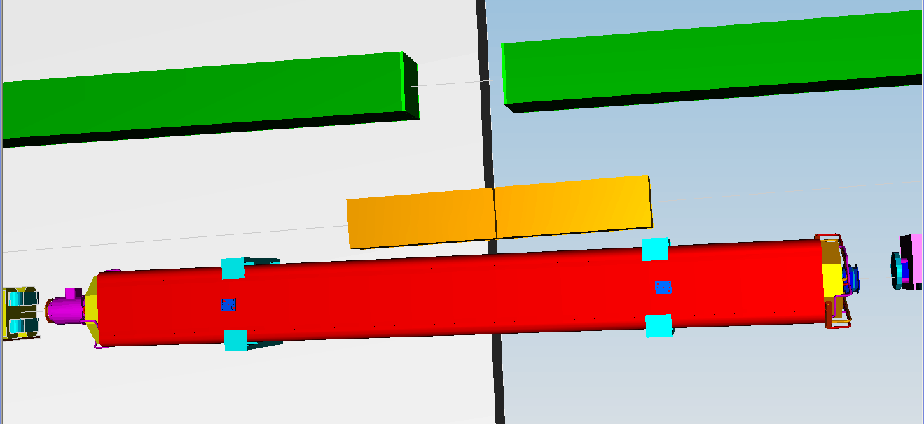
3D plot: RR to P150 line @Q703
RRLAM
RR:Q522B
Q902A,B
Q901A,B
VUP2
P150 line:Q703
P150 line:Q702

Slide 16
2D project view for the line of RR to P150 line @Q703
Q901B&A
0.25m
Q902B&A
Further adjustment has been done:
Move group Q901A & Q901B downstream and Q902A and Q902B upstream 0.25m, so that increased the distance between the magnet Q901A and vacuum pine in Recycler ring, Minimun distance: 1.75”/2 (Recycler beam tube in vertical is 1.75”). Gain about 1.29”, and totally the distance is now about 3.17”.
Also increased is distance between Q902B and the magnet Q525 in P150 line.

Slide 17
Kicker@RR Q520B
Similar to the kicker design for Nova @R232
the bump size at RR lambertson is +25 mm
the separation of the center orbits at the lambertson between circulate beam and the extracted beam is 50 mm.
Borrow the same kicker module used in Nova, the kicker strength obtained is:
K522B_ang=-1.317214E-03
It is equivalent to: K522B_ang*(Bρ)=390.563 Gaussian/m
Just for the reference, the RR extraction kicker for Nova at 232 is 358 Guassian/m

Slide 18
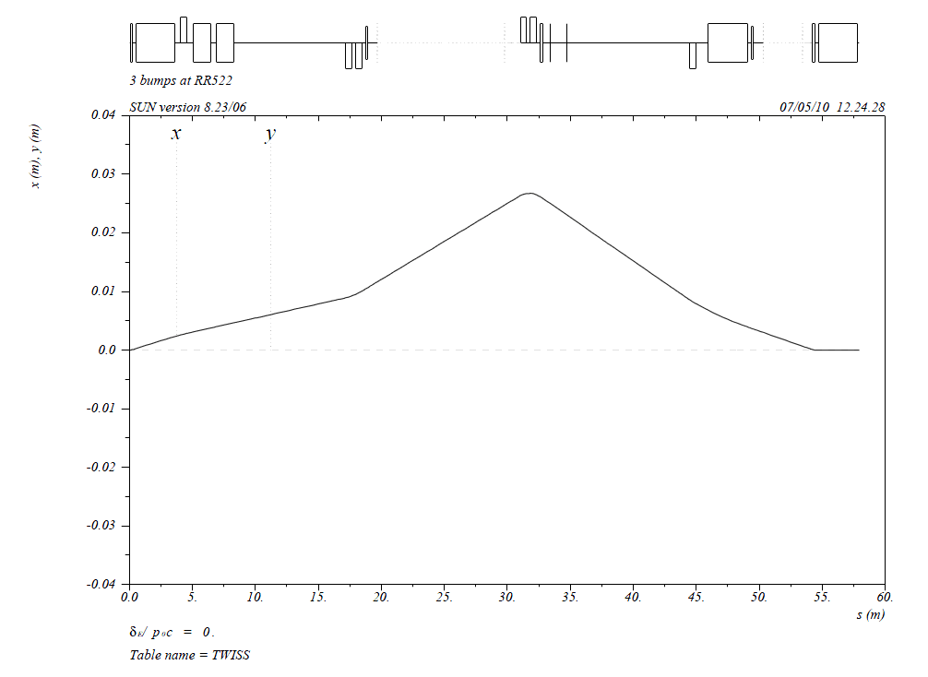
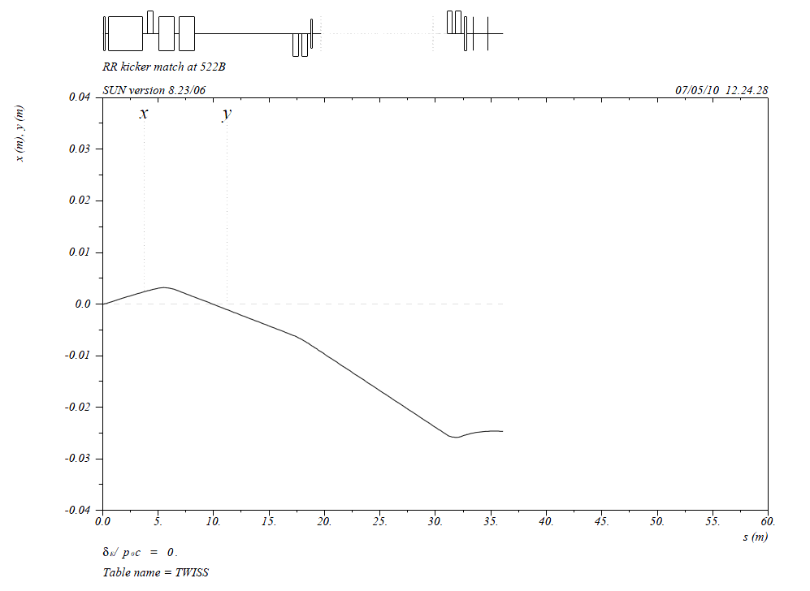
H520
Kicker model 1 & 2
H522
RRLAM
H524
+25 mm
at the entrance
of the Lamb
Circulating trajectory
(closed orbit bump)
H520
H522
RRLAM
Extraction trajectory
(starting at H520)
-25 mm
at the entrance
of the Lamb

Slide 19
Beam size at Recycler lambertson
Beam size at lambertson:
σ_{x}=3.518mm
σ_{y}=2.627mm
6σ=21.11mmx15.76mm (Red dash line)
10σ=35.18mmx26.27mm (Blue solid line)
75mm dia round through quads
Beam pipe(V):44.45mm
25mm
bump
25mm offset
50mm sq
Septum
5mm
Recycler center line
Beam pipe(H):95.25mm

Slide 20
Available aperture at B1_5FT bending magnet
take the modified B1_5Ft (1.524m long)
for vertical bending
The bending strength could be up to :
51.48 mrad
The bending strength required:
20.996 mrad
the sagitta is 1.524*0.021/2=16.0mm
The physical aperture is
1.27"x4.77“(32.258mmx121.158mm)
The beam size at this location is: 1.989mmx4.377mm
The acceptance is:
Horizontal: 32.258/1.989=16.2*σ_{x} Vertical: (121.158-16.0)/4.377=24.0*σ_{y}
y
Eixt
x
B1_5FT
D=L*tan(0.021)
=1.524*0.021/2
=0.016m
Entrance

Slide 21
Elements for cost evaluations (1)
Element | Requirement
Kicker (The same as Cleanup kicker for Nova) | Angle: 1.317 mrad,(0.391 kG-m integrated field). Need bending the beam outside of the RR, B-field is also up Orientation: Horizontal Location: Center of kicker is 2.769 m “Down Stream” MRK 520(proton direction) Physical and field aperture: 33 mm VX 81 mm H elliptical shape Field Flattop time 1. 534 µs (81 52.809 MHz buckets) Field Rise Time 57 ns maximum Field Fall time 57 ns maximum Flattop ripple and tilt +/- 4% Flattop repeatability +/- 3% Max kick to circulating beam +/- 3% of nominal Physical beam line space Distance to be determined Vacuum < 10⁻⁸ Torr, 6" Conflat flange, install bellows down stream end. Power Supply & Cooling Location MI-52 (new service building?) Number of injection per cycle 12 Time between transfers .067 seconds Time between machine loads 1.33 seconds
Lambertson | Bending angle: 20.996 mrad, (6.225 kG-m integrated field), (8 GeV injection Lambertson, L=2.286m, aperture: 120mm(H), 44mm(V) Roll angle : 2.7º Power supply: DC
V-bending dipole | Bending angle: 20.996 mrad, (6.225 kG-m integrated field) ADCW (modified B1 style to open aperture) Roll angle: 3.97º Powwe Supply: DC

Slide 22
Elements for cost evaluations (2)
Elements | Requirements
Quads | 4 permanent RR type, +/- 10% standard strength. 4 trim quads for +/- 20% adjustable ability, power supply : DC
BPMs | 2 Horizontal and 2 vertical 8 GeV style BPM 4" aperture
Correctors | 1 Horizontal and 1 vertical, power supply:DC
Loss monitors | 2
Multiwires | 2

Slide 23
Summary
Preliminary design was done.
Site coordinates were fitted in detail from RR to P150 line @Q703
3D models have been constructed for the transfer line to make sure there are no magnet interferences with the other beam lines.
Apertures have be checked.
Survey/Stakeout file can be generated for Survey group if needed.

