Slide 1
Mu2e RF Systems
17 Nov 2010
David Peterson

Slide 2
Mu2e Beam Time Structure
σ < 40 ns
150 ns
Mu2e experiment requires very narrow beam pulses that are separated by a time interval that is ~ 2×864 nsec (twice the μ⁻ lifetime in Al)
The narrow pulses are formed by 2.5 MHz RF manipulations in the Accumulator and Debuncher rings.
These RF systems require high voltages (~100 kV) for long time intervals (~100 – 400 msec)
Extinguish the beam in here to the 10⁻¹⁰ level.
t
1.7 μs
Debuncher revolution period
Requirement: ~2×864 ns
From S. Werkema

Slide 3
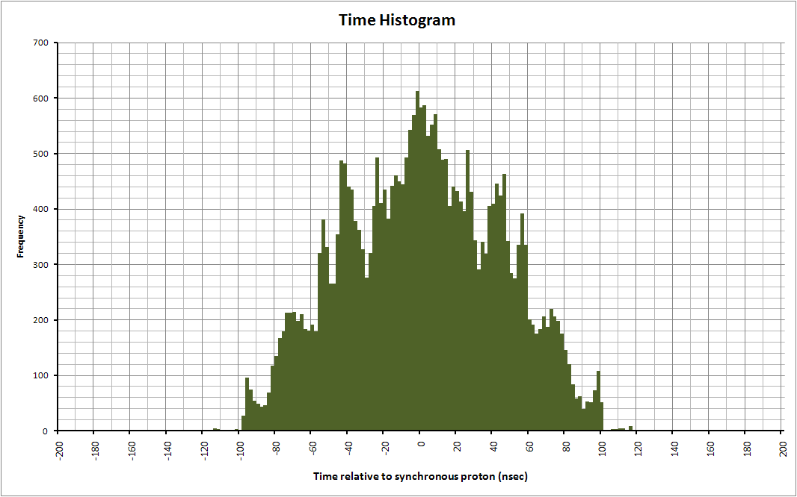
Mu2e Bunch Formation
RF Tracking Simulation
Beam pulse after 2.5 MHz RF manipulations
2.5 MHz Flat-top: 60 kV
Barrier Bucket volts: 10 kV
30,000 protons tracked for 200 msec
ΔE (MeV)
φ (deg)
σ_{t}
Width (nsec / MeV)
σ_{E}
t (msec)
From S. Werkema

Slide 4
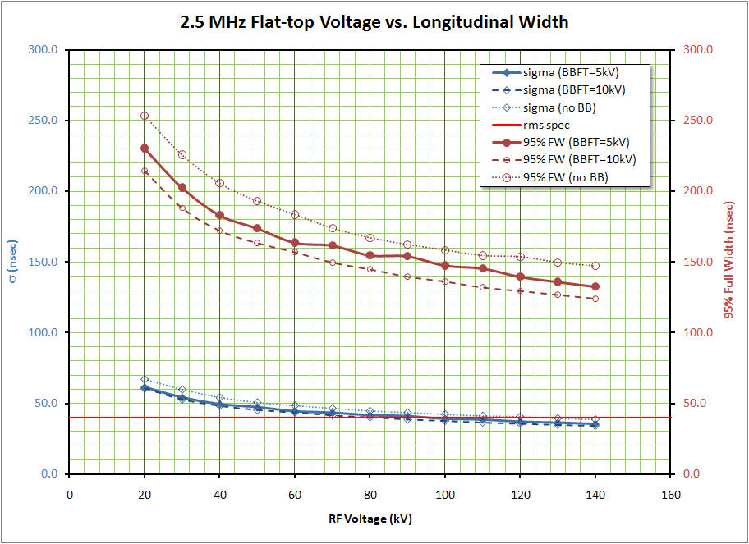
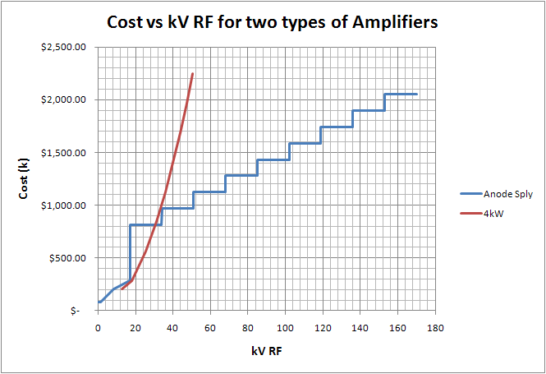
Mu2e Bunch Formation
Steve Werkema
Dave Peterson Mu2e-doc-1111
The resulting pulse width gets smaller with increasing RF voltage. Increases in RF voltage are very expensive (~$10 k/kV).

Slide 5
RF Requirements
Accumulator 53 MHz, H=84 : 100 kV, 100%
Accumulator 2.5 MHz, H=4 : 100 kV, 100%
Debuncher 2.5 MHz, H=4 : 100 kV, 100%
Bunch Narrowing, 5 MHz & 7.5 MHz :10kV each
Studies : Same systems, Lower voltage

Slide 6
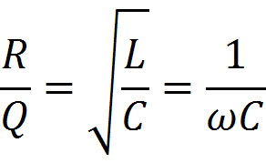
Cavity Design Considerations
Desirable to have low R/Q for stability
ARF4 R/Q = 166Ω
MI = 106Ω
NOvA = 14Ω

Slide 7
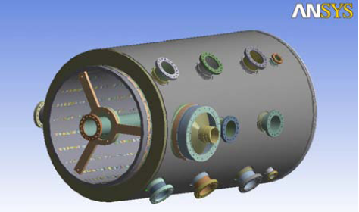
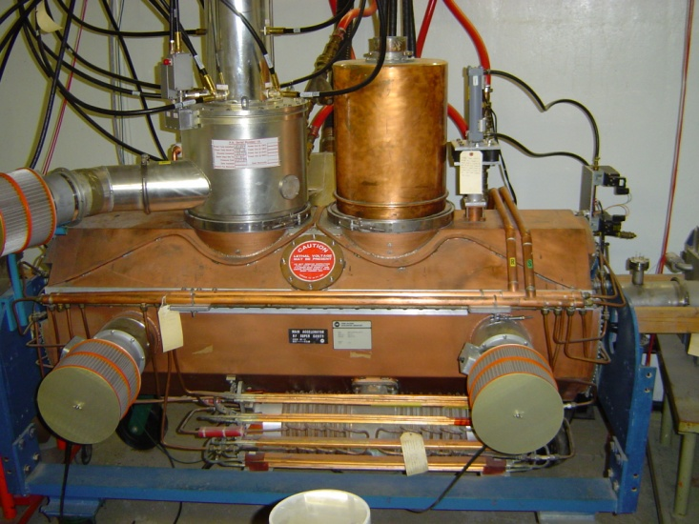
53 MHz Cavity
100 kV
Prefer Rs <84 kΩ means Power >60kW
NOνA style?
Or
Modified MI style?
Higher R/Q
Older but proven technology
Dissipation concerns

Slide 8
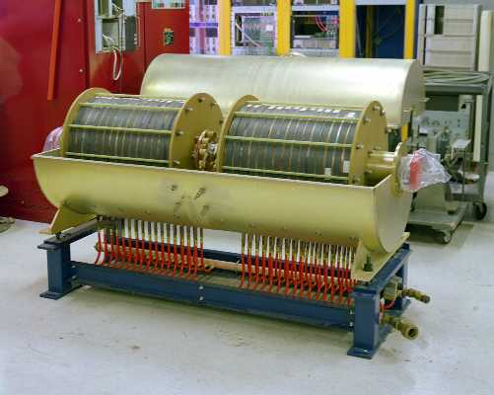
2.5 MHz Cavities
Air Cooled MI Cavity
Also can learn from Brookhaven AGS and KEK.
Water Cooled Accumulator Cavity

Slide 9
2.5 MHz Cavity Considerations
100kV for each system.
125 kW for each system. (Assuming active feedback factor of 10 or better.)
Philips Ferroxcube 4M2 Ferrites, 28 to 34 per cavity.
CPI Y567B Tetrodes (a.k.a. special 4CW150,000E)
Experience in Pbar and Main Ring points to upper voltage limit of ~17kV per cavity.
Reducing R/Q means less ferrite, more power and more current. Roll-off could occur at lower voltage.
Ferrite rings are dominant cost.
Water cooling will be needed. Thermal analysis is important.

Slide 10
Ferrite Performance

Slide 11
Ferrite Specifications

Slide 12
Ferrite Specifications cont’d

Slide 14
Alternative
Finemet RF Cavity
with Amplifier
Very low Q

Slide 15
Active Feedback
A 53MHz feedback example with 10λ each way to the cavity and back
In use on Main Injector cavities. Gain and stability depend on Q and delay.
Factors of 10 are straightforward, factors of 100 are achievable.

Slide 16
Low Level RF
Hardware
High Speed FPGA based
I/O channels for each cavity
RF pickup from cavity gaps and wall current monitor
Features
Active feedback for impedance reduction
Coupled bunch mode damping
Local Beam Synch generation
Momentum Stacking curves
Bucket-to-Bucket Acc-Deb transfer with phase hop
Cavity Tuning Control

Slide 17
Alternatives
Accumulator / Debuncher RF alternatives
Higher voltage flat-top in Accumulator
Higher RF voltage is more expensive
A much higher (~150 kV) voltage would cause a beam momentum spread approaching the momentum aperture of the Accumulator and A-D beamline
Bunch narrowing ramp in Debuncher
More momentum aperture available
Higher voltage more expensive
Larger momentum spread increases beam tune spread via chromaticity – this complicates resonant extraction
Capture with higher harmonic in Debuncher
Higher harmonic number → narrower bucket for same voltage → narrower beam
Requires that h=4 bunches from the Accumulator be sufficiently narrow to fit in higher frequency bucket. Any beam not captured will go to the tails of the beam time distribution causing higher extinction beam loss.
NOTE: a higher harmonic system in the Accumulator is precluded by the achievable rise and fall times for the Accumulator extraction kicker.

Slide 18
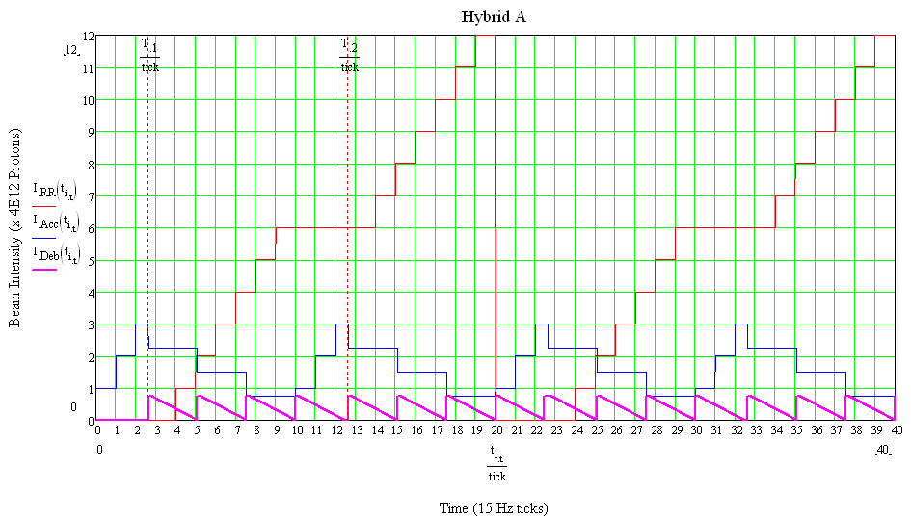
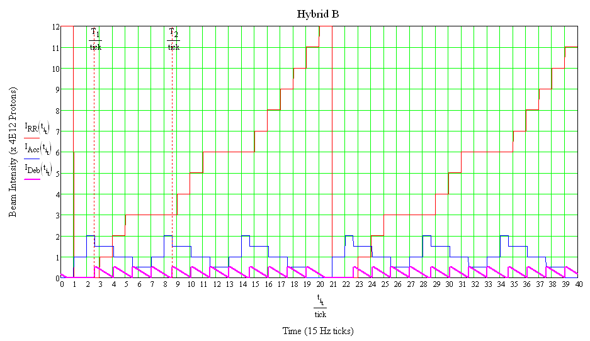
Alternatives
Accumulator / Debuncher RF alternatives (continued)
Stacking fewer proton batches prior to bunch formation yields narrower bunches
Stacking 2 batches lowers duty factor (~15%) and increases instantaneous intensity on target (~18%)
Stacking only one batch would likely lower the integrated intensity delivered to Mu2e
Operating scenarios have been developed that allow the stacking of 3 batches or 2 batches
Stack 3 Booster batches – 92% duty factor
Stack 2 Booster batches – 78% duty factor
Recycler
Debuncher
Accumulator

Slide 19
References
J.Dey et al, “A New RF system for bunch coalescing in the Fermilab Main Ring.”, Proceedings of PAC, 1996. accelconf.web.cern.ch/accelconf/p95/ARTICLES/WPP/WPP08.PDF
J.Dey and J.Steimel, “Improving the linearity of ferrite loaded cavities using feedback”, PAC2001
C. Ader and D.W. Wildman, “Design Methodology and Considerations for Nova 53 MHz RF Cavities”, FERMILAB-CONF-10-142-AD
http://lss.fnal.gov/archive/2010/conf/fermilab-conf-10-142-ad.pdf
Heba Elnaiem, “Prototype NOvA RF Cavity for the Fermilab Recycler Ring”, NOVA Document 4421
J. Griffin et al, PD Design Report, Ch5, RF Systems,
http://www-bd.fnal.gov/pdriver/oldpdriver/designreport/ch05.pdf
John Reid, MI RF Upgrade, Proton Driver Director’s Review, 2005
tdserver1.fnal.gov/presentations/PD_DIR...05.../PD_DIR_REV_Reid.ppt

