Slide 1
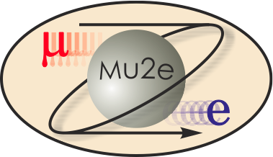
Debuncher and Accumulator Beam Abort Systems
Pre CD-1 Internal Review
11/17/2010
Jim Morgan, L3 Storage Rings Manager
Brian Drendel, L3 Storage Rings Deputy

Slide 2
Debuncher and Accumulator Beam Aborts
Debuncher
Requirements
Beam line
Dump
Accumulator
Requirements
Beam line and dump
Base plan: Accumulator abort at A50 or A30.
Option: Send beam to the Debuncher and then to the Debuncher abort.

Slide 3
Debuncher Dump Requirements
The Mu2e Debuncher beam abort will have two modes of operation.
It will be fired at the end of every beam cycle in the Debuncher to “clean-up” beam not resonantly extracted.
Removes beam anytime that the beam permit is dropped.

Slide 4
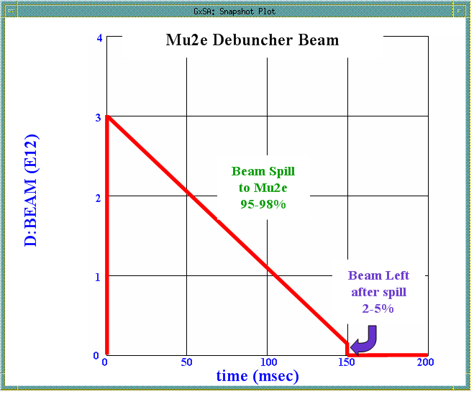
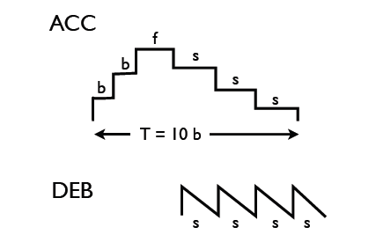
Debuncher Leftover Beam
Bunch
Formation
4E12
3E12
4E12
3E12
3E12
4E12
3E12
Ten 15Hz Booster Cycles
3E12
3E12
3E12
3E12
4 spill cycles
Beam leftover after each Debuncher spill cycle needs to be sent to an abort
In a 1.33 second Nova cycle, there are eight iterations of 3.0eE12 8GeV protons being injected into the Debuncher and resonantly extracted to the Mu2e experiment.
It is assumed that 95-98% of the beam will be successfully spilled each cycle
The remaining 2-5% of the beam (5% would be 9.0E11 protons/sec) needs to be sent to a beam abort.

Slide 5
Lost Beam Permit
We also need to send beam to the Debuncher abort when there is a permit trip.
There is a finite amount of time needed to reset an abort trip.
Experience with Booster and MiniBooNE shows us that we would never expect more than one permit trip per minute.
In this case the abort would need to be able to take the entire injected Debuncher beam intensity (3.0E12).
3.0E12 protons/minute or 5E10 protons/sec.

Slide 6
Beam Intensity Requirements
Per Pulse Rate
3E12 protons/pulse
Peak Rate
1.8E13 protons/sec
Sustained rate (5% of 4.0E20)
2.0E19 protons/year.

Slide 7
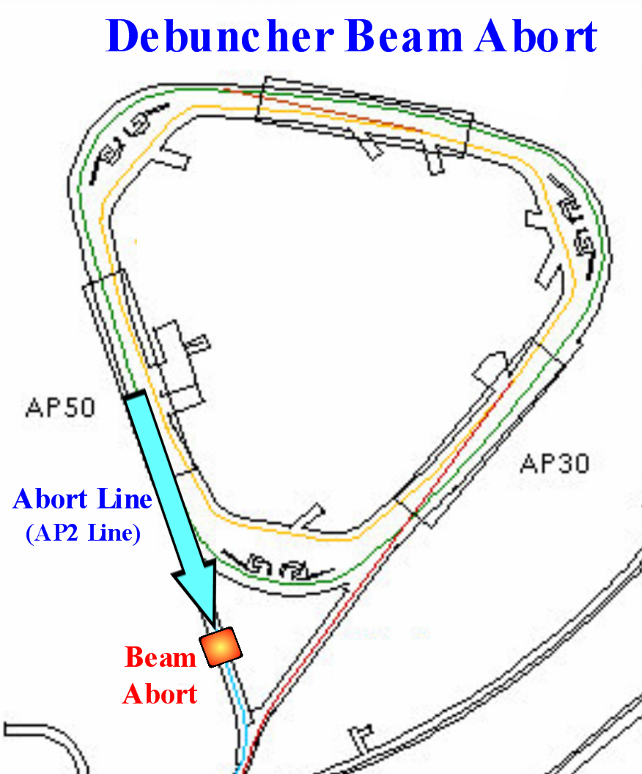
Location of Debuncher Beam Abort
Use the existing AP-2 line for the Debuncher Beam Abort
The AP-2 line is not used for Mu2e.
The AP-2 line connects to the Debuncher in the correct direction to abort circulating Mu2e Debuncher beam.

Slide 8
Debuncher Abort Kicker & Septum
Debuncher Abort Kicker
Use the existing three D:IKIK kicker modules to provide 6.1mr kick needed to get into the field region of the injection septum
Beam is mostly contained in a single short 2.5MHz bunch, so a relatively slow 400nsec rise and fall time should be sufficient.
The flattop of the kicker needs to be at least 1.68 usec long to remove any beam that is not in the central bunch.
Kicker has to cycle at 7.5Hz.
“Accumulator and Debuncher Kickers” portion of this review has more details.
150 ns
t
1.7 μs
Debuncher revolution period
Debuncher Abort Septum
Will need to operate at 7.5Hz.
Booster septum design will be used.

Slide 9
AP-2 Line Optics
Keeping optics the same at the beginning of the line avoids power supply or magnet changes.
First 40m of the line is very congested.
IQ24 to IQ29 has lots of open areas for abort line and dump.
Add a vertical bend, ABV1, just upstream of IQ28.
Betas small to avoid unnecessary losses
Not too far upstream of F quad IQ28.

Slide 10
Debuncher Abort Beam Line
ABV1 bends the beam 3° (52mr) downward to the dump. We can use either a wide gap B1 (like IBV1) or a wide gap SDE (like EB6).
ABV1 can be rolled ~20° or a separate horizontal bend added to bend beam toward the horizontal center for enclosure
AQ1 is a “D” quad roughly at the mid-point in the line. Could move IQ27 over (if not needed for g-2).
AHT1 and AVT1 are horizontal and vertical trim magnets used to steer the beam in the line
Beam dump is about 30m downstream between IQ25 and IQ24
Diagnostics added to line to monitor the beam line (SEM, Toroid, BPMs, BLMs, thermocouples, etc..).
Existing shielding will need to be removed between IQ27 and IQ26.
If g-2 is approved ABV1 we would use SDE wide-gap, with an oversized beam pipe attaching to the two beam lines on the downstream end.

Slide 11
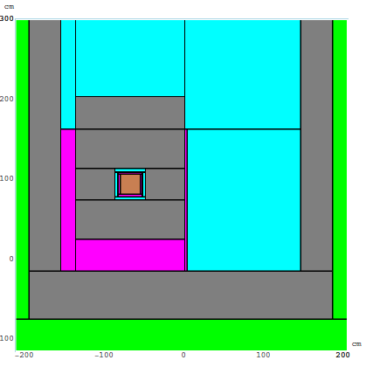
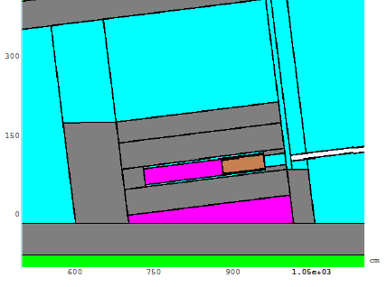
Designing the Dump
We will base the design of our dump on the existing Booster MI-8 Line dump.
The Booster sits on the floor of the MI-8 enclosure against the tunnel wall.
The dump has a steel core surrounded by concrete and steel shielding.
A graphite block is placed in front of the steel to address thermal issues.
Additional steel and concrete shielding was put in place to stay within ground water, surface water and air activation limits.
I. Rakhno (FERMILAB-TM-2340-AD) showed that addition of a minimal amount of shielding to the MI-8 dump increased the allowed beam from 3E18 protons/year to 5E18 protons/year .
Air
Graphite
Steel
Concrete
Soil

Slide 12
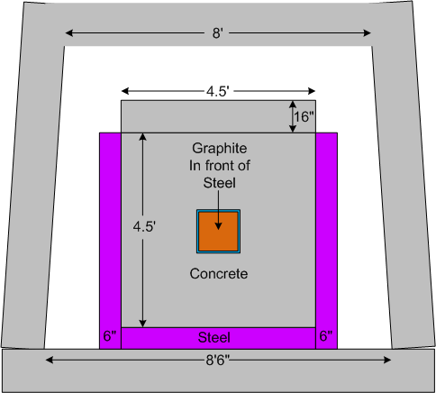
AP-2 Line Dump
Tunnel enclosure is 8’6” wide at floor level and 8’ at ceiling level.
A beam dump of the size of the MI-8 fits nicely in the AP-2 line with space on all sides for additional shielding.
Shielding could be expanded to make a shielding wall and block passageway to transport.
A gap for beam pipe would need to be left in the top of the shielding to allow a beam pipe if g-2 operations.

Slide 13
Comparing MI-8 and Mu2e Dumps
Specification | MI-8 Dump | Mu2e Debuncher Dump
Peak Beam Intensity (protons/pulse) | 7x10¹² | 3x10¹²
Maximum Beam Intensity (protons/year) | 6.8x10¹⁸ | 2.0x10¹⁹
Mu2e Dump advantages
Moving dump to the center of the enclosure, maximizes the amount of shielding that we can add.
Lots of room for additional shielding on all sides of the dump.
Could stack shielding from wall to wall and floor to ceiling if necessary.

Slide 14
Accumulator Abort Requirements
The Accumulator abort will only be used when the permit drops.
Peak Rate: Over short periods the worst case scenario would have the permit dropping once per minute and would need to be able to handle the full intensity of all three booster batches injected.
3 * (4E12 protons) / 60 seconds = 2E11 protons/sec
Average Rate: Over the course of a day we would expect permit trips on the order of 10-100 times. For a day with 100 trips with 80% uptime
3 * (4E12 protons) * 100 * 0.8 = 9.6 E14 protons/day or 3.5E17 protons/year.
This number is two orders of magnitude smaller than the Debuncher abort.

Slide 15
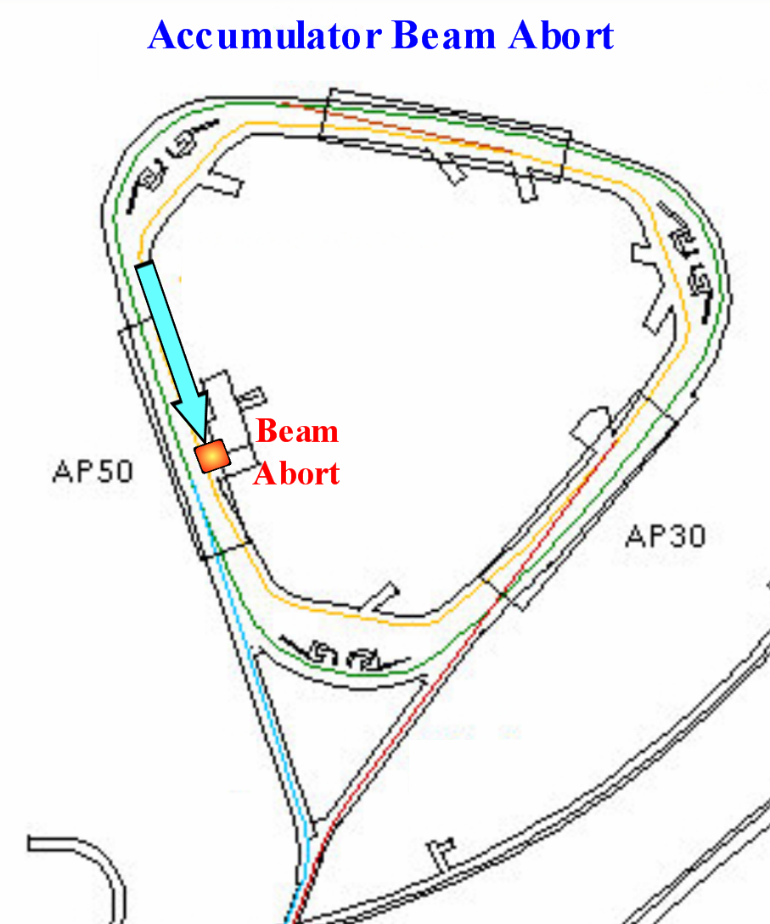
Accumulator Beam Abort
The base plan is to place the Accumulator abort in one of the long straight sections.
The abort could be placed in either in A30 or A50, but not A10 due to a space conflict with the Accumulator extraction septa.
Here we show the abort in A50.
In this scenario, a kicker and septum combination would both bend the beam down to a beam dump located in the A50 pit.
Kicker and septum magnets and power supplies could be repurposed from systems currently in use.

Slide 16
Separate Dump at A50
Three kicker modules located between A5Q4 and A5B3 would provide a 4mr kick downward to the beam.
Beam enters the field region of a septum downstream of A5Q1.
A c-magnet and diplole further bend beam down to a dump at the end of the A50 pit.

Slide 17
Technical Challenges
Not enough room to easily bend beam enough vertically downward into the pit.
The beam exiting the septum would have a displacement of about 80mm and an angle of 45-50mr (combination of residual angle and septum bend).
To get beam below floor level a c-magnet and dipole would be added.
There is not enough room for the beam dump to be very long, so this may not be practical.
Competition with space for RF.
If the Accumuator RF is located in A50, there will not be enough space to locate the abort line at this location.
In this case mirror symmetry of the lattice would allow us to locate the dump in A30.
Since there is no pit in that location, the dump would be at floor level and as a result the c-magnet and extra dipole could be eliminated.

Slide 18
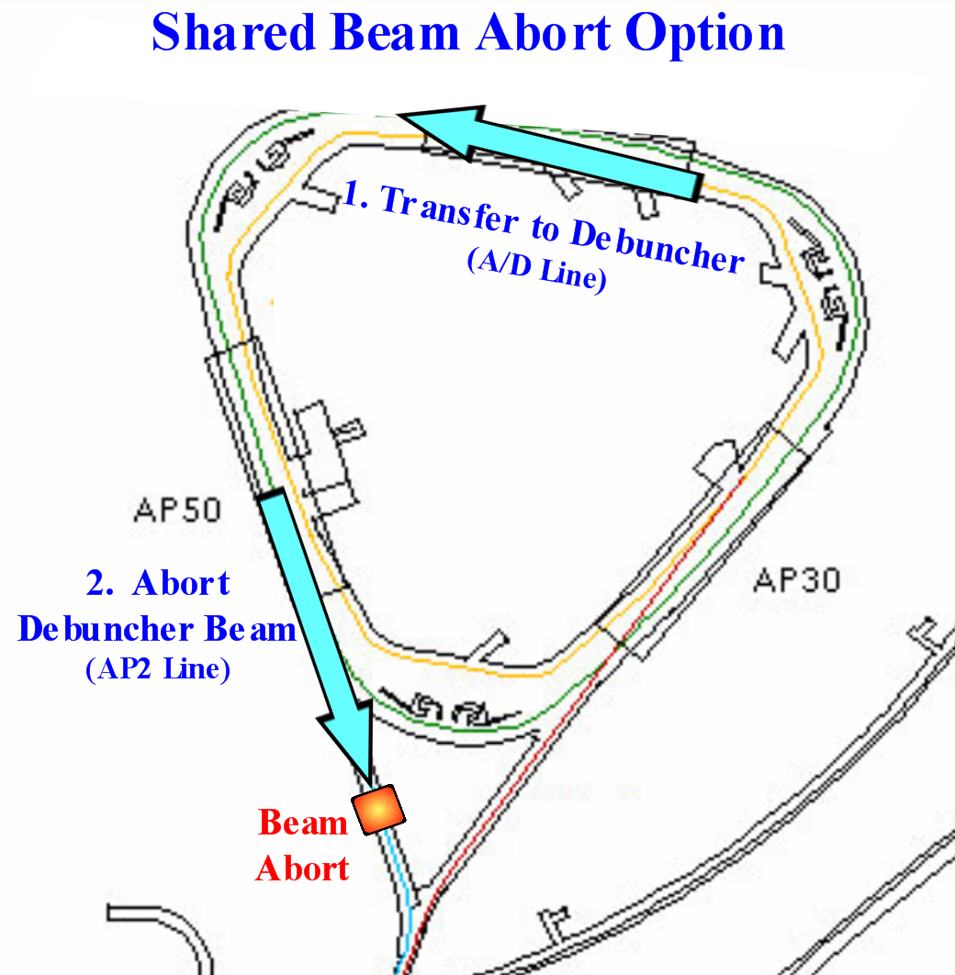
Shared Beam Abort Option
In the shared abort option, the Accumulator beam would be transferred to the Accumulator via the A/D line, and then sent to the Debuncher dump.
Accumulator Extraction kicker flattop time is not long enough.
Extraction kicker has a flattop short enough to selectively extract one of the four bunches
For the abort, we need to extract the entire circumference.
We could use the existing A:EKIK tank in the A:IKIK location, modified so that the modules are wired in parallel instead of series. This would leave us short on spares.
Because of the low duty cycle we could also repurpose the existing kicker electronics and PFN’s
Synchronization issues if you want an immediate abort. Power supplies would have to be able to rapidly charge after their normal beam transfer discharges.
If we could live with losing beam during the cycle and wait to abort the beam until the end of the cycle, then we could synchronize an abort following a permit trip with the normal Debuncher clean-up at the end of the cycle.

Slide 19
Summary
Debuncher Beam Abort
The Debuncher beam abort will be modeled after the Booster MI-8 line abort.
The unused AP-2 line will be used to house the abort line and dump.
Accumulator Beam Abort
The base plan is to place a separate Accumulator abort in either the A30 or A50 straight section, depending which location the Accumulator RF is located.
An optional plan has the Accumulator beam going to the Debuncher abort.

Slide 20
References
M. Syphers, Status of Mu2e Operating Scenario, Mu2e Document #787, February, 2010.
I. Rakhno, Radiation Shielding of the beam absorber in the MI 8 GeV beam line, FERMILAB-TM-2340-AD, January 2006.
B. Pellico, Proton Plan Dump Relocation, Director’s Review, August 23-25, 2005.
B. Pellico, Booster Beam Dump Justification, Internal Documentation, August 2006
FESS Tunnel Drawings, Section 6.2.2, http://fess-oracle-web.fnal.gov:7778/gps/project_idx
Technical Division, Accelerator Support Web, http://tdserver1.fnal.gov/AcceleratorSupport/index.html.

Slide 21
Appendix
Some extra slides not used in this talk

Slide 22
Designing the Dump
We will base the design of our dump on the existing Booster MI-8 Line dump.
The Booster sits on the floor of the MI-8 enclosure against the tunnel wall.
It has an outer shell of concrete 54”x54”x122”.
Inside the concrete is a 11.5”x11.5”x58” steel core that is slid into a 1” steel collar.
In front of the steel core is a 10”x10”x32” graphite block enclosed in a 1” steel jacket. The graphite is used to counteract heating issues.
Steel has a melting point of ~1000 °C while graphite has a 3000 to 5000 °C melting point.
The Booster dump can run 6E12/pulse at 10Hz for 20 minutes before the steel core runs into melting issues.
Booster has 4 thermocouples installed to monitor temperature.
I. Rakhno (FERMILAB-TM-2340-AD) showed that addition of a minimal amount of shielding to the MI-8 dump increased the allowed beam from 3E18 protons/year to 5E18 protons/year while staying within ground water, surface water and air activation limits.
16” of concrete added at the top
1” steel slab on right
6” steel slab underneath
6” steel slab on left
Extra concrete added in front of and behind the dump
Air
Graphite
Steel
Concrete
Soil

Slide 23
AP-2 Tunnel

Slide 24
Shared Abort Option Advantages
Sharing a common dump saves the design and building of a second dump.
The additional beam load due to the Accumulator on the Debuncher dump is small, so the Debuncher dump would not have to be redesigned to handle the extra load.

Slide 25
Shared Abort Challenges
Accumulator Extraction for Abort
Accumulator Extraction Kicker
Flat is only long enough to extract one of the four 150nsec bunches.
Extracting to the abort will require a 1.6 usec flattop to remove the entire circumference of the beam.
Having dual PFNs of different lengths on the same kicker was discussed with experts and is believed to not be practical.
Accumulator Abort Kicker
We would need a separate kicker, but the same septum.
A solution to this would be to use the existing A:EKIK tank in the A:IKIK location, modified so that the modules are wired in parallel instead of series.
This is a low duty cycle kicker, so the existing electronics and PFNs would be reused.

Slide 26
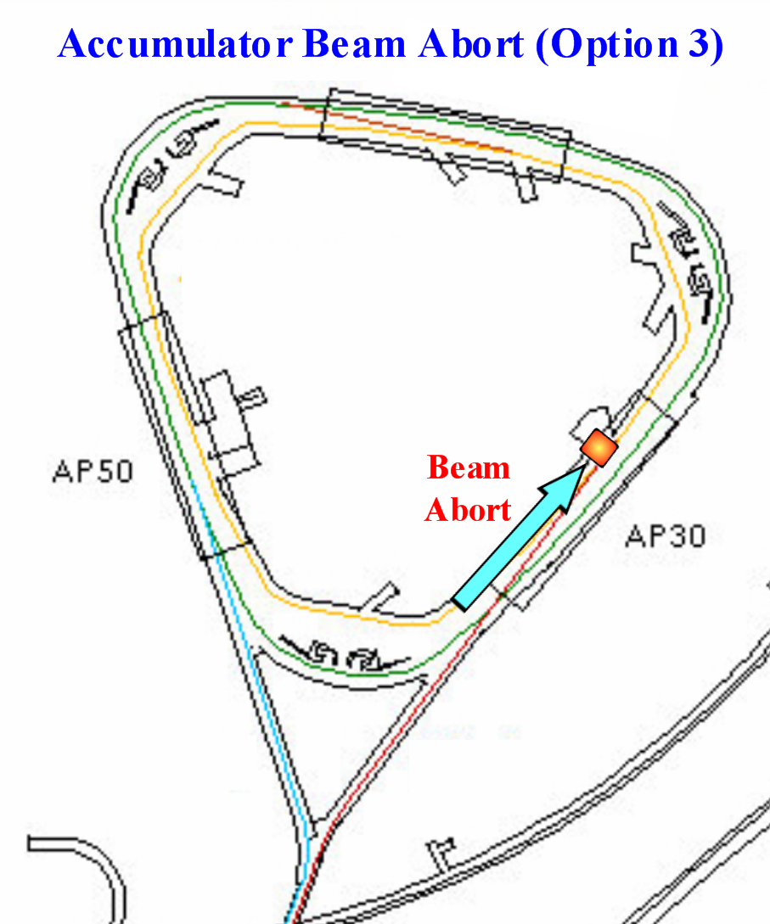
Accumulator Beam Abort
Another option is to place a separate Accumulator abort in the A30 straight section.
This option is very similar to the A50 beam dump option, with the exception that the beam dump would be at floor level instead of below floor level in a pit.

Slide 27
Separate Dump at A30
Three kicker modules located between A3Q4 and A3B3 would provide a 4mr kick downward to the beam.
Beam enters the field region of a septum downstream of A5Q3
Beam dump would sit on the floor in the A30 region.
If the Accumuator RF is located in A30, there will not be enough space to locate the abort line at this location.

