Slide 1
SPAFOA meeting at Fermilab
On behalf of FNAL… Welcome!
FNAL was instrumental in forming LCFOA (now SPAFOA) and strongly supports the resulting industry-lab partnership
We believe this has been successful and can be more successful in the future

Slide 2
We believe this partnership has long term benefits the labs scientific mission
..AND in some sense provides additional justification for our very existence.
Fermilab subscribes strongly to the idea that our role is not to compete with industry, but rather to encourage and enhance American Industrial capability and competitive advantage
As an example… recent SRF ARRA funding ( of $ 52.7 M received… more than 80% went to industry, large pieces aimed at tech transfer)

Slide 3
Another example:
Focused on Lab-Industry
Partnerships
Jointly funded by DOE and Illinois DCEO
$ 20 M of state funds, $ 13 M Federal plus use of the $ 35 M CDF building.
Will break ground in the spring

Slide 4
Many future projects planned for FNAL envision significant Industrial participation.
Working with Ken we have set up an agenda to tell you about the status of these Projects today and where possible, the opportunities they might represent for your company.

Slide 5
http://indico.fnal.gov/conferenceDisplay.py?confId=3863

Slide 6
Now… a blatant plug…

Slide 7
SRF2011
Largest international SRF conference
Held every two years (Berlin in 2009)
This year it will be in Chicago
July 25-29, 2011
Jointly hosted by ANL/FNAL
Mike Kelly and I are co-chairs

Slide 8
SRF2011 Conference
Expect 300-400 participants
Latest information on SRF Technology and SRF projects
Great Venue:
Sheraton in Downtown Chicago
Great restaurants; Chicago Jazz & nightlife
Boat trips on the lake, architectural tour, etc

Slide 9
SRF2011 Conference
Space provided for industrial exhibits
Great opportunity for vendors
Display capabilities and products
Make or renew existing customer contacts
Representatives from essentially every SRF project and laboratory in the world

Slide 10
SRF2011 Conference
Opportunities to promote your company by sponsoring events
Coffee breaks, reception, banquet subsidy, conf bags, flash drives, etc
Tony Favale has agreed to coordinate industrial sponsorships

Slide 11
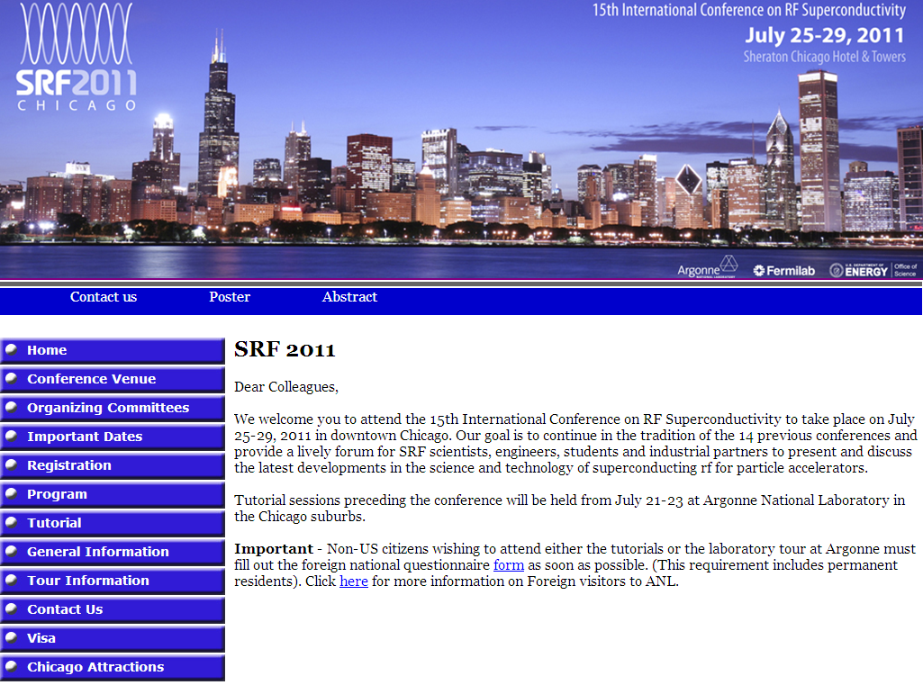
http://conferences.fnal.gov/srf2011/index.html
Web site live now… registration starts Jan 1

Slide 12
Link to SPAFOA Agenda
http://indico.fnal.gov/conferenceDisplay.py?confId=3863

