Slide 1
LBNE
Jim Strait
Fermilab
SPAFOA Member's Meeting
December 15, 2010

Slide 2

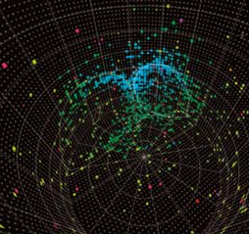
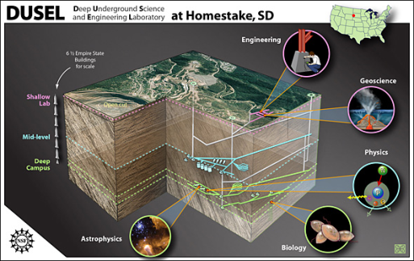
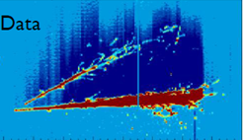
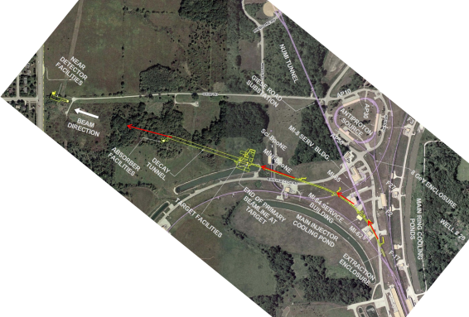
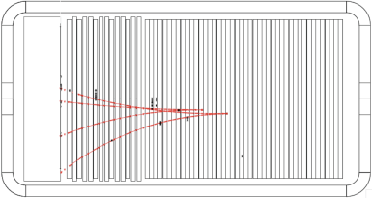
Sample with bullet points
Long Baseline Neutrino Experiment
First Bullet
Second Bullet
  More
  Yet more
  Still more
      Less important
        Trivial
New Neutrino Beam at Fermilab…
…Directed towards NSF’s proposed DUSEL
Precision Near Detector on the Fermilab site
100 kT Water Cherenkov Detector
20 kT Liquid Argon TPC Far Detector

Slide 3
Scientific Goals of LBNE
How do the the three types of neutrinos – ν_{e}, ν_{μ}, ν_{μ} – transform from one type to another as they travel from point “a” to point “b”?
Search for the transformation ν_{μ} -> ν_{e} which has never been seen before.
Look for matter – antimatter vs. asymmetry in behavior of
ν vs. ⁻ν . . . which may hold the clue as to why there is matter in the universe but no anti-matter, i.e. why we are here(!)
Is matter stable? Do protons decay?
Search for the the decay of protons into lighter particles, ultimately electrons and neutrinos.
Predicted by theories that unify the fundamental forces of nature.
Provides a window into physics at energies far beyond what particle accelerators can ever achieve.

Slide 4
Long-Baseline Neutrino Experiment Collaboration
Alabama: J. Goon, I Stancu
Argonne: M. D’Agostino, G. Drake. Z. Djurcic, M. Goodman, X. Huang, V. Guarino, J. Paley, R. Talaga, M. Wetstein
Boston: E. Hazen, E. Kearns, J. Raaf, J. Stone
Brookhaven: M. Bishai, R. Brown, H. Chen, M. Diwan, J. Dolph, G. Geronimo, R. Gill, R. Hackenberg, R. Hahn, S. Hans, D. Jaffe, S. Junnarkar, J.S. Kettell, F. Lanni, L. Littenberg, J. Ling, D. Makowiecki, W. Marciano, W. Morse, Z. Parsa, C. Pearson, V. Radeka, S. Rescia, T. Russo, N. Samios,R. Sharma, N. Simos, J. Sondericker, J. Stewart, H. Tanaka, C. Thorn, B. Viren, Z. Wang, S. White, L. Whitehead, M. Yeh, B. Yu
Caltech: R. McKeown, X. Qian, C. Zhang
Cambridge: A. Blake, M. Thomson
Catania/INFN: V. Bellini, G. Garilli, R. Potenza, M. Trovato
Chicago: E. Blucher
Colorado: R. Johnson, A. Marino, M. Tzanov, E. Zimmerman
Colorado State: M. Bass, B. Berger, J. Brack, N. Buchanan, J. Harton, V. Kravtsov, W. Toki, D. Warner, R. Wilson
Columbia: R. Carr, L. Camillieri, C.Y. Chi, G. Karagiorgi, C. Mariani, M. Shaevitz, W. Sippach, W. Willis
Crookston: D. Demuth
Dakota State: B. Szcerbinska
Davis: R. Breedon, T. Classen, J. Felde, P. Gupta, M. Tripanthi, R. Svoboda
Drexel: C. Lane, J. Maricic, R. Milincic, K. Zbiri
Duke: J. Fowler, J. Prendki, K. Scholberg, C. Walter, R. Wendell
Duluth: R. Gran, A. Habig
Fermilab: D. Allspach, B. Baller, D. Boehnlein, M. Campbell, A. Chen, S. Childress, B. DeMaat, A. Drozhdin, T. Dykhuis, A. Hahn, S. Hays, J. Howell, P. Huhr, J. Hylen, M. Johnson, J. Johnstone, T. Junk, B. Kayser, G. Koizumi, T. Lackowski, P. Lucas, B. Lundberg, T. Lundin, P. Mantsch, N. Mokhov, C. Moore, J. Morfin, B. Norris, V. Papadimitriou, R. Plunkett, C. Polly, S. Pordes, O. Prokofiev, G. Rameika, B. Rebel, D. Reitzner, K. Riesselmann, R. Rucinski, R. Schmidt, D. Schmitz, P. Shanahan, J. Strait, S. Striganov, K. Vaziri, G. Velev, G. Zeller, R. Zwaska
Hawaii: S. Dye, J. Kumar, J. Learned, S. Matsuno, S. Pakvasa, M. Rosen, G. Varner
Indian Universities: V. Singh (BHU); B. Choudhary, S. Mandal (DU); B. Bhuyan [IIT(G)]; V. Bhatnagar, A. Kumar, S. Sahijpal(PU)
Indiana: W. Fox, C. Johnson, M. Messier, S. Mufson, J. Musser, R. Tayloe, J. Urheim
Iowa State: M. Sanchez
IPMU/Tokyo: M. Vagins
Irvine: G. Carminati, W. Kropp, M. Smy, H. Sobel
Kansas State: T. Bolton, G. Horton-Smith
LBL: R. Kadel, B. Fujikawa, D. Taylor
Livermore: A. Bernstein, R. Bionta, S. Dazeley, S. Ouedraogo
London-UCL: J. Thomas
Los Alamos: S. Elliott, V. Gehman, G. Garvey, T. Haines, D. Lee, W. Louis,
C. Mauger, G. Mills, A. Norrick, Z. Pavlovic, G. Sinnis, W. Sondheim,
R. Van de Water, H. White
Louisiana State: W. Coleman, T. Kutter, W. Metcalf, M. Tzanov
Maryland: E. Blaufuss, R. Hellauer, T. Straszheim,
G. Sullivan
Michigan State: E. Arrieta-Diaz, C. Bromberg,
D. Edmunds, J. Huston, B. Page
Minnesota: M. Marshak, W. Miller
MIT: W. Barletta, J. Conrad, T. Katori, R. Lanza, L. Winslow
NGA: S. Malys, S. Usman
New Mexico: B. Becker, J. Mathews
Notre Dame: J. Losecco
Oxford: G. Barr, J. DeJong, A. Weber
Pennsylvania: J. Klein, K. Lande, A. Mann, M. Newcomer, R. vanBerg
Pittsburgh: D. Naples, V. Paolone
Princeton: Q. He, K. McDonald
Rensselaer: D. Kaminski, J. Napolitano, S. Salon, P. Stoler
Rochester: R. Bradford, K. McFarland
SDMST: X. Bai, R. Corey
SMU: T. Liu, J. Ye
South Carolina: H. Duyang, S. Mishra, R. Petti, C. Rosenfeld
South Dakota State: B. Bleakley, K. McTaggert
Texas: S. Kopp, K. Lang, R. Mehdiyev
Tufts: H. Gallagher, T. Kafka, W. Mann, J. Schnepps
UCLA: K. Arisaka, D. Cline, K. Lee, Y. Meng, F. Sergiampietri, H. Wang
Virginia Tech: E. Guarnaccia, J. Link, D. Mohapatra, R. Raghavan
Washington: S. Enomoto, J. Kaspar, N. Tolich, H.K. Tseung
Wisconsin: B. Balantekin, F. Feyzi, K. Heeger, A. Karle, R. Maruyama, D. Webber, C. Wendt
Yale: E. Church, B. Fleming, R. Guenette, M. Soderberg, J. Spitz
288 Scientists and Engineers
57 Institutions
25 States
4 Foreign countries
… And still growing!
17 November 2010

Slide 5

New Neutrino Beam at Fermilab

Slide 6
How to Make a Neutrino Beam

Slide 7
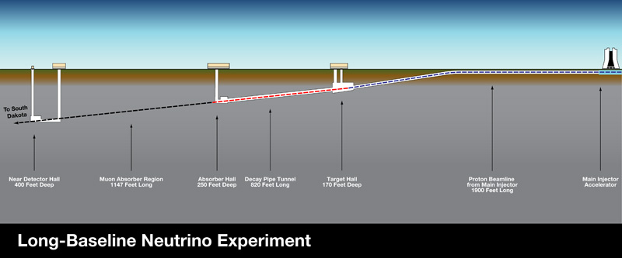
Aiming the Neutrino Beam to South Dakota

Slide 8
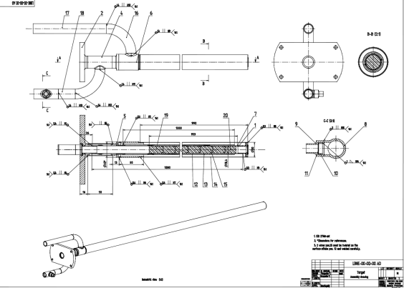
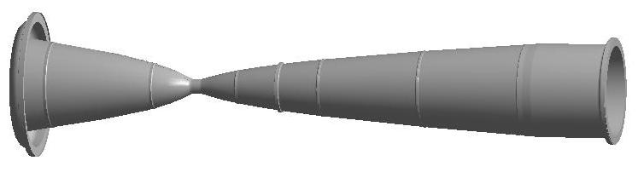
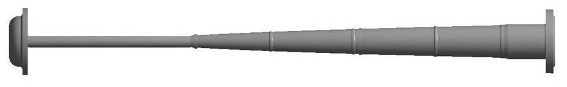
Target and Focusing (“Horn”) System

Slide 9
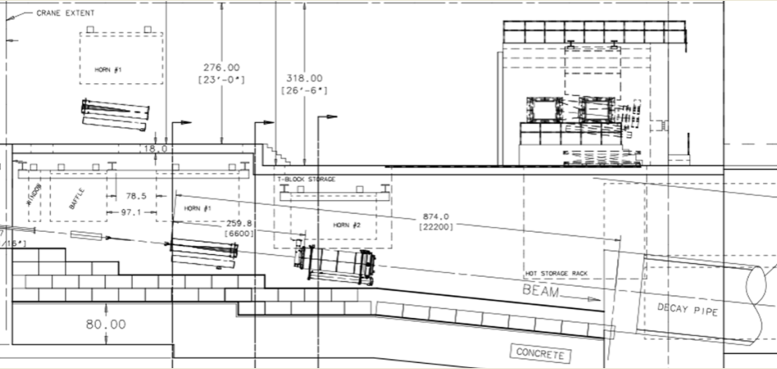
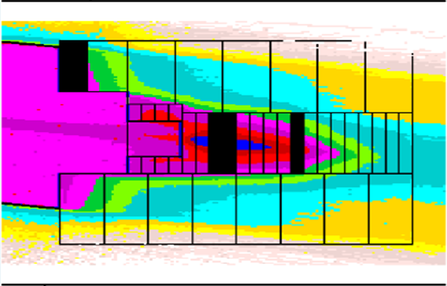
Target, Horn, Decay Pipe, and Absorber Engineering

Slide 10
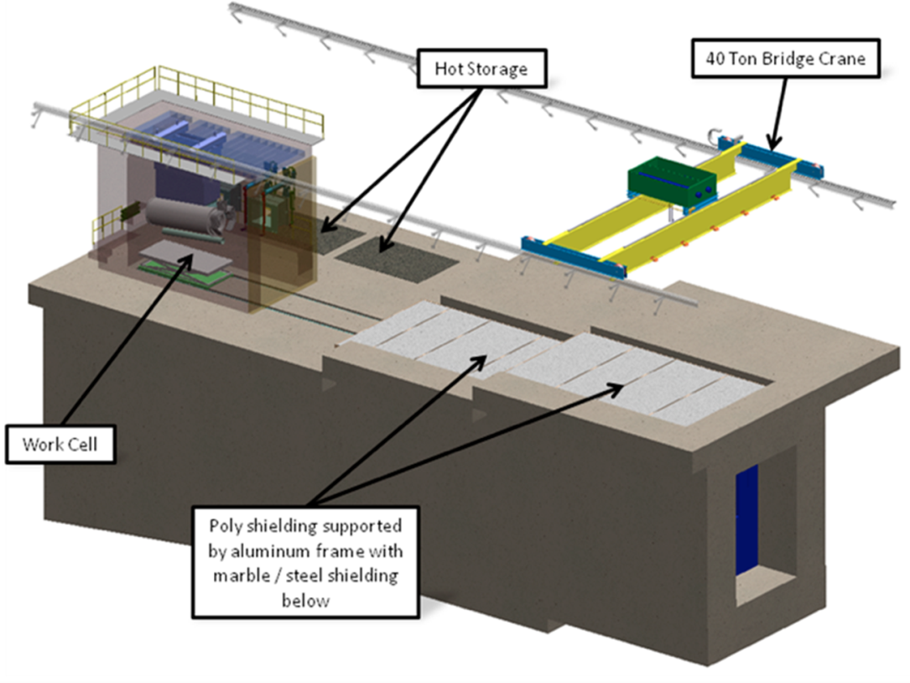
Target Station Shielding and Remote Handling Systems

Slide 11
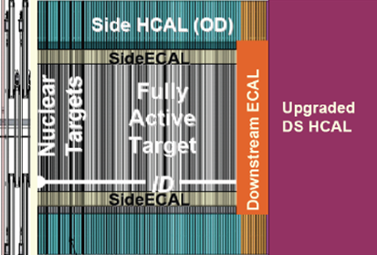
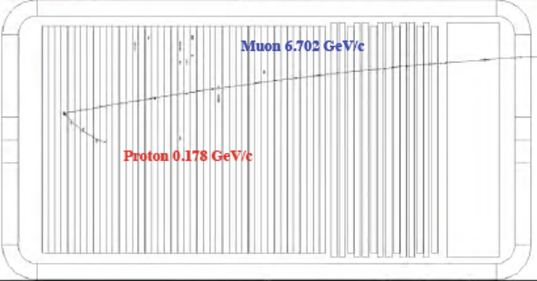
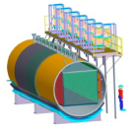
Near Detector:
Measure neutrinos as the leave Fermilab
Subproject led by
Los Alamos National
Laboratory with
collaboration input.
Several options under consideration:
Scintillator tracker Straw-tube tracker LAr TPC

Slide 12
Near Detector:
Measure neutrinos as the leave Fermilab
Subproject led by
Los Alamos National
Laboratory with
collaboration input.

Slide 13
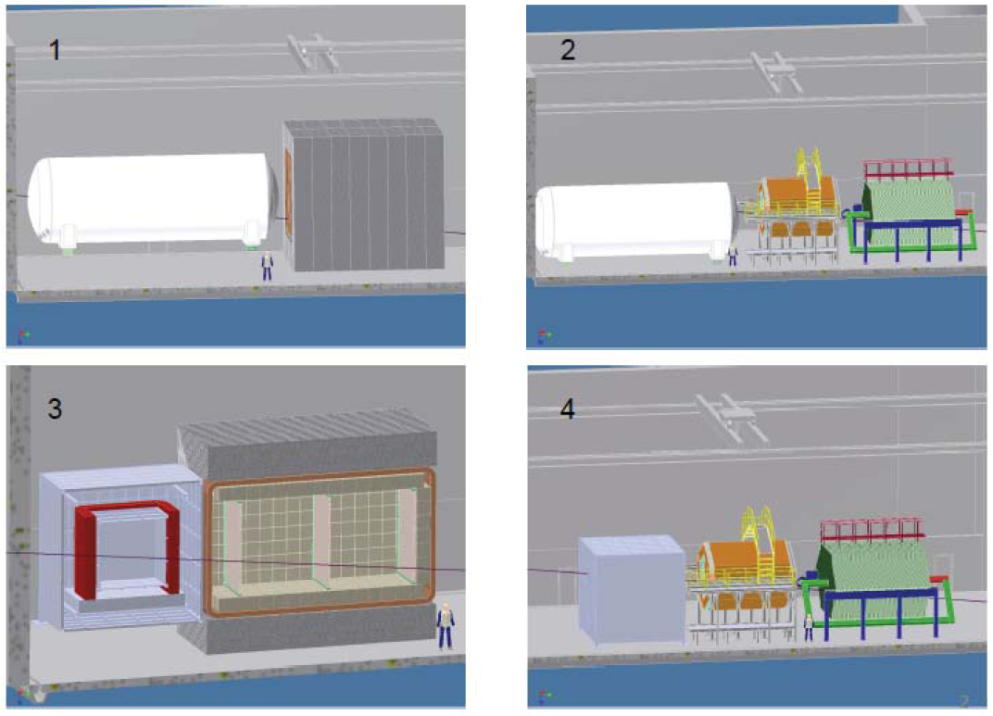
Near Detector:
Several Options Under Consideration
Non-Magnetized LAr
+ Straw-tube Tracker
Non-Magnetized LAr
+ Scintillator Tracker
Magnetized LAr
+ Straw-tube Tracker
Magnetized LAr
+ Scintillator Tracker

Slide 14
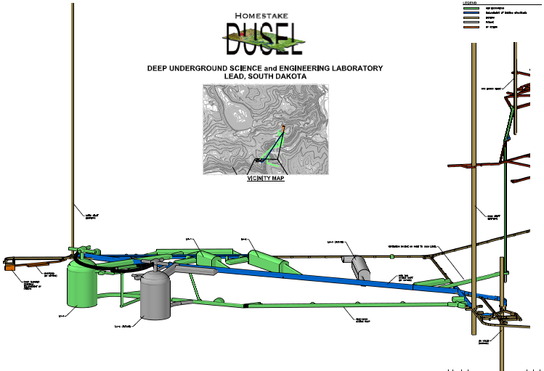
Water Cherenkov Far Detector
Subproject led by Brookhaven National Laboratory with collaboration support.
To be located 4850 feet underground in Deep Underground Science and Engineering Lab (DUSEL), in old Homestake Gold Mine in Lead, SD

Slide 15
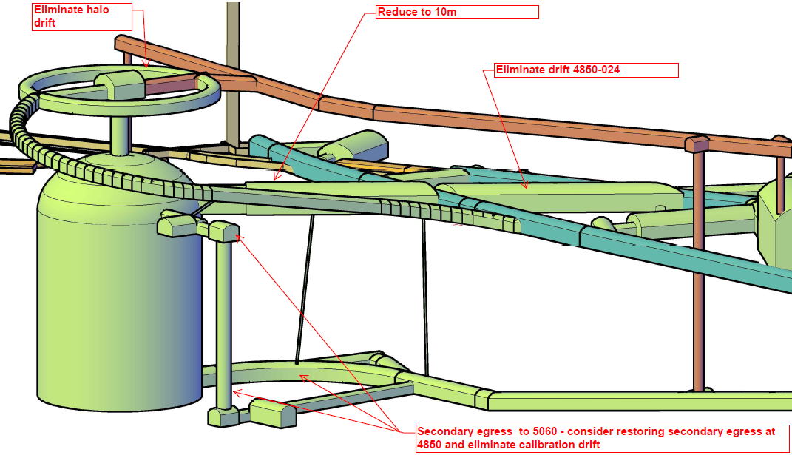
Water Cherenkov Far Detector
Subproject led by Brookhaven National Laboratory with collaboration support.
To be located 4850 feet underground in Deep Underground Science and Engineering lab (DUSEL), in old Homestake Gold Mine in Lead, SD
83m
55m

Slide 16
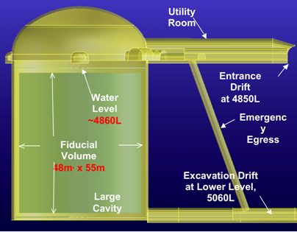
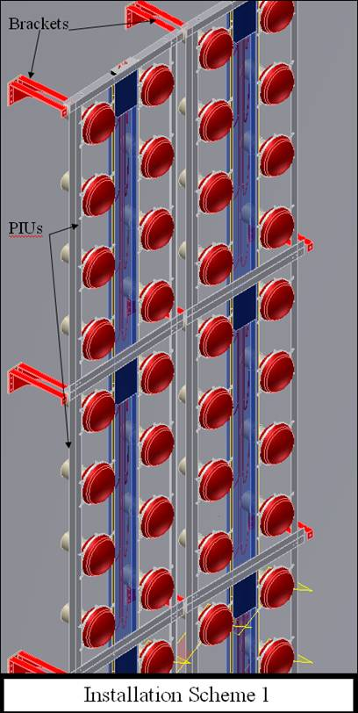
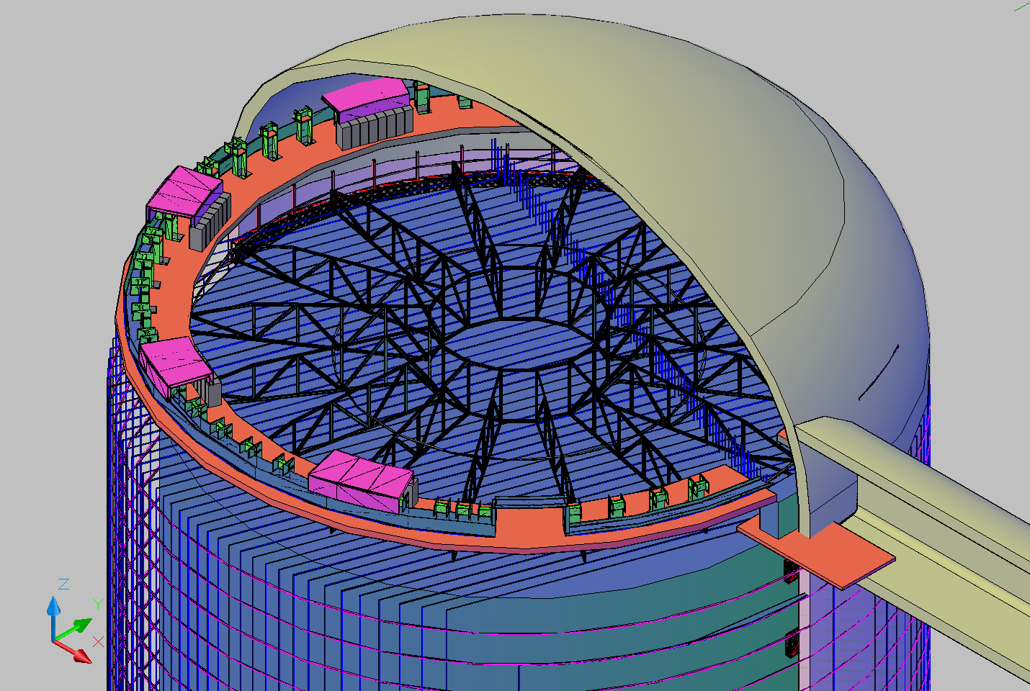
Water Cherenkov Detector
10’s of thousands of photo- multiplier tubes watching
100 ktons of ultra-pure water

Slide 17
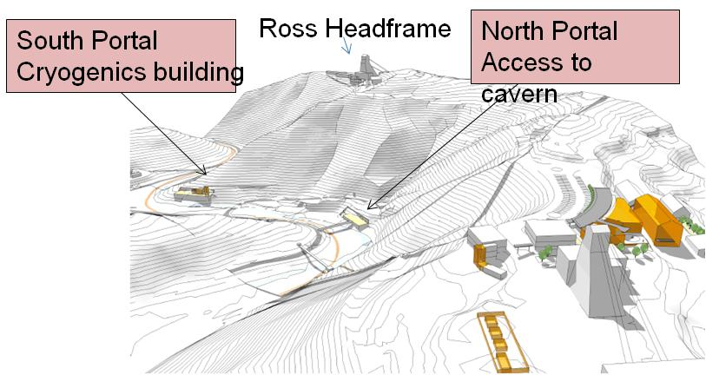
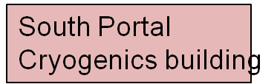
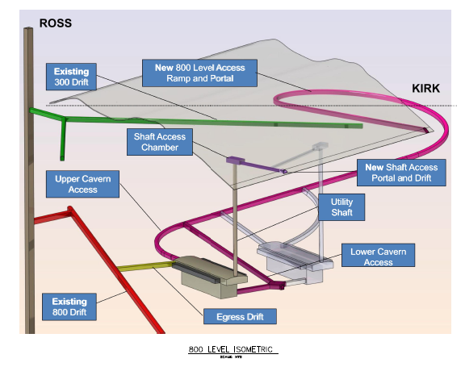
Liquid Argon TPC Far Detector
Subproject led by Fermilab with collaboration support.
To be located 800 feet underground in DUSEL, in old Homestake Gold Mine in Lead, SD

Slide 18
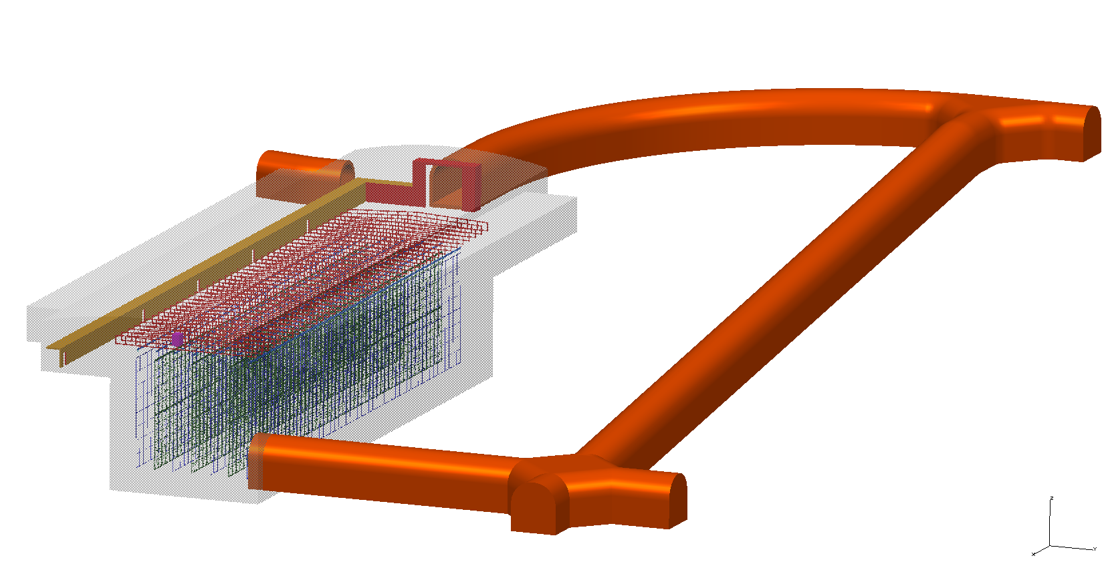
WBS 1.5 – LAr TPC
70m
20m

Slide 19
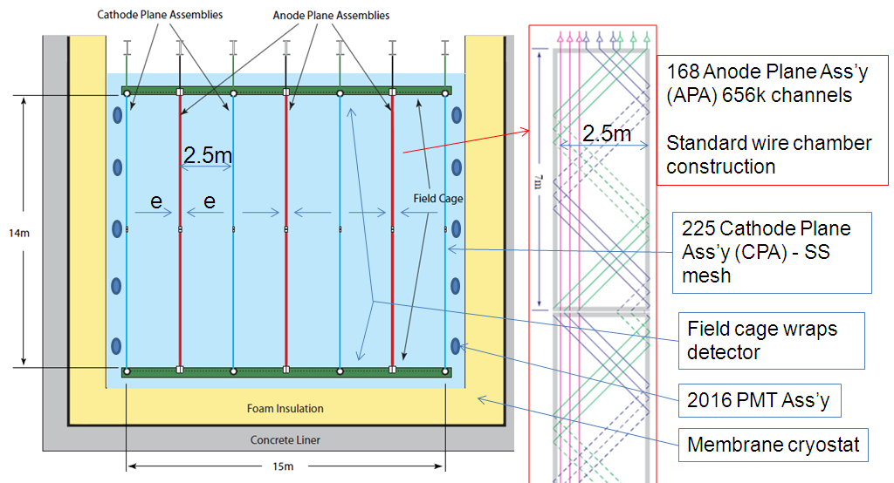
WBS 1.5 – LAr TPC

Slide 20
LBNE Project Time Line
DOE CD-0 (Approve Mission Need) January 2010
CD-1 (Conceptual design, preliminary
cost and schedule range) Fall 2011
CD-2 (Project baseline)
depending on funding . . . late FY2013/2014
CD-3 (start construction)
depending on funding . . . ~ 2015
Schedule for construction under development
=> estimate that project will be complete >~ 2020

