Slide 1
SCRF Industrialization for ILC
A Global Project Plan for the ILC Technical Design
Marc Ross, (Fermilab)
Nick Walker, (DESY)
Akira Yamamoto, (KEK)
ILC GDE Project Managers for Technical Design
Objectives, schedule, funding, industrial participation

Slide 2
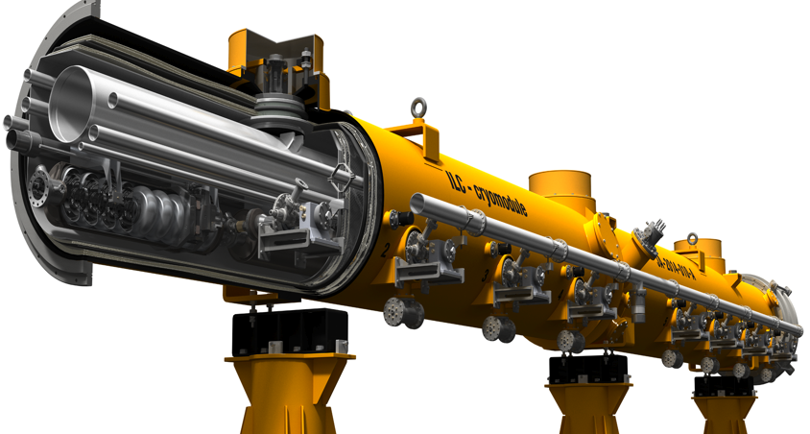
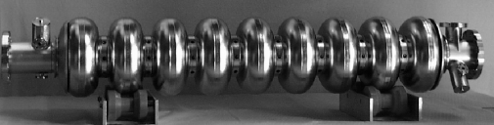
ILC SCRF – Main Linac
RDR Parameters | Value
C.M. Energy | 500 GeV
Peak luminosity | 2x10³⁴ cm⁻²s⁻¹
Beam Rep. rate | 5 Hz
Macro Pulse duration | 1 ms
Average beam current | 9 mA (in pulse)
Avg. gradient | 31.5 MV/m
# 9-cell cavity | 14,560
# cryomodule | 1,680
2009 Baseline

Slide 3
CLIC (normal conducting) & ILC roadmaps
CY
2010
2011
2012
2013
2014
2015
2016
2017
2018
Baseline established
Technical Design Report complete
Decision to proceed
TDR reviews
ILC
Technical design & R&D program
Site EOI’s
Site/host established
Cost Estimating
SRF system tests
Project Implementation Plan complete
XFEL operation
CERN Council approval of program continuation
European Strategy update
Project Implementation Plan
CTF3+
Conceptual design study
Project Preparation
CLIC
Site studies
Cost Estimating
Review CLIC baseline
CTF3 system tests
Decision to proceed
Final energy staging
Physics Run 1
Interconnect repair
Physics Run 2
LHC
Existence of low-lying SUSY known
Higgs energy scale known

Slide 4
R & D Plan Resource Table
Resource total: 2009-2012
Not directly included:
  Other Project-specific, general infrastructure or generic R&D resources overlap with ILC R&D
Notes:
4

Slide 5
Global Plan for SCRF R&D
Year | 07 | 2008 |  | 2009 |  | 2010 |  | 2011 | 2012
Phase | TDP-1 |  |  |  |  |  | TDP-2
Cavity Gradient in vert. test ≥ 35 MV/m | → Yield 50% |  |  |  |  |  | → Yield 90%
Cavity-string to reach 31.5 MV/m, with one-cryomodule |  | Global effort for string assembly and test (DESY, FNAL, INFN, KEK)
System Test with beam acceleration |  |  | FLASH (DESY) (also EU - XFEL) , NML (FNAL) , STF2 (KEK) (extends beyond 2012)
Preparation for Industrialization |  |  |  |  | Production Technology R&D
Communication with industry: | 2009: 1st step: Visit Vendors 2010: 2nd step: Organize Workshop 2011: 3rd step: Send specification & receive response

Slide 6
Completion: 2014

Slide 8
Cavity Fabrication (TESLA Cavity)
12 EBW place
Short End group
End cell : short side
HOM1
input port
beam pipe
Dumbbell x8
× ８
center cell x8
56 parts:
Nb = 46, Nb-Ti = 10: deep-draw, de-burr, machine
75 Electron Beam Welds (EBW) :
Long End group
beam pipe
pickup port
HOM2
End cell : long side

Slide 9
Standard Process Defined -
Cavity Production and Yield
 | Standard Cavity Recipe
Fabrication | Nb-sheet (Fine Grain)
 | Component preparation
 | Cavity fabrication w/ EBW (w/ experienced venders)
Process | 1st (Bulk) Electro-polishing (~150um)
 | Ultrasonic degreasing with detergent, or ethanol rinse
 | High-pressure pure-water rinsing
 | Hydrogen degassing at > 600 C
 | Field flatness tuning
 | 2nd Electro-polishing (~20um)
 | Ultrasonic degreasing or ethanol
 | High-pressure pure-water rinsing
 | Test Antenna Assembly
 | Baking at 120 C
Vertical Cold Test | Performance Test with temperature and mode measurement (1st / 2nd successful RF Test)

Slide 10
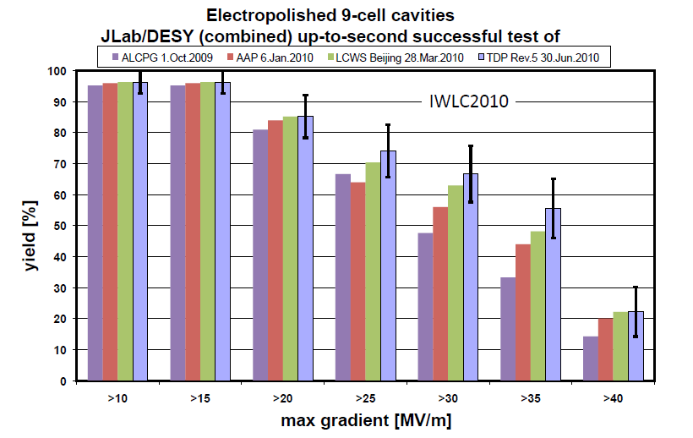
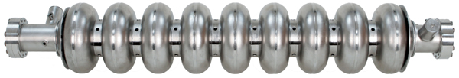
Cavity Gradient Milestone Achieved
TDR
Goal
2010
Milestone

Slide 12
Preparing for ILC SCRF Industrialization
Learn from previous efforts and on-going programs:
  Study of the TESLA project (1990’s)
    Assuming to manage ~ 20,000 cavities
  R&D progress in past 10 years
    Varied industrialization efforts
  On-going Industrialization in the XFEL Project
Develop Industrialization Model
  Need to adapt various governance models and in kind contribution models from multiple regions, countries, and laboratories,
  Make our own effort to seek for the best cost-effective production technology and approach
    An example: A pilot-plant at KEK (Japan)
  Communicate with industry and laboratories to seek for cost-effective manufacturing and quality control

Slide 13
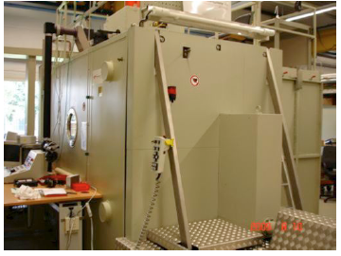
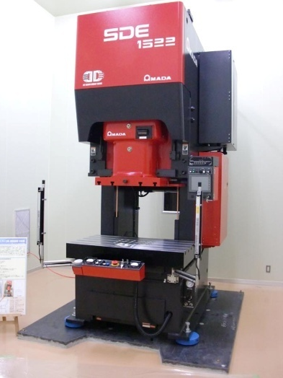
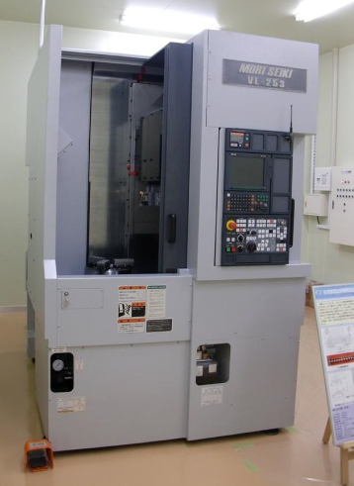
Pilot Plant for Industrial R&D - KEK
Chemical Polish room
19m x 14m ISO class-5 clean room
Electron Beam Welder (04/11)
Press machine
Operational in 2011
work together with industry to develop cost-effective cavity production techniques
Trimming machine

Slide 14
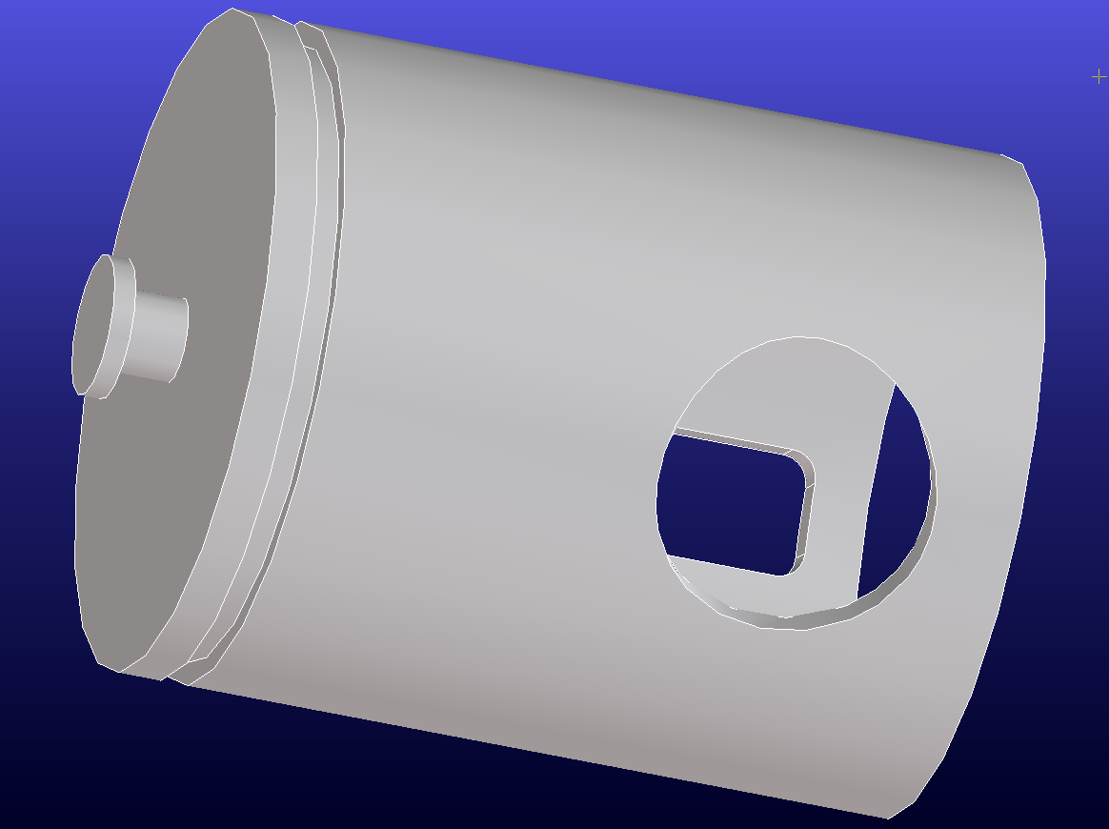
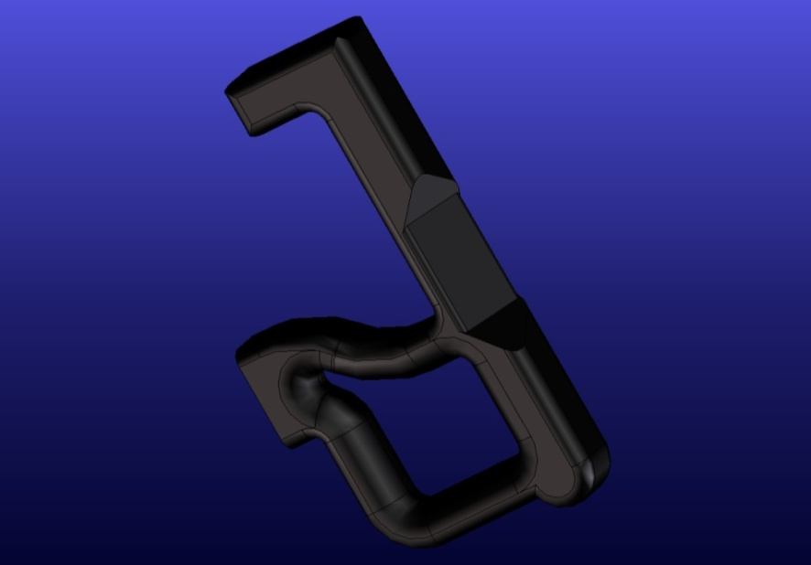
HOM-coupler – Example (KEK)
(1) Deep Drawing of HOM-
antenna housing,
(2) Cut-out of holes, or
deburring of holes.
(3) Develop cost effective
shape of tuning knob.
(4) Press cut-out antenna from thick plate,
(5) Press cut-out of slope region,
(6) Press forming into design
shape

Slide 15
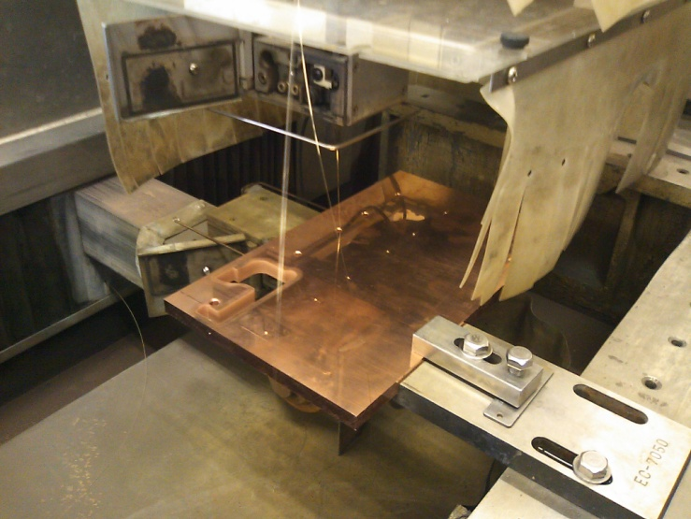
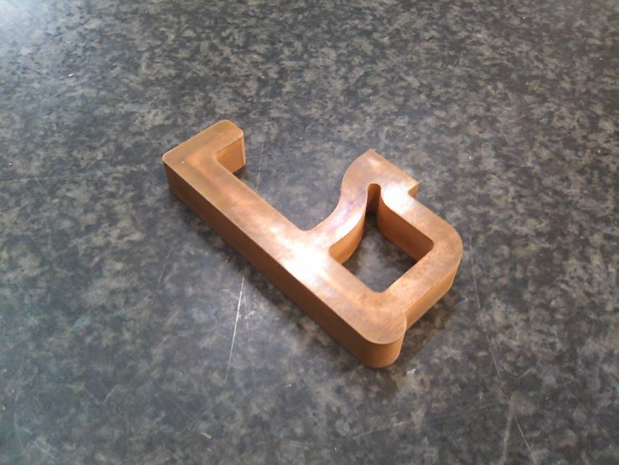
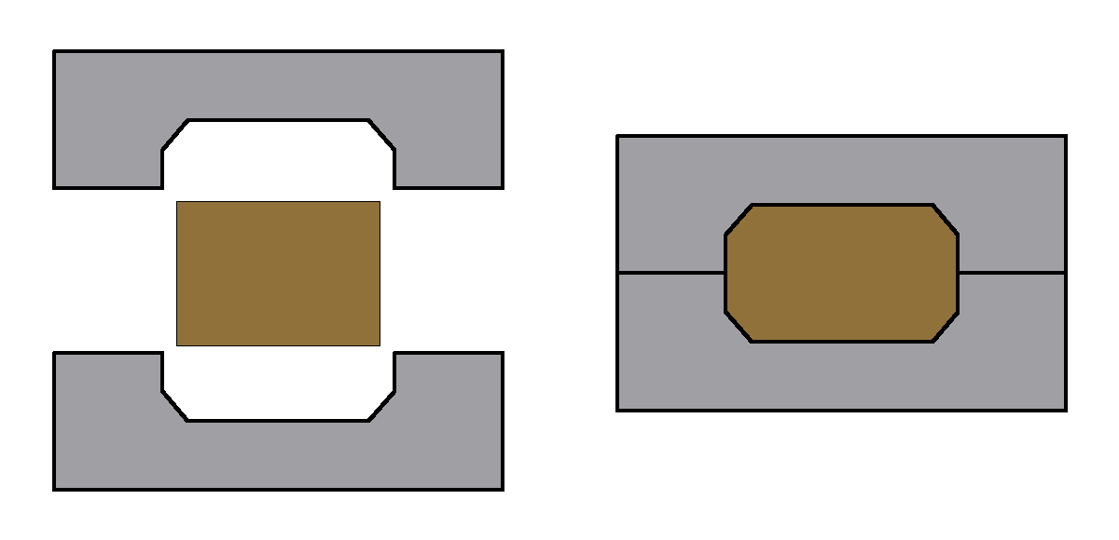
‘HOM Antenna’- Fineblanking
Use of Cu material at first, then go to Nb
Wire cut for
preliminary
work
Simulating press-cut of HOM Antenna
Edge shaping by press

Slide 16
Next Step - Preparing Industrialization
Plan for 2010-2011:
  Extend our own effort for industrialization at laboratories,
  Prepare for “ILC Cavity/cryomodule Specification” and
  Ask for responses/advice from cavity/cryomodule vendors
Boundary Conditions assumed:
  Plug-compatible, build-to-print, specification
    Including design parameter, interfaces, manufacturing process,
    Requirements on QC, QA, and minimum acceptance criteria
  Possible mass-production model
    Scale of production: 4,000 ~ 8,000 (25 ~ 50 %, for example)
      Possible industrial collaboration (grouping etc.. )
    Scale of production period: 2 + 5~6 years
      pre-series + main production period, assuming ≥ 2 x EU XFEL construction period

Slide 17
Industrialization Models
Production Models and Production Rate of SCRF Cavities
Project | Total numbers of Cavities | Fraction Of Production Sharing | # of Cavity production | Production period (years) | Production Rate: (Cavities/day/vendor) (at 250 work-days/yr)
SNS | ~ 110 (including +20%) | 100 % |  | 3 | 0.15
XFEL | ~640 | 50 % |  | 3 | 0.43
ILC | ~ 16,000 (including +10% ) | 100 % 50 % 25 % 12.5 % | 16,000 8,000 4,000 2,000 | 6 (= 2 x 3)* | 10.7 5.4 2.7 1.35
*Assumption : ILC full production-rate period to be twice of production time of XFEL

Slide 18
Two Levels of Communication
1: Call-for-Response/ Request for Information (un-paid)
  Send technical specifications to possible vendors
    General design parameters, plug-compatibility, fabrication process, process specification
    2nd series of visit to cavity/cryomodule vendors to explain the specification and to receive questions,
  Request their response without commercial contract
    A standard process in advance of the call-for-tender process
2: Contracts with Specific Companies (paid)
  Request specific studies of the industrial models and facilities
    Receive best cost effective way of manufacturing including factory layout and working models ,
    Property of the study result to be transferred to us (GDE/labs).

Slide 19
Guideline for Industrialization Study
Global industrial market expected for
  Sub-Components purchasing, w/ established tech.
    supplied by manufacturers without strong constraints for regional/national balance
  Industrial competition encouraged for
    Healthy competition in bidding, and cooperation in manufacturing process with risk mitigation,
    Keeping control of cost and schedule,
Laboratory responsibility required for
  Assembly/integration/test work,
    System engineering including ongoing development,
    Facility hosted by laboratories for benefit of further development and applications in each region/country

Slide 20
Possible Models of Industrialization
Possible work sharing items | Commercially supplied, relying on market | Region/ Laboratory responsible | Notes, constraint
# of participants → | 1: possible , ≥ 2: desired | ≥2: most likely
Cavity:
Nb and raw material | Yes
Main cell, He-Jacke | Yes with care |  | High Pressure Code
End-group, HOM etc. | Yes
Input Coupler, Tuner | Yes
Surface Process | Yes /Possible | Yes/Possible
Integration |  | Most Likely | High Pressure Code
Cavity Perform.. Test |  | Most Likely | Lab should be responsible
Cryomodule:
Vacuum vessel | Yes
C.M. component | Yes with care |  | High Pressure code
Cavity-CM Assembly |  | ≥2: Most likely 1: special case
Cryomodule test |  | Most likely | Lab should be responsible

Slide 21
Reviewer’s Comments (11/2010):
EU-XFEL costs are high and does not reflect ILC strategy
ILC should follow the LHC example:
  (Properly assumed in the proposed model)
  Ask for the minimum required effort for each part.
  LHC magnets could have been 2x or more expensive. But it turned out much better.
bring the final assembly and test factories on site
  as done for the LHC at CERN.
Demystify the cost-drivers in the fabrication process
  Welding, deep drawing, sheet preparation
Complete the transition - R&D to production

