Slide 1
Fermilab-India Agreements and Collaboration
Shekhar Mishra
Project-X, International Collaboration Coodinator
Fermi National Accelerator Laboratory
Batavia, IL, USA

Slide 2
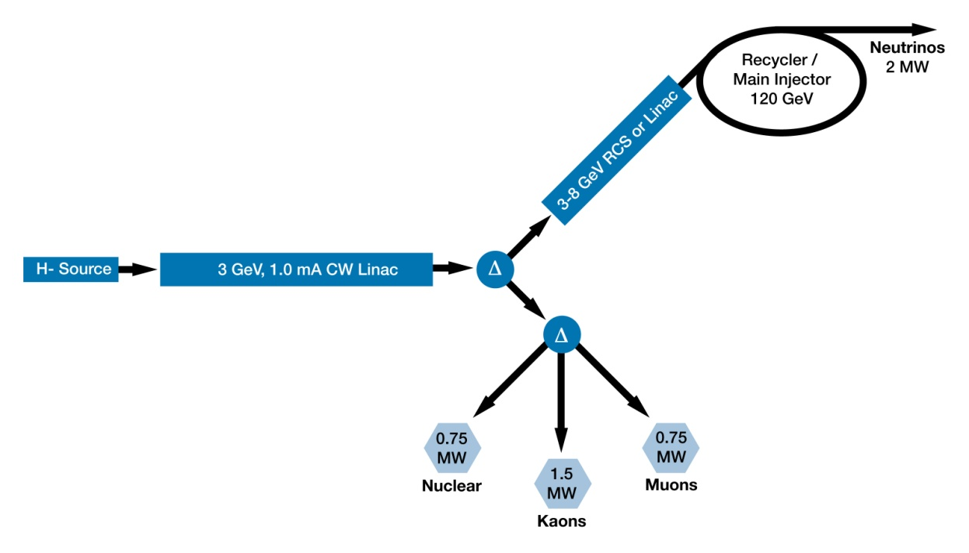
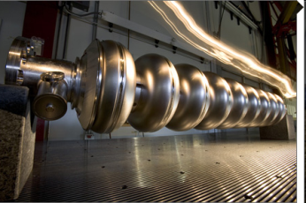
Fermilab Next 10 yrs Strategy
1300 MHz
325 & 650 MHZ
A multi-MW proton source, Project-X, is the key element of Fermilab’s strategy for future development of the accelerator complex.
  Project-X is designed to provide flexibility in evolving Fermilab physics program
  Prepare to response to results from the LHC
  Fermilab is diversifying in the areas of Nuclear Physics and Energy

Slide 3
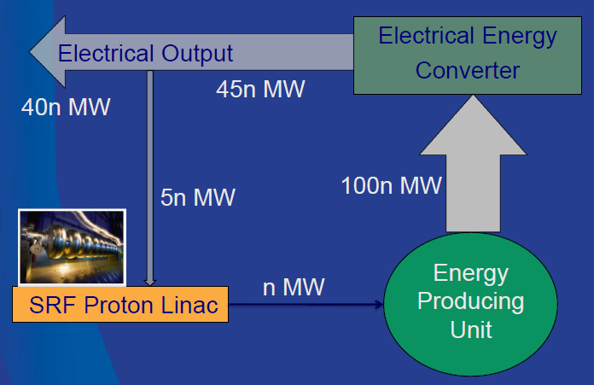
Indian Next 10-15 yrs Strategy
A multi-MW proton source could be the key element of a Nuclear Energy program, including transmutation
  Multi MW CW beam at 1-2 GeV (similar to Fermilab Project-X) could be the accelerator and target technology demonstration project.
  Indian Institutions are working on a Project Document for funding.

Slide 4
MOU: US and Indian Laboratories
On Jan 9, 2006, US (Fermilab, SLAC, Jlab, Cornell) and Indian Institutions (BARC, RRCAT, VECC, IUAC, DU) signed an MOU to collaborate on Accelerator and High Energy Physics
We are collaborating under four addendums to the MOU
  Fermilab, RRCAT, BARC, IUAC and VECC Collaboration on ILC Main Linac SRF Accelerator Technology R&D
  SLAC, RRCAT, BARC, IUAC and VECC Collaboration on ILC RF Power Sources and Beam Dump Design R&D
  Fermilab and Indian Accelerator Laboratories Collaboration on High Intensity Proton Accelerator and SRF Infrastructure Development (Phase I Accelerator)
  US and Indian Institutions Collaboration on Neutrino Physics, Related Experiments and Detector Development (Phase 1 HEP).

Slide 5
Three Phases of Collaboration
Current Phase – I: Continue as planned under Addendum MOU - III, introduce project engineering and management for timely delivery.
Phase – II: (RD&D of HIPA): Develop a new MOU using the same frame work as established in Jan 2006 to participate in all aspects of the HIPA RD&D at Fermilab, with a goal of getting involved in Phase – III.
  Details of Phase – III should to be agreed upon.
Phase – III (Construction of HIPA): Develop a US-DOE to India-DAE collaboration on the construction of HIPA in respective countries.
  India is expected to make significant In-Kind contributions
  US will share accelerator technology
Notes:
5

Slide 6
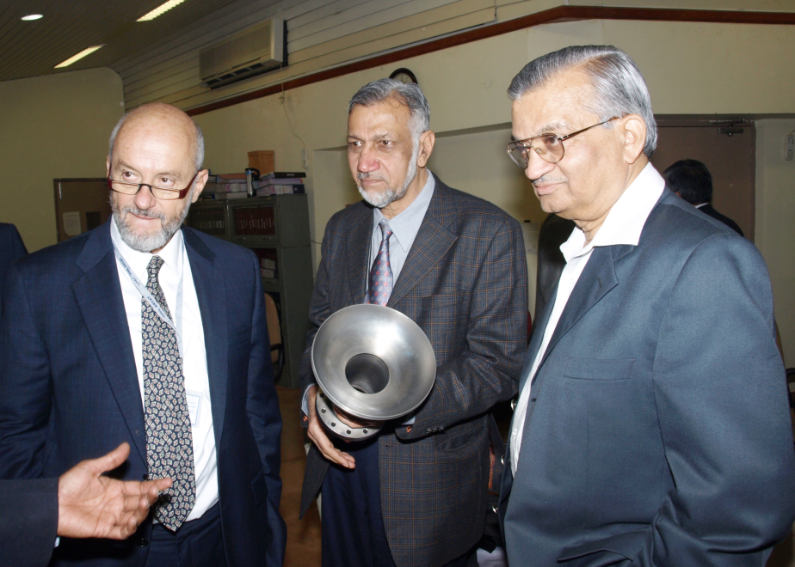
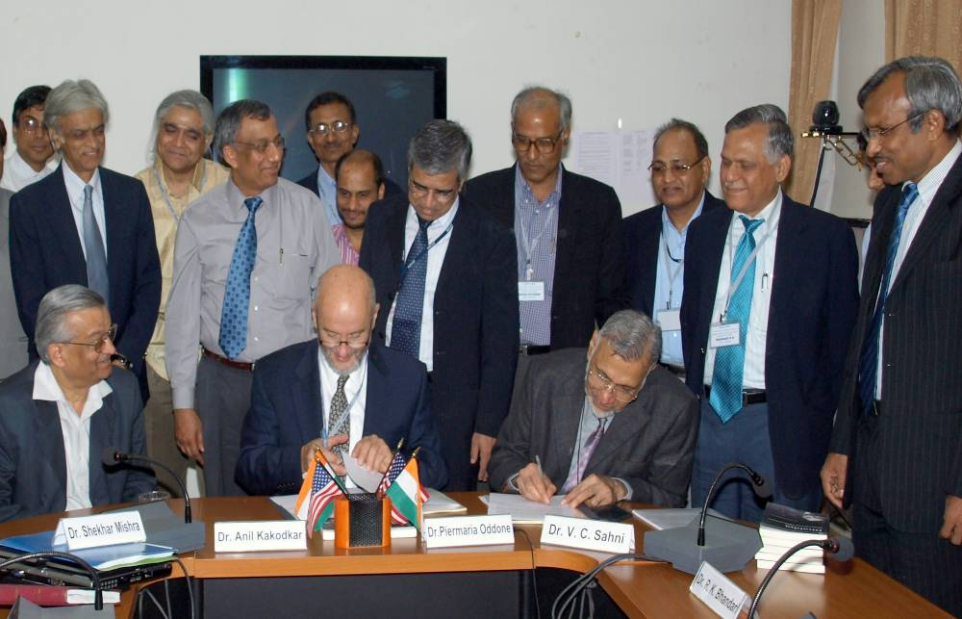
Jan 2009: Addendum MOU III
Addendum III includes all SRF aspects of
  High Intensity Proton Accelerator.
  SRF infrastructure
  Personnel exchange and Training of manpower
  Indian Industries involvement

Slide 7
Phase I: R&D work at Indian Institutions
Project-X Accelerator Physics
  Project-X Lattice design
Cavity prototype and fabrication
  SSR1
  1300 MHz → 650 MHz, β = 0.9 & 0.6 cavity design, prototype and fabrication
1300 MHz → 650 MHz Cryomodule design
  He Vessel
  Blade Tuner
SRF Infrastructure
  Vertical Test Stand design
  Horizontal Test Stand design and cryostat
  Cryomodule Test Stand design and cryostat
SSR0
SSR1
SSR2
β=0.6
β=0.9
ILC
325 MHz 2.5-160 MeV
650 MHz 0.16-3 GeV
3-8 GeV
Indian Institution

Slide 8
Phase II: R&D
The Phase II of this collaboration would expand the present R&D collaboration to all non SRF areas of Project-X
Elements of Phase II: R&D
  Front End: Source and RFQ
  325 MHz RF Power
  650 MHz RF Power
  Power Coupler
  Instrumentations and Controls
  Superconducting Magnet
  Cryogenics
The technical discussions have already started
  This meeting will outline these areas of collaboration

Slide 9
Phase III: Project-X
Fermilab and DAE accelerator laboratories have proposed to jointly work
  On the construction and commissioning of the Project-X accelerator at Fermilab
  Development of Indian capabilities and industrial infrastructure that could lead the construction of HIPA in India.
India is expected to make significant In-Kind contributions
  US will share accelerator technology and knowledge
The Accelerator collaboration started in 2006 and has now gone into the 3rd stage
  Component level → Scientists to Scientists
  System Level → Laboratories to Laboratories
  Facility Level → Agency to Agency
    Fermilab has worked with US DOE in developing a DOE-DAE agreement based on IIFC discussion to date)
    At present the US-DOE and DAE are working to negotiate the language and high level details of DOE-DAE agreement.

Slide 10
Collaboration on High Energy Physics
Indian institutions have been collaborating on Fermilab based High Energy Physics experiments since 1986.
  Several students have received PhD from Indian universities while working on Fermilab experiments.
Recently we have established a Neutrino Physics collaboration with India
  Indian Institutions have joined MINOS, MIPP and LBNE
  Students and faculties are contributing to the analysis
    Several PhD thesis
  Faculty and engineering staff are getting involved in design of future experiments.
We are holding a joint workshop in Jan 2011 to discuss collaboration on all aspect

Slide 11
US Industry Interest
The US industry will have great advantage with this collaboration.
  If this accelerator driven nuclear energy program of India succeeds, India will build several accelerators to couple them to their 3rd stage Nuclear Reactors.
The US industries presentably working with and developing the Fermilab Project-X accelerator program
  Should capture this growing market from the start.
    Get involved with the agencies in these negotiation that your interest is protected.
  US industries are having tough competition with foreign companies in getting international contract, especially in Europe and Japan.
It is in US Industries best interest to work with Fermilab in developing this connection.

Slide 12
Summary
Indian Institutions and Fermilab have established an excellent working relationship and are collaborating on SRF part of the High Power Linac for HIPA.
  Progress is being made on several fronts.
Fermilab has proposed to build a 3 GeV CW, ~3 MW SRF linac for its High Energy Physics program.
  The design of this SRF linac is aligned with Indian 3rd Stage Nuclear program.
This is an unprecedented opportunity for both Indian and US Institutions, and agencies to collaborate on jointly developing accelerators for its domestic program.

